Slide 1
Department of Informatics
Networks and Distributed Systems (ND) group
IN 3230 / IN 4230
Networks
Michael Welzl

Slide 2
Organisational matters
Physical attendance
  1 two-hour lecture per week
  Physical attendance in Lille auditorium.
  1 two-hour common group exercise (not this week)
Theoretical knowledge
  70% of the grade
  examined in a written 4-hour exam
Practical knowledge
  1 mandatory assignment (must be passed for admission to written exam)
  1 written 4-hour midterm exam (30% of the final grade)
  Content: network programming, based on mandatory assignment and home exams (will be given out as preparation help)

Slide 3
Course outline
Pensum
All lectures
All lecture slides
All group lessons
All mandatory assignments and home exams
Not pensum
The recommended books
What does that mean?
  The books are recommended to improve understanding of the material that is pensum.
  The books contain more topics.
  These are not part of the course’s pensum.
  In a few cases, the lecture is more up-to-date than the books.

Slide 4
Problem area and focus
What today's networks really are
  Why they are the way they are
  How we could make them better
→ Critical thinking!
Principles, concepts, and generality
...and learning by doing
  Understand principles and concepts by
  building examples

Slide 5
Internet, previously:
Internet, today:

Slide 6
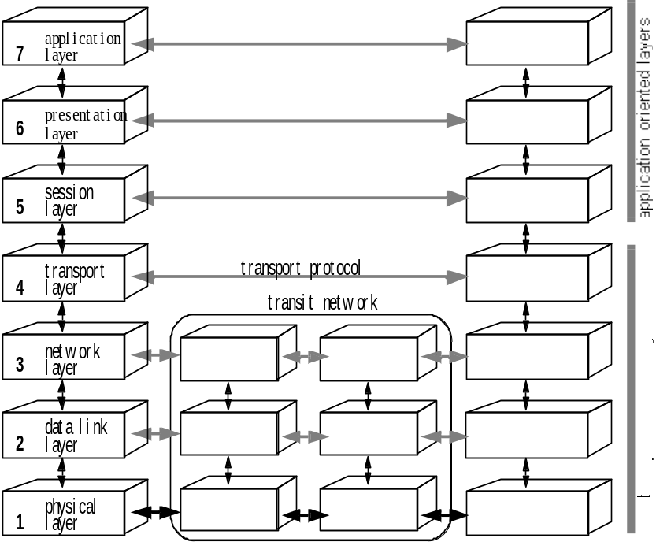
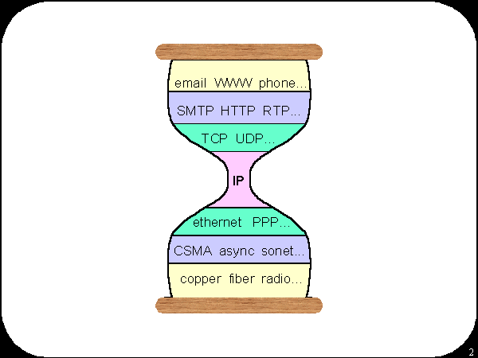
Theory
ISO/OSI model
DoD model
5. Application
4. Transport
3. Network
2. Link Layer

Slide 7
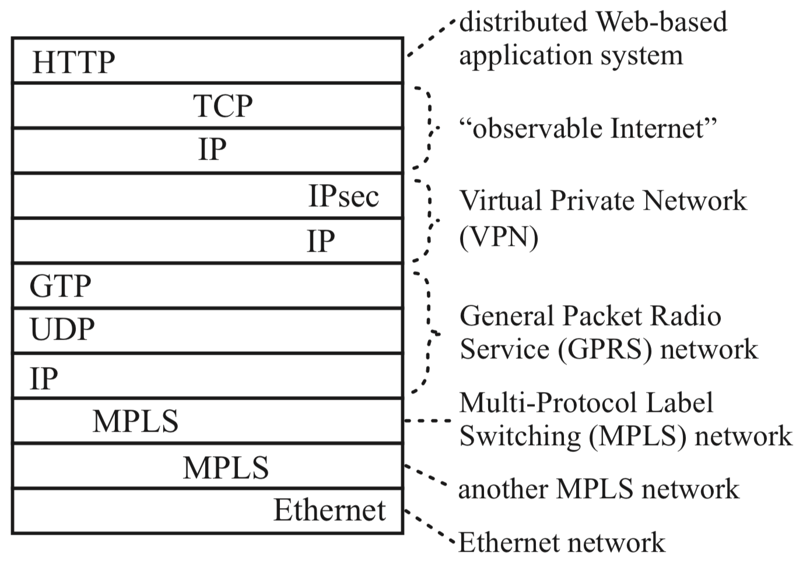
Reality
Typical packet from AT&T backbone network
Pamela Zave and Jennifer Rexford. 2019. The compositional architecture of the internet.
Commun. ACM 62, 3 (February 2019), 78-87. DOI: https://doi.org/10.1145/3226588

Slide 8
Example problem 1: IP fragmentation
IP must get all fragments of a packet to reassemble
=> What if a fragment is lost?
  Early 70's: IP was split from TCP => TCP’s retransmissions are distinct, not recognized by IP
  Must hold fragments for a long time, in vain
  => wastes buffer space
Fix: Path MTU Discovery
  Disable fragmentation & find the largest possible packet that can be sent: start big, reduce size upon incoming ICMP error
    Actually this doesn’t work either: many nets filter ICMP
    Solution: PAcketization Layer PMTUD (PLPMTUD):
    start small, assume ok when ACKs arrive
    ...can you see problems with this?

Slide 9
Example problem 2: multi-path transfer
TCP makes many assumptions
(little re-ordering, almost no loss, ..)
  IP tries to be neutral; yet, new in-network mechanisms must not break TCP's assumptions
Multi-path data transfer
  Network layer; routers should not look at transport header
  Per-packet operation creates re-ordering for TCP
  Mechanisms like Equal-Cost Multi-Path (ECMP) or
  Link Aggregation Group (LAG) divide per-connection
  Need to track connections, need functions per transport protocol
  IPv6 flow label could help... but ECMP/LAG rules in RFCs allow hashing on transport header
    Maybe some router vendors want this?
SCTP, UDP, ... QUIC?

Slide 10
Non-technical reasons for these problems
Compromises
  Standards: often "group 1 demands X,
  group 2 demands Y, so let's have both X and Y !"
Opposing incentives
  Google, Cisco, Netgear, Akamai, Telenor, Apple, Microsoft, ...
Common open interfaces?

Slide 11
By the way… the IT world is not only AI !
Below: some names of companies that have participated in the July 2024 meeting of the Internet Engineering Task Force (IETF)
  and want your network know-how!
Akamai, Apple, Bell, Cloudflare, Cisco, Deutsche Telekom, Ericsson, Fastly, Google, Juniper Networks, Meta, Microsoft, Mozilla, Netflix, NEC, Nokia, Prime Video, RedHat, Telefonica, Telenor, TikTok, Switch, Verizon, Vodafone

Slide 12
Conclusion
The Internet is quite different from “theory”
  Layers are often neither OSI nor DoD
  Not much real theory until quite recently
    Recursive architectures offer a "cleaner" look
You will learn what the Internet really is like
  You should learn to appreciate good vs. bad design
  Hopefully deeper understanding than public press or some tech blogs!

Slide 13
Thank you!
Questions?

