Slide 1
Dialogue systems (3)
Pierre Lison plison@nr.no
IN4080, Autumn 2024, video lecture 3 (October 21, 2024)

Slide 2
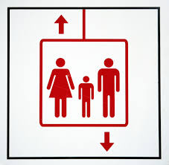

Oblig 4
The last obligatory assignment was released last week
Two parts:
  Dialogue systems
  Machine translation
Submission deadline: November 3, 2024 at 23:59
Do start early!
  And let us know if you experience any issues

Slide 3
Weeks 42 and 43
The lectures on dialogue systems will be done remotely, through a series of shorter videos
Don’t hesitate to reach out to me (plison@nr.no) or on our Discourse channel if you have any questions!
Plan:
Video 1: intro, basic chatbot models
Video 2: retrieval and generative models
Video 3: dialogue management
Video 4: system development and evaluation

Slide 4
Outline
Intro to dialogue management
Properties of human dialogues
Dialogue management approaches

Slide 5
Outline
Intro to dialogue management
Properties of human dialogues
Dialogue management approaches

Slide 6

Quick recap
Language
Understanding
Generation / response selection
User
input signal
(user utterance)
output signal
(machine utterance)

Slide 7
Quick recap
Rule-based approaches
= «triggered» patterns
Language
Understanding
Generation / response selection
= recognition of handcrafted patterns (e.g. regular expressions)
= handcrafted responses or templates to fill
User
input signal
(user utterance)
output signal
(machine utterance)

Slide 8
Quick recap
NLU approaches
Intent + detected slots
Language
Understanding
Generation / response selection
= intent recognition (classification) + slot filling (sequence labelling)
= handcrafted responses or templates to fill
User
input signal
(user utterance)
output signal
(machine utterance)

Slide 9
Quick recap
IR approaches
(sparse or dense) embedding
Language
Understanding
Generation / response selection
= vectorize utterance (+ context)
= search for most similar utterance in corpus, and select follow-up
User
input signal
(user utterance)
output signal
(machine utterance)

Slide 10
Quick recap
Generative approaches
LLM output (token vectors and next-token predictions)
Language
Understanding
Generation / response selection
= Process user input (+ context & instructions) through an instruction-tuned LLM
= Decode the answer token-by-token
User
input signal
(user utterance)
output signal
(machine utterance)

Slide 11
Limitation of chatbot models
Language
Understanding
Generation / response selection
Chatbots are typically built for short interactions
  Often an initial question/request + perhaps some follow-up response(s)
Can we build systems able to handle longer and more complex interactions?
Many dialogue turns, lists of tasks to complete, etc.
Rich external context, multi-party dialogues, etc.

Slide 12
Dialogue management tasks
  Keeping track of the dialogue state over time (dialogue state tracking)
  Often done by defining the variables/slots that are relevant for the task and updating those based on incoming inputs/observations
  Selecting what to say/do next based on this state (dialogue policy)
  Decision-making under uncertainty: find the best way to fulfill the system goals, taking uncertainties into account (misunderstandings, unclear intents, ambiguous context, etc.)

Slide 13
Dialogue management
Extra linguistic context
Non-verbal actions
Dialogue manager
Dialogue management can be implemented via a separate module that mediates understanding and generation
State tracking
Dialogue
state
Action selection
Language
Understanding
Generation
… or, as is increasingly the case nowadays, integrated into generative models through prompting, fine-tuning and LLM chaining
  One can use a first LLM for state tracking, and insert its output in the prompt of another LLM employed to generate the response

Slide 14
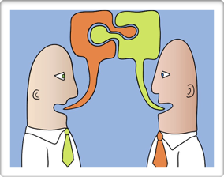
Dialogue management
The role of the dialogue manager is to control the dialogue flow
  What to say/do and when to say/do it
Conversational skills to emulate:
  Interpret utterances contextually
  Manage turn-taking
  Fulfill conversational obligations & social conventions
  Manage uncertainties
➔ What are those skills, and how are humans using them?

Slide 15
Outline
Turn-taking
Dialogue acts
Deictics
Grounding
Conversational implicatures
Alignment
Intro to dialogue management
Properties of human dialogues
Dialogue management approaches

Slide 16
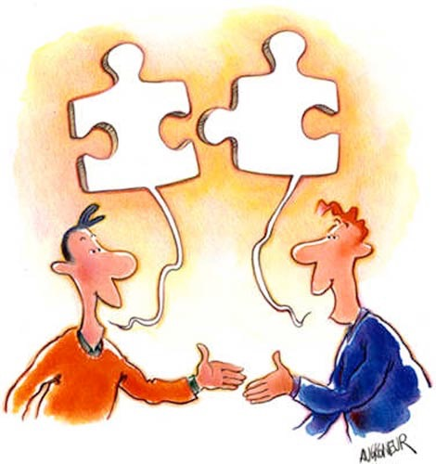
What is dialogue?
  Spoken (“verbal”) + possibly non-verbal interaction between two or more participants
  Dialogue is a joint, social activity, serving one or several purposes for the participants
  What does it mean to view dialogue as a joint activity?

Slide 17
Turn-taking
Dialogue participants take turns
  Turn = continuous contribution from one speaker
  Turn-taking is a resource allocation problem
Surprisingly fluid in normal conversations:
  Minimise both gaps (no speaker) and overlaps (more than one speaker)
  Interval between speakers is around 250 ms
[Duncan (1972): «Some Signals and Rules for Taking Speaking Turns in Conversations», in Journal of Personality and Social Psychology]

Slide 18
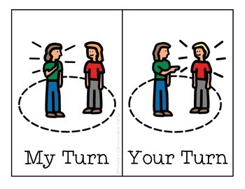
Turn-taking
How are turns taken or released?
Markers for turn boundaries:
  Complete syntactic/semantic unit?
  Dialogue structure (greetings → greetings, question → answer)
  Intonation (falling intonation → speaker is finished)
  Non-verbal cues (eye gaze, gestures)
  Silence & hesitation markers (unfilled pauses ≠ filled pauses)
  Social conventions

Slide 19
Example of turn-taking
Speaker 1: | han vil bo i skogen ?
Speaker 2: | # altså hvis jeg hadde kommet og sagt " skal vi flytte i skogen ? " så hadde han sagt ja
Speaker 1: | mm
Speaker 2: | men jeg vil ikke bo i skogen
Speaker 1: | nei det skjønner jeg
Speaker 2: | så vi må jo finne et sted som er mellomting og det jeg vil ikke bo utpå landet # i hvilken som helst (uforståelig) ...
Speaker 1: | * men det kommer jo an på hvor i skogen da
[«Norske talespråkskorpus - Oslo delen» (NoTa), collected and annotated by the Tekstlaboratoriet]

Slide 20
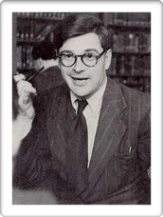
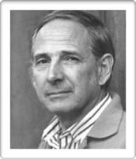
Dialogue acts
Each utterance is an action performed by the speaker
  The speaker has a specific goal (which might be only to establish or maintain rapport with the listeners)
  The utterance produces specific effects upon the listeners, or the world at large
  «Language as action» perspective
J.L. Austin (1911-1960)
philosopher of language
J. Searle (1932, - )
philosopher of language
[J. L. Austin (1955), How to do things with words.]

Slide 21
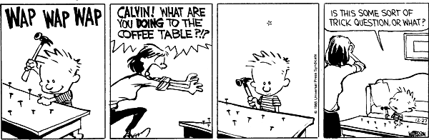
Dialogue acts
The mother reaction has a specific purpose
  Communicating her suprise/anger, and stop Calvin
Her question will trigger some effects:
  A psychological reaction from Calvin (e.g. surprise)
  Possibly a real-world effect as well (Calvin stopping his action)

Slide 22
Deixis
Deictics can be:
Pronouns
Adverbs of time and place
Demonstratives
Tense markers
Non-verbal signs
…
Dialogue often referential to a spatio-temporal context
Such references are called deictics
  Related concepts: indexicals, anaphora
The meaning of a deictic depends on the context in which it is uttered (including the speaker perspective)
« I am lecturing in this room right now »:
depends on who says it
depends on where it is said
depends on when it is said

Slide 23
Grounding
Speaker A’s knowledge
Dialogue is a joint, collaborative process between the participants
  Need to ensure mutual understanding
Gradual expansion and refinement of common ground
  Common ground = shared knowledge
Speaker B’s knowledge
Common
ground
[H. H. Clark and E. F. Schaefer (1989), «Contributing to discourse», in Cognitive Science]

Slide 24

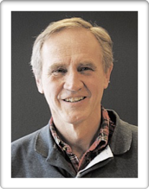
Grounding
Grounding is the process of gradually augmenting the common ground during the interaction
  Variety of signals and strategies
Multiple levels:
  Contact (attention to interlocutor)
  Perception (detection of utterance)
  Understanding (comprehension of utterance)
  Attitudinal reactions
Herbert H. Clark
psycholinguist
[Jens Allwood (1992), «On discourse cohesion», in Gothenburg papers in Theoretical Linguistics.]
Jens Allwood linguist

Slide 25
Grounding acts
Backchannels: «uh-uh», «mm», «yeah»
Explicit feedback: «ja det skjønner jeg»
Implicit feedback: A: «I want to fly to Rome» → B: «there are two flights to Rome on Wednesday: ... »
Clarification strategies: «Did you mean to Rome or to Goa?», «could you confirm that ...»
Repair strategies: «OK, you’re not going to Goa. Where do you want to go then?»

Slide 26
Examples of grounding
Speaker 1: | vi vasker den hver dag vi # vi har mopp
Speaker 2: | mm ## ja det er fort og faren til M27 legger nytt teppe han # det er gjort på to timer ## så det er fort gjort
Speaker 1: | ja ## da er ikke noe sak
Speaker 2: | vi har skifta teppe tre ganger allerede han gjør det gratis
Speaker 1: | hæ ?
Speaker 2: | vi har skifta teppe tre ganger og # han han ...
Speaker 1: | * jeg skjønner ikke hvorfor dere har teppe
Speaker 2: | jeg syns det var rart jeg òg # men e # (sibilant)
[«Norske talespråkskorpus - Oslo delen» (NoTa), collected and annotated by the Tekstlaboratoriet]

Slide 27
Examples of grounding
Speaker 1: | e # nei det er ikke mange
Speaker 2: | ja * nei
Speaker 1: | men heldigvis så var ikke Petter Rudi tatt ut denne gangen da
Speaker 2: | ja # jeg skjønner ikke hva han skal på landslaget å gjøre
Speaker 1: | * nei han har ingen ting på landslaget
Speaker 2: | nei # definitivt
Speaker 1: | å gjøre # han er ubrukelig
Speaker 2: | * moldensere
Speaker 1: | hm?
Speaker 2: | ja disse moldenserne
Speaker 1: | en gang til?
Speaker 2: | disse moldenserne
Speaker 1: | * å ja (fremre klikkelyd) # unnskyld # jeg hørte ikke hva du sa
implicit feedback (repetition of landslaget)
clarification requests
[«Norske talespråkskorpus - Oslo delen» (NoTa), collected and annotated by the Tekstlaboratoriet]

Slide 28
Conversational implicatures
Very often, part of the meaning of utterance is not explicitly stated, but only implied
How can we retrieve this «suggested» meaning, and go beyond literal interpretations?
  Need to make some assumptions about the speaker to help us infer the hidden part
A: «Is William working today?»
B: «He has a cold»

Slide 29
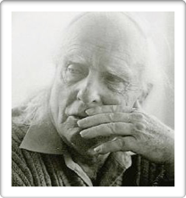
Conversational implicatures
Paul Grice (1913-1988)
philosopher of language
Same idea again: dialogue as a collaborative process
Grice’s Cooperative Principle:
  Maxim of Quality: «be truthful»
  Maxim of Quantity: «be exactly as informative as required»
  Maxim of Relation: «be relevant»
  Maxim of Manner: «be clear»
We assume our conversational partners adhere to those maxims
If an utterance initially seems to violate a maxim, we (unconsciously) infer additional hypotheses to make sense of our partner’s contribution
[Paul Grice (1975), Logic and Conversation.]

Slide 30
Conversational implicatures
A: «Is William working today?»
B: «He has a cold»
At first glance, B seems to violate the maxim of relevance - he does not directly answer A’s question
But looking at the utterance more closely, we can read it as implying that (due to his cold) he is probably at home, and thus not working today
This is because we assume that B is cooperative and wouldn’t have uttered «he has a cold» if it didn’t help answering A’s question

Slide 31
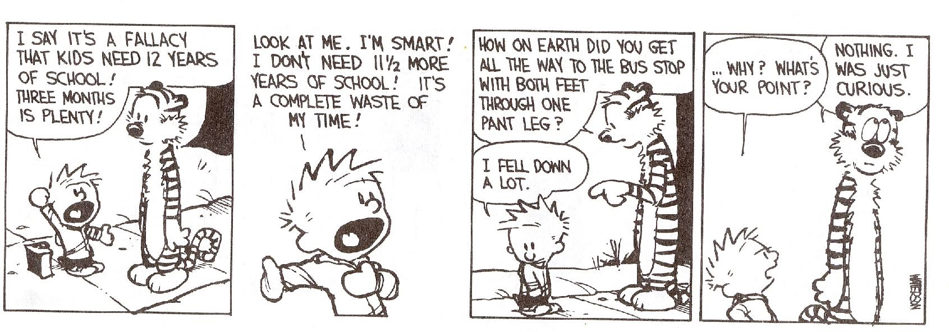
Conversational implicatures
Hobbes’ question is suggesting something about Calvin’s need for schooling, without stating it explicitly
We can understand it because we assume that Hobbes’ contribution is cooperative and thus relevant to the discussion

Slide 32
Alignment
Participants in a dialogue continuously align their mental representations
  Notion of common ground discussed earlier
But dialogue participants also align at other levels, by unconsciously imitating each other
As the interaction unfolds, the participants automatically align their wording, pronunciation, speech rate, and gestures
[Garrod, S., & Pickering, M. J. (2009). Joint action, interactive alignment, and dialog. Topics in Cognitive Science]

Slide 33
Outline
Intro to dialogue management
Properties of human dialogues
Dialogue management approaches
Flowcharts
Frame-based systems
Data-driven techniques (based on e.g. reinforcement learning)

Slide 34

Flowcharts
= encode dialogue strategies as finite-state automata
  the nodes represent machine actions
  and the edges possible (mutually exclusive) user responses
M: here’s an apple
U: thank you
M: you’re welcome!
M: apples or
oranges?
U: apples
M: here’s an orange
U: oranges
U: sth else
U: thank you
M: what? sorry i didn’t understand

Slide 35
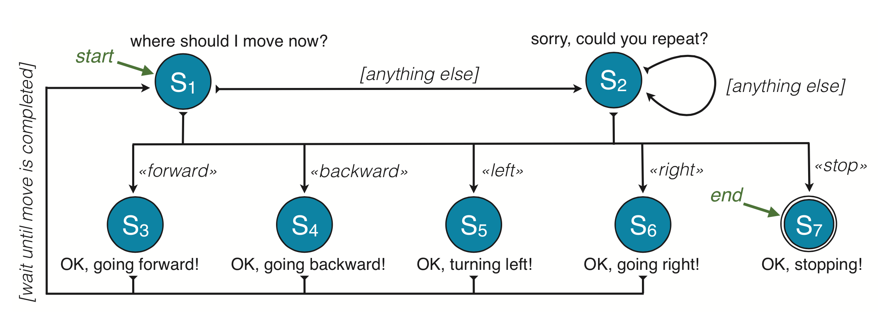
Flowcharts
Transitions can relate to other signals than user inputs (for instance, external events)
And can also express complex conditions (pattern matching on the user input, confidence thresholds, etc.)

Slide 36
Finite-state automata
Advantages | Limitations
Easy to design Fast, efficient Does not require dialogue data Predictable system behaviour (both for the user and for the system designer) | Only allows for scripted interactions - not "true" conversation No principled account of uncertainties Difficult to scale to complex domains with many variables and alternative inputs

Slide 37
Frame-based managers
The interaction flow can be made slightly more flexible in frame-based systems
The state is represented as a frame with slots to be ﬁlled by the user’s answers
Slot | Question
ORIGIN CITY | «From what city are you leaving?»
DESTINATION CITY | «Where are you going?»
DEPARTURE TIME | «When would you like to leave?»
ARRIVAL TIME | «When do you want to arrive?»

Slide 38
Frame-based managers
The user will sometimes provide additional information to the system's questions
  System: What is your departure?
  User: I want to leave from Oslo before 9:00 AM»
The system should fill the slots with all available information
Given the current state, the dialogue manager selects an unfilled slot and ask the user for its value
  … and we repeat until all slots are filled

Slide 39

Interaction style
Rigid, repetitive structure of the interaction
Irritating confirmations & acknowledgements
  No good management of uncertainties
No user or context adaptivity
“Saturday night live” sketch comedy, 2005

Slide 40
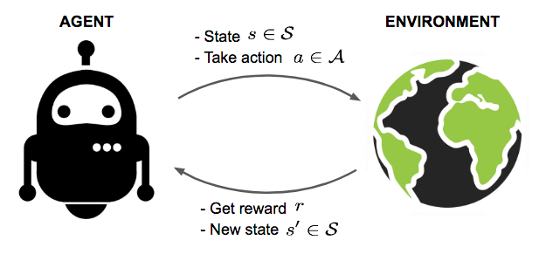
Data-driven techniques
Can we optimize dialogue strategies from data? Yes!
Several approaches:
  Supervised learning: imitate «good dialogues» from experts
  Learn from human preferences (using e.g. Direct Preference Optimization)
  Learn dialogue strategies through Reinforcement Learning

Slide 41
Reward model
Interactive tasks must often encode trade-offs between multiple competing objectives
  A flight booking system must book the right ticket
  But it must do so with the fewest number of requests
Typically encoded via rewards (utilities) associated to particular state/action pairs
State | Action | Reward
User wants to book ticket x | Booking x | +10
User wants to book ticket x | Booking y ≠ x | −30
User wants to book ticket x | Clarification request | −1

Slide 42
Policy optimisation
Given a reward model, we can optimize a model for selecting the best action to execute at any given time
This works by letting the system interact many times with its «environment» and gradually improve its action selection based on the rewards it receives
  Here, the «environment» = the user
  This user may be a real human, but in most cases, it is easier to develop a simulated user
The action may be a high-level command («ConfirmPurchase») or, for generative models, the next token to produce
The technical name for this action selection process is a policy (mapping from states to actions)

Slide 43
Markov Decision Processes
We can define these ideas more precisely using a formalism called Markov Decision Processes (MDPs)
Markov Decision Processes are an extension of Markov Chains where the agent selects an action at each state
  This action will then modify the state space
  And will yield a particular reward for the agent
D1
D2
Dn-1
S1
S2
S3
...
...
Sn-1
Sn
R1
R2
Rn-1

Slide 44
Graphical notation
P(S2|S1,d) determines the probability of reaching S2 when executing action D in state S1
(decision variable)
D
S1
S2
(random variable)
(random variable)
R
R(S1,D) determines the utility of executing action D while in state S1
P(S1) determines the probability of being in state S1
(utility variable)

Slide 45
Markov Decision Processes
A MDP is as a tuple <S,A,T,R>, where:
S is the state space (possible states in the domain)
A is the action space (possible actions for the agent)
T is the transition function, defined as T(s, a, s′) = P(s′|s, a). It is the probability of arriving to state s’ after executing action a in state s.
R is the reward function, defined as R : S × A → R. It is a real number encoding the utility for the agent to perform action a while in state s.
Notes:
45

Slide 46
Expected cumulative reward
In an MDP, the agent seeks to maximise its expected cumulative reward Q(s,a)
How much worth is a reward expected at time (t+i) compared to one received right now?
  We use a discount factor γ to capture this balance
  Related to delayed gratification in psychology
The agent must try to predict future inputs/rewards
The rewards accumulate over time

Slide 47

Bellman equation
The Bellman equation tells us that we can write the expected cumulative reward Q in a recursive fashion:
Notice that we are estimating the Q-values based on... our estimation of the Q-values (can be used to iteratively refine these estimates until convergence)
[R. Bellman (1957): «Dynamic Programming»]

Slide 48

MDP policy
Given an MDP, a (dialogue) policy tells us which action to execute in each state
A dialogue policy is a mapping π: S → A from states to actions
An optimal dialogue policy π* is a policy that always outputs the action yielding the maximum expected cumulative reward:

Slide 49
Types of RL techniques
Directly estimate the policy (or Q-values) from data
Model-based vs. model-free methods
As the state-action space is high-dimensional, the policy or Q-value model is typically expressed as a deep neural network
Many techniques exist, but a popular choice in NLP is Proximal Policy Optimization (PPO)
Estimate the MDP model from interaction data, and then derive the policy from it
Schulman, et al (2017). Proximal policy optimization algorithms. arXiv preprint arXiv:1707.06347.
R. Sutton & A. Barto (2018): «Reinforcement Learning: An Introduction» (complete book available online!)

Slide 50
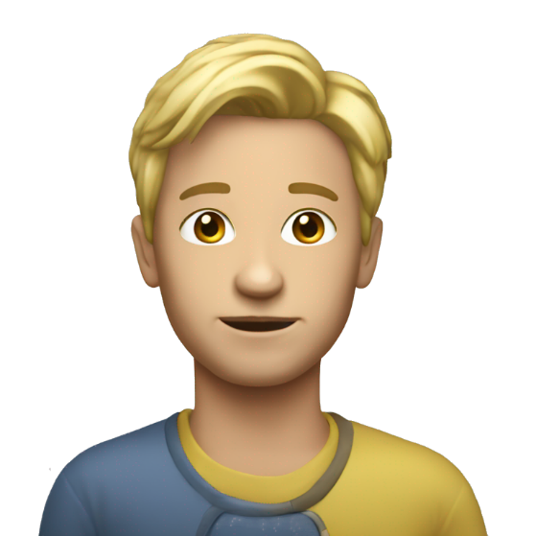
Challenges
Real or simulated interactions?
  Simulated users often necessary due to slow convergence speed
  However, this may lead to poor behaviours when applied to real users
Reward design
  What constitutes a “good” dialogue?
  Possible to learn a reward model from human preferences … but we might as well then directly learn from those?

Slide 51

Next lecture
In the next lecture, we will talk about how to
  Practically design and develop conversational systems
  Evaluate their performance of those systems
Don’t hesitate to get in touch if you have any questions!

Slide 52
Reading
Chapter 15 from Jurafsky and Martin
Section 24.6 from the previous edition of Jurafsky and Martin, available on https://github.com/rain1024/slp2-pdf/

