Slide 1
Large Language Models
Pierre Lison plison@nr.no
IN4080, autumn 2024, lecture 8

Slide 2

Oblig 3
The third obligatory assignment is about building a RAG system that can answer Star Wars questions
Submission deadline: October 13 (this Sunday!)
The best way to do this assignment is on Fox, the HPC cluster from UiO
  Do register ASAP if you haven’t yet done so!
  If you have problems registering to Fox or running code on it, you can also use on your own computer

Slide 3
Outline
Quick recap on the Transformer
Training LLMs
Model alignment
Prompting LLMs
Generation
Retrieval-Augmented Generation (RAG)
Open challenges

Slide 4
Outline
Quick recap on the Transformer
Training LLMs
Model alignment
Prompting LLMs
Generation
Retrieval-Augmented Generation (RAG)
Open challenges

Slide 5
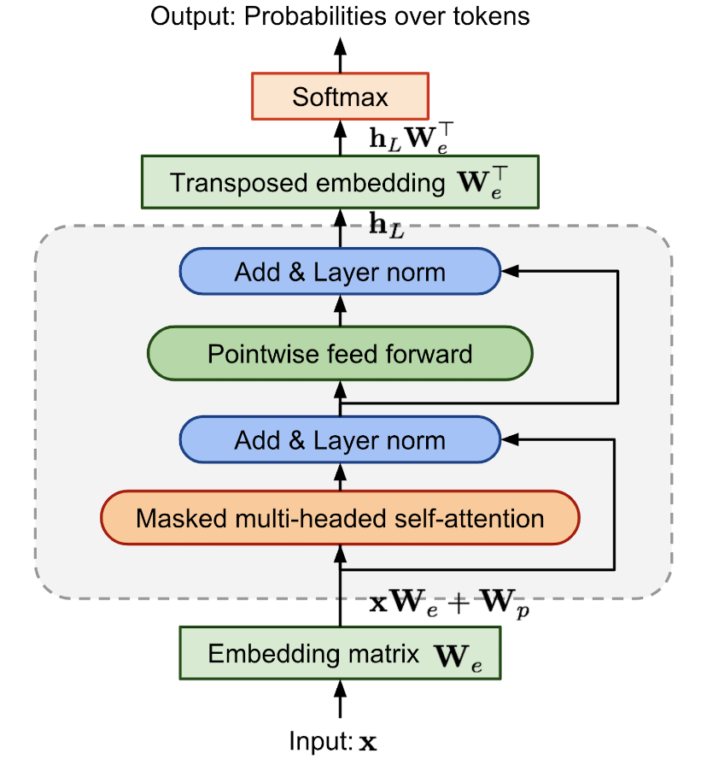
Large language models
All variants of the same neural architecture: the Transformer
Key mechanism: self-attention (takes into account the context of each word)
Many layers stacked onto each other
Input: sequence of tokens
Output: probabilities for the next token

Slide 6
Self-attention
Each token vector x_{i} is mapped via learned linear projections to three distinct vectors: the query q_{i}, key k_{i} and value v_{i}
Query
Key
Value
Token vectors at layer l
x₁
x₂
x₃
x₄
x₅
….
He sat on the bench
Initial tokens

Slide 7
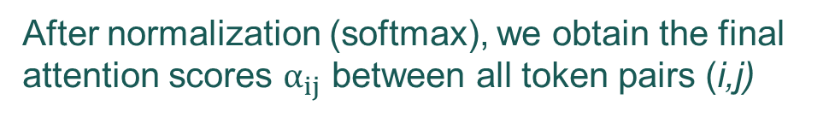

Self-attention
After normalization (softmax), we obtain the final attention scores $α_{ij}$ between all token pairs (i,j)
= (unnormalized) attention score of token 5 for token 2:
$$\frac{{k_{2}∙ q}_{5}}{\sqrt{d_{k}}}$$
We then compute the attention scores between tokens
(by computing the dot products between query and keys)
Query
Key
Value
x₁
x₂
x₃
x₄
x₅
….
He sat on the bench
Initial tokens

Slide 8
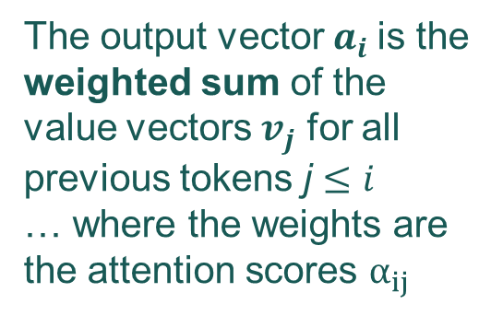
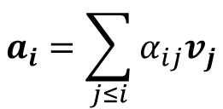
Self-attention
$$a_{i}=\sum_{j≤i}{α_{ij}v_{j}}$$
The output vector $a_{i}$is the weighted sum of the value vectors $v_{j}$ for all previous tokens j $≤i$
… where the weights are the attention scores $α_{ij}$
Query
Key
Value
Token vectors at layer l
x₁
x₂
x₃
x₄
x₅
….
He sat on the bench
Initial tokens

Slide 9

Self-attention
This process is repeated several times (one per “head”), and the final output vector is the concatenation of all heads, followed by a linear projection
${(a}_{i}^{1} + a_{i}^{2}$ $+$ $a_{i}^{3})W$
Token vectors at layer l
x₁
x₂
x₃
x₄
x₅
….
He sat on the bench
Initial tokens

Slide 10
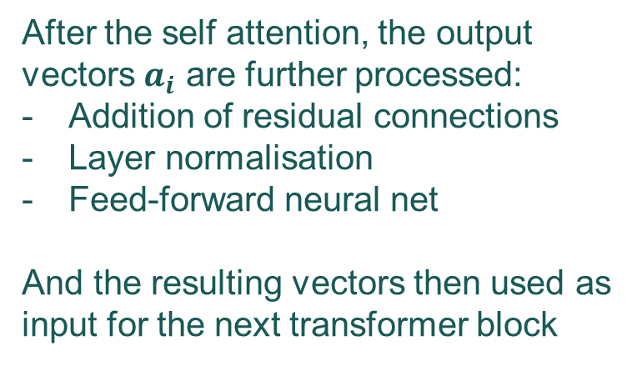
Large language models
After the self attention, the output vectors $a_{i}$ are further processed:
Addition of residual connections
Layer normalisation
Feed-forward neural net
And the resulting vectors then used as input for the next transformer block

Slide 11
Outline
Quick recap on the Transformer
Training LLMs
Model alignment
Prompting LLMs
Generation
Retrieval-Augmented Generation (RAG)
Open challenges

Slide 12
Large Language Models
= Machine learning models optimized to predict the next word in text
Deep neural net
(Transformer architecture)
with many billions of parameters
Trained on huge collections of texts crawled from the web (Wikipedia, books, web fora, etc.)
As a by-product of this “guessing game”, the neural model will gradually build up representations of both linguistic and world knowledge
This model can then be adapted for various text processing tasks (generate answers in a dialogue, follow instructions, summarize texts, etc.)

Slide 13
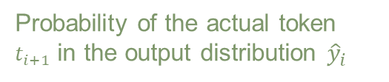
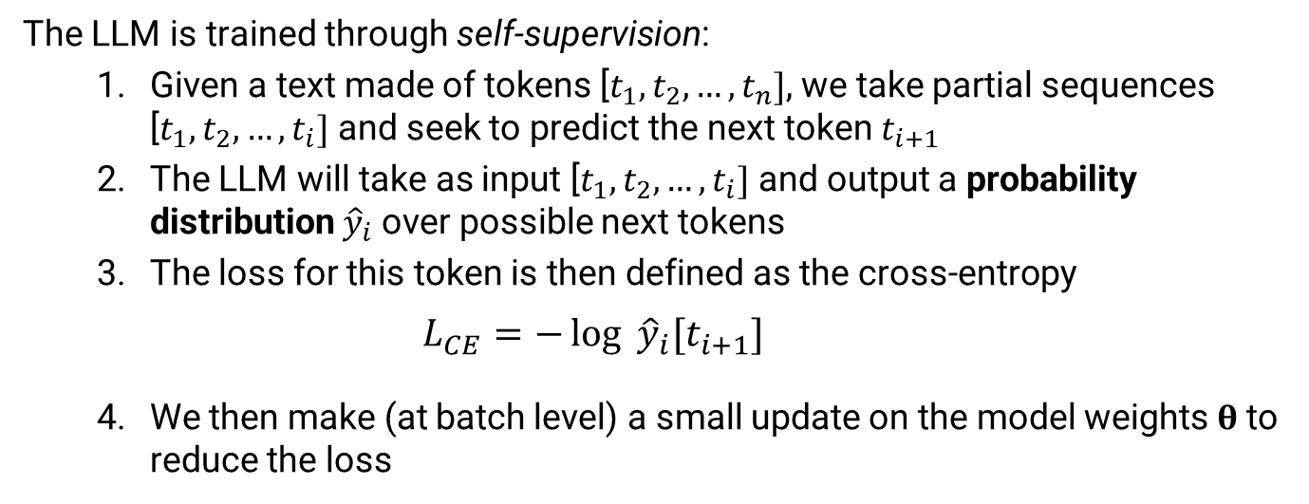
Training process
The LLM is trained through self-supervision:
  Given a text made of tokens [$t_{1},t_{2}, …,t_{n}]$, we take partial sequences [$t_{1},t_{2}, …,t_{i}]$ and seek to predict the next token $t_{i+1}$
  The LLM will take as input [$t_{1},t_{2}, …,t_{i}]$ and output a probability distribution ${\hat{y}}_{i}$ over possible next tokens
  The loss for this token is then defined as the cross-entropy
    $$L_{CE}=−\log{{\hat{y}}_{i}[t_{i+1}]}$$
  We then make (at batch level) a small update on the model weights $θ$ to reduce the loss
Probability of the actual token $t_{i+1}$ in the output distribution ${\hat{y}}_{i}$

Slide 14
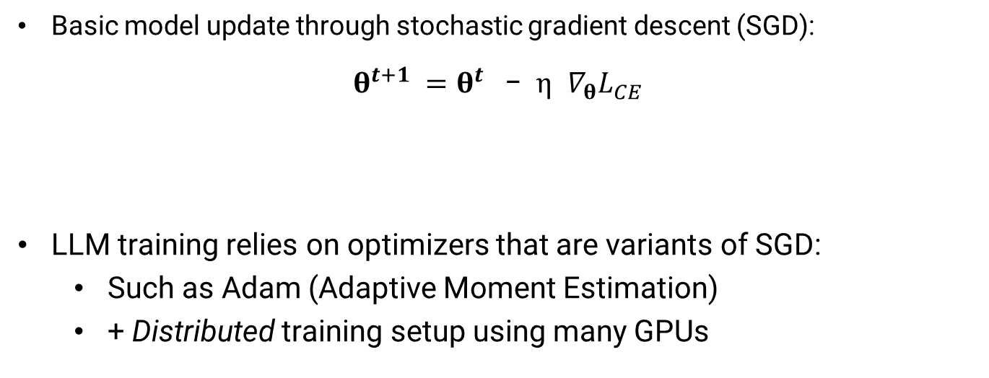
Training process
Basic model update through stochastic gradient descent (SGD):
$$θ^{t+1} =θ^{t} \text{−} η { ∇}_{θ}L_{CE}$$
LLM training relies on optimizers that are variants of SGD:
  Such as Adam (Adaptive Moment Estimation)
  + Distributed training setup using many GPUs
Gradient of the cross-entropy loss as a function of the model weights
Updated model weights
Current model weights
Learning rate (controlling the step size of each update)

Slide 15
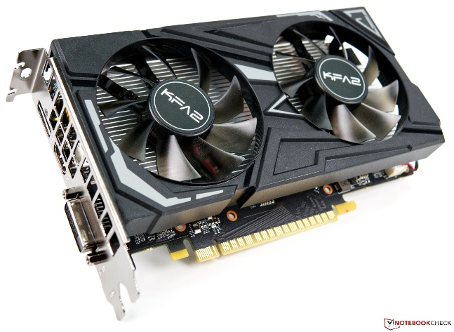
Training process
State-of-the-art Large Language Models:
  have hundreds of billions of parameters
  Are trained with petabytes of data
  Optimized with thousands of GPUs for many days
  May consist of several «specialized» LLMs (mixture of experts, MoE)

Slide 16
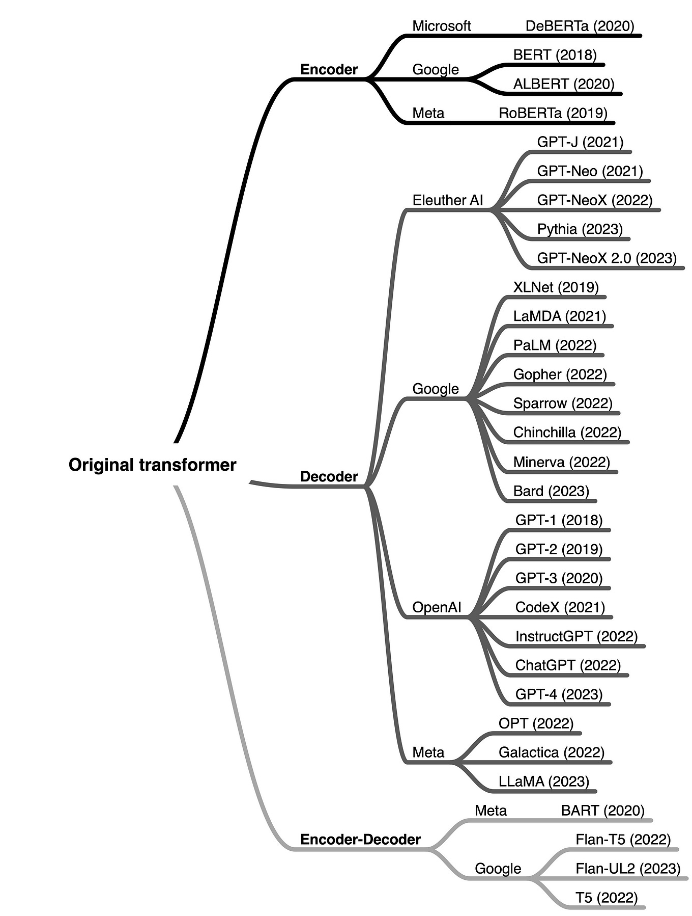
Types of LLMs
Encoder-only:
  Masked language modelling
  Smaller & older models, but still very good for IE tasks
Decoder-only:
  Now the dominant approach to LLMs
Encoder-decoder:
  Both self-attention and cross-attention
  Employed for tasks such as MT

Slide 17
Outline
Quick recap on the Transformer
Training LLMs
Model alignment
Prompting LLMs
Generation
Retrieval-Augmented Generation (RAG)
Open challenges

Slide 18
Fine-tuning
Once a model has been (pre)-trained, it can be fine-tuned for a particular task
  Basically “further” training with smaller amounts of in-domain data, taking the pretrained model as starting point
  Much more data-efficient than learning a model from scratch!
  (why? because the initial model has
  internalized “semantic representations”
  that can be transferred to the task to solve)

Slide 19
Fine-tuning
For smaller models like BERT, we can easily do “full” fine-tuning
For larger LLMs (like Llama, Phi, Mistral, Qwen, …), this is more complicated
Solution: only optimize a small fraction of parameters
  So-called Parameter-Efficient Fine Tuning (PEFT)
IA3 (Intrinsic Attention-guided Adaptation) Adjusts attention mechanism in transformer layers
Adapters Insert small trainable modules between layers
LoRA (Low-Rank Adaptation) Modifies the model weights using low-rank matrices
Soft Prompting Appends trainable vectors to the input prompt

Slide 20
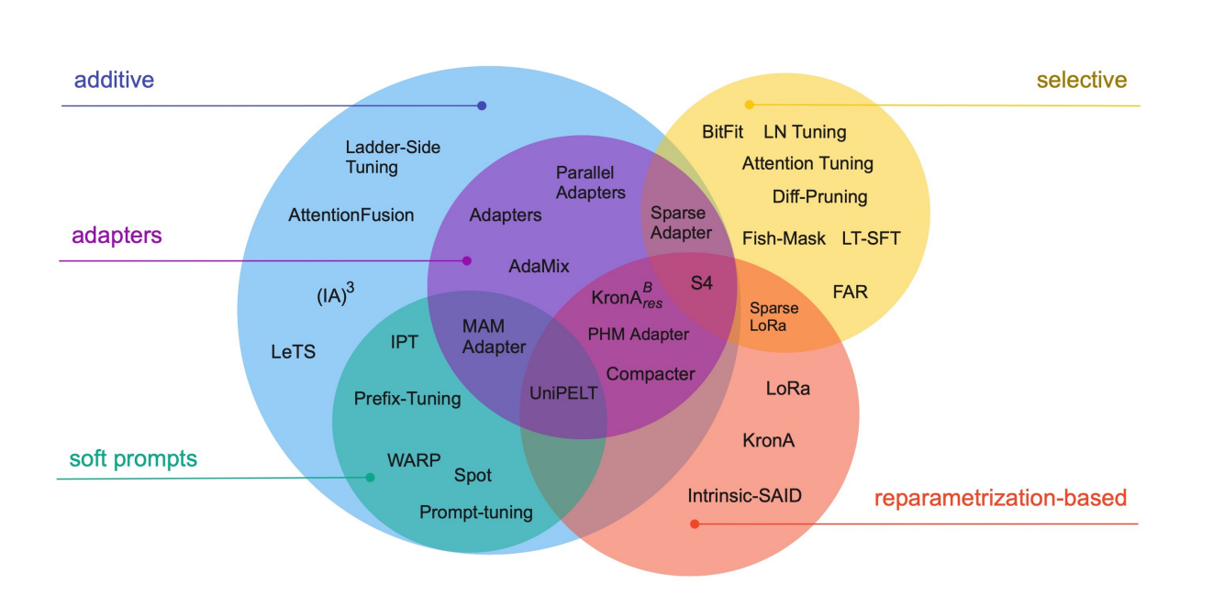
Parameter-efficient Fine-tuning
And many more…
(new fine-tuning techniques pop up every month)
To get started with PEFT: https://huggingface.co/docs/peft

Slide 21
Model alignment
A “standard” LLM is optimized to find likely continuations of an input string
Input: Translate to French: The small dog
Output: crossed the road
We often want our LLMs to follow instructions and generate outputs that satisfy certain quality criteria
A perfectly plausible continuation, but not what we were looking for
Be relevant and informative, do not spread disinformation, avoid offensive or abusive language, refrain from producing dangerous/illegal content, etc.

Slide 22

Model alignment
Getting the model to output “what we want” is often called alignment
  We seek to “align” the model with certain values & rules of conduct
This is not a pure technological question!
  Deep ethical/political questions about what the LLM should “align” towards
Two alignment strategies:
  Instruction tuning
  Preference alignment

Slide 23
Instruction tuning
Classical fine-tuning on a language modelling objective (= next token prediction), but on a dataset of <instruction, correct response> pairs
How to collect such dataset?
  Manually, by asking humans to write a question/problem and a correct answer to that problem
  By converting existing datasets for supervised NLP tasks (for text classification, sentiment analysis, NER, machine translation, etc.) to prompts > answers
  By using LLMs to generate instructions-> responses, based on external databases, general ethical guidelines, etc.

Slide 24


Preference alignment
One can also improve the model alignment using preference data, such as ratings of answers to prompts
  Several formats are possible, but a common one is to use triples <prompt, chosen response, reject response>
  The ratings can be collected by paying crowdworkers (based on guidelines that define what constitutes a “good” response), or by asking users to rate the responses they get
Notes:
Direct preference optimization (DPO)

Slide 25
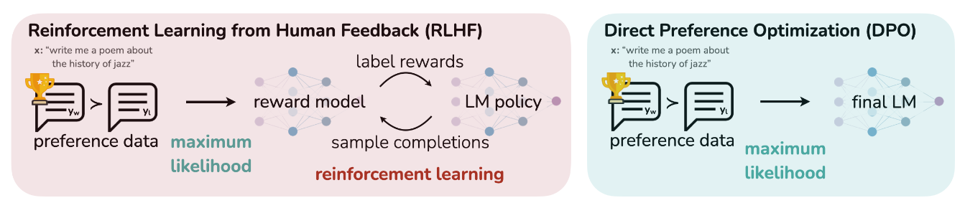
Preference alignment
Given a dataset of human preferences, the goal is to optimize the LLM to maximise the probability of getting a positive rating, and minimize the probability of a negative rating
Several optimization methods are possible, most prominently RLHR and DPO
[from Rafailov et al, Direct preference optimization: Your language model is secretly a reward model. NeurIPS, 2023]
Notes:
Direct preference optimization (DPO)

Slide 26
Outline
Quick recap on the Transformer
Training LLMs
Model alignment
Prompting LLMs
Generation
Retrieval-Augmented Generation (RAG)
Open challenges

Slide 27
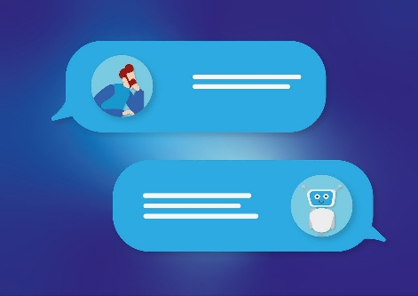
Prompting
A prompt is simply the input to the LLM, which can be a question or instructions on the task to perform
Many LLMs distinguish between the system and user prompt:
  System prompt: Generic instructions, defined by the system provider, on how the system should respond (be helpful, avoid offensive language, etc.) and how it should present itself to the user (“You are ChatGPT, a large language model trained by OpenAI…”)
  User prompt: Specific instructions provided by the system

Slide 28

Prompting
How a prompt is formulated can have a large influence on the response quality
Specify the format and length of the response.
For structured outputs, prefer human-readable formats such as JSON or YAML
If the prompt has both an instruction and a long input text, put the instructions at the end:
“Translate this into French: Here is the text….”
“Here is the text...
Translate the above text into French”
If the LLM should classify text, or select predefined responses, do specify them clearly in the prompt
“Brussels is the capital of
(A) Belgium
(B) Netherlands
Answer with a single letter corresponding to the correct answer (A or B).”
x
Add DO and DO NOT whenever necessary
For some prompts, indicating the “intended audience” may also help:
“explain how logistic regression works to a high-school student”.
v
May depend on LLM!

Slide 29
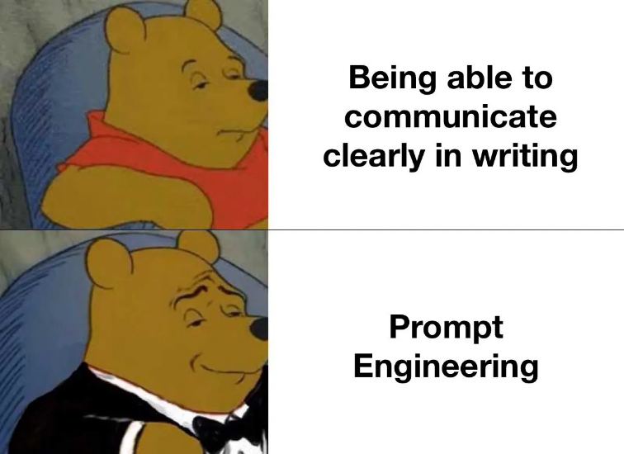
Prompting
Lots of hype 2-3 years ago on the new job of “prompt engineer”
  Increasingly less relevant today, as instruction-tuned LLMs get better & better
But automated prompt tuning can improve performance
  Often through some form of iterative improvement search
Method for generating variants of a given prompt
Scoring metric (based on e.g labelled data)
Initial prompt

Slide 30

In-context learning
Given a text, find all mentions of (direct or indirect) personal identifiers and return them in a list. Do not output anything else.
Examples:
Text: “My name is Pierre Lison, I am 42 years old and work as a researcher in NLP”
Output: [Pierre Lison, 42,
researcher]
…
Now find the personal identifiers in this text:
“Yves Scherrer is an Associate Professor at the University of Oslo.”
For complex tasks, inserting in the prompt a few examples / demonstrations can help the model understand what kind of output is expected
➔ Called “in-context learning” or “few-shots prompting”
Not really “learning” (the model stays unchanged), but biasing the LLM towards certain types of outputs

Slide 31

In-context learning
No need to include hundreds of examples! Often 1-5 shots are sufficient
Including examples / demonstrations will increase the length of the prompt, and therefore the cost of each LLM inference
You should include demonstrations that are as relevant as possible for the actual input to process
  Either by searching for “similar” demonstrations in a dataset
  Or programmatically, using prompt optimization tools such as DSPy

Slide 32

Chain-of-Thought
LLMs are still quite limited in their abilities to perform complex, “multi-hop” reasoning
  Math, science, advanced coding, planning, etc.
But those “reasoning” capabilities can be improved by forcing the LLM to generate longer, step-by-step responses
  “Let’s think step by step”
  In-context demonstrations of reasoning steps involved in solving similar problems
  Can also ask the model to criticize or debate its own responses
OpenAI’s new o1 model is build precisely on those tricks

Slide 33
Outline
Quick recap on the Transformer
Training LLMs
Model alignment
Prompting LLMs
Generation
Retrieval-Augmented Generation (RAG)
Open challenges

Slide 34
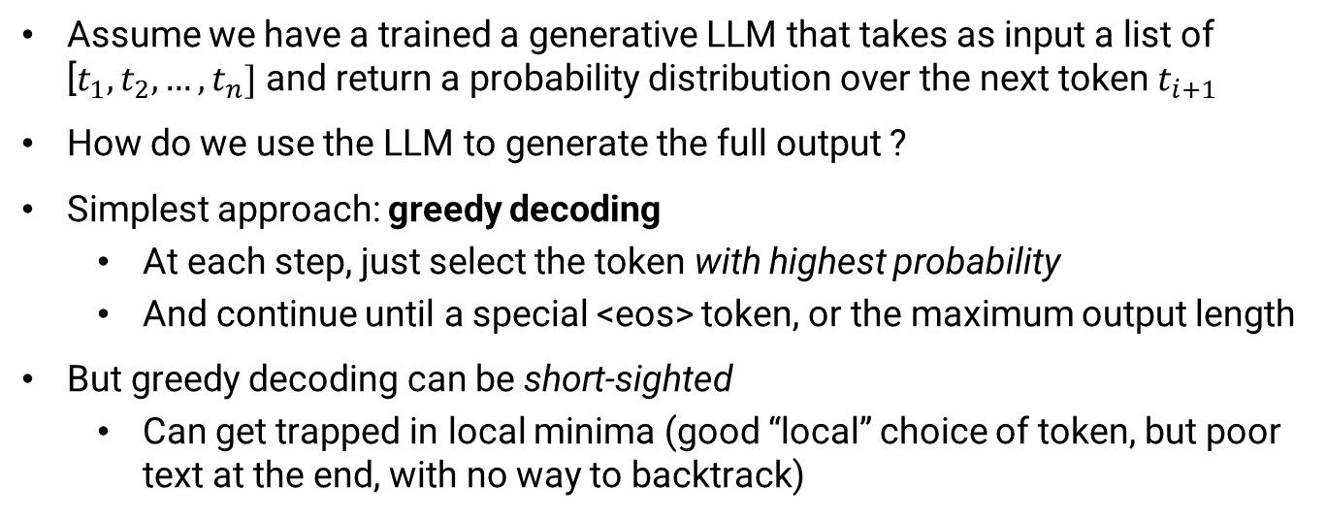
Generation
Assume we have a trained a generative LLM that takes as input a list of [$t_{1},t_{2}, …,t_{n}]$ and return a probability distribution over the next token $t_{i+1}$
How do we use the LLM to generate the full output ?
Simplest approach: greedy decoding
  At each step, just select the token with highest probability
  And continue until a special <eos> token, or the maximum output length
But greedy decoding can be short-sighted
  Can get trapped in local minima (good “local” choice of token, but poor text at the end, with no way to backtrack)

Slide 35
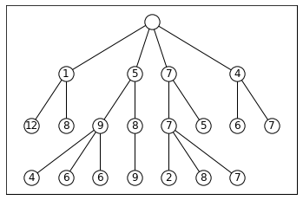
Beam search decoding
Alternative strategy: beam search
  we keep at each step a «beam» of K hypotheses representing the best partial outputs so far
  Those K hypotheses are gradually expanded, token by token
  Until we reach <eos> or the maximum output length
  Finally, we take the hypothesis with max probability among the K alternatives
Beam search with K=3
Less risk for local minima, but computational cost increases with K

Slide 36
Sampling strategies
We can also sample the tokens one by one
Top-K sampling
  At each step, we select the K tokens with highest probability
  We sample the next token only among those K possibilities (after renormalising the distribution)
  And continue until <eo> or max sentence length
Top-p sampling
  Same principle, but instead of a fixed K, we select tokens among those making up the top p % of the distribution mass

Slide 37
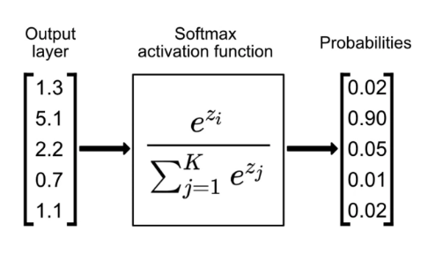

Temperature
The «creativity» of the generation can be controlled by the temperature
Recall the softmax function that turns logits into a proper distribution
We can divide the logits by a value T, which gives:
V
      $$P\left(w_{i}\right)= \frac{e^{\frac{z_{i}}{T}}}{\sum_{j=1}^{V}{e^{\frac{z_{j}}{T}}}}$$
Temperatures < 1 will make the decoder more “conservative”, increasing its focus on high-probability tokens
Temperatures > 1 will make the decoder more “creative”

Slide 38
Outline
Quick recap on the Transformer
Training LLMs
Model alignment
Prompting LLMs
Generation
Retrieval-Augmented Generation (RAG)
Open challenges

Slide 39
Retrieval-augmented generation
A standard LLM has all of its knowledge stored in its weights
Many shortcomings:
  Cannot add, remove or update factual knowledge without retraining the model
  Lack of transparency: difficult to inspect the model knowledge, or understand where it comes from
  How can we connect LLM to internal databases or to specialized knowledge sources ?
Retrieval-augmented generation (RAG) provides an elegant solution

Slide 40
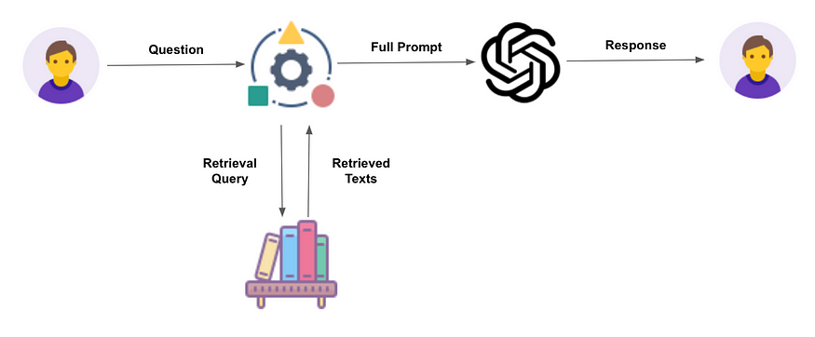
Retrieval-augmented generation
Basic idea:
  Given a user prompt, we first search for relevant documents in a text database
  The most relevant texts are then retrieved and added to the prompt to generate the response:
  «Given the following information: [RETRIEVED TEXTS], answer the following question: [USER QUESTION]»
Retrieval stage
Reading stage

Slide 41
Retrieval-augmented generation
The retrieval stage is essentially a Information Retrieval problem
  Can use «sparse» retrieval algorithms like BM25
  Or «dense» retrievers that operate on document embeddings
  Can also retrieve information from non-text sources
The reading stage is done with a standard LLM, ideally fine-tuned to take advantage of the retrieved documents to produce a good response

Slide 42
Retrieval-augmented generation
Main advantages of RAG systems:
  Easier to edit the LLM’s factual knowledge: simply update the underlying database, without needing to retrain anything!
  Cleaner distinction between «linguistic» and «factual» knowledge
  Better transparency: if a model produces a wrong answer, we can check whether the error stems from the retrieved documents
  Better attribution: the LLM can indicate the sources that have been used to generate its response

Slide 43
Outline
Quick recap on the Transformer
Training LLMs
Model alignment
Prompting LLMs
Generation
Retrieval-Augmented Generation (RAG)
Open challenges

Slide 44
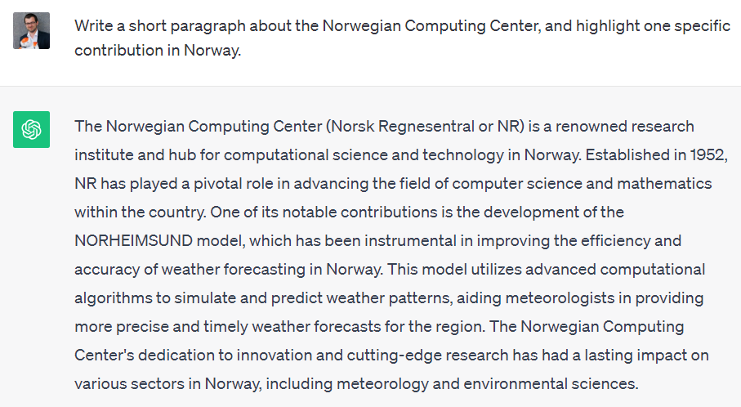
??

Slide 45
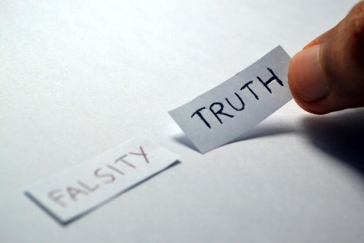
Factuality
Language Models are optimized to produce plausible texts, not necessarily correct ones!
Incorrect answers may come from the training data, which may contain various types of errors or disinformation…
… But language models may still hallucinate with a “perfect” training set!
And often do so in an overly confident tone

Slide 46


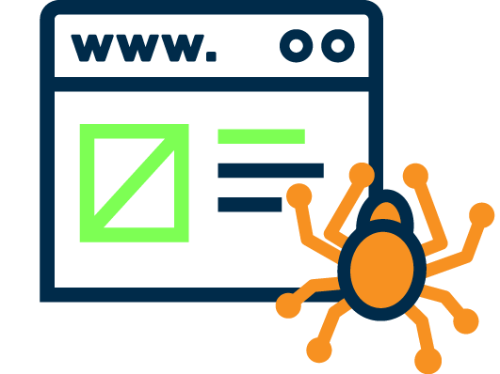
What we haven’t touched
Multimodal foundation models combining text with other modalities, in particular images, videos, but also physical environments (for robotics)
Watermarking of LLM-generated content
Broader societal questions, such as questions related to web crawling and copyright

Slide 47

Next two weeks
We will talk about dialogue systems
  Text-based (chatbots) or speech-based
  From simple systems based on “intent classification” to LLM-based agents
There won’t be any physical lecture in the next two weeks
  Instead, I’ll publish video recordings on the topics that we will cover
  Don’t hesitate to contact me or the group teachers for any question!

