Slide 1
LLMs (final part) &
Dialogue systems (part 1)
Pierre Lison plison@nr.no
IN4080, Autumn 2025

Slide 2

Reminder Oblig3
Oblig3 is about building a RAG system that can answer questions about Star Wars trivia
Submission deadline: October 17 (this Friday)
The best way to do this assignment is on Fox, the HPC cluster from UiO
  Do register ASAP if you haven’t yet done so!
  If you have problems registering to Fox or running code on it, you can also use on your own computer

Slide 3
Outline
Large Language Models (final part)
  Generation
  Open questions
Dialogue systems
  NLU-based chatbots
  Retrieval-based chatbots

Slide 4
Outline
Large Language Models (final part)
  Generation
  Open questions
Dialogue systems
  NLU-based chatbots
  Retrieval-based chatbots

Slide 5
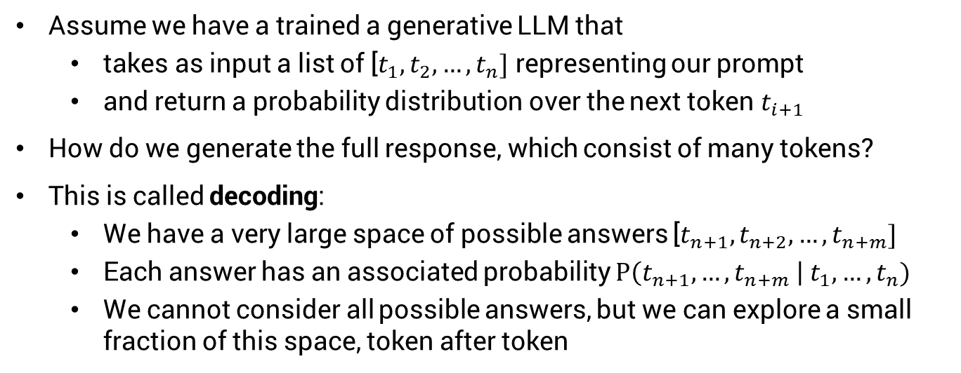
Generation
Assume we have a trained a generative LLM that
  takes as input a list of [$t_{1},t_{2}, …,t_{n}]$ representing our prompt
  and return a probability distribution over the next token $t_{i+1}$
How do we generate the full response, which consist of many tokens?
This is called decoding:
  We have a very large space of possible answers [$t_{n+1},t_{n+2}, …,t_{n+m}]$
  Each answer has an associated probability $P\left(t_{n+1}, …,t_{n+m} \right| t_{1}, …,t_{n})$
  We cannot consider all possible answers, but we can explore a small fraction of this space, token after token

Slide 6
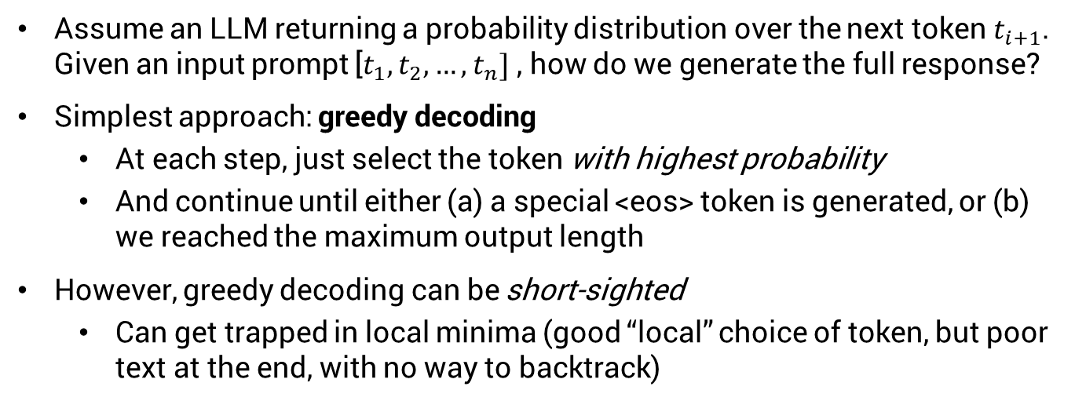
Generation
Assume an LLM returning a probability distribution over the next token $t_{i+1}$. Given an input prompt [$t_{1},t_{2}, …,t_{n}]$ , how do we generate the full response?
Simplest approach: greedy decoding
  At each step, just select the token with highest probability
  And continue until either (a) a special <eos> token is generated, or (b) we reached the maximum output length
However, greedy decoding can be short-sighted
  Can get trapped in local minima (good “local” choice of token, but poor text at the end, with no way to backtrack)

Slide 7
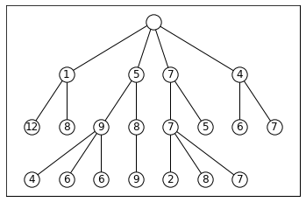
Beam search decoding
Alternative strategy: beam search
  we keep at each step a «beam» of K hypotheses representing the best partial outputs so far
  Those K hypotheses are gradually expanded, token by token
  Until we reach <eos> or the maximum output length
  Finally, we take the hypothesis with max probability among the K alternatives
Beam search with K=3
Less risk for local minima, but computational cost increases with K

Slide 8
Sampling strategies
We can also sample the tokens one by one
Top-K sampling
  At each step, we select the K tokens with highest probability
  We sample the next token only among those K possibilities (after renormalising the distribution)
  And continue until <eos> or max sentence length
Top-p sampling
  Same principle, but instead of a fixed K, we select tokens among those making up the top p % of the distribution mass

Slide 9
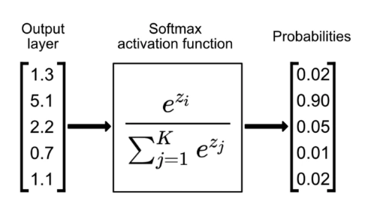

Temperature
The «creativity» of the generation can be controlled by the temperature
Recall the softmax function that turns logits into a proper distribution
We can divide the logits by a value T, which gives:
V
      $$P\left(w_{i}\right)= \frac{e^{\frac{z_{i}}{T}}}{\sum_{j=1}^{V}{e^{\frac{z_{j}}{T}}}}$$
T < 1 will make the decoder more “conservative”, increasing its focus on high-probability tokens
T > 1 will make the decoder more “creative”

Slide 10
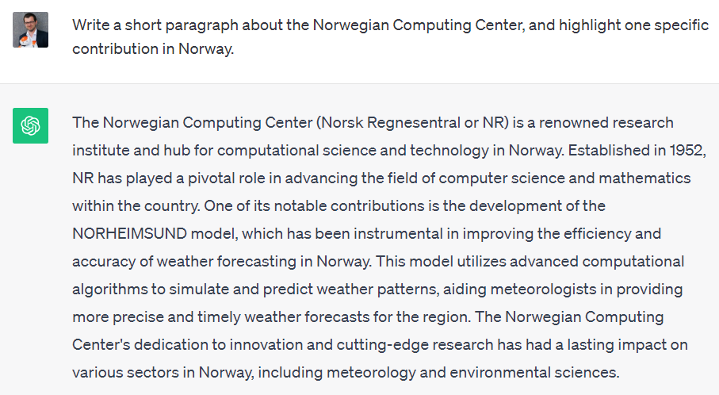
??

Slide 11
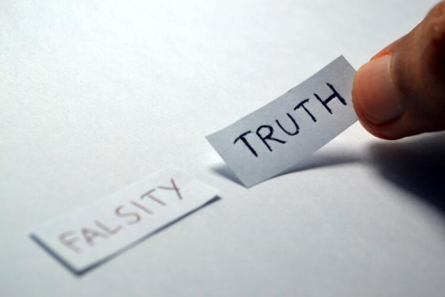
Factuality
Language Models are optimized to produce plausible texts, not necessarily correct ones!
Incorrect answers may come from the training data, which may contain various types of errors or disinformation…
… But language models may still hallucinate with a “perfect” training set!
And often do so in an overly confident tone

Slide 12
Factuality
Multiple approaches to mitigate hallucinations:
  RAG with quality-checked sources (online or internal)
  Reasoning models that proceed step-by-step and weight the pros and cons of a given response
  Tool use (e.g. through programming languages) for tasks requiring logical or mathematical reasoning
  Alignment methods that incentivises LLMs to express uncertainties or knowledge gaps (e.g. allowing them to answer “I don’t know”)
But we can never guarantee the absence of hallucinations

Slide 13


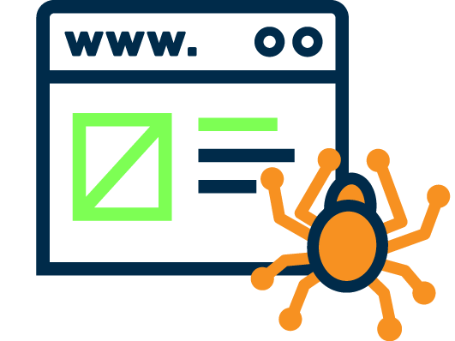
What we haven’t touched
Multimodal foundation models combining text with other modalities (images, videos, but also physical environments for robotics)
Watermarking of LLM-generated content
Sycophantic behaviours in LLMs optimised from human feedback
Broader societal questions, such as questions related to web crawling, privacy and copyright

Slide 14
Outline
Large Language Models (final part)
  Generation
  Open questions
Dialogue systems
  NLU-based chatbots
  Retrieval-based chatbots

Slide 15
The next 2 weeks
What are they?
What applications?
How does (human-human) dialogue actually work?
Dialogue systems
What are the core components of dialogue systems?
Can they be learned from data?
How are dialogue systems designed, built and evaluated?

Slide 16

Dialogue systems?
A dialogue system is an artificial agent designed to interact with humans using (spoken or text-based) natural language
Dialogue system
output signal
(machine utterance)
input signal
(user utterance)
User

Slide 17

What for?
Highly intuitive: no need for training or expertise: all you need is to talk/write!
Touch-based interfaces may be inadequate, cumbersome or dangerous (car driving)
Language is the ideal medium to express complex ideas in a flexible and efficient way

Slide 18

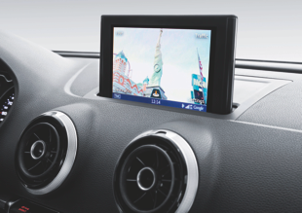
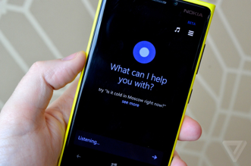


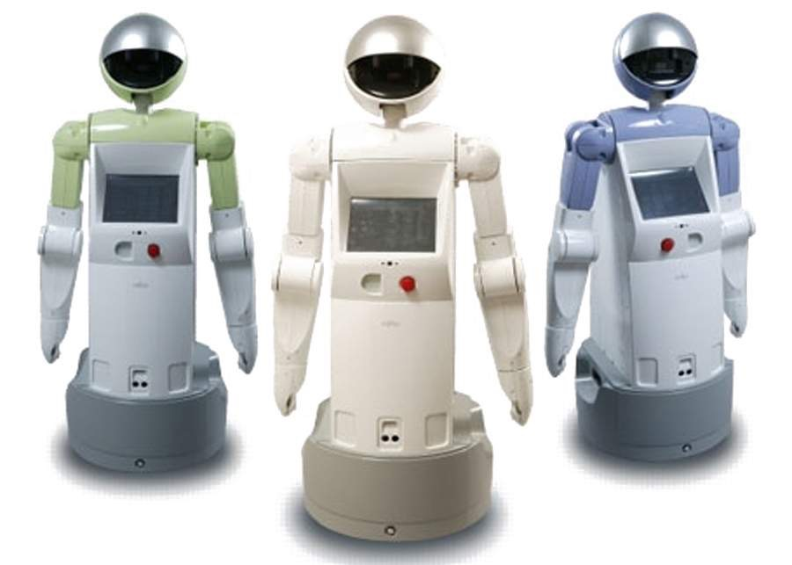
Applications
Chatbots
In-car navigation & control
Virtual assistants
Tutoring systems
Service robots
Smart home environments

Slide 19
Basic architecture
Representation of user intent (discrete category, embeddings from LLM, etc.)
Language
Understanding
Generation / response selection
User
input signal
(user utterance)
output signal
(machine utterance)

Slide 20
Outline
Large Language Models (final part)
  Generation
  Open questions
Dialogue systems
  NLU-based chatbots
  (rule-based or data-driven)
  Retrieval-based chatbots

Slide 21
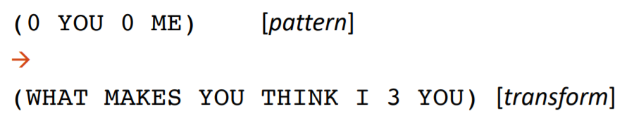
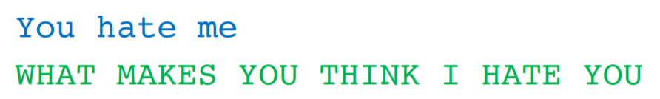
Rule-based models
Pattern-action rules
For instance:
[example from D. Jurafsky]

Slide 22
NLU-based chatbots
Language
Understanding
Generation / response selection
Difficult to write handcrafted patterns to robustly detect the user’s intent
Alternative: frame language understanding as a classification problem, and learn/fine-tune a classifier from data

Slide 23
Intent recognition
Goal: map user utterance to its most likely intent
Input: sequence (of characters or tokens) + possibly preceding context
Output: intent (what the user tries to accomplish)
Intent= GetInfoOpenHours
Intent recognition
Response selection
"When is the recycling station open?"
"The recycling station is open on weekdays from 10 to 18"

Slide 24
Intent recognition
Many possible classification models:
  Classical machine-learning models with a predefined set of features (bag-of-words, manually defined features, etc.)
  Encoder LLMs with a classification head
  (= logistic regression where the input features are the final embeddings computed from the input text)
  Decoder LLMs where the generated response is constrained to the predefined intent categories
Notes:
24

Slide 25
Intent recognition with an encoder LLM
  Example of BERT-like encoding with classification on the special [CLS] token:
Distribution over intents (linear layer + softmax)
Final embeddings
(after N layers)
= multinomial logistic regression
…
…
…
…
…
…
Embeddings after one layer
Initial embeddings
[CLS]
When is ... open ?
(special classif. token)
Notes:
25

Slide 26
Intent recognition with a decoder LLM:
P(GetInfo) = 0.78
…
Distribution over next token
Final embeddings
(after N layers)
…
…
…
…
…
Embeddings after one layer
Initial embeddings
When is ... open ?

Slide 27
Intent recognition
Need to collect training data to learn this classification model
  Data: user utterances (+ context) manually annotated with their intent(s)
  Often annotated by "chatbot trainers" in industry
Multiclass or multilabel?
  If a user input always have one intent → Multiclass
  If the input may have multiple (or zero) intents → Multilabel

Slide 28
Intent recognition
What if we don’t have any data for the fine-tuning?
In-context prompting with an instruction-tuned LLM often provides surprisingly good results
Your task is to find the most likely intent for the given user input provided through a chat interface.
Possible intents are:
1) AskForOpeningHours
Examples: When is your store open?
2) …
Just print the intent, without any explanation or comment.
User Input: “Are you guys open right now?”
Corresponding Intent:

Slide 29
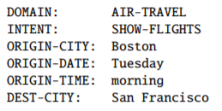
Slot filling
In addition to intents, we also sometimes need to detect specific entities ("slots"), such as mentions of places or times
Slots are domain-specific
  And so are the ontologies listing all possible values for each slot
«Show me morning flights from Boston to San Francisco on Tuesday»

Slide 30
Slot filling
Can be framed as a sequence labelling task (as in NER), using e.g. BIO schemes
O
O
B-ORG
I-ORG
O
Final embeddings
(after N layers)
…
…
…
…
…
…
Embeddings after one layer
Initial embeddings
Where is Norsk Regnesentral ?

Slide 31
Slot filling
O
O
B-ORG
I-ORG
O
Final embeddings
(after N layers)
…
…
…
…
…
Embeddings after one layer
Initial embeddings
Token-level classification task
  Output classes: BIO-prefixed categories
Slot-filling models also need to be trained / fine-tuned on annotated training data
Possible to fine-tune intent classifier and slot filler with the same model

Slide 32
Response selection
Response selection
Given an intent, how to create a response?
In commercial systems, often written by hand
  Need to retain control over the system responses (liability concerns, etc.)
  Sometimes in templated form: "{Place} is open from {Start-time} to {Close-time}"
Intent
System response
NLU
User utterance
Notes:
32

Slide 33
NLU-based chatbots
Fine-grained control of the dialogue flow
+
NLU-based chatbots frame “language understanding” as a text classification problem
  Mapping from user inputs to predefined intents (and slots)
  The intents are associated to handcrafted system responses
-
Somewhat rigid dialogue behaviour
Time-consuming to collect & annotate dialogue data
Can we build dialogue models that can be trained from “raw” dialogues (i.e. without needing to annotate user intents)?

Slide 34
Outline
Large Language Models (final part)
  Generation
  Open questions
Dialogue systems
  NLU-based chatbots
  (rule-based or data-driven)
  Retrieval-based chatbots

Slide 35
Information-Retrieval models
Dialogue corpus
"Did you see the new policy?"
"Yes, skimmed it this morning."
"Thoughts on the flex hours?"
"Quite beneficial for work-life balance."
"Agree. And the remote work rules?"
"A bit strict but necessary."
"Might affect teamwork, don’t you think?"
"Yes, regular virtual catch-ups could help."
"Should we propose that soon?"
"Definitely, in our next team meeting."
"What about the new training modules?"
"They seem thorough, perhaps too long."
"Maybe suggest a condensed version?"
"Good idea, especially for seasoned staff."
"I’ll draft something for our feedback.“
…
= data-driven approach where the chatbot selects a response based on a dialogue corpus
Key idea:
  Given a user input q, find the utterance t in the corpus that is most similar to q
  Then return as response the utterance r that directly follows t in the corpus
Closest utterance t
Selected response r
User input q: “what do you think about rules for remote work?”

Slide 36
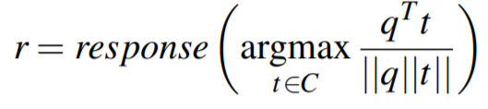
IR models
How to determine which utterance in the training corpus is «most similar» to the actual user input?
➔ Cosine similarity over some vectors
  The vectors can be e.g. TF-IDF weighted words …
  (=sparse retrieval)
  Or document embeddings (=dense retrieval)

Slide 37
Example
TF vectors:
Corpus:
hei !
hei ! har du det bra ?
ja , hva med deg ?
bare bra
har du spist ?
ja
bare | bra | deg | det | du | ja | har | hei | hva | med | spist | , | ! | ?
 |  |  |  |  |  |  | 1 |  |  |  |  | 1
 | 1 |  | 1 | 1 |  | 1 | 1 |  |  |  |  | 1 | 1
 |  | 1 |  |  | 1 |  |  | 1 | 1 |  | 1 |  | 1
1 | 1
 |  |  |  | 1 |  | 1 |  |  |  | 1
 |  |  |  |  | 1
37

Slide 38
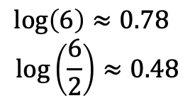
Example
TF-IDF vectors:
Corpus:
hei !
hei ! har du det bra ?
ja , hva med deg ?
bare bra
har du spist ?
ja
bare | bra | deg | det | du | ja | har | hei | hva | med | spist | , | ! | ?
 |  |  |  |  |  |  | .48 |  |  |  |  | .48
 | .48 |  | .78 | .48 |  | .48 | .48 |  |  |  |  | .48 | .48
 |  | .78 |  |  | .48 |  |  | .78 | .78 |  | .78 |  | .48
.78 | .48
 |  |  |  | .48 |  | .48 |  |  |  | .78
 |  |  |  |  | .48
New user utterance q: "går det bra med deg?"
TF-IDF vector:
 | .48 | .78 | .78 |  |  |  |  |  | .78 |  |  |  | .48
38

Slide 39
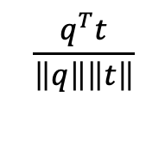

Example
bare | bra | deg | det | du | ja | har | hei | hva | med | spist | , | ! | ?
 |  |  |  |  |  |  | .48 |  |  |  |  | .48
 | .48 |  | .78 | .48 |  | .48 | .48 |  |  |  |  | .48 | .48
 |  | .78 |  |  | .48 |  |  | .78 | .78 |  | .78 |  | .48
.78 | .48
 |  |  |  | .48 |  | .48 |  |  |  | .78
 |  |  |  |  | .48
0
1.07
1.45
0.23
0
0
0
0.50
0.56
0.17
0
0
 | .48 | .78 | .78 |  |  |  |  |  | .78 |  |  |  | .48
39

Slide 40
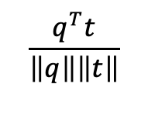
Example
Corpus:
hei !
hei ! har du det bra ?
ja , hva med deg ?
bare bra
har du spist ?
ja
0
0.50
0.56
0.17
0
0
The utterance closest to q in our corpus is utterance 3: « ja, hva med deg?»
the system should choose as response utterance 4
New user utterance q: "går det bra med deg?"
System response: "bare bra"
40

Slide 41
Dual encoders
Another type of IR-based chatbots
We compute here the dot product between the user input (called "context") and a possible response
u_{c}
Utterance encoder (context)
Where are you ?
Dot product u_{c} ∙ u_{r}
u_{r}
Utterance encoder (response)
(= score expressing how good/appropriate the response is for the given context)
Over there !

Slide 42
Dual encoders
Typically based on transformer-based encoder LLMs (BERT or similar)
Utterance encoder (context)
u_{c}
Where are you ?
u_{c} ∙ u_{r}
u_{r}
Utterance encoder (response)
Over there !
The two encoders often have shared layers, apart from a last transformation step that is specific for the context or response

Slide 43
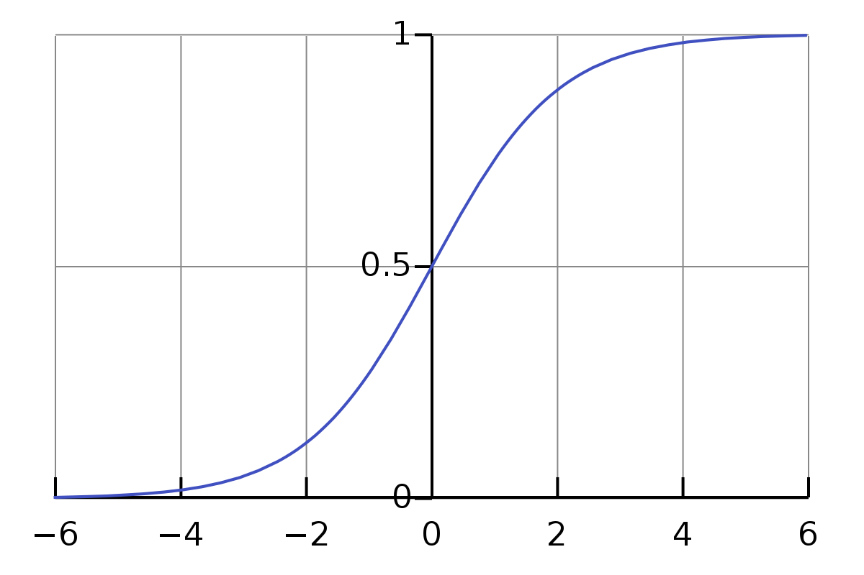
Dual encoders
σ(x) = $\frac{1}{1+e^{−x}}$
u_{c}
Utterance encoder (context)
Where are you ?
σ(u_{c} ∙ u_{r})
u_{r}
Utterance encoder (response)
We can add a sigmoid function to compress the score into the [0,1] range
Over there !
Dual encoders are trained with both positive and negative examples:
Positive : actual consecutive pairs of utterances observed in the corpus ➔ output=1
Negative: random pairs of utterances ➔ output=0

Slide 44
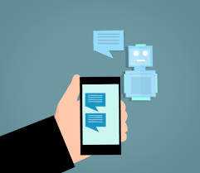
Next week
No physical lecture next Monday – but I’ll put online a series of 3 shorter videos on more advanced topics related to dialogue systems:
  Generative models
  Dialogue management (including reinforcement learning)
  System development and evaluation
We’ll meet again in two weeks for a physical lecture on speech processing

