Slide 1
Dialogue systems (4)
Pierre Lison plison@nr.no
IN4080, Autumn 2025, video lecture

Slide 2
Week 43
The second lecture on dialogue systems will be done remotely, through a series of shorter videos
Don’t hesitate to reach out to me (plison@nr.no) or on our Discourse channel if you have any questions!
Plan:
Video 1: generative dialogue models
Video 2: dialogue management
Video 3: system development and evaluation

Slide 3

Obligatory assignment 4
The final obligatory assignment of the IN4080 course is now out!
  See github repo
Deadline: Friday, November 7 at 23:59
Two parts:
  Implementation of a talking elevator
  Machine translation experiments
Don’t wait until the last minute!
  And let us know if you experience problems

Slide 4
Outline
System development
Evaluation metrics

Slide 5
Outline
System development
Evaluation metrics

Slide 6

Quick recap
Language
Understanding
Generation / response selection
User
Extra linguistic context
Non-verbal actions
input signal
(user utterance)
output signal
(machine utterance)

Slide 7
Pipeline architectures
Acronyms:
ASR: Automatic Speech Recognition
NLU: Natural Language Understanding
DM: Dialogue Management
NLG: Natural Language Generation
TTS: Text-to-speech Synthesis
Components connected in processing chain
Each component is a black box getting inputs from its predecessor and generating an output
ASR
NLU
DM
NLG
TTS
  Limitations:
  No feedback between components
  Rigid information flow
  Poor turn-taking behaviour (system does not react until the full pipeline has been traversed)

Slide 8
End-to-end architectures
ASR
TTS
NLU + DM + NLG
(single LLM model)
Dialogue context (history, external knowledge etc.)
Single LLM mapping user inputs to responses
Pro: no need for separate modules
Con: less modular setup (harder to debug and interpret)
Dialogue management either done implicitly or by modifying the prompt

Slide 9
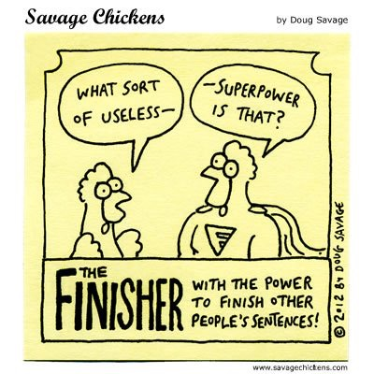
Incrementality
Humans process and produce language incrementally:
When listening, we don't wait for an utterance to be fully pronounced to process it!
We gradually refine our understanding as we go, phoneme by phoneme
We also continuously provide feedback signals
Human-human dialogues are full of interruptions, speech overlaps, backchannels, and co-completion of utterances

Slide 10

Incrementality
But many dialogue systems operate in «batch mode»
  NLU expects full utterance as input
  TTS waits for complete system response to start synthesis
Leads to «ping-pong» turn-taking behaviour:
  Alternating turns between user & system, one speaker at a time
However, recent work has shown how LLMs can be adapted to operate in «full-duplex» mode
[Wang, P. et al (2024). A Full-duplex Speech Dialogue Scheme Based On Large Language Models. NeurIPS 2024]

Slide 11
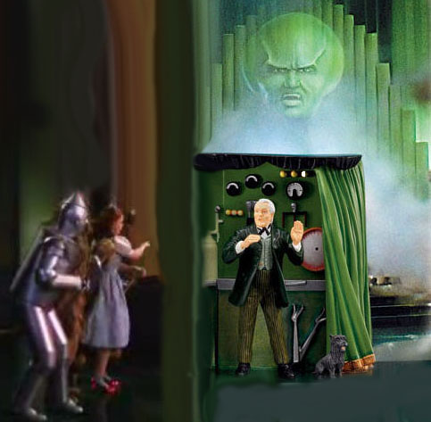
How to collect data?
"Chicken-and-egg" problem:
  Need data to train models
  But to collect in-domain data, we need a system that can interact with users
One solution: Wizard-of-Oz studies
= experiment in which users interact with a seemingly autonomous system, but which is actually operated by an unseen human being

Slide 12
Outline
System development
Evaluation metrics

Slide 13

Evaluation
Some dialogue processing tasks have standard evaluation metrics:
  ASR: Word Error Rate
  NLU: [precision, recall, F-score] for intent recognition and slot-filling
  TTS: evaluation by human listeners on sound intelligibility and quality
But how do we evaluate the end-to-end conversational behaviour of the system?

Slide 14
Evaluation
One way to evaluate is via user satisfaction ratings
The ratings can be obtained from surveys that users are asked to fill after interacting with the system:
TTS Performance | Was the system easy to understand ?
ASR Performance | Did the system understand what you said?
Task Ease | Was it easy to find the message/flight/train you wanted?
Interaction Pace | Was the pace of interaction with the system appropriate?
User Expertise | Did you know what you could say at each point?
System Response | How often was the system sluggish and slow to reply to you?
Expected Behavior | Did the system work the way you expected it to?
Future Use | Do you think you’d use the system in the future?
[M. Walker et al. (2001), «Quantitative and Qualitative Evaluation of Darpa Communicator Spoken Dialogue Systems», Proceedings of ACL]

Slide 15
Evaluation
However, user evaluation surveys are expensive and time-consuming
  Not feasible to conduct after each system change!
  Can we automate the evaluation process?
Possible solution: rely on metrics that can be extracted from interaction logs & are known to correlate with user satisfaction
  Hypothesis: improving these observable metrics should therefore increase user satisfaction
[M. Walker et al. (1997), "PARADISE: A general framework for evaluating spoken dialogue agents", Proceedings of ACL]

Slide 16
Evaluation
Criteria | Description | Possible metrics
Task completion success | How often did the system complete its task successfully? | κ agreement on slots completion ratio
Efficiency costs | How efficient was the system in executing its task? | nb of turns (from user, system, or both) total elapsed time
Quality costs | How good was the system interaction? | nb of ASR rejection prompts nb of user barge-ins nb of error messages
NB: this list of metrics is of course not exhaustive!

Slide 17
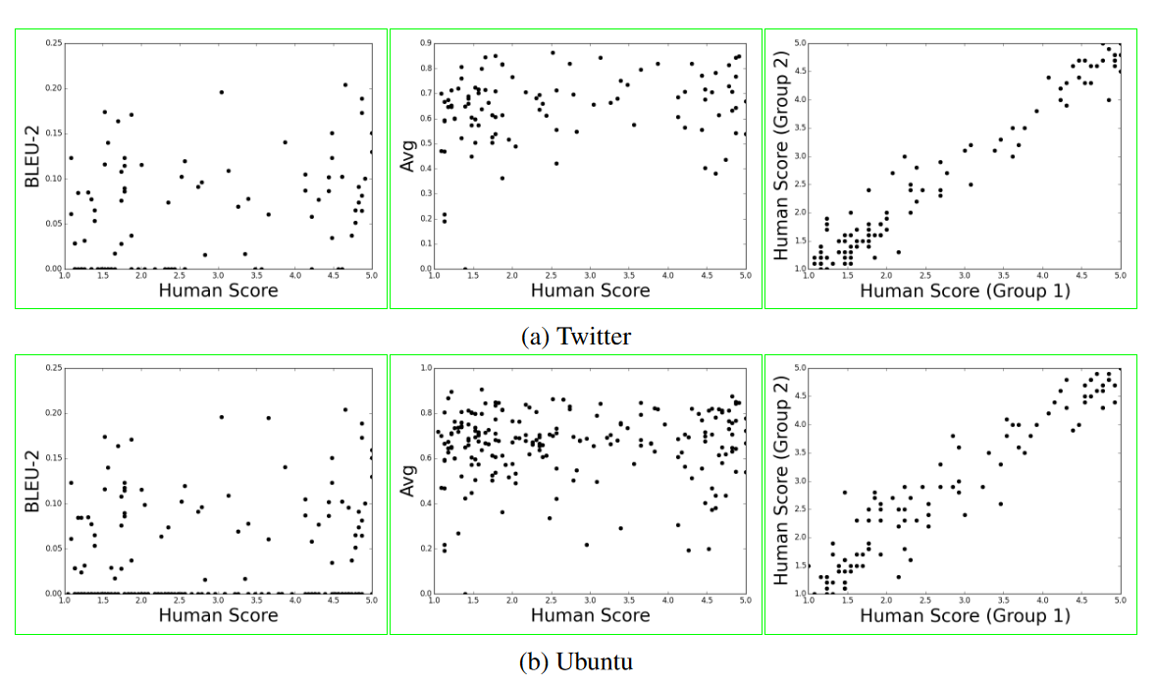
Evaluation
Can we use overlap-based metrics (BLEU, ROUGE etc.) to compare system outputs with human responses?
  Benefit: straightforward if you have access to high-quality responses
  But: weak correlation between BLEU scores and human judgments!
[Liu et al (2016). How NOT To Evaluate Your Dialogue System: An Empirical Study of Unsupervised Evaluation Metrics for Dialogue Response Generation. In EMNLP.]

Slide 18
Evaluation
To get a more “semantic” view on the similarity between the system outputs and human references, metrics such as BERTScore are preferable
  And ideally with more than one reference response…
Many reference-free metrics are also available:
  ADEM, DynaEval, USR, etc.
  Typically optimized to correlate with human ratings, by identifying features that characterize “good responses”
Yeh, Y. T., Eskenazi, M., & Mehri, S. (2021). A Comprehensive Assessment of Dialog Evaluation Metrics. In The First Workshop on Evaluations and Assessments of Neural Conversation Systems.

Slide 19
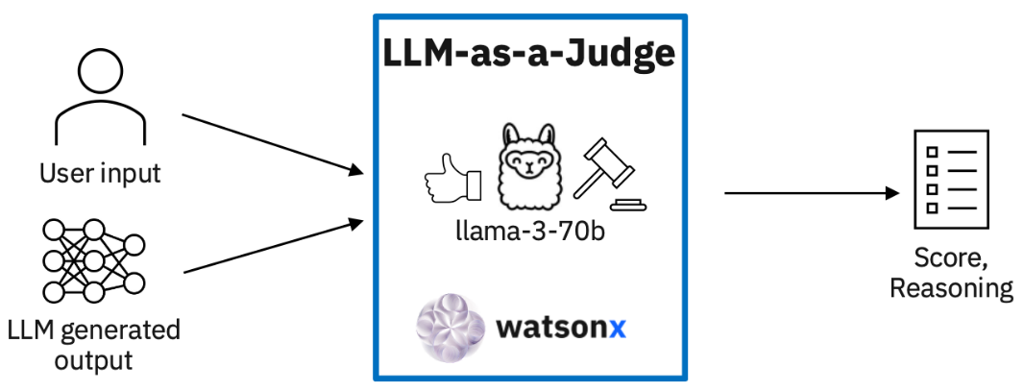
LLM-as-a-judge
Idea: Ask an LLM to judge the quality of the system responses
  Preferably using another model than the one employed to generate the response
  Need to describe precisely the evaluation criteria (along with examples)
Can give useful insights…
But: beware of large variances, depending on the prompt (in particular how the evaluation criteria are described), model, and dialogue domain!
Bavaresco, A et al (2024). LLMs instead of human judges? A large-scale empirical study across 20 NLP evaluation tasks. arXiv.

Slide 20
Human evaluations
Selection/ranking of preferred responses (to compare systems)
Surveys after the dialogue is complete
➔ Need to provide human evaluators with well-defined criteria they will need to assess along with a scale (i.e. Likert)
You should include several evaluators in your study and compute their inter-annotator agreement
When comparing systems, compute the statistical significance of your findings (using e.g. the Wilcoxon signed-rank test)

Slide 21

What we haven’t covered
Speech (lecture next week)
Multimodal & situated systems
Furhat robot (initially developed at KTH, Stockholm), see www.furhatrobotics.com

