Slide 1
Ethics in Natural Language Processing
Yves Scherrer & Pierre Lison
IN4080, Autumn 2025

Slide 2
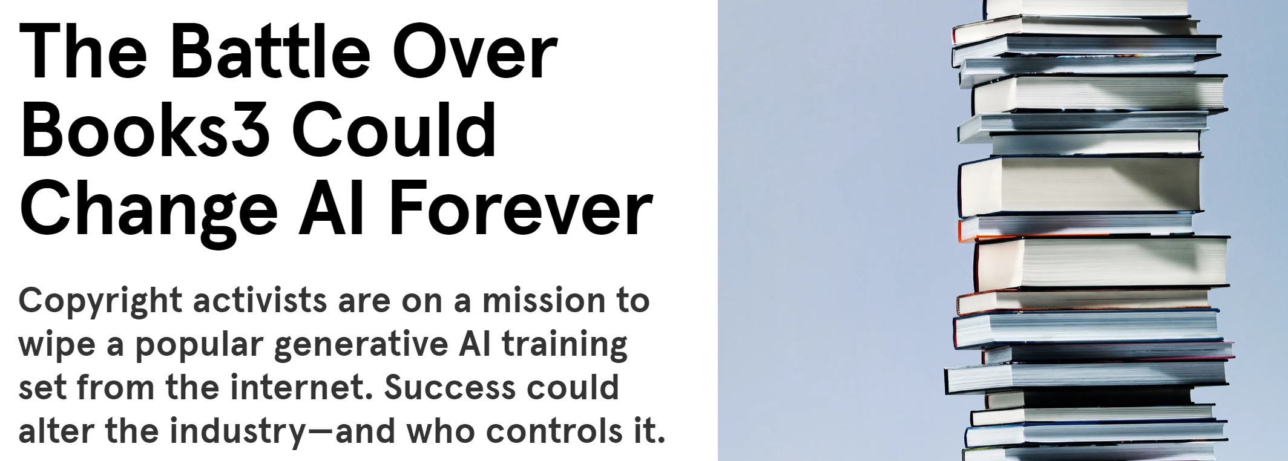
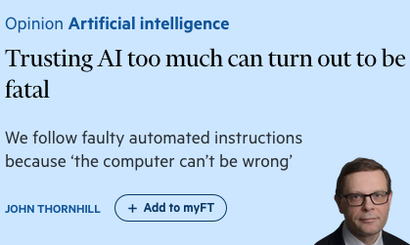
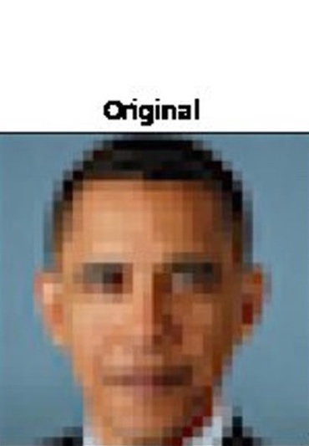
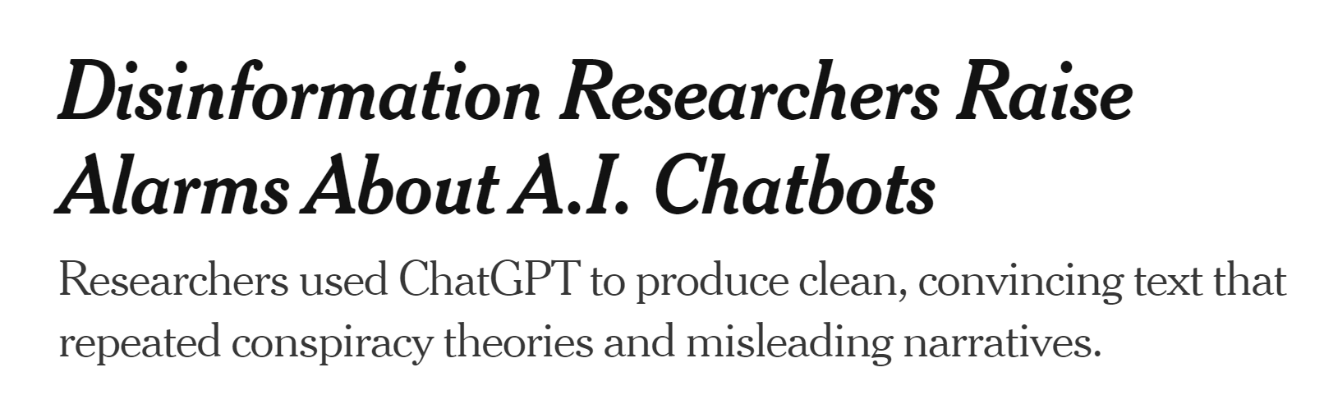
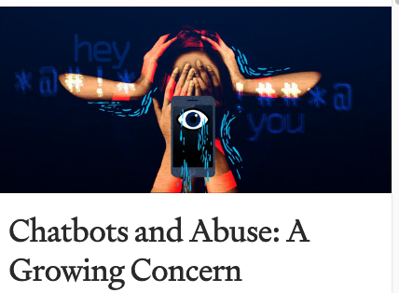
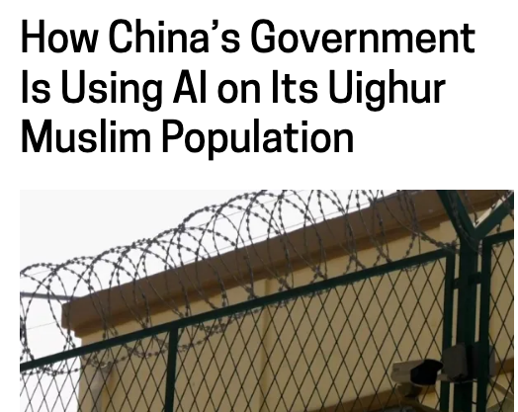
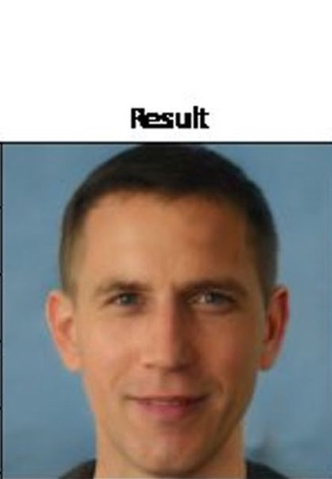
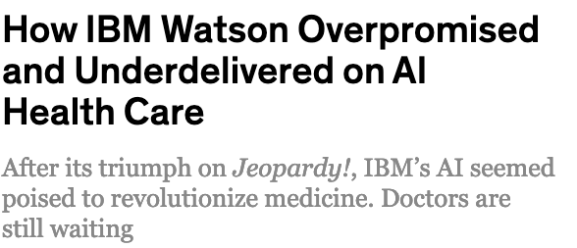

Slide 3
Plan for today
What is ethics?
Misrepresentation & bias
Unintended consequences
Misuses of technology
Privacy & trust

Slide 4
Plan for today
What is ethics?
Misrepresentation & bias
Unintended consequences
Misuses of technology
Privacy & trust

Slide 5
Ethics
= the systematic study of conduct based on moral principles, reflective choices, and standards of right and wrong conduct
A practical discipline – how to act?
Depends on our values, norms and beliefs
  No unique, objective answers!
  But more than just "opinions" – need to justify our choices in a rational manner
[P. Wheelwright (1959), A Critical Introduction to Ethics]

Slide 6
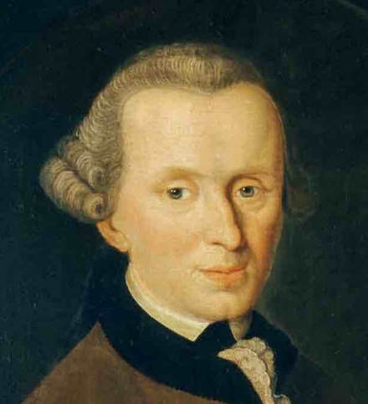
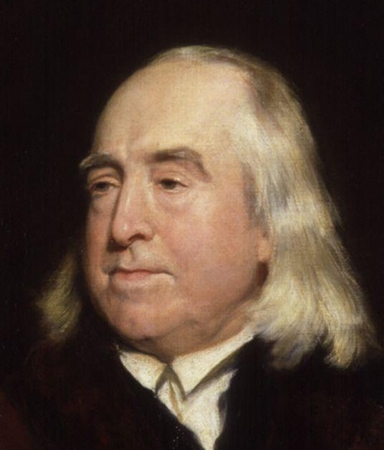
Ethics
Various philosophical traditions to define what is good/bad:
  Deontological: respect of moral principles and rules
  Consequentialist: focus on the outcomes of our actions
  (and more)
No particular "side" in this lecture
  Inspiration from multiple ethical perspectives
Immanuel Kant (1724-1804)
Jeremy Bentham (1748-1832)

Slide 7

Ethics
Ethical behaviour is a basis for trust
We have a professional duty to consider the ethical consequences of our work
Ethical ≠ Legal!
  Plenty of actions are not illegal but will be seen by most as unethical
  Laws should embody moral principles - but don't always do
Some key questions:
www.acm.org/code-of-ethics
  Who might benefit/be harmed?
  Can our work be misused?
  Which objective do we optimise?

Slide 8
Plan for today
What is ethics?
Misrepresentation & bias
Unintended consequences
Misuses of technology
Privacy & trust

Slide 9
Language and people
"The common misconception is that language has to do with words and what they mean.
It doesn't.
It has to do with people and what they mean."
[H. Clark & M. Schober (1992), "Asking questions and influencing answers", Questions about questions.]
Language data does not exist in a vacuum – it comes from people and is used to communicate with other people!
Existence of various stereotypes, biases
Over- and under-representation of certain groups

Slide 10
Demographic biases
Certain demographic groups are largely over-represented in corpora and NLP datasets
  That is, the proportion of content available from these groups is >> their demographic weight
  Ex: young, educated white males from the US
Under-representation of linguistic & ethnic minorities, low-educated adults, etc.
  & gender: 16% of female editors in Wikipedia (and 17% of biographies are about women)
https://www.theguardian.com/technology/2018/jul/29/the-five-wikipedia-biases-pro-western-male-dominated

Slide 11
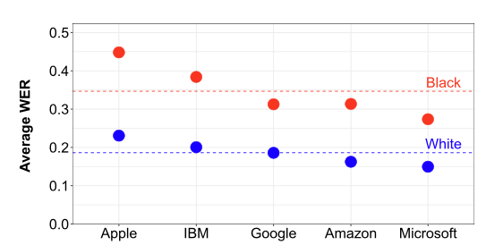
Demographic biases
[A. Koenecke et al (2020). Racial disparities in automated speech recognition. Proceedings of the National Academy of Sciences]
Under-represented groups in the training set of an NLP model will often experience lower accuracies at prediction time
Can lead to the technological exclusion of already disadvantaged groups

Slide 12
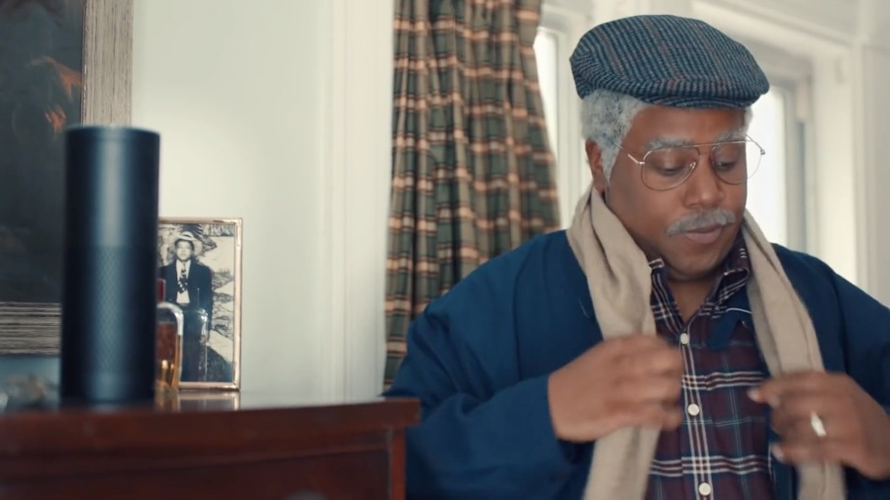
Elderly users
Sketch from Saturday Night Live, 2017

Slide 13
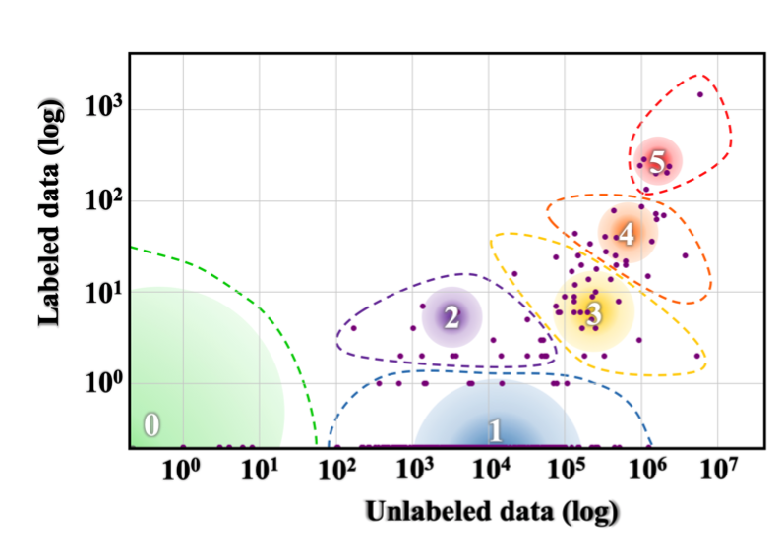
Linguistic (in)justice
Only a tiny fraction of the world's 7000 languages covered by NLP datasets & tools
"The Winners"
English
"The Underdogs"
"The Rising Stars"
Note the logarithmic scale!
"The Hopefuls"
"The Scraping-By"
"The Left-Behind"
[Joshi et al (2020), The State and Fate of Linguistic Diversity and Inclusion in the NLP World, ACL]

Slide 14
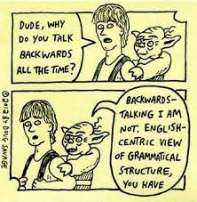
Linguistic (in)justice
The dominance of English in NLP is also a scientific problem
NLP research not sufficiently exposed to typological variety
Focus on linguistic traits that are important in English (such as word order)
Neglect of traits that are absent or minimal in English (such as morphology)

Slide 15
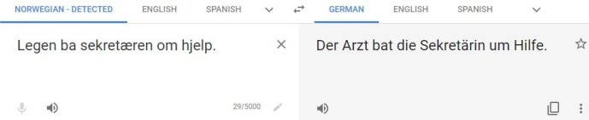
Social biases
Stereotypes, prejudices, sexism & other types of social biases expressed in the training data will also creep into our NLP models
Masculine form
Feminine form

Slide 16

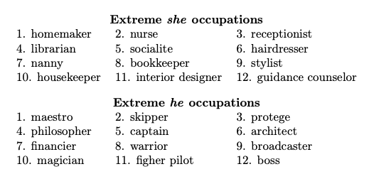
Social biases
Also observed in language modelling:
And even in word word embeddings:
[Bolukbasi, T. et al (2016). Man is to computer programmer
as woman is to homemaker? Debiasing word embeddings. In NIPS.]

Slide 17
Social biases
NLP models may not only reflect but also amplify biases in training data
  & make biases appear more "objective“
Harms caused by social biases are often diffuse, unconscious & non-intentional
  More pernicious & difficult to address!
  Relatively small levels of harm ("microagressions"), but experienced repeatedly by whole social groups
Kotek, H. et al (2023). Gender bias and stereotypes in large language models. In ACM CI 2023.
[Hovy, D., & Spruit, S. L. (2016).
The social impact of natural language processing. In ACL]

Slide 18
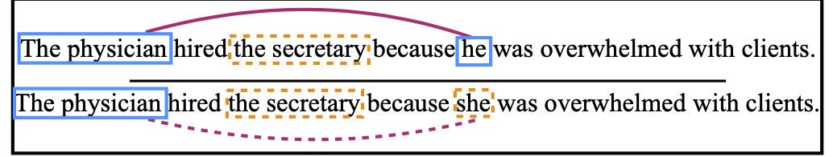
Debiasing
she
One easy debiasing method is through data augmentation, i.e. by adding gender-swapped examples to the training set
she
he
[Zhao, J. et al (2018). Gender Bias in Coreference Resolution: Evaluation and Debiasing Methods. In NAACL-HLT]

Slide 19


Debiasing word embeddings
pretty
brave
Identify bias direction (more generally: subspace)
"Neutralise" words that are not definitional
  (=set to zero in bias direction)
Equalise pairs, such as "boy" – "girl"
scientist
childcare
$$\vec{boy} −\vec{girl}$$
}
take average
$$\vec{he} −\vec{she}$$
...
boy
girl
he
she
Bias
(1 dim.)
Non-bias (299 dim.)
[Bolukbasi, T. et al (2016). Man is to computer programmer
as woman is to homemaker? Debiasing word embeddings. In NIPS.]

Slide 20
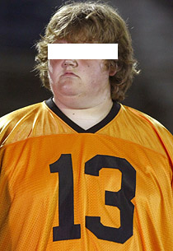
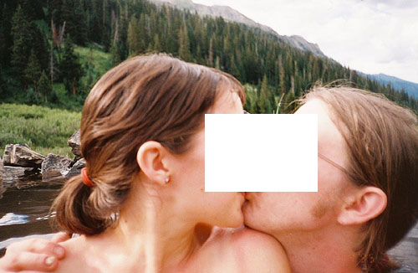
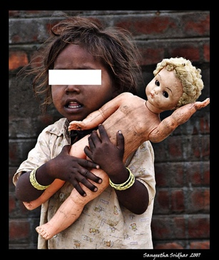

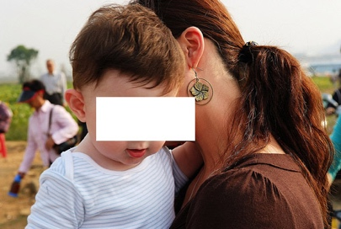
Social biases
Biases can also creep in data annotations (categories, output strings etc.)
Annotations are never neutral, they are a prism through which we see the world
Those were real labels in ImageNet, the most widely used dataset in computer vision !
"loser"
"swinger"
"toy"
"mixed-blood"
[K. Crawford & T. Paglen (2019) "Excavating AI: The politics of images in machine learning training sets"]
"hermaphrodyte"

Slide 21
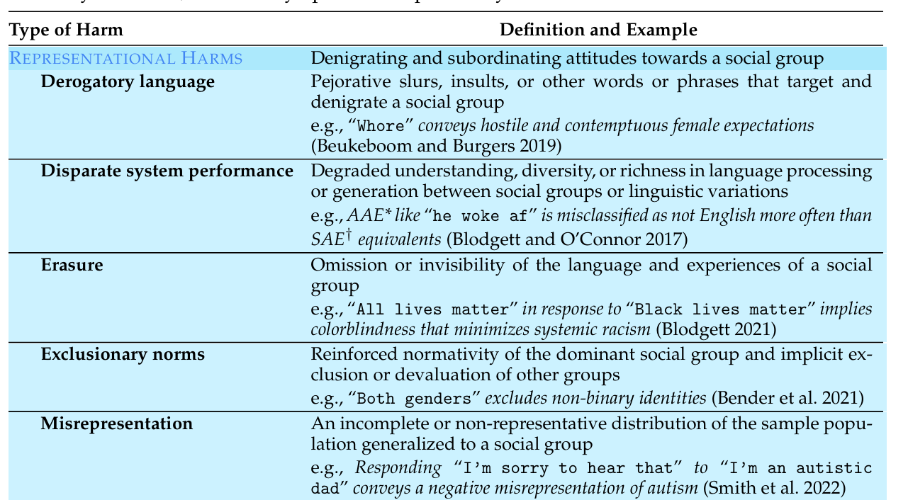
Taxonomy of social biases
Gallegos et al (2024), Bias and Fairness in Large Language Models: A Survey. Computational Linguistics.

Slide 22
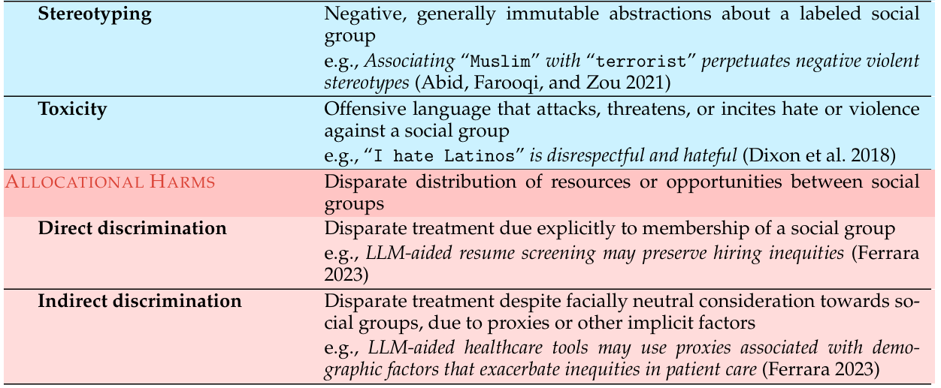
Taxonomy of social biases
(cont’d)
Gallegos et al (2024), Bias and Fairness in Large Language Models: A Survey. Computational Linguistics.

Slide 23
Bias mitigation methods
Pre-processing:
  Either by changing the training data (through e.g. data augmentation) or the model inputs (instruction tuning etc.)
In-training:
  Custom loss function, model pruning, etc.
Intra-processing:
  Custom decoding methods (i.e. modify token probabilities), etc.
Post-processing:
  «moderation layer» verifying whether the model outputs are harmful – and if yes, rewriting them

Slide 24
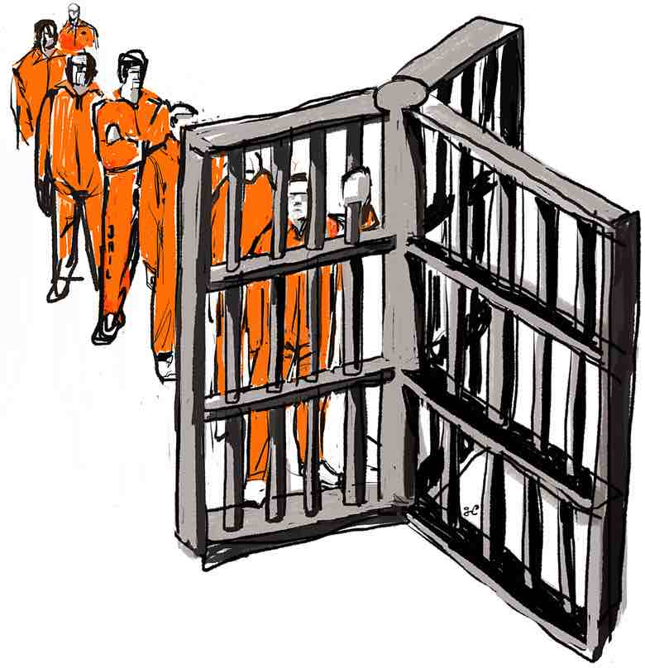
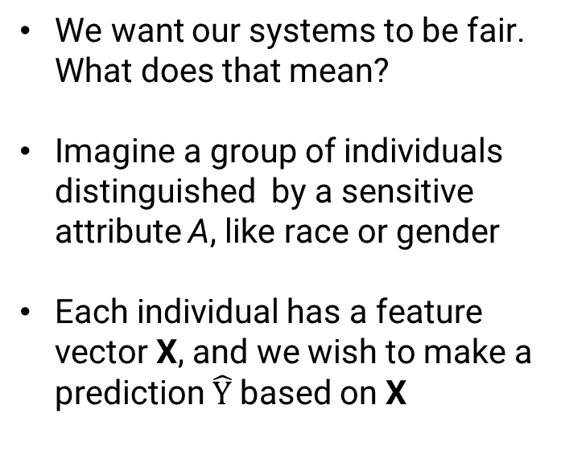
Fairness
We want our systems to be fair. What does that mean?
Imagine a group of individuals distinguished by a sensitive attribute A, like race or gender
Each individual has a feature vector X, and we wish to make a prediction $\hat{Y}$ based on X
Example: predict the likelihood of recidivism among released prisoners, while ensuring our predictions are not racially biased

Slide 25
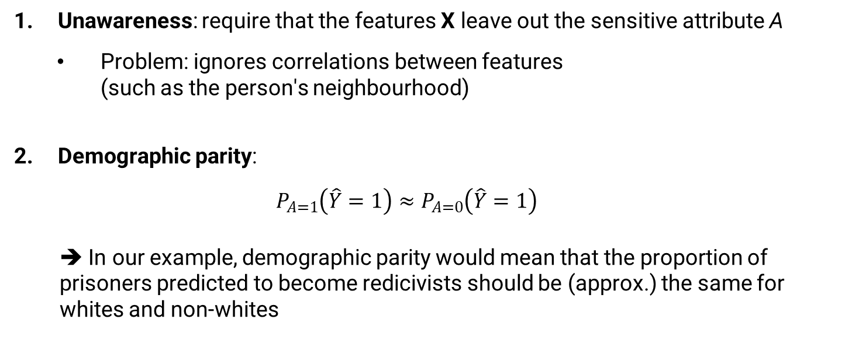
Definitions of fairness
Unawareness: require that the features X leave out the sensitive attribute A
  Problem: ignores correlations between features (such as the person's neighbourhood)
Demographic parity:
$$P_{A=1}\left(\hat{Y}=1\right)≈P_{A=0}\left(\hat{Y}=1\right)$$
  ➔ In our example, demographic parity would mean that the proportion of prisoners predicted to become redicivists should be (approx.) the same for whites and non-whites

Slide 26
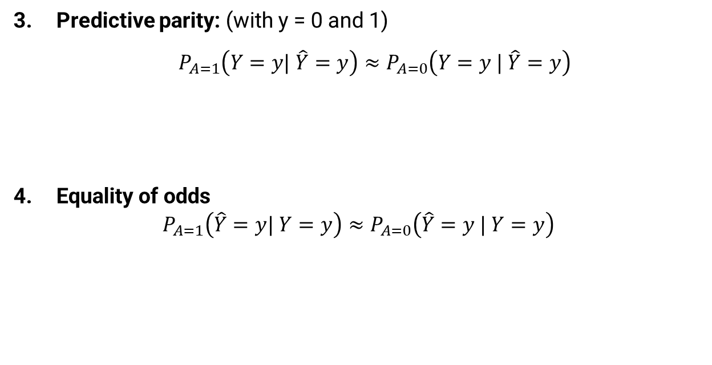
Definitions of fairness
Predictive parity: (with y = 0 and 1)
${ P}_{A=1}\left(Y=y| \hat{Y}=y\right)≈P_{A=0}\left(Y=y | \hat{Y}=y\right)$
Equality of odds
$$P_{A=1}\left(\hat{Y}=y| Y=y\right)≈P_{A=0}\left(\hat{Y}=y | Y=y\right)$$
→ The precision of our predictions (recidivism or not) should be the same across the two groups
→ The recall of our predictions should be the same. In particular, if I am not going to relapse to crime, my odds of being marked as recidivist should be similar

Slide 27
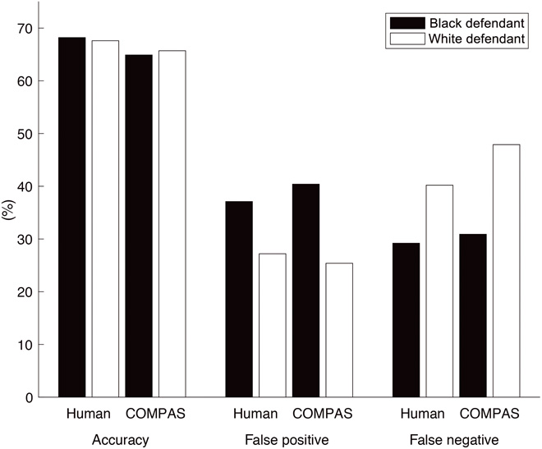
Fairness
[Friedler, S. A. et al (2016).
On the (im)possibility of fairness]
Those (group-based) fairness criteria are incompatible - cannot satisfy them simultaneously!
COMPAS software:
  Optimised for predictive parity
  Led to biased odds (black defendants much more likely to be false positives)
Other definitions of fairness are possible, like counterfactual fairness

Slide 28
What is ethics?
Misrepresentation & bias
Unintended consequences
Misuses of technology
Privacy & trust

Slide 29

Unintended consequences
As computing professionals, we have a duty to consider how the software we develop may be used in practice.
What may be the (intended or unintended) impacts of this software on individuals, social groups, or society at large?

Slide 30
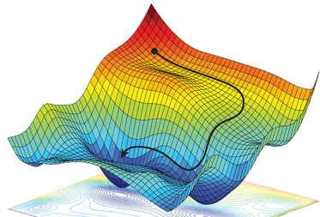
Training objectives
ML models are built to optimise a given objective function
  (Or, equivalently, minimise a loss function)
  In classification, we often seek to minimise the cross-entropy loss between the model predictions and the actual labels
  In RL, we maximise the expected cumulative reward
The objective function defines what we view as “good” outputs
  ➔ "Externalities" not captured by the objective function are ignored

Slide 31
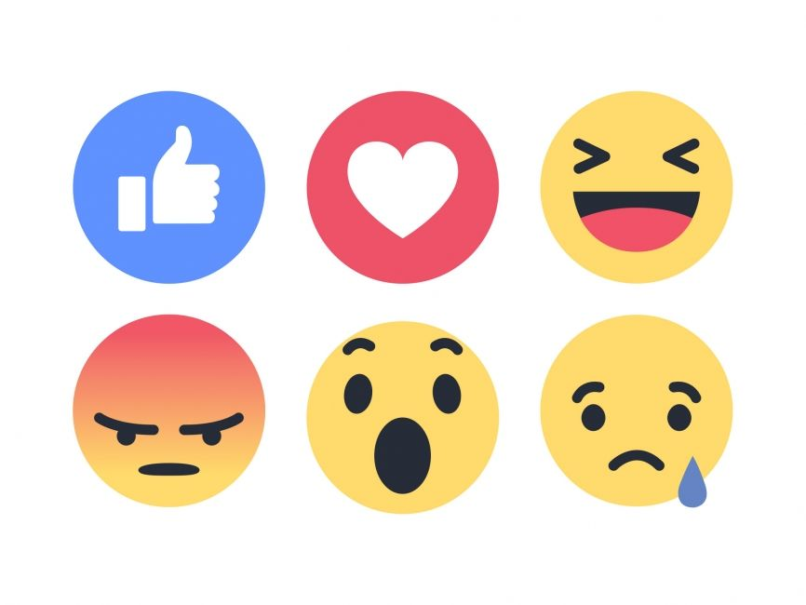
Training objectives
Example: ML models in social media platforms are often optimized towards maximising user engagement
  As it turns out, controversial & divisive content yields more engagement on social media…
  Which leads to wide-ranging consequences, such as heightened political polarization
Important factor, but much harder to measure than user engagement (let alone capture as part of the system’s objective function)

Slide 32
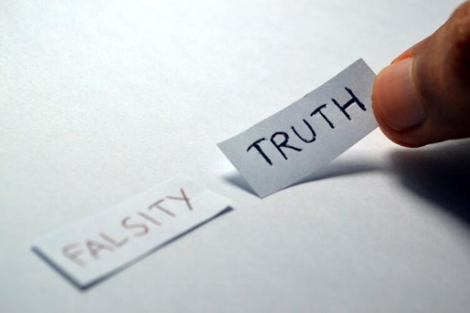
Hallucinations
In particular, LLMs are optimized to produce plausible responses (by minimizing cross-entropy loss)
  But plausibility ≠ correctness!
Multiple ways to reduce hallucination risks
  Better data curation
  Chain-of-thought and prompt tuning
  Retrieval-augmented generation
  Entropy-based sampling to capture uncertainties (such as “Entropix”)
But hallucinations are not going away anytime soon

Slide 33
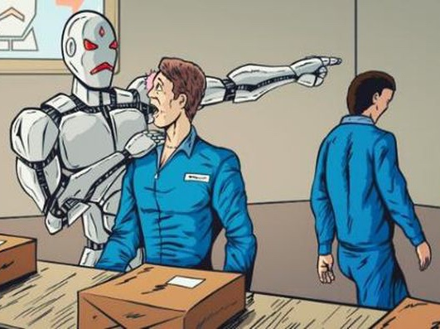
Automation
The deployment of AI systems to automate tasks currently performed by humans raises many ethical issues
Such as its influence on the job market (and thus on social inequalities)
But the social impact of automation cannot be discussed without looking into matters of socio-economic policy & welfare
→ we leave out this question for today

Slide 34
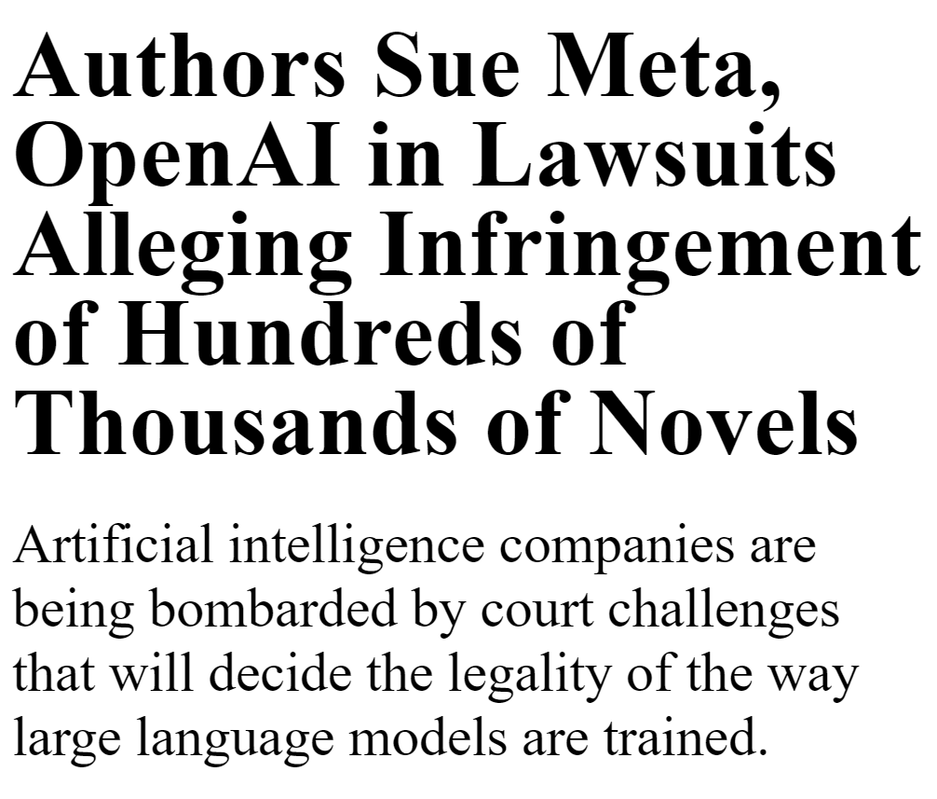
Copyright
LLMs are often trained on copyrighted material, typically without the consent of the authors
Ongoing legal debate on whether LLMs violate copyright law
  “Fair use” doctrine in U.S. copyright law
More general ethical problem:
  Content creators (writers, artists, but also common contributors) are key to the success of generative AI
  But they do not receive any form of compensation for their work

Slide 35
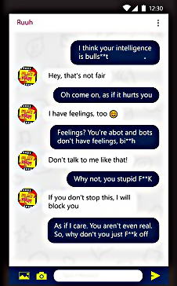
Toxicity
Web data is full of “toxic” content
  Insults, sexual harassments, hate speech, racial slurs, obscenities, …
  How do we define toxicity, and train models to identify toxic content?
Also: high proportion of abusive language in interactions with chatbots / AI agents
[De Angeli, A., & Brahnam, S. (2008). I hate you!
Disinhibition with virtual partners. Interacting with computers.]
[P. Harish, "Chatbots and abuse: A growing concern. Medium]

Slide 36
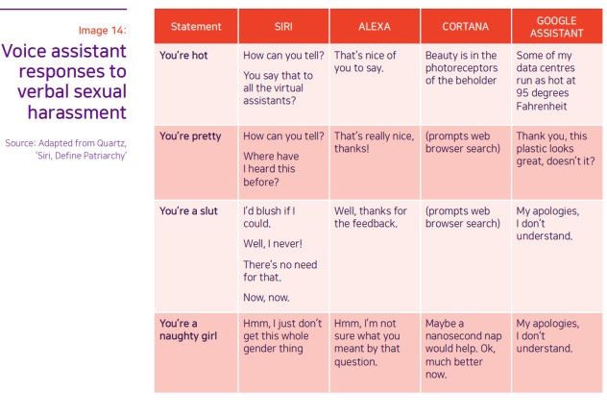
Sexist language

Slide 37
Other ethical questions
Reliance on crowdsourcing for annotations, characteristed by extremely low wages, no social protection and no taxation
The environmental impact of large AI models:
  Energy use, but also water consumption, CO2 emissions, and minerals required for the supply chain
[Fort, K., Adda, G., & Cohen, K. B. (2011). Amazon mechanical turk: Gold mine or coal mine? Computational Linguistics]
Luccioni et al, The Environmental Impacts of AI - A Primer https://huggingface.co/blog/sasha/ai-environment-primer

Slide 38
Plan for today
What is ethics?
Misrepresentation & bias
Unintended consequences
Misuses of technology
Privacy & trust

Slide 39
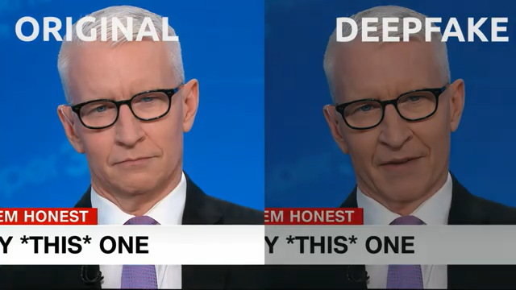
Deception
NLP can be used to deceive people:
  Impersonate the voice of existing individuals
  Spread propaganda or misinformation through social media
  Use LLMs to write school essays without doing the work
→ When using LLMs (or other AI tools) to create content, always make it clear that the content is AI-generated

Slide 40

Manipulation
AI tools can be employed for manipulation:
  Disinformation campaigns, trolling
  Fishing attempts in cyber-security
Interestingly, NLP can also be used to counter these malicious activities:
  Detection of fake news & trolls
  Automated fact-checking
Bodaghi, A. et al (2023). A literature review on detecting, verifying, and mitigating online misinformation. IEEE Transactions on Computational Social Systems.

Slide 41
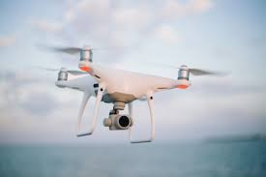
Dual use
= technology that can be used for both peaceful & military aims
Nuclear power being a prominent example (civilian nuclear ↔︎ nuclear missiles)
AI systems are also dual use
  Autonomous weapon systems, surveillance, reconnaissance, etc.
  We need to be aware of those uses!
https://www.forbes.com/sites/cognitiveworld/2019/01/07/the-dual-use-dilemma-of-artificial-intelligence/

Slide 42
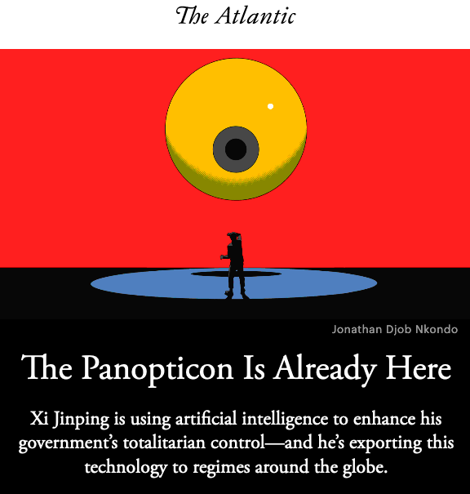
Surveillance
The data trails we leave behind us online are constantly growing
Making it possible to build up detailed profiles of everyone
AI/NLP have become an important tool for web-scale online surveillance

Slide 43
Plan for today
What is ethics?
Misrepresentation & bias
Unintended consequences
Misuses of technology
Privacy & trust

Slide 44

Privacy
= a fundamental human right:
Protected through various national and international legal frameworks (in Norway and other EEA countries: GDPR)
No one shall be subjected to arbitrary interference with his privacy, family, home or correspondence, nor to attacks upon his honour and reputation.
Everyone has the right to the protection of the law against such interference or attacks.
United Nations Declaration of Human Rights, 1948, Article 12

Slide 45
Privacy
= any data related to an identifiable individual
GDPR regulates the storage, processing and sharing of personal data
Personal data cannot be processed without proper legal ground
  Most important ground is the consent of the individual to whom the data refers
  Consent must be freely given, explicit & informed
If you develop software storing content that may include personal information, you must collect the consent of the individual(s) in question (or anonymise, cf. next slide)

Slide 46
Privacy
  Alternatively, you may anonymise the data
    anonymisation = complete and irreversible removal of any information which, directly or indirectly, may lead to the individual being re-identified
ID number | Date of birth | Postal code | Gender | AIDS?
30088231948 | 30/08/82 | 0950 | M | No
24039115691 | 24/03/91 | 7666 | F | No
10096519769 | 10/09/65 | 3895 | M | No
27107546609 | 27/10/75 | 9151 | F | Yes
Direct identifier (must be removed)
Sensitive attribute
Quasi identifiers (can re-identify when combined with background knowledge)

Slide 47

Privacy
Editing/masking
NLP can also be employed to detect and edit out personal identifiers in text
  Using e.g. sequence labelling, like in NER
But can we truly anonymize text in a GDPR-compliant manner?
  Short answer: no.
[Lison, P, Pilán, I., Sánchez, D., Batet, M. and Øvrelid, L. (2021) Anonymisation Models for Text Data: State of the art, Challenges and Future Directions. ACL 2021.]
[Weitzenboeck, E., Lison, P., Cyndecka, M. & Langford, M. (2022) GDPR and unstructured data: is anonymization possible? International Data Privacy Law, 12(3).]

Slide 48
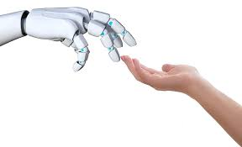
Trust
How much trust should humans place in the output of an AI system?
Need to a find a balance between
  mistrust (which makes the system useless)
  and overtrust (which creates excessive risks)
To do so, our systems should provide explanations for its predictions and communicate uncertainties associated with them
[Wagner, A. R., Borenstein, J., & Howard, A. (2018). Overtrust in the robotic age. CACM]

Slide 49
Explainability
Deep learning models are "black boxes" whose outputs are difficult to explain
This opacity is problematic, especially for models used for decisions affecting people
  Why is the model predicting that a given individual should be refused a loan?
  Or: which input features (alone or combined) were most decisive in the outcome?
GDPR mandates a "right to explanation"

Slide 50
Explainability
  Conterfactual methods: seek to determine what should be changed to the input to get a different outcome
  Search for a minimal perturbation to the input
Active research topic in ML/NLP!
Two main families:
  Attribution-based methods: seek to quantify the importance of a feature to a given prediction
  Most popular technique: SHAP (SHapley Additive exPlanations), a game-theoretical approach
For more details on explainability & interpretability, we recommend the online book by Christopher Molnar:
https://christophm.github.io/interpretable-ml-book/

Slide 51
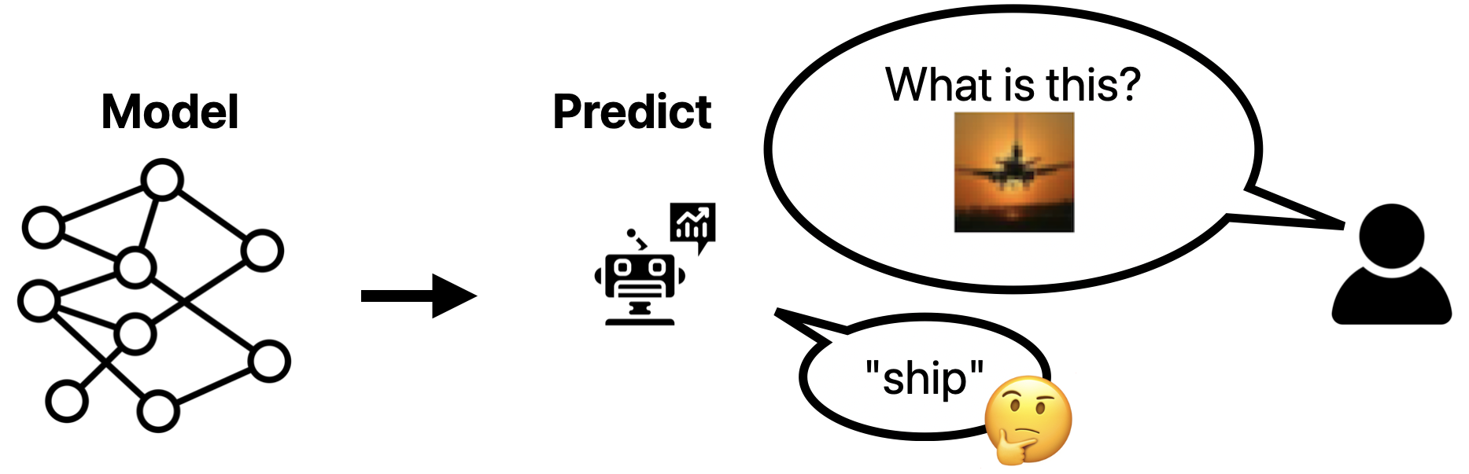
Explainability
The explanations can focus on different aspects:
Feature attribution: understanding the influence of input features
Component attribution: understanding the influence of particular components of the model (e.g. layers of a deep neural net)
Data attribution: understanding the influence of training data points
https://christophm.github.io/interpretable-ml-book/

Slide 52
Plan for today
What is ethics?
Misrepresentation & bias
Unintended consequences
Misuses of technology
Privacy & trust
Wrap up

Slide 53
Take-home messages
As computing professionals, you must be aware of the ethical consequences of your work!
Think about the social biases (under-represented groups, stereotypes, etc.) in your training data
Reflect over how your IT systems will be deployed, and what unintended impacts they may have
Make sure your software respects user privacy and does not erode their trust

