Slide 1
Speech processing
Pierre Lison plison@nr.no
IN4080, autumn semester 2025

Slide 2

Spoken dialogue systems
Generation / response selection
Language
Understanding
Transcription hypotheses
Speech synthesis
Utterance to synthesise
Speech recognition
Note: An alternative is to rely on speech language models, which work directly at the speech level, without using text transcriptions as intermediate
[Cui et al. ACL 2025.]
Speech interfaces add a layer of complexity:
Need to handle uncertainties, ASR errors etc.
Speech communicates more than just words (intonation, emotions in voice, etc.)
Need to handle turn-taking

Slide 3
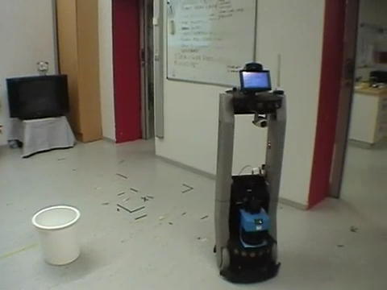
A difficult problem!

Slide 4
Outline
Short intro to phonetics and acoustics
Speech recognition
Speech synthesis
Disfluencies

Slide 5
Outline
Speech production
Speech perception
Short intro to phonetics and acoustics
Speech recognition
Speech synthesis
Disfluencies

Slide 6
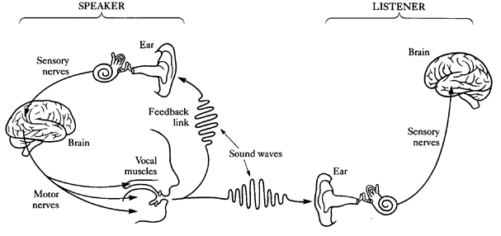
The speech chain
[Denes and Pinson (1993), «The speech chain»]

Slide 7
Speech production
Sounds are variations in air pressure
How are they produced?
  An air supply: the lungs (we usually speak by breathing out)
  A sound source setting the air in motion (e.g. vibrating) in ways relevant to speech production: the larynx, in which the vocal folds are located
  A set of 3 filters modulating the sound: the pharynx, the oral tract (teeth, tongue, palate,lips, etc.) & the nasal tract

Slide 8
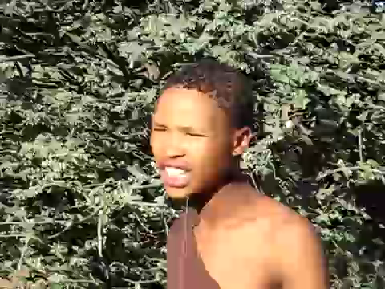

Speech production
Visualisation of the vocal tract via magnetic resonance imaging [MRI]:
NB: A few languages also rely on sounds not produced by vibration of vocal folds, such as click languages (e.g. Khoisan family in south-east Africa):

Slide 9
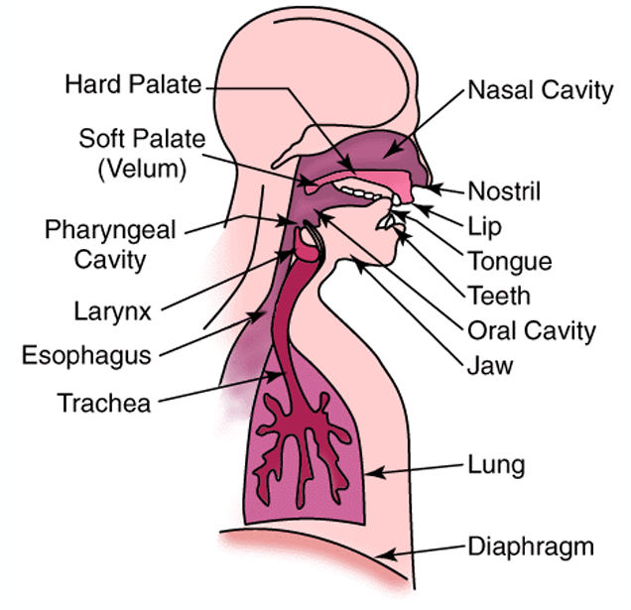
Speech production
Key differences between speech sounds:
Voiced vs voiceless: are the vocal cords vibrating?
How does the restriction of airflow occur?
Where does the restriction occur?
Diff between e.g. [p] and [b]
Note: all vowels are voiced
Stop, nasal, fricatives, etc.
Labial, coronal, guttural

Slide 10
Speech production
Words can be pronounced very differently:
  Phonetic processes: aspirations, assimilations, deletions
  Co-articulation: anticipation of next phone by articulators, or perseverance of previous move
  Influence of various contextual factors: age, gender, environment, rate of speech, dialect, register

Slide 11
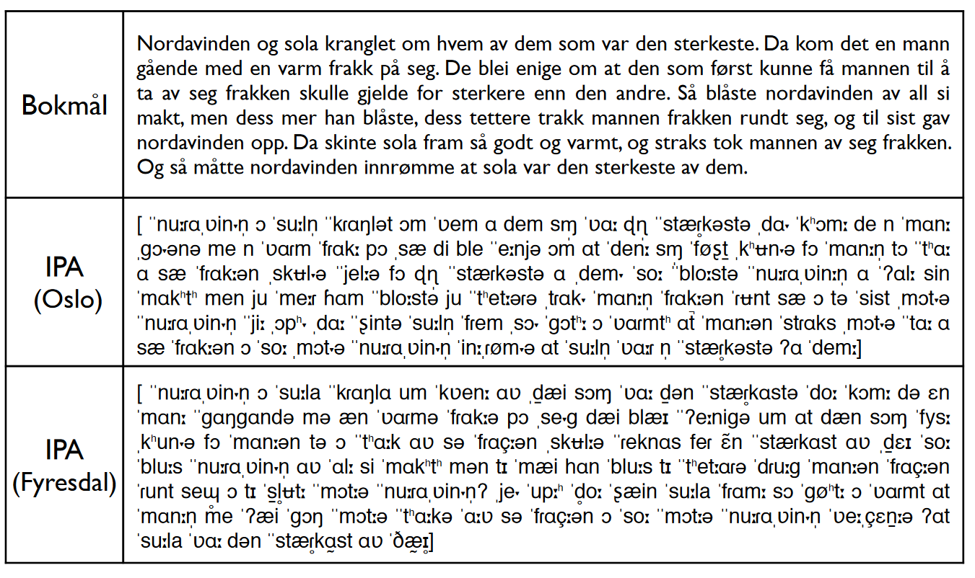

IPA transcription
[ Nordavinden og sola, en norsk dialektprøvedatabase på nettet, https://www.hf.ntnu.no/nos/list.php ]

Slide 12
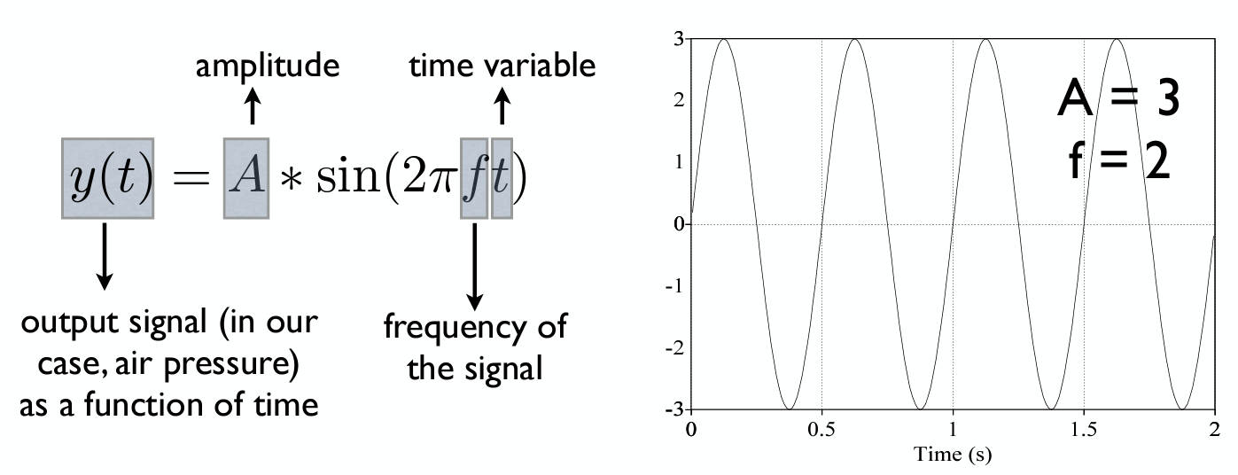
Speech perception
A (speech) sound is a variation of air pressure
This variation originates from the speaker’s speech organs
We can plot a wave showing the changes in air pressure over time (zero value = normal air pressure)

Slide 13
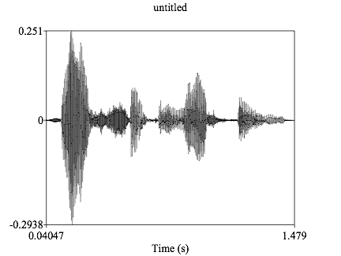
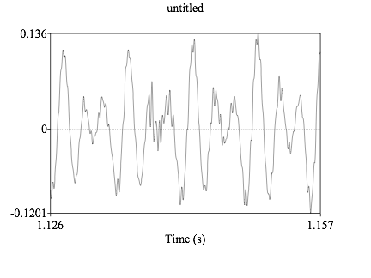
Speech perception
Of course, speech is more complex than a simple sine function
But it can still be described using the same mathematical apparatus, in terms of frequency, amplitude etc.
  zoom on the part between 1.126 and 1.157 s.
About 4 cycles in the waveform, which means a frequency of about 4/0.03 ≈129 Hz

Slide 14
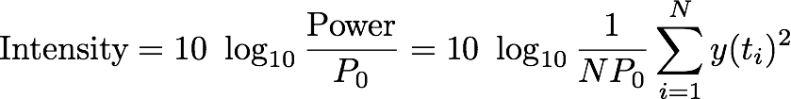
Important measures
  The fundamental frequency F0: lowest frequency of the sound wave, corresponding to the speed of vibration of the vocal folds (between 85-180 Hz for male voices and 165-255 Hz for female voices)
  The intensity: the signal power normalised to the human auditory threshold, measured in dB (decibels):
Total energy of signal
for a sample of N time points t1,... tN
P0 is the human auditory threshold, = 2 x 10⁻⁵ Pa
Note: dB scale is logarithmic, not linear!

Slide 15
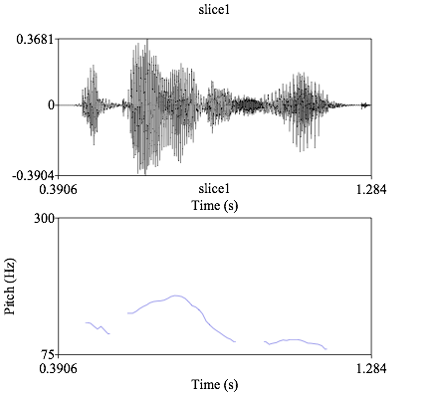
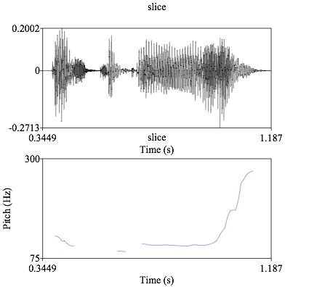
Why are F0 and the intensity important?
F0 correlates with the pitch of the voice, and the pitch movement for an utterance will give us its intonation
Interrogative utterance
= rising intonation at the end
"The ball is red"
"Is the ball red?"

Slide 16
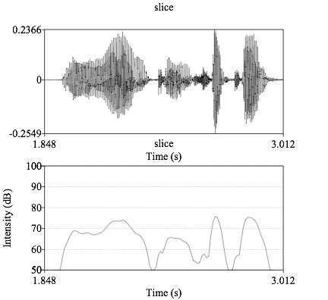
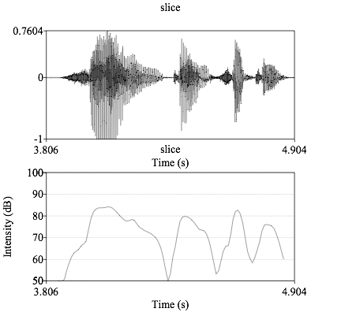
Why are F0 and the intensity important?
F0 correlates with the pitch of the voice, and the pitch movement for an utterance will give us its intonation
  The signal intensity corresponds to the loudness of the speech sound
low intensity
high intensity

Slide 17
Outline
Short intro to phonetics and acoustics
Speech recognition
Speech synthesis
Disfluencies

Slide 18

Why is ASR difficult?
Many sources of variation:
speaker voice (and style),
accents,
ambient noise
etc.

Slide 19

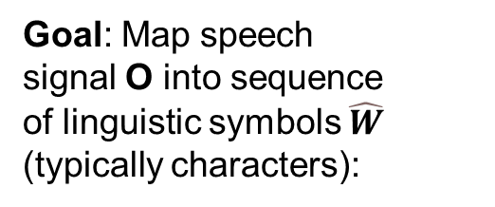
The speech recognition task
Input: Audio data
Output: Transcription
"The ball is red"
Goal: Map speech signal O into sequence of linguistic symbols $\hat{W}$ (typically characters):
Sequence O of acoustic observations (i.e. every 20 ms)

Slide 20
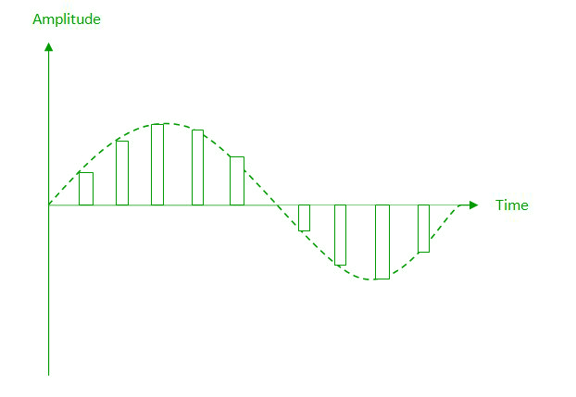
Feature extraction
Most ASR models do not operate on the raw waveform, but on (long!) sequences of acoustic feature vectors
Step 1: Conversion from analog signals (from microphone) to digital signals
  Sampling: Measures of signal amplitude (x times per second)
  Quantization: Storage in integers of given precision (8 or 16 bit)

Slide 21
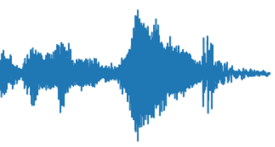
Feature extraction
Step 2: Windowing = Division of the signal into frames
  NB: The frames may overlap (to ensure no information is lost)
  Window/frame size, in milliseconds
Window shape (here rectangular)
Shift or offset: how much we “move” between successive windows

Slide 22
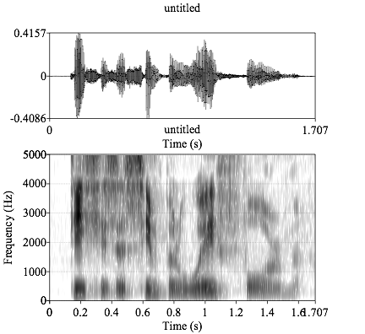
Feature extraction
Step 3: spectral analysis
= Convert the signal to a representation of the signal's component frequencies
Based on the (Fast) Discrete Fourier Transform (DFT)
spectrogram showing which frequencies are most active at a given time

Slide 23
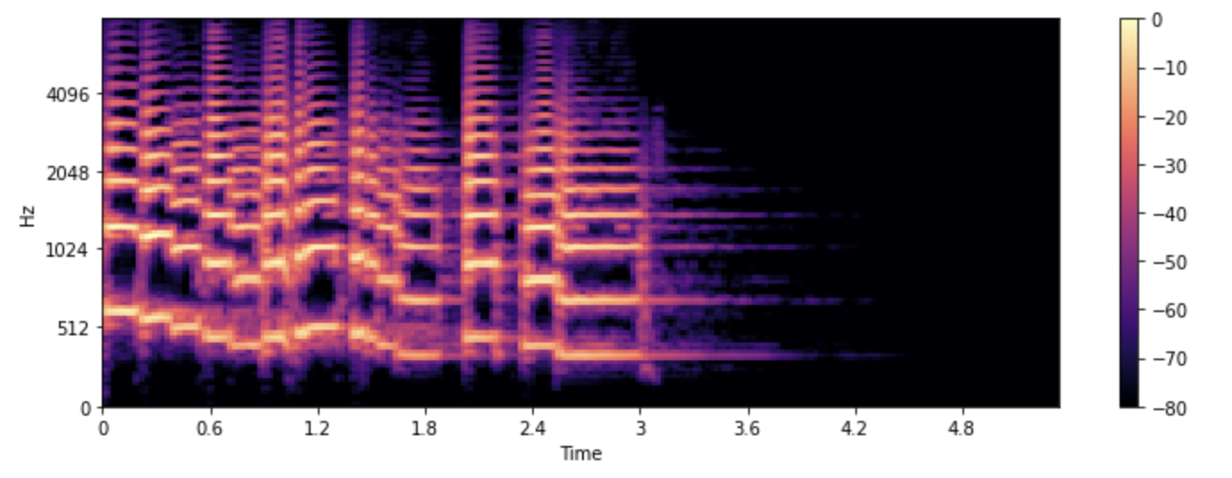
Feature extraction
Step 4: Log Mel-filter bank: conversion of the spectral values to get better resolution at low frequencies
  Mimic the sensitivity of the human ear
Once those preprocessing steps are complete, we end up with a long sequence of frames, each frame being expressed by a feature vector

Slide 24
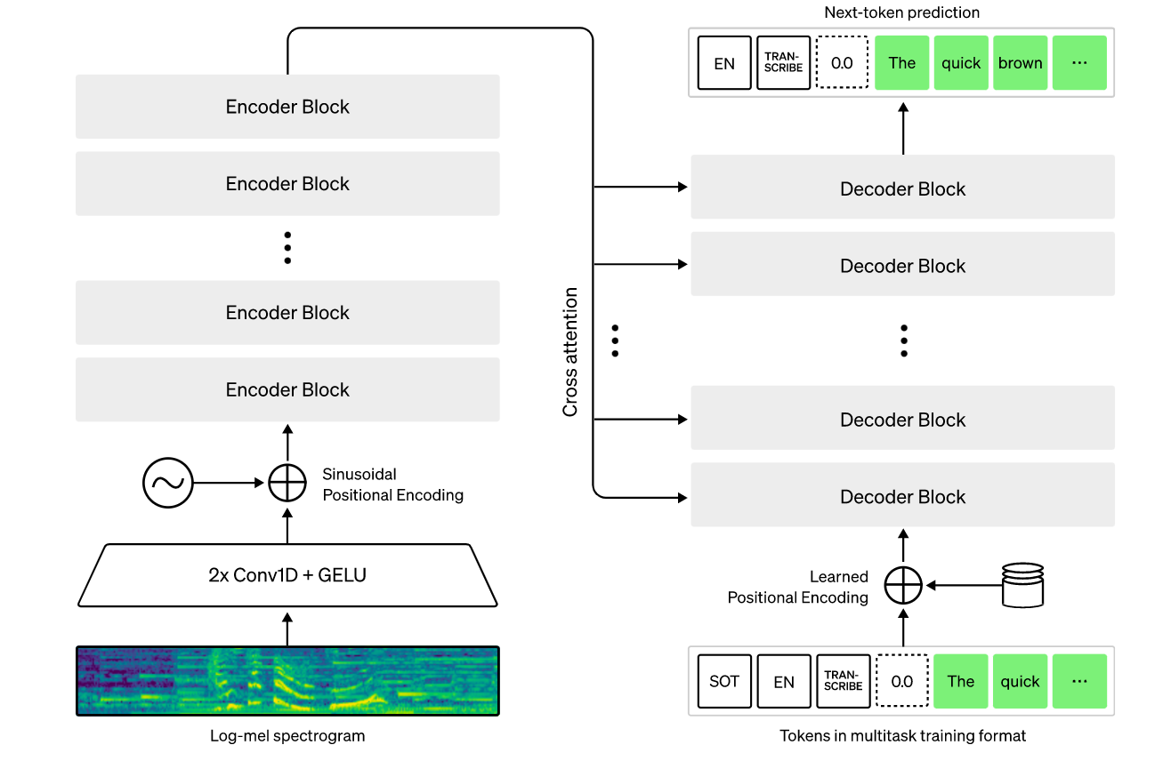
Encoder-decoder models
ASR Models like Whisper rely on an encoder-decoder transformer
Input: Sequence of feature vectors (one per frame)
Output: sequence of tokens or letter
Input much longer than output !

Slide 25
Encoder-decoder training
The ASR model is trained end-to-end on <audio, transcription> examples
As usual, the loss function is the cross-entropy loss
The model is applied to each token w_{i} of the transcription
  Teacher forcing: when predicting the token at position i, the input is the audio and the previous tokens w₁, … w_{i-1} from the actual transcription
Measure of the error between
- the next-token distribution predicted by the model
- the actual token (from gold standard transcript)

Slide 26
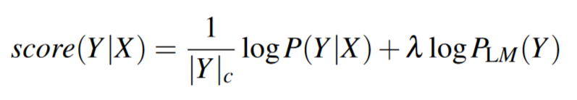
Language model rescoring
A classical ASR model is only trained from (audio, transcription) pairs
If there are enough transcriptions, the model will have learned a language model (conditioned on audio input) from the transcriptions
But it will have seen drastically less text data than a “full” LLM
We can use an LLM to rescore the recognition hypotheses:
From the ASR
Weight of the LLM rescoring

Slide 27
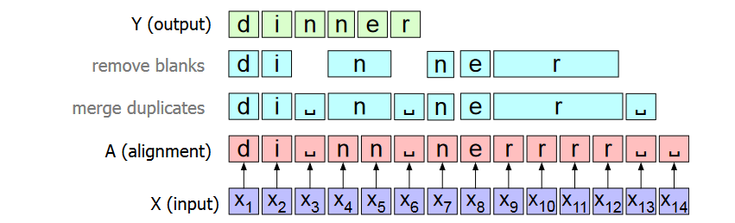
CTC speech recognition
Once can also do speech recognition with a pure encoder model
Idea: we predict a letter/symbol for each audio frame
As there is no one-to-done mapping, we merge duplicate letters
We use a special “blank“ symbol to prevent the merge of double letters
(and for frames where we don’t want to transcribe anything)

Slide 28
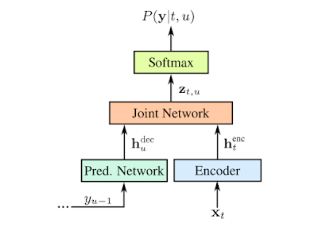
CTC speech recognition
https://ai.googleblog.com/2019/03/an-all-neural-on-device-speech.html
CTC models do not reach the same performance as encoder-decoders, but they are easier to apply to streaming audio
Example of a relatively simple system: Google’s 2019 on-device ASR
  Encoder maps audio signal x_{t} to hidden representations with CTC
  Pred. Network is a language model
  The two representations are then merged, and the output is predicted character-by-character

Slide 29
ASR evaluation
Common metric: Word Error Rate (WER)
  Measures how much the utterance hypothesis h differs from the «gold standard» transcription t*
  = Minimum edit distance between h and t*, counting the number of word substitutions, insertions and deletions:

Slide 30
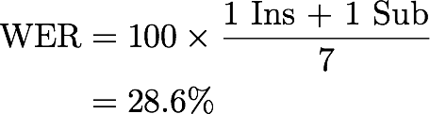
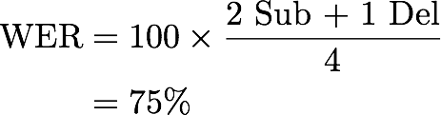
ASR evaluation
Gold standard transcription | yes can you now rotate this triangle
ASR hypothesis | yes can you not rotate this triangle there
Gold standard transcription | there is five and
ASR hypothesis | the size and
1 Sub + 1 Ins
2 Sub + 1 Del
30

Slide 31
Outline
Short intro to phonetics and acoustics
Speech recognition
Speech synthesis
Disfluencies

Slide 32
Text-to-Speech
Modern TTS based on either:
  Encoder-decoder models (but this time from string → waveforms)
  Decoder-only models (with so-called “speech tokens”)
  Diffusion-models (like in image generation)
Three steps:
  Text normalization: verbalization of non-standard words
  Spectogram prediction: from input strings to mel spectrograms
  Vocoding: from mel spectrograms to waveforms

Slide 33
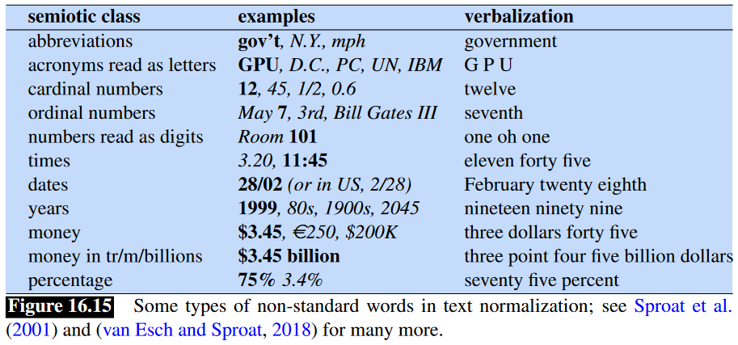
Text normalisation

Slide 34
Text normalisation
Can be implemented with
handcrafted rules
fine-tuned LLMs,
or hybrid systems combining the two (using rules to constrain or steer the LLM outputs)

Slide 35
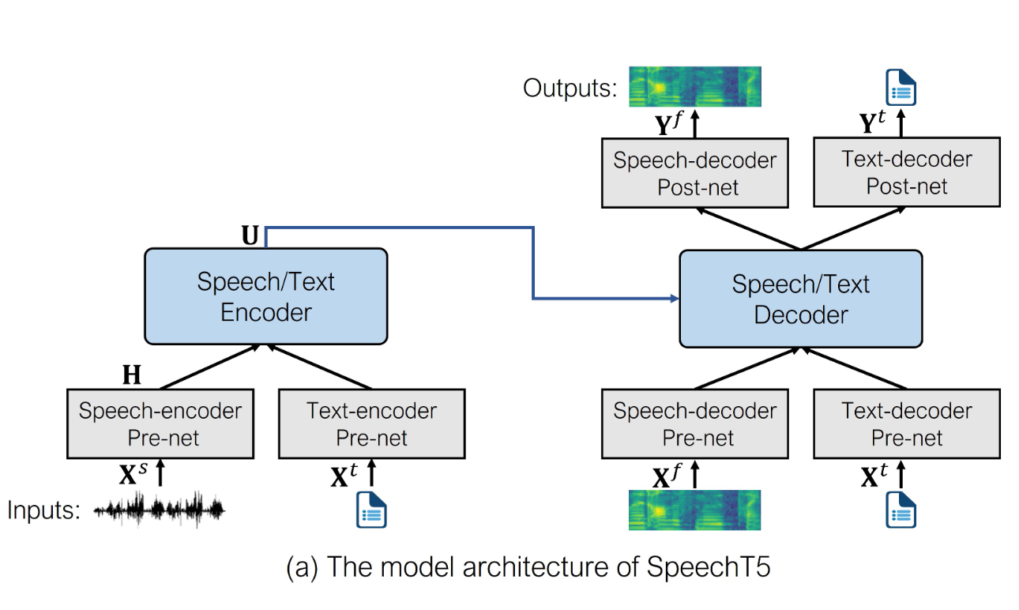
SpeechT5
→ Using shared representations for multiple speech processing tasks

Slide 36
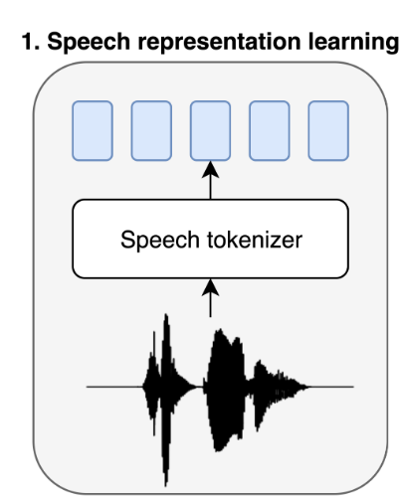
Decoder-only TTS
One can also build a TTS model using a pure decoder-only approach
To do this, we must discretise our speech signal, to express the full input (= text input and speech already synthesized) as a sequence of tokens
We can train a speech tokenizer from audio data using an autoencoding approach
The output of the speech tokenizer is a sequence of speech tokens, also called speechcodes
[Łajszczak, M. et al (2024). BASE TTS: Lessons from building a billion-parameter text-to-speech model on 100K hours of data. arXiv preprint arXiv:2402.08093.]

Slide 37
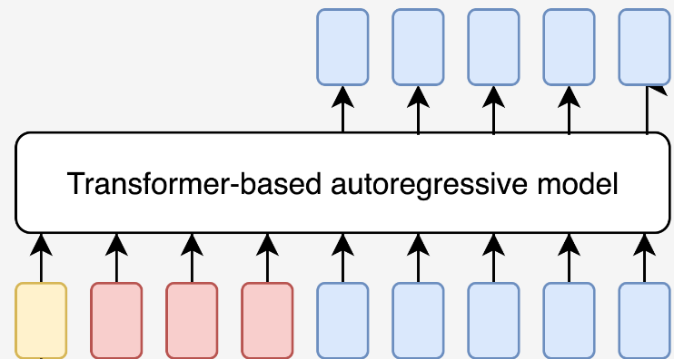
Decoder-only TTS
When we have a speech tokenizer, we can formalize TTS as an autoregressive task where we generate speechcodes one by one, conditioned on:
The text tokens corresponding to the string to synthesise
The speechcodes generated until now
Context information about the speaker and/or speaking style
My name is
Yellow: context embedding
Red: text tokens
Blue: speech tokens
Can be a speech encoding extracted from another utterance from the same speaker (like in BASE TTS)

Slide 38

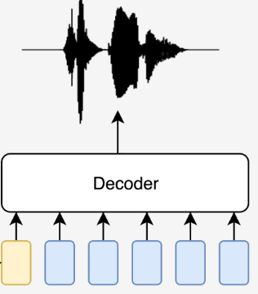
Decoder-only TTS
One the sequence of speechcodes is generated, it can be mapped to a waveform in two final steps:
Converting the speechcodes (and a speech encoding that captures the user voice) to a mel spectrogram
A vocoder converting the spectrogram to a waveform

Slide 39
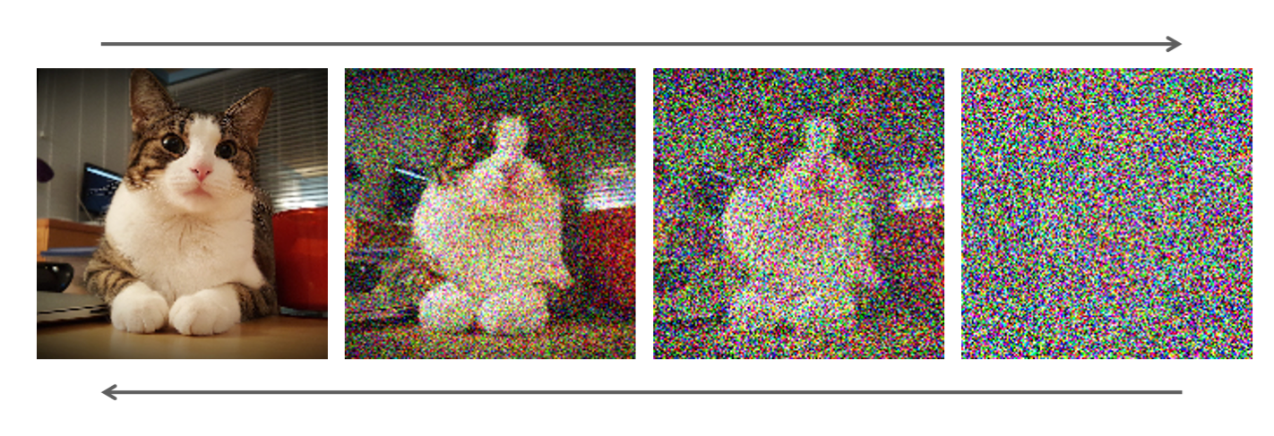
Diffusion-based TTS
Diffusion models used in many generative ML tasks, notably image generation
  Intuition: start with random noise and gradually «denoise it»
Diffusion can also be applied for TTS
  Gradual «denoising» of the mel-spectogram, based on the text prompt
A recent diffusion-based TTS: NaturalSpeech 3 from Microsoft

Slide 40
Outline
Short intro to phonetics and acoustics
Speech recognition
Speech synthesis
Disfluencies

Slide 41
Disfluencies
Speakers construct their utterances «as they go», incrementally
  = Production leaves a trace in the speech stream
Presence of multiple disfluencies
  Pauses, fillers («øh», «um», «liksom»)
  Repetitions («the the ball»)
  Corrections («the ball err mug»)
  Repairs («the bu/ ball»)

Slide 42

Disfluencies
Internal structure of a disfluency:
reparandum: part of the utterance which is edited out
interregnum: (optional) filler
repair: part meant to replace the reparandum
[Shriberg (1994), «Preliminaries to a Theory of Speech Disfluencies», Ph.D thesis]

Slide 43
Some disfluencies
[«Norske talespråkskorpus - Oslo delen» (NoTa), collected and annotated by the Tekstlaboratoriet]
så gikk jeg e flytta vi til Nesøya da begynte jeg på barneskolen der
og så har jeg gått på Landøya ungdomsskole # som ligger ## rett over broa nesten # rett med Holmen
jeg gikk på Bryn e skole som lå rett ved der vi bodde den gangen e barneskole
videre på Hauger ungdomsskole
da hadde alle hele på skolen skulle liksom # spise julegrøt og det va- det var bare en mandel
og da var jeg som fikk den da ble skikkelig sånn " wow # jeg har fått den " ble så glad

