Slide 1

ECOSYSTEM ORCHESTRATION
Daniel Stedjan Svendsrud
26.09.2022

Slide 2
Agenda for the day
What do we mean when we speak about orchestration?
Ecosystem governance: «top down» – strategy
Ecosystem orchestration: «bottom-up» - strategy
Two different strategic options dependent on knowledge of value
Empirical llustrations

Slide 3



TECHNICAL ARCHITECTURE
SPAN
OF CONTROL
GOVERNANCE STRUCTURE

Slide 4
A firm`s span of control
Which components in a technical architecture a given firm controls at a given point in time (Baldwin, 2015)
Representation of organizational boundaries
Strategic concern: what will be done inhouse and what will be outsourced to other parties?
A firm may influence, but does not control what happens outside its span of control

Slide 5
ORCHESTRATION

Slide 6
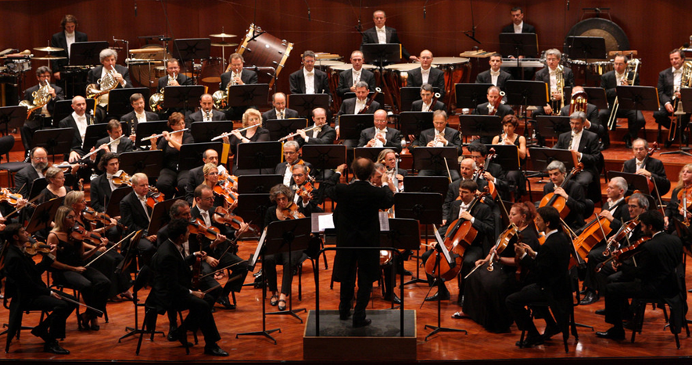

Slide 7
The orchestration metaphor
“If the metaphor for traditional organizations is an army, the metaphor for platform ecosystems is a symphony. The platform owner is like the conductor and the app developers are like the musicians. Each musician contributes a unique part of the overall musical score. The conductor helps the diverse musicians synchronize their own contributions to help ensure overall coherence in their collective performance. The conductor does not direct but rather orchestrates. The individual musicians choose to follow the lead of the conductor, who has limited direct authority or the depth of specialized musical talent of all of the musicians contributing to the performance. A good performance results from each musician being able to independently play her part but in synchrony with the others. Like in a symphony, orchestration rather than control should be the focus of governance in platform ecosystems.» (Tiwana, 2013, p. 117).

Slide 8
The orchestration metaphor
Popular metaphor to use within business administration
Been increasingly used in an ecosystem context
The relationship between the platform company and third-party actors

Slide 9
The concept: Network orchestration
Stemming from studies on inter-organizational networks
One firm is able to take on a leadership position in a network
Individual firm-based characteristics
Orchestrating is about creating competitive advantage in a networked world
Inter-firm network is a resource in itself

Slide 10
The “hub” firm
“We define network orchestration as the set of deliberate, purposeful actions undertaken by the hub firm as it seeks to create value (expand the pie) and extract value (gain a larger slice of the pie) from the network.” (Dhanaraj & Parkhe, 2006, p. 659).

Slide 11
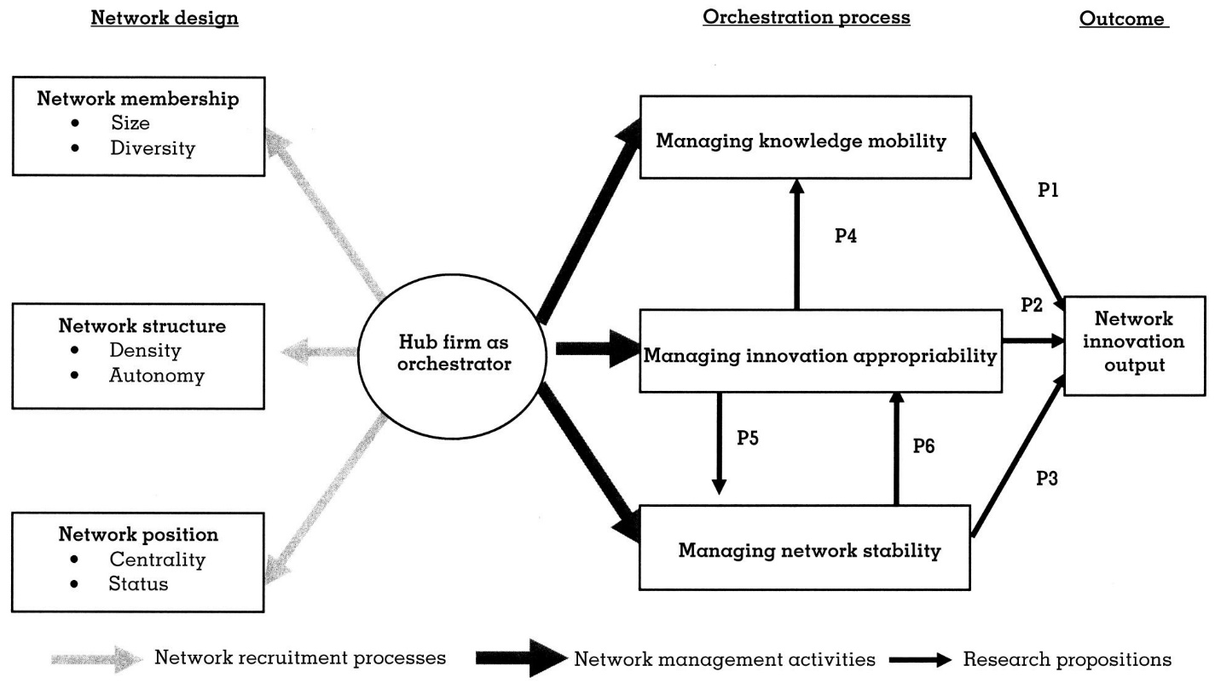

Slide 12
Three orchestration processes
Managing knowledge mobility
Managing innovation appropriability
Managing network stability

Slide 13
Managing knowledge mobility
Knowledge is dispersed
Knowledge is accessed, transferred and transformed
The creation of a common identity – enable sharing of knowledge
Identity as a network – creation of new value/knowledge

Slide 14
Managing innovation appropriability
The capturing of value
Appropriability regime: a fair distribution of value
Accordance between investments and outcome
  Avoiding «free riding» and «opportunism»
Trusting relationships
Transparent decision-making processes

Slide 15
Managing network stability
Dilemma: Tension between stability and flexibility
Dynamic stability
Hub firm`s reputation as a market leader – enhancing this reputation to the network

Slide 16
Ecosystem orchestration
«the set of deliberate, and purposeful actions undertaken by the ecosystem orchestrator to encourage voluntarily, value co-creating inputs and effect coordination among hierarchically independent participants of the ecoststem» (Autio, 2021. p. 12)
Orchestration represents the distinctive governance challenge in ecosystems

Slide 17
Four defining characteristics
Participant heterogenity
Ecosystem outputs
Participant interdependence
Non-contractual governance

Slide 18
Modular platform ecosystems
Platform ecosystems are in principle modular in both production and consumption
Platform ecosystems are in principle the subject of network governance
Platform ecosystems are in principle a system designed to produce a complex artifact

Slide 19
 | Modular system | Network governance | Complex artifact
Participant heterogenity | X
Participant interdependence | X
Ecosystem output |  |  | X
Non-contractual governance |  | X

Slide 20
Recap on complex artifact
A complex artifact is a system composed of different components that interact in an unpredictable way
Two types of systems:
  1. Technical architecture (the design of the division of tasks)
  2. Organizational structure (the division of labor)
An ecosystem is created on the basis of perceived market value

Slide 21
Which leaves us to…
The complexity of an actual ecosystem depends on the ability of the platform owner/initiating actor to define the question of value

Slide 22
The question of value depends on:
How the end-user of the modular offering (product or service) combines the different modules at their discretion
A prediction that can be made by the ecosystem orchestrator on the basis of how well-known the market context is

Slide 23
The “digital” in ecosystems
End users play a more active role in ecosystems as opposed to other inter-organizational networks as the specific combination of modules can act as a source of generative input (Zittrain, 2008)
The product or service the ecosystem is to produce and deliver cannot systemically be specified beforehand according to contractual governance

Slide 24
Generative innovation
Innovation that «runs» by itself
Does not need to be initiated by any actor in the ecosystem
Why an ecosystem model is so attractive in the first place; relates to the scale and growth opportunities

Slide 25
Two governance strategies
Top-down ( Governance strategy)
Well-know market context: Clear understanding of value
Distribution of roles given in advance
Strategic issue: how to design a functional architecture
Main focus: how to create system interfaces
Bottom-up (orchestration strategy)
Novel market context: Unclear understanding of value
The distribution of roles not given in advance
Strategic issue: how to design a co-creation arrangement
Main focus: how to create economic value in an ecosystem-collaboration

Slide 26
Top-down strategy
The technical architecture and organizational structure can be designed beforehand
Functional architecture ----> value ----> the value proposition of the ecosystem in question
Conventional blueprint of a platform ecosystem : Stable core (the platform and associated firm), dynamic periphery (ad-on software/sub-systems and associated application developers)

Slide 27
Bottom-up strategy
The very idea of co-value has to be created
Co-value: value has to be created by several organizations
At the heart of every ecosystem lies a value proposition (in contrast to a platform) that describes what the key product or service offering are to deliver to what type of user group/customer segment
There can be multiple – potential - ecosystems in one existing value chain configuration (Adner, 2017)

Slide 28
The iPhone as a product and platform
iPhone as a physical product (the hardware)
iPhone as a Software-based platform ecosystem with enhanced functionality

Slide 29



Slide 30
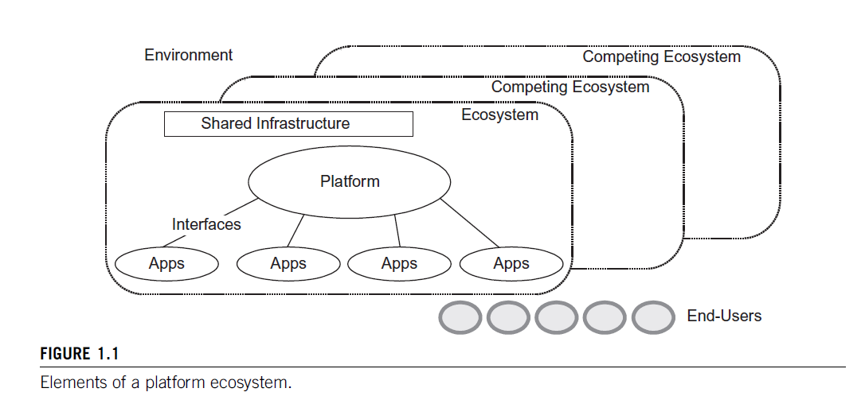
The «blueprint» of top-down governance
Source: (Tiwana, 2013)

Slide 31
iPhone as an example of top-down strategy
Influencing the interaction through strategically designing interfaces: open versus closed APIs
Apple as the hub firm govern the ecosystem on the basis of iPhone functioning as the stable core in the ecosystem architecture
App-developers as the unstable components in the periphery

Slide 32
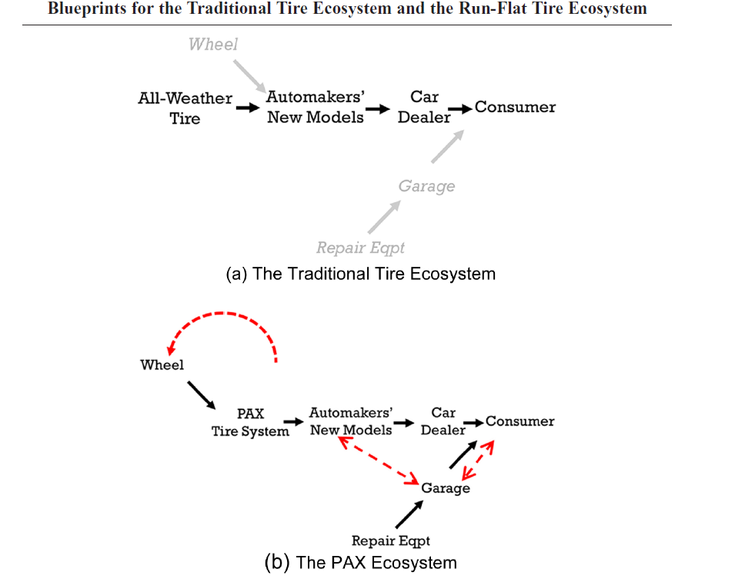
The «blueprint» of bottom-up orchestration
Source: (Adner, 2017)

Slide 33
iPhone as an example of bottom-up strategy
Smartphone as an innovative value proposition
Not given in advance who will be ecosystem orchestrator and ecosystem follower
Not given in advance how, by whom and in what way value are to be created

Slide 34
Traditional market (latent ecosystem) context
Application developer (module 2)
Dumpphone
Cell phone manufacturer
End user
Application developer (module 1)
Realized ecosystem context
Application developer (module 2)
Complement (module 2)
Smartphone
Cell phone manufacturer
End user
Complement (module 1)
Application developer (module 1)

Slide 35
Examples
from my own research

Slide 36
Indus and Digitize
Indus: established company in the Norwegian oil and gas industry
Digitize: a newly started software-as-a-serivice company
Value proposition: Utilize industrial data in order to optimize internal work processes
Data-centered platform: Functionality connected to data sharing across siloed systems

Slide 37
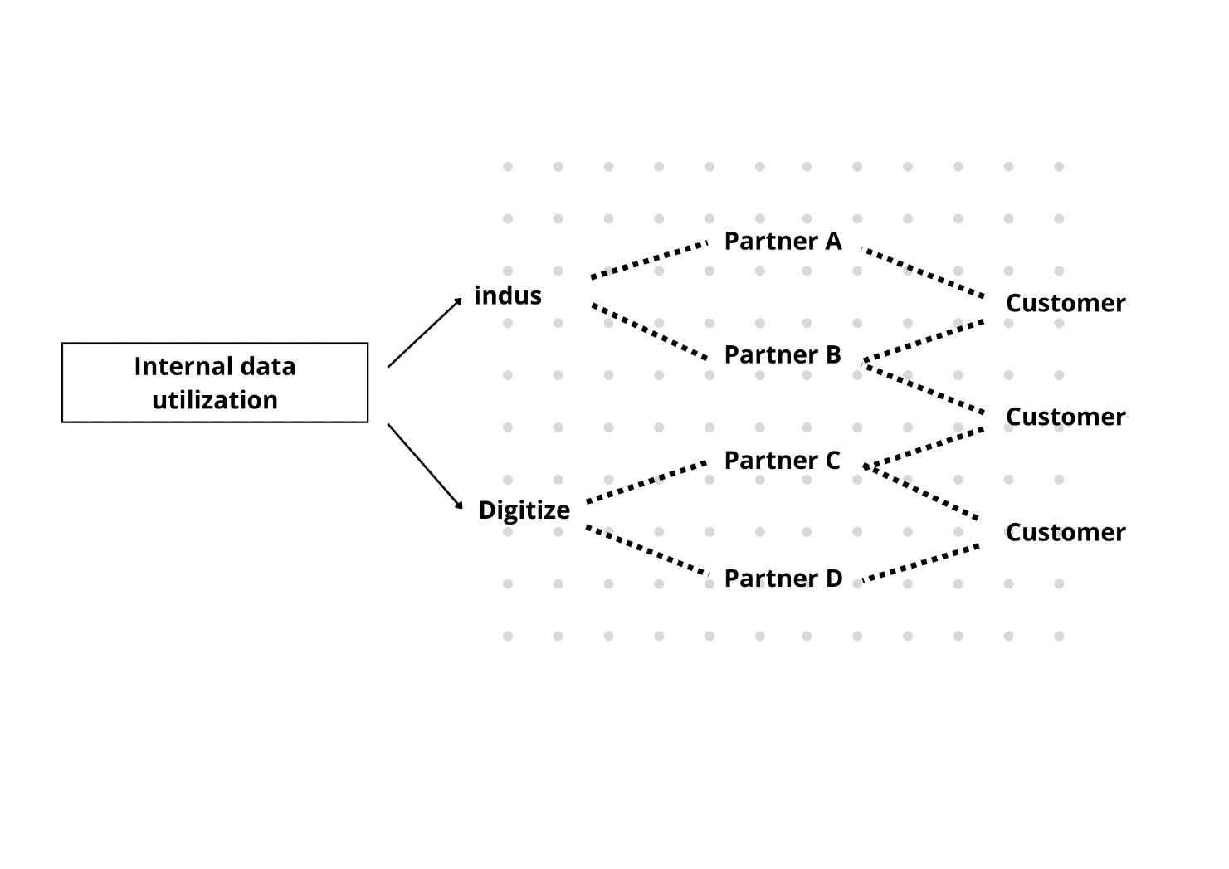
How the ecosystem looks

Slide 38
How it might have looked as a top-down strategy
Shared infrastructure
Ecosystem
Apps
Apps
Apps
Digitize platform
Apps
Apps
Apps
Apps
Apps

Slide 39
Another empirical example

Slide 40
Case study on TiVo
Pioneered Digital Video Recorder (DVR) technology
Aimed at creating an ecosystem around the novel value proposition: to record and watch television programs at the viewers discretion
Challenged the existing U.S. television ecosystem
The tension of coopetition (working with collaborators and competitors)
The ecosystem was in constant development over several years (1995-2012) – and so was the platform

Slide 41



Slide 42
An example of bottom-up orchestration
Market value was not given and in constant negotiation
The core technology was modified according to meet the needs of incumbent firms.
Not at all clear who the main orchestrator/hub firm is
Several competing ecosystems

Slide 43
In conclusion
Orchestration is the leadership, and not the management, of an ecosystem
A governance process, not a governance structure
Orchestration is necessary due to a novel value proposition

Slide 44
Management vs. leadership
Management
Influencing the actions of someone else on the basis of holding organizational positions
«Mangement» dependent on being a «manager»
Based on a formal hierarchy (governance structure)
Leadership
Influencing the meanings of someone else and how others interpret reality
«Leadership» not dependent on being a «leader»
Based on informal hierarchy (social capital)

Slide 45
Management and leadership
Intentional attempts at influencing other actors
Taking place in a situation with power asymmetry

Slide 46
Another definition of orchestration
Orchestration is the leadership process of influencing the combination of modular components in both production and in-use in the intent of co-creating novel organizational value

Slide 47
Breaking the definition down
Leadership process: the act of influencing is fluid, dynamic, unfolds over time and is not bounded to one specific actor
Combination of modular components: happens at the system level (system integration)
In both production and in-use: the influence is sought at both sides in a platform ecosystem
In the intent of co-creating novel organizational value: value-driven action towards innovation outcomes

Slide 48
Comparing the three definitions
Dhanaraj and Parkhe, 2006 | Autio, 2021 | Svendsrud
We Define Network Orchestration As The Set Of Deliberate, Purposeful Actions Undertaken By The Hub Firm As It Seeks To Create Value (Expand The Pie) And Extract Value (Gain A Larger Slice Of The Pie) From The Network.” | The Set Of Deliberate, And Purposeful Actions Undertaken By The Ecosystem Orchestrator To Encourage Voluntarily, Value Co-creating Inputs And Effect Coordination Among Hierarchically Independent Participants Of The Ecosystem | The Leadership Process Of Influencing The Combination Of Modular Components Combining Components In Both Production And In-use In The Intent Of Co-creating Novel Organizational Value
Assumes one orchestrator (the hub firm) Does not take into account platform ecosystem dynamics More suitable for incumbents Orchestration happens on the production side exclusively Assumes that there is one succesful outcome | Assumes one orchestrator More suitable for incumbents Emphasized the characteristics – the distinctive governance challenge - of ecosystems Orchestration happens on the production side exclusively Assumes that there is one succesful outcome | Specific on leadership Orchestration happens outside a formal hierarchy The result of the orchestration initiative is open-ended, i,e. might not happen Deals with both sides in the ecosystem: production and consumption

Slide 49
THANK YOU
DANIEL STEDJAN SVENDSRUD
daniessv@ifi.uio.no

