Slide 1

THEORETICAL FRAMEWORK
Definition of theory:
«a statement of relations among concepts within a boundary set of assumptions and constraints. It is no more than a linguistic device used to organize a complex empirical world … the purpose of a theoretical statement is twofold: to organize (parsimoniously) and to communicate (clearly). (Bacharach, 1989, p. 496)

Slide 2
What are the main concepts in a theory of digtial ecosystems?

Slide 3
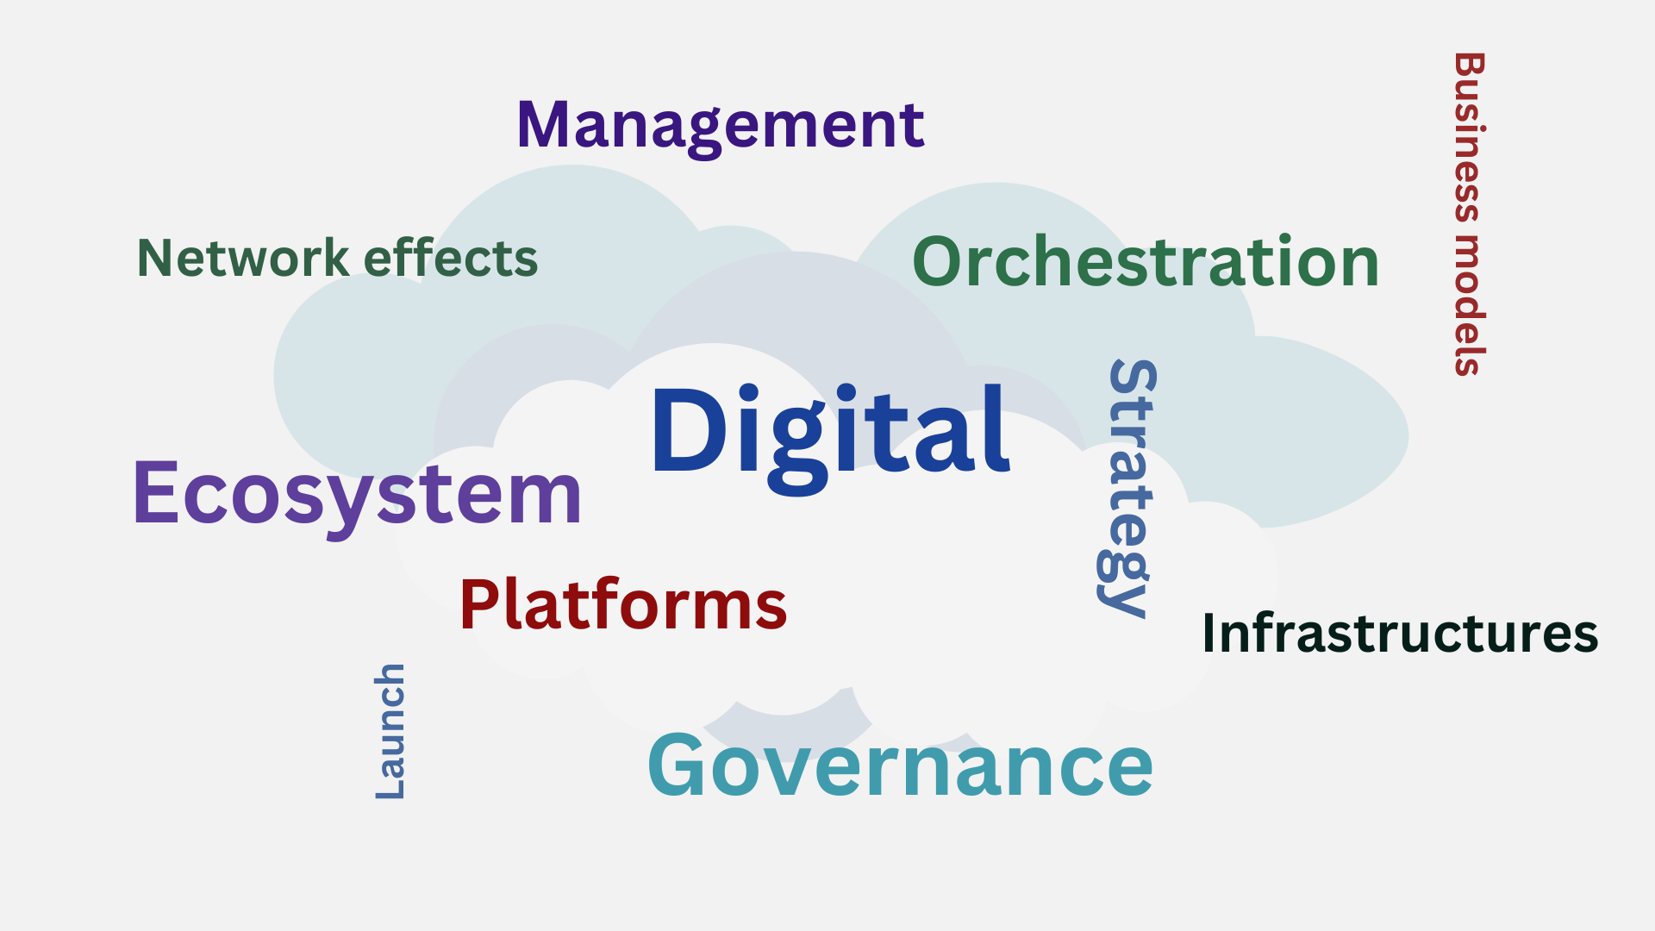

Slide 4
In class exercise: Write an essay where you share your understanding of platforms, Infrastructures and ecosystems, and how these concepts relate to each other.

Slide 5
YOUR ANSWERS
Platform: Structural foundation that connect different market sides in order to generate value
Ecosystem: Composed of heterogenous and interdependent actors that collaborate naturally due to the possibilites afforded by the internett. Has a leader (orchestrator)
Infrastructure: a structure of shared resources that is needed for a society or organization to function

Slide 6
IN COMPARISON
Platform: more concrete concept (more bounded). A system with a clear function
Ecosystem: Actors come togehter to create something (life as they do in the natural world). Has a leader (orchestrator)
Infrastructure: more broad and more essential concept, could be a platform if the platform becomes essential. Example: a shared technology or standards.

Slide 7
PLATFORM
Oxford English dictionary: a raised level of surface on which people or things can stand, usually a discrete structure intended for a particularly
A specific architectural set up.
  Seperating between core components with low variability (platform) and the periphery components with high variability (applications)
  A platform established the systems interfaces
  Has a particular functionality

Slide 8
INFRASTRUCTURE
Infrastructure in general can be defined as the basic physical and organizational structures needed for the operation of a society or enterprise, or the services and facilities necessary for an economy to function (Wikipedia)

Slide 9
INFRASTRUCTURE
Digital infrastructures can be defined as the basic information technologies and organizational structures, along with the related services and facilities necessary for an enterprise or industry to function. These infrastructures can be further defined with respect to the entity being supported or enabled as global, national, regional, industry, or corporate infrastructures. Morphologically, digital infrastructures can be defined as shared, unbounded, heterogeneous, open, and evolving sociotechnical systems comprising an installed base of diverse information technology capabilities and their user, operations, and design communities. (Tilson, Lyytinen & Sørensen, 2010, pp. 748-749).

Slide 10
ECOSYSTEM
A geographic area where plants, animals, and other organisms, as well as weather and landscape, work together to form a bubble of life (National Geographic society)
A digital (innovation) ecosystem is: “a community of hierarchically independent, yet interdependent participants who collectively generate an ecosystem output” (Thomas & Autio, 2020, p. 16)

Slide 11
FOUR DEFINING CHARACTERISTICS
PARTICIPANT HETEROGENITY
ECOSYSTEM OUTPUTS
PARTICIPANT INTERDEPENDENCE
NON-CONTRACTUAL GOVERNANCE

Slide 12
PATRICIPANT HETEROGENEITY
Members from several industries
Can span the public/private divide
Both collaborators and competitors
Span customer segments

Slide 13
ECOSYSTEM OUTPUT
Ecosystems are intentionally initiated
A coherent system-level goal of collaboration

Slide 14
ECOSYSTEM OUTPUT
Ecosystems are intentionally initiated
A coherent system-level goal of collaboration

Slide 15
NON-CONTRACTUAL GOVERNANCE
Important part of what separates ecosystems from other organizational collectives
What the overall ecosystem is to produce cannot be determined beforehand
There exist not a contract that can say how the different apps are to be used by customers for what purpose

Slide 16
DIGITAL ECOSYSTEMS
What are ecosystems?
What makes ecosystems digital?

Slide 17
An ecosystem is digital when it is sociotechnical system which is nonhierarhical modular in production and generative modular in use
  Nonhierarchical: An ecosystem is in principle the subject of network governance
  Generativity: An ecosystem is in principle an arrangement with more innovation potential than other collaborative arrangements

Slide 18
THANK YOU!
ANY QUESTIONS?

