Slide 1
Group seminar
Ecosystem governance
20.09.2022

Slide 2
Framework for designing platform ecosystems
 | Technical architecture | Organizational structure
Purpose | Produce an artifact | Create market value out of an artifact
Design structure | Break the production process into seperate interconnected tasks | Break the organization into seperate functional units
Question of interest | What knowledge do we really need to produce artifact X | What type of people do we really need to produce and create value out of artifact X

Slide 3
Task 1
Task 2
Task 3
Task 4
Task 5
Task 6
Task 7
Task 8
Task 9
Person 1
Person 2
Person 3
Person 4
Person 5
Person 6
Person 7
Person 8
Person 9

Slide 4
Task 1
Task 2
Task 3
Task 4
Task 5
Task 6
Task 7
Task 8
Task 9
Unit 1
Unit 2
Unit 3
Unit 4
Unit 5
Unit 6
Unit 7
Unit 8
Unit 9
Person 1
Person 2
Person 3
Person 4
Person 5
Person 6
Person 7
Person 8
Person 9
=

Slide 5
Framework for comparing modular and monolithic systems
Dimension | Monolithic | Modular
Complexity | Less components | More components
Innovation | Greater integration (innovation realization) | Greater recombination (innovation potential)
System adaptability | Rigidity | Flexibility
Coordination | Faster communication | Focused attention – capitalizing on specialized knowledge
Governance structure | Larger span of control | Smaller span of control
Growth | Internally based on efficiencies in mass production | Externally based on network effects

Slide 6
Case description I
After your graduation from the master program you have started a successful consultant agency specialized in digital business strategy development. BigCar Inc. a large traditional automobile company that produces traditional cars to a traditional market segment, has heard about your success and decided to seek your consultancy services. The automobile company wants to digitalize and generally transform their organization, and the vital part of this strategy is to develop a new car model: GTI-id5. Their previous car model: GTI-XV is a classical model, interpreted by BigCar to be outdated according to modern market standards. GTI-XV has a manual gearbox, runs on gas, has a CD-player and manual hand-crank windows and looks something like this:

Slide 7
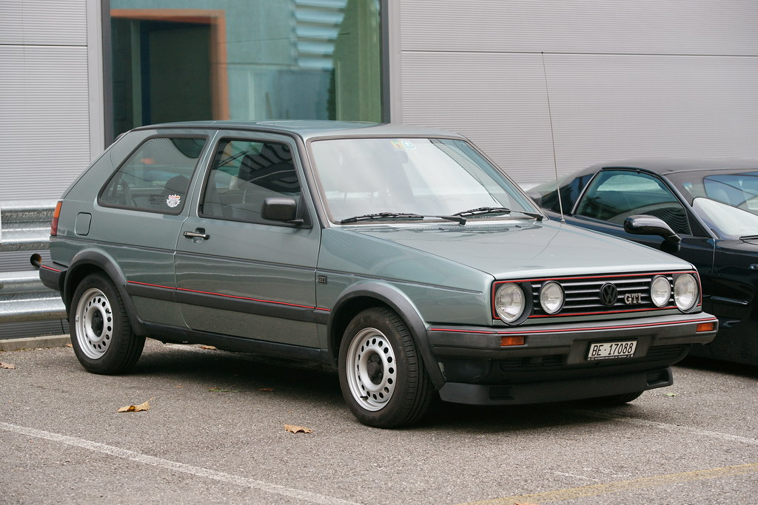

Slide 8
Case description II
The goal of BigCar is to develop the technical architecture of GTI-XV from a monolithic architecture/governance system into a digital platform ecosystem. Based on industry standards: they envision the new car prototype, GTI-id5 to have the following functionality:
Automatic gearbox
Electric motor
Seamless integration with smart phone
Sensor technology as an enablement for autonomous driving, automated parking functions, radar sensor and cameras.
Run-flat tire technology
And look something like this:

Slide 9
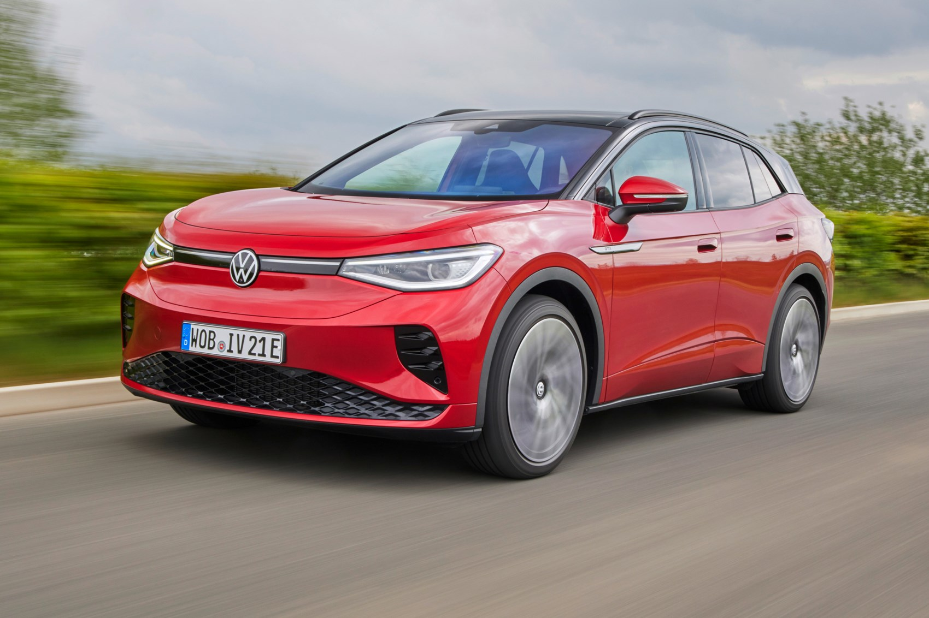

Slide 10
Case description III
The specification you have gotten from BigCar is to provide them with a strategy document consisting of the following points:
Provide a sketch of a modular technical architecture with the task components you see that is part of the system that needs to produce the new GTI-id5 model.
Provide a sketch of a modular organizational structure with organizational units you see that is part of the system that needs to produce the new GTI-id5 model.
Reflect upon the following: in what way can a monolithic architecture/organizational system enable BigCar`s journey towards a vibrant and valuable digital platform ecosystem?
What difficulties does a modular architecture/organizational system create for BigCar in their attempts at governing a platform ecosystem?

Slide 11
Group work
Go in groups and try and solve these tasks
Make a PPT-presentation consisting of 3-5 slides explaining how you solved these tasks

