Slide 1

Introduction to IN4150
Digital ecosystems
Raissa Pershina
Daniel Svendsrud

Slide 2
Lecturers
Raissa Pershina (raissap@ifi.uio.no)
Daniel Svendsrud (daniessv@ifi.uio.no)
Ole Hanseth (oleha@ifi.uio.no)
Guest lecturers, scholars and practitioners

Slide 3






Raissa

Slide 4
Daniel
Daniel Stedjan Svendsrud, PhD research fellow, Department of Informatics, University of Oslo
Background: Master in Political Science and Management
Research interests: Platform ecosystem development in the Oil and gas sector, the increasing role of digitial data
Lens: Ecosystem orchestration

Slide 5
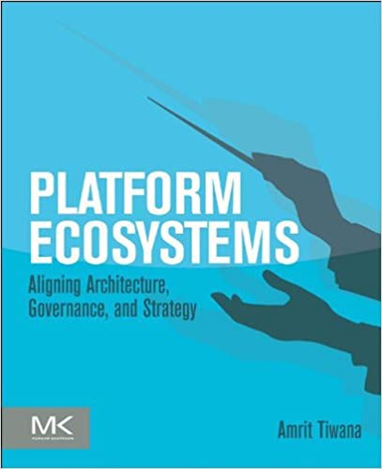
Recommended book
Tiwana, A. (2014) Platform Ecosystems: Aligning Architecture, Governance, and Strategy. Elsevier Inc.

Slide 6

Lectures and group seminars
14 lectures (incl. in-class activities, quizes, discussions);
14 seminars (reading, group work and presentations, discussions, various activities, feedback on group projects);
All lectures will take place in room KN, Lille auditorium from 10:15 – 12:00 and all group seminars in room OJD, Seminarrom Logo from 10:15 – 12:00
We strongly encourage attendance of at least 80% of all lectures and group seminars.
This course is designed as an interactive class and active participation is expected.

Slide 7
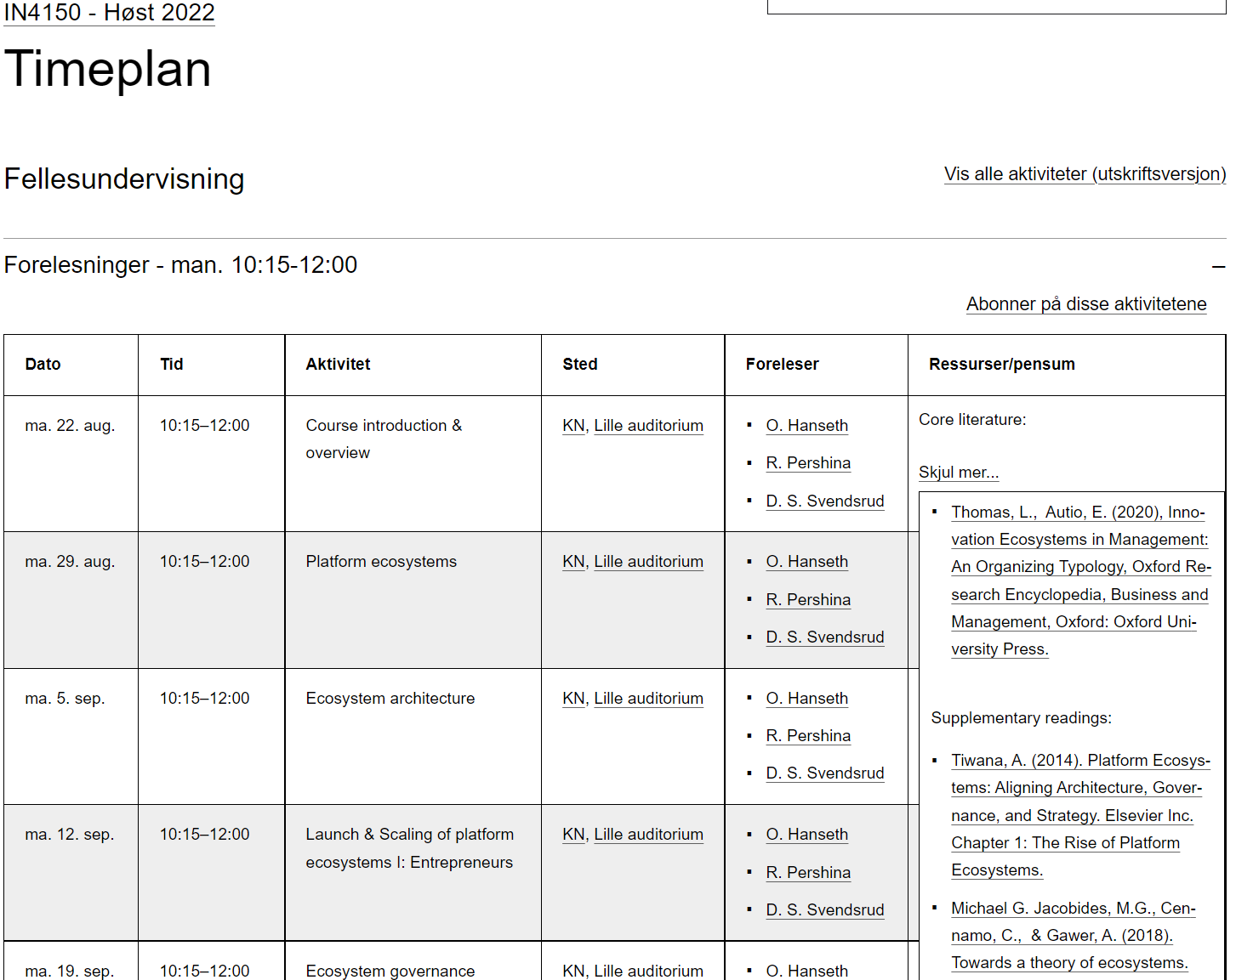
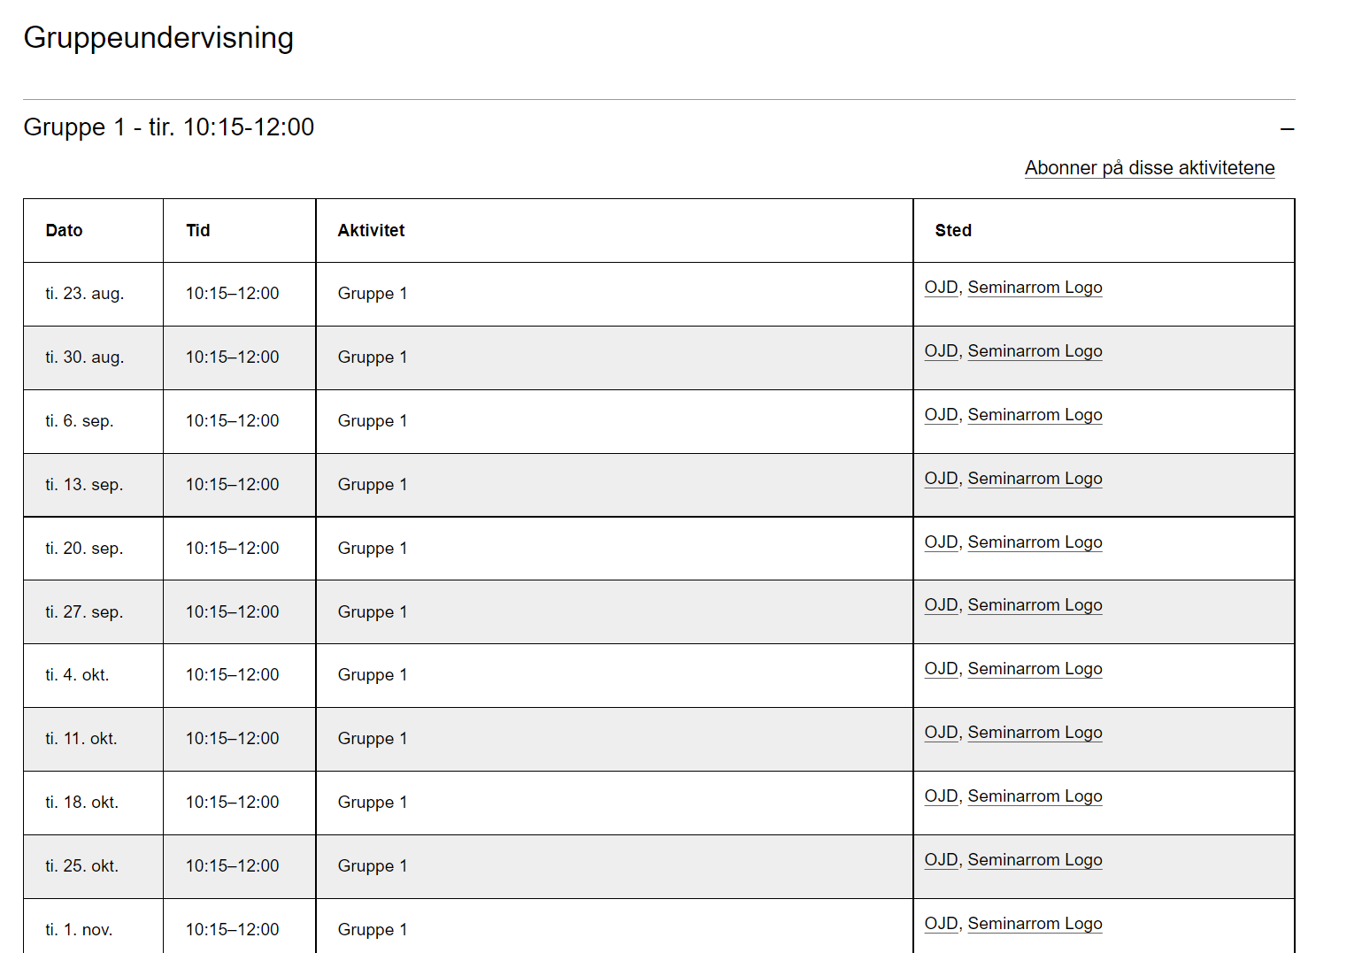
Webpage
https://www.uio.no/studier/emner/matnat/ifi/IN4150/h22/timeplan/index.html#FOR

Slide 8
Are you familiar with Canvas?

Slide 9
Group seminars: Important dates
Sept. 27th & October 4th - Feedback sessions on project work
November 1st & 8th – Presentations of group projects.
Any questions so far?

Slide 10

Two main assignments
  (see .doc)

Slide 11
Group project: Summary
Main aims:
  1) To get you thinking strategically about platforms and their development;
  2) Apply concepts and theories to practice;
  3) Develop analytical skills, research skills, other “soft” skills…
Contribute to the group work (see .doc)
Start early!
Notes:
Many issues regaring members not contributing enough or outright free riding. That will not work. We all have stuff. Do you best. Your classmates are an important part of your network. To make a good impression on them is as important as to make it on your teachers.
critical thinking, problem solving, public speaking, professional writing, teamwork, digital literacy, leadership, professional attitude, work ethic, career management and intercultural fluency.

Slide 12

Assigned Groups

Slide 13
Digital ecosystems
What is ecosystems?
What makes ecosystems digital?

Slide 14
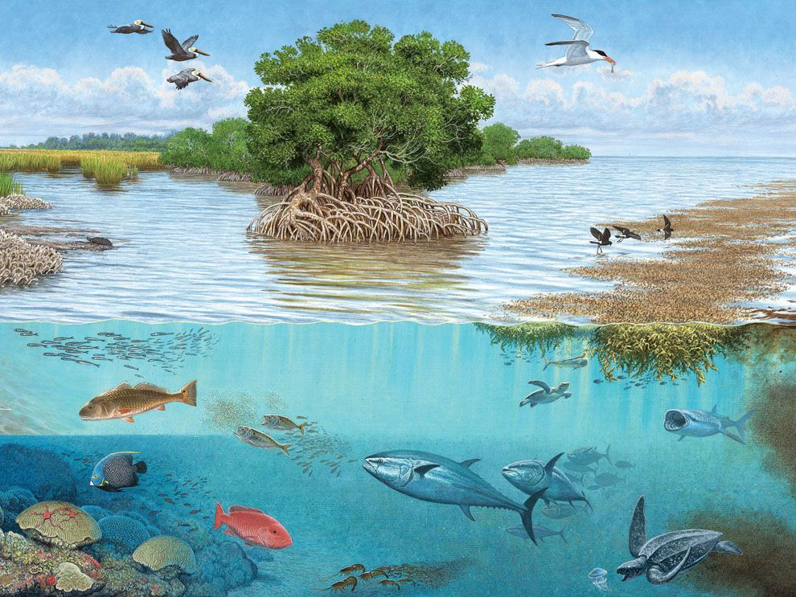
Ecosystem as a metaphor

Slide 15
The origins behind the term
James F. Moore, 1993: «ecological» understanding of strategy
More complex environments:
  Organizations
  Institutions
  Individuals
  Customers
  Suppliers
  Governments
  R&D institutions

Slide 16
Ecosystem as a concept
An abstraction we make of a phenomenon to make sense of it
Go through different conceptions of the ecosystem phenomenon

Slide 17
Different ecosystem concepts
Platform ecosystems, innovation ecosystems, industrial ecosystems, knowledge ecosystems entrepreneurial ecosystems, business ecosystems, technological ecosystems
Platform (innovation) ecosystems
As a specific type of an meta-organizational arrangement, a platform ecosystem has a larger innovation potential than other forms of organizations

Slide 18
Meta-organization
Ecosystems as a production system: input – throughput – output
Formal (single) organizations, interorganizational networks and meta-organizations
Meta-organization: several autonomous organization and/or individual persons working together to achieve a common (system-level) goal
Decision-making and coordination

Slide 19
Innovation potential
Generative capacity: innovation that «runs» by itself
Underlying phenomena: digitalization opening up new ways for companies to share ideas and knowledge and flexibly combine their outputs without contract-based coordination

Slide 20
A broad definition of ecosystems
“a community of hierarchically independent, yet interdependent participants who collectively generate an ecosystem output” (Thomas & Autio, 2020, p. 16)

Slide 21
Four defining characteristics
Participant heterogenity
Ecosystem outputs
Participant interdependence
Non-contractual governance

Slide 22
Participant heterogeneity
Members from several industries
Can span the public/private divide
Both collaborators and competitors
Span customer segments

Slide 23
Ecosystem outputs
Ecosystems are intentionally initiated
A coherent system-level goal of collaboration

Slide 24
Participants interdependence
Technological interdependence
Economic interdependence
Cognitive interdependence

Slide 25
Non-contractual governance
Important part of what separates ecosystems from other organizational collectives
What the overall ecosystem is to produce cannot be determined beforehand
There exist not a contract that can say how the different apps are to be used by customers for what purpose

