Slide 1
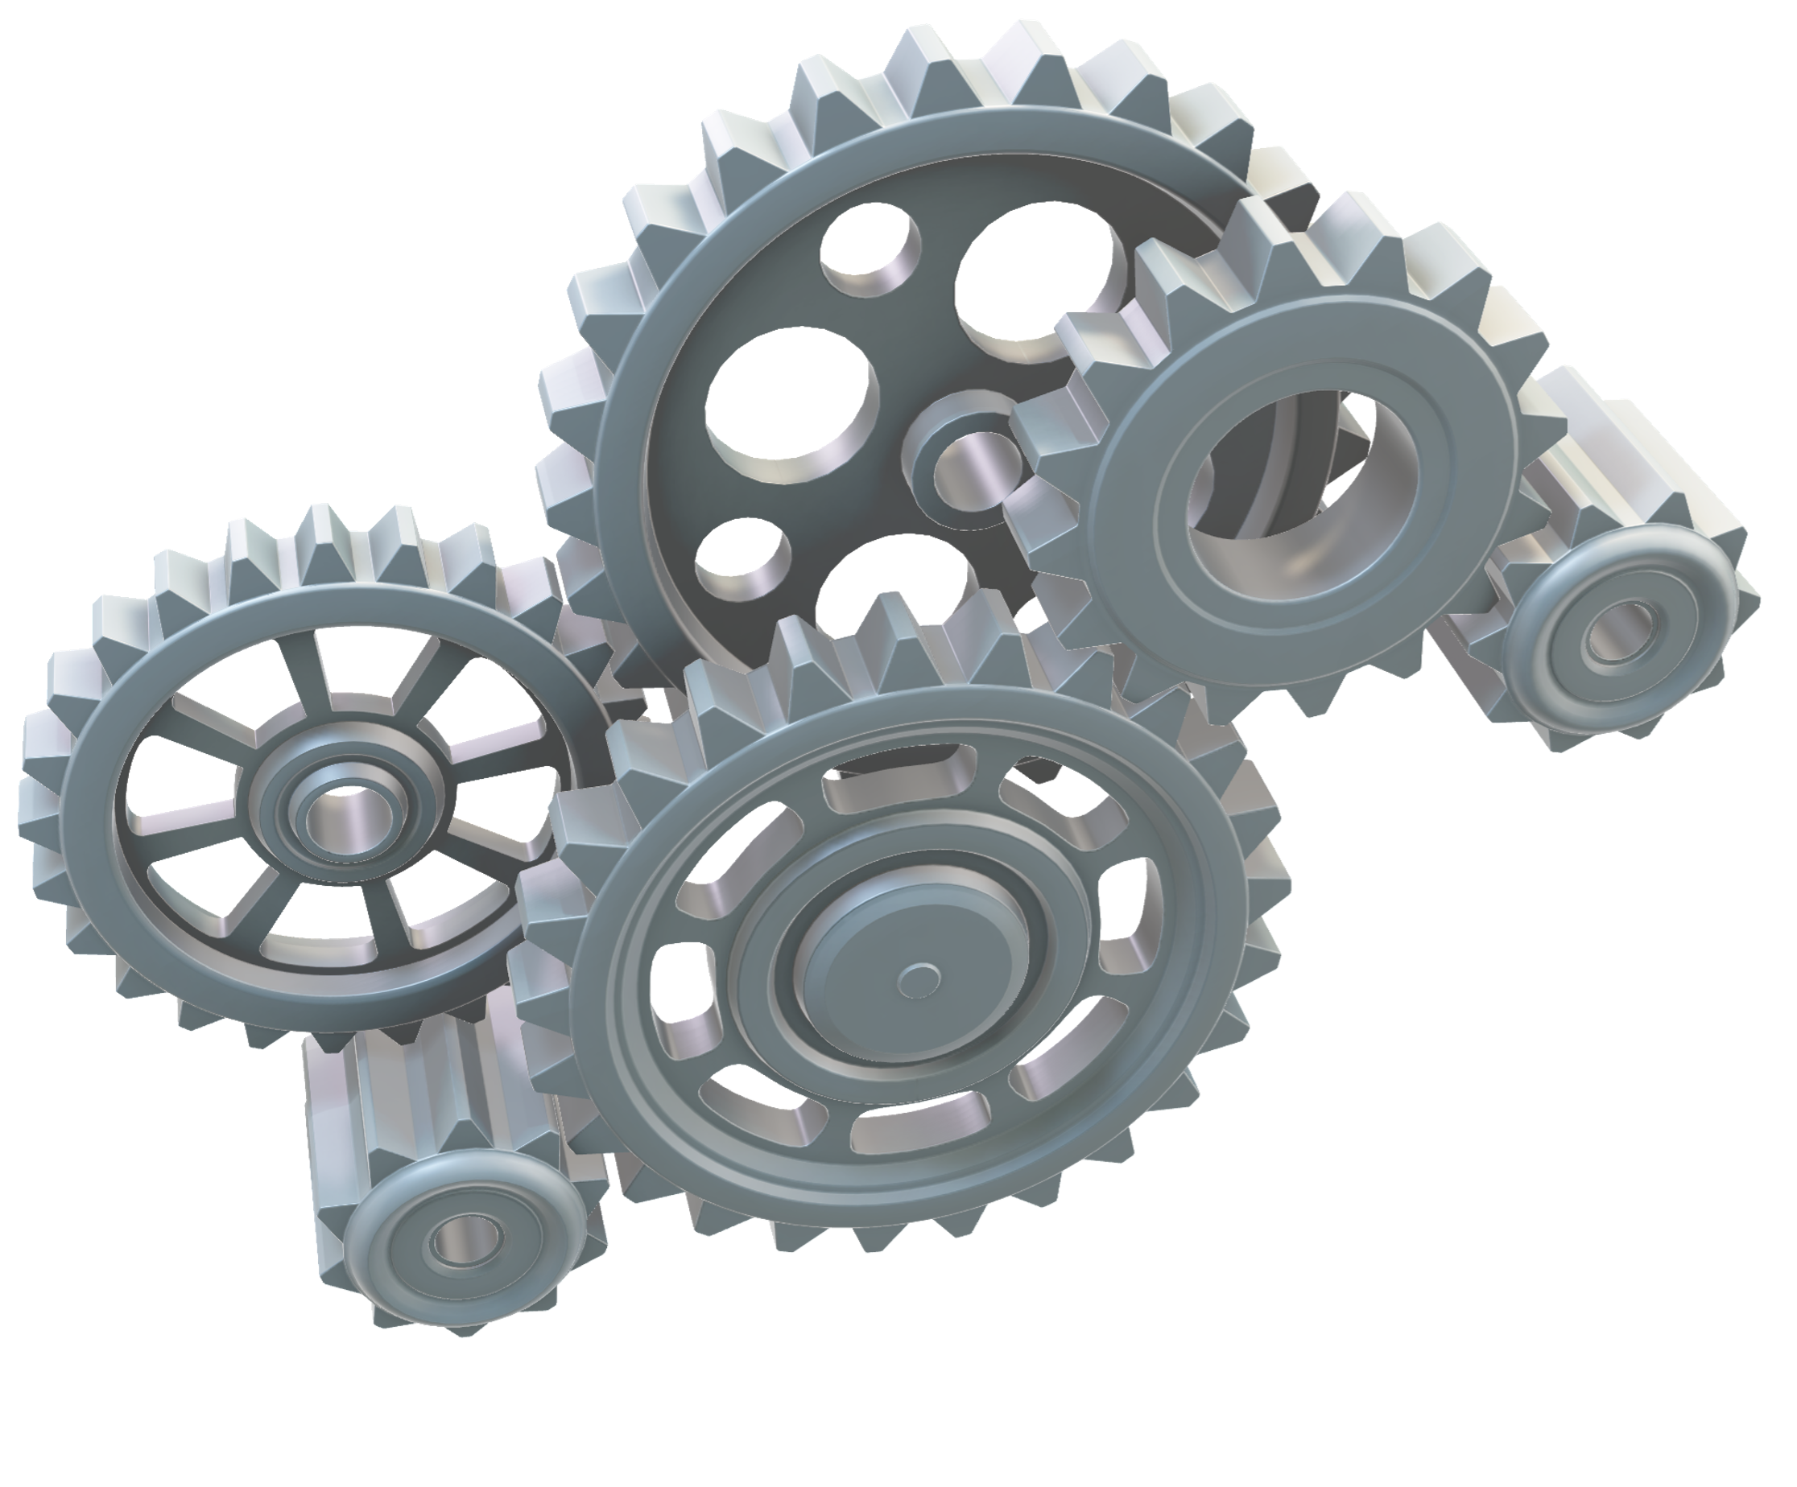
ECOSYSTEM GOVERNANCE
Daniel Stedjan Svendsrud
19.09.2022

Slide 2
Agenda for the day (and next time)
Understand the concept of governance and what it means for ecosystem management
The connection between governance and architecture as overall design questions
Ecosystem governance: «top down» – strategy
Ecosystem orchestration: «bottom-up» - strategy
Platform ecosystems as complex systems

Slide 3
DO YOU KNOW
What is governance??

Slide 4
GOVERNANCE

Slide 5
The term “Governance” in general
IT governance
Organizational governance
Corporate governance
Network governance
Ecosystem governance
“Blueprint” over management structures

Slide 6
Defining governance structures
“Governance structures are the formal and informal rules and procedures that control resource accumulation, development, and allocation; the distribution of the organization’s production; and the resolution of the conflicts of interest associated with group behavior…An organization is defined by its governance structure, which we identify as the fundamental rules about who is in, who is out, and who gets what.” (Klein, Mahoney, McGahan & Pitelis, 2019, p. 9).

Slide 7
Defining IT governance
“IT governance is the responsibility of the Board of Directors and executive management. It is an integral part of enterprise governance and consists of the leadership and organizational structures and processes that ensure that the organization’s IT sustains and extends the organization’s strategy and objectives.”
(De Haes & Van Grembergen, 2004, p. 1).

Slide 8
Defining Management
The handling and training of horses and a household
Organizational function
Wikipedia: Management in all business and organizational activities is the act of getting people together to accomplish desired goals and objectives using available resources efficiently and effectively. Management comprises planning, organizing, staffing, leading or directing, and controlling an organization (a group of one or more people or entities) or effort for the purpose of accomplishing a goal.

Slide 9
Governance + management
Both refer to some formality
Organization of authority
Hierarchy
Governance is essentially about managerial coordination

Slide 10
Organizational (IT) governance vs. network (ecosystem) governance
Organizational governance
Explicit hierarchy
Takes place inside the borders of formal organizations
Clear relationship between management levels
Governance is heavily regulated
Network governance
Implicit hierarchy
  Takes place outside the borders of formal organizations
More loose relationships
Governance is not a legal issue

Slide 11
Why the network term?
Single organizations cannot do things alone
Network organizations – goal initiated networks
An ecosystem is an organizational network, and thus the subject of network governance.

Slide 12
COMPLEXITY

Slide 13
Characteristics of platform ecosystem
Tiwana (2013, p. 77) says that a platform ecosystem can be envisioned as a “complex system”.

Slide 14
Complexity
A complex is an artifact that is composed of two or more separate or analyzable items, parts constituents or symbols that can vary when it comes to patterns and are thus hard to understand, and because of this needs to be studied or examined to be fully understood (Baldwin & Clark, 2000, p. 5).

Slide 15
Artifacts
Artifacts: tangible and intangible objects that are designed by human beings
Tangible: computers, cars, airplanes, boats, telephones, buildings
Intangible: organizations, laws and company strategies
Technology: the knowledge that is needed to create these artifacts.
Science: the knowledge we use to understand how all these artifacts work in the world and beyond.

Slide 16
Limited cognitive capacity
A single human being is limited in their cognitive capacity.
Consequences for decision-making capabilities
Economic man model: the decision maker has clear goals, complete information on all possible solutions and also complete information on the consequences of doing certain things
Administrative man model: rationality is limited , unclear and shifting goals, good enough (not perfect) solutions
Source: Simon, H. A. (1947). Administrative behavior; a study of decision-making processes in administrative organization. Oxford, England, Macmillan.

Slide 17
Complex artifacts = formal organization
More complex artifacts (consisting of more and more separate parts with unclear patterns)
The design of the artifact can be divided into different parts that are to be made by different people
Single man operation versus collective operation
To make money you would need to be more people and coordinate work: and then you have an organization.

Slide 18
Two implications of making artifacts
You need more than one to comprehend how to make it (division of knowledge)
You need more than one to make it (division of labour)

Slide 19
Two designs of complex systems
A system is an abstract description of how different components work as part of a bigger whole
A system is designed to fit a purpose – artifacts are made to solve a problem and create value
System 1: The abstract description of the division of labour = organizational (social) structure
System 2: The abstract description of the division of knowledge = technical (product) architecture

Slide 20
Organizational structure “mirrors” the technical architecture
Technical architecture
The design of the tasks that needs to be done and how task are connected to produce the artifact
What type knowledge do we really need?
Determined by the underlying technology and is a blueprint of the material structure of a product and the technical tasks needed to produce the product
Organizational structure
The design of the specific competence profiles and communication channels
What type of people do we really need?
A social structure that realizes the technical architecture
Governance structure is an important part

Slide 21
Task 1
Task 2
Task 3
Task 4
Task 5
Task 6
Task 7
Task 8
Task 9
Person 1
Person 2
Person 3
Person 4
Person 5
Person 6
Person 7
Person 8
Person 9

Slide 22
Task 1
Task 2
Task 3
Task 4
Task 5
Task 6
Task 7
Task 8
Task 9
Unit 1
Unit 2
Unit 3
Unit 4
Unit 5
Unit 6
Unit 7
Unit 8
Unit 9
Person 1
Person 2
Person 3
Person 4
Person 5
Person 6
Person 7
Person 8
Person 9
=

Slide 23
MODULARITY

Slide 24

HAVE YOU SEEN
THIS BEFORE?

Slide 25
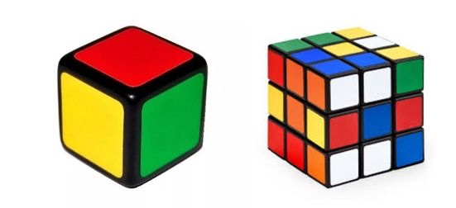
MONOLITHIC
MODULAR

Slide 26
Modular architecture/governance vs. monolithic architecture/governance
Modular system
Artifact: Car
Functionality: Transportation from A to B
Several independent sub-systems (modules) that interact through interfaces
Technical architecture: The car consists of different components that constitue the car
Organizational structure: Several units, several organization
Governance structure: Developing interfaces
Monolithic system
Artifact: Car
Functionality: Transportation from A to B
One highly interdependent system with no independent sub-systems
Technical architecture: The whole car
Organizational structure: One unit, one organization
Governance structure: Intense supervision and coordination inside the boundaries of one firm

Slide 27
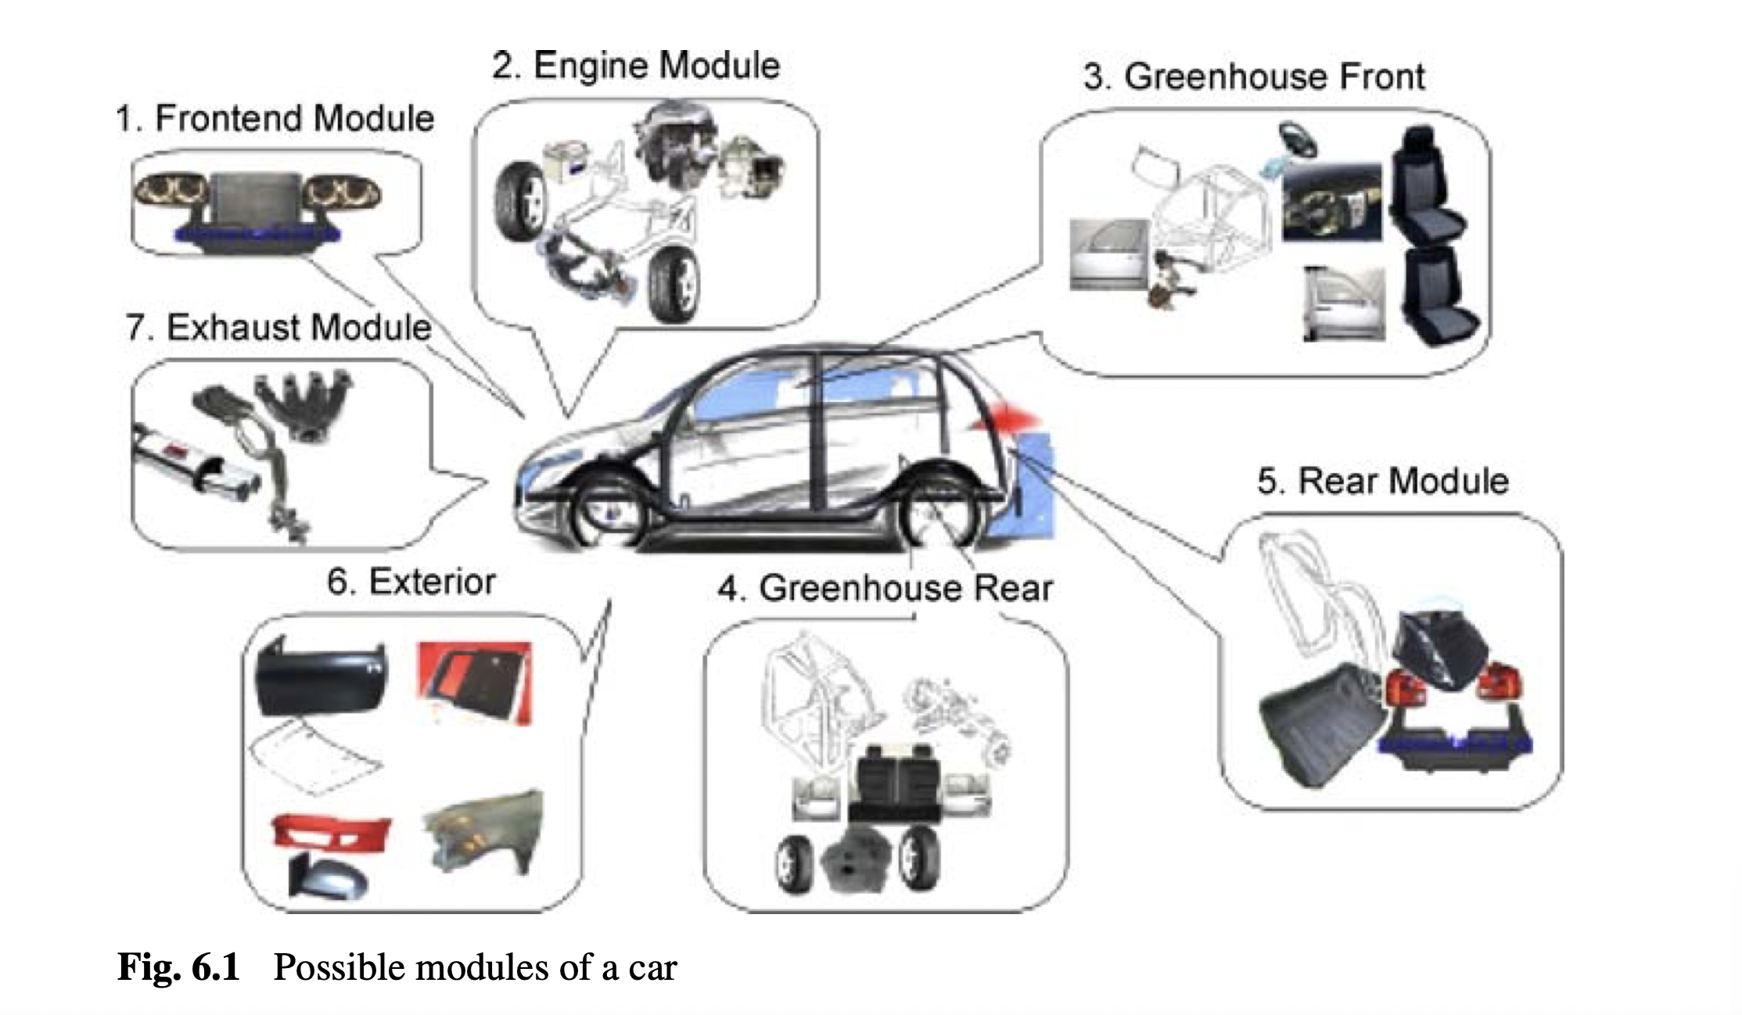

Slide 28
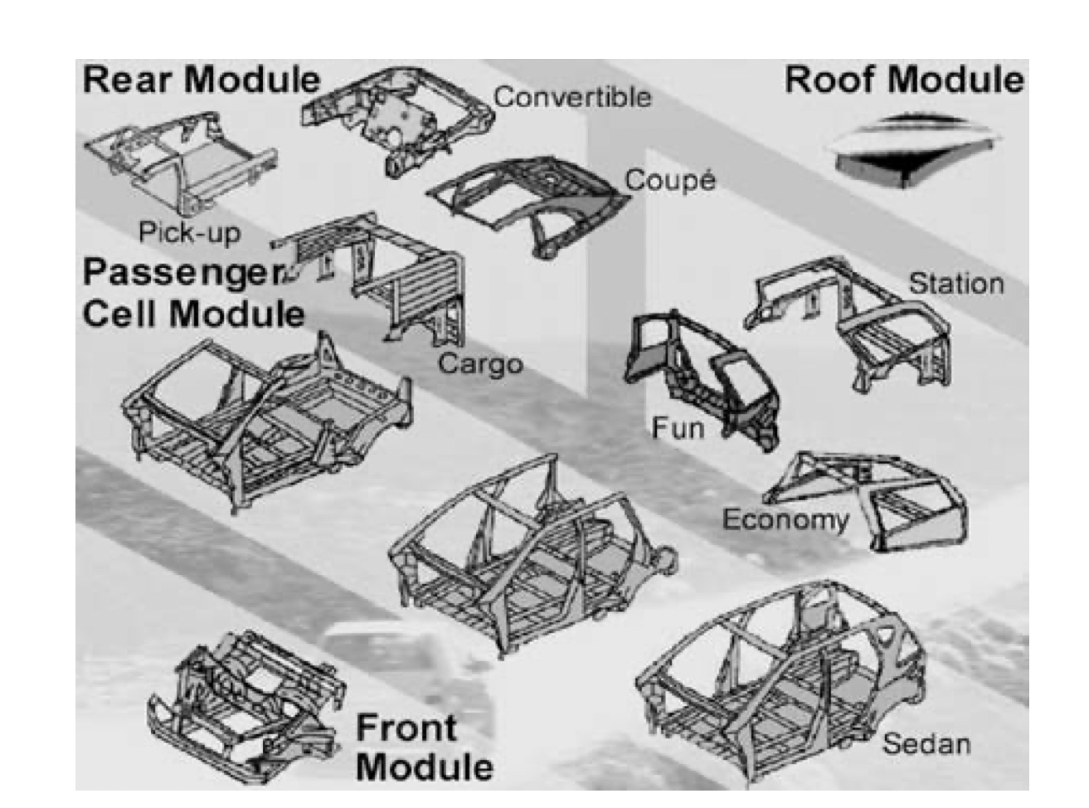
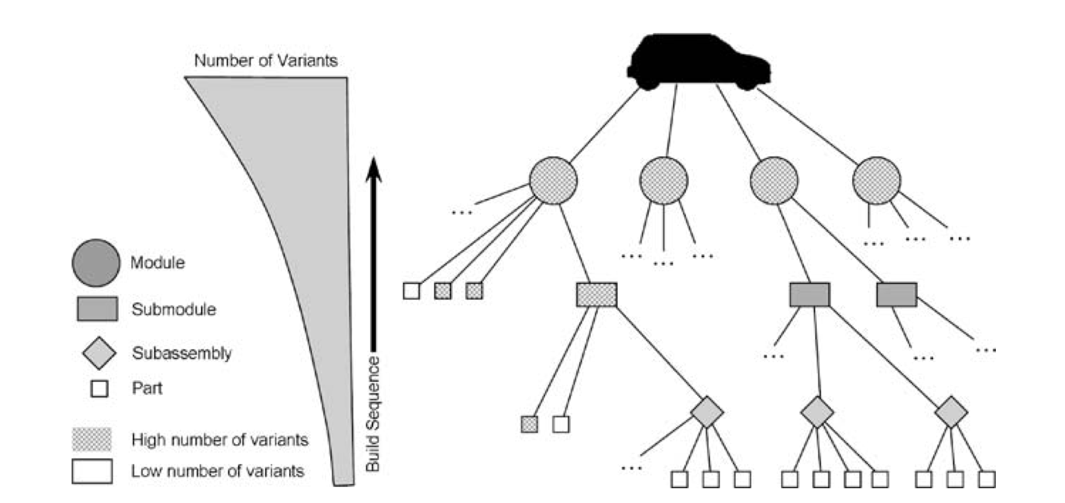

Slide 29
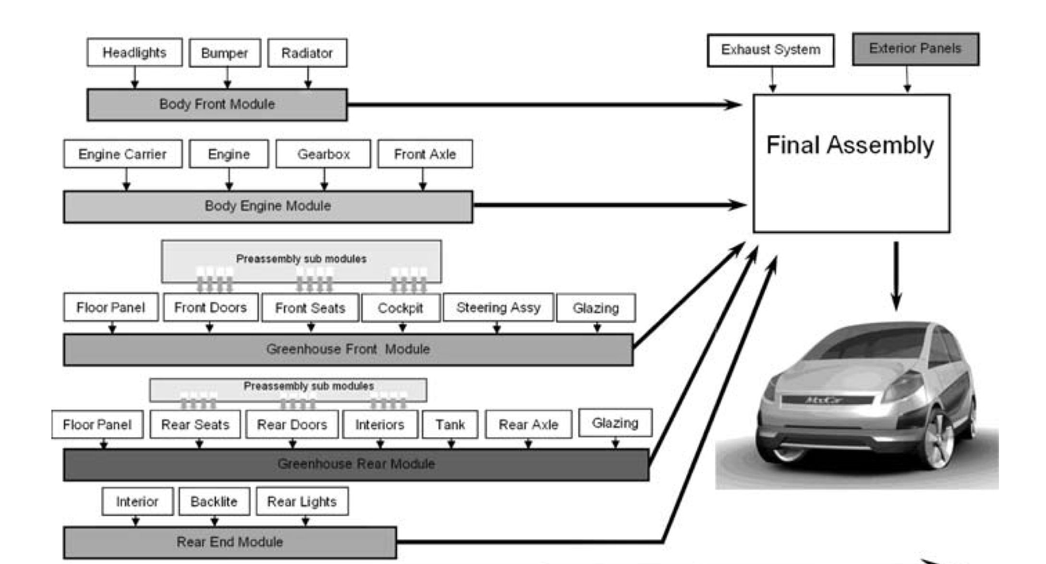

Slide 30
Pros and cons
Modular system
Recombinational use
Focused attention – capitalizing on specialized knowledge
Greater flexibility and agility
More innovation potential
Monolithic system
Less complexity
Faster and more direct communication
More central controll and oversight
Perhaps more capacity for innovation realization?

Slide 31
Two different growth logics
Modular system
Scales by growing externally – an ecosystem of users on both sides
The logic of network effects
Less span of control
Monolithic system
Scales by growing internally – an organization of contractually directed employees
The logic of mass production
Larger span of control

Slide 32
THANK YOU
DANIEL STEDJAN SVENDSRUD
daniessv@ifi.uio.no

