Slide 1
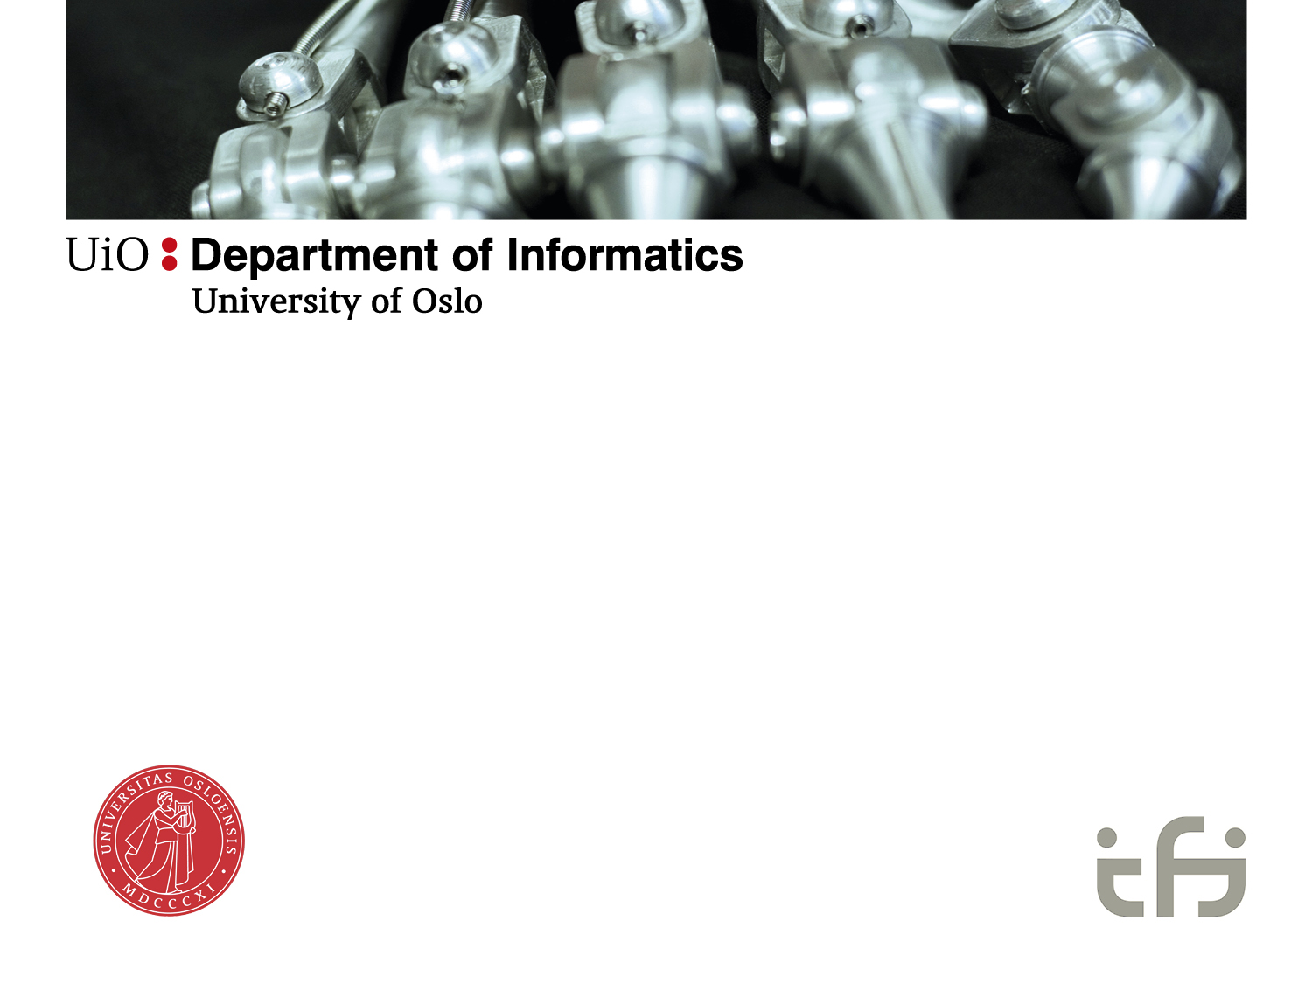

Information infrastructures
-
Emergence and evolution
The history of E-health in Norway
Ole Hanseth

Slide 2
Trends
More solutions – more integration
  Aker BP 700, Nordea 2000, Equinor 3000, Helse SørØst 5000 solutions
Industry wide integration/infrastructures
Installed base: From sociology to “Geology” of IS
  Layers upon layers
  ”sand” becoming “rock/stone” (or “digital concrete”)

Slide 3
Digital transformation of industries
Airline industry: booking systems, 1950-ies
Banking:
  SWIFT, 1960-ies
  Vipps, payment solutions, credit cards, shopping platforms, ..
Media
Advertizing

Slide 4
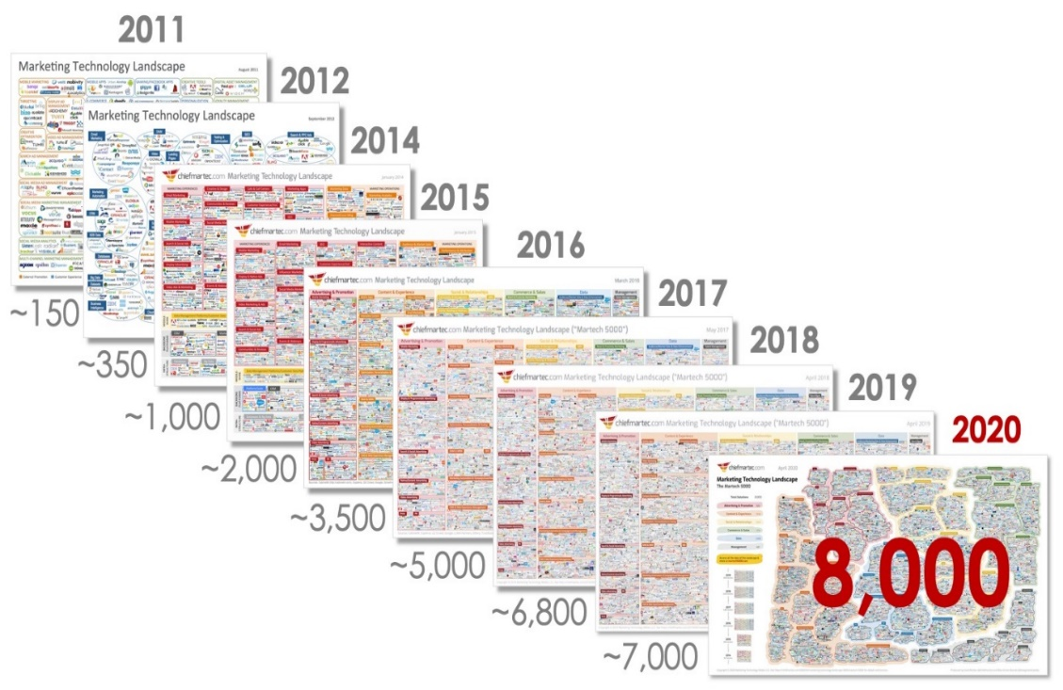
No of AdTech companies in US

Slide 5
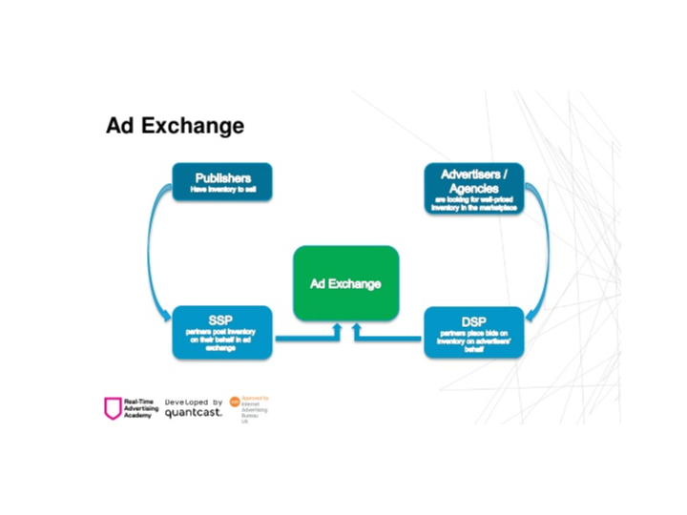
Example: Programatic advertizing

Slide 6
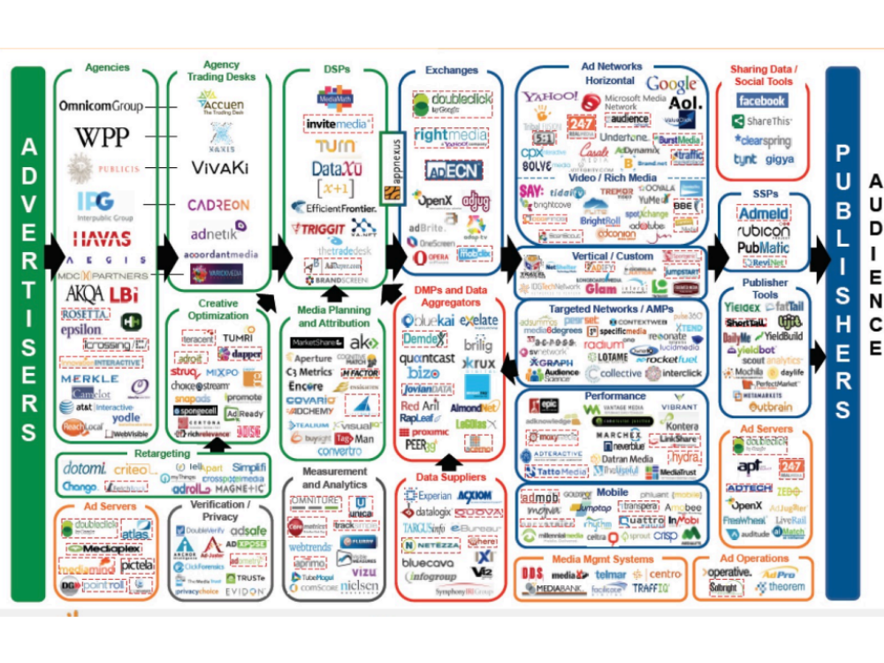
Platform-Oriented Infrastructures

Slide 7
Socio-technical regime
A technological regime is the rule-set or grammar embedded in a complex of engineering practices, production process technologies, product characteristics, skills and procedures, ways of handling relevant artefacts and persons, ways of defining problems; all of them embedded in institutions and infrastructures (Rip and Kemp, 1998: 340, Geels 2017).
Transition studies (e.g. from sail to steam ships, carbon to green energy)
Niche, regime, landscape
Sector and service regimes, splintering regimes

Slide 8
.. In short
Architecture
Governance (organizing) structures
Process (agile or water-fall)
“the mirroring hypothesis” (Conway’s law)

Slide 9
Regime - strategy
Infrastructures – multiplicity of actors:
  Norwegian health sector & e-health industry
  How are strategies established?
  How do they change?
  Who are in control?

Slide 10
Information infrastructure
«a shared, evolving, open, standardized, and heterogeneous installed base» (Hanseth)
«fractionally coherent object» (Grisot/Law)
Multiplicities of infrastructures – multiplicities of regimes:
  connected,
  layered,
  Overlapping and criss-crossing,
  …

Slide 11
The history of (”geology”) e-health infrastructures in Norway.
Regimes – dominant actors.
1970-1990: application developer/user constellations
1990-2002: Standardization committees
2002-2008: Regional IT management
2008-2012: IT architects
2012-2019: Regional top management, Directorate of e-health
2019- : Platform-oriented infrastructure (?)

Slide 12
Evolution (the landscape/interacting regimes)
New technologies (mainframes, PCs, network, cloud/platforms, IoT, ..)
New medical knowledge (and non-IT technologies: genetic tech, drugs (e.g. mRNA vaccines), ..
Changing organizational structures
Shifts: destabilization – emergence of new regime – (re-)stabilization

Slide 13
Pre ‘90: stand-alone applications
New applications, started from scratch
Developer – user constellations
In-house, vendors taking over
Focus: innovation
Emerging infrastructure, distributed controlled, loosely coupled (uncoupled)

Slide 14
1990-2002:
Destabilization:
  growing redundancy and inconsistency - emergence of communication technology
  Fürst’s lab report transfer solution
Emergence of new regime
  IT-industry, Telenor (Telemedicine in Northern-Norway), Andersen Consulting
  -> standards – formal standards (ISO)!!
Stabilization
  Consensus about Telenor’s approach
  Ministry, Health Directorate, KITH
  Standardization committees, pilots

Slide 15
2002-2008
Destabilization:
  Government takeover of hospitals
Emergence of new regime
  regional enterprises: reg management & IT dep
  Regional application standards
Stabilization
  Governance structures (Gartner’s Y-model)
  Tendering processes & regional “framework contracts”

Slide 16
2008-2012:
Destabilization:
  National ICT (2003): board, secretary, projects
  National IT architecture
    Key IT experts (architects) from regions involved
    (portal project at Rikshospitalet)
    => SOA & Role Based Clinical Work Space (RBCWS)
Emergence:
  Proposal immediately accepted
Stabilization
  Implementation projects started in HM, HN & HV
  RBCSW (KA) project at OUH – critical for the merge

Slide 17
2012-2019
Destabilization
  KA project failed => OUH merge postponed => hearing in Parliament’s Control and Constitution Committee
Emergence
  «Modellen er .. designet for ansvarsfraskrivelse»
  Management control (& Government control)
Stabilization
  New IT-strategy and governance model: Consolidation – Digital Renewal program
  ”one citizen – one medical record”, Directorate of e-health
  Epic

Slide 18
2019 -
Destabilization
  Digital Renewal failure
  Outsourcing (privacy) scandal
  Akson killed – heated public debate
Emergence
  New management: “the time of big projects is over”
  Ecosystem approach
Stabilization
  Slow transformation towards ecosystem approach

Slide 19
Regimes
1970-1990: stand-alone applications, application developer/user constellations, innovation
1990-2002: loose-tight: distributed dev of applications & Standardization committees
2002-2008: Regional application standards - regional IT management, framework contracts - procurement
2008-2012: SOA & RBCWS, IT architects – smooth infra evolution
2012-2019: consolidation, regional top management, Directorate of e-health – procurement/implementation
2019- : Ecosystem (?)

Slide 20
Destabilization
New technologies – IT regimes:
  Mainframes, PCs, networks, cloud based platforms, IoT, ..
Global e-health technologies
Medical knowledge and instruments
Existing infrastructure (installed base)
Events!!

Slide 21
Regime shifts
Destabilzation processes bring in new actors
New actors’ world view determines the new regime

Slide 22
Events - actors
1990: new com tech -> Telenor -> formal standards
2002: Government takeover of hospitals -> regional management – reginal application standards
2008: NICT (projects) -> IT architects -> SOA & CWS
2012: CWS failure -> Parliament - > tight centralized control, consolidation
2019: Digital Renewal , Akson failures (costs, ++) –> broad IT community –> ecosystems

Slide 23
Stabilization
Key actors in the emergence of a regime do not necessarily become key actors in a stabilized regime
1990: emergence: Telenor, regime: KITH
2002: emergence: government, regime: regional management
2012: emergence: Parliament, regime: top regional management, Directorate of e-health

Slide 24
Installed Base
Evolution of IT, medicine, infrastructure: different problems require different solutions
Regimes embed their own failure!
>1990: fragmentation, redundancies, inconsistencies,
1990-2002: too bureaucratic, too slow – more pragmatism would have helped
2012-2019: unmanageable complexities
Regimes are not deterministic: pragmatism & competence matters (KA)

