Slide 1
Introduction: What is engaged research?
Silvia Masiero
silvima@ifi.uio.no
IN4340 – Engaged Qualitative Research Methods
23.08.2023

Slide 2
Overview
Welcome to IN4340!
Introduction
  Course Motivation
  Learning Objectives
  Assessment
  Course Structure
Expectations!
Introduction: What is engaged research?

Slide 3
Introductions!

Slide 4
About us…
Dr Silvia Masiero
Associate Professor of Information Systems, HISP Centre
Research interests: information & communication technology for development (ICT4D), ICT use for emergency management, digital platforms for socio-economic development
https://www.mn.uio.no/ifi/english/people/aca/silvima/
https://www.researchgate.net/profile/Silvia-Masiero
Email: silvima@ifi.uio.no

Slide 5
About us…
Josue Kuika Watat
Doctoral Research Fellow, HISP Centre & Department of Informatics
Research interests: information & communication technology for development (ICT4D), Digital Health, Digital Governance, Transfer and Diffusion of Technology
https://www.mn.uio.no/ifi/english/people/aca/josuekw/
https://www.researchgate.net/profile/Josue-Kuika-Watat
Email: josuekw@ifi.uio.no

Slide 6
Introduction to IN4340

Slide 7
Course Motivation
Engaged research: a participatory form of research for studying complex real-world problems from the perspectives of key stakeholders
In this course we learn about engaged qualitative research methods, focusing on how to apply such methods to your MSc thesis.
We will study different methods of engaged qualitative research, so to gain the methodological skills you will need to complete MSc work.
Real-life examples: an engaged course, both in name and in substance! :-)

Slide 8
Course Motivation
This course introduces you to the epistemologies (knowledge paradigms) of engaged qualitative research, then zooming on four methodologies through which qualitative research can be conducted:
  Case studies;
  Action research;
  Ethnography;
  Grounded theory.
We will also learn about the ethics of engaged qualitative research, as well as the practicalities of conducting such research on the field.

Slide 9
Course Motivation
The course is designed to equip you with the skills needed to approach the writing of your MSc thesis proposal:
  December 2023 – choice of a MSc thesis project;
  June 2024 – MSc thesis proposal essay: problem statement; research question; methodology; proposed empirical study and expected contribution.
In the course you will learn about essential aspects of proposal writing: formulating a research question; data collection and analysis; writing and reporting on research; facing and solving ethical and practical dilemmas.

Slide 10
Learning Objectives
After completing the course, you can:
Understand and distinguish different epistemological paradigms and their implications for research design and execution;
Explain and compare different methodologies for engaged research including case studies, ethnography, action research and grounded theory methods;
Explain and compare different methods used in engaged research on digital health including interview, participant observation, studying situated practices and document analysis;

Slide 11
Learning Objectives
After completing the course, you can:
Use engaged qualitative research methods for your own research on digitalisation in the health sector;
Make qualified and well-motivated choices of research methodology for your own research and assess others’ choices of methodology;
Understand and apply core concepts and practices of research ethics;
Perform field interviews and observations and analyse the resulting empirical data.

Slide 12
Course Structure
Weekly lectures (Wednesday, 12.15-14.00)
Weeks 5-8: lecture & practice seminar!
Practice seminars (simulation of real fieldwork situations): Thursday, weeks 5-8, 14.15-15.45

Slide 13
Assessment
Home exam (available 24 November, submit by 13 December)
  Four questions, open-ended
  Answer two questions (each counts for 50% of the final grade)
Skills assessed in the exam:
  Knowledge of course contents (pensum)
  Ability to critically and independently comment on core problems and matters of engaged qualitative research.
  University of Oslo marking scheme: https://www.uio.no/english/studies/examinations/grades/#:~:text=The%20University%20of%20Oslo%20employs,is%20used%20in%20a%20course

Slide 14
Assessment
In preparation for the exam…
Familiarise with the pensum (core, supplementary, optional readings)
Attend lectures and practice seminars
Be participative in class
Ask questions! :-)
Form study groups
Write a mock exam!

Slide 15
Readings
Three types of reading are available in the pensum:
Core readings (1-2 per lecture; mandatory; needed to form the knowledge required to pass the exam)
Supplementary readings (1-2 per lecture; additional readings which will help you understand the lecture content in greater detail)
Optional readings: a list of research studies on digitalisation in the health sector, conducted predominantly by the HISP Network. While these readings are optional, they offer many useful examples of how engaged research on digital health is made.

Slide 16
Expectations!
Join lectures and practice seminars (be active in class!)
Our motto: “no question is a wrong question!”
Engage with the pensum: mandatory weekly readings; supplementary and optional readings to deepen your knowledge of the topics
Adopt a critical approach to readings – don’t be afraid to challenge the arguments made
Do come to office hours (open-door) if you have questions, and indeed, if you wish to discuss your MSc research proposal!

Slide 17
Where I sit…
Room HBU036, Nemko building, Gaustadalléen 30
Open-door office hours!
Email: silvima@ifi.uio.no

Slide 18
Questions?

Slide 19
Introduction: What is engaged research?

Slide 20
Engaged research…
Engaged research: a participatory form of research for studying complex real-world problems from the perspectives of key stakeholders (Mathiassen, 2017)
What’s in a definition?

Slide 21

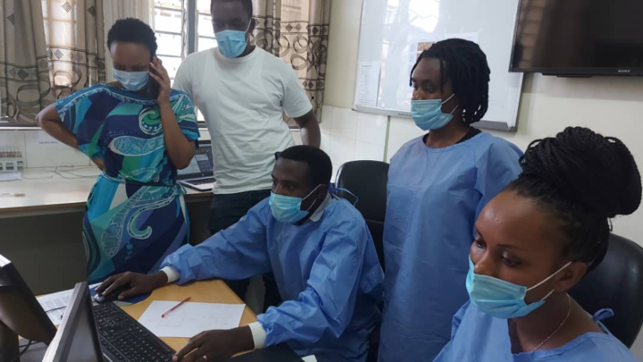

For example…
Supporting effective health data use in the Democratic Republic of the Congo with DHIS2 - DHIS2
Integrating laboratory COVID-19 testing results with Tracker in Rwanda - DHIS2
Innovating with DHIS2 for an integrated COVID-19 tracking system in Norway - DHIS2

Slide 22
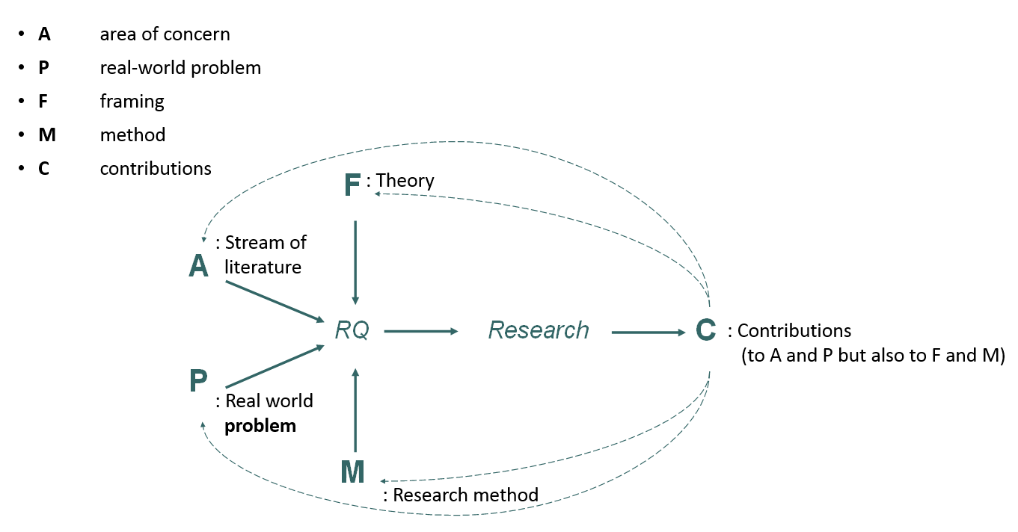
Research Design (Mathiassen, 2017)

Slide 23
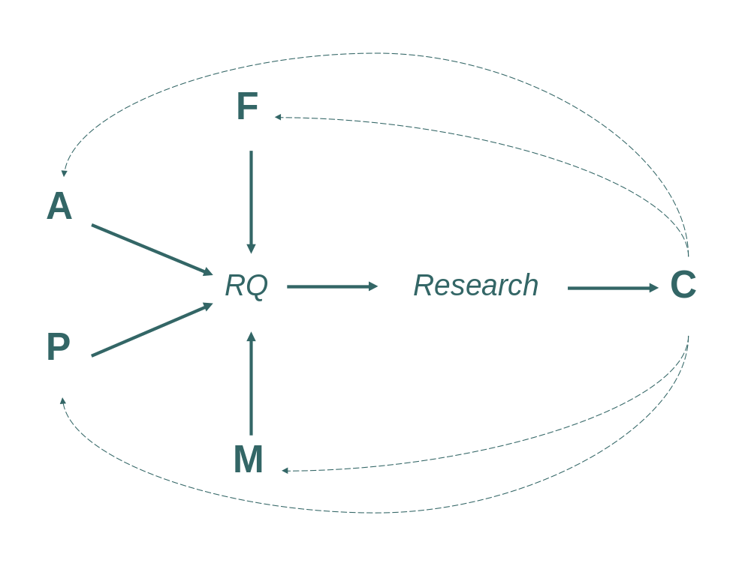
An example (Amuha, 2021)
Education Management Information Systems (EMIS) data management process and decision making at district level
Institutional theory,
institutional logics
Contributions (mainly) to EMIS literature (A) and IS literature
Contribution to P; computerized, decentralized data management. Readily available data to guide decision making
How can decentralization of EMIS using a digital platform support data management and decision making at district level?
Largely manual data management process, no readily available data at districts to guide decision making
Interpretive qualitative case study:
participant observation, informal interviews and conversation, and reviews of documentation

Slide 24
Key take-homes from Mathiassen (2017):
Engaged research enables us to contribute to practical problem solving on real-world problems, while also developing new theoretical insights.
A creative process, in which the researcher discovers and evaluates different possible ways to build the research question and its response
Research design as strictly intertwined with publication design (in our case: the design of your MSc thesis!)
Often developed among researchers and practitioners
The research process is never predictable – but identifying its core components, we are in the position to design it in a clear and coherent way.

Slide 25
Doing engaged research (Van de Ven, 2018)
Engaged scholarship is designed to bridge the gap between theory and practice, in response to perceived “lack of practical relevance” of research
This point – which Van de Ven (2018) makes for managerial research – holds strongly for research on digitalisation of the health sector.
Practitioners should be involved in research not only to increase its relevance, but most importantly, to increase the likelihood of advancing knowledge for science and practice (e.g. health planners; decision-makers)
Involving practitioners involves both challenges and opportunities!
But: by involving stakeholders in the research process, we gain a deeper and better understanding of the problem investigated.

Slide 26
So…
Engaged research: a participatory form of research for studying complex real-world problems from the perspectives of key stakeholders
In this course, substantial focus will be placed on designing the core components of an engaged research study, so to solve a practical problem and, at the same time, developing new theory.
To do so, we need to learn about research epistemologies and methodologies – which are the focus of the next lectures!

Slide 27
Thank you!
silvima@ifi.uio.no

Slide 28
Readings
Core Reading
Mathiassen, L. (2017). Designing engaged scholarship: From real-world problems to research publications. Engaged Management Review, 1(1), 17-28.
Van de Ven, A. H. (2018). Academic-practitioner engaged scholarship. Information and Organization, 28(1), 37-43.
Supplementary Reading
Van De Ven, A. (2011). Engaged scholarship: Stepping out. Business Strategy Review, 22(2), 43-45.
Myers, M. D., & Avison, D. (Eds.). (2002). Qualitative Research in Information Systems: A Reader. London: Sage. Chapter 1.

