Slide 1
Engaged Qualitative Research: Methods
Silvia Masiero
silvima@ifi.uio.no
IN4340 – Engaged Qualitative Research Methods
13.09.2023

Slide 2
Overview
Data collection: methods for qualitative research
Data analysis: narrative and thematic coding
Field stories!

Slide 3
After this lecture, you can…
Describe the fundamentals of data collection methods such as interviews, direct observation, participant observation, documents, archival records, digital and physical artefacts
Explain the difference between narrative and thematic analysis, and discuss the fundamental elements of such data analysis techniques
Apply the fundamentals of data collection and analysis to your own research design, describing how you would use particular methods of interpretive research to collect and analyse your data.

Slide 4
From last week…
Epistemology
Theoretical perspective
Methodology
Methods
Structuring elements of social research
(Crotty, 1998)

Slide 5
The structuring elements of social research
Epistemology: our assumptions about knowledge and how it can be obtained
Theoretical perspective: the philosophical stance informing the methodology and providing context for the process and grounding its logic and criteria
Methodology: the plan of action, process or design lying behind the choice and use of particular methods
Methods: the techniques or procedures used to gather and analyse data

Slide 6
Research methods!

Slide 7
A fundamental difference…
In research we distinguish between methods for data collection and analysis, both of which are fundamental in answering a research question.
Methods for data collection are methods through which we gather our data from the field. These include interviews, direct observation, participant observation, physical or digital documents and artefacts.
Methods for data analysis enable us to read our data, deriving from them the answer to our research questions. Here we focus on two widely used data analysis methods: narrative and thematic analysis.

Slide 8
Writing a (good) research question!

Slide 9
Writing a research question…
A research question is the question that your research will answer. The research question is a fundamental element of a research project.
Three rules for a strong research question:
  Clear – your question needs to clearly indicate the purpose of the study, so to give a structured direction to the research.
  Feasible – you need to be able to answer your research question in the time and with the resources you have to conduct the study.
  Relevant – your research question should be relevant to the field you wish to contribute to (e.g. digital health), so to enable you to make an original contribution to that field.

Slide 10
For instance…
How does the existing institution of in-service training shape the introduction of online training for health staff in Indonesia?
What are the technological and social factors that constrain and enable innovation in software ecosystems?
How can we understand the role of boundary resources in platform owners' efforts to cultivate third-party development?
How has the interplay between technology and work practice influenced contact tracing of COVID-19 in Norway?
How can global public good platforms facilitate inclusive innovations by enabling effective participation in strengthening health information systems?

Slide 11
Less good research questions…
Unclear terms or topic!
Questions in the future (how “could” a certain application work…?)
Unfeasible research plans (breadth; access issues)
Limited originality – familiarise with the essential literature!
Limited innovation – fail to specify the importance of the study
Lack of relevance for your research field
Excess of abstraction – inability to answer through data
Replication of existing studies!

Slide 12
So…
Before thinking of your research methods, it is important to formulate research questions that are clear, feasible to answer within your time and resources, and relevant to the field you aim to contribute to
Each paper (or thesis!) is part of a scholarly conversation, to which you will contribute based on the findings of your research.
Existing published literature is a very good way to see how a (good) research question is formulated!

Slide 13
Data collection!
Data collection is the process through which we gather our field data. Qualitative methods for data collection involve the use of qualitative data to understand and explain social phenomena.
In the interpretive research tradition, data collection aims at accessing the meanings and interpretations that people form of reality
Interviews, direct and participant observation, physical and digital documents and artefacts can all form part of a qualitative research project!

Slide 14
Interviews
Walsham (2006): a more or less structured conversation where the interviewee(s) convey, through language or other means, their meaning and interpretations of the studied phenomena.
Organisation of the interview: an ice-breaking phase, setting the scene and context for the conversation, followed by a more or less participant-led discussion of one or more themes of relevance to the study
Preparation as crucial to the interview process: a sign of respect for the interviewee(s), but also key to high-quality data collection!
Tape-recording or not?

Slide 15
Interviews
Interviewing styles:
Structured – the researcher builds a fixed questionnaire, and strictly attains to it in the conduct of the interview
Semi-structured – the researcher builds a topic guide (list of questions), and then uses it to guide the interview process, letting the respondent elaborate on the questions asked and adding more questions where needed
Unstructured – the researcher leaves the respondent to elaborate freely on the topic of the interview, without any guidance from the interviewer.

Slide 16
Direct observation
A method of collecting evaluative information in which the evaluator watches the subject in his or her usual environment without altering that environment.
It is useful when we are trying to understand an ongoing process or behavior, or an unfolding situation or event, and there is physical evidence, or products or outcomes that can be seen.
It can be conducted in public or private situations, and a key to it is planning who, how, and what to observe: observing people’s practices in a given setting offers a window on people’s lived experience of a research object.

Slide 17
Participant observation
Walsham (2006): different styles of involvement in research, from a completely detached observer who does not intervene in the setting, to the involved researcher, which participates in the researched phenomenon.
Participant observation occurs when the researcher actively participates in the activities of the research subjects. The observers immerse themselves into the context, becoming an active part of the researched activities.
In participant observation, data emerge from a reality that is co-produced by the researcher, which makes the awareness of positionality (where do we stand in relation to the research object?) especially important
More involved styles of research, such as action research, may resonate especially well with participant observation!

Slide 18
Digital and physical documents
Document analysis: a process that involves evaluating digital or physical documents to interpret them, understand their meaning in context and develop upon the information they provide.
Increased availability of digital documents, but physical ones still very relevant in many research contexts (e.g. archival records)
Documents play a twofold role in research: increase our awareness of the research objects (e-g. in preparation for fieldwork), and contribute to the data we collect on the same object, enriching the image that we form of it
It is always good to provide an appendix detailing the digital and physical sources of your research! (Example of a documental appendix)

Slide 19
Digital and physical artefacts
Digital artefacts (e-books, infrastructures, platforms like DHIS2...) and physical artefacts (computers, objects, mobile devices...) can form an integral part of a qualitative data collection process!
Research can concern both the features of the artefact (functionalities of the platform, how it is designed and implemented…) and the ways the artefact is used by people (their reactions to it, their positive aspects and concerns)
When studying artefacts, the researcher uses them as data sources on key aspects of the research: what features makes the artefact what it is? What role do these features play in the way the artefact is perceived?
In other words, even artefacts play a role in the lived experience that people have of a certain research object.

Slide 20
So…
There are many techniques to gather data when doing qualitative research! The data we gather will then need to be analysed, to form the understanding that leads to answering our research question.
Our findings in the research are data that have been collected and analysed, i.e. “cooked” in response to the question we initially asked.
In the next few weeks, we will see how different methodologies (case studies, action research, ethnography, grounded theory) inspire diverse combinations of methods for data collection and analysis.

Slide 21
Data analysis!

Slide 22
Data analysis!
Qualitative data analysis: the process of organising and interpreting qualitative data, in response to one or more research question.
During analysis we “cook” the data gathered during data collection, so to arrive at the research findings on which the central contribution of our research is based.
How many... cooking recipes do you know?

Slide 23
As it happens...
...there are many ways to “cook” data, as well!
Qualitative data analysis can be deductive or inductive: in deductive research, we use a theory or framework in order to read or analyse our data. Examples include grand theories (institutional theory, actor-network theory...) and midrange theories, which explain a specific phenomenon.
In inductive research, we step into the field without a conception of the theory that will inspire our study. An example is grounded theory, where theory is derived directly from the collected data.

Slide 24
So...
The theory through which we structure our study may offer the means (for example, a theoretical framework) for conducting our analysis.
But we can also generate theory directly from the data, deriving a theoretical contribution from them without the mediation of a framework.
Two well-known ways of doing this are narrative analysis (which takes whole narratives to make sense of phenomena) and thematic analysis, which makes use of coding!

Slide 25
Narrative analysis
Narrative analysis is a type of qualitative data analysis that focuses on interpreting the core narratives from personal stories of respondents.
Differently from methodologies that involve coding, it is the whole narrative, not the bits and pieces derived from coding, that acts as the data source.
Narrative analysis tends to involve long, unstructured (or semi-structured) interviews, where the participant talks at length about one or more objects of research. Processes of image formation (how has the respondent arrived at their perception of a certain object?) are captured well by this method.
It also involves extensive reads of interview data, capturing the richness of the picture of the research object emerging from the respondent’s words.
A go-to book on narrative analysis: Riessman, 1993

Slide 26
Thematic analysis
Thematic analysis involves reading through a set of data (collected through interviews, observation, documents...) and looking for patterns in the meaning of the data to find themes.
While in narrative analysis it is the whole narrative that counts, in thematic analysis we look for specific themes in the data, trying to use such themes to build an answer to our research question.
Coding – the process of arriving at theoretical categories from the data – is a useful tool for thematic analysis!

Slide 27
Coding
First-order codes: categories grouping together data that have a common characteristic, such as the same theme (thematic coding).
  For example: if we are studying reactions to a new health data management app by medical staff, we may have codes such as “ease of use”, “disappointment with core functions”, “difficulty to use the system”…
Aggregate categories: categories that group together codes with a common theme.
  For example “approval”, “disapproval” or “misunderstanding” of a certain app or system.
Abstract categories: categories that, grouping together aggregate dimensions, constitute the building blocks of the theory.

Slide 28
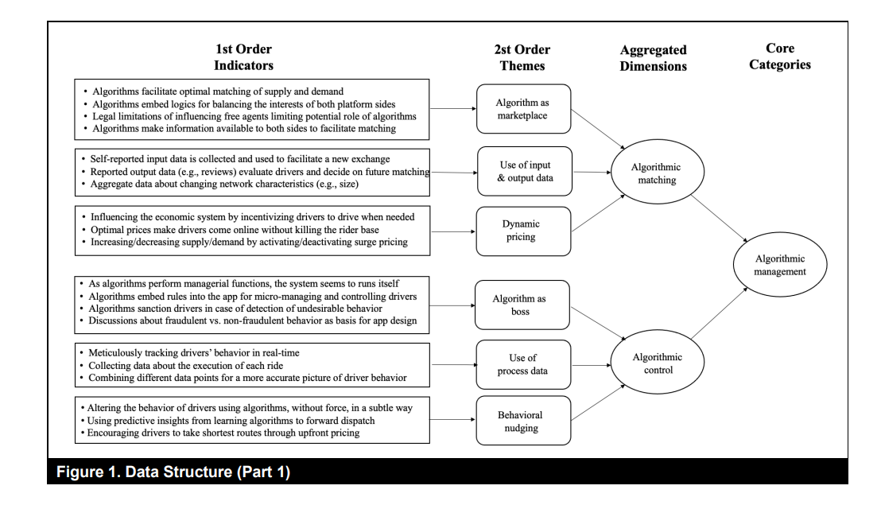
For example...

Slide 29
Field stories!

Slide 30
To recap…
We have learned the fundamentals of qualitative methods for data collection, meaning the process of gathering data, and data analysis, meaning the process of using data to answer our research question
We have seen how these methods can form integral part of research design, helping us to arrive at research findings and from them, to the contribution that our study will make.
Now we are all ready to delve – from next week on – in the world of research methodologies, which we will see in theory and practice!

Slide 31
Thank you!
silvima@ifi.uio.no

Slide 32
Readings
Core Reading
Myers, M. D. (1997). Qualitative Research in Information Systems. MISQ Discovery, 1-18.
Walsham, G. (2006). Doing interpretive research. European Journal of Information Systems, 15(3), 320-330.
Supplementary Reading
Mathiassen, L., & Nielsen, P. A. (2008). Engaged scholarship in IS research. Scandinavian Journal of Information Systems, 20(2), 3-20.

