Slide 1
Ethnography
Silvia Masiero
silvima@ifi.uio.no
IN4340 – Engaged Qualitative Research Methods
11.10.2023

Slide 2
Overview
Ethnography: method and conduct
Doing ethnographic work
An example: doing ethnography on India’s social protection system

Slide 3
After this lecture, you can…
Describe the fundamentals of ethnography, including interaction with the field, conduct of research, reporting on it, and ethical considerations
Draw the fundamental distinctions between ethnography and other qualitative methods, recognising the specificities of ethnographic work
Apply the fundamentals of ethnography to your own research design, explaining how you would answer your own research question using an ethnographic approach.

Slide 4
Ethnography

Slide 5
Ethnography
“One of the most in-depth research methods possible” (Myers, 1997)
Ethnographers immerse themselves in the lives of the people they study, seeking to place the phenomena studied in their social and cultural context.
Going native: the ethnographer explores social, political and cultural phenomena from the point of view of the subject of the study.

Slide 6
Ethnography (Myers, 1997)
The goal of ethnographic research is to improve our understanding of human thought and action through interpretation of human actions in context.
For an ethnographer, the context is what defines the situation and makes it what it is. This explains the long time spent appraising it.
Anthropological approaches to ethnography, unlike action research, do not prescribe direct involvement of the researcher with the research object.
While taking the participants’ perspective, the researcher does not influence it, but absorbs it through multiple channels combined within fieldwork: language; interaction with participants; field presence.

Slide 7
So…
Different from case studies and action research:
In the perspective taken, that of the studied subject (e.g. hospital patients; health managers; contact tracers; workers in a business organisation)
In the form of involvement: unlike the action researcher, the ethnographer develops a form of learning from the field that does not involve action
In the time of research: the anthropological tradition sees ethnographers living for long times, even years, on the field (not always so in information systems and digital health research).

Slide 8
But...
…lack of action does not prevent us from being critical!
Myers (1997): Critical Ethnography
A form of ethnography that, while not translating into action research (the researcher is still an observer), engages a critical epistemology, i.e. a view of knowledge that questions the oppressive conditions of the status quo.
While in the position of observer, the researcher uses ethnography as a window on the conditions of alienation and oppression that pervade the field.
This does not make the researcher an “activist”, but enables them to appraise socio-historical conditions that deeply affect the lives of participants.

Slide 9
For example...
Lin et al. (2015): Extending ICT4D studies: The Value of Critical Research
An Information & Communication Technology for Development (ICT4D) project in a school in Taiwan, based on computers for school teaching
The mainstream narrative: a successful project, highlighted by mainstream media and the School principal as a landmark tech-for-development success
Critical ethnography uncovers a different reality: parents and teachers reveal frustration with the ICT4D project, which while creating an appealing image to the media, is stifling learning and disempowering class teachers.
The ethnographer does not take action, but her enquiry uncovers an oppressive, alienating reality lived every day by the study participants.

Slide 10
Epistemic violence
Tuhiwai Smith (2012): systemic violence operated by researchers on Indigenous populations – imposing colonial relations through research
Epistemic violence: a form of violence exerted on knowledge and through it, by imposing outsider knowledge systems on the studied subjects
For example, decades of research on Indigenous populations have resulted in the imposition of Western systems of thought on Indigenous people, with systematic data extraction for “research” purposes
Data colonialism (Couldry & Mejias, 2019): reproduces the same extractive dynamics in a digital world, through tech diffusion in the Global South
Core ethical principle of research: “do not harm”

Slide 11
An example…

Slide 12
India’s Biometric Food Security System
My research of 12 years!
Core problem: what role(s) for digital technologies in strengthening/reforming existing digital social protection schemes?
Social protection schemes: social safety nets aimed at achieving poverty reduction (multiple domains), increasingly computerised on a global scale.
A good summary: Masiero, S. (2020). Biometric infrastructures and the Indian public distribution system. South Asia Multidisciplinary Academic Journal, 23, 1-18.

Slide 13
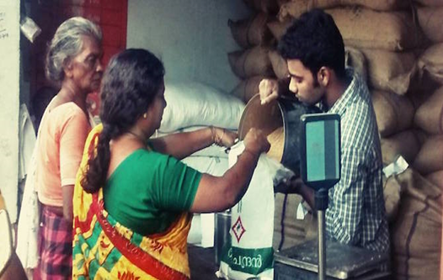
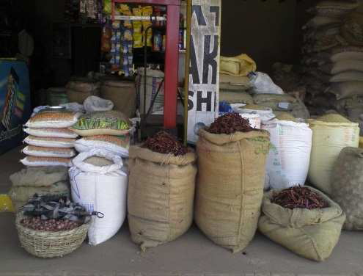
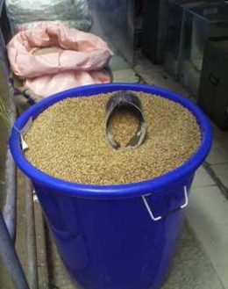
My research context…
Public Distribution System (PDS): main Indian food security net
  Distributes subsidised essential items to entitled users
  Centralised procurement, distribution through ration shops
Chronic issues of leakage and diversion
  Limited monitoring of commodities along the supply chain
  Problem of leakage – rice mafia diverting goods to the market

Slide 14
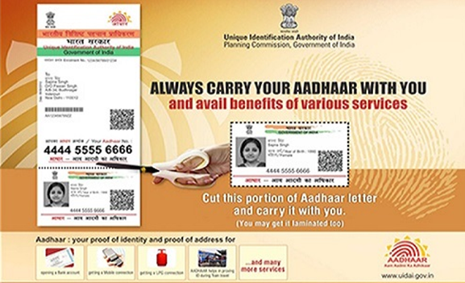
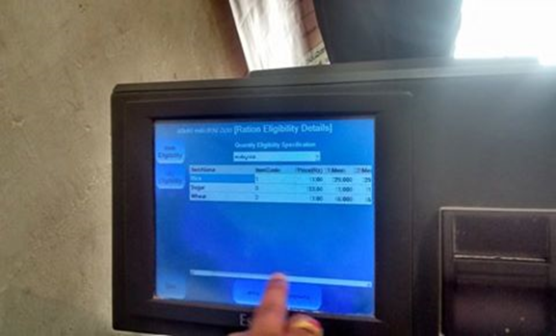
The Aadhaar-based PDS
Aadhaar – the world’s largest biometric database - identifies enrolees with a 12-digit unique ID number and biometric details (10 fingerprints, iris scan)
Integrated with PDS: users recognised at ration shops on the basis of Aadhaar – fingerprint reveals user identity and entitlement.

Slide 15
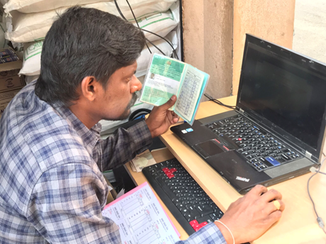
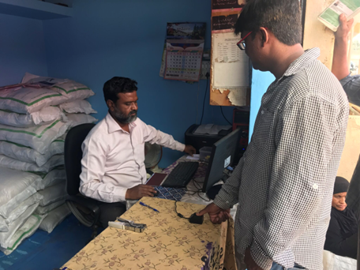
Exploring context ethnographically…
My work takes place (mostly) in the ration shops, where I sit at the interface between the person and the technology.
I witness biometric transactions of users coming to the shop to collect their monthly rations, trying to grasp their lived experience of the system.
In doing so, I do not try to change the system, but to paint a picture of how users form their own impression (image) of the system, through their experience of biometric PDS transactions.
A «historiography of images» (Masiero, 2020)

Slide 16
Started interpretively…

Slide 17
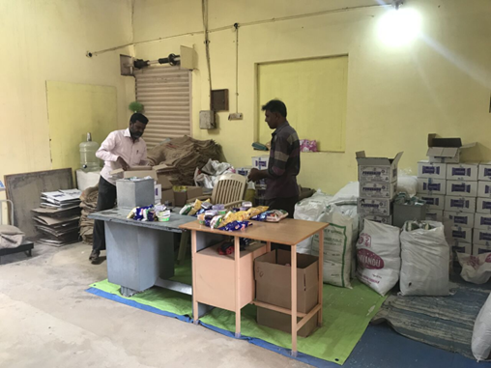
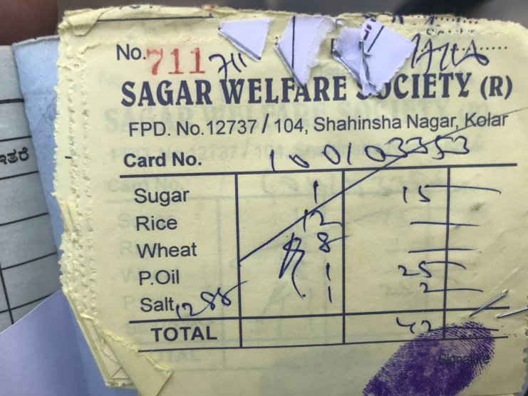
…but became critical over time!
Over the years, my work revealed three main forms of injustice in the biometric PDS:
Legal – right to food made conditional to biometric registration
Informational – users not fully informed of how biometric/demographic data are handled
Design-related – system designed to combat inclusion errors, but exclusions remain
These findings, formed through long years of ethnographic work, have turned my initial, interpretive perspective into a critical approach to the core object of my research.

Slide 18
Some reflections…

Slide 19
So...
Ethnography is a qualitative research method characterised by immersion in the lives of the studied people, and by adoption of their perspective.
“Engagement” in ethnography does not translate into action, but into an appraisal of people’s lived experience of the studies context, an appraisal which can assume the character of critical ethnography.
Rather than an activist, the critical ethnographer is an observer with the potential of restoring epistemic justice, i.e. bringing to light participant narratives that the mainstream discourse has silenced.
The critical ethnographer is therefore a change agent, but their action happens at the level of reporting rather than that of fieldwork.

Slide 20
Thank you!
silvima@ifi.uio.no

Slide 21
Readings
Core Reading
Myers, M. D. (1997). Critical Ethnography in Information Systems. In Information Systems and Qualitative Research (pp. 276-300). Springer, Boston, MA.
Lin, C. I., Kuo, F. Y., & Myers, M. D. (2015). Extending ICT4D studies. Mis Quarterly, 39(3), 697-712.
Supplementary Reading
Myers, M. D., & Avison, D. (Eds.). (2002). Qualitative Research in Information Systems: A Reader. London: Sage. Chapter 10.
Von Deden, M., Masiero, S., & Ravishankar, M. N. (2020). Mobile phone dependency among highly vulnerable migrants: A belongingness perspective. In European Conference of Information Systems (ECIS), 18-20 June 2020.

