Slide 1
Grounded Theory
Silvia Masiero
silvima@ifi.uio.no
IN4340 – Engaged Qualitative Research Methods
18.10.2023

Slide 2
Overview
Grounded theory: methodology and conduct
Coding: deriving theory from data
An example from ICT4D research

Slide 3
After this lecture, you can…
Describe the fundamentals of grounded theory, discussing its core characteristics as a methodology to derive theory from data
Discuss the use of coding as a means to theory-building: derive first-order codes, aggregate and abstract theoretical categories from data
Apply grounded theory to your own research design, explaining how you would use grounded theory as a methodology to answer your own research question.

Slide 4
Grounded theory
“A research method that seeks to develop theory that is grounded in data systematically gathered and analysed” (Myers, 1997)
Widely seen in the Information Systems (IS) community as the qualitative method that best accommodates a positivist epistemology
Strong reliance on coding: an analytical process that consists in developing codes from qualitative data and using them to arrive at theoretical categories (Strauss & Corbin, 1998).

Slide 5
Grounded theory
Importantly, grounded theory is not in itself a theory, but a methodology that produces a theory grounded in the data.
“The discovery of theory from data - systematically obtained and analysed in social research” (Glaser and Strauss, 1967). The theory so produced comes from the data, rather than from a pre-existing framework.
Grounded theory is therefore a methodology of theory-building, where qualitative data analysis is done with the purpose of generating theory.

Slide 6
Grounded theory
The basics of grounded theory (Urquhart, 2012):
The aim of grounded theory is to generate or discover a theory.
Theory asserts a plausible relationship between concepts and sets of concepts.
The resulting theory can be reported in a narrative framework or a set of propositions.
Rather than verifying the propositions of grand theory (e.g. institutional theory, structuration theory…) grounded theory aims to generate theory from what is discovered on the field.

Slide 7
Grounded theory
The basics of grounded theory (Urquhart, 2012):
Grounded theory comes from the need to generate new theories rather than force data into existing ones;
It relies on the idea that qualitative and quantitative data are both useful for the generation of theory.
Coding is the process of turning raw data into categories, and it is hence seen by some as a way to converting qualitative into quantitative data.

Slide 8
For example…
Mohlmann et al. (2021): how does a platform’s use of algorithmic management influence platform work?
Grounded theory study of Uber drivers, subjected to diverse forms of surveillance (algorithmic management) by the company and adopting different techniques of response/resistance to it
Multiple sources of qualitative data, including observations, written dialogue and interviews. Three waves of data collection between 2015 and 2019.
Focus on Uber drivers’ perceptions, supplemented with interviews with executives and engineers at the company
Findings: Uber drivers respond to surveillant work management adopting techniques of work execution, work compensation and work belonging, all of which emerge from data collected on the field.

Slide 9
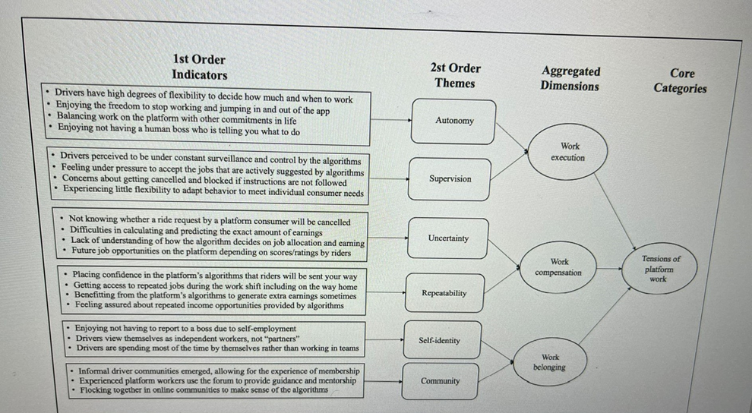
For example…
Data structure: how Uber drivers respond to algorithmic control (Mohlmann et al., 2021)

Slide 10
For example…
Behind the codes… (Uber driver interviews, Mohlmann et al., 2021)
“She [the passenger] starts fighting with me: “why are you not dropping me first?” I said, “Miss, if you have a problem, just order UberX. It’s UberPOOL; it’s all about the Uber system, so I am just driving how they’re telling me to drive.”
“Now we are partners? You take 40% of the fare, we give our sweat, blood, and expenses, and you call us partners? What kinda partnership is that? You get to wear the pants while I do everything and I’m still stuck with the bills? Partnership? Partners? Employer? Master?”
“Use Uber, don’t get used by them! Don’t take the side of Uber. Uber is not a human who will understand your pain. Uber never listens to drivers or pax and never will in future!”

Slide 11
So…
Grounded theory is identified by IS researchers as capable to accommodate a positivist epistemology, due to its treatment of qualitative data through systematically designed codes and categories.
Behind those codes are, however, the perceptions of study participants, which are central to the study as well as they are in other qualitative research methodologies.
It is therefore very possible to combine an engaged qualitative research methodology with the use of grounded theory!

Slide 12
Questions?

Slide 13
Grounded theory: Coding
Coding!
The process of converting raw data into categories
Many forms of coding, varying across studies and disciplines.
Here we learn a three-step coding process that takes the researcher from raw field data (interviews, observation notes…) to first-order codes, aggregate categories grouping such codes, and abstract categories which constitute the building blocks of a theory.

Slide 14
Coding
First-order codes: categories grouping together data that have a common characteristic, for example, the same theme (thematic coding).
  For example: if we are studying reactions to a new health data management app by medical staff, we may have codes such as “ease of use”, “disappointment with core functions”, “difficulty to use the system”…
Aggregate categories: categories that group together codes with a common theme.
  For example “approval”, “disapproval” or “misunderstanding” of a certain app or system.
Abstract categories: categories that, grouping together aggregate dimensions, constitute the building blocks of the theory.

Slide 15
For example…
Sandeep & Ravishankar (2018): impact sourcing is the practice of bringing digitally enabled outsourcing jobs to underprivileged communities. Impact sourcing employees face the difficult task of transitioning from their traditional communities to the impact sourcing workplace.
Question: how do impact sourcing employees manage sociocultural transitions in the workplace and in the community?
Data: qualitative research with interviews and observation at an impact sourcing enterprise in northern India. Long conversations with impact sourcing employees, eliciting their perceptions of sociocultural challenges
Findings: employees manage sociocultural transitions through two strategies of boundary management between traditional community and impact sourcing workplace, and three forms of cognitive adjustments with it.

Slide 16
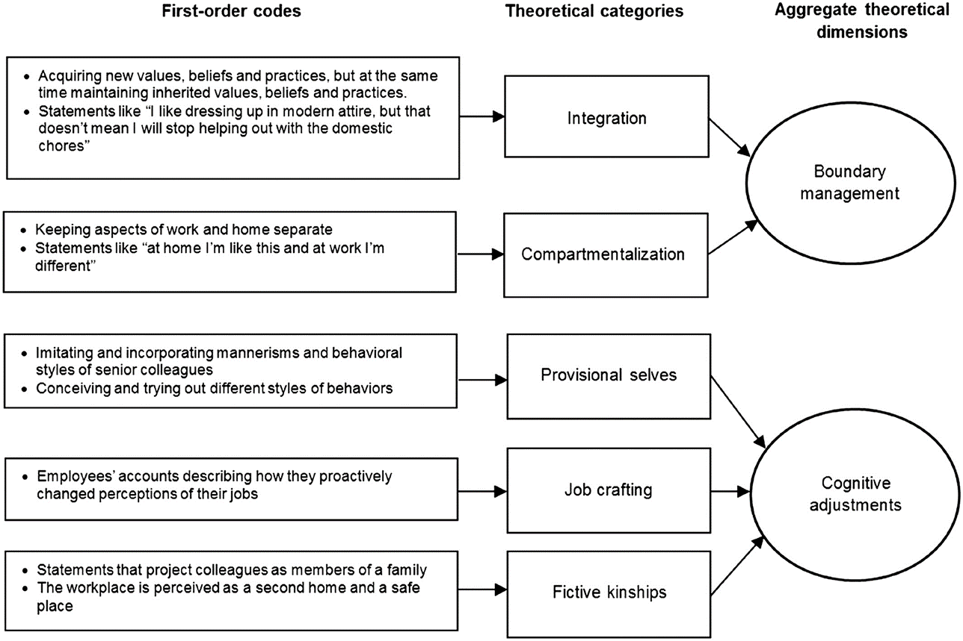
For example…
Sandeep & Ravishankar (2018): First-order codes, theoretical categories, and aggregate theoretical dimensions

Slide 17
Grounded theory: limitations?
Some researchers consider grounded theory as limited, due to the need to inscribe data in categories and, therefore, the loss of those data that the coding process forces out of the scheme.
In choosing a research methodology, the researcher is faced with a trade-off between methodologies who leave greater freedom of interpretation of data and more structured ones that, like grounded theory, offer a systematic approach to theory-building.

Slide 18
So…
Grounded theory, a methodology to generate theory directly from field data, can be used to make sense of digital health phenomena.
Coding – the process of converting raw data into categories – is functional to generating new theory, rather than applying pre-existing theoretical frameworks to new research objects.
The researcher faces a trade-off between methods that leave more freedom of interpretation, and the structured approach to theory-building that grounded theory offers.

Slide 19
Thank you!
silvima@ifi.uio.no

Slide 20
Readings
Core Reading
Urquhart, C. (2012). Grounded theory for qualitative research: A practical guide. London: Sage. Chapters 1-2.
Supplementary reading
Russpatrick, S., Sæbø, J., Monteiro, E., Nicholson, B., & Sanner, T. (2021). Digital resilience to COVID-19: a model for national digital health systems to bounce forward from the shock of a global pandemic. IFIP 9.4 Virtual Conference, 26-28 May 2021.
Sandeep, M. S., & Ravishankar, M. N. (2018). Sociocultural transitions and developmental impacts in the digital economy of impact sourcing. Information Systems Journal, 28(3), 563-586.

