Slide 1
Research Practice:
Lessons learned key takeaways
josuekw@ifi.uio.no

Slide 2
After this session, you can…
Appreciate field data collection practicalities
Build valuable hands-on knowledge and skills needed to tackle field data collection with confidence.

Slide 3
My research
How DHIS2 Impact Decision making and Organizational Performance
Research Background: Build within the IS Litterature and ICT4D Litterature
Theoretical Choices: Effective Use Theory by Burton-Jones and Grange(2006)
Research Practice: Deductive Method
Research Design: Mixed Methodology( surveys and interviews).
Empirical setting: Health Information Unit, Ministry of Public Health, Cameroon

Slide 4
Preparing for Field Work
Fill in your knowledge of the subject, the environment.
Discuss the group you plan to research with an informant/gatekeeper.
Develop an identity with the people to be studied.
Realize that your initial contact with the group can influence your observations.

Slide 5
What is an interviews?
Interviews are one-on-one or small group question and answer sessions.
Interviews will provide a lot of information from a small number of people and are useful when you want to get an expert or knowledgeable opinion on a subject.
It is based on qualitative research (feelings, in-depth experiences, personal responses to situations) What is an Interview?

Slide 6
What is an interviews?
Researcher asks the subjects to describe and explain his or her behaviour.
Useful for determining the motivation for the subject’s behaviour.
To be valid, the interview questions should ask subjects to discuss actions after they occur rather than to speculate about what they might do.
It should be expected by the interviewer that a subject may choose not to answer all questions. The privacy and anonymity of a subject is essential to ethical research.

Slide 7
Seven Stages of Interviewing
Thematizing
Design
Interviewing
Transcribing
Analyzing
Verifying and checking facts
Reporting

Slide 8
Consider the following Interrogations when beginning to think about conducting research:
What do I want to discover?
How do I plan on discovering it? (This is called your research methods or methodology)
Who am I going to talk to/observe/survey? (These people are called your subjects or participants)
How am I going to be able gain access to these groups or individuals?
What are my biases about this topic?
How can I make sure my biases are not reflected in my research methods?
What do I expect to discover?

Slide 9
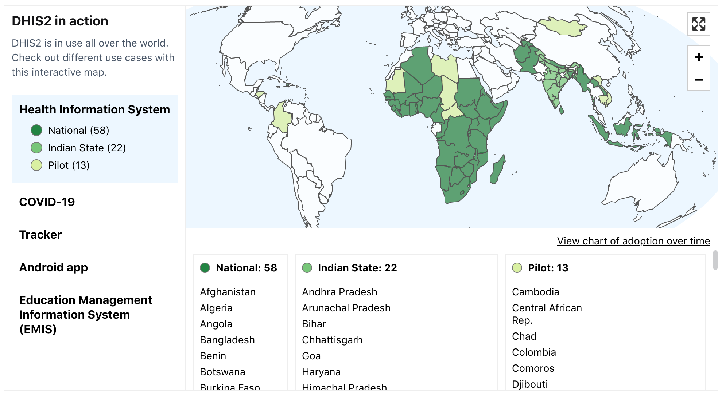
Initial Engagements

Slide 10
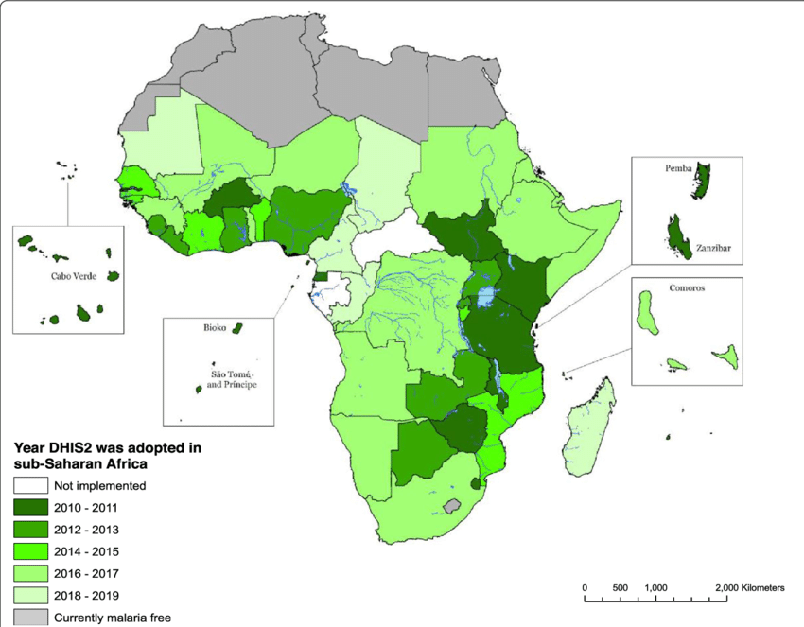
Initial Engagements

Slide 11
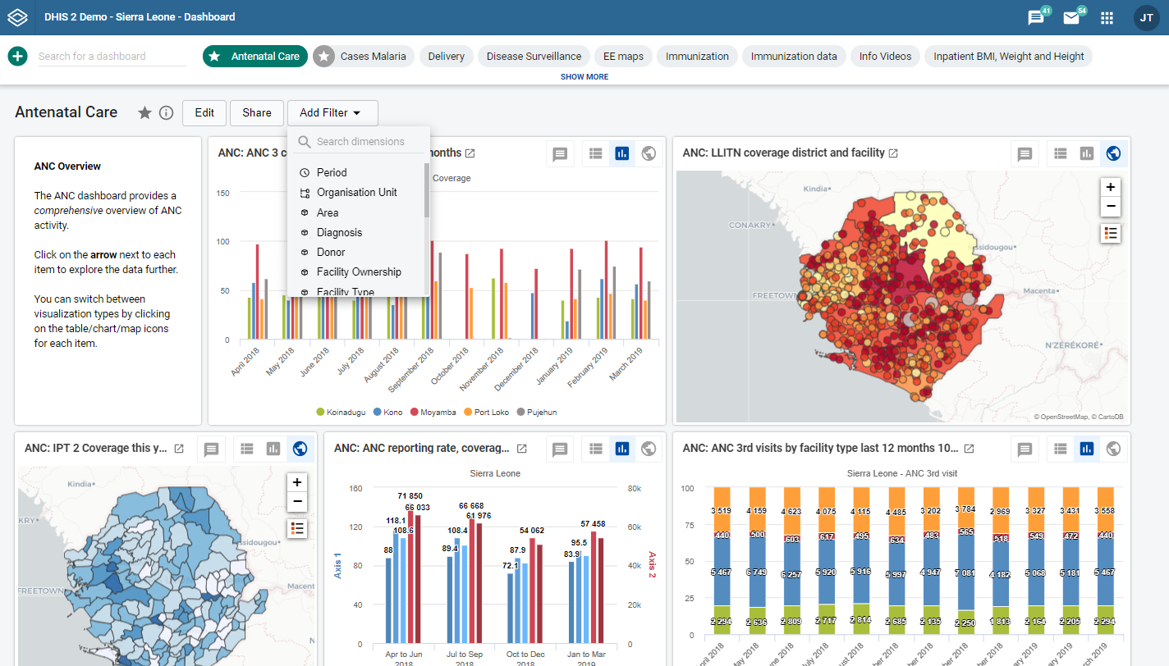
Initial Engagements

Slide 12
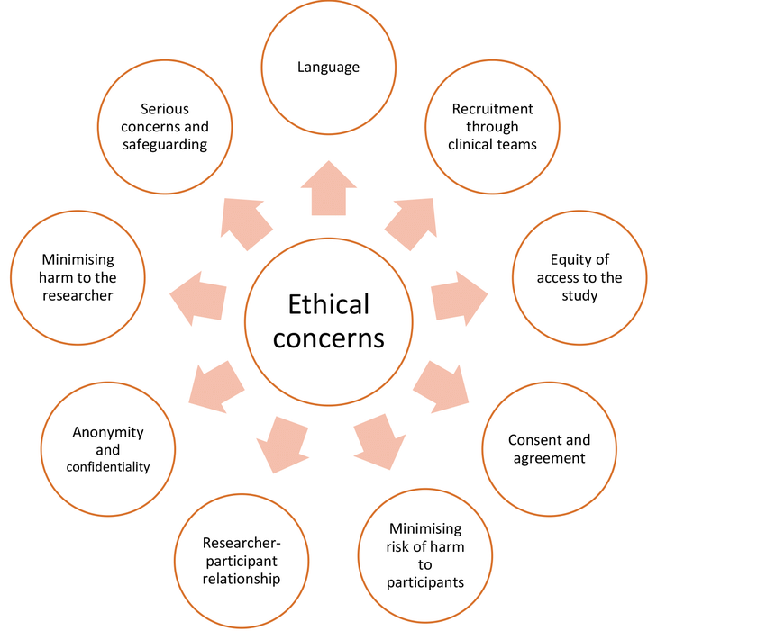
Ethical Considerations
Discussing any ethical considerations regarding data handling and stakeholder engagement

Slide 13
Pitfalls to be avoided during the interview (1/5)
When creating questions you want to avoid:
  Biased questions ► Biased questions are questions that encourage your participants to respond to the question in a certain way. They may contain biased terminology or are worded in a biased way.
  Biased question: Don't you agree that campus parking is a problem?
  Revised question: Is parking on campus a problem?

Slide 14
Pitfalls to be avoided during the interview (2/5)
Questions that assume what they ask
  These questions are a type of biased question and lead your participants to agree or respond in a certain way.
  Biased question: There are many people who believe that campus parking is a problem. Are you one of them?
  Revised question: Do you agree or disagree that campus parking is a problem?

Slide 15
Pitfalls to be avoided during the interview (3/5)
Double-barreled questions:
  A double-barreled question is a one that has more than one question embedded within it. Participants may answer one but not both, or may disagree with part or all of the question.
  Double-barreled question: Do you agree that campus parking is a problem and that the administration should be working diligently on a solution?
  Revised question: Is campus parking a problem? (If the participant responds yes): Should the administration be responsible for solving this problem?

Slide 16
Pitfalls to be avoided during the interview (4/5)
Confusing or wordy questions
  Make sure your questions are not confusing or wordy. Confusing questions will only lead to confused participants, which leads to unreliable answers.
  Confusing questions: What do you think about parking? (This is confusing because the question isn't clear about what it is asking--parking in general? The person's ability to park the car? Parking on campus?) Do you believe that the parking situation on campus is problematic or difficult because of the lack of spaces and the walking distances or do you believe that the parking situation on campus is ok? (This question is both very wordy and leads the participant.
  Revised question: What is your opinion of the parking situation on campus?

Slide 17
Pitfalls to be avoided during the interview (5/5)
Questions that do not relate to what you want to learn
  Be sure that your questions directly relate to what it is you are studying. A good way to do this is to ask someone else to read your questions or even test your survey out on a few people and see if the responses fit what you are looking for.
  Unrelated questions: Have you ever encountered problems in the parking garage on campus? Do you like or dislike the bus system?

Slide 18
Improving Interviews
Talk little, listen a lot (don’t lead the witness)
Record Accurately
Begin Writing Early
Let reader’s “see” for themselves – primary data
Report Fully, even contradictory stuff
Be candid (about subjectivity)
Seek feedback
Write accurately

Slide 19
Guidelines - Taking Research Notes
Don’t trust your memory. Take notes while you observe.
Take sketchy notes in the field and rewrite them later (as soon as possible), filling in the details.
Record everything.
Things that don't seem important may turn out to be significant.
Realize that most of your field notes will not be reflected in your final project.

Slide 20
Components of social life pertinent
Encounters: people meeting and interacting
Practices: talking, reading a book
Encounters: people meeting and interacting
Settlements neighborhoods
Lifestyles/subcultures urban, homeless

Slide 21
Role of the researcher: Raymond Gold(1958)
Complete Observer (Secret Outsider)
Participant as Observer (Recognized Outsider)
Observer as Participant (Marginal Participant)
Complete Participant (Full Participant)

Slide 22

Role of the researcher: Raymond Gold(1958) (1 / 4)
Complete Observer (Secret Outsider)
  It is a disconnected observer mode wherein the researcher is neither seen nor noticed by the participants.
  This minimizes the Hawthorne effect, as participants are more likely to behave in a natural fashion when they are unaware that they are being observed.
  More suitable as an approach for the ethnographer, although it raises ethical questions. Example: How would you react if you were told that someone was observing you without you being aware of it?
  Meanwhile, in public places like airports, public restrooms, coffee shops, being a complete observer may be the only way to gather the kind of data you need.

Slide 23

Role of the researcher: Raymond Gold(1958) (2 /4)
Participant as Observer (Recognized Outsider)
  In this case, the researcher is deeply committed to participants. He/she is much more of a friend or colleague rather than a neutral third party. While there' s full engagement with the participants, they still know that He/she is a researcher.
  This method is often used to study isolated indigenous populations or inner-city cultures.

Slide 24

Role of the researcher: Raymond Gold(1958) (3 / 4)
Observer as Participant (Marginal Participant)
  In this situation, the researcher is known and acknowledged by the participants and, under many circumstances, participants are aware of the research objectives
  There is interactions with participants, but this interaction are limited. The research objective is to assume a neutral position as much as possible.
  Such an approach is commonly employed when "following a customer home" to figure out and understand how an individual uses software products to achieve their goals.

Slide 25

Role of the researcher: Raymond Gold(1958) (4 / 4)
Complete Participant (Full Participant)
  This is a fully engaged researcher
  the researcher engages completely with participants and participates in their activities.
  Participants are not aware that the observation and research is taking place, although they are fully interacting with the researcher.
  this approach is often described as "going native," in reference to conducting indigenous fieldwork.
  The idea is that the best way to understand a type of role, people or culture is to experience it firsthand.

Slide 26
So…
In this session we have learnt some practical guidelines for conducting data collection in the field
We learned some pitfalls to avoid as well as referral mechanisms during the interviews.

Slide 27
Thank you
josuekw@ifi.uio.no

