Slide 1
Reflecting on AR in HISP

Slide 2
HISP (Health Information Systems Programme)
HISP is a global action research project considered as one of the University of Oslo's greatest international successes. HISP has developed the DHIS2 software - an IT system for collecting, validating, analyzing and presenting data for health information management activities.
https://www.mn.uio.no/hisp/english/
https://dhis2.org/

Slide 3
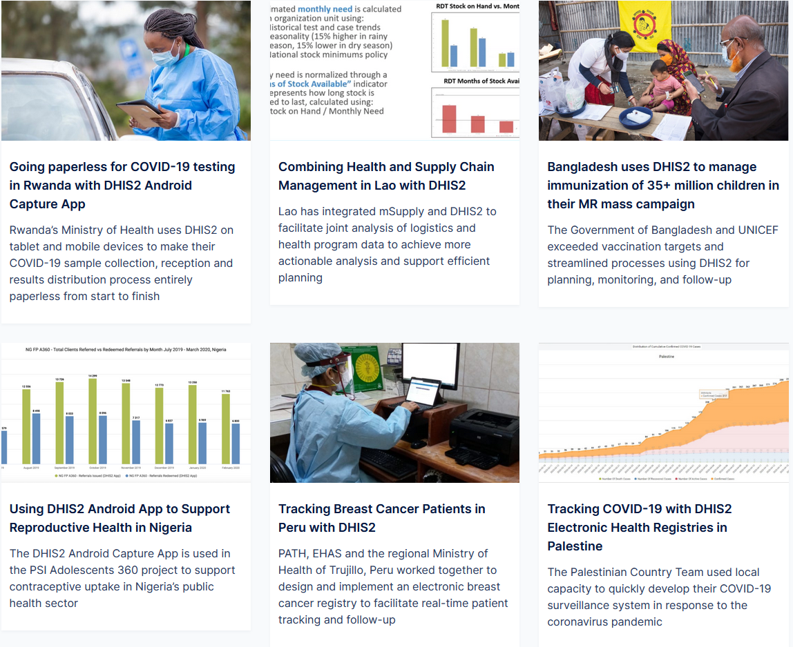

Slide 4
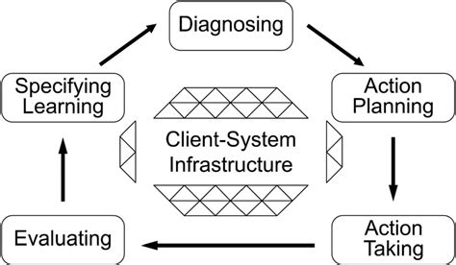
(Theoretical) Action research: ordered and clear

Slide 5
1: «My AR»: method chapter of my PhD thesis
2: Open discussion/questions
My AR experience
  Messy
  Open-ended
  Pragmatic and opportunistic (networks of action)
  Reciprocal

Slide 6
Strengthening health information systems
This is a big task, involves a lot of different work
From technical to high level policy
  Setting up computers, programming, writing job descriptions, advising ministries and WHO
From health facilities to ministries
  Rural health posts, busy hospitals. Conference venues. Everything between
Many countries
  Botswana, Sierra Leone, Tajikistan, Cuba, Tanzania, Malawi, West Africa, East Africa, South-East Asia
Understanding through action

Slide 7
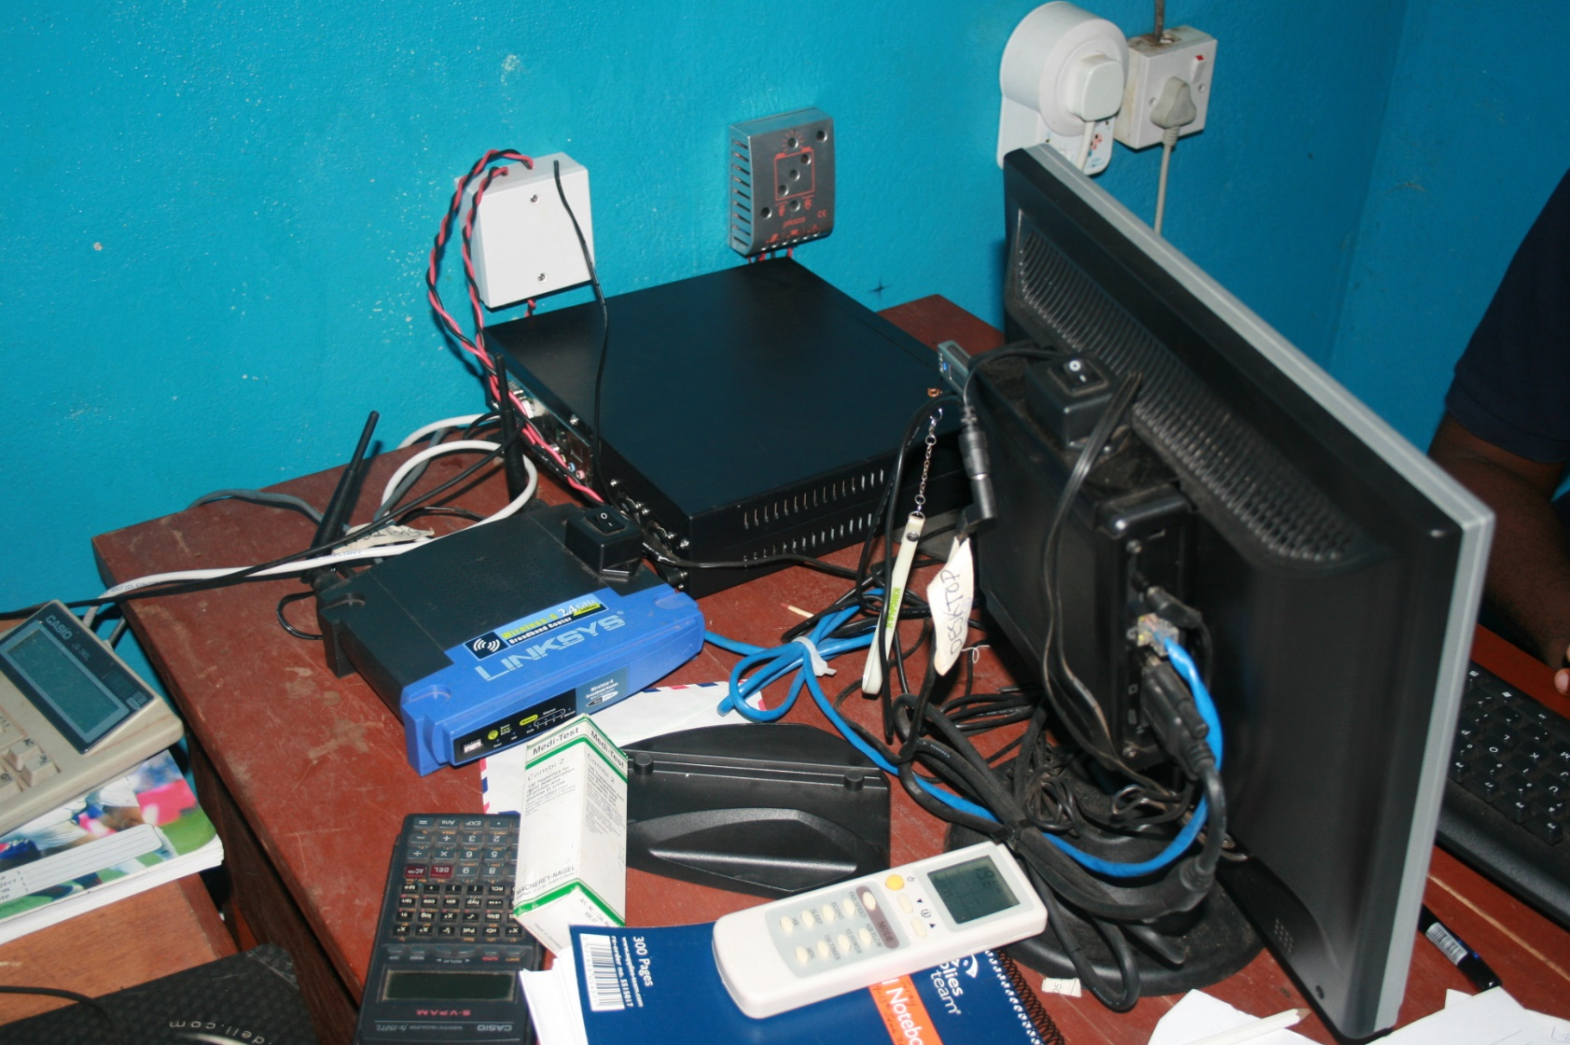
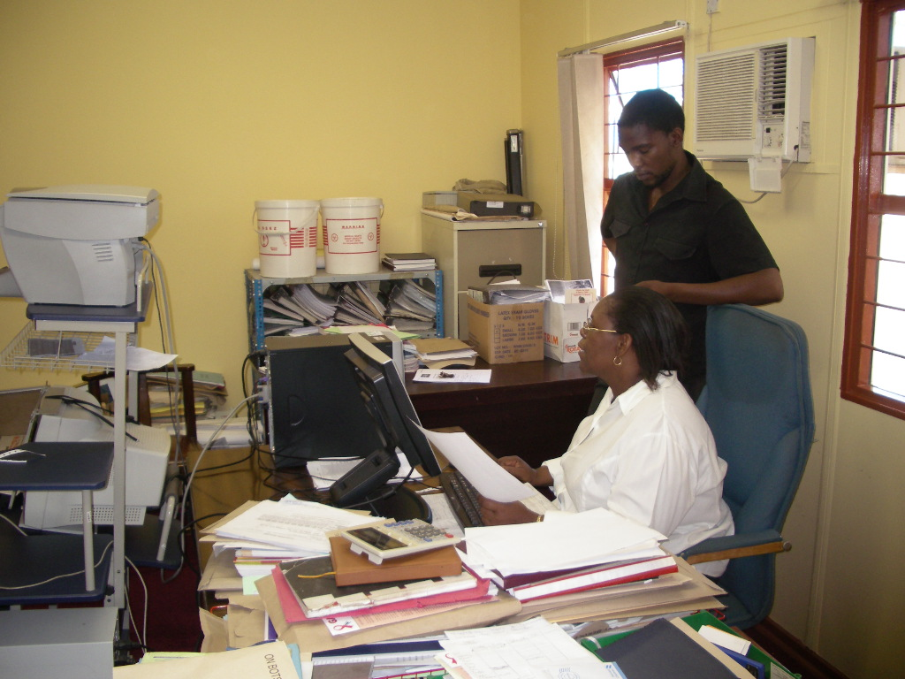
What have I done?

Slide 8
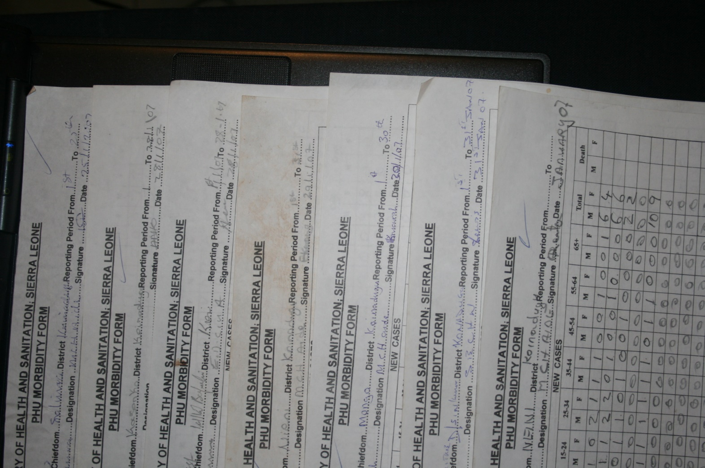
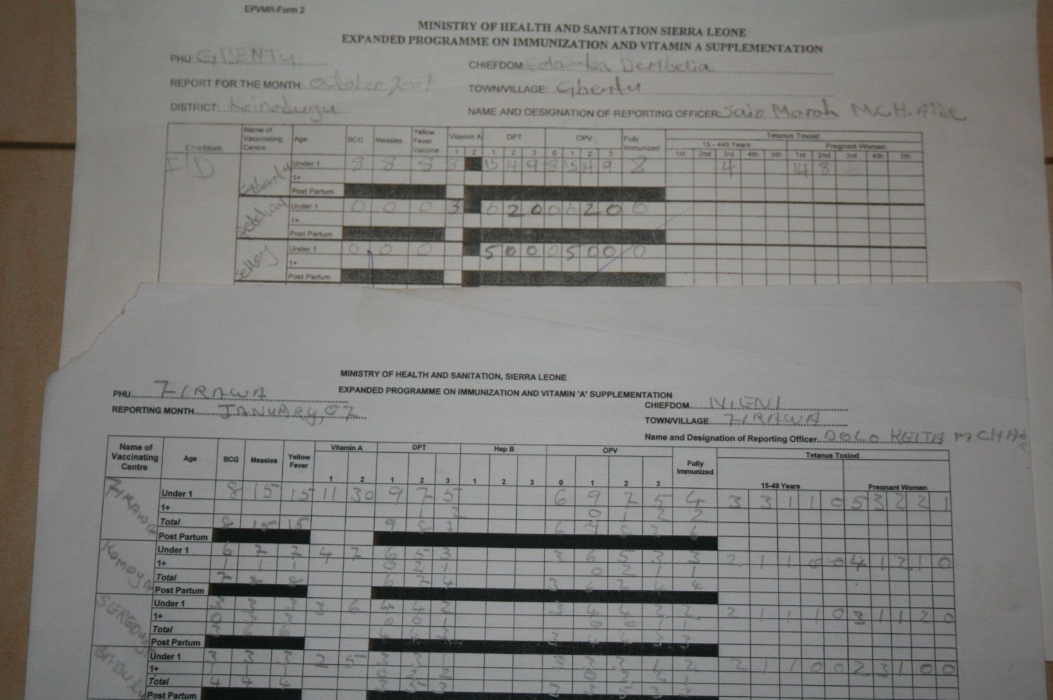
Examining paper forms

Slide 9
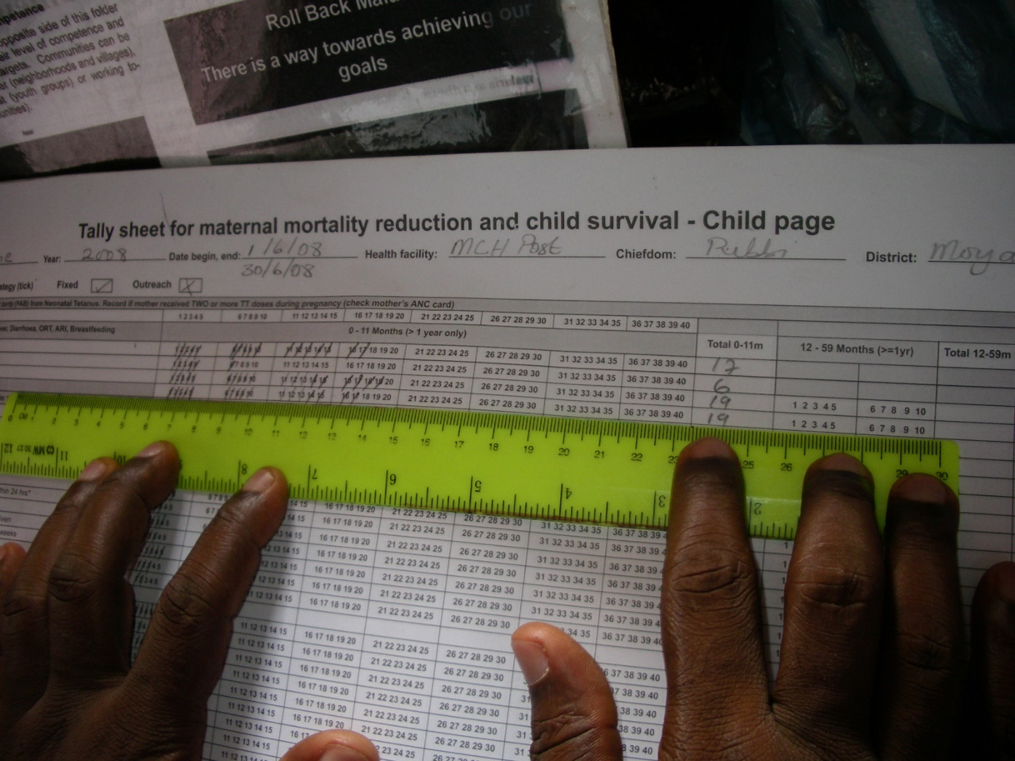
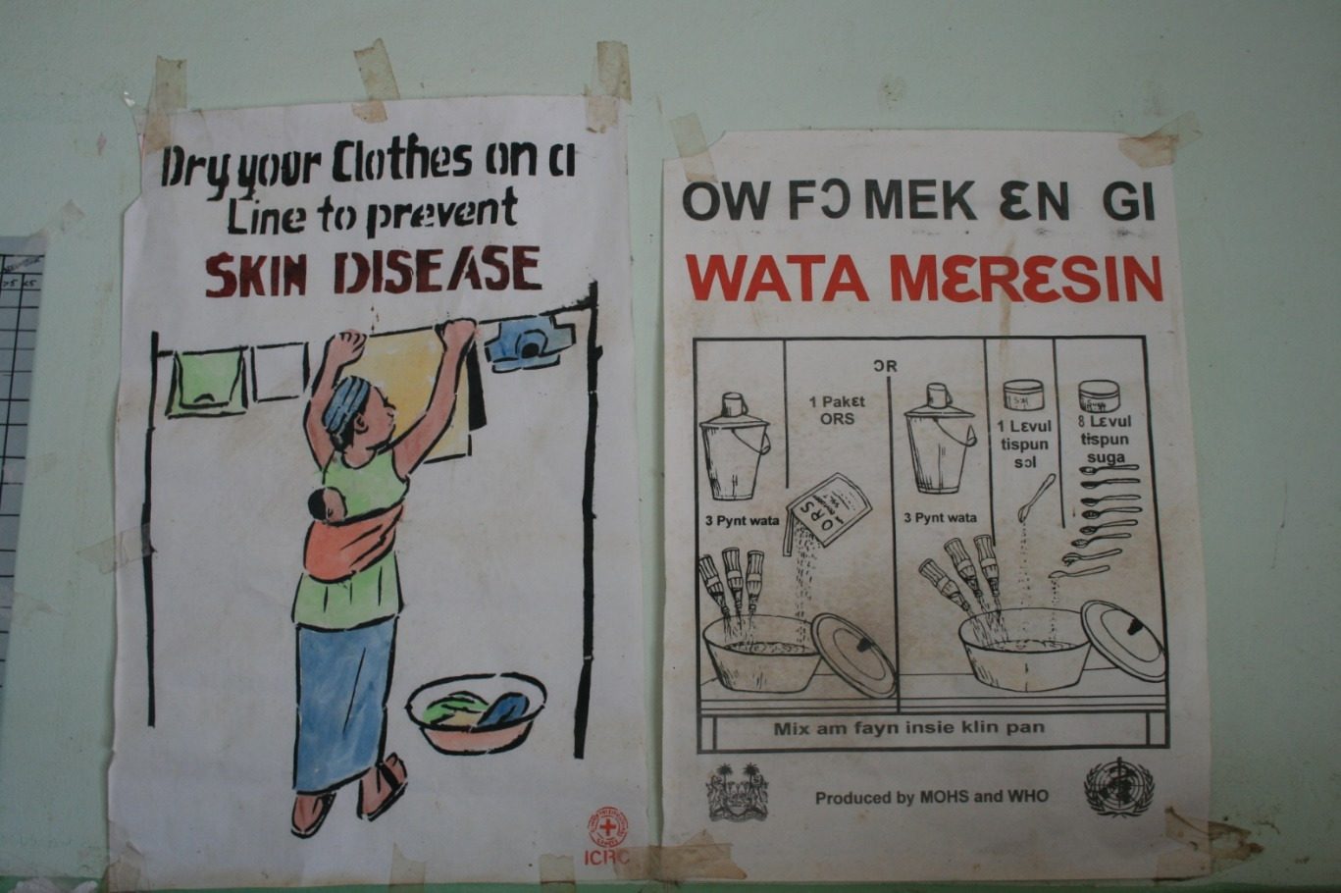
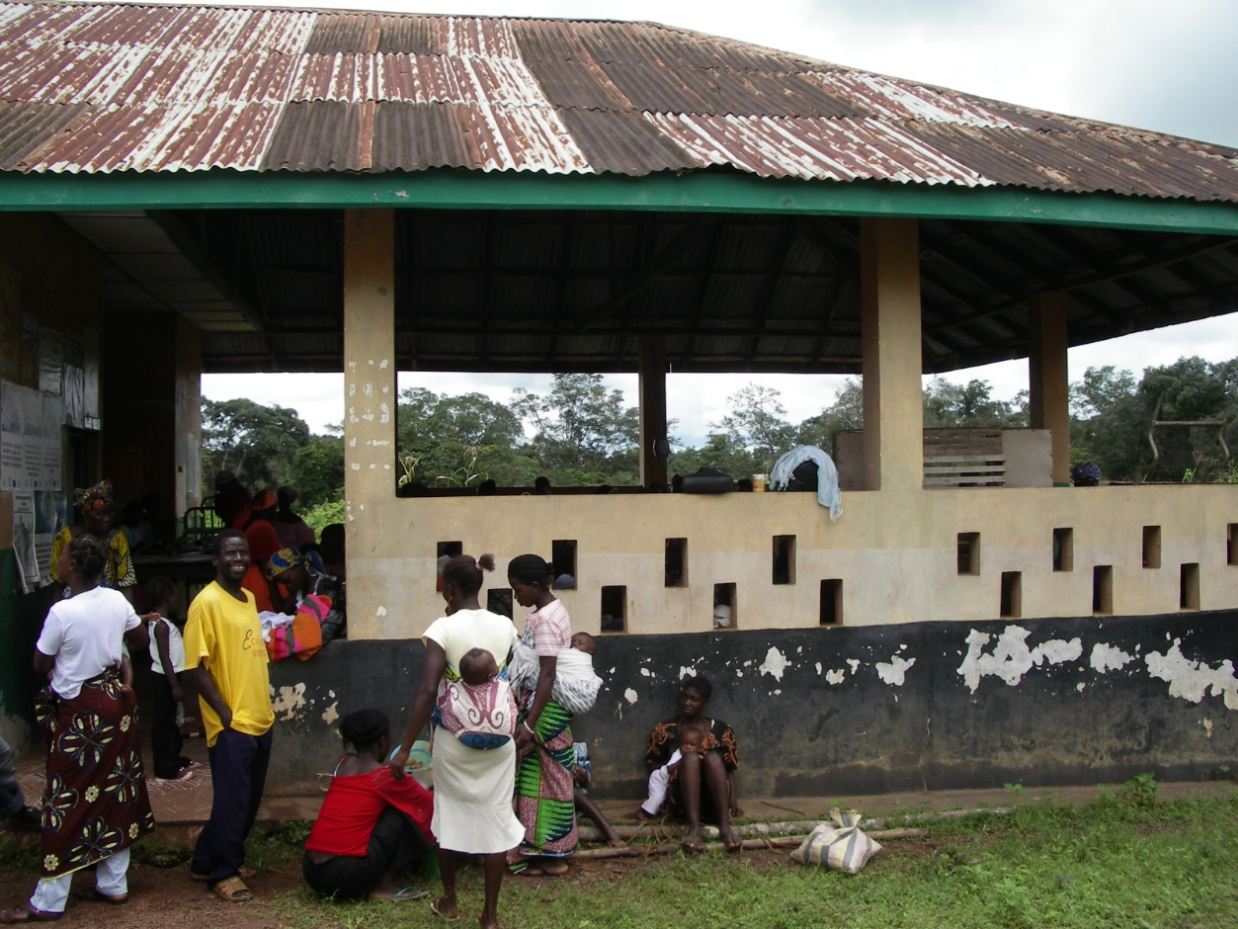
Examining practices

Slide 10
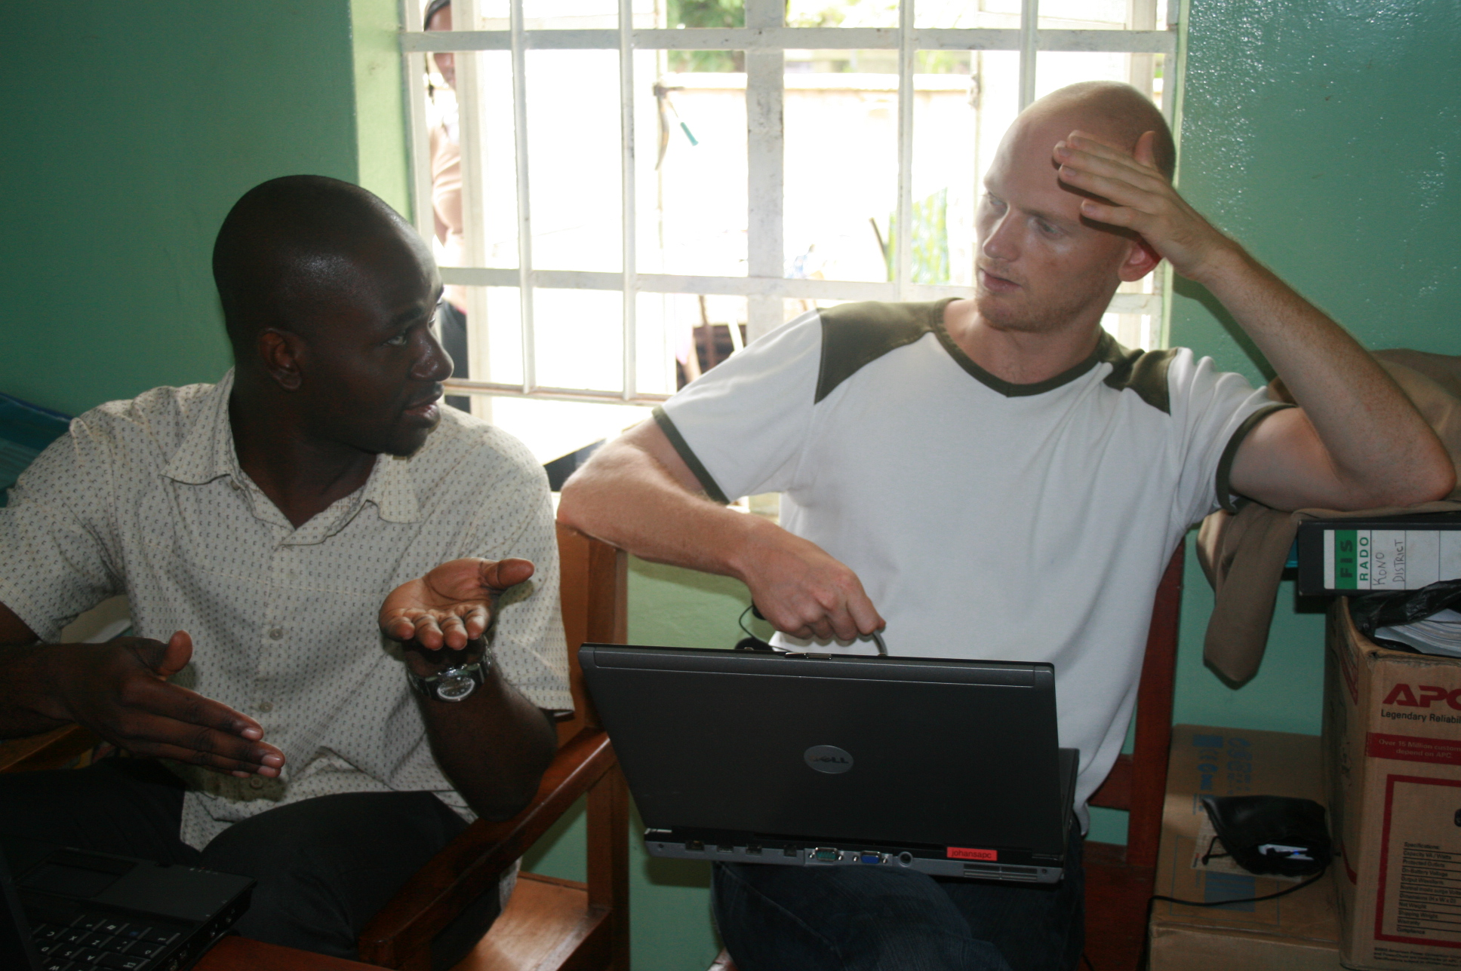
Designing

Slide 11
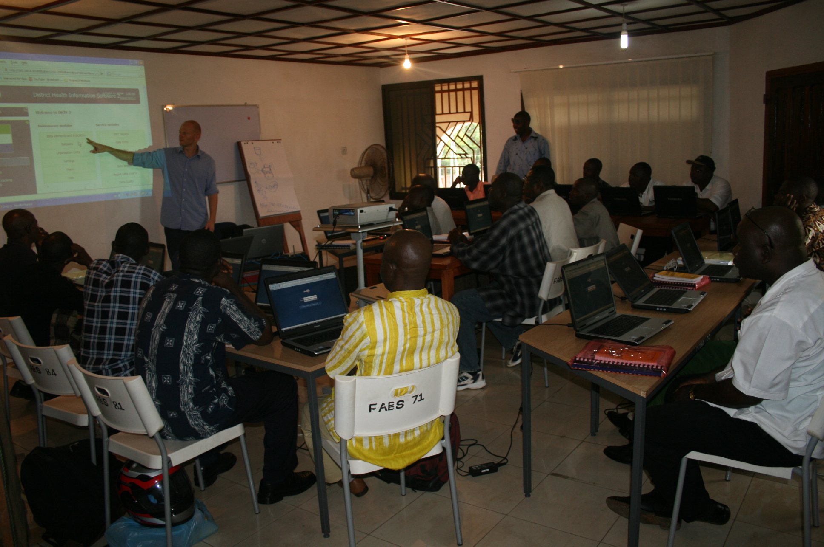
Training, training, training

Slide 12
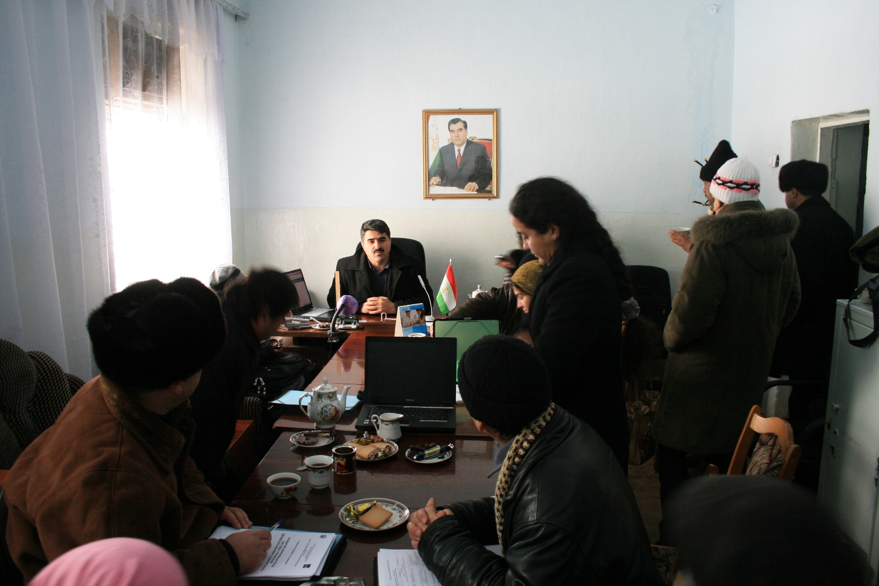
Meetings, meetings, meetings…

Slide 13
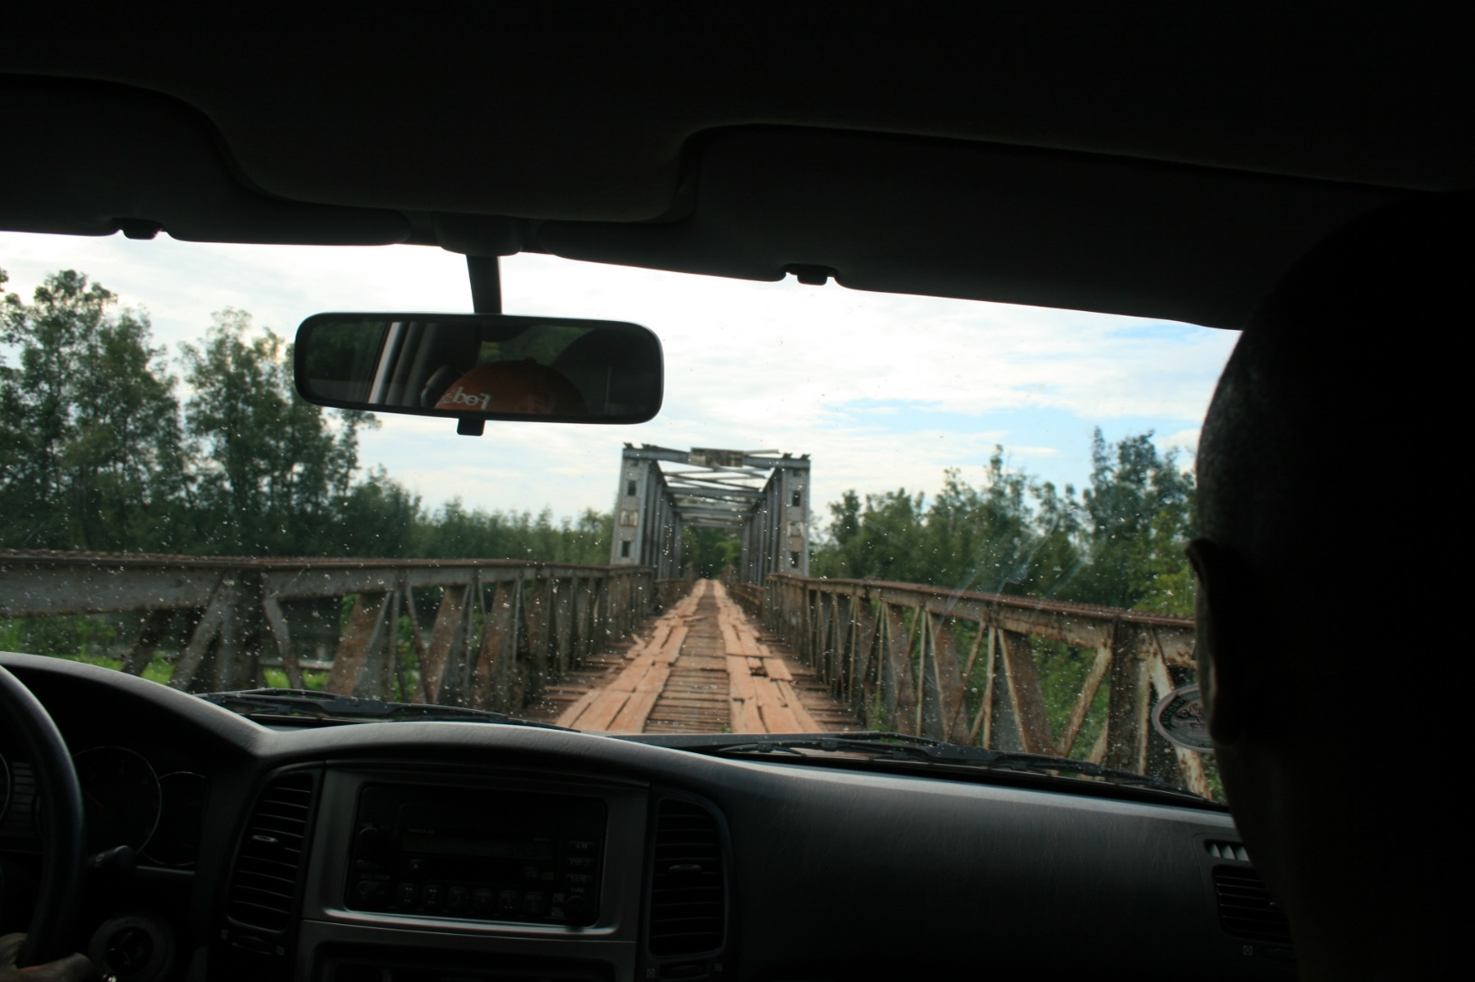
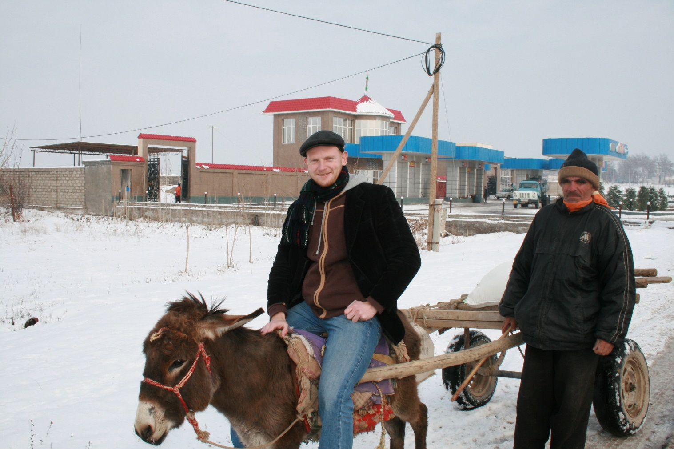
A fair amount of traveling: an occasion for analysis and getting to know your colleagues

Slide 14
What is similar to (Canonical) AR?
Solving real-world problems! Immersion
Cyclic: Identify problem, make plans, do something, reflect, publish
  Smaller cycles: daily/weekly in-country on specific problems
  Medium cycles: Related to single projects. Months and years
  Long cycles: Between countries/projects. Years…

Slide 15
What is dissimilar to (Canonical) AR?
The risk of it becoming consultancy
  Only action, no research. When can I retreat from the action, if people and organizations depen on my continuous involvement?
Not always clear client-system infrastructure

Slide 16
HISP Tradition of AR
Critical: emancipation, participation
Dual participation: Researchers participate in «action», practitioners participate in research
Distinction between field and home becomes blurred
Networks of action: reduce risk, increase sharing and learning
  This is inherently also an acknowledgement of opportunism

Slide 17
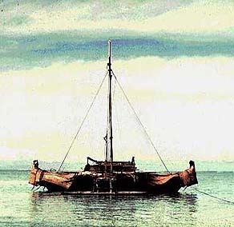
Is the problem «neat»?
Researchers seldom have control (neither do anyone else)
Directional improvisation: vision in place, but not a detailed plan
Opportunistic in case selection

Slide 18
Action gaining primacy over research?
Short answer: Yes
Reciprocity, responsibilities
  Finish what you started
  Never-ending problems…
  Information system strengthening is not a finite process
But this is about priorities.

Slide 19
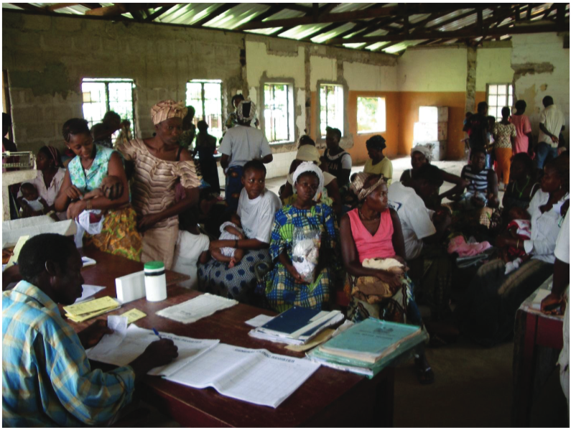
Data collection methods
What is data?

Slide 20
Training as the single most important data collection method for me
Many people, diverse audiences
Training as occasion to explore design (of IT, of systems,of practices)
Often quite informal as they cover many days; trust develops
  not always possible in interviews. Takes time
What to label this? Participant observation… interviews…

Slide 21
Recording data
When everything is data?
Not «4x1 hour interviews». But weeks in action. 10-12 hours per day for several weeks. How to record (and filter and analyse) all this?
Field diary, pictures, emails
Data analysis is not something at the end. EVERY DAY is an occasion for analysis.

Slide 22
Analysing data
The role of theory?
  Scaffolding: support mechanism
  Grounded theory: build theory «from scratch»
Comparative studies: contrasting
Two objectives: practical problem solving, and theory-generating
  «There is nothing so useful as a good theory»

Slide 23
Summing up my experience with AR
Total immersion, continuous data collection, analysis, learning
An «exit strategy» is useful, but difficult

Slide 24
Open discussion

