Slide 1

IN5020/9020 - Distributed Systems
Group Session - Introduction Meeting
Truong-Thanh Le
truongl@ifi.uio.no
August 28, 2025

Slide 2
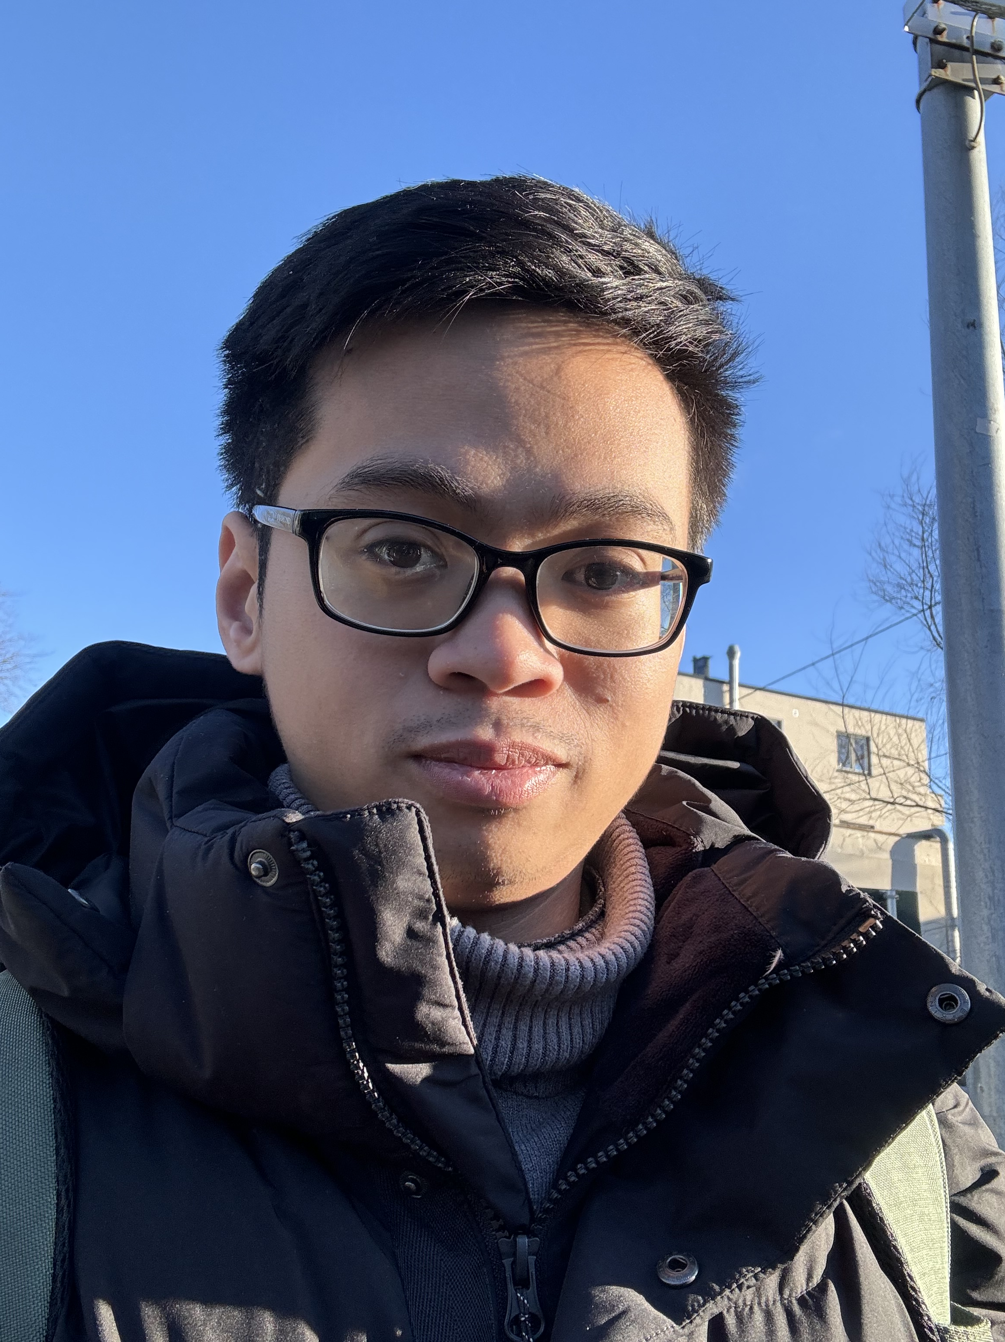
Bio
Name: Truong-Thanh Le
Short name: Thanh
PhD fellow at Networks and Distributed Systems (ND)
Group
PhD Topic:
Deep Neural Network Distribution over Edge devices
Contact Details:
Office Location: 5168 in IFI
Email: truongl@ifi.uio.no (please use the subject: IN5020 - ...)

Slide 3
Theoretical Exercises
There will be couple of exercises (questions) for each topic discussed in the lectures
Based on the lectures and the textbooks
The detailed schedule of the topics are available in the course website

Slide 4
Programming Assignments
The course consists of 3 programming assignments.
  Java language is used for the assignments.
  No other programming language is permitted.
All the assignments are mandatory (required for final exam).
The Students will be working on Group of 4 for the assignments.
  No individual work is allowed
Each Group will be assigned a group number .

Slide 5
Programming Assignments
Each assignment has a deadline of 2 weeks. After submission, each group have to present their solution. EACH MEMBER SHOULD WELL UNDERSTAND THE WORK.
  All theories/knowledge from the lectures, which is related to the assignment, must be correctly applied and understanded.
You have to answer several questions about the assignment OR will be given a small written question during your presentation.
The assignments will be SIGNIFICANTLY INTENSIVE. The students will be required to put a PLENTY AMOUNT OF TIME to solve the assignments. It is necessary to have a good understanding of Java language to solve the assignments.
Assignment submission: https://devilry.ifi.uio.no/

Slide 6
Programming Assignments
All the members of the group must physically attend the presentation.
  If you have acceptable reasons (according to UiO rules), you need to inform TA for a discuss.
  Reasons such as the presentation is on workday, travelling, etc are not accepted.
The due date is typically Thursday. Then you will receive feedbacks before the end of the nearest Sunday.
  The presentation will be organized in the following week.

Slide 7
Group Composition
The students can form their own group
If you don’t have enough members in your group, the remain ones will be automatically assigned.
If a student doesn't have any other members and wants to be assigned to a group, I will group the student will 3 others. The grouping process is random.
No more than 1 PhD in a group

Slide 8
Group Composition
Group Formation:
Send an email to truongl@ifi.uio.no by Wed 03.09.2025, 23:59
  Failing to send an email by this deadline equals to “drop the course”
  Late submission is only permitted when having acceptable reasons (according to UiO rules)
The email subject should be "IN5020 - Group Composition"
If you have formed your own group (4 students) - One of you can act as a leader for the group and send me the names and email addresses of the students. Also cc the other 3 students in the mail.
If you have less than 4 students in your group – follow the above process. I will assign the remain members.
If you want to be randomly assigned a group – send me a mail with your name. I will randomly assign a group.
Assignment Submission:
During submission, EACH MEMBER HAS TO INDIVIDUALLY SUBMIT THE FILES.
NO LATE SUBMISSION.

Slide 9
Assignments Overview (Updating)
 | Topic | Tools | Publishing Date | Submission Deadline
Assignment 1 | Object-Based Distributed Systems | JAVA RMI API | 04.09.2025 | 18.09.2025
Assignment 2 | Replication in Distributed Systems | In-built simulator | 25.09.2025 | 09.10.2025
Assignment 3 | Peer to Peer Systems | In-built simulator | 16.10.2025 | 30.10.2025

Slide 10
Thank You

