Slide 1
IN5040
Assignment 1
Thomas Plagemann

Slide 2
Important information
Deadline: Wednesday September 24th – 23:59
Deliverable:
  What: a PDF file containing
    Query and results for questions: 1 -3 - 4 – 6 – 7 – 8
    Query, results and a short-written answer for question 2
    Short written answer for question 5
  Where: https://devilry.ifi.uio.no

Slide 3
Overview
In this assignment we simulate a meteorological institute which receives summarised daily weather recordings from two weather stations
Period: 2014 – 2018
Weather stations:
  JFK airport – New York
  San Francisco Airport

Slide 4
Purpose of the Assignment
To gain an understanding of some of the basic techniques used for analysing stream data
For this task, we will be using Esper, which is a software for Complex event processing (CEP) and Stream processing

Slide 5
Esper
Language, compiler and runtime system for DSM & CEP
Basic version is a library that can be imported in Java or .NET
Event Processing Language(EPL) enables rich expressions over events and time
We will be using version 8.2.0
http://esper.espertech.com/release-8.2.0/reference-esper
  Look at page 3 points 2.1 - 2.10 and 2.17 for some of the most important points for the assignment
Documentation: http://esper.espertech.com/release-8.2.0/reference-esper
Try online: https://esper-epl-tryout.appspot.com/epltryout/mainform.html

Slide 6
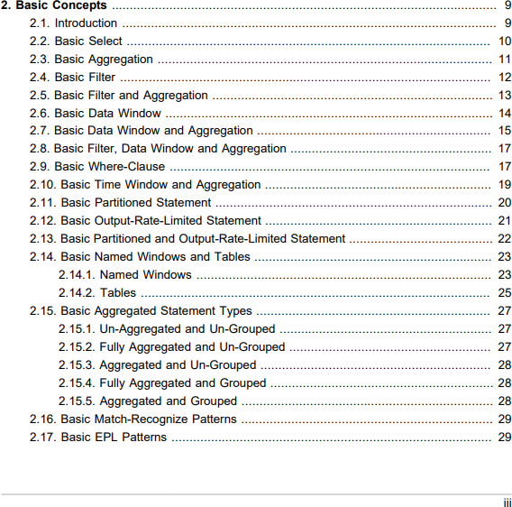
How to learn syntax and features?
Documentation
  Focus on the basic concepts to begin with
Esper notebook
  https://www.esperonline.net/
Esper EPL online
  https://esper-epl-tryout.appspot.com/epltryout/index.html
http://esper.espertech.com/release-8.2.0/reference-esper/pdf/esper_reference.pdf

Slide 7
Getting Started
Download assignment1.tar.gz from the IN5040 course page
Extract: tar –xzvf assignment1.tar.gz

Slide 8
Assignment 1 contents
Assignment1.pdf
Assignment1.java
WeatherTuple.java
Makefile
jfk.csv
san_francisco.csv
query_1.epl, query_2.epl, …..query_8.epl
lib folder

Slide 9
Compilation
make all:
  cleans java class files
  compiles java files
make runX: runs the java files and the query_X.epl, where X is the query number

Slide 10
Assignment1.java
You don't have to make changes here, but it's useful to understand what's happening
What the program does
  creates runtime system and deploys the selected query
  Reads from the two data set files
  Sets up two threads, one for each data set
  The threads sleep between each processed event
  You can comment out the sleep invocation in the java program to speed up the execution, but don't do it for the last query (query 8)
  Reason is that query 8 looks at both data streams

Slide 11
Structure of a WeatherTuple
Timestamp
weatherStation
stationName
averageTemperature
minimumTemperature
maximumTemperature
averageWindSpeed
precipitation
weather

Slide 12
Query Structure
SELECT *
FROM jfk
SELECT *
FROM san_francisco

Slide 13
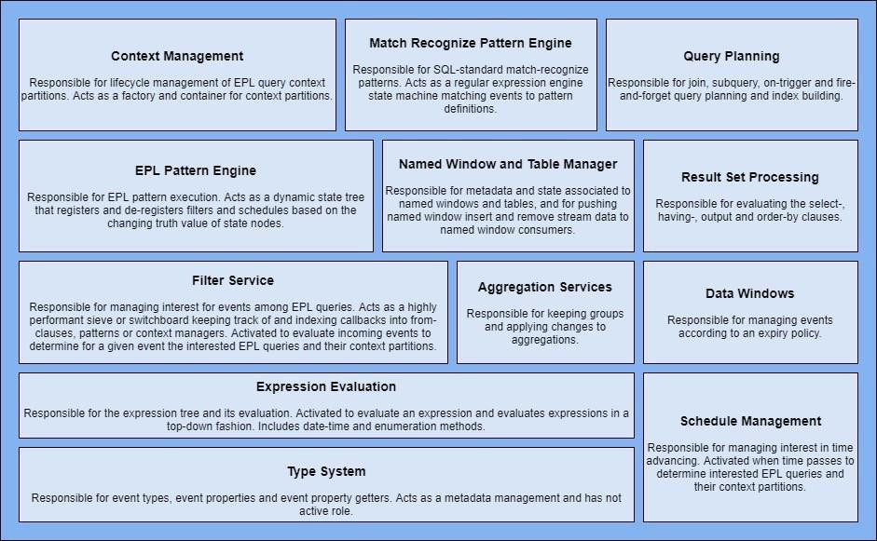
Esper Architecture

Slide 14
EPL Syntax
Create schema
Data Stream Management:
CEP
create schema SchemaName(field_name1 type, field_name2 type)
select ID as sensorId, sum(countTags) as numTagsPerSensor from AutoIdRFIDExample#win:time(60 seconds)
where Observation[0].Command = 'READ_PALLET_TAGS_ONLY’
group by ID
select a.custId, sum(a.price + b.price) from pattern [every a=ServiceOrder ->
b=ProductOrder(custId = a.custId)
where timer:within(1 min)]#win:time(2 hour)
where a.name in ('Repair', b.name) group by a.custId
having sum(a.price + b.price) > 100

Slide 15
Window
Choose correct window when writing EPL queries!
Examples of windows/views:
Window | Syntax | Description
Time window | win:time(time period) | Sliding time window
Externally-timed window | win:ext_timed(timesta mp expression, time period) | Sliding time window, based on themillisecond time value supplied by an expression
Time batch window | win:time_batch(time period[,optional reference point] [, flow control]) | Tumbling window that batches events and releases them every specified timeinterval, withflow control options
Externally-timed batch window | win:ext_timed_batch(timestamp _ expression, time_period [,optional_reference_point]) | Tumbling window, based on the millisecond time value supplied by an expression

Slide 16
Example: https://esper-epl-tryout.appspot.com/epltryout/mainform.html
EPL Statements
EPL Module Text
Enter EPL Here:
Time And Event Sequence
Beginning Of Time
Provide a timestamp to start at:
2001-01-01 08:00:00.000
Scenario Results
All Output Events
create schema ProductOrder(custId string, name string, price double);
create schema ServiceOrder(custId string, name string, price double);
@Name('Out') select a.custId, sum(a.price + b.price) from pattern [every a=ServiceOrder -> b=ProductOrder(custId =a.custId) where timer:within(1 min)]#win:time(20 min)
where a.name in ('Repair', b.name) group by a.custId having sum(a.price + b.price) > 100;
ServiceOrder={custId='customer1', name='Repair', price=60.5}
t=t.plus(5 seconds)
ProductOrder={custId='customer1', name='12345', price=53}
t=t.plus(60 seconds)
ServiceOrder={custId='customer2', name='6789', price=90}
t=t.plus(25 seconds)
ProductOrder={custId='customer2', name='6789', price=60}
t=t.plus(120 seconds)
ServiceOrder={custId='customer1', name='Repair', price=60.5}
t=t.plus(10 seconds)
ProductOrder={custId='customer1', name='7654', price=0.5}
At: 2001-01-01 08:00:05.000
Statement: Out
Insert
Out-output={a.custId='customer1', sum(a.price+b.price)=113.5}
At: 2001-01-01 08:01:30.000
Statement: Out
Insert
Out-output={a.custId='customer2', sum(a.price+b.price)=150.0}
At: 2001-01-01 08:03:40.000
Statement: Out
Insert
Out-output={a.custId='customer1', sum(a.price+b.price)=174.5}

