Slide 1



SIMD (and SIMT)
IN5050:
Programming heterogeneous multi-core processors
single scull: one is fast
quad scull: many are faster
Notes:
scull: 2000m world records:
-- single: 6.30
-- quad: 5.32

Slide 2
Types of Parallel Processing/Computing?
Bit-level parallelism
  4-bit → 8-bit → 16-bit → 32-bit → 64-bit → …
Instruction level parallelism
  classic RISC pipeline
  (fetch, decode, execute, memory, write back)
IF | ID | EX | MEM | WB
IF | ID | EX | MEM | WB
IF | ID | EX | MEM | WB
IF | ID | EX | MEM | WB
IF | ID | EX | MEM | WB
Notes:
An instructionn pipeline is a technique used in the design of computers to increase their instruction throughput (the number of instructions that can be executed in a unit of time). Pipelining does not reduce the time to complete an instruction, but increases instruction throughput by performing multiple operations in parallel.
Today, in the Core series II processors (i3, i5, and i7), there are 14 stages in the processor pipeline.
Microarchitecture Pipeline stages
P5 (Pentium) 5
P6 (Pentium 3) 10
P6 (Pentium Pro) 14
NetBurst (Willamette) 20
NetBurst (Northwood) 20
NetBurst (Prescott) 31
NetBurst (Cedar Mill) 31
Core 14
Bonnell 16
Sandy Bridge 14
Silvermont 14 to 17
Haswell 14
Skylake 14
Kabylake 14
ARM up to 7: 3 stages (still widely used is simpler devices)
ARM 8-9: 5 stages;
ARM 11: 8 stages;
Cortex A7: 8-10 stages;
Cortex A8: 13 stages;
Cortex A15: 15-25 stages

Slide 3

Types of Parallel Processing/Computing?
Task parallelism
  Different operations are performed concurrently
  Task parallelism is achieved when the processors execute different threads (or processes) on the same or different data
  Examples: Scheduling on a multicore

Slide 4

Types of Parallel Processing/Computing?
Data parallelism
  Distribution of data across
  different parallel computing nodes
  Data parallelism is achieved when each
  processor performs the same task on different
  pieces of the data
  Examples?
  When should we not use data parallelism?
for each element a
perform the same (set of) instruction(s) on a
end
Notes:
NOT WHEN:
- using the "results so far" for the next iteration and the order is important -- Fibonacci numbers

Slide 5
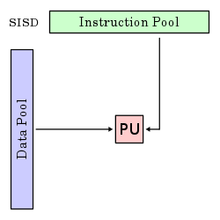
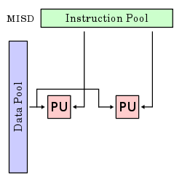
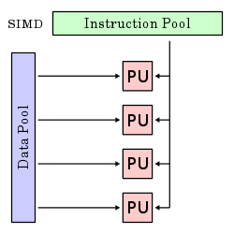
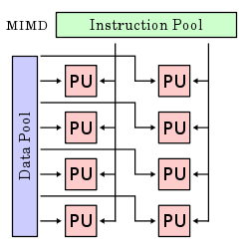
Flynn's taxonomy
 | Single instruction | Multiple instruction
Single data
Multiple data
Notes:
SISD
A sequential computer which exploits no parallelism in either the instruction or data streams. i.e. one operation at a -- traditional uniprocessor machines (PC) or old mainframes.
SIMD
A computer which exploits multiple data streams against a single instruction stream to perform operations which may be naturally parallelized. Example: array processor
MISD
Multiple instructions operate on a single data stream. Uncommon architecture which is generally used for fault tolerance. Heterogeneous systems operate on the same data stream and must agree on the result. Example: Space Shuttle flight control computer.
MIMD
Multiple autonomous processors simultaneously executing different instructions on different data. Distributed systems are generally recognized to be MIMD architectures; either exploiting a single shared memory space or a distributed memory space. A multi-core superscalar processor is an MIMD processor.

Slide 6
Vector processors
A vector processor (or array processor)
  CPU that implements an instruction set
  containing instructions that operate on
  one-dimensional arrays (vectors)
  Example systems:
    Cray-1 (1976)
      4096 bits registers (64x64-bit floats)
    IBM
      POWER with ViVA (Virtual Vector Architecture) 128 bits registers
      Cell – SPE 128 bit registers
    SUN
      UltraSPARC with VIS 64-bit registers
    NEC
      SX-6/SX-9 (2008) with 72x 4096 bit registers
    Intel
    ARM
    …

Slide 7
Vector processors
People use vector processing in many areas…
Scientific computing
Multimedia Processing
(compression, graphics, image processing, …)
Standard benchmark kernels
(Matrix Multiply, FFT, Convolution, Sort)
Lossy Compression (JPEG, MPEG video and audio)
Lossless Compression (Zero removal, RLE, Differencing, LZW)
Cryptography (RSA, DES/IDEA, SHA/MD5)
Speech and handwriting recognition
Operating systems (memcpy, memset, parity, …)
Networking (checksum, …)
Databases (hash/join, data mining, updates)
…
Instruction sets:
  MMX
  SSE
  AVX
  AltiVec
  3DNow!
  NEON
  …

Slide 8
Vector Instruction sets
MMX
  MMX is officially a meaningless initialism trademarked by Intel; unofficially,
    MultiMedia eXtension
    Multiple Math eXtension
    Matrix Math eXtension
  Introduced on the “Pentium with MMX Technology” in 1998.
  SIMD computation processes multiple data in parallel with a single instruction, resulting in significant performance improvement;
  MMX gives 2 x 32-bit computations at once.
  MMX defined 8 “new” 64-bit integer registers (mm0 ~ mm7), which were aliases for the existing x87 FPU registers – reusing 64 (out of 80) bits in the floating point registers.
  3DNow! was the AMD extension of MMX (closed down in 2010).

Slide 9

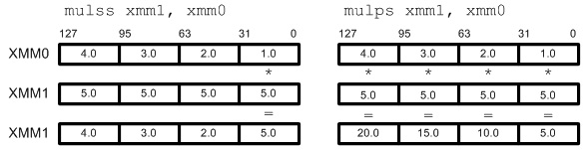
Vector Instruction sets
SSE
  Streaming SIMD Extensions (SSE)
  SIMD; 4 simultaneous 32-bit computations
  SSE defines 8 new 128-bit registers (xmm0 ~ xmm7) for single-precision floating-point computations. Since each register is 128-bit long, we can store total 4 of 32-bit floating-point numbers (1-bit sign, 8-bit exponent, 23-bit mantissa/fraction).
  Single or packed scalar operations: __SS vs __PS
Altivec has same size (128-bit),
has some more advanced instructions,
but seems to have lost the performance battle
Notes:
Altivec – Apple, IBM, Motorola (Freescale)

Slide 10
Vector Instruction sets
AVX-512 AVX SSE
AVX
  Advanced Vector Extensions (AVX)
  SIMD; 8 simultaneous 32-bit computations
  A new-256 bit instruction set extension to SSE
  16-registers available in x86-64
  Registers renamed from XMM_{i} to YMM_{i}
  Yet a proposed extension is AXV-512
  A 512-bit extension to the 256-bit XMM
  supported in from Intel's Xeon Phi x200 (Knights Landing) and Skylake-SP, and onwards
Notes:
https://en.wikipedia.org/wiki/AVX-512

Slide 11
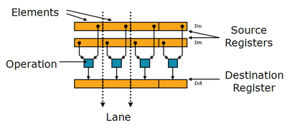
Vector Instruction sets
NEON
  Also known as ”Advanced SIMD Extensions”.
  Introduced by ARM in 2004 to accelerate media and signal processing
    NEON can for example execute MP3 decoding on CPUs running at 10 MHz
  128-bit SIMD Extension for the ARMv7 & ARMv8.
    Data types can be: signed/unsigned 8-bit, 16-bit, 32-bit or 64-bit.
More next week – home exam!

Slide 12




SIMD: Why not just “auto-magical”?
Why should I bother? Libraries, frameworks and
compiler optimizations can do the work for me…
True… but… lot of performance at stake!
  simplified
    4 cores can potentially give a 4x speedup
    AVX-512 can potentially give an 8x speedup
    Combined, 32x!!
  optimizers are good, but sometimes fail to meet your needs!
  learn invaluable understanding of the best use of vectorization!

Slide 13
Vector Multiplication using SSE (and AVX)

Slide 14
Element-wise Vector Multiplication
Find element-wise product of 2 vectors:
a₁ | a₂ | a₃ | a₄ | a₅ | a₆ | … | a_{n}
* | * | * | * | * | * |  | *
b₁ | b₂ | b₃ | b₄ | b₅ | b₆ | … | b_{n}
= | = | = | = | = | = |  | =
a₁*b₁ | a₂*b₂ | a₃*b₃ | a₄*b₄ | a₅*b₅ | a₆*b₆ | … | a_{n}*b_{n}
void vec_eltwise_product(vec_t* a, vec_t* b, vec_t* c)
{
size_t i;
for (i = 0; i < a->size; i++) {
c->data[i] = a->data[i] * b->data[i];
}
}

Slide 15
Element-wise Vector Multiplication
Unroll loop
void vec_eltwise_product(vec_t* a, vec_t* b, vec_t* c)
{
size_t i;
for (i = 0; i < a->size; i++) {
c->data[i] = a->data[i] * b->data[i];
}
}
SSE can take 4 x 32-bit operations in parallel using the 128-bit registers
→ unroll loop to a 4-element operation
void vec_eltwise_product_unrolled(vec_t* a, vec_t* b, vec_t* c)
{
size_t i;
for (i = 0; i < a->size; i+=4) {
c->data[i+0] = a->data[i+0] * b->data[i+0];
c->data[i+1] = a->data[i+1] * b->data[i+1];
c->data[i+2] = a->data[i+2] * b->data[i+2];
c->data[i+3] = a->data[i+3] * b->data[i+3];
}
}
void vec_eltwise_product(vec_t* a, vec_t* b, vec_t* c)
{
size_t i;
for (i = 0; i < a->size; i++) {
c->data[i] = a->data[i] * b->data[i];
}
}

Slide 16
Element-wise Vector Multiplication
Use SSE assembly instructions:
void vec_eltwise_product_unrolled(vec_t* a, vec_t* b, vec_t* c)
{
size_t i;
for (i = 0; i < a->size; i+=4) {
c->data[i+0] = a->data[i+0] * b->data[i+0];
c->data[i+1] = a->data[i+1] * b->data[i+1];
c->data[i+2] = a->data[i+2] * b->data[i+2];
c->data[i+3] = a->data[i+3] * b->data[i+3];
}
}
operations on these 4 elements
can be performed in parallel
; void vec_eltwise_product_unrolled (a, b, c)
vec_eltwise_product_SSE:
pushall
mov ebp, esp
mov edi, [ebp+12] ; a
mov ebx, [ebp+16] ; b
mov eax, [ebp+20] ; c
mov ecx, SIZE_OF_VECTOR ; counting i down
shr ecx, 2 ; use 4-increment of i
xor esi, esi ; array index = 0
for-loop:
movups xmm1, [edi + esi] ; read in a
movups xmm2, [ebx + esi] ; read in b
mulps xmm1, xmm2 ; multiply
movups [eax + esi], xmm1 ; result back in c
add esi, 4 ; next 4 elemens
loop for-loop
exit:
popall
ret
void vec_eltwise_product_unrolled(vec_t* a, vec_t* b, vec_t* c)
{
size_t i;
for (i = 0; i < a->size; i+=4) {
c->data[i+0] = a->data[i+0] * b->data[i+0];
c->data[i+1] = a->data[i+1] * b->data[i+1];
c->data[i+2] = a->data[i+2] * b->data[i+2];
c->data[i+3] = a->data[i+3] * b->data[i+3];
}
}
MOVUPS (Move Unaligned Packed Single-Precision Floating-Point Values) moves four packed single-precision floating-point numbers from the source operand (second operand) to the destination operand (first operand)
MULPS (Packed Single-Precision Floating-Point Multiply) performs a SIMD multiply of the four packed single-precision floating-point values from the source operand (second operand) and the destination operand (first operand), and stores the packed single-precision floating-point results in the destination operand.
LOOP decrements ECX and jumps to the address specified by arg unless decrementing ECX caused its value to become zero.
Notes:
NOTE:
MULPS may use a 128-bit memory element as first operand, i.e., the b does not really need to be moved to xmm2 first
MOVUPS may have either xmm registers or 128-bit memory elements as operands
LOOP decrements ECX and jumps to the address specified by arg unless decrementing ECX caused its value to become zero.
Different move instructions:
movss: copy a single floating-point data movlps: copy 2 floating-point data (low packed) movhps: copy 2 floating-point data (high packed) movaps: copy aligned 4 floating-point data (fast) movups: copy unaligned 4 floating-point data (slow) movhlps: copy 2 high elements to low position movlhps: copy 2 low elements to high position
movaps requires that the data in memory must be aligned 16 byte boundary for better performance.

Slide 17
Element-wise Vector Multiplication
Use SSE intrinsic functions:
intrinsic SSE functions exist,
e.g., for gcc on Intel Linux:
  dst = _mm_loadu_ps(src) → movups dst, src
  src1 = _mm_mul_ps(src1, src2) → mulps src1, src2
  src1 = _mm_add_ps(src1, src2) → addps src1, src2
  …
…which can be used without any
(noticeable) performance loss
; void vec_eltwise_product_unrolled (a, b, c)
vec_eltwise_product_SSE:
pushall
mov ebp, esp
mov edi, [ebp+12] ; a
mov ebx, [ebp+16] ; b
mov eax, [ebp+20] ; c
mov ecx, SIZE_OF_VECTOR ; counting i down
shr ecx, 2 ; use 4-increment of i
xor esi, esi ; array index = 0
for-loop:
movups xmm1, [edi + esi] ; read in a
movups xmm2, [ebx + esi] ; read in b
mulps xmm1, xmm2 ; multiply
movups [eax + esi], xmm1 ; result back in c
add esi, 4 ; next 4 elemens
loop for-loop
exit:
popall
ret
void vec_eltwise_product_SSE(vec_t* a, vec_t* b, vec_t* c)
{
size_t i;
__m128 va;
__m128 vb;
__m128 vc;
for (i = 0; i < a->size; i+= 4) {
va = _mm_loadu_ps(&a->data[i]);
vb = _mm_loadu_ps(&b->data[i]);
vc = _mm_mul_ps(va, vb);
_mm_storeu_ps(&c->data[i], vc);
}
}
; void vec_eltwise_product_unrolled (a, b, c)
vec_eltwise_product_SSE:
pushall
mov ebp, esp
mov edi, [ebp+12] ; a
mov ebx, [ebp+16] ; b
mov eax, [ebp+20] ; c
mov ecx, SIZE_OF_VECTOR ; counting i down
shr ecx, 2 ; use 4-increment of i
xor esi, esi ; array index = 0
for-loop:
movups xmm1, [edi + esi] ; read in a
movups xmm2, [ebx + esi] ; read in b
mulps xmm1, xmm2 ; multiply
movups [eax + esi], xmm1 ; result back in c
add esi, 4 ; next 4 elemens
loop for-loop
exit:
popall
ret
Notes:
Usually: SSE datatypes:
__m128 for float
__m128d for double
__m128i for int, short, char.

Slide 18
Element-wise Vector Multiplication
Use SSE intrinsic functions:
; void vec_eltwise_product_unrolled (a, b, c)
vec_eltwise_product_SSE:
pushall
mov ebp, esp
mov edi, [ebp+12] ; a
mov ebx, [ebp+16] ; b
mov eax, [ebp+20] ; c
mov ecx, SIZE_OF_VECTOR ; counting i down
shr ecx, 2 ; use 4-increment of i
xor esi, esi ; array index = 0
for-loop:
movups xmm1, [edi + esi] ; read in a
movups xmm2, [ebx + esi] ; read in b
mulps xmm1, xmm2 ; multiply
movups [eax + esi], xmm1 ; result back in c
add esi, 4 ; next 4 elemens
loop for-loop
exit:
popall
ret
void vec_eltwise_product_SSE(vec_t* a, vec_t* b, vec_t* c)
{
size_t i;
__m128 va;
__m128 vb;
__m128 vc;
for (i = 0; i < a->size; i+= 4) {
va = _mm_loadu_ps(&a->data[i]);
vb = _mm_loadu_ps(&b->data[i]);
vc = _mm_mul_ps(va, vb);
_mm_storeu_ps(&c->data[i], vc);
}
}

Slide 19
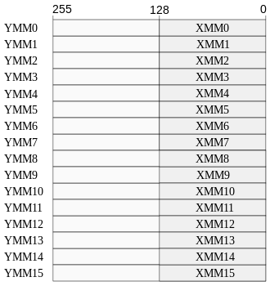
Element-wise Vector Multiplication
SSE vs AVX (Advanced Vector Extensions)
  AVX is similar to SSE, but has twice the width
  of the registers: 256 bit
  renamed registers (now 16) from XMM_{i} to YMM_{i}
  available from Intel's Sandy Bridge and
  AMD's Bulldozer prosessors (2011)
void vec_eltwise_product_SSE(vec_t* a, vec_t* b, vec_t* c)
{
size_t i;
__m128 va;
__m128 vb;
__m128 vc;
for (i = 0; i < a->size; i+= 4) {
va = _mm_loadu_ps(&a->data[i]);
vb = _mm_loadu_ps(&b->data[i]);
vc = _mm_mul_ps(va, vb);
_mm_storeu_ps(&c->data[i], vc);
}
}
void vec_eltwise_product_SSE(vec_t* a, vec_t* b, vec_t* c)
{
size_t i;
__m128 va;
__m128 vb;
__m128 vc;
for (i = 0; i < a->size; i+= 4) {
va = _mm_loadu_ps(&a->data[i]);
vb = _mm_loadu_ps(&b->data[i]);
vc = _mm_mul_ps(va, vb);
_mm_storeu_ps(&c->data[i], vc);
}
}
→ __m256 va;
→ __m256 vb;
→ __m256 vc;
→ i += 8;
→ va = _mm256_loadu_ps(&a->data[i]);
→ vb = _mm256_loadu_ps(&b->data[i]);
→ vc = _mm256_mul_ps(va, vb);
→ _mm256_storeu_ps(&c->data[i], vc);

Slide 20
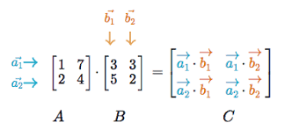
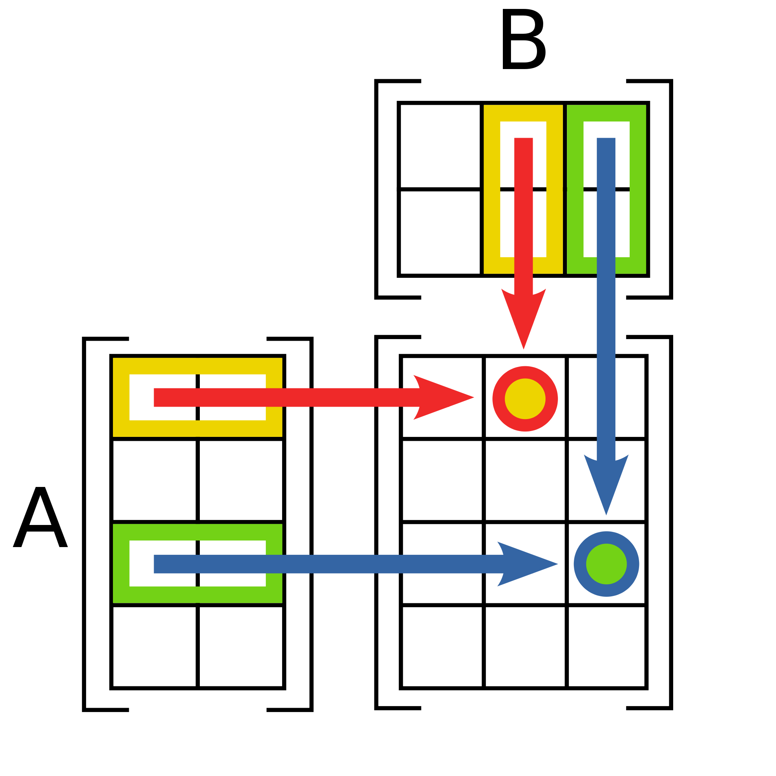
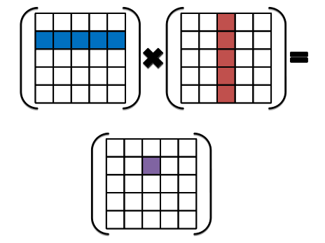
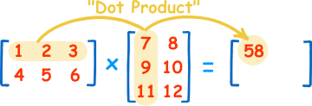
Matrix multiplication using SSE
Notes:
m x n *

Slide 21
Matrix Multiplication
1 | 1 | 1 | 1
2 | 2 | 2 | 2
3 | 3 | 3 | 3
4 | 4 | 4 | 4
1
2
3
4
1
2
3
4
10
2
4
6
8
20
3
6
9
12
30
4
8
12
16
40
Notes:
[h1 x b1][h2 x b2] = [h1 x b2] ➔ [4 x 4][4 x 1] = [4 x 1]

Slide 22
Matrix Multiplication - C
#include <stdio.h>
float elts[4][4] = {1,1,1,1,2,2,2,2,3,3,3,3,4,4,4,4};
float vin[4] = {1,2,3,4};
float vout[4];
void main(void)
{
vout[0] = elts[0][0] * vin[0] + elts[0][1] * vin[1] +
elts[0][2] * vin[2] + elts[0][3] * vin[3];
vout[1] = elts[1][0] * vin[0] + elts[1][1] * vin[1] +
elts[1][2] * vin[2] + elts[1][3] * vin[3];
vout[2] = elts[2][0] * vin[0] + elts[2][1] * vin[1] +
elts[2][2] * vin[2] + elts[2][3] * vin[3];
vout[3] = elts[3][0] * vin[0] + elts[3][1] * vin[1] +
elts[3][2] * vin[2] + elts[3][3] * vin[3];
printf("%f %f %f %f\n", vout[0], vout[1], vout[2], vout[3]);
}

Slide 23
Matrix Multiplication – SSE
#include <stdio.h>
float elts[4][4] = {1,1,1,1,2,2,2,2,3,3,3,3,4,4,4,4};
float vin[4] = {1,2,3,4};
float vout[4];
void main(void)
{
vout[0] = elts[0][0] * vin[0] + elts[0][1] * vin[1] +
elts[0][2] * vin[2] + elts[0][3] * vin[3];
vout[1] = elts[1][0] * vin[0] + elts[1][1] * vin[1] +
elts[1][2] * vin[2] + elts[1][3] * vin[3];
vout[2] = elts[2][0] * vin[0] + elts[2][1] * vin[1] +
elts[2][2] * vin[2] + elts[2][3] * vin[3];
vout[3] = elts[3][0] * vin[0] + elts[3][1] * vin[1] +
elts[3][2] * vin[2] + elts[3][3] * vin[3];
printf("%f %f %f %f\n", vout[0], vout[1], vout[2], vout[3]);
}
Efficient multiplication,
MULPS a, b = [A0*B0, A1*B1, A2*B2, A3*B3]
… but no “efficient” way to do the horizontal add:
HADDPS a, b = [B0+B1, B2+B3, A0+A1, A2+A3]
after (first row) multiplication we have x = [1, 2, 3, 4], add:
y = __mm_hadd_ps(x, x) = [1+2, 3+4, 1+2, 3+4]
z = __mm_hadd_ps(y, y) = [1+2+3+4, 1+2+3+4, 1+2+3+4, 1+2+3+4]
move z0 to destination register
1 | 1 | 1 | 1
2 | 2 | 2 | 2
3 | 3 | 3 | 3
4 | 4 | 4 | 4
1
2
3
4
1
2
3
4
10
2
4
6
8
20
3
6
9
12
30
4
8
12
16
40
Notes:
SLOW horisontal ADD (2 instructions) + move instruction into dest register → column-major order

Slide 24
Matrix Multiplication – SSE
Assuming elts in a COLUMN-MAJOR order:
a | b | c | d
e | f | g | h
i | j | k | l
m | n | o | p
a | e | i | m | b | f | j | n | c | g | k | o | d | h | l | p
1 | 1 | 1 | 1
2 | 2 | 2 | 2
3 | 3 | 3 | 3
4 | 4 | 4 | 4
1
2
3
4
1
2
3
4
10
2
4
6
8
20
3
6
9
12
30
4
8
12
16
40
Notes:
SLOW horisontal ADD (2 instructions) + move instruction into dest register → column-major order

Slide 25
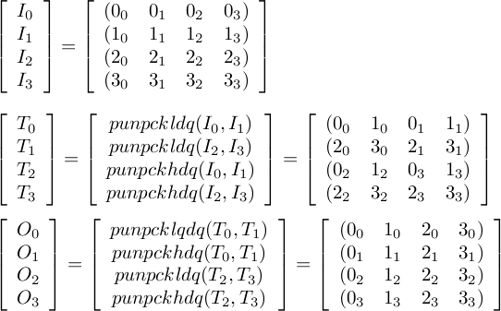
Matrix Multiplication – SSE
Store elts in column-major order – transpose using unpack low/high-order data elements:
Assuming elts in a COLUMN-MAJOR order:
a | b | c | d
e | f | g | h
i | j | k | l
m | n | o | p
a | e | i | m | b | f | j | n | c | g | k | o | d | h | l | p
<load matrix into IO, ..I3 __m128i registers >
/* Interleave values */
__m128i T0 = _mm_unpacklo_epi32(I0, I1);
__m128i T1 = _mm_unpacklo_epi32(I2, I3);
__m128i T2 = _mm_unpackhi_epi32(I0, I1);
__m128i T3 = _mm_unpackhi_epi32(I2, I3);
/* Assigning transposed values back into I[0-3] */
O0 = _mm_unpacklo_epi64(T0, T1);
O1 = _mm_unpackhi_epi64(T0, T1);
O2 = _mm_unpacklo_epi64(T2, T3);
O3 = _mm_unpackhi_epi64(T2, T3);
__m128i _mm_unpacklo_epi32 (__m128i a, __m128i b);
Interleaves the lower 2 signed or unsigned 32-bit integers in a with the lower 2 signed or unsigned 32-bit integers in b.
__m128i _mm_unpackhi_epi32 (__m128i a, __m128i b);
Interleaves the upper 2 signed or unsigned 32-bit integers in a with the upper 2 signed or unsigned 32-bit integers in b.
__m128i _mm_unpackhi/lo_epi64 (__m128i a, __m128i b);
Interleaves the upper / lower signed or unsigned 64-bit integers in a with the upper signed or unsigned 64-bit integers in b.

Slide 26
Transpose alternative
#define _MM_TRANSPOSE4_PS(row0, row1, row2, row3) { \
__m128 tmp3, tmp2, tmp1, tmp0; \
\
tmp0 = _mm_shuffle_ps((row0), (row1), 0x44); \ 44 = 01 00 01 00
tmp2 = _mm_shuffle_ps((row0), (row1), 0xEE); \ EE = 11 10 11 10
tmp1 = _mm_shuffle_ps((row2), (row3), 0x44); \
tmp3 = _mm_shuffle_ps((row2), (row3), 0xEE); \
\
(row0) = _mm_shuffle_ps(tmp0, tmp1, 0x88); \ 88 = 10 00 10 00
(row1) = _mm_shuffle_ps(tmp0, tmp1, 0xDD); \ DD = 11 01 11 01
(row2) = _mm_shuffle_ps(tmp2, tmp3, 0x88); \
(row3) = _mm_shuffle_ps(tmp2, tmp3, 0xDD); \
}

Slide 27
Matrix Multiplication – SSE
__asm {
mov esi, VIN
mov edi, VOUT
// load columns of (transposed) matrix into xmm4-7
mov edx, ELTS
movups xmm4, [edx]
movups xmm5, [edx + 0x10]
movups xmm6, [edx + 0x20]
movups xmm7, [edx + 0x30]
// load v into xmm0.
movups xmm0, [esi]
// we'll store the final result in xmm2; initialize it
// to zero
xorps xmm2, xmm2
// broadcast x into xmm1, multiply it by the first
// column of the matrix (xmm4), and add it to the total
movups xmm1, xmm0
shufps xmm1, xmm1, 0x00
mulps xmm1, xmm4
addps xmm2, xmm1
// repeat the process for y, z and w
movups xmm1, xmm0
shufps xmm1, xmm1, 0x55
mulps xmm1, xmm5
addps xmm2, xmm1
movups xmm1, xmm0
shufps xmm1, xmm1, 0xAA
mulps xmm1, xmm6
addps xmm2, xmm1
movups xmm1, xmm0
shufps xmm1, xmm1, 0xFF
mulps xmm1, xmm7
addps xmm2, xmm1
// write the results to vout
movups [edi], xmm2
}
Assuming elts in a COLUMN-MAJOR order:
a | b | c | d
e | f | g | h
i | j | k | l
m | n | o | p
a | e | i | m | b | f | j | n | c | g | k | o | d | h | l | p

Slide 28
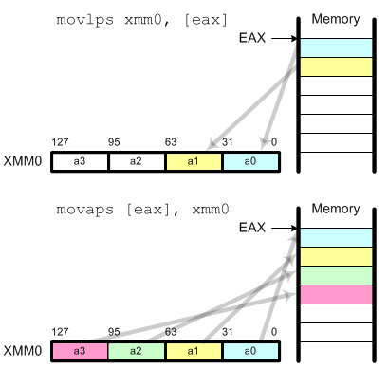
Matrix Multiplication – SSE
__asm {
mov esi, VIN
mov edi, VOUT
// load columns of (transposed) matrix into xmm4-7
mov edx, ELTS
movups xmm4, [edx]
movups xmm5, [edx + 0x10]
movups xmm6, [edx + 0x20]
movups xmm7, [edx + 0x30]
// load v into xmm0.
movups xmm0, [esi]
// we'll store the final result in xmm2; initialize it
// to zero
xorps xmm2, xmm2
// broadcast x into xmm1, multiply it by the first
// column of the matrix (xmm4), and add it to the total
movups xmm1, xmm0
shufps xmm1, xmm1, 0x00
mulps xmm1, xmm4
addps xmm2, xmm1
// repeat the process for y, z and w
movups xmm1, xmm0
shufps xmm1, xmm1, 0x55
mulps xmm1, xmm5
addps xmm2, xmm1
movups xmm1, xmm0
shufps xmm1, xmm1, 0xAA
mulps xmm1, xmm6
addps xmm2, xmm1
movups xmm1, xmm0
shufps xmm1, xmm1, 0xFF
mulps xmm1, xmm7
addps xmm2, xmm1
// write the results to vout
movups [edi], xmm2
}
Notes:
movss: copy a single floating-point data movlps: copy 2 floating-point data (low packed) movhps: copy 2 floating-point data (high packed) movaps: copy aligned 4 floating-point data (fast) movups: copy unaligned 4 floating-point data (slow) movhlps: copy 2 high elements to low position movlhps: copy 2 low elements to high position
movaps requires that the data in memory must be aligned 16 byte boundary for better performance.

Slide 29
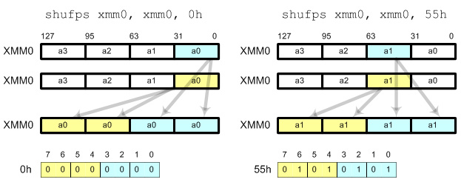
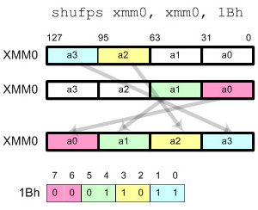
Matrix Multiplication – SSE
__asm {
mov esi, VIN
mov edi, VOUT
// load columns of (transposed) matrix into xmm4-7
mov edx, ELTS
movups xmm4, [edx]
movups xmm5, [edx + 0x10]
movups xmm6, [edx + 0x20]
movups xmm7, [edx + 0x30]
// load v into xmm0.
movups xmm0, [esi]
// we'll store the final result in xmm2; initialize it
// to zero
xorps xmm2, xmm2
// broadcast x into xmm1, multiply it by the first
// column of the matrix (xmm4), and add it to the total
movups xmm1, xmm0
shufps xmm1, xmm1, 0x00
mulps xmm1, xmm4
addps xmm2, xmm1
// repeat the process for y, z and w
movups xmm1, xmm0
shufps xmm1, xmm1, 0x55
mulps xmm1, xmm5
addps xmm2, xmm1
movups xmm1, xmm0
shufps xmm1, xmm1, 0xAA
mulps xmm1, xmm6
addps xmm2, xmm1
movups xmm1, xmm0
shufps xmm1, xmm1, 0xFF
mulps xmm1, xmm7
addps xmm2, xmm1
// write the results to vout
movups [edi], xmm2
}
shufps requires 2 operands and 1 mask.
shufps selects 2 elements from each operand (register) based on the mask.
2 elements from the first operand are copied to the lower 2 elements in destination register and 2 elements from the second operand are copied to the higher 2 elements in the destination register.
Using shufps instruction, you can shuffle any 4 data elements with any order.
Notes:
Shuffle Instruction
shufps requires 2 operands and 1 mask. shufps selects 2 elements from each operand (register) based on the mask. 2 elements from the first operand are copied to the lower 2 elements in destination register and 2 elements from the second operand are copied to the higher 2 elements in the destination register. Using shufps instruction, you can shuffle any 4 data elements with any order. The frequent usages of shufps are broadcast, swap and rotate.BroadcastIt copies all 4 fields with a single data element. The possible masks are
00h: Broadcast the least significant data element 55h: Broadcast the second data element AAh: Broadcast the third data element FFh: Broadcast the most significant data element

Slide 30
Matrix Multiplication – SSE
__asm {
mov esi, VIN
mov edi, VOUT
// load columns of (transposed) matrix into xmm4-7
mov edx, ELTS
movups xmm4, [edx]
movups xmm5, [edx + 0x10]
movups xmm6, [edx + 0x20]
movups xmm7, [edx + 0x30]
// load v into xmm0.
movups xmm0, [esi]
// we'll store the final result in xmm2; initialize it
// to zero
xorps xmm2, xmm2
// broadcast x into xmm1, multiply it by the first
// column of the matrix (xmm4), and add it to the total
movups xmm1, xmm0
shufps xmm1, xmm1, 0x00
mulps xmm1, xmm4
addps xmm2, xmm1
// repeat the process for y, z and w
movups xmm1, xmm0
shufps xmm1, xmm1, 0x55
mulps xmm1, xmm5
addps xmm2, xmm1
movups xmm1, xmm0
shufps xmm1, xmm1, 0xAA
mulps xmm1, xmm6
addps xmm2, xmm1
movups xmm1, xmm0
shufps xmm1, xmm1, 0xFF
mulps xmm1, xmm7
addps xmm2, xmm1
// write the results to vout
movups [edi], xmm2
}
2 | 2 | 2 | 2
1 | 2 | 3 | 4
2 | 4 | 6 | 8

Slide 31
Matrix Multiplication – SSE
__asm {
mov esi, VIN
mov edi, VOUT
// load columns of (transposed) matrix into xmm4-7
mov edx, ELTS
movups xmm4, [edx]
movups xmm5, [edx + 0x10]
movups xmm6, [edx + 0x20]
movups xmm7, [edx + 0x30]
// load v into xmm0.
movups xmm0, [esi]
// we'll store the final result in xmm2; initialize it
// to zero
xorps xmm2, xmm2
// broadcast x into xmm1, multiply it by the first
// column of the matrix (xmm4), and add it to the total
movups xmm1, xmm0
shufps xmm1, xmm1, 0x00
mulps xmm1, xmm4
addps xmm2, xmm1
// repeat the process for y, z and w
movups xmm1, xmm0
shufps xmm1, xmm1, 0x55
mulps xmm1, xmm5
addps xmm2, xmm1
movups xmm1, xmm0
shufps xmm1, xmm1, 0xAA
mulps xmm1, xmm6
addps xmm2, xmm1
movups xmm1, xmm0
shufps xmm1, xmm1, 0xFF
mulps xmm1, xmm7
addps xmm2, xmm1
// write the results to vout
movups [edi], xmm2
}
1 | 2 | 3 | 4
2 | 3 | 4 | 5
3 | 5 | 7 | 9

Slide 32
Matrix Multiplication – SSE
1 | 2 | 3 | 4
1 | 2 | 3 | 4
1 | 2 | 3 | 4
1 | 2 | 3 | 4
1
2
3
4
xmm0 - VIN :
__asm {
mov esi, VIN
mov edi, VOUT
// load columns of (transposed) matrix into xmm4-7
mov edx, ELTS
movups xmm4, [edx]
movups xmm5, [edx + 0x10]
movups xmm6, [edx + 0x20]
movups xmm7, [edx + 0x30]
// load v into xmm0.
movups xmm0, [esi]
// we'll store the final result in xmm2; initialize it
// to zero
xorps xmm2, xmm2
// broadcast x into xmm1, multiply it by the first
// column of the matrix (xmm4), and add it to the total
movups xmm1, xmm0
shufps xmm1, xmm1, 0x00
mulps xmm1, xmm4
addps xmm2, xmm1
// repeat the process for y, z and w
movups xmm1, xmm0
shufps xmm1, xmm1, 0x55
mulps xmm1, xmm5
addps xmm2, xmm1
movups xmm1, xmm0
shufps xmm1, xmm1, 0xAA
mulps xmm1, xmm6
addps xmm2, xmm1
movups xmm1, xmm0
shufps xmm1, xmm1, 0xFF
mulps xmm1, xmm7
addps xmm2, xmm1
// write the results to vout
movups [edi], xmm2
}
4 | 3 | 2 | 1
xmm1:
4 | 3 | 2 | 1
1 | 1 | 1 | 1
4 | 3 | 2 | 1
4 | 3 | 2 | 1
2 | 2 | 2 | 2
8 | 6 | 4 | 2
4 | 3 | 2 | 1
3 | 3 | 3 | 3
12 | 9 | 6 | 3
4 | 3 | 2 | 1
4 | 4 | 4 | 4
16 | 12 | 8 | 4
xmm2 - result - VOUT :
0 | 0 | 0 | 0
4 | 3 | 2 | 1
12 | 9 | 6 | 3
24 | 18 | 12 | 6
40 | 30 | 20 | 10
xmm4:
4 | 3 | 2 | 1
xmm5:
4 | 3 | 2 | 1
xmm6:
4 | 3 | 2 | 1
xmm7:
4 | 3 | 2 | 1

Slide 33
Changing picture brightness using SSE

Slide 34


Brightness
make_brighter
Make a simple program that change the brightness of a picture by adding a brightness value between -128 and 127 to each pixel. A positive value makes the picture brighter, a negative value darker.
Assume it is a one byte pixel in gray scale, or a YUV picture where you operate on the Y-part only (luma - brightness).

Slide 35
Brightness – main
<.. includes ..>
int main (int argc, char *argv[])
{
< ... more variables ... >
unsigned char *bw_image;
int image_len, bright_value;
< open input and output files >
bright_value = atoi( argv[…] ); /* a value between -128 and 127 */
image_len = atoi( argv[…] ) * atoi( argv[…] ); /* picture width x picture height */
bw_image = (unsigned char *) malloc(image_len + 15); /* +15 to allow 16-byte alignment */
if ((((long)bw_image) % 16) != 0) bw_image += 16 - ((long)bw_image % 16); /* align */
< read picture to into memory with first pixel at "bw_image" >
if (bright_value !=0 ) brightness( bw_image, image_len, bright_value );
< write picture back to file >
< free memory, close descriptors >
}

Slide 36
Brightness – Naïve C
void brightness (unsigned char *buffer, int len, int v)
{
int t, new_pixel_value;
if (v > 0) {
for (t = 0; t < len; t++) { /* make brighter */
new_pixel_value = buffer[t] + v;
if (new_pixel_value > 255) new_pixel_value = 255;
buffer[t] = new_pixel_value;
}
} else {
for (t = 0; t < len; t++) { /* make darker */
new_pixel_value = buffer[t] + v;
if (new_pixel_value < 0) new_pixel_value = 0;
buffer[t] = new_pixel_value;
}
}
}
What is the potential for parallelization using SSE-vectors?

Slide 37
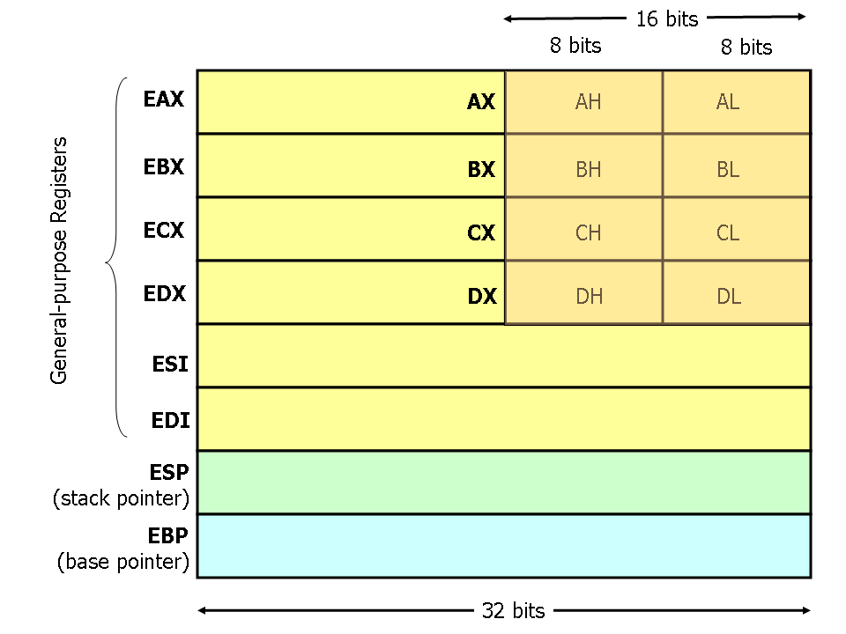
Brightness – SSE ASM
; void brightness_sse_asm(unsigned char *image, int len, int v)
brightness_sse_asm:
pushall
mov ebp, esp
mov edi, [ebp+12] ; unsigned char *image
mov ecx, [ebp+16] ; int len
mov eax, [ebp+20] ; int v in [-128, 127]
test eax, 0x80000000 ; check if v is negative
jz bright_not_neg
xor al, 255 ; make al abs(v)
inc al ; add 1
bright_not_neg:
shr ecx, 4 ; len = len / 16 (shift right 4)
mov ah, al ; xmm1=(v,v,v,v,v,v,v,v,v,v,v,v,v,v,v,v)
pinsrw xmm1, ax, 0 ; Packed Insert Word
pinsrw xmm1, ax, 1
pinsrw xmm1, ax, 2
pinsrw xmm1, ax, 3
pinsrw xmm1, ax, 4
pinsrw xmm1, ax, 5
pinsrw xmm1, ax, 6
pinsrw xmm1, ax, 7
test eax, 0xff000000 ; if v was negative,
jnz dark_loop ; make darker
bright_loop:
movdqa xmm0, [edi] ; move aligned double quadword
paddusb xmm0, xmm1 ; packed add unsigned
movdqa [edi], xmm0
add edi, 16 ; ptr = ptr + 16
loop bright_loop ; while (count>0)
jmp exit
dark_loop:
movdqa xmm0, [edi]
psubusb xmm0, xmm1
movdqa [edi], xmm0
add edi, 16 ; ptr=ptr+16
loop dark_loop ; while (count>0)
exit:
popall
ret
;; Fewer instructions ALTERNATIVE
;; using shufps
move ah, al
pinsrw xmm1, ax, 0
pinsrw xmm1, ax, 1
shufps xmm1, xmm1, 0x00
PINSRW (Packed Insert Word) moves the lower word in a 32-bit integer register or 16-bit word from memory into one of the 8 word locations in destination MMX/SSE register. The insertion is done in such a way that the 7 other words from the destination register are left untouched.
MOVDQA (move aligned double) Moves a double quadword from the source operand (second operand) to the destination operand (first operand).
PSUBUSB (Packed Subtract Unsigned with Saturation) instruction subtracts packed unsigned byte integers. When an individual byte result is less than zero (a negative value), the saturated value of 0x00 is written to the destination operand.
PADDUSB (Packed Add Unsigned with Saturation) instruction adds packed unsigned byte integers. When an individual byte result is beyond the range of an unsigned byte integer (that is, greater than 0xFF), the saturated value of 0xFF is written to the destination operand.
Notes:
eax contains v in lower 8 bits, move
lower 16-bit eax = ax
lower 8-bit ax = al
higher 8-bit ax = ah -→ ah,al = ax
Test sets ZF based on condition bitwise AND on two operands
Jump if not zero (ZF=0)

Slide 38
Brightness – SSE Intrinsics
void brightness_sse (unsigned char *buffer, int len, int v)
{
__m128 pixel_vector;
__m128 value_vector;
int t;
if (v > 0) {
< make v char >
value_vector = _mm_set1_epi8( v ); /* PINSRW, SHUFPS, etc..*/
for (t = 0; t < len; t += 16) {
pixel_vector = (__int128 *)(buffer+t); /* MOVDQA */
pixel_vector = _mm_adds_epi8(pixel_vector, value_vector); /* PADDUSB */
*((__m128 *)(buffer+t)) = pixel_vector; /* MOVDQA */
}
} else { % (v <= 0)
v=-v;
< make v char >
value_vector = _mm_set1_epi8(v);
for (t = 0; t < len; t += 16) {
pixel_vector = (__int128 *)(buffer+t); /* MOVDQA */
pixel_vector = _mm_subs_epi8(pixel_vector, value_vector); /* PSUBUSB */
*((__m128 *)(buffer+t)) = pixel_vector; /* MOVDQA */
}
}
}

Slide 39

Brightness – SSE Intrinsics
void brightness_sse (unsigned char *buffer, int len, int v)
{
__m128 pixel_vector;
__m128 value_vector;
int t;
if (v > 0) {
< make v char >
value_vector = _mm_set1_epi8( v ); /* PINSRW, SHUFPS, etc..*/
for (t = 0; t < len; t += 16) {
pixel_vector = (__int128 *)(buffer+t); /* MOVDQA */
pixel_vector = _mm_adds_epi8(pixel_vector, value_vector); /* PADDUSB */
*((__m128 *)(buffer+t)) = pixel_vector; /* MOVDQA */
}
} else { % (v <= 0)
v=-v;
< make v char >
value_vector = _mm_set1_epi8(v);
for (t = 0; t < len; t += 16) {
pixel_vector = (__int128 *)(buffer+t); /* MOVDQA */
pixel_vector = _mm_subs_epi8(pixel_vector, value_vector); /* PSUBUSB */
*((__m128 *)(buffer+t)) = pixel_vector; /* MOVDQA */
}
}
}

Slide 40
SIMT single instruction multiple threads

Slide 41
SIMT
Single Instruction Multiple Threads (SIMT) ≈ SIMD + multithreading
Nvidia's CUDA GPU microarchitecture introduced the SIMT execution model where multiple independent threads execute concurrently using a “single instruction”
Flexibility: SIMD < SIMT < SMT
  SIMT is more flexible in SIMD in three areas:
    Single instruction, multiple register sets
    Single instruction, multiple addresses
    Single instruction, multiple flow path
Performance: SIMD > SIMT > SMT
  Less flexibility usually means higher performance
  However, massive parallelism in SIMT?
  (2-16x (64x) operations vs. 1000+ threads?)
SIMT – easier code?
Now: CUDA = SIMD? SIMT? MIMD? MIMT?
Notes:
SMT = Simultaneous Multi Threading
https://yosefk.com/blog/simd-simt-smt-parallelism-in-nvidia-gpus.html

Slide 42


Slide 43

Summary
Vector instructions (assembly or their intrinsic functions) can be used for SIMD operations – single operation on multiple data elements
SIMT is more or less SIMD + multithreading
Friday, video coding examples using SIMD (SSE/AVX)
Next Tuesday, no lecture
Next Friday, ARM and NEON (to be used in your home exam)

Slide 44
Some SSE/AVX Resources
SSE instructions:
https://msdn.microsoft.com/en-us/library/t467de55(v=vs.90).aspx
Intrinsics:
https://software.intel.com/en-us/node/582251

