Slide 1
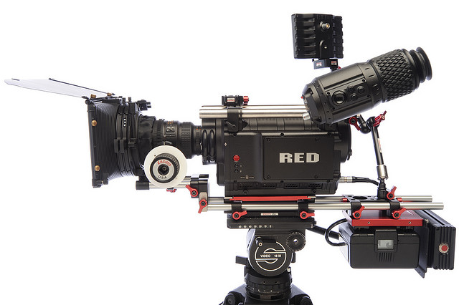
Introduction to video coding
IN5050:
Programming heterogeneous multi-core processors
January 27, 2025
using slides by
Håvard Espeland, Pål Halvorsen,
Preben N. Olsen, Carsten Griwodz

Slide 2
Why ?
IN5050 is about programming heterogeneous multi-core processors.
Why an intro to video coding?
Parallel processing without workloads has always targeted individual algorithms: counting, searching, sorting, ...
Real workloads use multiple, different algorithms that need to cooperate and be interconnected and have non-parallelizable steps as well
We want to look at parallelism that is required for everyday tasks, not at super-high-end scientific computing or incomprehensible machine learning stages
We know a bit more about video streaming than other casual tasks:
Many of its applications are time-critical
A codec can become memory-bound, CPU-bound, IO-bound
A single codec has opportunities for data parallelism, functional parallelism, and pipelining
It is also a very important workload in its own right
According to Cisco predictions in 2019, Internet video globally
… consumed 159 Exabytes per month in 2019.
… had a compound annual growth rate of 31%.
… was expected to reach 280 exabytes/month in 2022.
… had 82% of consumer Internet traffic in 2021.
Statista reports
>3900 mio other-the-top (OTT) streaming users in 2024
Expect > 4100 mio in 2025

Slide 3
High data volumes: Need for compression
PAL video sequence
  25 images per second
  3 bytes per pixel
    RGB (red-green-blue values)
    YUV (luminance + 2 chrominance values), usually often a compression already
  Uncompressed data rate depending on resolution:
    VGA: 640 * 480 * 3 Byte * 25/s = 23.040.000 byte/s = ~ 22 MByte/s
    HD 720p: 1280 * 720 * 3 Byte * 25/s = 69.120.000 byte/s = ~ 66 Mbyte/s
    HD 1080p: 1920 * 1080 * 3 Byte * 25/s = 155.520.000 byte/s = ~ 148 Mbyte/s
Network rates
  5 Mbps ADSL: 4% of 1 HD1080p
  1 Gbps Ethernet: 84% of 1 HD1080p
Need for compression

Slide 4


Data Compression
Alternative description of data requiring less storage and bandwidth
Uncompressed: 1 Mbyte
Compressed (JPEG): 50 Kbyte (20:1)
... while, for example, a 20 Megapixel camera creates 6016 x 4000 images,
in 8-bit RGB that makes more than 72 uncompressed Mbytes per image

Slide 5
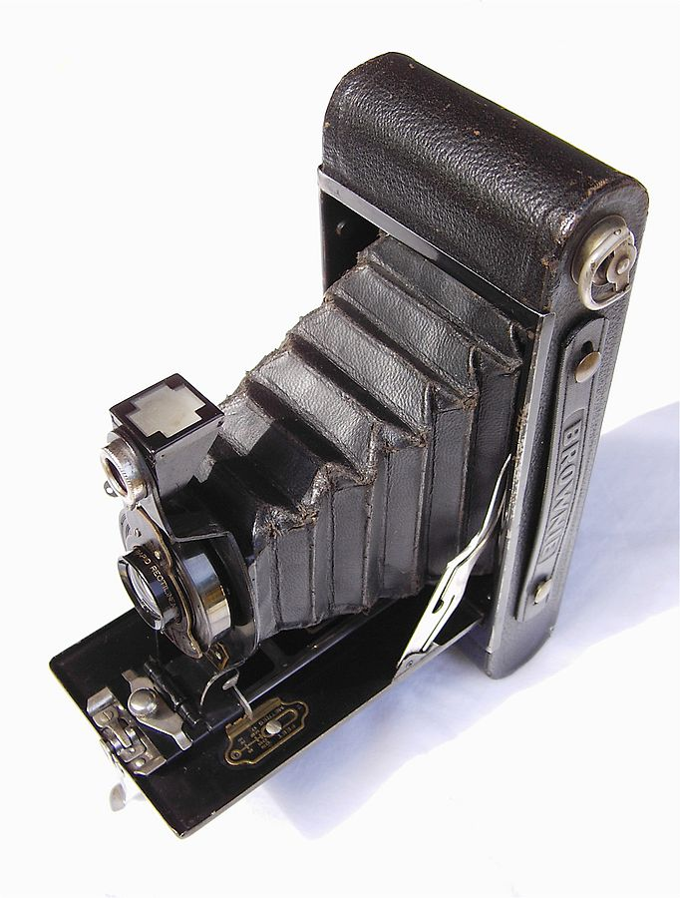
Coding pictures
IN5050:
Programming heterogeneous multi-core processors
„Kodak No 2-A Folding Autographic Brownie (ca 1917)“ by Carsten Corleis – own work. Licensed under Creative Commons Attribution-Share Alike 3.0

Slide 6
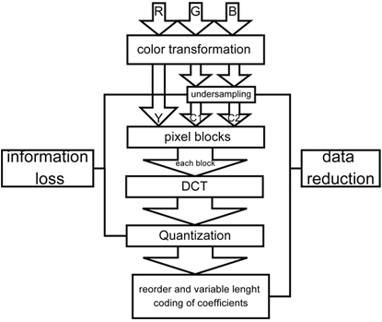
JPEG
“JPEG”: Joint Photographic Expert Group
International Standard:
  For digital compression and
  coding of continuous-tone still images
  Gray-scale and color
Compression rate of 1:10 yields
reasonable results
(better rates are also possible)

Slide 7
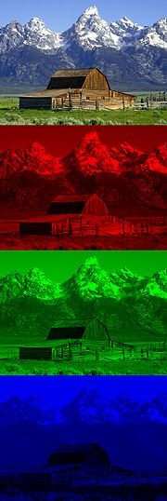

Color conversion: RGB to YCbCr
RGB
YCbCr
Y image is a greyscale version of the main image
the white snow is represented as a middle value in both Cr and Cb
the brown barn is represented by weak Cb and strong Cr
the green grass is represented by weak Cb and weak Cr
the blue sky is represented by strong Cb and weak Cr
R
Y
G
Cb
B
Cr
Notes:
Originally, YUV was for analog signals and YCbCr was used for digital encoding of color information suited for video and still-image compression. Today, the term YUV is commonly used in the computer industry to describe file-formats that are encoded using YCbCr.
invented when engineers wanted color television in a black-and-white infrastructure -- UV representation of chrominance was chosen over straight R and B signals because U and V are color difference signals. This meant that in a black and white scene the U and V signals would be zero and only the Y' signal would need to be transmitted.

Slide 8
(Chroma) Downsampling
Downsampling (first compression step)
  humans can see considerably more fine detail in the brightness,
  i.e., can reduce the spatial resolution of the Cb and Cr components
  4:4:4
  (no downsampling)
  4:2:2
  (reduce by factor of 2 in
  horizontal direction)
  4:2:0
  (reduce by factor of 2 in
  horizontal and vertical
  directions)
YCbCr
Y
Cb
Cr

Slide 9
Split each picture in 8x8 blocks
Each Y, Cb and Cr picture is divided into 8x8 blocks

Slide 10

Discrete cosine transform (DCT)
Each 8×8 block (Y, Cb, Cr) is converted to a frequency-domain representation, using a normalized, two-dimensional DCT
Notes:
A discrete cosine transform (DCT) expresses a finite sequence of data points in terms of a sum of cosine functions oscillating at different frequencies.
it has a strong "energy compaction" property: most of the signal information tends to be concentrated in a few low-frequency components of the DCT -- this stems from the boundary conditions implicit in the cosine functions.

Slide 11
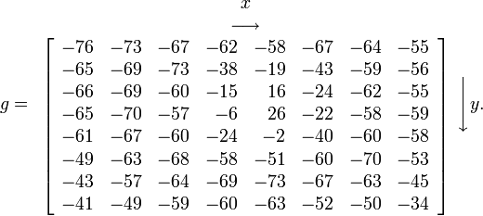

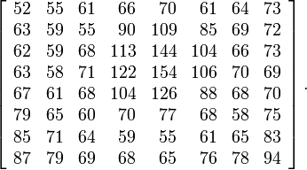
DCT
- 128 =
Each 8×8 block (Y, Cb, Cr) is converted to a frequency-domain representation, using a normalized, two-dimensional DCT
  initially, each pixel is represented by a [0, 255]-value
  each pixel is transformed to a [-128, 127]-value

Slide 12


DCT
- 128 =
Each 8×8 block (Y, Cb, Cr) is converted to a frequency-domain representation, using a normalized, two-dimensional DCT
  two-dimensional DCT:
    G_{u,v} is the DCT at output coordinates (u,v)
    u and v are from {0, ..., 7}
    g_{x,y} is the pixel value at input coordinates (x,y)
    α is a normalizing function:
Notes:
Note: if u and v are 0, cos(0)=1 has a lot of weight. So, we normalize “harder” by multiplying with 1/8. On the left and upper edge, one of the cos values is 1, so we multiply with sqrt(1/8)*sqrt(2/8)=1/4*sqrt(1/2)=1/5.66. Inside, no cos values are 1, so we multiply with sqrt(2/8)^2=1/4

Slide 13
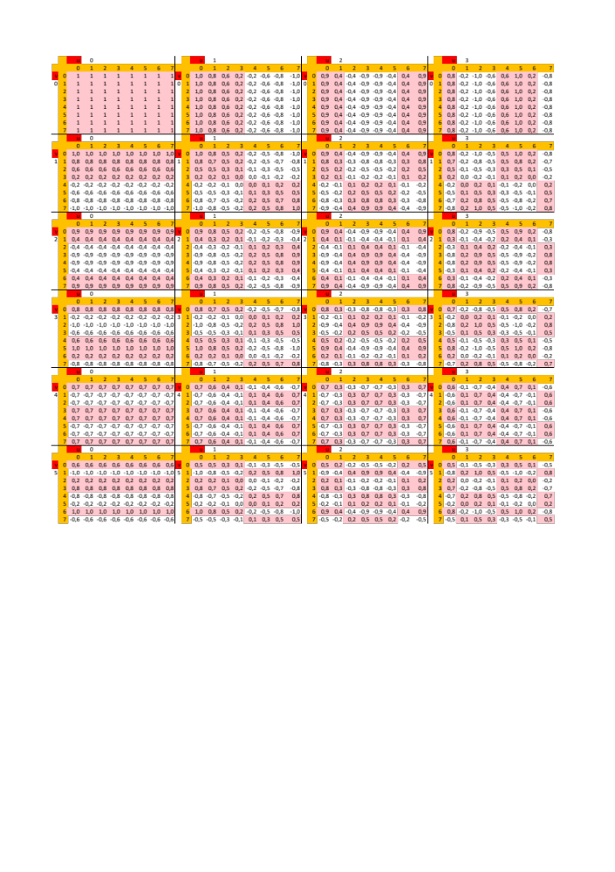
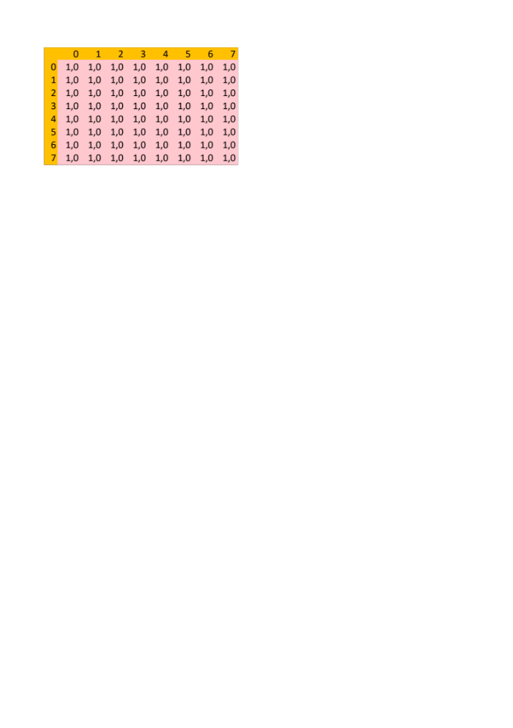


DCT
$$g_{x,y}=$$
- 128 =
Each 8×8 block (Y, Cb, Cr) is converted to a frequency-domain representation, using a normalized, two-dimensional DCT
  two-dimensional DCT:
    G_{u,v} is the DCT at output coordinates (u,v)
    u and v are from {0, ..., 7}
    g_{x,y} is the pixel value at input coordinates (x,y)
    α is a normalizing function:
Notes:
Note: if u and v are 0, cos(0)=1 has a lot of weight. So, we normalize “harder” by multiplying with 1/8. On the left and upper edge, one of the cos values is 1, so we multiply with sqrt(1/8)*sqrt(2/8)=1/4*sqrt(1/2)=1/5.66. Inside, no cos values are 1, so we multiply with sqrt(2/8)^2=1/4

Slide 14
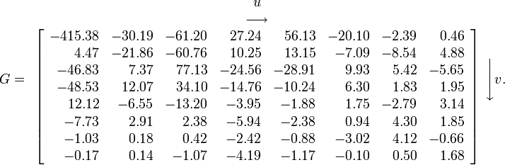
DCT
- 128 =
Apply DCT =
Note the rather large value of the top-left corner (DC coefficient). The remaining 63 are AC coefficients. The advantage of the DCT is its tendency to aggregate most of the signal (the block average) in one corner of the result, as may be seen to the right.
Compression possible: the following quantization step accentuates this effect while simultaneously reducing the overall size of the DCT coefficients

Slide 15
DCT
- 128 =
explain DC & AC
Apply DCT =
Note the rather large value of the top-left corner (DC coefficient). The remaining 63 are AC coefficients. The advantage of the DCT is its tendency to aggregate most of the signal in one corner of the result, as may be seen to the right.
Compression possible: the following quantization step accentuates this effect while simultaneously reducing the overall size of the DCT coefficients

Slide 16
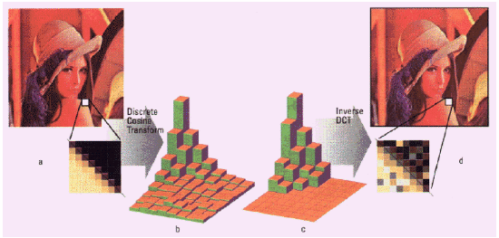
Quantization
The human eye
  is good at seeing small differences in brightness over a large area
  not so good at distinguishing the exact strength of a high frequency brightness variation
  can reduce the amount of information in the high frequency components
  Simply dividing each component in the frequency domain by a known
  constant for that component, and then rounding to the nearest integer:
  where Q_{j,k} is a quantization matrix

Slide 17
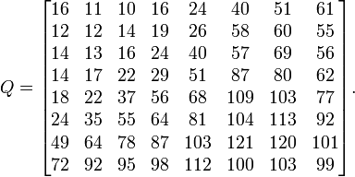
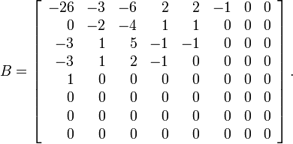
Quantization Example

Slide 18
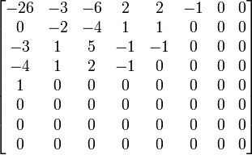
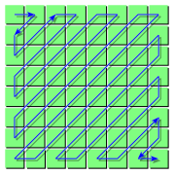
Lossless compression
The resulting data for all 8×8 blocks is further compressed with a loss-less algorithm
1. organize numbers in zigzag pattern
  -26, -3, 0, -3, -2, -6, 2, -4, 1, -4, 1, 1, 5, 1, 2, -1, 1, -1, 2, 0, 0, 0, 0, 0, -1, -1, 0 , 0, 0, 0, 0, 0, 0, 0, 0, …., 0, 0
2. run-length coding

Slide 19
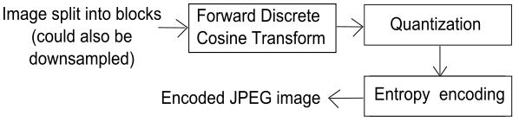
JPEG Encoder Overview
Prepare
(RGB2YUV)
F_{n}
(current)
DCT
Quant
Entropy coding
Encoding:

Slide 20
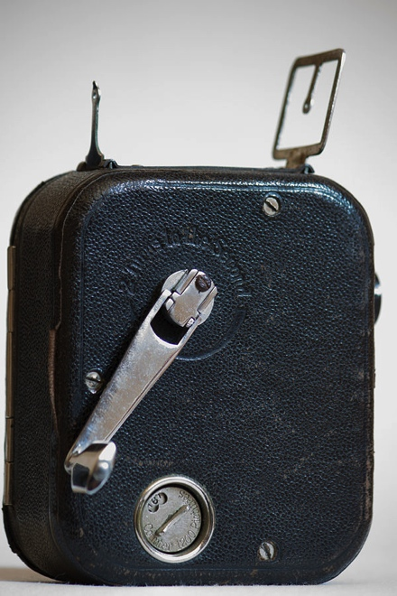
Coding videos
IN5050:
Programming heterogeneous multi-core processors
"Pathé-Baby hand movie camera (right)” by Cquoi - Own work.
Licensed under Creative Commons Attribution-Share Alike 3.0

Slide 21
Motion JPEG
Prepare
(RGB2YUV)
F_{n}
(current)
DCT
Quant
Entropy coding
Motion JPEG
  compress video by repeating JPEG steps
  allows pipelining of frames
Motion JPEG is not a standard
  Apple has a Quicktime container
  Microsoft has another container
  the IETF has defined an RTP profile
  ...
  and they are all (mostly) incompatible
Still
very typical for
video editing tools
(but nothing else)

Slide 22
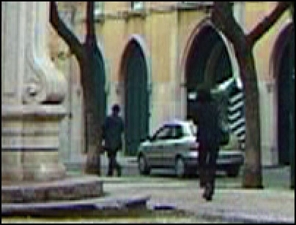
A picture

Slide 23
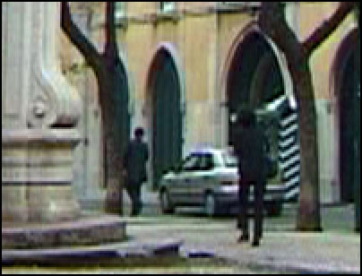
A new pictures? A changed picture!

Slide 24
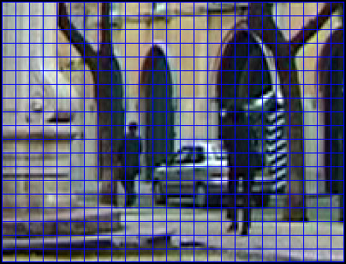
Macro blocks

Slide 25
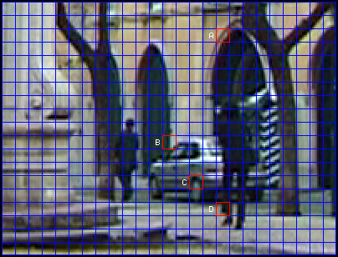
Focusing on blocks A B C & D

Slide 26
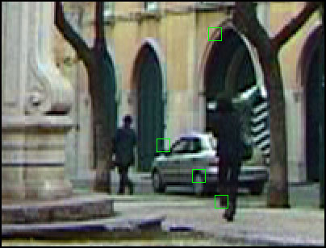
Best match in reference frame

Slide 27
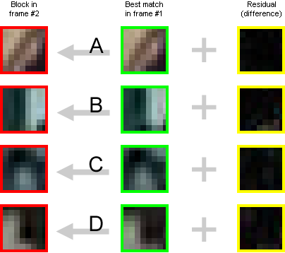
1. Challenge: small differences

Slide 28

Challenge: Displacement

Slide 29
Adding Motion to the JPEG pipeline
Prepare
(RGB2YUV)
F_{n}
(current)
DCT
Quant
Entropy coding

Slide 30
Adding Motion to the JPEG pipeline
Prepare
(RGB2YUV)
F_{n}
(current)
DCT
Quant
Entropy coding
Motion estimation
F_{n-1}
(reference)

Slide 31
Inter-Prediction
Predict a macroblock by reusing pixels from another frame
  Motion vectors are used to compensate for movement
  H.263: search in 1 frame
  MPEG-1/2: search in 2 frames
  H.264 (AVC) + H.265 (HEVC):
  search in 16 frames

Slide 32

Full Search Motion Estimation
F_{n-1}
(reference)
F_{n}
(current)
Find best match
and so on ...
For comparing blocks:
SAD - Sum of Absolute Differences
W: fixed set, but
not only integers !

Slide 33
Diamond Motion Estimation Pattern
Heuristic
  start at the same place in previous frame
  search neighourhood first
  move search center to location with smallest SAD
  repeat until stable

Slide 34
Motion Estimation
The estimators often use a two-step process, with initial coarse evaluation and refinements
Don’t do this for every frame, you must sometimes encode macroblocks in a “safe” mode that doesn’t rely on others
This is called “Intra”-mode
  When a complete frame is encoded in I-mode (always in MPEG-1 and MPEG-2), this is called an I-frame
  x264 calls I-frames "keyframes". But the word keyframe has many, many other meanings as well. Avoid misunderstandings. Write I-frame.
Refinements include trying every block in the area, and also using sub-pixel precision (interpolation)
  quarter pixel in H.264

Slide 35
Adding Motion to the JPEG pipeline
Prepare
(RGB2YUV)
F_{n}
(current)
DCT
Quant
Entropy coding
Motion estimation
F_{n-1}
(reference)
F_{n-1}
(reference)
Motion compen-sation

Slide 36
Motion Compensation
When the best motion vector has been found and refined, a predicted image is generated using the motion vectors
The reference frame can not be used directly as input to the motion compensator
  The decoder never sees the original image. Instead, it sees a reconstructed image, i.e. an image that has been quantized (with loss)
A reconstructed reference image must be used as input to motion compensation

Slide 37
Adding Motion to the JPEG pipeline
Prepare
(RGB2YUV)
F_{n}
(current)
DCT
Quant
Entropy coding
Motion estimation
F_{n-1}
(reference)
F_{n-1}
(reference)
Motion compen-sation

Slide 38
Adding Motion to the JPEG pipeline
Prepare
(RGB2YUV)
F_{n}
(current)
DCT
Quant
Entropy coding
Motion estimation
F_{n-1}
(reference)
F_{n-1}
(reference)
iDCT
iQuant

Slide 39
Frame Reconstruction
The motion compensator requires as input the same reference frame as the decoder will see
De-quantize and inverse-transform the residuals and add them to our predicted frame
The result is (roughly) the same reconstructed frame as the decoder will receive

Slide 40
Residual Transformation
The pixel difference between the original frame and the reconstructed frame is called residuals
Since the residuals only express the difference from the prediction, they are much more compact than full pixel values such as in JPEG
Residuals are transformed using DCT and Quantization
MPEG uses special Quantization tables for residuals
in IN5050, we don’t

Slide 41
Adding Motion to the JPEG pipeline
Prepare
(RGB2YUV)
F_{n}
(current)
DCT
Quant
Entropy coding
Motion estimation
F_{n-1}
(reference)
F_{n-1}
(reference)
Motion compen-sation
recon-struction
iDCT
iQuant

Slide 42
Adding Motion to the JPEG pipeline
Prepare
(RGB2YUV)
F_{n}
(current)
DCT
Quant
Reorder
Entropy coding
Motion estimation
F_{n-1}
(reference)
F_{n-1}
(reference)
Motion compen-sation
recon-struction
iDCT
iQuant

Slide 43
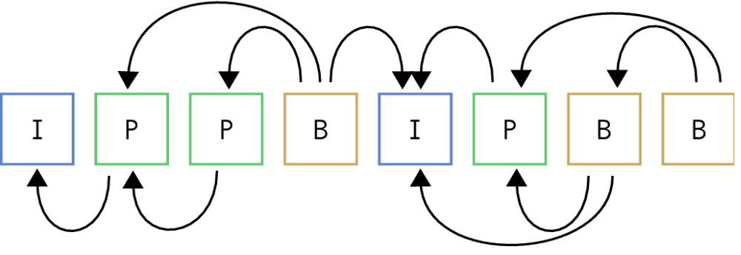
Macroblock Types
MPEG-1 macroblocks are 8x8 pixels,
they can be of type I, P or B
  Intra-MBs use Intra-prediction (like JPEG)
  Predicted MBs use Inter-prediction
  Bi-Directional Predicted MBs use prediction both backward and forward in time
  The frames are reordered in such a way that frames used for predicting other frames are decoded first
oldest
frame
newest
frame

Slide 44
Adding Motion to the JPEG pipeline
Prepare
(RGB2YUV)
F_{n}
(current)
DCT
Quant
Reorder
Entropy coding
Motion estimation
F_{n-1}
(reference)
F_{n-1}
(reference)
Motion compen-sation
recon-struction
iDCT
iQuant

Slide 45
Simplified MPEG Encoder Overview
Prepare
(RGB2YUV)
F_{n}
(current)
DCT
Quant
Reorder
Entropy coding
Motion estimation
ok
F_{n-1}
(reference)
F_{n-1}
(reference)
Motion compen-sation
Intra prediction
fail
recon-struction
iDCT
iQuant

Slide 46
GOP-based Approach
Delay pictures until there are multiple keyframes within the encoder pipeline
Intra-frames do not depend on previous frames, and thus can be used as starting points for multiple encodes
Adds a considerable pipeline to the encoder

Slide 47
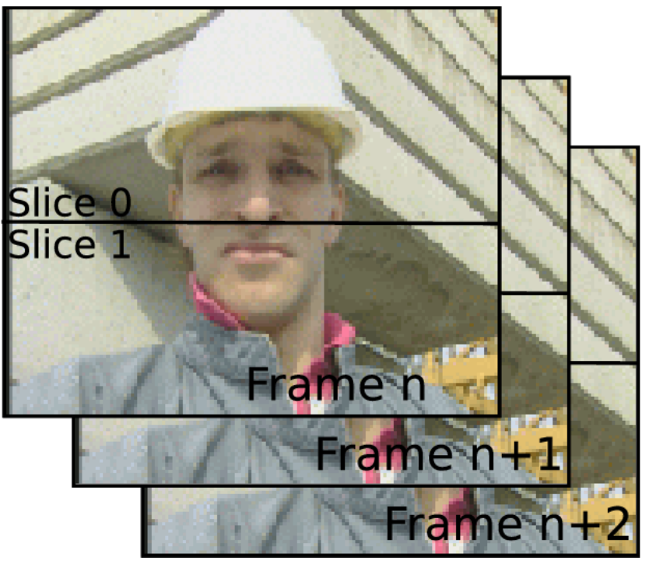
Slice-Based Approach
Split every frame into one or more slices
Supported since MPEG-1
Slices are completely independent – one may not predict across borders
Severely hurts compression efficiency

Slide 48
Video Quality Assessment
Evaluating video quality is a research field by itself
Usually requires a panel of subjects that rate which version is best
  Subjects have different preferences for artifacts and quality reductions
Objective measurements give a rough number which says something about the difference between the original frames and the reconstructed frames
  Typically SSIM or PSNR
  A shell script for finding PSNR values of YUV frames can be found in the mplayer source tree under TOOLS/

Slide 49
Conclusion
Video encoding is mainly about trying (and failing) different prediction modes limited by user-defined restrictions (resource usage)
The “actual” encoding of the video when the parameters are known (forgetting about all the failed tests) usually accounts for a small percentage of the running time
  This makes decoding cheap
  An important goal of MPEG
Any (reasonable) codec can produce the desired video quality
–
what differs between them is the size of the output

