Slide 1
Memory Hierarchies
IN5050:
Programming heterogeneous multi-core processors
Carsten Griwodz
February 9, 2026

Slide 2
Hierarchies at scale
Distributed storage
CPU registers
L1 cache
NAS and SAN
L2 cache
Disks arrays
On-chip
memory
Hard (spinning)
disks
L3 cache
Solid state
disks
Locally attached
main memory
Bus attached
main memory
Battery-backed
RAM

Slide 3
Registers
Classical registers
  6502: 4 (AX, DX, DY, stack pointer (SP))
  8080: 7x 8-bit + SP OR 1x 8-bit and 3x 16-bit + SP
  8086: 8x 16-bit incl SP OR 8x 8-bit, 4x 16-bit incl SP
  68000: 8x 32-bit data, 8x 32-bit address, 8x 32-bit float
  Cell PPE core: 32x 64bit, 32x 64-bit float, 32x 128-bit SIMD
  Cell SPE core: 128x 128-bit SIMD
  Core i7/i9: 16x (64-/32-/16-/8-bit) + 32x (512-/256-/128-bit SIMD)
  ARM A64: 31x 64-bit + 32x 64-bit float
  CUDA CC 5.x: 1x (64-/32-bit) + 128x 512-bit SIMD

Slide 4
Registers
Register sets in typical processors
processor | Generic | Special | Float | SIMD
MOS 6502 | 2 | 1xAccu 1x16 SP
Intel 8080 | 7x8 or 1x8 + 3x16 | 1x16 SP
Intel 8086 | 8x16 or 8x8 + 4x16
Motorola 68000 | 8x32 | 8x32 address | 8x32
ARM A64 (each core) | 31x64 | zero-register | 32x64
Intel Core i7 (each core) | 16x (64|32|16|8) |  |  | 32x (512|256|128)
Cell PPE (each core) | 32x64 |  | 32x64 | 32x128
Cell SPE (each core) |  |  |  | 128x128
CUDA CC 5.x (each SM) | 1x (64|32) |  |  | 128x512
Notes:
does the i7 use general or SIMD registers for float ops?
CUDA CC 8.X Ampere -

Slide 5
Registers
Register sets in typical processors
processor | Generic | Special | Float | SIMD
CUDA CC 8.x (128 SMs per chip) | 4 x 16384 x 32 |  |  | 4 x 512 x 1024
CUDA CC 12.x (12.0: 192 SMs per die) | = | = | = | =
IBM Power 1 | 32x32 | 1 link, 1 count | 32x32
OpenPOWER | 32x64 |  | 32x64 | 32x128 SIMD
IBM Power 10 (15x or 30x per chip) | 1xSMT 32x64 | 4x64 Matrix (4 ML pipes) | 32x64 | 32x128 SIMD 8x512 SIMD
IBM Power 11 (16x or 30x per chip) | 1xSMT 32x64 | 4x128 Matrix 4x2x512 Accu | ? | 64x128 SIMD
PC per SIMD cell -> nearly generic
Notes:
does the i7 use general or SIMD registers for float ops?
CUDA CC 8.X Ampere -

Slide 6
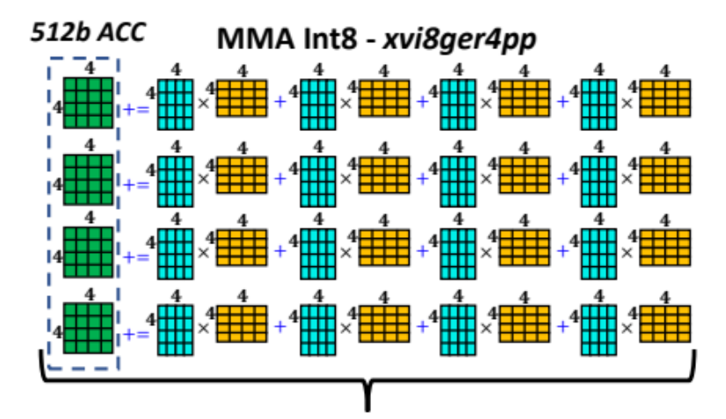
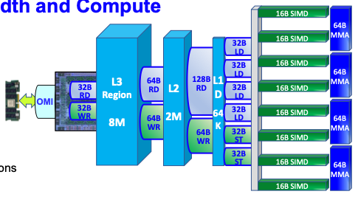
Registers
Register sets in typical processors
processor | Generic | Special | Float | SIMD
IBM Power 10 (15x or 30x per chip) | 1xSMT 32x64 | 4x64 Matrix (4 ML pipes) | 32x64 | 32x128 SIMD 8x512 SIMD
Single use-only with a weird load/store semantic
IBM’s POWER10 processor
Willian Stark, Brian Thompto, Hot Chips 32, 2020
Note: CUDA SM’s similar but more flexible TensorCore is counted as a compute unit
Notes:
does the i7 use general or SIMD registers for float ops?
CUDA CC 8.X Ampere -

Slide 7
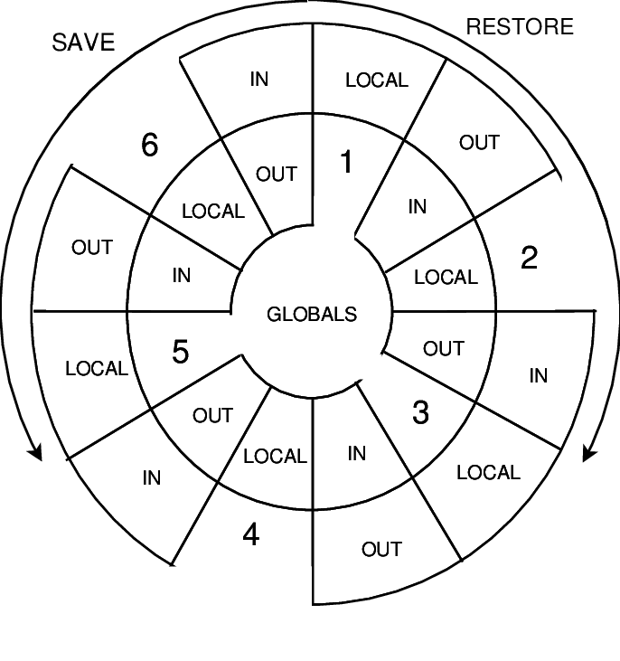
Registers
Register windows
  Idea: compiler must optimize for a subset of actually existing registers
  Function calls and context changes do not require register spilling to RAM
  Berkeley RISC: 64 registers, but only 8 visible per context
  Sun Sparc: 3x8 in a shifting register book, 8 always valid
very useful if OS should not yield on kernel calls
nice with upcall concept
otherwise:
totally useless with multi-threading

Slide 8
CPU caches
Effects of caches
 |  | Latency
 |  | Intel Broadwell Xeon E5-2699v4 | Intel Broadwell Xeon E5-2640v4 | Intel Arrow Lake
Cache level | L1 | 4 cyc | 4 cyc | 4 cyc
 | L1.5 |  |  | 9 cyc
 | L2 | 12-15 cyc | 12-15 cyc | 17 cyc
 | L3 | 4MB: 50 cyc | 4 MB: 49-50 cyc | 4MB: >80 cyc
Random load from RAM regions of size ... | 16 MB | 21 ns | 26 ns | reportedly 70-100ns (up to 127ns)
 | 32-64 MB | 80-96 ns | 75-92 ns
 | 96-128 MB | 96 ns | 90-91 ns
 | 384-512 MB | 95 ns | 91-93 ns
Notes:
Arrow Lake is slower. But it has much larger caches.
Arrow Lake has higher L3 architecture because of an internal ring bus architecture, and increased capacity.
Arrow Lake has a 30ms latency penalty because the memory controller moved out of the compute tile.

Slide 9
CPU caches
Effects of caches
 |  | Latency
 |  | Intel Broadwell Xeon E5-2699v4 | Intel Broadwell Xeon E5-2640v4 | IBM POWER8
Cache level | L1 | 4 cyc | 4 cyc | 3 cyc
 | L1.5
 | L2 | 12-15 cyc | 12-15 cyc | 13 cyc
 | L3 | 4MB: 50 cyc | 4 MB: 49-50 cyc | 8MB: 27-28 cyc
Random load from RAM regions of size ... | 16 MB | 21 ns | 26 ns | 55 ns
 | 32-64 MB | 80-96 ns | 75-92 ns | 55-57 ns
 | 96-128 MB | 96 ns | 90-91 ns | 67-74 ns
 | 384-512 MB | 95 ns | 91-93 ns | 89-91 ns
Notes:
POWER8: low-level NUMA design (bought Sequent?) brings RAM assignment logic
Intel: QPI crossbar switch, but no RAM reassignment logic

Slide 10
Cache coherence
Problems
  User of one cache writes a cacheline, users of other caches read the same cacheline
    Needs write propagation from dirty cache to other cache
  Users of two caches write to the same cacheline
    Needs write serialization among caches
    Cacheline implies that sharing be true or false
Cache coherence algorithms
  Snooping
    Based on broadcast
    Write-invalidate or Write-update
  Directory-based
    Bit vector, tree structure, pointer chain
    Intel Knights Mill: cache coherent interconnect with MESIF protocol
Notes:
MESIF – modified exclusive shared invalid forward – only S and F are unsafe, at most one cache can be in F state for a cacheline, it is then the designated responder for incoming S requests

Slide 11
GPU caches
CUDA and OpenCL – the SIMT method
Relevance of alignment between threads
Cache coherence

Slide 12
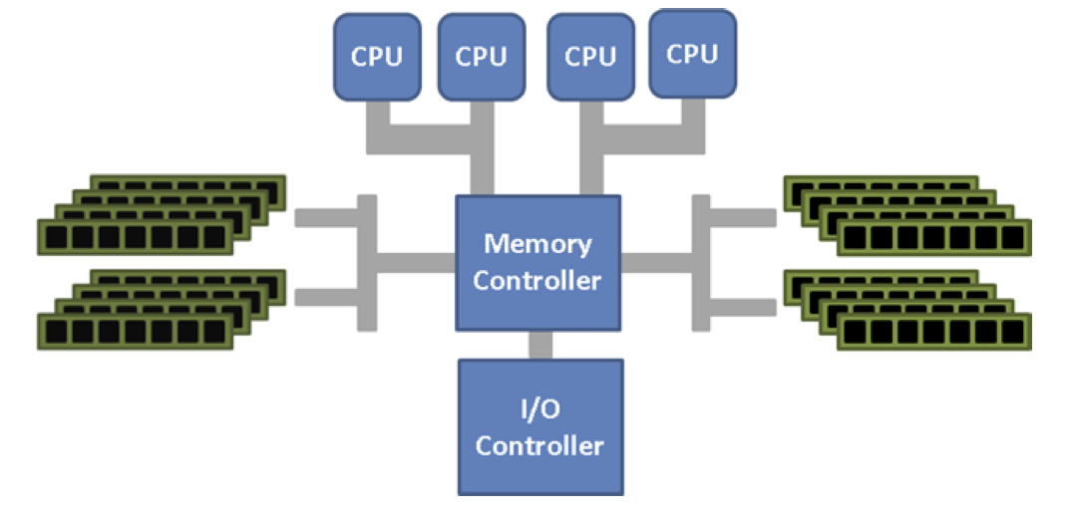
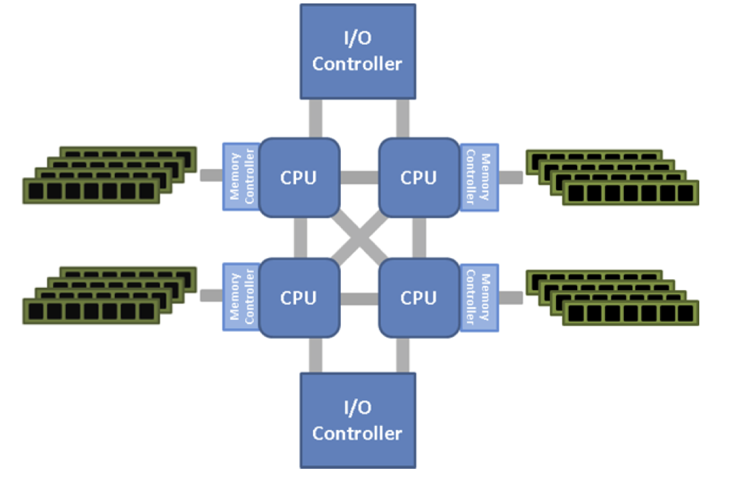
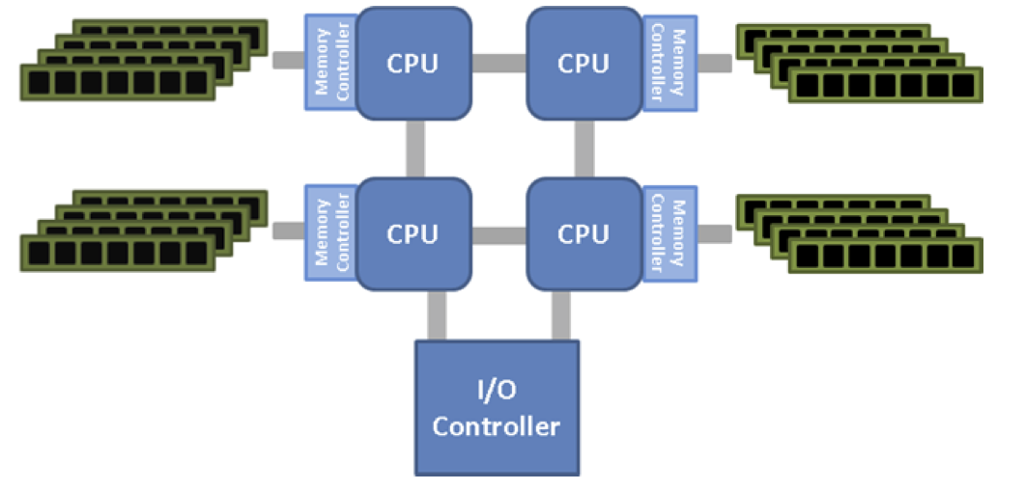
Main memory
Classical memory
attachment,
e.g. Front-side bus
-
uniform addressing
but bottlenecked
AMD HyperTransport
memory attachment
Intel Ultra Path Interconnect
memory attachment
Notes:
Ultra Path Interconnect
- Only for Xeon
- follows the Quick Path Interconnection, since 2017

Slide 13
Main memory
Memory
Controller
CPU
CPU
Memory
Controller
Memory
Controller
CPU
CPU
Memory
Controller
Memory
Controller
CPU
CPU
Memory
Controller
Memory
Controller
CPU
CPU
Memory
Controller
but only 3 channels per CPU,
so effectively that’s a
cube-shape for 8 CPUs
(and 8 is max)
At the next hierarchy level, there are switches
Following the Omni Path Interconnect
Intel Ultra Path Interconnect
memory attachment

Slide 14
Types of memory: NUMA
Same memory hierarchy level - different access latency
AMD Hypertransport hypercube interconnect example
  Memory banks attached to different CPUs
  Streaming between CPUs in hypercube topology
  (Fully mesh in QPI helps)
  Living with it
    Pthread NUMA extensions to select core attachment
    Problem with thread migration
    Problem with some «nice» programming paradigms such as actor systems

Slide 15
Types of memory: non-hierarchical
Historical Amiga
  Chip memory
    shared with graphics chips
    accessible for Blitter
  Local memory
    onboard memory
  Fast memory
    not DMA-capable, only CPU-accessible (CPU never shares bus cycles)
  DMA memory
    accessible for Blitter
  Any memory
    on riser cards over Zorro bus, very slow
like a DMA engine only for memory, but also boolean operations on blocks of memory
PCIe’s follow-up standard
CXL will bring us a lot of this !

Slide 16
Types of memory: throughput vs latency
IXP 1200
  Explicit address spaces
    latency, throughput, plus price
    Scratchpad – 32bit alignment, to CPU only, very low latency
    SRAM – 32bit alignment, 3.7Gbps throughput read, 3.7 Gbps write, to CPU only, low latency
    SDRAM – 64bit alignment, 7.4Gps throughput, to all units, higher latency
  Features
    SRAM/SDRAM operations are non-blocking
    hardware context switching hides access latency
    (the same happens in CUDA)
    «Byte aligner» unit from SDRAM
not unified at all:
different assembler instructions for Scratchpad, SRAM and SDRAM
Intel sold the IXP family to Netronome
renamed to NFP-xxxx chips, 100 Gbps speeds
C compiler is still broken in 2020

Slide 17
Types of memory: throughput vs latency
Netronome NFP-4000 (Agilio CX)
  Grand-grand-grandchild of the IXP 1200
location | name |  | size | access time
Microengine | CS | code store | 32 kB
 | LM | local memory | 4 kB | 1-3 cycles
Island | CLS | cluster-local scratch | 64 kB | 20-50 cycles
 | CTM | cluster target memory | 256 kB | 50-100 cycles
Global | IMEM | internal memory | 4 MB | 150-250 cycles
 | EMEM | external memory | 2 GB | 150-500 cycles

Slide 18
Hardware-supported atomicity
Ensure atomicity of memory across cores
Transactional memory
  e.g. Intel TSX (Transactional Synchronization Extensions)
    available in Core 4, 8 and 9, definitely removed since Core 10
    Hardware lock elision: prefix for regular instruction to make them atomic
    Restricted transactional memory: extends to an instruction group including up to 8 write operations
  e.g. IBM Power 11
    To be used conjunction with the compiler
    Transaction tbegin (full/short), tend, tabort, tsuspend, tresume, tcheck
    Transaction fails in case of access collision within a transaction, exceeding a nesting limit, or exceeding a writeback buffer size
  Allow speculative execution with memory writes
  Conduct memory state rewind and instruction replay of transaction whenever serializability is violated
Notes:
tsuspend and tresume are interesting because they allow a non-speculative "thing" like a mutex to the be manipulated inside an otherwise speculative transaction

Slide 19
Hardware-supported atomicity
Ensure atomicity of memory across cores
IXP hardware queues
  push/pop operations on 8 queues in SRAM
  8 hardware mutexes
  atomic bit operations
  write transfer registers, read transfer registers for direct communication between microengines (cores)
Cell hardware queues
  Mailbox to send queued 4-byte messages from PPE to SPE and reverse
  Signals to post unqueued 4-byte messages from one SPE to another
“push/pop” is badly named: they are queues, not stacks

Slide 20
Hardware-supported atomicity
Ensure atomicity of memory across cores
CUDA
  Atomic in device memory
  Atomic in shared memory
  Atomic in all managed memory (incl. host)
  shuffle, shuffle-op, ballot, reduce
  cooperative groups
    sync freely defined subset of a threads in block
    multiple blocks
    multiple devices
really slow
rather fast

Slide 21
Content-addressable memory
Content addressable memory (CAM)
  solid state memory
  data accessed by content instead of address
Design
  simple storage cells
  each bit has a comparison circuit
  Inputs to compare: argument register, key register (mask)
  Output: match register (1 bit for each CAM entry)
  READ, WRITE, COMPARE operations
  COMPARE: set bit in match register for all entries where Hamming distance between entry and argument is 0 at key register positions
Applications
  Typical in routing tables
    Write a destination IP address into a memory location
    Read a forwarding port from the associated memory location
TCAM (ternary CAM) merges argument and key into a query register of 3-state symbols

Slide 22
NEW STUFF
NPUs
CXL and memory export
ML-specific memory

Slide 23
Swapping and paging
Memory overlays
  explicit choice of moving pages into a physical address space
  works without MMU, for embedded systems
Swapping
  virtualized addresses
  preload required pages, LRU later
Demand paging
  like swapping, but lazy loading

Slide 24
Swapping and paging
More physical memory than CPU address range
  Commodore C128
    one register for page mapping
    set page choice globally
  X86 ”Real Mode”
    Select page at the “instruction group level”
    Two address registers, some bits from one for the prefix, some bits from the other for the offset
  Pentium Pro
    Physical address extension
    MMU gives each process up to 2^32 bytes of addressable memory
    But the MMU can manage up to 2^64 bytes of physical memory
  ARMv7
    Large Physical Address Extension
    As above, but only up to 2^40 bytes of physical memory

Slide 25
DMA – direct memory access
DMA controller
  Initialized by a compute unit
  Transferring memory without occupying compute cycles
  Usually commands can be queued
  Can often perform scatter-gather transfer, mapping to and from physically contiguous memory
Modes
  Burst mode: use the bus fully
  Cycle stealing mode: share bus cycles between devices
  Background mode: use only cycles unused by the CPU
Challenges
  Cache invalidation
  Bus occupation
  No understanding of virtual memory
SCSI DMA, CUDA cards, Intel E10G Ethernet cards: own DMA controller, priorities implementation-defined
Amiga Blitter
(bus cycles = 2x CPU cycles)
ARM11 – background move between main memory and on-chip high-speed TCM (tightly coupled memory)

Slide 26
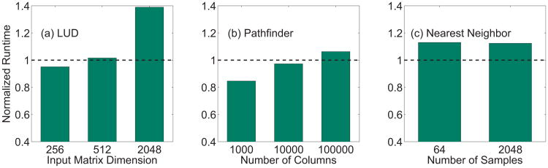
Automatic CPU-GPU memory transfer
CUDA Managed Memory
  Allocates a memory block like malloc
  Can be accessed from CPU and from GPU
    Easy on shared-memory designs (laptops, special HPC designs)
    “unified memory”
    Hard on computers where CPU and GPU have different memories
DMA-capable
Compiler and runtime decide when to move data
Rodinia benchmark,
Normalized to hand-coded speed
DOI 10.1109/HPEC.2014.7040988

Slide 27
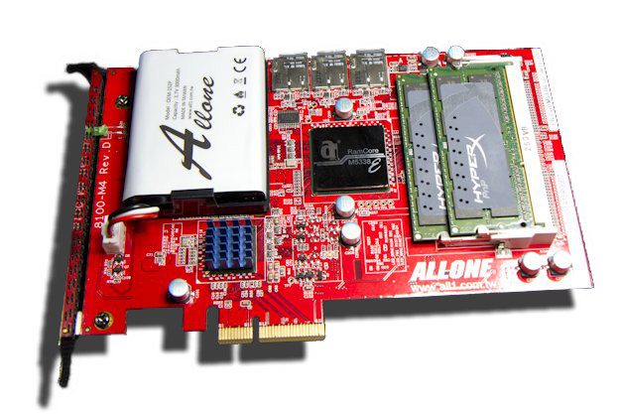
Battery-backed RAM
Battery-backed RAM is a form of disk
Faster than SSD, limited by bus speed
Requires power for memory refresh
Not truly persistent
Nothing like this was recently marketed. Replaced by HDDs with a Flash buffer for persistence.
Hybrid BBRAM/Flash
Speed of BBRAM
Battery for short-term persistence
SD card for long-term persistence
ALLONE Cloud Disk Drive 101 RAMDisk – 32GB capacity

Slide 28
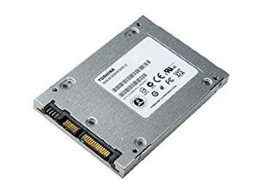
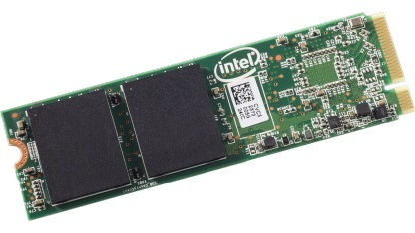
SSD - Solid Stage Disks storage
Emulation of «older» spinning disks
in terms of latency between RAM and spinning disks
limited lifetime is a major challenge
With NVMe
  e.g. M.2 SSDs
  Memory mapping
  DMA
  could make serial device
  driver model obsolete
Notes:
NVMe: non-volatile memory express

Slide 29
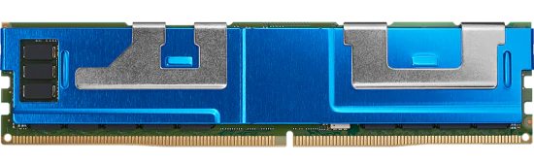
Persistent memory
Intel Optane persistent memory (discontinued)
  SSD package on the DRAM bus
  Can be partly volatile or partly persistent
    Reconfigure and reboot
  Faster than SSD, slower than DRAM
Drop-in replacement for RAM
  Bandwidth and access times
  similar to RAM (factor 2-4)
  Persistence of an NVMe disk
  Desired for object-oriented paradigms for decades, e.g. OODBs
  Too rare for a well-integrated programming paradigm
Notes:
https://software.intel.com/content/www/us/en/develop/topics/persistent-memory.html
PMDK: https://pmem.io/pmdk/?utm_source=ISTV&utm_medium=Video&utm_campaign=ISTV2019_ISTV1926

Slide 30
Persistent memory
Intel Optane persistent memory
  SSD package on the DRAM bus
  Can be partly volatile or partly persistent
    Reconfigure and reboot
  Faster than SSD, slower than DRAM
Using persistent memory
  ndctl: vmalloc
  opmctl: command line
  PMDK: libraries, C++ bindings
    Persistence
    Persistent smart pointers
    Transactions
    Synchronization
    Containers
Notes:
https://software.intel.com/content/www/us/en/develop/topics/persistent-memory.html
PMDK: https://pmem.io/pmdk/?utm_source=ISTV&utm_medium=Video&utm_campaign=ISTV2019_ISTV1926

Slide 31
Hard disks
Baseline for persistent storage
  Persistent
  Re-writable
  Moderate throughput
  Decent lifetime
head here
Average delay is 1/2 revolution
“Typical” average:
8.33 ms (3.600 RPM)
5.56 ms (5.400 RPM)
4.17 ms (7.200 RPM)
3.00 ms (10.000 RPM)
2.00 ms (15.000 RPM)
block I want

Slide 32
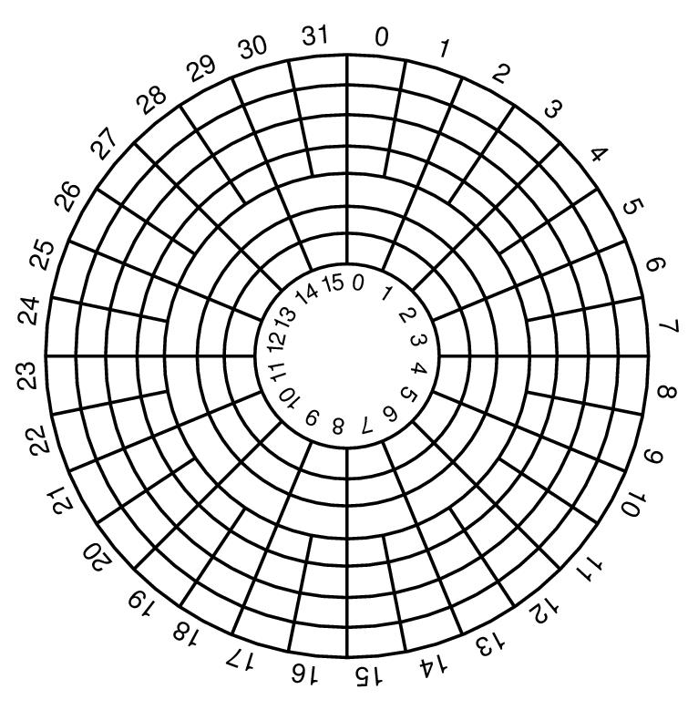
Disk storage
Partitions
  Location matters on spinning disks
    High sector density on outside of disk
    gives more throughput per rotation
Priorities between disks
  SCSI / SAS / FibreChannel disks
    Prioritized Ids – gives DMA priority
  PCIe-attached storage blades
    Non-standardized priority
Typical disk today
Zoned Constant-Area Velocity Disk
Spare sectors at the edge of each zone
note that some zCAV disks are slowing down a bit on outer cylinders:
reduces transfer errors

Slide 33
Disk storage
Filesystem considering location
  JFS
    PV - physical volume
      a disk or RAID system
    VG - volume group
      physical volumes with softraid policy
      enables physical move of disks
    LV - logical volume
      partition-like hot-movable entity on a VG
      can prefer specific disk regions, also non-contiguous
      another softraid layer
    FS – file system
      can grow and shrink
like Linux UUID for disks

Slide 34
HSM - Hierarchical storage management
See here: https://en.wikipedia.org/wiki/Hierarchical_storage_management
  Disk and tape
  Old and new disks
  Fast and slow disks
  Older ideas:
    Mixing low and high throughout sectors

Slide 35
Tape drives
Features
  High capacity (LTO9: 10 TB uncompressed/tape)
  Excellent price/GB (0,10 NOK)
  Very long lifetime (1970s tapes still working)
  Decent throughput due to high density (1 TB/hr)
  Immense latency
    Robotic tape loading
    Spooling
Famous example
  StorageTek Powderhorn
Google uses Tape for backup

Slide 36
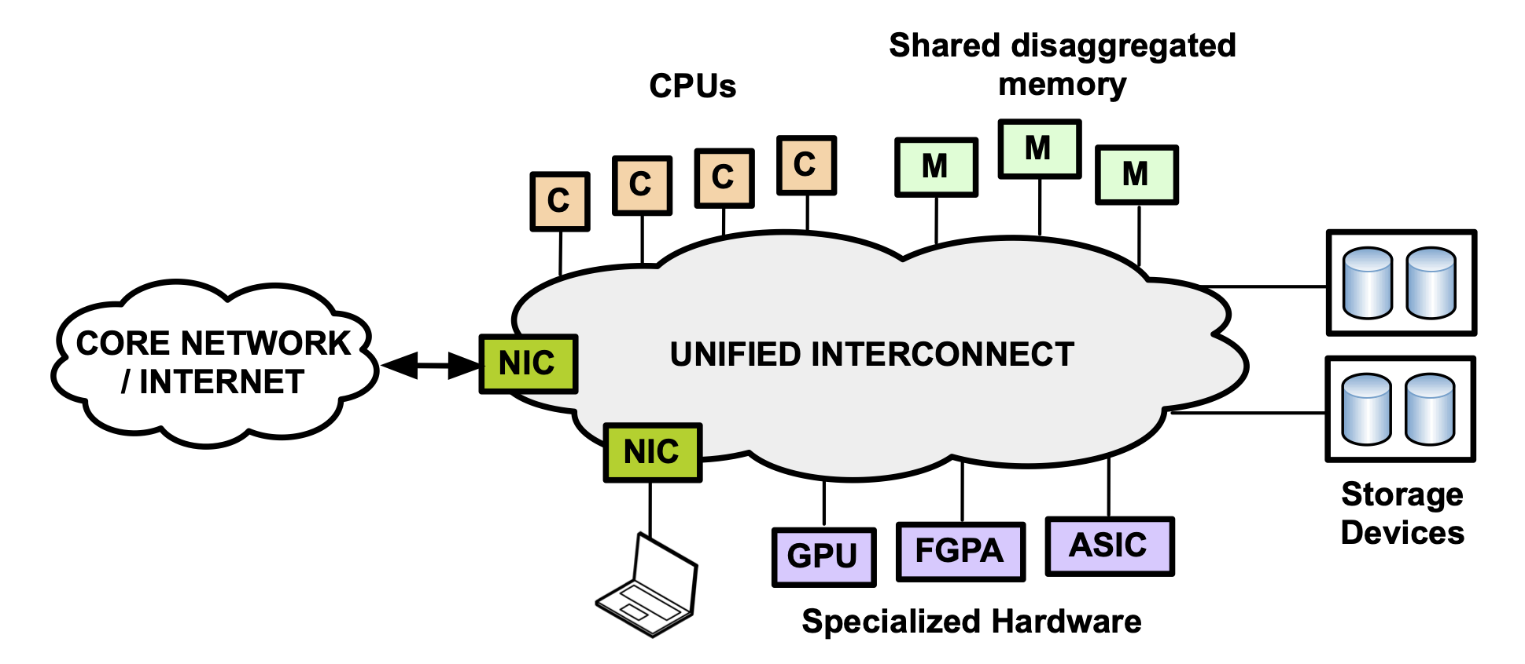
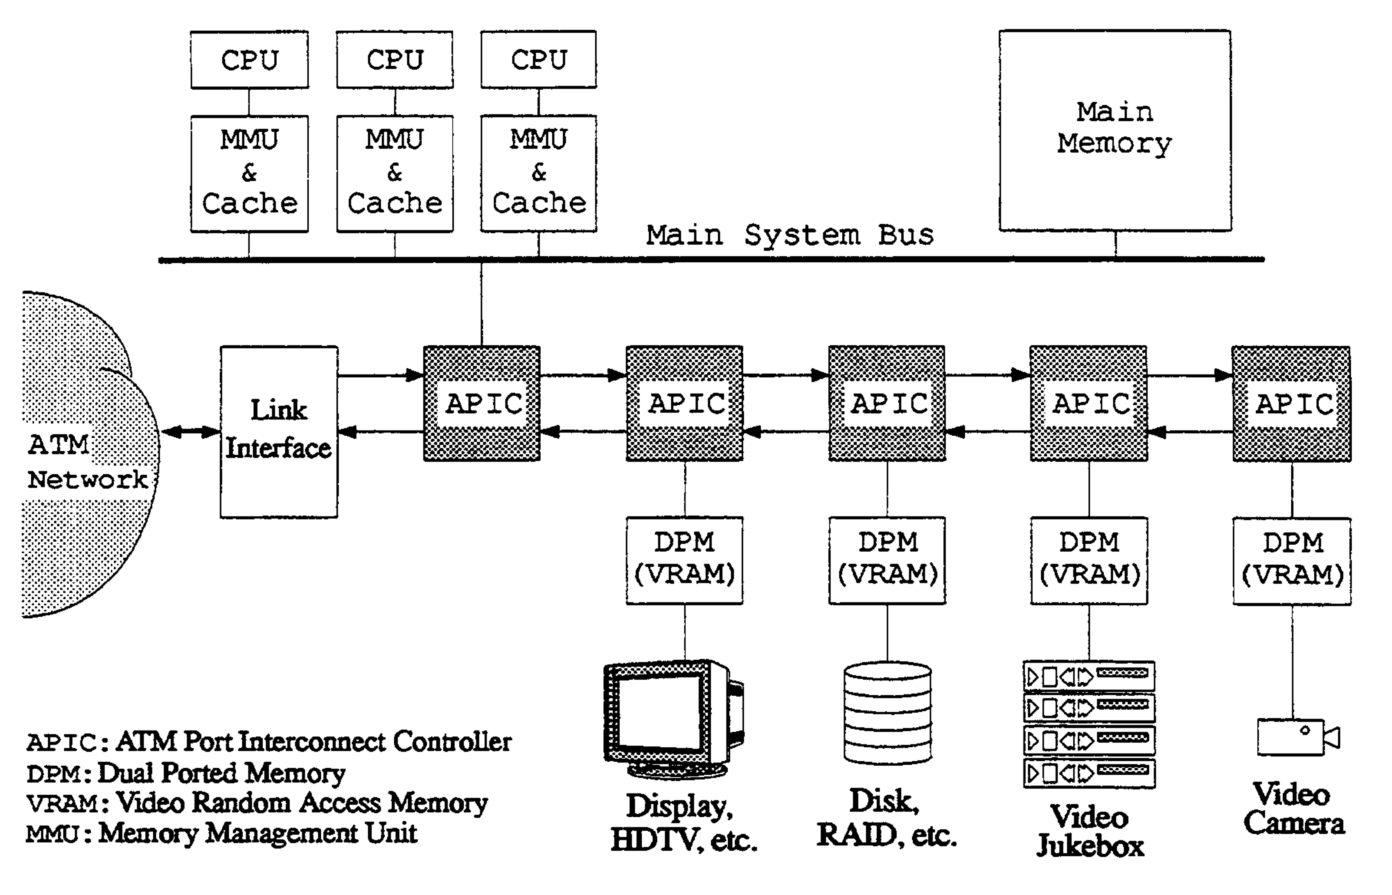
Resource disaggregation
Build computers from infrastructure inside a cluster
  Build virtual machine
  From physical hardware
  Page mapping across a network infrastructure
  Different attachment for every kind of device
  Memory integrated by an MMU
    MMU is part of the CPU
Ancient vision
  ATM as internal and external interconnect
  i.e. a unified interconnect
Network support for resource disaggregation in next-generation datacenters
Sangjin Han, Norbert Egi, Aurojit Panda, Sylvia Ratnasamy, Guangyu Shi, Scott J. Shenker
ACM HotNets 2013
Using an ATM interconnect as a high performance I/O backplanet
Z.D. Dittia, J.R. Cox, G.M. Parulkar
IEEE Hot Interconnects II, 1993

Slide 37
Remote memory
Distributed operating systems
  Remote memory access is deeply hardcoded into the OS
  Treat like NUMA systems with extreme speed differences

Slide 38
Network attached storage and storage area networks

Slide 39
Networked file systems
Remote file system
  e.g. NFS - Network file system, CIFS – Common Internet file system
  Limited caching, file locking, explicit mount like a separate file system
Distributed file system
  e.g AFS – Andrews file system, DFS – DCE file system
  Aggressive caching, unique global directory structure
Cluster file systems
  e.g. HadoopFS, GPFS – General parallel file systems, Lustre
  Sacrifice ease of use for bandwidth
P2P file systems
  e.g. OceanStore – files striped across peer nodes, location unknown
  Sacrifice speed (latency and bandwidth) for resilience and anonymity

Slide 40
Network cards
Interrupt reduction
Collating receives, DMA on receive
No sending DMA; but both Nagle and Pacing increase latency

Slide 41
Links
IXP memory http://www.ecs.umass.edu/ece/wolf/courses/ECE697J/docs/IXP1200%20HW%20Ref%20Manual.pdf

