Slide 1

Mobile Ecosystem
IN5060: Performance in distributed systems

Slide 2
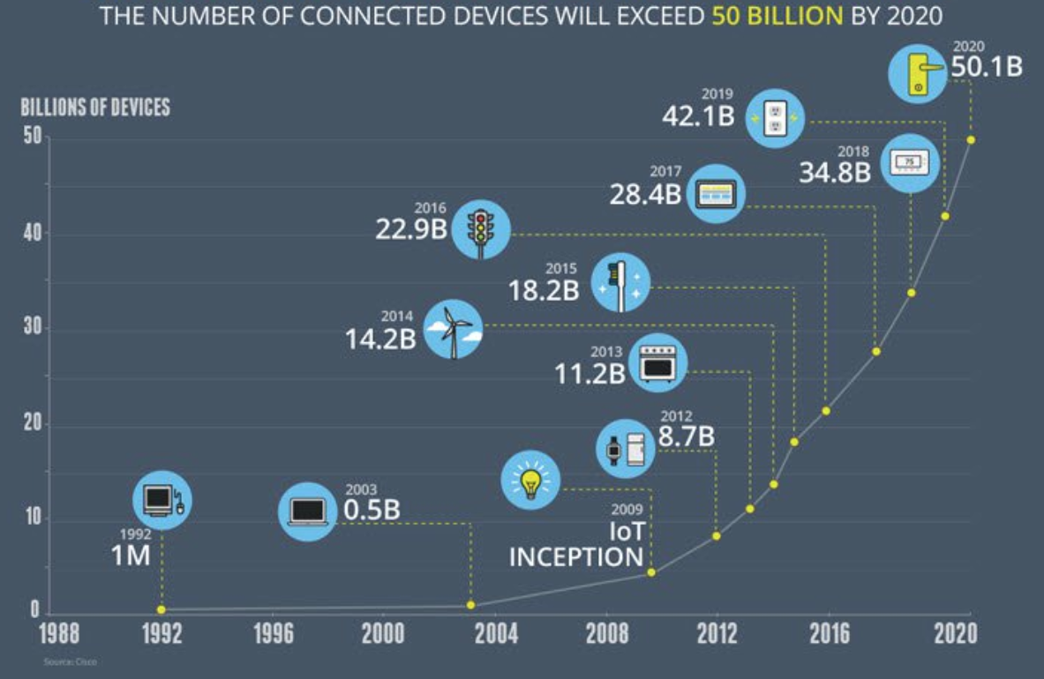
Growth in the number of connected devices

Slide 3
Connected devices in 2010

Slide 4
Connected devices today

Slide 5
How it all fits in 5G?

Slide 6
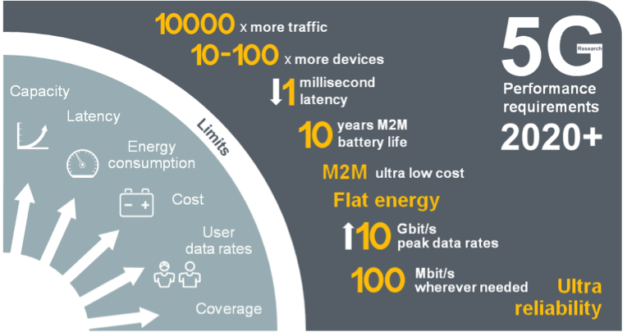
5G Mobile Network Expected Performance
Multi domain
performance
  Energy Performance
  Critical machine type
  of communications
  Global
  standard

Slide 7
Back in the day…

Slide 8
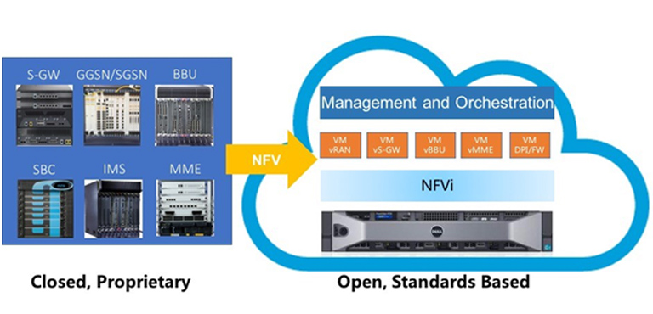
Network Flexibility: Virtualization

Slide 10
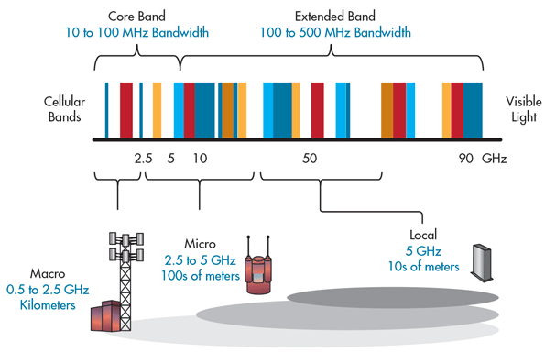
5G Bands and its impact on Cell size

Slide 11
Technologies for 5G

Slide 12
Connectivity for Massive IoT: Narrow Band IoT (NB-IoT)

Slide 13


Key Challenges for NB-IoT
Optimized for low power
Consumption 10+ years
battery consumption
NB-IoT
Extended long range coverage and Deep penetration indoor & outdoor
Low cost
devices
Billions of connections
150K per cell
Secure and reliable industry standards based
Integrates into cellular system Easy deployment

Slide 14
What is NB-IoT?
LPWAN radio technology standard developed by 3GPP to meet IoT application requirements
Builds on the LTE ecosystem, and can be deployed as a simple addition of new software to existing LTE infrastructure
  leading to fast development, scalibility, and global roaming
Includes state-of-the-art LTE security
  Identity management
  Authentication and authorization (embedded SIM)
  End to end encription of device data and signalling
Future feature growth for MBB and NB-IoT use cases

Slide 15
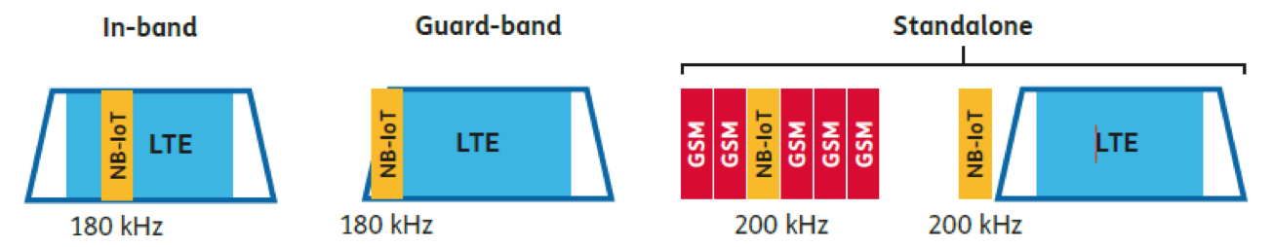
NB-IoT Specification
Spectrum Deployment
Modulation and Access | Modulation: BPSK/QPSK MAC: DL: OFDMA, UL: SC-FDMA
Peak data rate | DL: 250 kbps UL: 20 kbps
UE Max Tx Power | 23 dBm
Range | 1 km (urban), 10 km (rural)
Energy Efficiency | Power Saving Mode (PSM) extended Discontinuous Reception (eDRx)
Rel-13

Slide 16
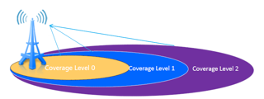
NB-IoT Coverage
Coverage Enhancement (CE) Techniques (w.r.t. LTE)
  Power Spectral Density boost: Tx power focused on smaller bands
  Repetitions: messages can be repeated up to 128 times
CE Level (CL) | # Repetitions
0 | [0-2]
1 | [4-16]
2 | [32-128]
CL0 = LTE coverage

Slide 17
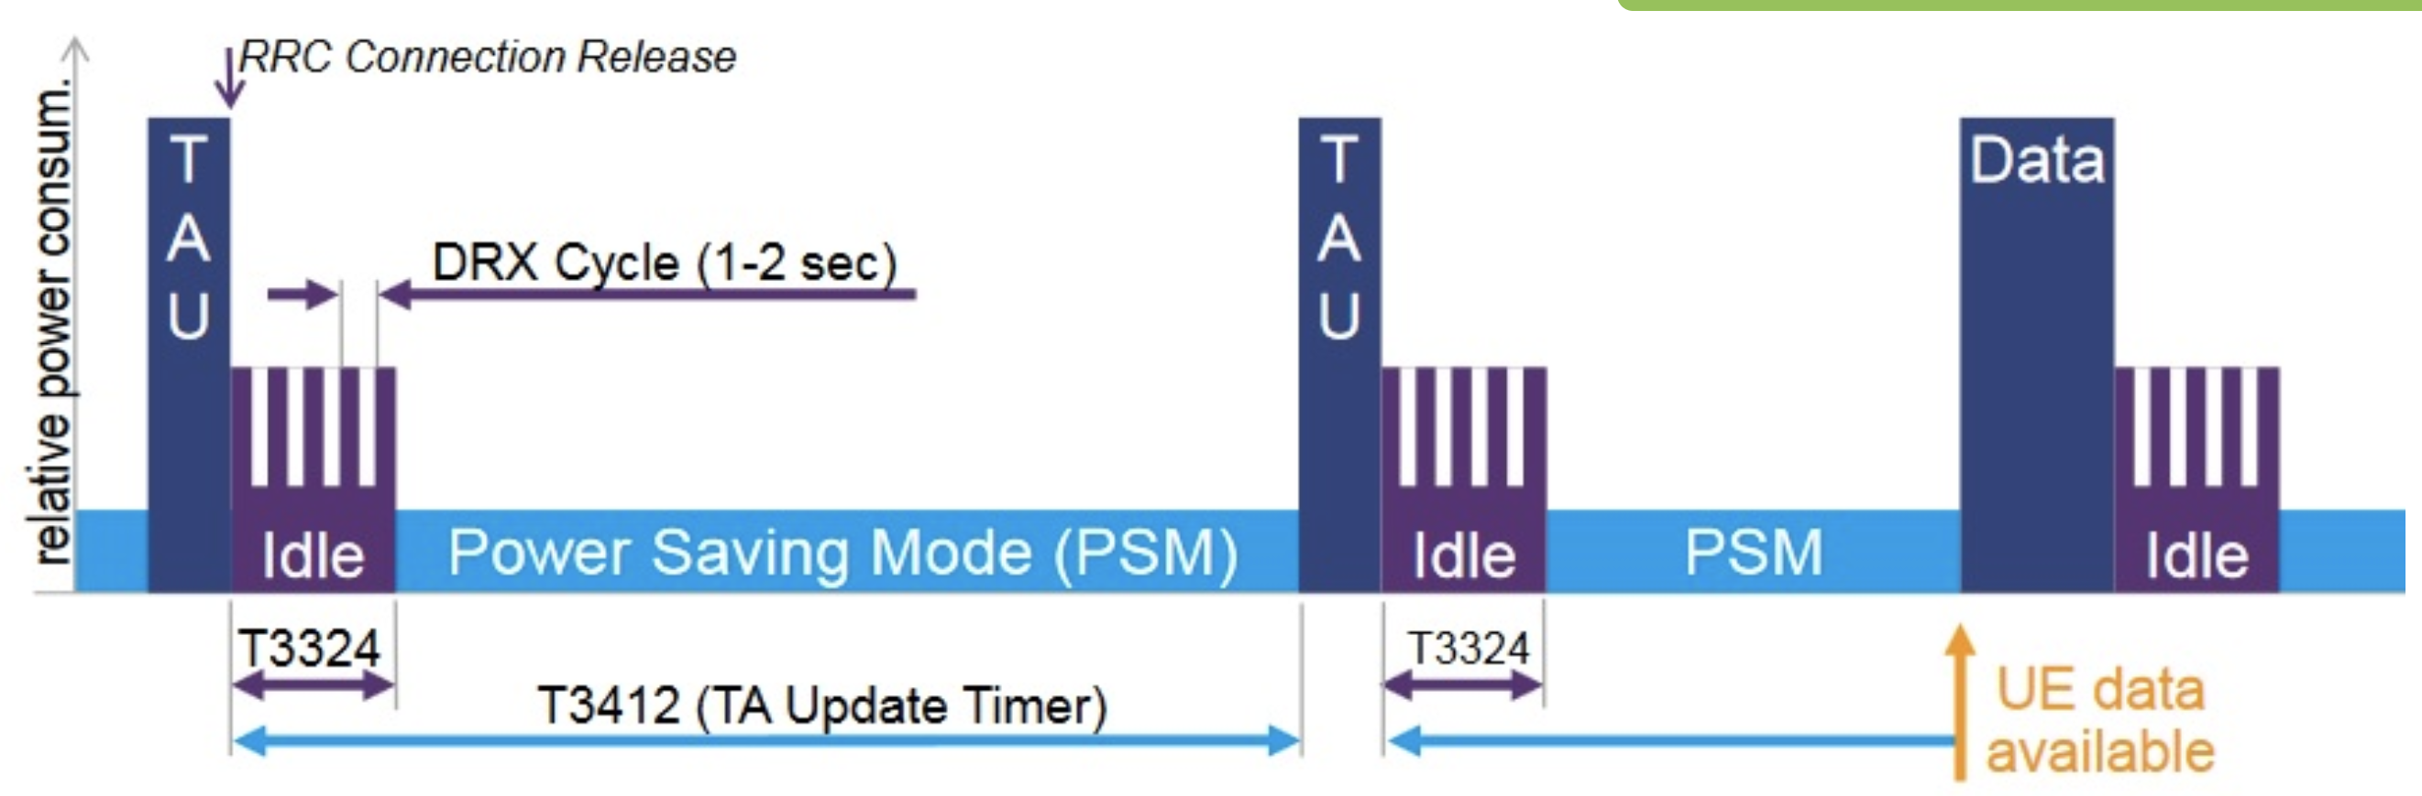
NB-IoT Power Savings
Power Saving Mode (PSM) is a power-off mode, in which the device nevertheless remains registered on the network
TAU: Tracking Area Update
RRC: Radio Resource Control
DRX: Discontinuous Reception

Slide 18
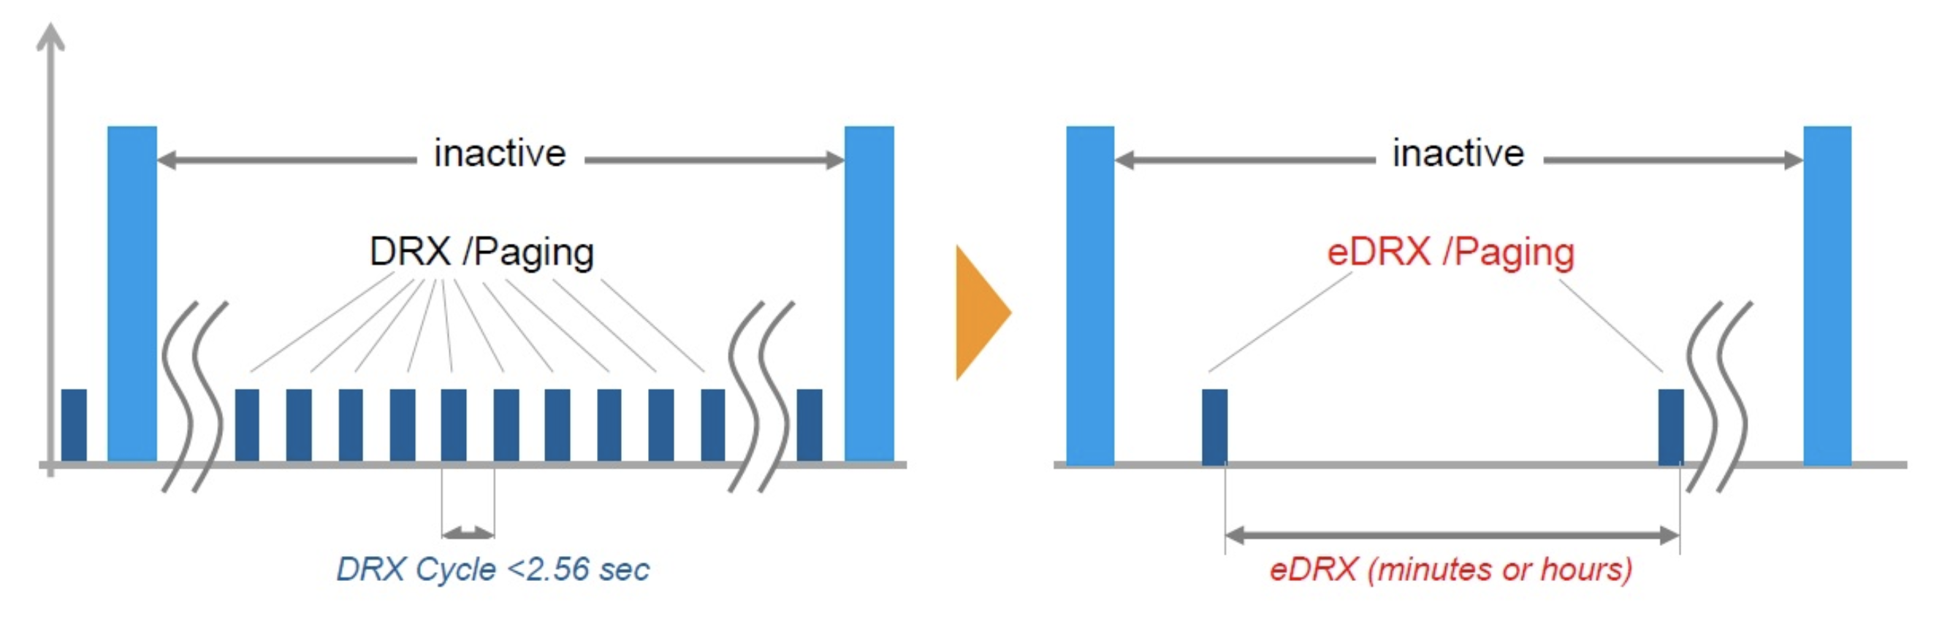
NB-IoT Power Savings
extended Discontinuous Reception (eDRx) mode allows you to significantly increase the period of time when the receiving path of the device is turned off.

Slide 19
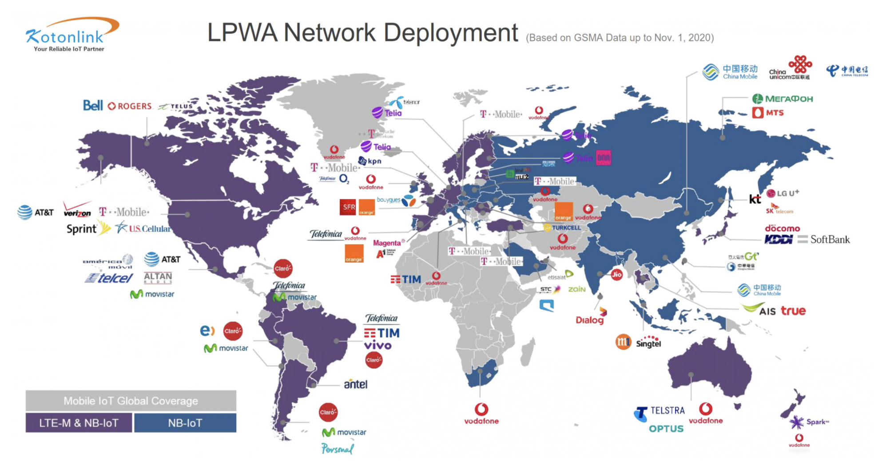
NB-IoT Deployment
*Source: https://www.kotonlink.com/NewsDetail/2434022.html

Slide 20
Coverage and Deployment Analysis of Narrowband Internet of Things in the Wild
K. Kousias, G. Caso, O. Alay, A. Brunstrom, L. De Nardis, M-G. Di Benedetto and M. Neri,
IEEE Communications Magazine, 2020 [Open Data]

Slide 21
NB-IoT field trials and testing
NB-IoT entered the market and is being globally deployed
Field trials and testing: deployment validation, issues pinpoint, optimization towards Beyond 5G
A complete field trial: Passive + Active measurements
Passive Measurements | Active Measurements
Scanner-based | UE (prototype)-based
Non-intrusive experiments | On-purpose experiments
DL coverage and RF conditions | Connectivity (RACH) and DL/UL performance
Technology + Network-wide overview: Multiple BSs, operators, and technologies | Focus on the “serving” technology, operator and BS

Slide 22
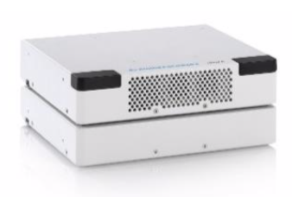

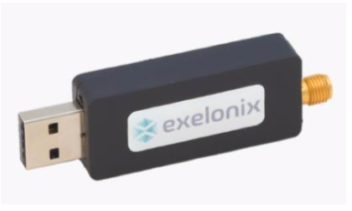
NB-IoT testing in Oslo
Extensive testing of NB-IoT deployment in Oslo
Passive + Active measurements under several conditions and scenarios, including:
  2 mobile network operators
  Indoor vs. Deep indoor
  Outdoor: Walking vs Driving
Analysis Focus
  NB-IoT and LTE coverage
  NB-IoT and LTE deployment
 | Scanner: R&S®TSMA6 System-in-a-box: PC and Scanner
 | UE: Exelonix NB-R410M Based on Qualcomm MDM9206 chipset

Slide 23
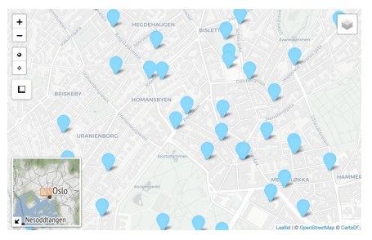
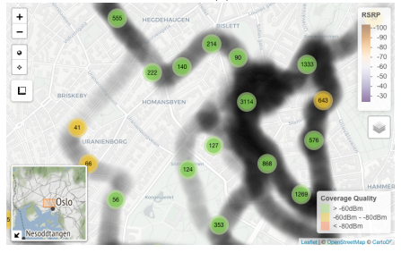
Coverage Maps and Data Visualization

Slide 24
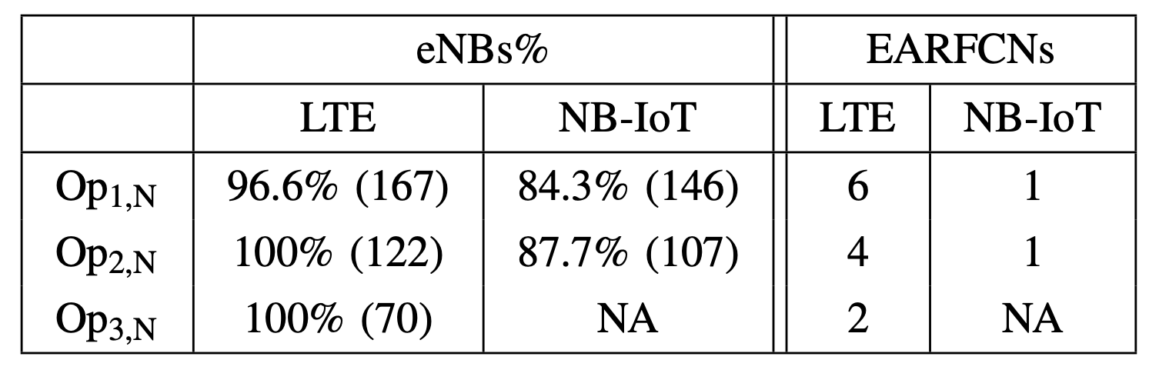
Network Deployment Strategy
Operators leverage the already existing LTE infrastructure for deploying NB-IoT, with no additional eNBs installed.
Nearly 86% of the detected LTE eNBs have been reconfigured for NB-IoT
Network deployment statistics with regard to number of eNBs per technology. eNBs% is defined as the ratio between the number of LTE/NB-IoT eNBs and the total number of eNBs. Absolute numbers are provided in parenthesis.

Slide 25
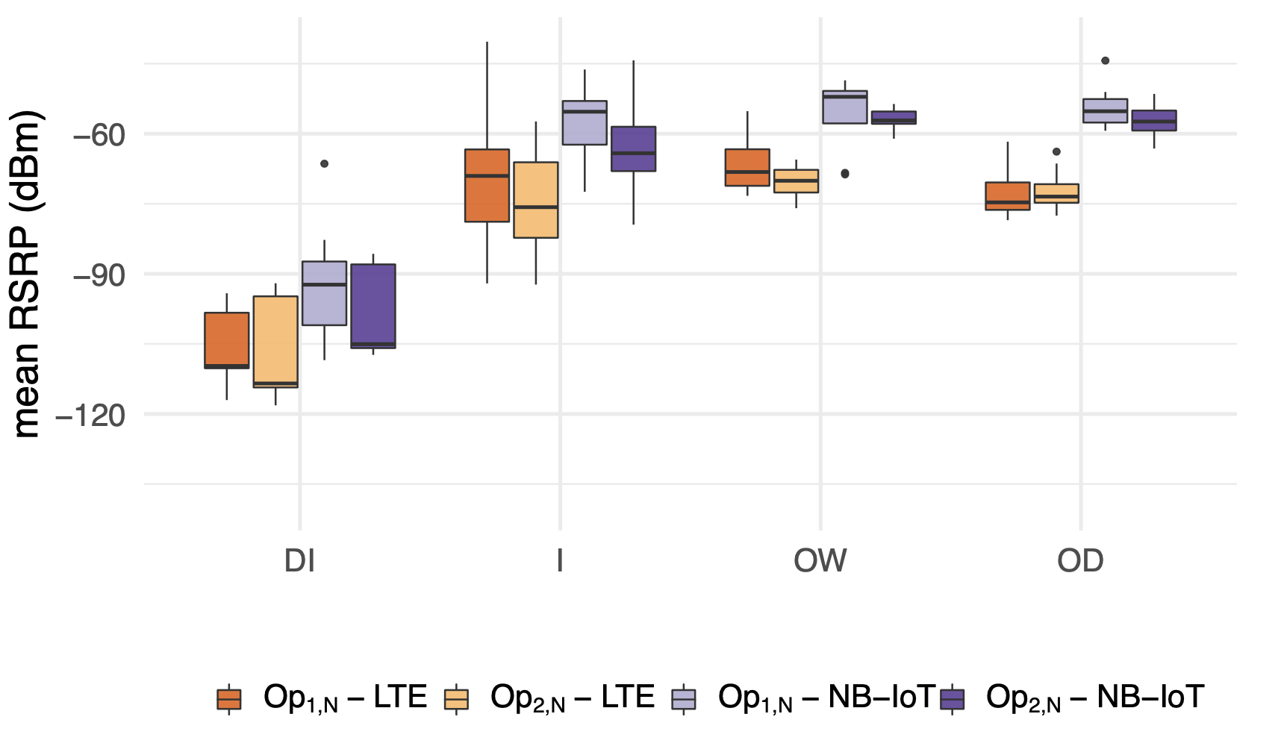
Radio Coverage
NB-IoT provides statistically significant RSRP boosts in line with the power boosting expected by 3GPP TS 36.104.
Op2,N has slightly lower RSRP compared to Op1,N.

Slide 26
Statistical Significance
Dunn’s test is used to identify significant difference between the means of two distributions for a given confidence interval
Null Hypothesis: There is no significant difference between the two distributions
Alternative Hypothesis: There is significant difference between the two distributions.
We report the p-values below — Significant codes: ‘*’ 0.05 , ‘**’ 0.01, ‘***’ 0.001
The lower the p-value, the more significant the difference is!

Slide 27
Operator and Technology comparison
Technology | DI | I | OW | OD
LTE | 0.2906 | 0.0274 * | 0.2480 | 0.3581
NB-IoT | 0.1594 | 0.00033 *** | 0.1152 | 0.1439
Operators have significant differences especially for Indoor scenarios.
Operator comparison
Operator | DI | I | OW | OD
1 | 0.0021 ** | 2.3e-09 *** | 0.0117 * | 1e-05 ***
2 | 0.0133 * | 1e-06 *** | 0.00078 *** | 1e-05 ***
Different technologies have significant differences for both operators.
Technology comparison

Slide 28
Scenario Comparison
Tech/ Operator | DI-I | DI-OW | DI-OD | I-OW | I-OD | OW-OD
LTE/1 | 4.8e-08 *** | 6.4e-06 *** | 0.00041 *** | 0.36033 | 0.30055 | 0.17261
LTE/2 | 5.7e-07 *** | 6.4e-06 *** | 3.6e-06 *** | 0.3686 | 0.5752 | 0.6063
NB-IoT/1 | 5.7e-07 *** | 3.1e-05 *** | 3.1e-06 *** | 0.5299 | 0.5299 | 0.9434
NB-IoT/2 | 3.1e-06 *** | 1.1e-06 *** | 1.6e-07 *** | 0.0492 * | 0.0442 * | 0.8244
Deep indoor has significant differences compared to other scenarios.

Slide 29
NB-IoT Coverage Modelling

Slide 30
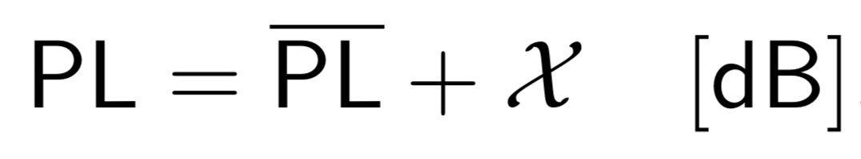
Coverage data ➜ Propagation modeling
Coverage data can be used to derive an empirical model of signal propagation, e.g., in terms of path loss (PL)
In short:
  PL tells how the signal power decreases on the cell (Tx) ➜ device (Rx) path
Realistic PL models are important: they are used in simulation-based studies (data are not always available and experiments are not always feasible…)
PL is usually modeled as:
Average
Deviation (random variable)

Slide 31
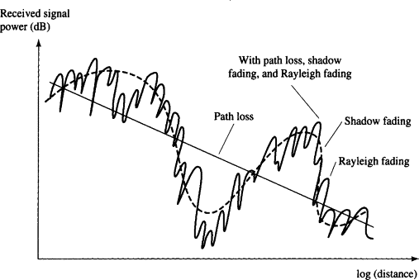
Fitting a model for NB-IoT
Let’s derive the PL model using the measurements from a single NB-IoT cell in our dataset (from an outdoor campaign)
Data, as always, need preprocessing:
  We need to average out signal deviation due to further factors (e.g., small-scale fading)
  Position of cells and measurements points are estimated (GPS) ➜ we need to limit the cell/device distance range under study

Slide 32
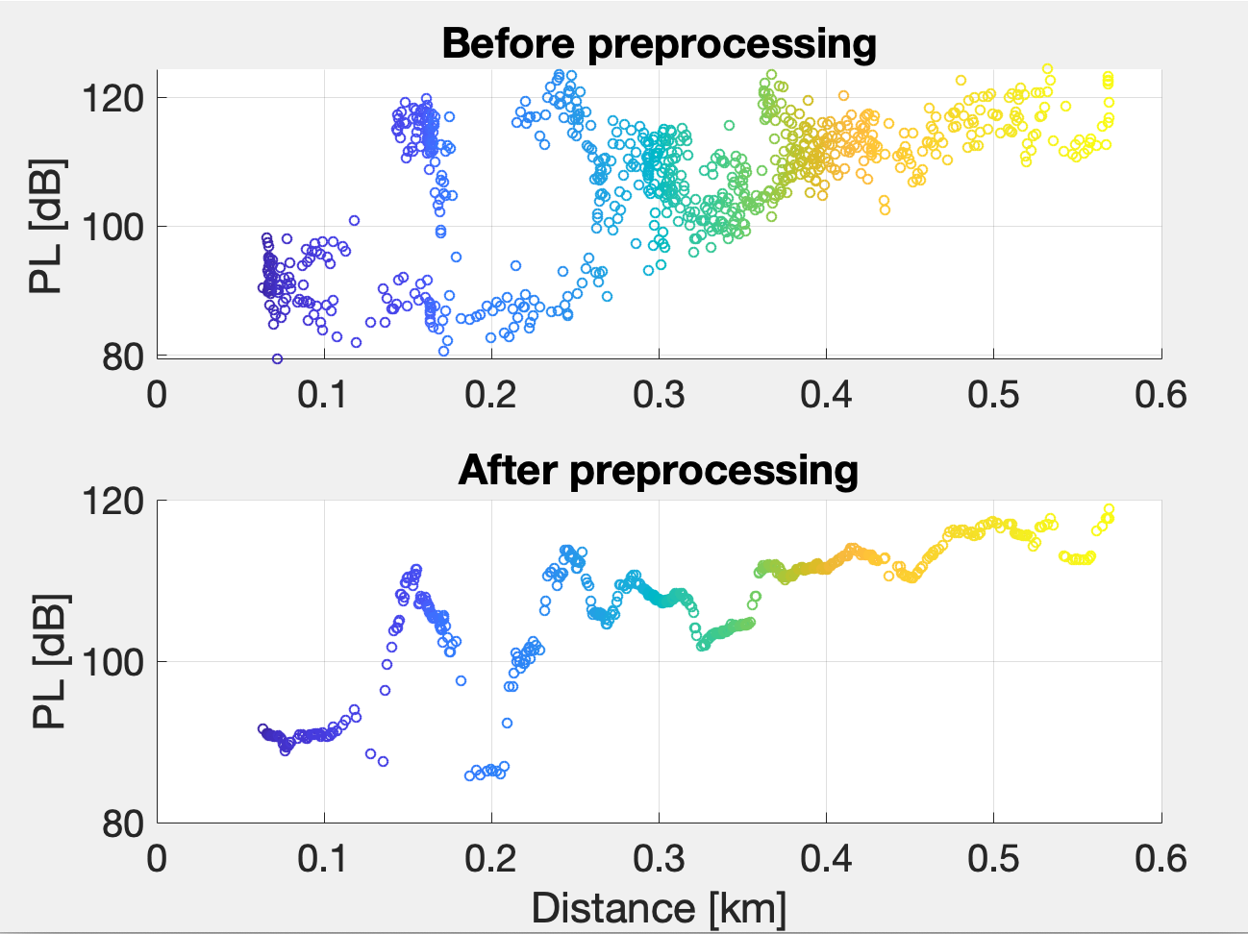
Fitting a model for NB-IoT
* W. C. Y. Lee, “Estimate of Local Average Power of a Mobile Radio Signal”, IEEE Trans. on Veh. Technol., Vol. 34, no. 1, 1985.

Slide 33
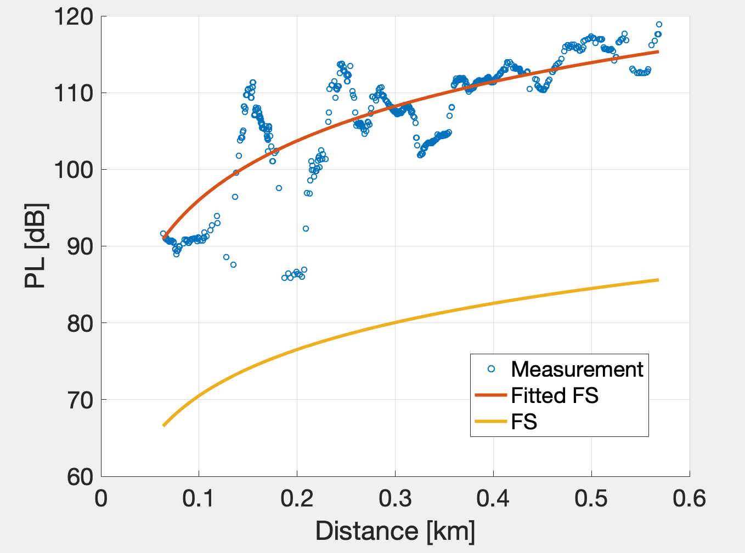
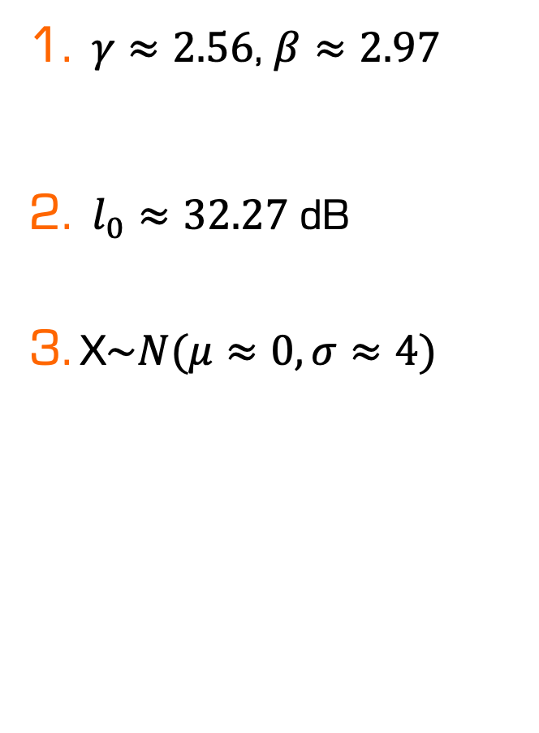
Fitting a model for NB-IoT
Now, we can fit via Least Squares the generalized FS on the cell
$γ≈2.56$, $β≈2.97$
$l_{0}≈32.27$ dB
X$\sim N(μ≈0,σ≈4)$
Higher than FS (indeed, the propagation is also non LoS (NLoS)
Fitted FS follows the measurements
Similar to FS!
Normal distribution approximates well the deviations from average PL, but is clearly not zero-mean for unfitted FS
FS underestimates PL

Slide 34
5G Coverage and Performance

Slide 35



From 4G to 5G Transition
Today – 4G Access
Device attaches to LTE/4G radio and Evolved Packet Core (EPC)
Early 5G – Non-Standalone
Device attaches to 5G-NR, which routes either via 4G Base Station to EPC, or direct to EPC
4G acts as control plane
5G Standalone
Device attaches to 5G-NR and 5G Core Network.
EPC
4G
5G-CN
5G

Slide 36
5G NSA field trials and testing
5G Non-Standalone (NSA) is being largely adopted for the rollout of 5G networks
It is key to investigate how 5G NSA performs in the wild
Large-scale measurement campaign on 5G NSA deployments for two Mobile Network Operators (MNOs) in Rome, Italy
Empirical analysis of the 5G coverage and application performance

Slide 37
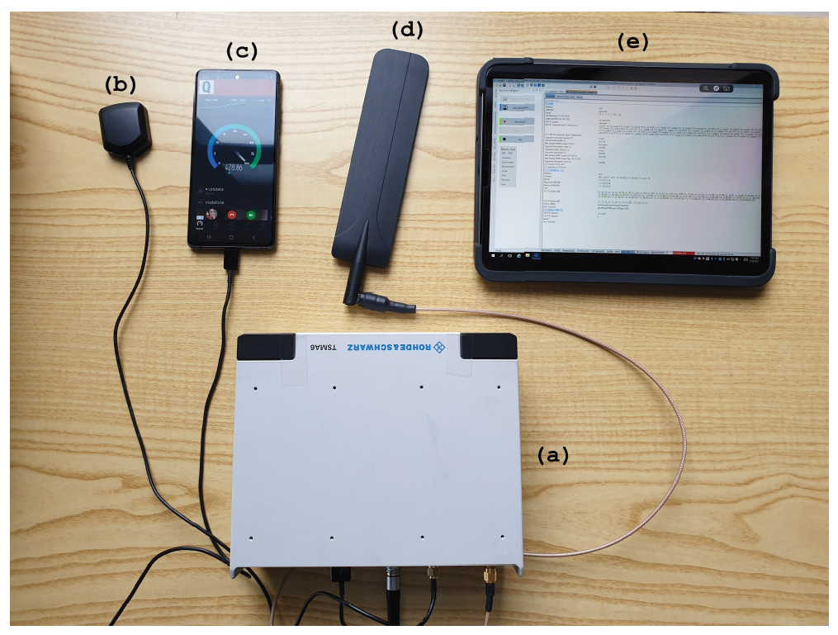
Measurement Setup and Campaign
Two MNOs (Op1 and Op2) offering 4G and 5G NSA connectivity in Rome, Italy
Measurements period: 7 weeks (12/2020-01/2021)
Campaign organized in “sub-campaigns”: different days, different times of the day and diifferent city areas and scenarios
Two scenarios under mobility:
  Outdoor Walking (OW): measurements while walking
  Outdoor Driving (OD): measurements performed while driving a car
R&S TSMA6 scanner
GPS antenna
Commercial 5G UE with R&S Qualipoc SW
RF antenna
R&S ROMES SW
Notes:
Outdoor Walking (OW): measurements while walking (average speed of 3.53 km/h, with stops due to traffic lights)
Outdoor Driving (OD): measurements performed while driving a car (average speed of 19.4 km/h, with stops due to traffic lights)

Slide 38
Passive Measurements
TSMA6 detects and decodes downlink control information
Measurements at PCI level (4G) and PCI/SSB level (5G) at each location
Dataset features:
  Spatial (Latitude and Longitude) and temporal (Time) information
  Carrier frequency identifiers
  Signal strength/quality indicators:
More features in the open-sourced dataset!
Notes:
4G: measurements on the Reference Signal (RS) sent by 4G PCIs
5G: measurements on the SSS, sent by 5G PCIs in the SSBs:
SS Reference Signal Received Power (SS-RSRP)
SS Reference Signal Received Quality (SS-RSRQ)
SS Signal to Interference and Noise Ratio (SS-SINR)

Slide 39
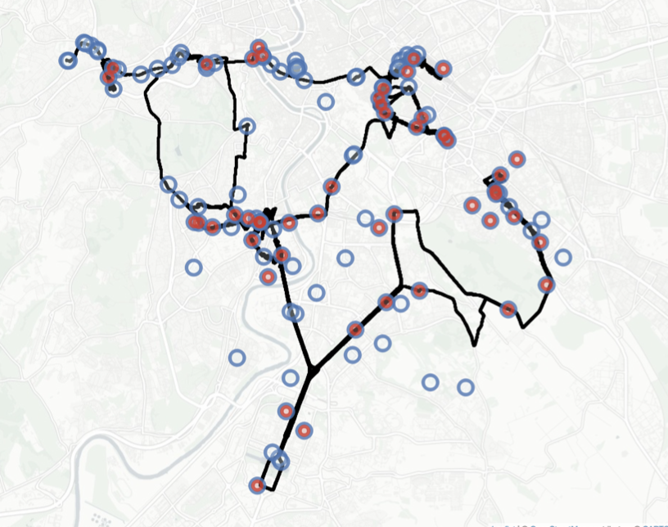
5G Deployment
Spatial representation of the RAN deployment for 𝑂𝑝1. The blue and red markers indicate the estimated positions of 4G eNBs and 5G gNBs, respectively. The black line in the background indicates the UE routes during the entire measurement campaign.

Slide 40
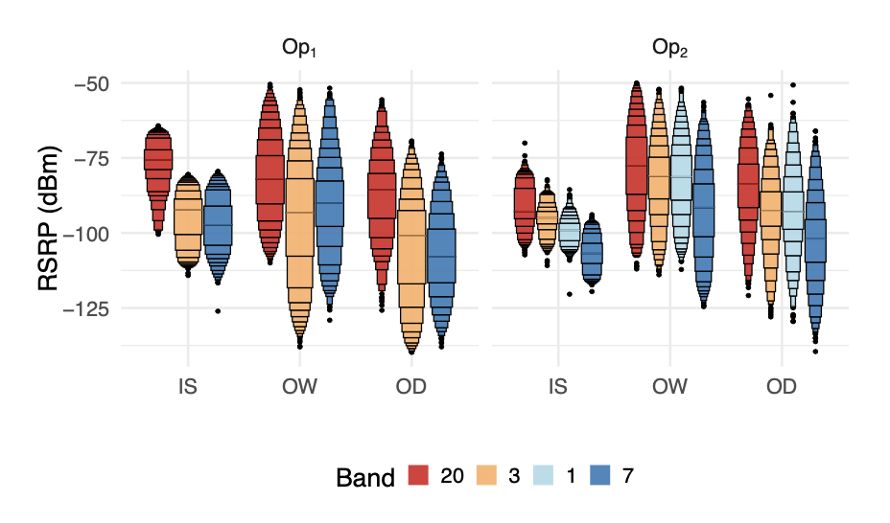
4G Coverage
Distribution of 4G RSRP [dBm] across carrier frequencies (in a letter-value plot format and order by highest to lowest frequency)

Slide 41
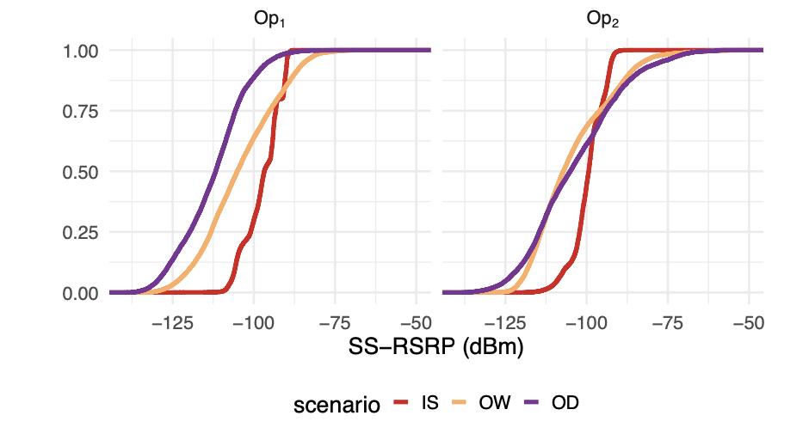
5G Coverage
Distribution of 5G SS-RSRP [dBm] (in an ecdf format), for 𝑂𝑝1 and 𝑂𝑝2 and grouped by scenario.

Slide 42
Behind the Doors:
NB-IoT and 5G Datasets

Slide 43
Data Sources
Coverage data:
  Each batch of samples sharing the same timestamp represents a single measurement point (in space).
  Each sample holds information for the UE - cell connection (e.g., GPS UE location, RSRP, RSRQ, SINR, cell identifiers, etc.)
Cell data:
  A separate set of data with additional information for each cell (e.g., GPS cell location, power, cell identifiers, etc.)

Slide 44
Preprocessing (1)
Missing Data:
  Handle missing data (if possible)
    Find and retrieve missing values using both data sources
Invalid Data (Requires domain knowledge):
  Look for outliers and extreme values
    Determine either extreme (of interest) behavior or measurement error

Slide 45
Preprocessing (2)
Merging Data:
  Merge the two data sources into a single cleaned dataframe
    Challenge: Define primary keys and secondary rules to break ambiguity
      For example, determine cell location using multiple GPS measurements. Due to measurement error, GPS values slightly differ.
        Solution: Mean/Median values, use additional information (e.g., vertical/horizontal estimation error)
Reshape/Summarize Data:
  Compute mean/std values for the metrics of interest (e.g., RSRP, RSRQ, SINR)
  Add external features to group the data (e.g., DI, I, OW, OD)
  Engineer new features to understand the data (e.g., distance to the cell)

Slide 46
Visualization
Data illustration with map visualization tools
  Pinpoint areas with low coverage at glance and view cell spatial distribution
  Can be generalized or expanded with new data
806 MHz
2662 MHz

Slide 47
Assignment

Slide 48
Dataset Statistics
Data is provided in a .csv file format
  Each sample represents a passive scan (i.e., given a location, a unique CellIdentity is reported alongside signal related information – next slide for a complete set of features):
  LTE and 5G:
    Indoor (106 sub-campaigns), for houses and multi-floor buildings
    Outdoor Walking (47 sub-campaigns), for outdoor while walking
    Outdoor Driving (37 sub-campaigns), for outdoor while on public transport
  NB-IoT:
    Indoor (21 sub-campaigns), for houses and multi-floor buildings
    Outdoor Walking (25 sub-campaigns), for outdoor while walking
    Outdoor Driving (34 sub-campaigns), for outdoor while on public transport

Slide 49
Features
Feature | Brief Description | Feature | Brief Description
Date | Measurement Date | eNodeB.ID | Unique eNodeB Identifier
Time | Measurement Time | Power | Power Received on the Entire Bandwidth [dBm]
Latitude | UE Latitude | SINR | Signal-to-Interference-plus-Noise Ratio [dB]
Longitude | UE Longitude | RSRP | Reference Signal Receive Power [dBm]
Speed | Moving Speed [Km/h] | RSRQ | Reference Signal Received Quality [dB]
EARFCN* | Band-Carrier Frequency | campaign | Name of the measurement campaign
Frequency | Carrier Frequency [MHz] | scenario | Scenario (DI/I/OS/OW/OD)**
PCI (NPCI) | Physical Cell Identifier | cellLongitude | Cell Longitude
MCC | Mobile Country Code | cellLatitude | Cell Latitude
MNC | Mobile Network Code | n_CellIdentities | # CellIDs per eNodeB
CellIdentity | Unique CellID Identifier | distance | Distance from the cell [m]
* EARFCN uniquely identify the LTE band and carrier frequency.
** Deep Indoor (DI)
Indoor (I)
Outdoor Static (OS)
Outdoor Walking (OW)
Outdoor Driving (OD)

Slide 50
What to evaluate
Coverage performance comparison
  Given a selected number of different campaigns, compare the coverage performance for different operators and different technologies (5G, NB-IoT and LTE).
  Given a selected number of different campaigns, compare the deployment strategies for different operators and different technologies (5G, NB-IoT and LTE).
  Given two or more campaigns at the same location (e.g., repetitions of indoor campaigns), show how the coverage changes over time. Is this change significant? (Do this for a given operator and for a given radio technology)

