Slide 1

IN5060
Performance in distributed systems
autumn course

Slide 2
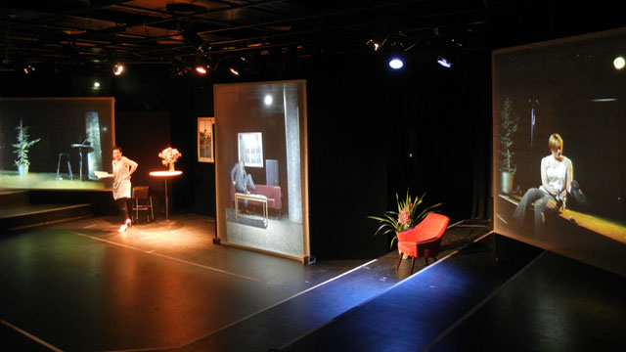
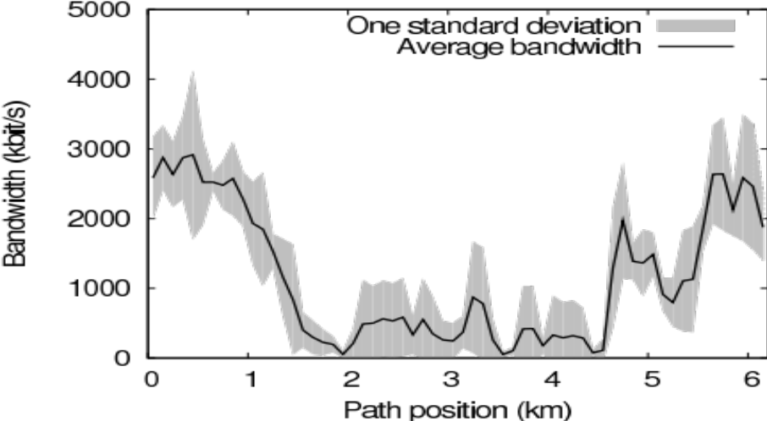
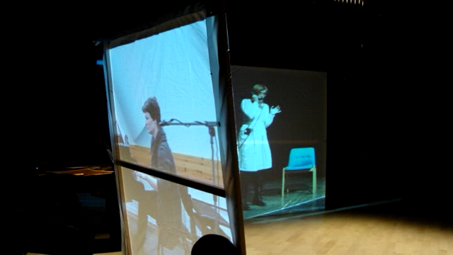
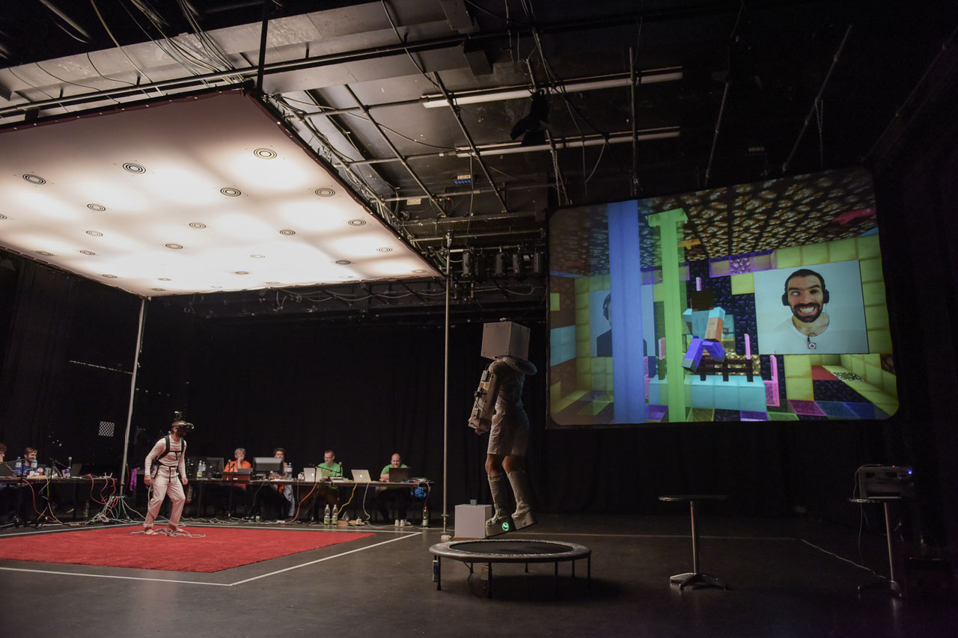
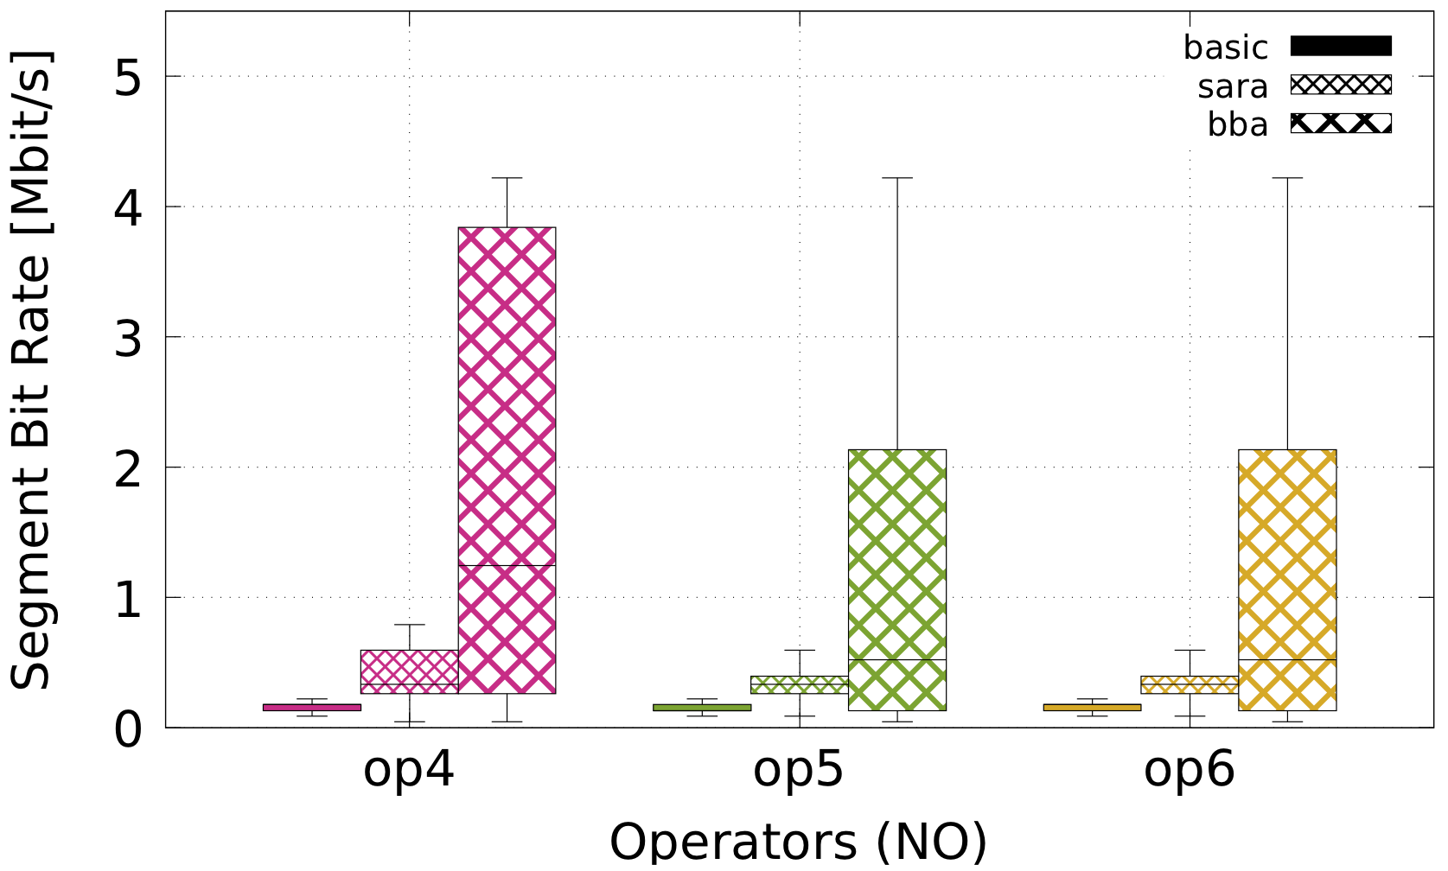
What is performance?
Stage performance
World Opera Production – Dec 2011 @ Tromsø
Download performance by position
HTTP Adaptive Streaming measured on Bygdøy Ferry, 2011
Download performance by operator & algorithm
HTTP Adaptive Streaming, MONROE nodes, 2018
Stage performance
Third Life Project@WUK – Oct 2015 @ Vienna

Slide 3
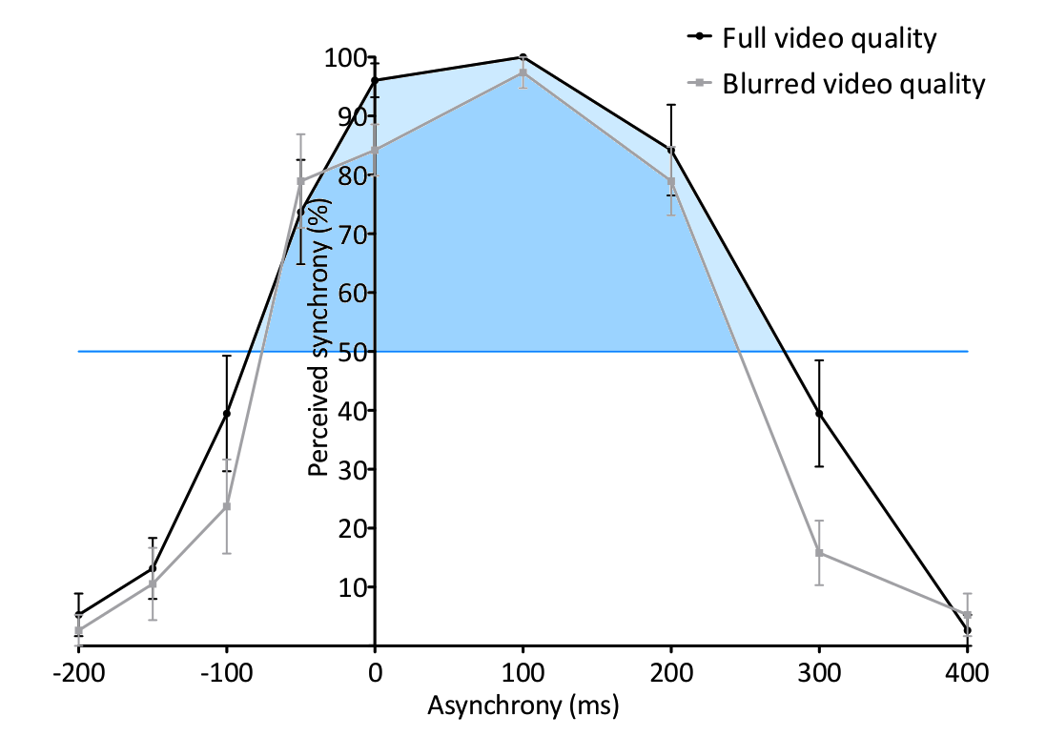
What is performance?
Stage performance
World Opera Production – Dec 2011 @ Tromsø
Download performance by position
HTTP Adaptive Streaming measured on Bygdøy Ferry, 2011
Users’ perception (Quality of Experience)
Asynchrony between audio and video, 2015
Download performance by operator & algorithm
HTTP Adaptive Streaming, MONROE nodes, 2018
Stage performance
Third Life Project@WUK – Oct 2015 @ Vienna

Slide 4
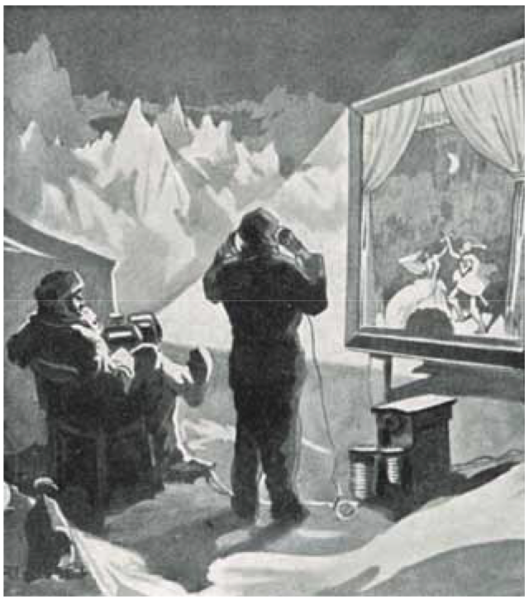
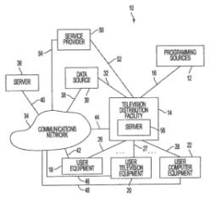


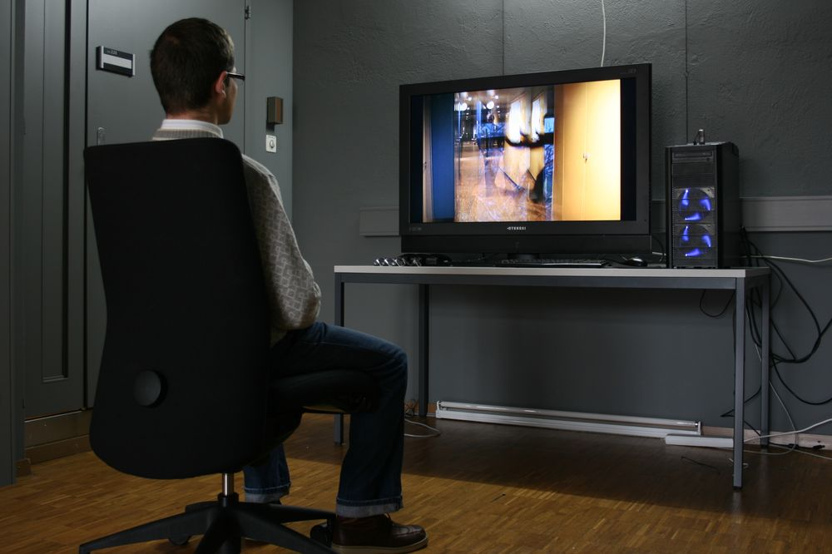
Performance in Distributed Systems
Engineers and researchers solve quantifiable challenges
Idea
Simulation Study
Prototype
Product
Deployment
Feedback

Slide 5
Performance in Distributed Systems
Engineers and researchers solve quantifiable challenges
Idea
Each step requires a
performance assessment
argue for feasibility
demonstrate practicality
study in a context
measure in the real world
assess value / success
Simulation Study
Prototype
Product
Deployment
Feedback
Performance Evaluation

Slide 6
Performance in Distributed Systems
Engineers and researchers solve quantifiable challenges
Idea
Simulation Study
Prototype
Simulation
Emulation
Analysis
Monitoring and measurement
User studies
Product
Deployment
Feedback
Performance Evaluation

Slide 7
Performance in Distributed Systems
Engineers and researchers solve quantifiable challenges
Idea
IN5060: experience 3 examples
Simulation Study
Prototype
Simulation
Monitoring and measurement
User studies
Product
Deployment
Feedback
Performance Evaluation

Slide 8
Performance in Distributed Systems
Designing and conducting studies
pre-considerations
avoiding bias
measurement points and methods
data reduction
drawing conclusions
Presentation and reporting
formulating a message
selecting relevant factors
extracting and interpreting statistics
dimension reduction
selecting presentation modes
Specific considerations
simulation
monitoring and measurement
user studies

Slide 9
Performance in Distributed Systems
This course is meant to provide you with a taste of the skills needed to become a good system analyst.
It will provide you with hands-on experience in system evaluation
It will (to some extent)
  confront you with the tradeoffs encountered when analysing real systems
  confront you with the error sources and red herrings encountered when analysing real systems

Slide 10

Performance in Distributed Systems
The course is based on the book “The Art of Computer Systems Performance Analysis: Techniques for Experimental Design, Measurement, Simulation, and Modeling” by Raj Jain
Reading the book is not mandatory
for the course or even necessary
to complete, but if you have a chance
to read it in full, do so!

Slide 11
System performance analysis
Who is interested in system performance analysis?
The HW designer (company) wants to show that their system is The Best and Greatest system of All Time
A software provider wants to show that their application is superior to the competition
The researcher wants to publish her papers, and needs to convince the reviewers that their research improves on the state- of-the-art
The system administrator or capacity planner needs to choose the system that is best suited for their purpose
The enthusiast who wants to see if the newest rage from <insert favourite multinational corporation> is real, or fake news
Notes:
Which of these is BIASed ?

Slide 12
System performance analysis
How do they achieve this?
  By providing a comparison between their own system and “the competition”
  The results need to be (or appear) convincing to the target audience
  This comparison is made through proper system performance analysis
The techniques of models, simulations and measurement are all useful for solving performance problems
  IN5060 will focus on experimental design, simulation, measurement and analysis
  For modelling try for instance: MAT-INF3100 - Linear Optimisation

Slide 13
Theory and practice
Theory / models will provide us with candidates for system optimisations
Deploying them in reality may in many cases lead to unforeseen results
  Hardware differences
  Non-deterministic systems
  Unexpected workloads
Key techniques needed
  Mathematical analysis
  Simulation
  Emulation
  Measurement
  User studies
  Measurement techniques (monitors)
  Data analysis (statistics and presentation)
  Experiment design

Slide 14
Performance in distributed systems
Key skills of performance analysts

Slide 15
Key skills needed – evaluation techniques
To select appropriate evaluation techniques, performance metrics and workloads for a system
You must choose which metrics to use for the evaluation
You must choose which workloads would be representative
What metrics would you choose to compare:
Two solid state disk (SSD) drives?
Two adaptive video streaming algorithms?
Two IaaS Clouds?

Slide 16
Key skills needed – measurements
Conduct performance measurements correctly
You must choose how to apply workloads to the system
You must choose how to measure (monitor) the system
Which type of monitor (or “probe”, hardware or software) would be suitable for measuring each of the following:
Number of instructions executed by a processor?
Context switch overhead on a multi-user system?
Response time of packets on a network?

Slide 17
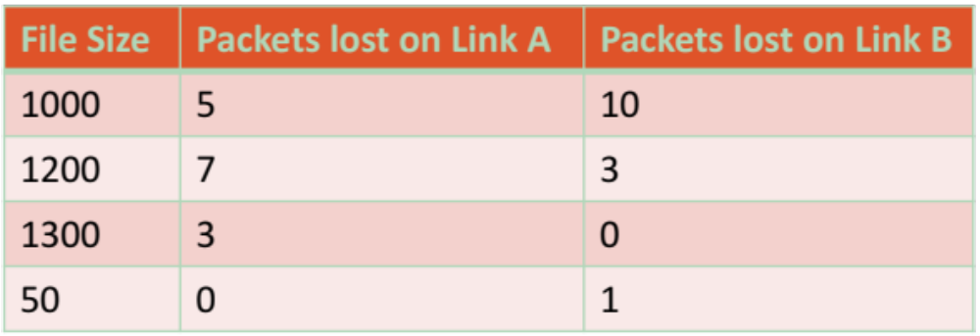
Key skills needed – proper statistical techniques
Use proper statistical techniques to compare several alternatives
Whenever there are non-deterministic elements in a system, there will be variations in the observed results
You need to choose from the plethora of available statistical methods in order to correctly filter and interpret the results
Which link is better?

Slide 18
Key skills needed – do not measure forever
Design measurement and simulation experiments to provide the most information with the least effort
You must choose the number of parameters to investigate
You must make sure you can draw statistically viable conclusions
The performance of a system depends on the following factors:
Garbage Collection Technique used: G1, G2, or none
Type of workload: editing, computing, or machine learning
Type of CPU: C1, C2, or C3
How many experiments are needed?
How do you estimate the performance impact of each factor?

Slide 19
Performance in distributed systems
Statistics 101

Slide 20


Why do we need statistics?
1. Noise, noise, noise, noise, noise!
445 446 397 226
388 3445 188 1002
47762 432 54 12
98 345 2245 8839
77492 472 565 999
1 34 882 545 4022
827 572 597 364
2. Aggregate data into meaningful information.
“Impossible things usually don’t happen.”
  - Sam Treiman, Princeton University
Statistics helps us quantify “usually.”

Slide 21
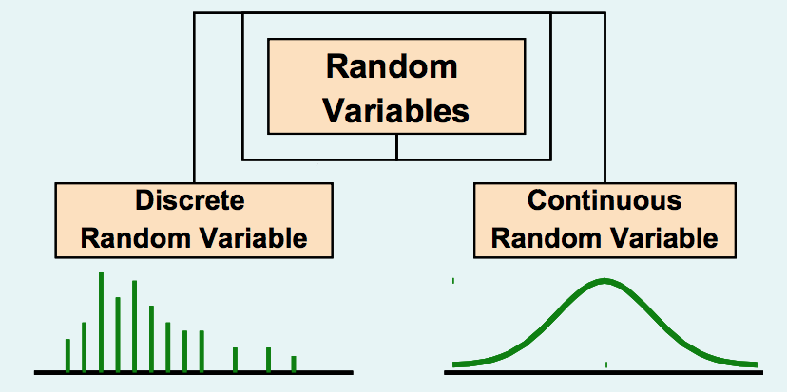
Basic Probability and Statistics Concepts
Independent Events:
  One event does not affect the other
  Knowing probability of one event does not change estimate of another
Random Variable:
  A variable is called a random variable if it takes one of a specified set of values with a specified probability

Slide 22
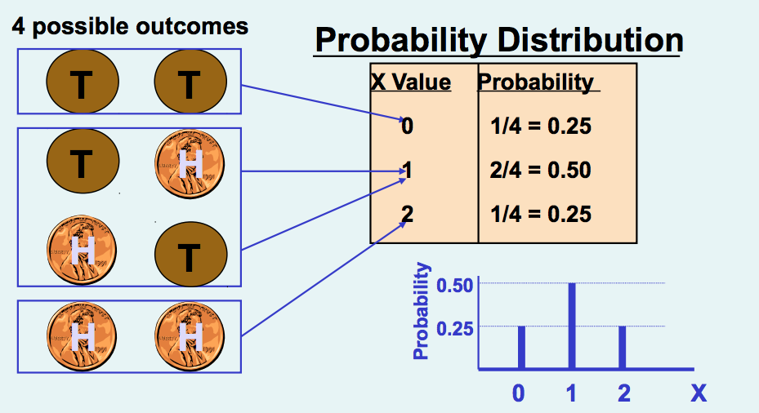
Discrete Random Variable Probability Distribution
Experiment: Toss 2 Coins. Let X = # heads

Slide 23
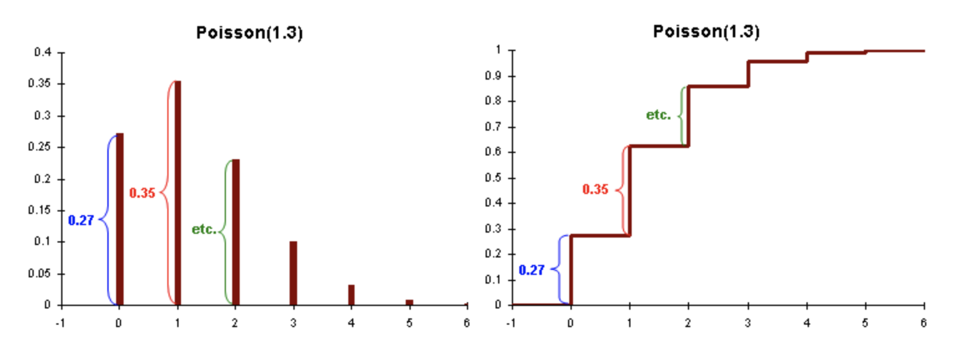
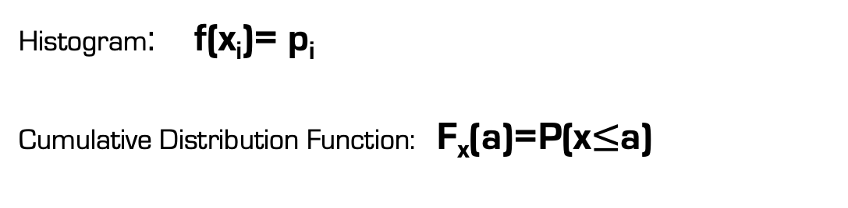
Histogram and Cumulative Distribition Function
Histogram: f(x_{i})= p_{i}
Cumulative Distribution Function: F_{x}(a)=P(x$≤$a)
Histogram
Cumulative Distribution Function (CDF)

Slide 24

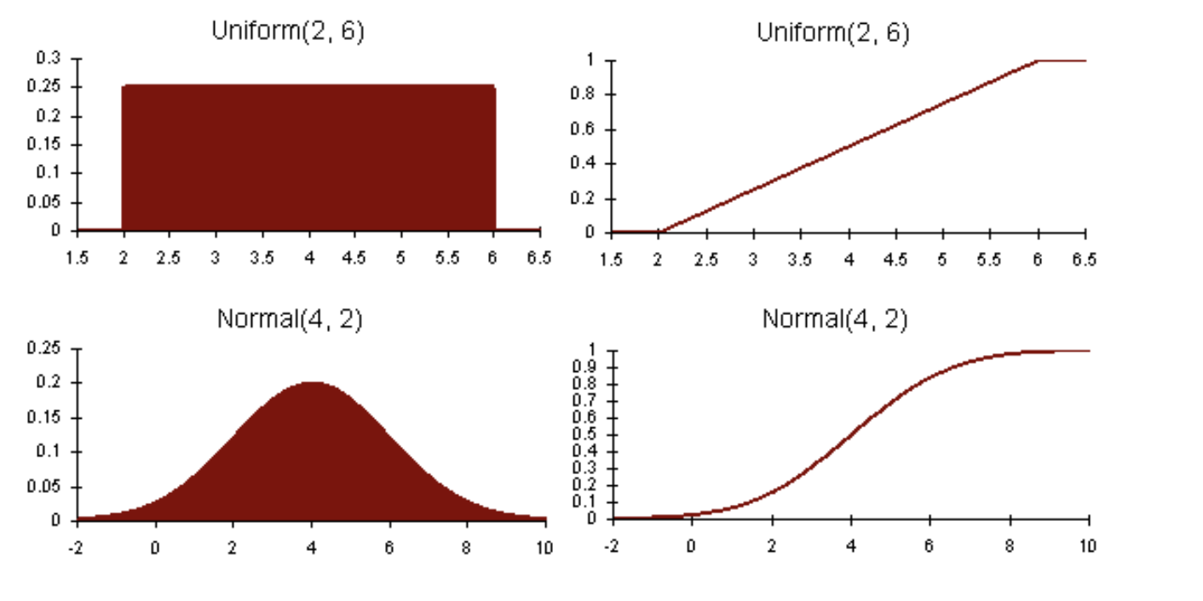
Continuous Random Variable Probability Density Function
      The probability density function, pdf, as .
      The cumulative distribution function, cdf, as .

Slide 25
Indices of central tendency
Summarizing Data by a Single Number
Mean – sum all observations, divide by number
Median – sort in increasing order, take middle
Mode – plot histogram and take largest bucket
Mean can be affected by outliers, while median or mode ignore lots of info
Mean has additive properties (mean of a sum is the sum of the means), but not median or mode

Slide 26
Relationship Between Mean, Median, Mode
mean
median
mode
modes
hist(x)
hist(x)
mean
median
no mode
hist(x)
(a)
mean
median
(b)
mode
mode
(c)
hist(x)
median
hist(x)
median
mean
mean
(d)
(d)

Slide 27
Summarizing Variability
“Then there is the man who drowned crossing a stream
with an average depth of six inches.” – W.I.E. Gates
Summarizing by a single number is rarely enough
→ need statement about variability
Frequency
Frequency
mean
mean
Response Time
Response Time
  If two systems have same mean, tend to prefer one with less variability

Slide 28
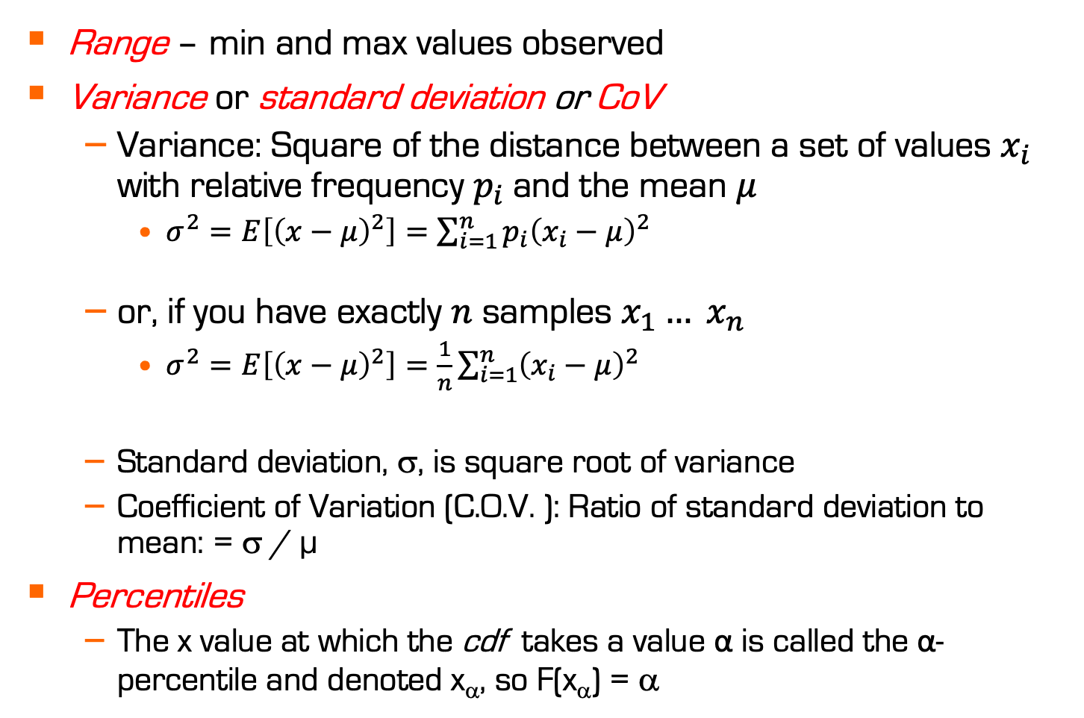
Indices of Dispersion
Range – min and max values observed
Variance or standard deviation or CoV
  Variance: Square of the distance between a set of values $x_{i}$ with relative frequency $p_{i}$and the mean $μ$
    $σ^{2}=E\left[{\left(x−μ\right)}^{2}\right]=\sum_{i=1}^{n}{p_{i}{\left(x_{i}−μ\right)}^{2}}$
  or, if you have exactly $n$ samples $x_{1}… x_{n}$
    $σ^{2}=E\left[{\left(x−μ\right)}^{2}\right]=\frac{1}{n}\sum_{i=1}^{n}{{\left(x_{i}−μ\right)}^{2}}$
  Standard deviation, σ, is square root of variance
  Coefficient of Variation (C.O.V. ): Ratio of standard deviation to mean: = σ / µ
Percentiles
  The x value at which the cdf takes a value α is called the α-percentile and denoted x_{α}, so F(x_{α}) = α
Notes:
This variance formula only if the distance between your X-values is not constant. If you have nothing else than a set of samples X, you divide by the number of samples N instead.
If you have a really large dataset and you must compute the variance from a subset of them, you must divide by N-1 instead. This is called sample variance.
Standard deviation is in the same unit as the original measurements. It is therefore easier to interpret when you want to illustrate, for example, the mean and dispersion side-by-side.

Slide 29
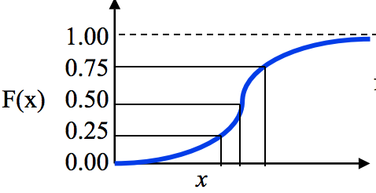
Indices of Dispersion
10- and 90-percentiles
(Semi-)interquartile range (SIQR)
  Q1, Q2 and Q3

Slide 30
Determining Distribution of Data
Additional summary information could be the distribution of the data
  Ex: Disk I/O mean 13, variance 48. Ok. Perhaps more useful to say data is uniformly distributed between 1 and 25.
  Plus, distribution useful for later simulation or analytic modeling
How do determine distribution?
  Plot histogram
For more formal testing: statistical comparison of
CDF (Komolgorov-Smirnov test ) or PDF (Chi-square test)
The Art of Computer Systems Performance Analysis, pp. 460-465

Slide 31
Comparing Systems Using Sample Data
“Statistics are like alienists – they will testify for
either side.” – Fiorello La Guardia
The word “sample” comes from the same root word as “example”
Similarly, one sample does not prove a theory, but rather is an example
Basically, a definite statement cannot be made about characteristics of all systems
Instead, make probabilistic statement about range of most systems
  Confidence intervals

Slide 32
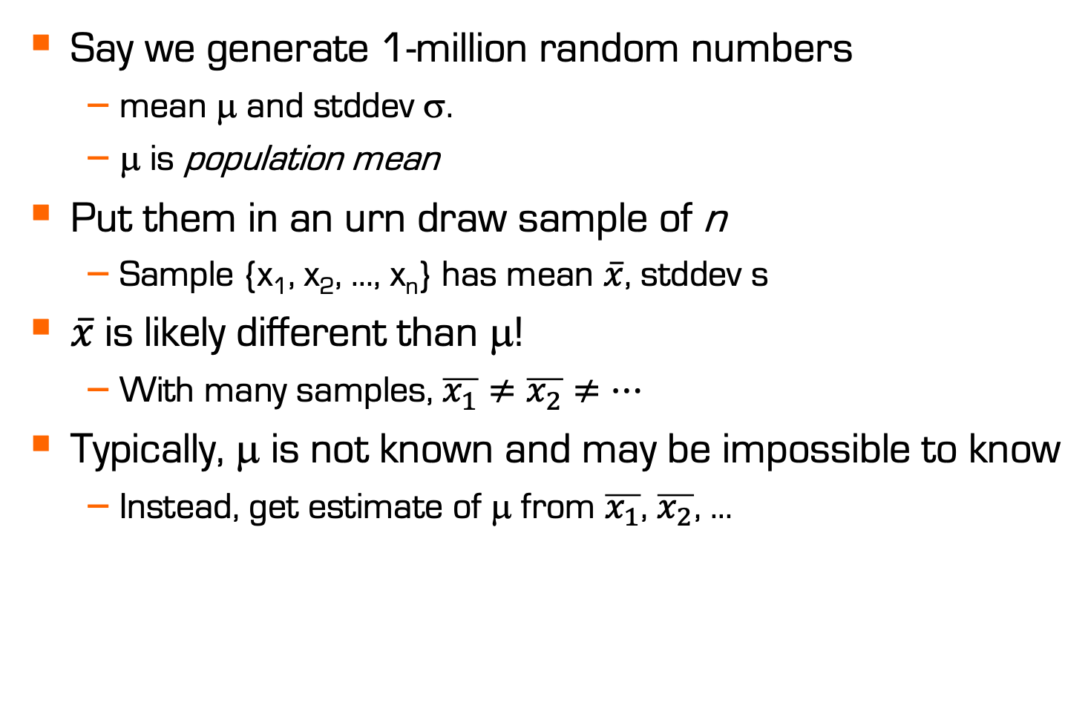
Sample versus Population
Say we generate 1-million random numbers
  mean μ and stddev σ.
  μ is population mean
Put them in an urn draw sample of n
  Sample {x₁, x₂, …, x_{n}} has mean $\overline{x}$, stddev s
$\overline{x}$is likely different than μ!
  With many samples, $\overline{x_{1}}≠\overline{x_{2}}≠…$
Typically, μ is not known and may be impossible to know
  Instead, get estimate of μ from $\overline{x_{1}}$, $\overline{x_{2}}$, …
Notes:
It is hard to find the real mean of the data (population mean), requires infinitely many experiments, we rather get samples and derive statistics.
Each sample mean is an estimate of the population mean.

Slide 33
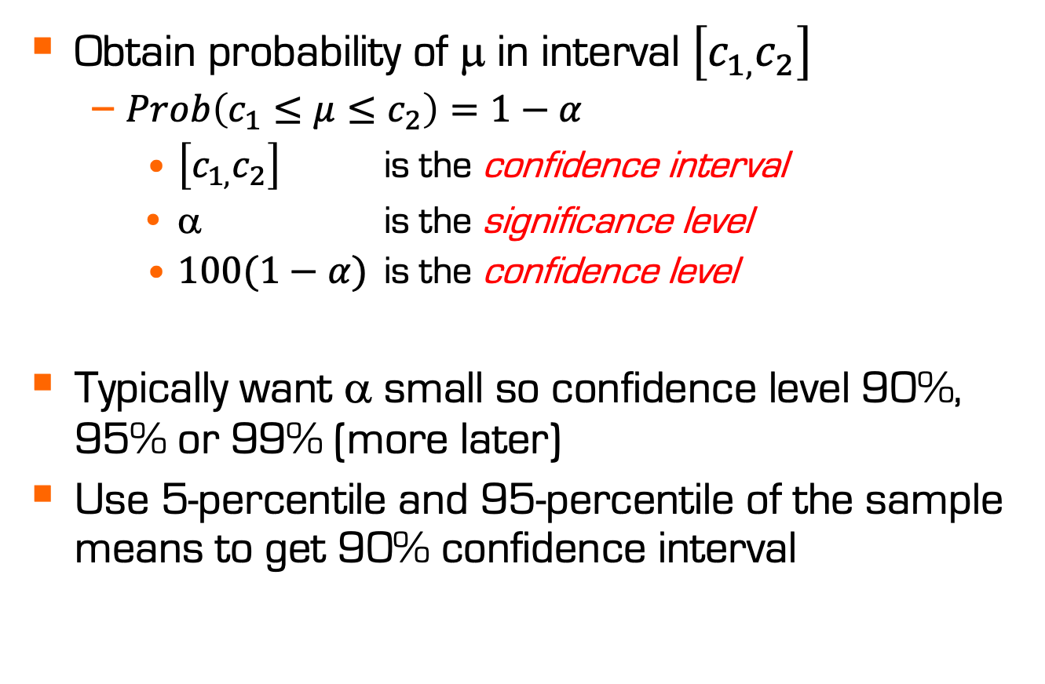
Confidence Interval for the Mean
Obtain probability of μ in interval $\left[c_{1,}c_{2}\right]$
  $Prob\left(c_{1}≤μ≤c_{2}\right)=1−α$
    $\left[c_{1,}c_{2}\right]$ is the confidence interval
    α is the significance level
    $100(1−α)$ is the confidence level
Typically want α small so confidence level 90%, 95% or 99% (more later)
Use 5-percentile and 95-percentile of the sample means to get 90% confidence interval
Notes:
So, perfectly finding the mean by sampling is impossible … but perhaps we can approximate its value with a certain confidence?

Slide 34
Meaning of Confidence Interval
For a 90% confidence level, if we take 100 samples and construct the confidence interval for each sample, the interval would include the population mean in 90 cases.
μ
f(x)
Sample Includes μ?
1 yes
2 yes
No
… ...
Total yes >100(1-α)

Slide 35

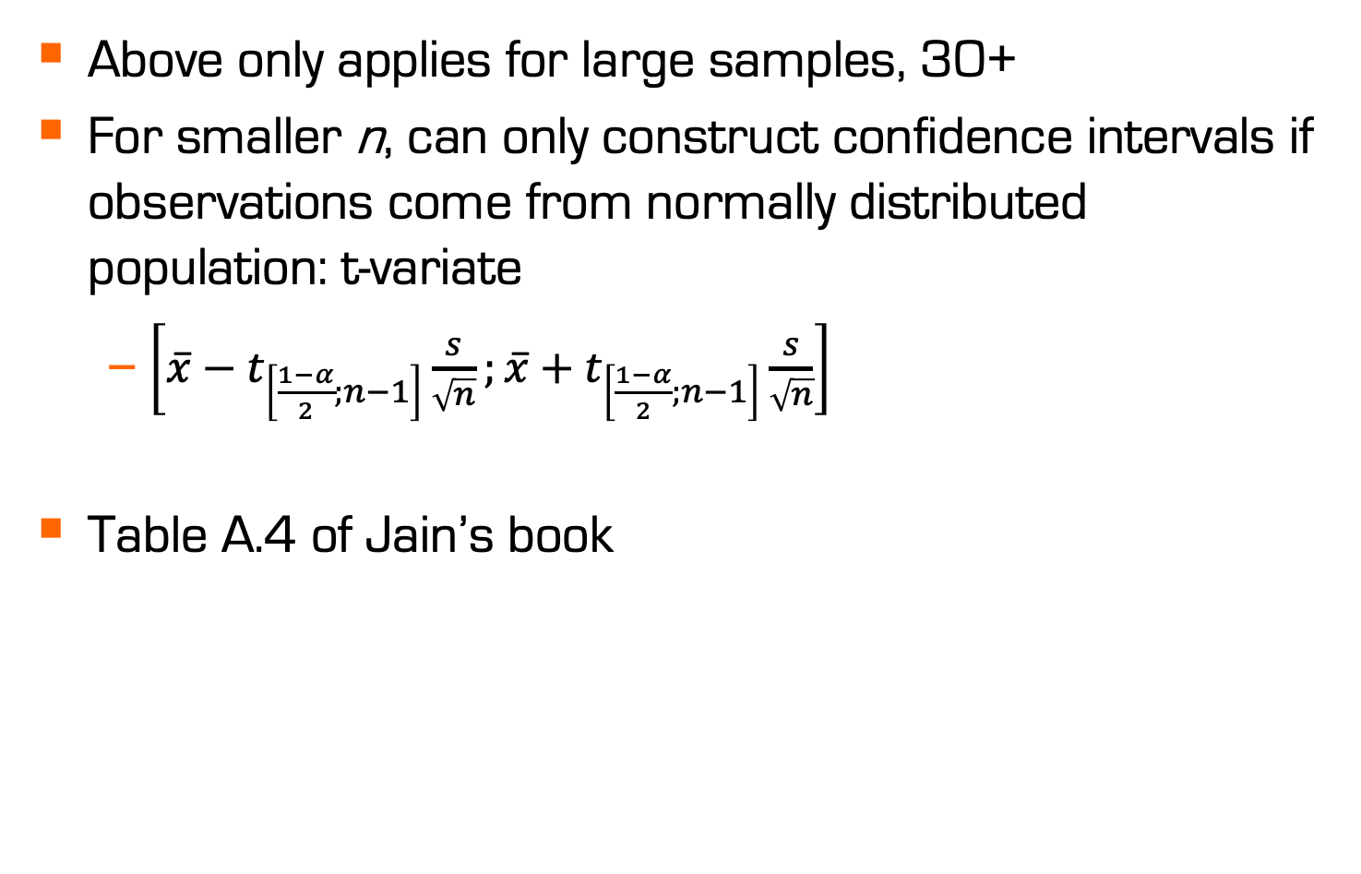
What if n not large?
Above only applies for large samples, 30+
For smaller n, can only construct confidence intervals if observations come from normally distributed population: t-variate
  $\left[\overline{x}−t_{\left[\frac{1−α}{2};n−1\right]}\frac{s}{\sqrt{n}};\overline{x}+t_{\left[\frac{1−α}{2};n−1\right]}\frac{s}{\sqrt{n}}\right]$
Table A.4 of Jain’s book
$\overline{x}$: sampled mean
s: sampled standard deviation
n: number of samples
$t_{\left[\frac{1−α}{2};n−1\right]}$: tabulated value of the student-t distribution

Slide 36
What Confidence Level to Use?
Often see 90% or 95% (or even 99%), but…
Example:
  Lottery ticket $1, pays $5 million
  Chance of winning is 10⁻⁷ (1 in 10 million)
  To win with 90% confidence, need 9 million tickets
    No one would buy that many tickets!
  So, most people happy with 0.01% confidence

Slide 37
Performance in distributed systems
Performance is an art

Slide 38
Performance evaluation is an art
Like a work of art, a successful evaluation cannot be produced mechanically
Every evaluation requires an intimate knowledge of the system and a careful selection of methodology, workloads and tools.
Example of the need for knowledge: know your tradeoffs
“Bufferbloat” is a term used when greedy, loss-based TCP flows probing for bandwidth fill up a large FIFO queue leading to added delay for all flows traversing this bottleneck.
To mitigate this, aggressively dropping timer-based AQMs or shorter queues are recommended.
What do you sacrifice by reducing the size of the queue?

Slide 39
Performance evaluation is an art
A major part of the analyst’s “art” is:
defining the real problem from an initial intuition, and
converting it to a form in which established tools and techniques can be used, and
where time and other constraints can be met
Two analysts may choose to interpret the same measurements in two different ways, thus reaching different conclusions

Slide 40
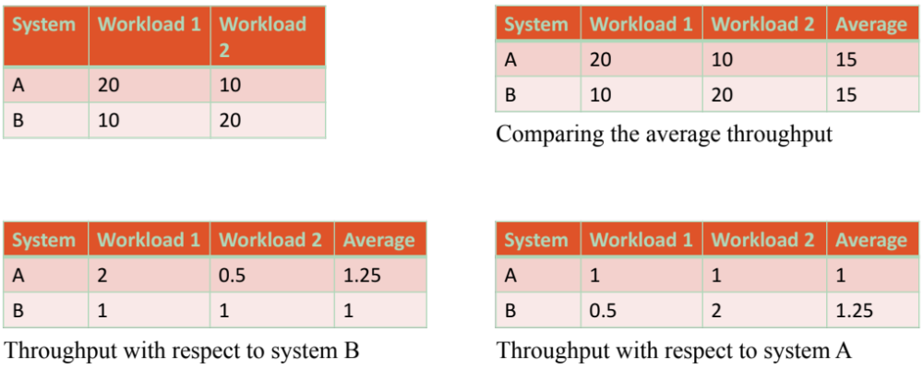
Performance evaluation is an art
The throughputs of two systems A and B were measured in transactions per second. The results were as follows:
This is called a ratio game. It is not appropriate for objective analysis, but useful for propaganda.

Slide 41
Performance evaluation is an art
The throughputs of two systems A and B were measured in transactions per second.
The results were as follows:

Slide 42
Performance in distributed systems
Real-world examples

Slide 43
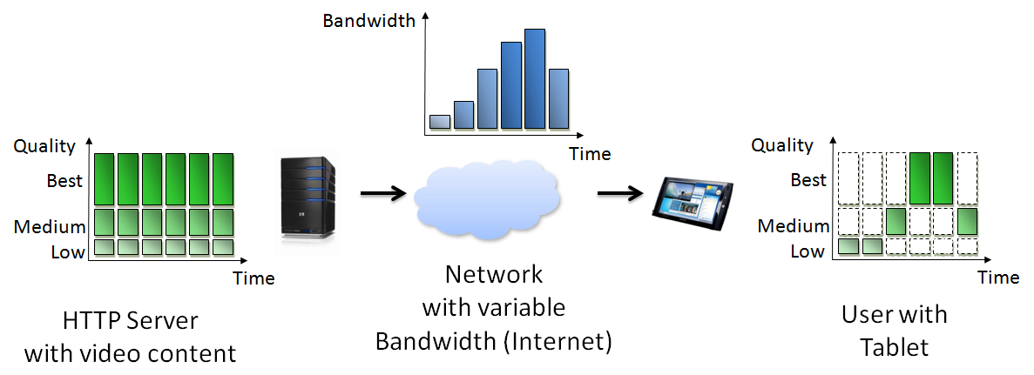
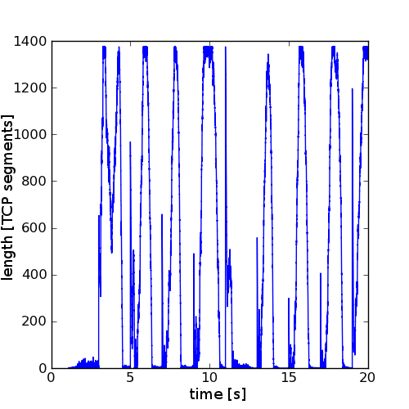
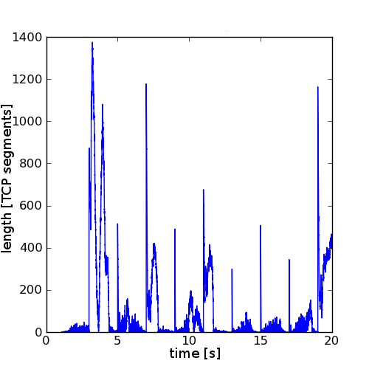
Emulation study
Investigation of router queue
length development in
DASH streaming for different
TCP Congestion Control algorithms
CUBIC
Vegas
Simple 2D graph
showing an independent
parameter X (time) and
a dependent parameter
Y (queue length)
does illustrate the unstable
queue length for CUBIC, but no actual distribution
not a quantifiable result, but anecdotal

Slide 44
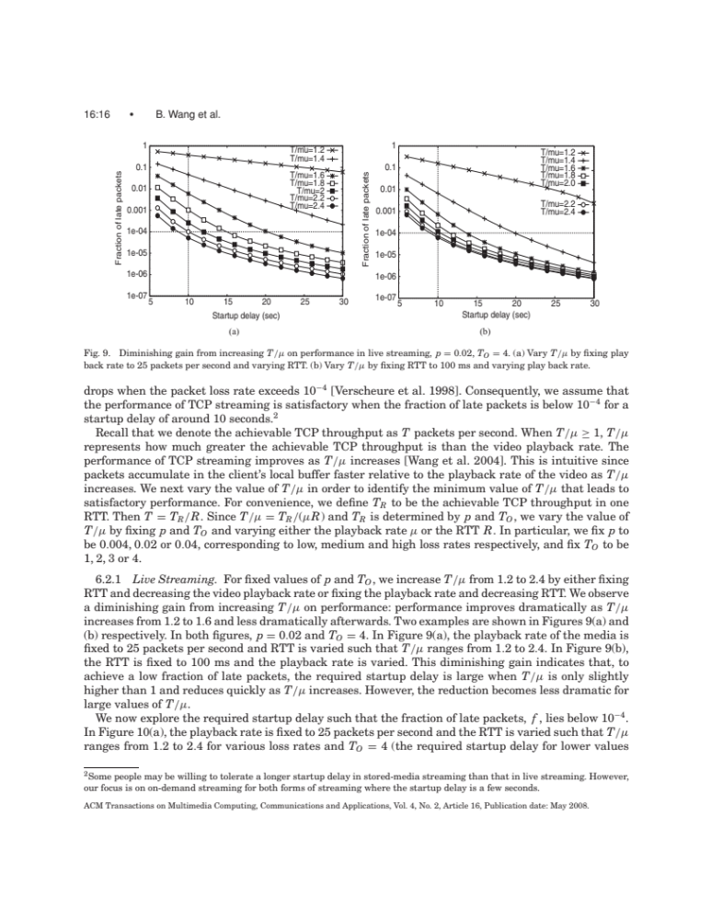
Analytical performance study
Analytical performance study to discover a relation between streaming (video) over TCP and the likelihood of stalling
Analytical graph provides
deterministic, repeatable results
symbols distinguish
conditions
Y-axis is logarithmic to
expose differences at when
very few packets are late
note that each point is a computation with different parameters

Slide 45
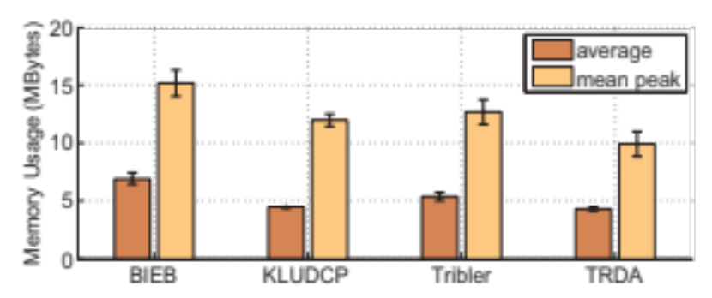
Simulation study
Investigation of memory requirements for several DASH streaming algorithms
Block diagram is suitable
when X-axis values have no
metric relation (no measure of any distance between them)
block diagram is also better if X-values have an order but no metric relation!
2D graph merges 2 questions into 1 graph: average memory use and average peak memory use (average of peaks of several simulation runs) – this does not scale to many questions
standard deviation is added for each of the averages
Notes:
Used in:
“Implementation and user-centric comparison of a novel adaptation logic for DASH with SVC”,
Sieber, C., Hossfeld, T., Zinner, T., Tran-Gia, P., & Timmerer, C, Workshops of IFIP Symposium on Integrated Network Management (IM 2013), pp. 1318-1323, 2013

Slide 46
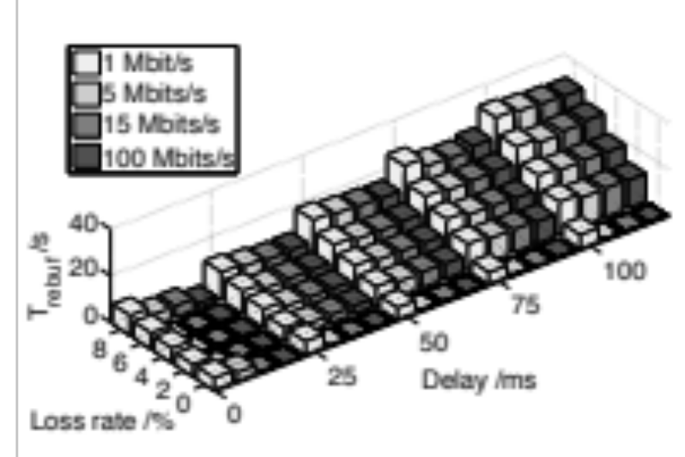
Emulation example
Some HTTP adaptive video streaming strategies can fails when packet loss is high and network delay is high as well. How long are the cumulative waiting times?
3D block diagram
3 independent variables shown
4D information (X, Y, Z, color)
3 independent variables (loss rate, delay, network capacity)
1 dependent variable (rebuffering time)
visually attractive
tolerances (confidence intervals etc.) cannot be expressed
absolute height cannot be ascertained by reader for all conditions
does not scale to many network capacities
Notes:
Used in:
“Measuring the quality of experience of HTTP video streaming”,
Mok, R. K. P., Chan, E. W. W., & Chang, R. K. C., Workshops of IFIP Symposium on Integrated Network Management (IM 2011), pp. 485-492, 2011

Slide 47
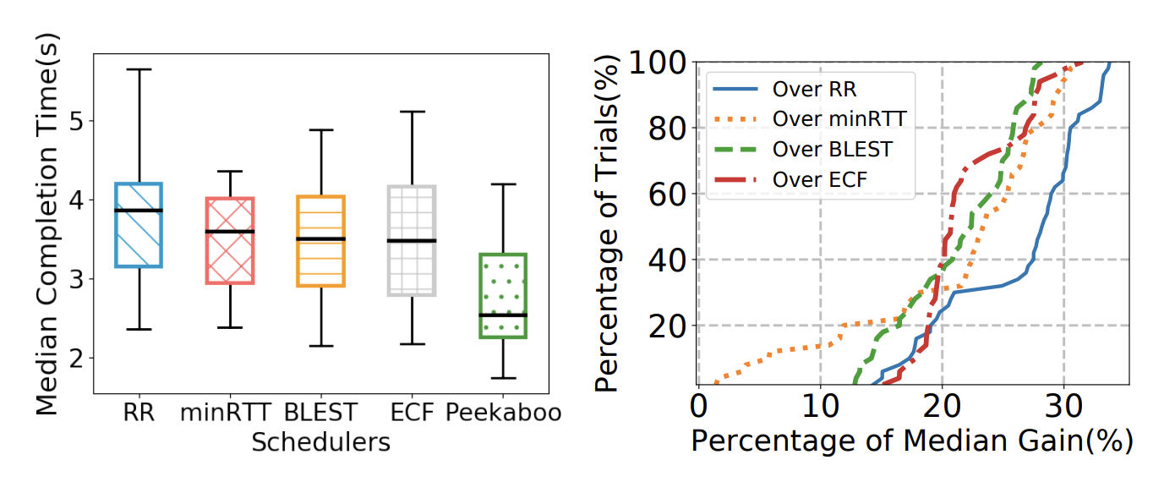
Emulation example
How will a learning-based multipath scheduler (Peekaboo) improve the completion time over heterogenous networks?
Boxplots and CDFs
Boxplots provide the statistical information both on the lower and upper percentiles
CDF of the gain illustrates the distribution of the gain
Quantifies both the basic characteristics of schedulers as well as the how well the proposed scheduler performs compared to others
Notes:
Used in:
“Measuring the quality of experience of HTTP video streaming”,
Mok, R. K. P., Chan, E. W. W., & Chang, R. K. C., Workshops of IFIP Symposium on Integrated Network Management (IM 2011), pp. 485-492, 2011

Slide 48
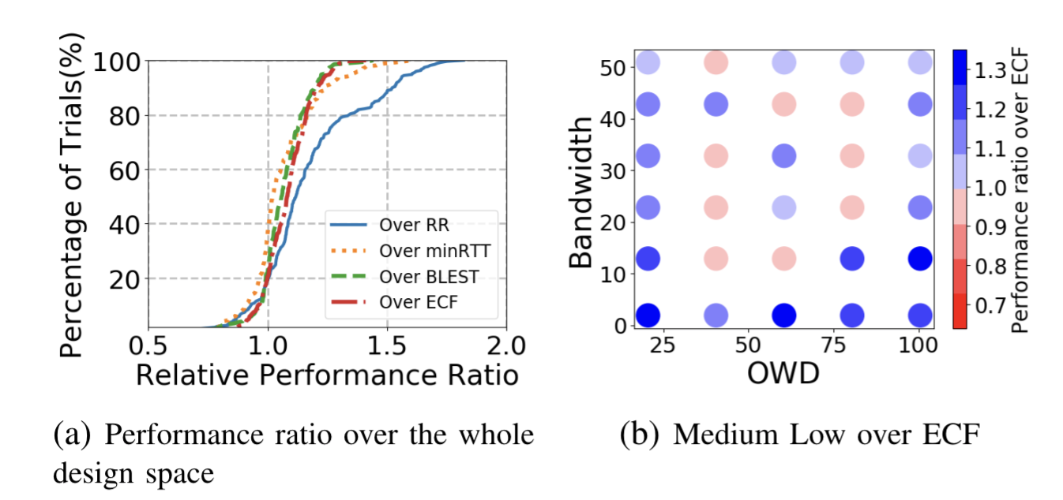
Emulation example
How will a learning-based multipath scheduler (Peekaboo) improve the completion time over heterogenous networks?
One-way delay
Design space exploration
Emulations are often done over a design space of variables
CDF of the gain illustrates the distribution of the gain but it does not tell where the gain comes from
A heatmap over a design space can show where the gains come from
Quantifies both the basic characteristics of gains as well as the where the gains (if any) coming from

Slide 49
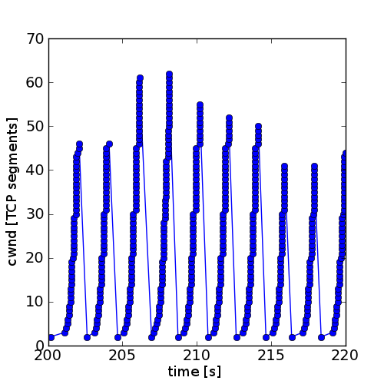
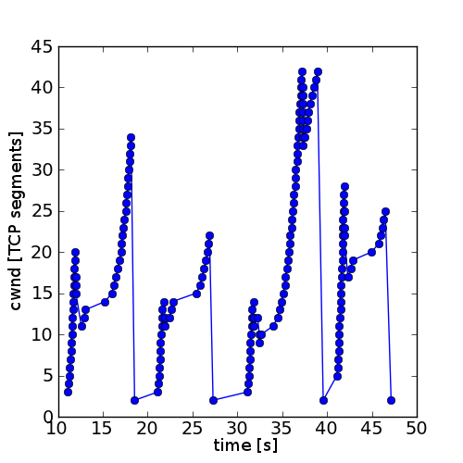
Emulation study
CUBIC
Investigation of sender’s congestion window size in the same study.
Video segments have a duration of 2 seconds (top) and 10 seconds (bottom), the algorithm attempts to choose a quality that can be downloaded in 1 second.
Simple 2D graph showing an
independent parameter X (time) and
a dependent Y (congestion window size)
serves to illustrate that CUBIC is incapable of maintaining its congestion window between 2-second DASH segments, but enters TCP slow start
not a quantifiable result, but anecdotal

Slide 50
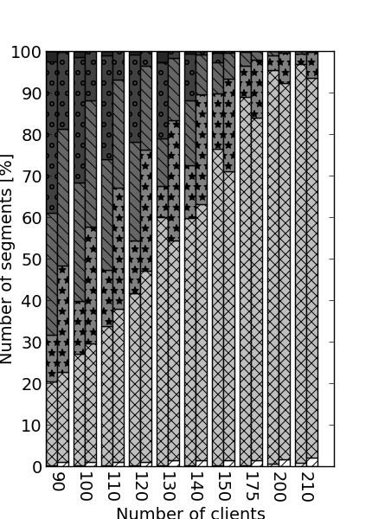
Emulation study
Investigation of the distribution of video quality in the same study.
Segments 2-sec. (left in each column) and 10-sec. (right). Patterns indicate qualities (0 stall, 5 best).
Shows the shares of qualities for entire film.
Graph with 3 dimensions (X and
segment duration independent,
Y dependent)
quite problematic
  hard to distinguish qualities, patterns are not easily enough recognized
  quality 1 is dominant, no visual comparison of the others
  change of order between left and right remains hidden

Slide 51
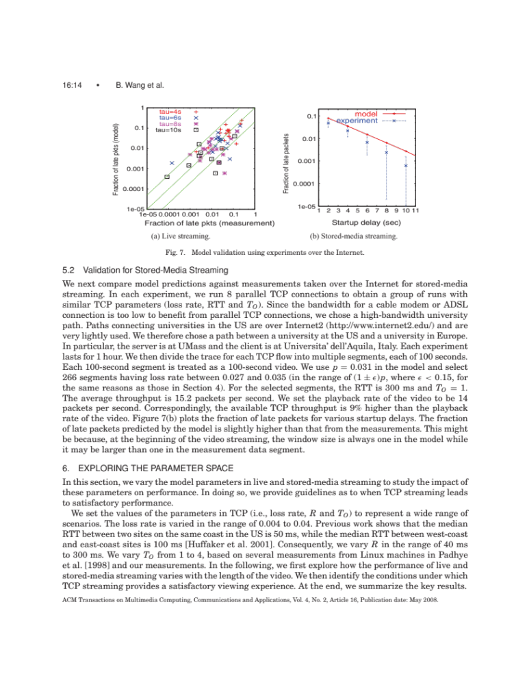
Combined study
Performance study to discover a relation between streaming (video) over TCP and the likelihood of stalling – model validated by ns-2 simulation (“experiment”)
Simulation
symbols distinguish
model and simulation
Y-axis is logarithmic
simulation is not deterministic,
and error bars show the
95% confidence interval
for the simulation, each point with error bars is derived from the results of 1000 simulation runs

Slide 52
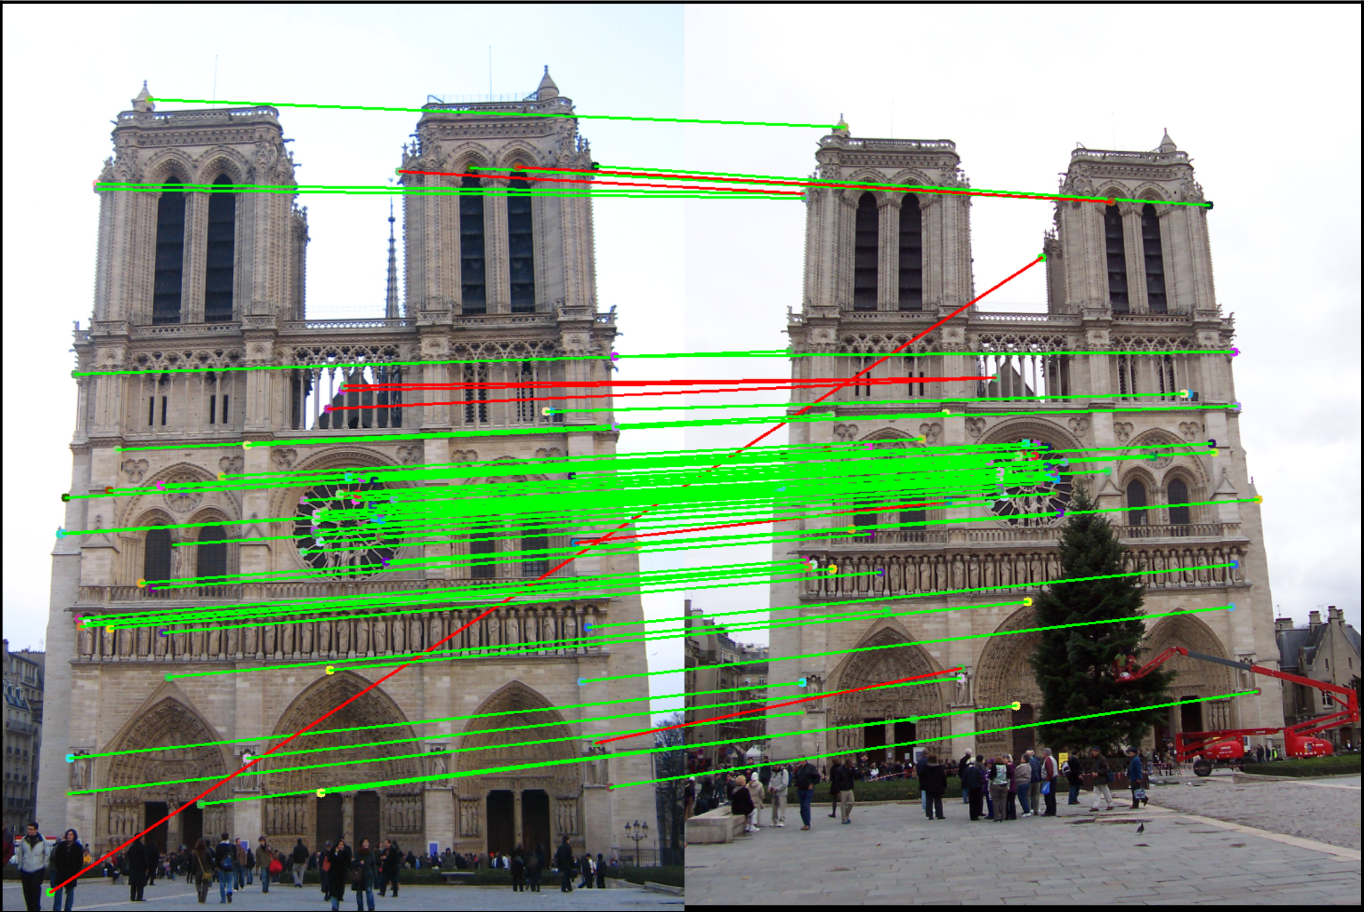
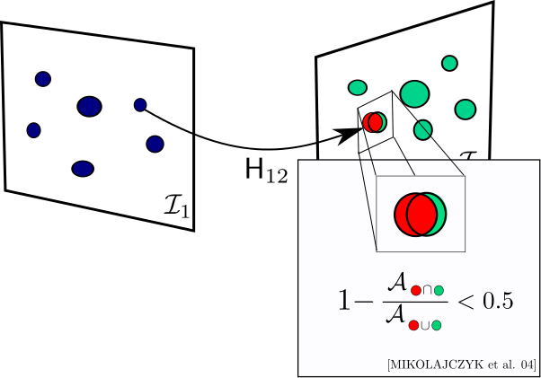
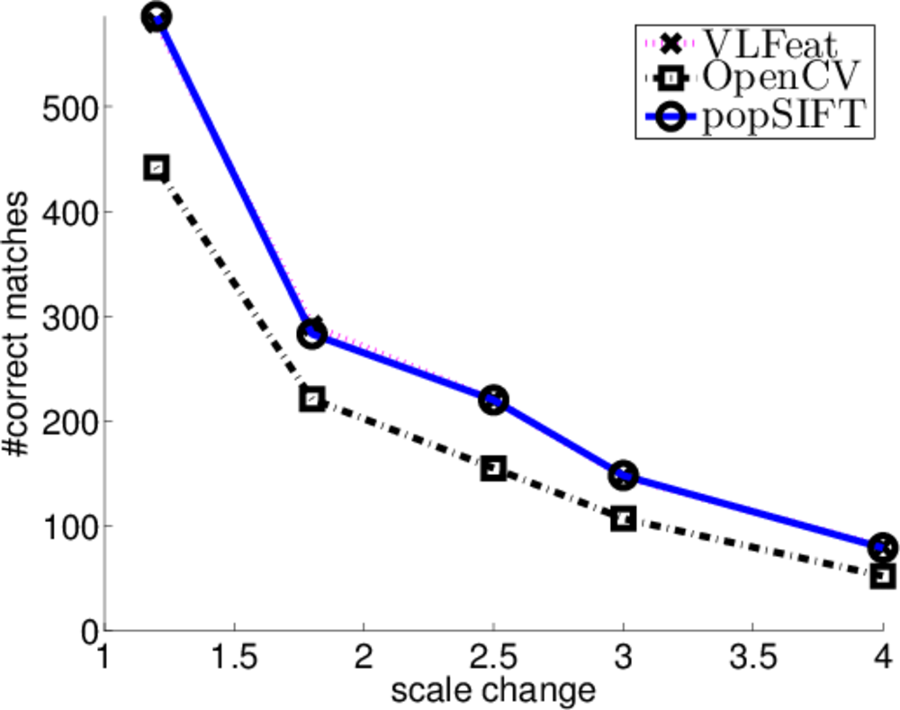
Emulation example
Comparing the performance of the 3 implementations of the algorithm “Scale-Invariant Feature Transform” (SIFT)
Very simple 2D plot, relating only to a set of very specific image pairs
100% deterministic and repeatable, no point in expressing errors
definition ahead of time: boolean condition that defines “match” (adopted from an independent study that developed a good comparison method)

Slide 53
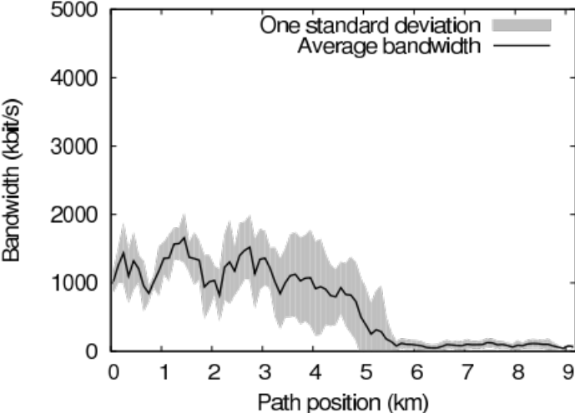
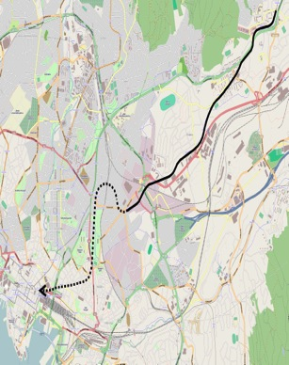
Emulation example
Documenting the repeatability of bandwidth measurement on a typical commuter path
Map shows the subway route from
Stovner to Oslo S
graph shows the measured bandwidth by distance from Stovner
figure does not represent any specific measurement run, the measurements have been collected, and the graph shows both the average bandwidth and 1 standard deviation
not only anecdotal but valid for predictions

Slide 54
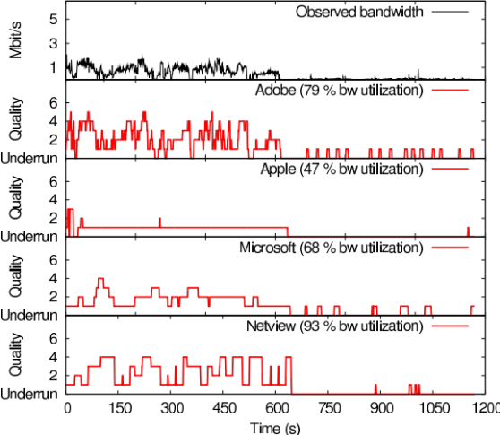
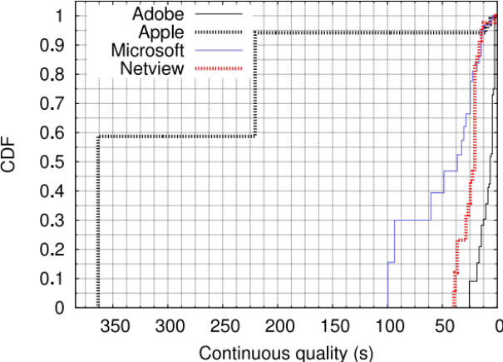
Emulation example
Comparing the bandwidth efficiency and stability of several HTTP Adaptive Streaming methods
Upper graph shows quality
development over time
by itself, it has only
anecdotal value
Lower graph shows CDF of quality changes
Apple HLS is most stable (a desirable property)
but upper graph exposes that the price for this is very low quality

Slide 55
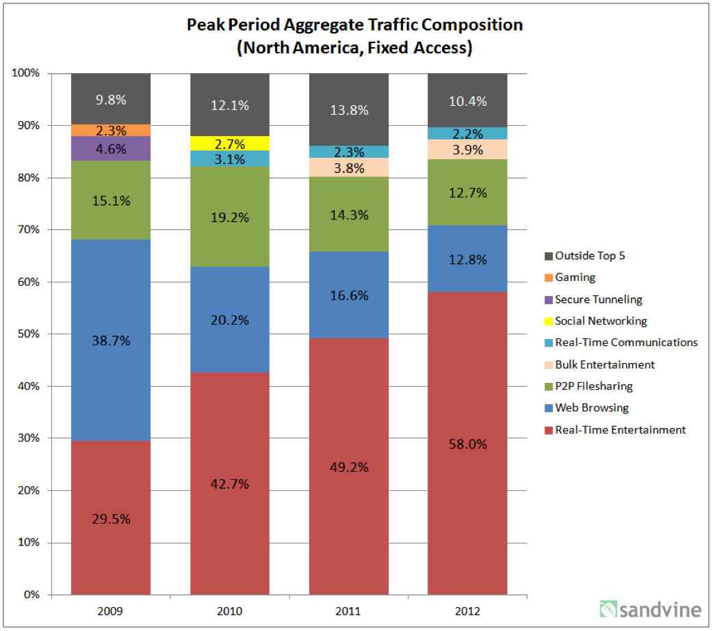
Measurement example
Development of traffic shares over time
A graph using percentages to express the share of application types on the Internet
no absolute values, only percentages
color as well as order allows easy recognition of types, as well as appearance of new types

Slide 56
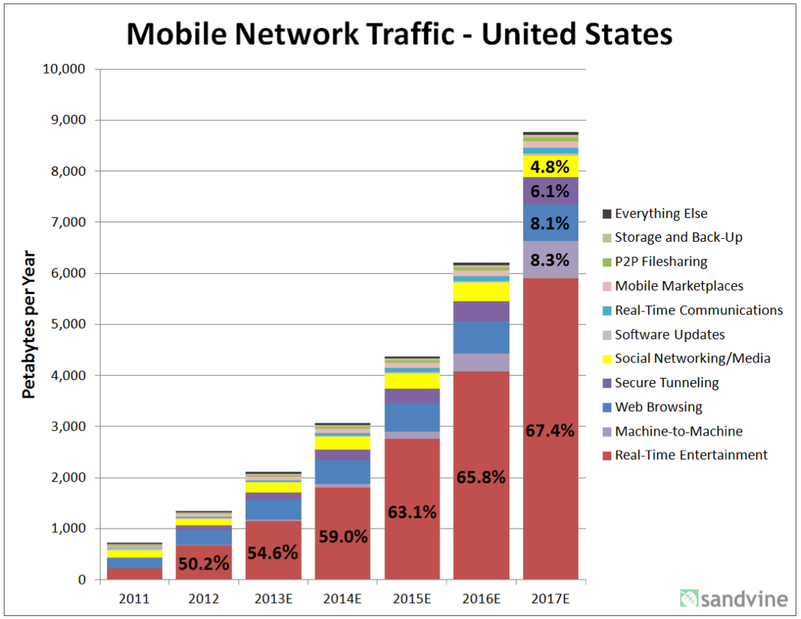
Measurement example
Development of absolute mobile traffic over time
A graph using absolute value to communicate the rapid growth of mobile traffic
percentages provided as text in graph
color as well as order allows easy recognition of types, as well as appearance of new types
note ”E” for estimates

Slide 57
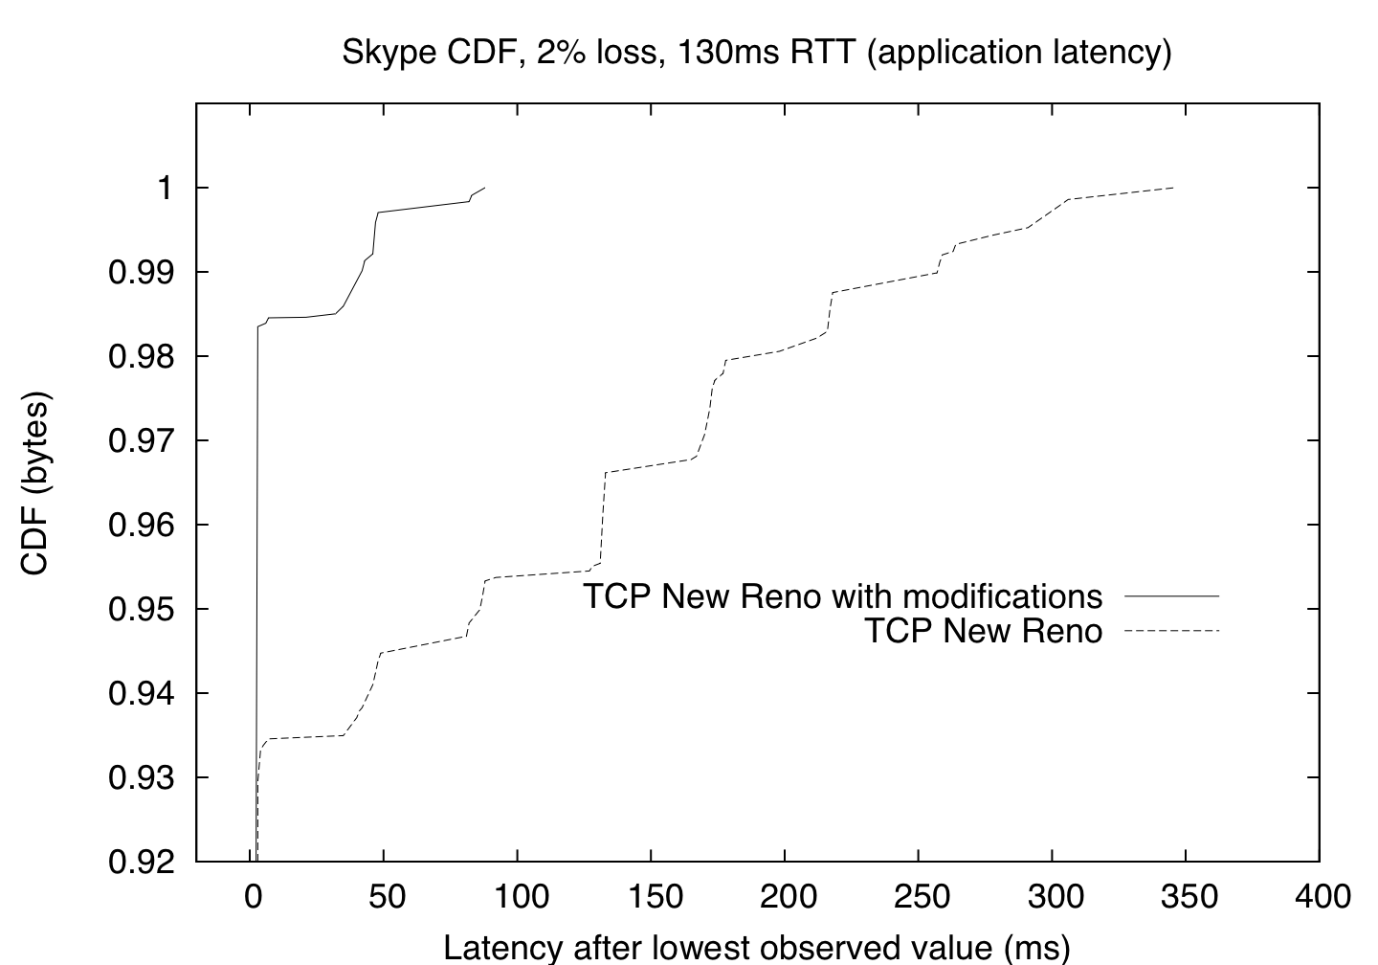
Measurement example
Hypothesis: “Thin-stream” modifications to Linux’s
implementation of TCP New Reno reduce latency.
Cumulative Distribution Function (CDF) provides the percentage of measurement points up to a given X value
useful if number of samples not identical
useful if number of samples is quite large
starts far away from 0

Slide 58

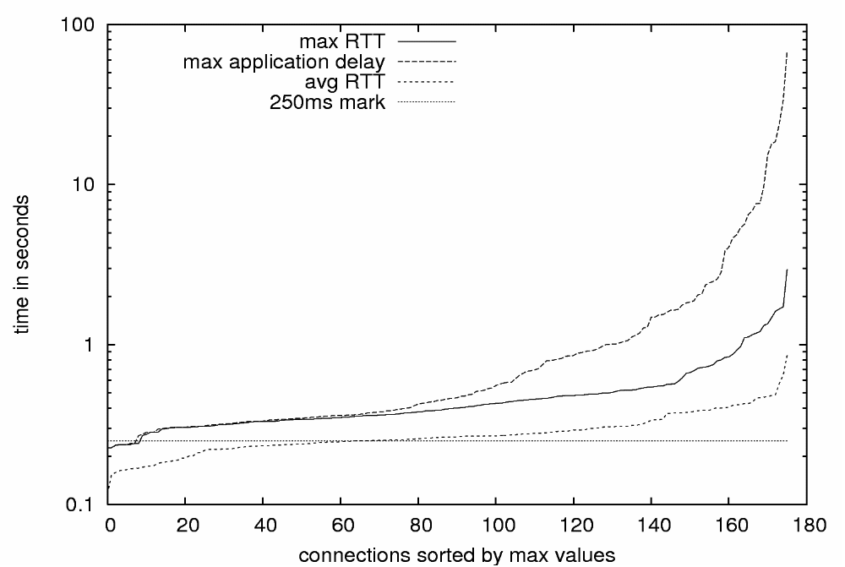
Measurement example
Application-layer behaviour of a popular MMORPG estimated from a single server-sided measurement probe
simple 2D presentation, both dimensions observed
data sorting can provide more information than histograms or cumulative distribution functions
Highest observed application-layer latency: 67 seconds!
Average RTT allows for a satisfactory user experience (in theory).

Slide 59
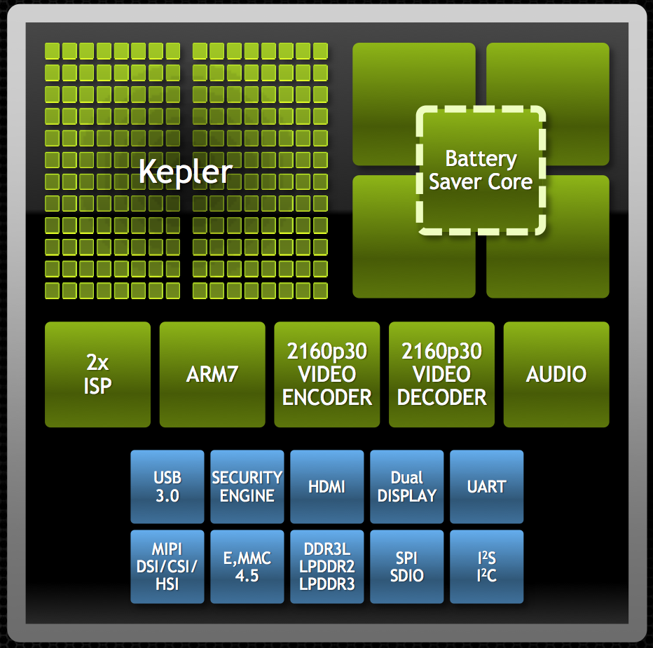
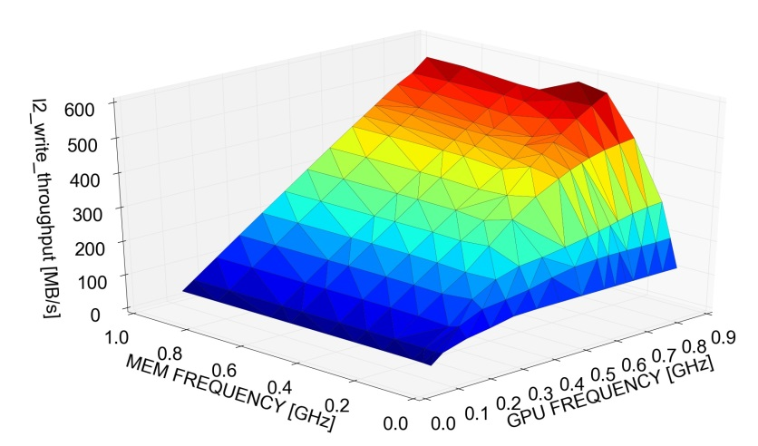
Measurement example
NVidia Tegra K1
impact of frequency on throughput
note: 4 dimensions in the presentation
additional dimension can be used to add information or to add expressiveness to one or more of the dimensions
Notes:
59

Slide 60
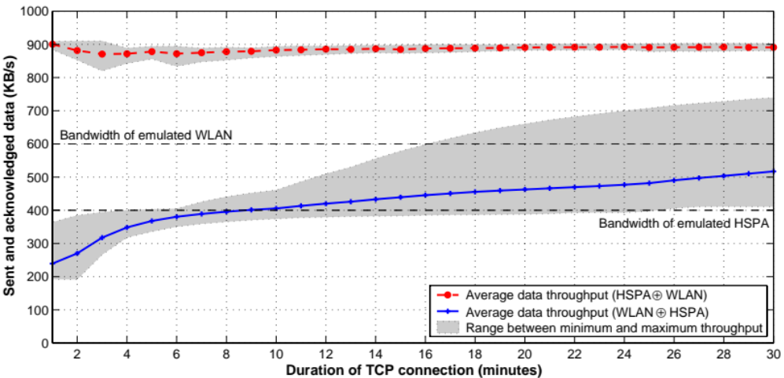
Measurement example
Linux TCP’s ability to recover from out-of-order delivery of packets
2D graph studying values for the average bandwidth of very long-lived TCP flows whose packets are alternately sent over 2 very different paths
details of short-term TCP behaviour are completely hidden
smoothness achieved by averaging
shaded areas illustrate uncertainty (range from min to max average throughput)

Slide 61
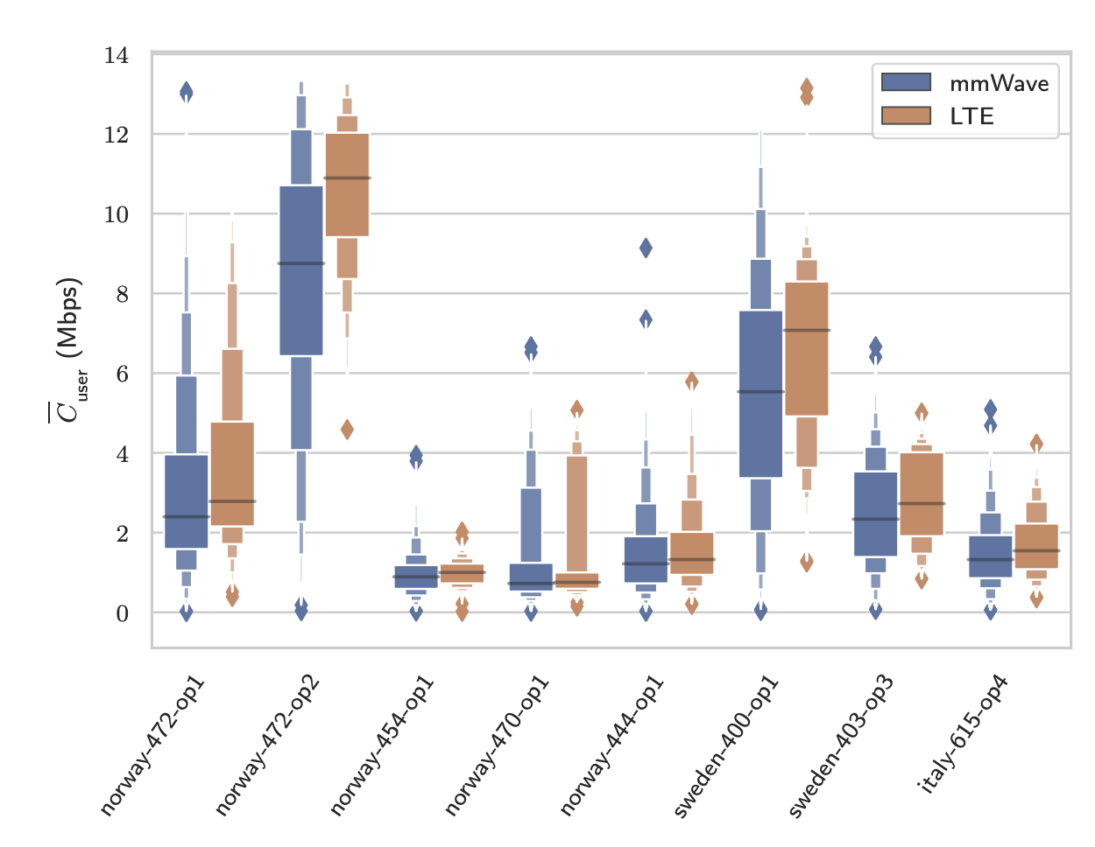
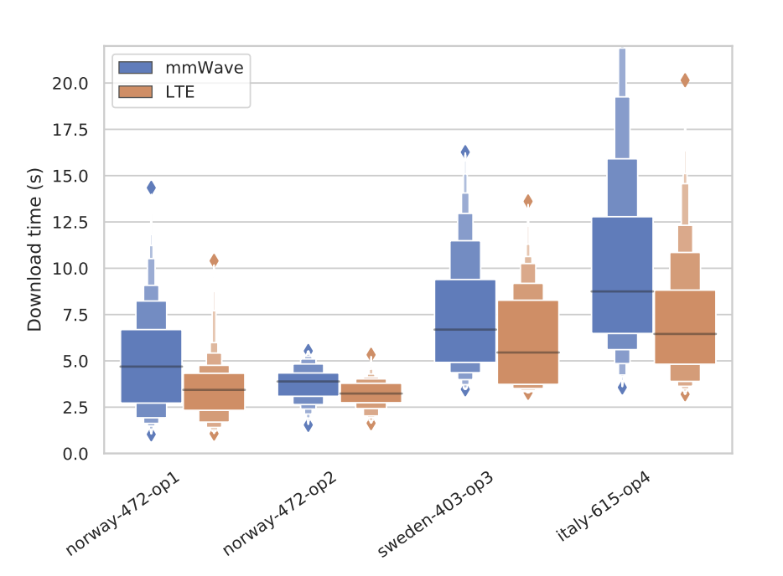
Measurement example
Investigation of the current operator SPEPs (used in 4G LTE networks) under mmWave-like dynamics using MONROE testbed
Different colors highlight the different settings
Boxplots display the first two letter values (the median and quartiles); letter-value plots display further letter values therefore more suitable for large datasets.

Slide 62
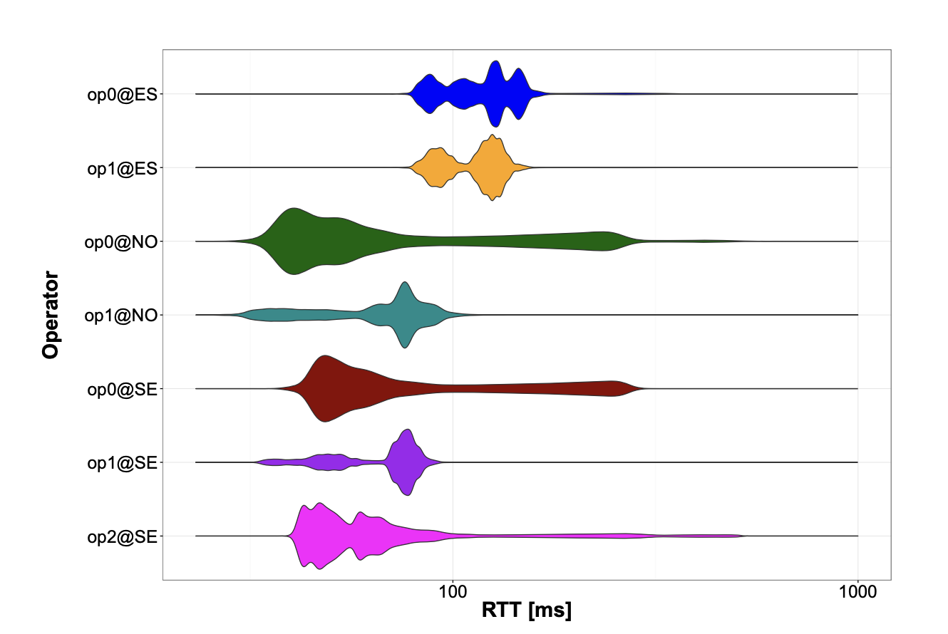
Measurement example
Investigation of latency for 4G LTE networks using MONROE testbed
Different colors highlight the different settings
Violin plots are similar to box plots, except that they also show the probability density of the data at different values.

Slide 63

Measurement example
Performance comparison of HTTP2 and QUIC over 4G networks under stationary and mobile scenarios
Color together with pattern is used to diffentiate different settings
Empirical PDF is presented together with empirical CDF
The bins are used to illustrate the relative difference levels

Slide 64

Measurement example
The impact of COVID-19 on the web performance over mobile networks
2D matrix form together with heatmap
The heatmap together with values in it provide more information
highly aggregated data
concept of certainty (e.g. confidence intervals) gets lost

Slide 65


Measurement example
The impact of COVID-19 on the performance of mobile networks
2D information (date vs time of the dat) together with heatmap
Diurnal pattern comparison
Visual patterns are visible, but details are hidden

Slide 66

Measurement example
Investigation of latency over multiple trips under mobility for mobile networks
3D information together with heatmap
Multiple laps are shown using the Y-axis offset based on relative timestamps to visually show the different trips
Potentially have the map to visualize the location as well

Slide 67

Measurement example (with some ML flavour)
The impact of different browsing features on the web quality of experience
Spearman’s correlation matrix
Heatmap has negative and positive values

Slide 68



User study example
Hypothesis: users can detect that they are experiencing hand-eye latency below 100ms
97-182
85.14
Cumulative Distribution Function (CDF) provides the percentage of measurement points up to a given X value (using dots in this case)
matched with a function (here cumulative gamma distribution)
  better describe the distribution and validate generality
  create simulations
39.00
51-90
14.10
26-40

Slide 69

User study example
Hypothesis: poor video quality can mask asynchrony between audio and video streams
(note: proven wrong)
Window of temporal integration
note: 3 dimensions
in the presentation
sample points are
plotted with error
bars
highlight color adds meta-information, here highlighting 50 percent of the study population
also typical to fit a typical behavior function from samples using linear regression (shown on next slide)
audio lead
audio lag

Slide 70

User study example
Pre-study: perception of asynchrony
for different content
Drums
Chess
Speech
note: 3 dimensions
in the presentation
curves generated from sample using linear regression
horizontal bar adds meta-information, here highlighting 50 percent of the study population
color is used to distinguish items (4th dimension) and to associate measurements with fitted curves

Slide 71


User study example
The influence of semantic relations between visual elements on human attention.
Heatmaps allow a presentation of 2D data accumulated over time.
2D input (axes), 1D output (color).
Can be overlaid over base data.

Slide 72
Performance in distributed systems
Projects

Slide 73
Performance measurement projects
In this course we will give you performance analysis tasks where you will wrestle the tradeoffs, the parameters, the metrics, the methodologies, the analysis and
the presentation.
We will
  introduce many of the main concepts of performance
  analysis
  introduce the topics that form the basis of the graded assignments
  provide example reports of good quality for you to study
  be available on email for guidance and pointers

Slide 74
Performance measurement projects
You must:
  Go to the literature (and the web) for details and resources to help you on the way
  Apply your own skills and judgement in the selection of metrics and methodology
  Justify your choices and try to avoid making random or biased selections
  You will face a lot of tradeoffs and difficult choices. Ask for advice. Communicate!
  This is what researchers and industry professionals are required to do in their practice

