Slide 1

Crash Course on 5G Networks
IN5060: Quantitative Performance Analysis

Slide 2
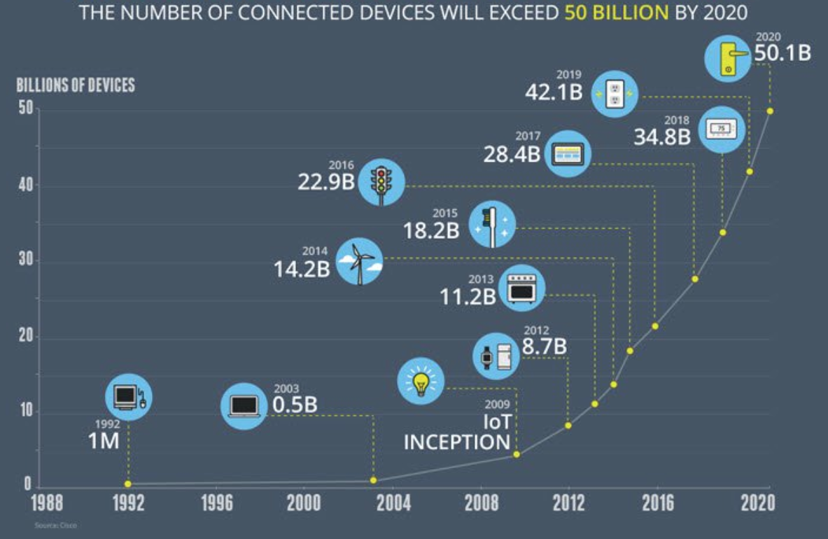
Growth in the number of connected devices

Slide 3
Connected devices in 2010

Slide 4
Connected devices today

Slide 5
How it all fits in 5G?

Slide 6
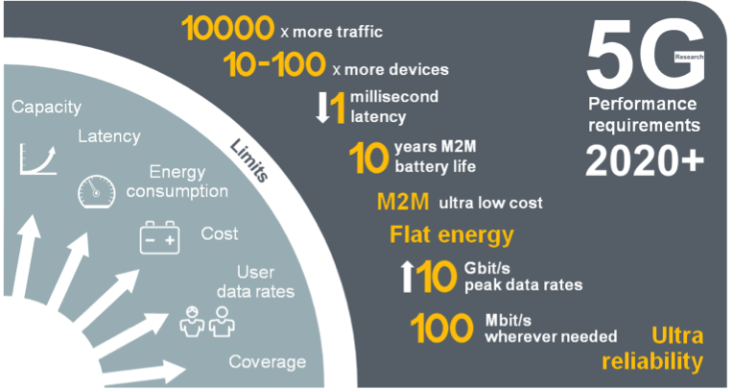
5G Mobile Network Expected Performance
Multi domain
performance
  Energy Performance
  Critical machine type
  of communications
  Global
  standard

Slide 7
Back in the day…

Slide 8
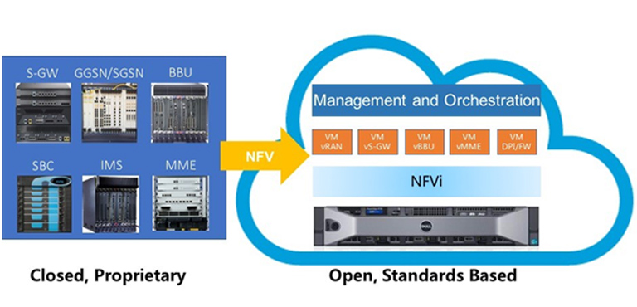
Network Flexibility: Virtualization

Slide 10
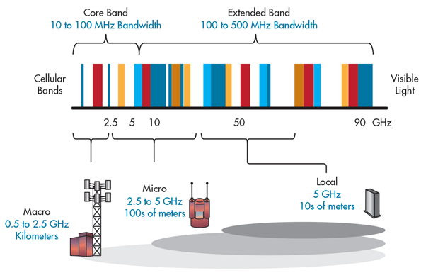
5G Bands and its impact on Cell size

Slide 11
What is mmWave?
Most wireless operates in this range
Millimeter Wave Bands
0
10GHz
20GHz
30GHz
40GHz
50GHz
60GHz
70GHz
80GHZ
90GHz
100GHz
Frequency Spectrum

Slide 12
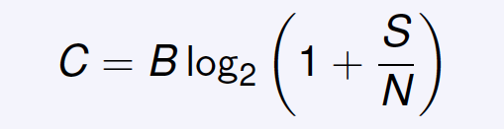
Why mmWave?
Shannon-Hartley Theorem
C—channel capacity (bps),
B—channel bandwidth (Hz),
S—average signal power, and
N— average noise and interference power.
At higher carrier rates, larger B -> higher
rates.
100-1000 times faster than existing wireless networks

Slide 13
How does mmWave work?
mmWave: High attenuation at high frequencies -> very short range
Client
AP

Slide 14
To address high attenuation: Beamforming
Beamforming is a signal processing technique used for directional signal transmission or reception.
Elements of an antenna array is combined in such a way that signals at particular angles experience constructive interference while others experience destructive interference.

Slide 15

An antenna radiates energy like....
from Mark Hickle https://youtu.be/vtPPAnvJS6c

Slide 16
Forming a beam

Slide 17
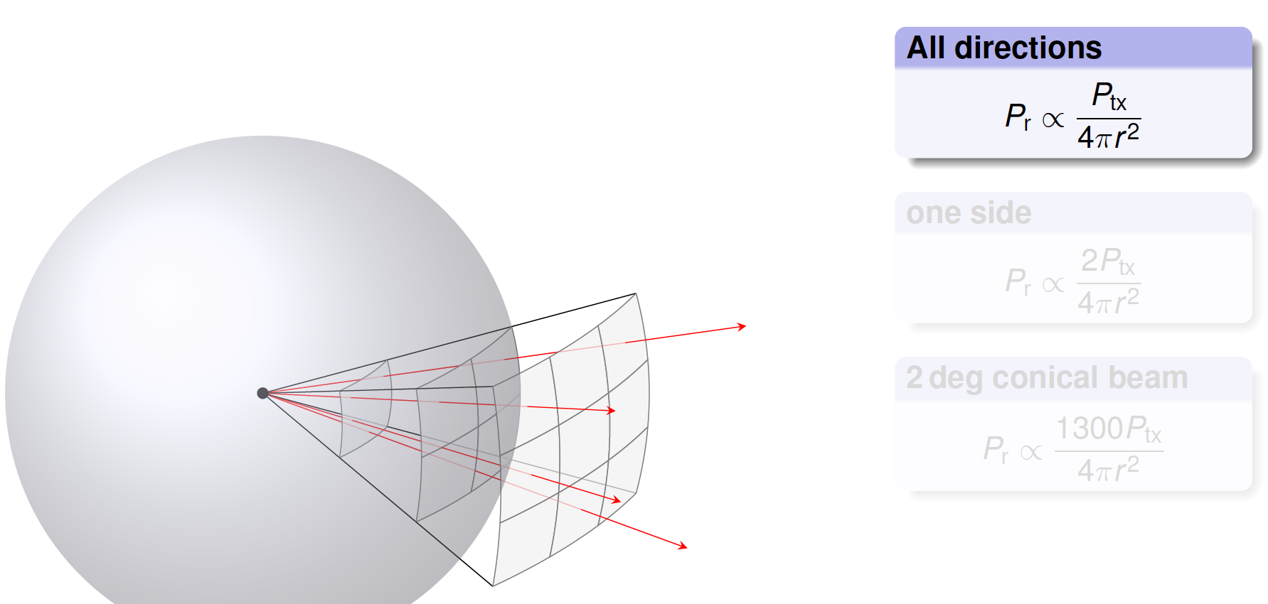
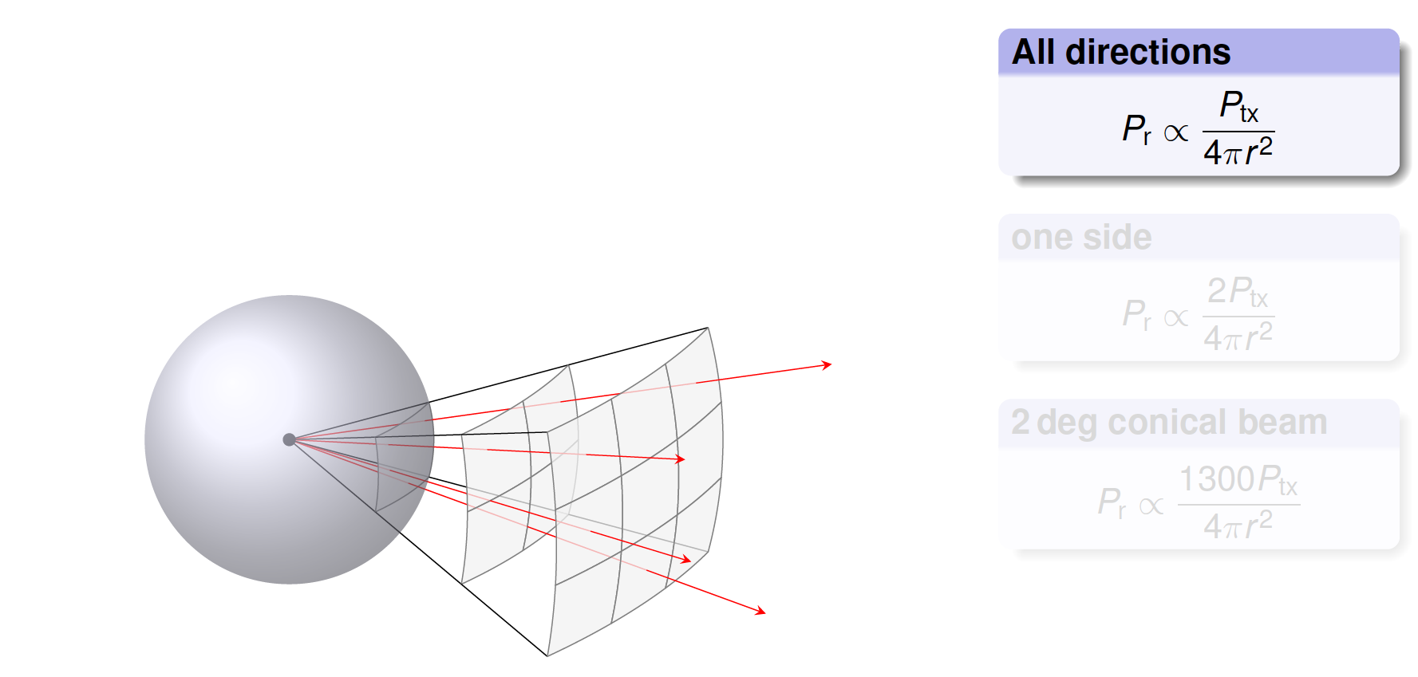
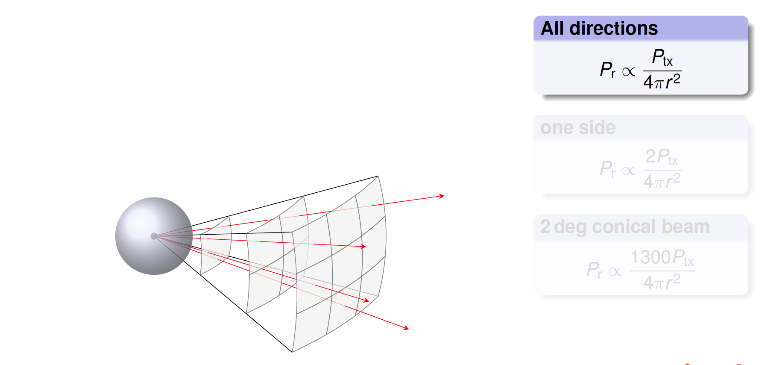
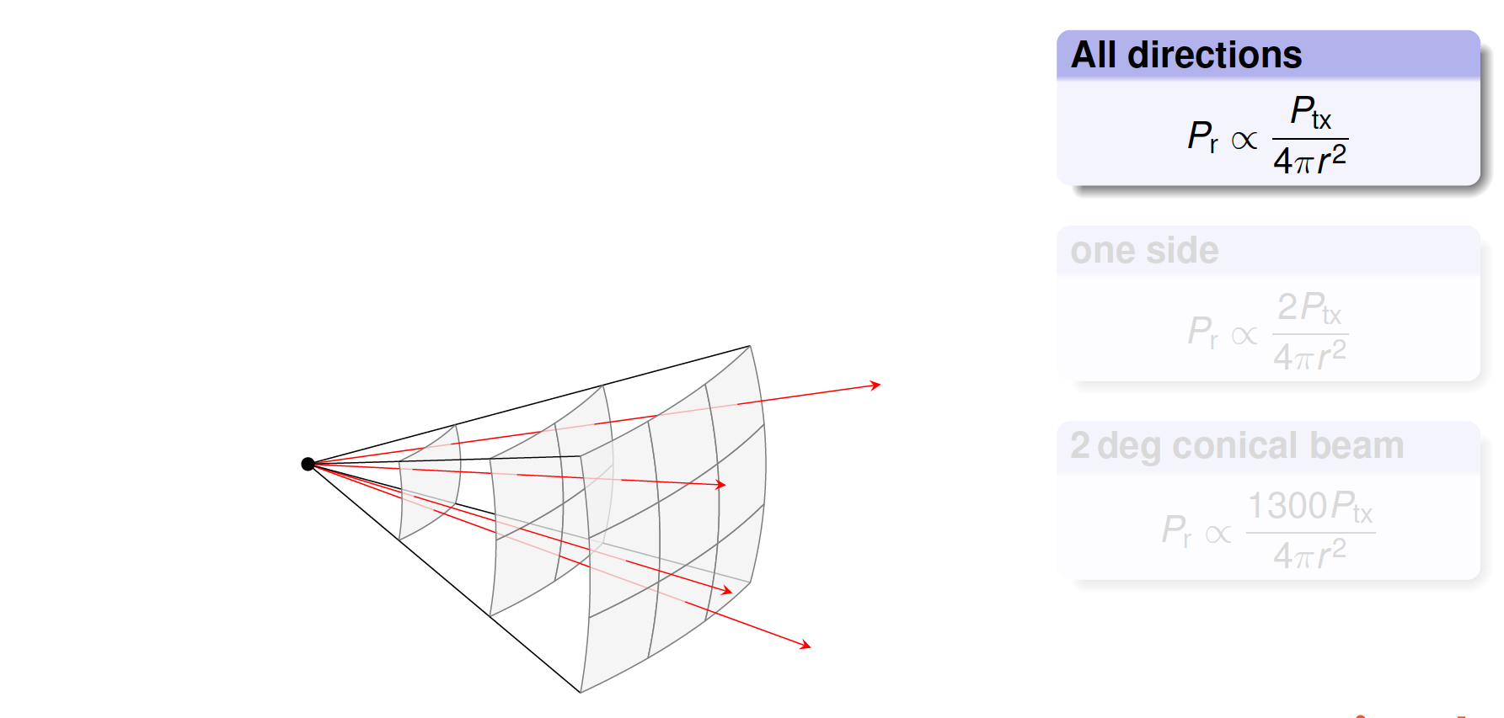
Transmit beam and receive strength

Slide 18
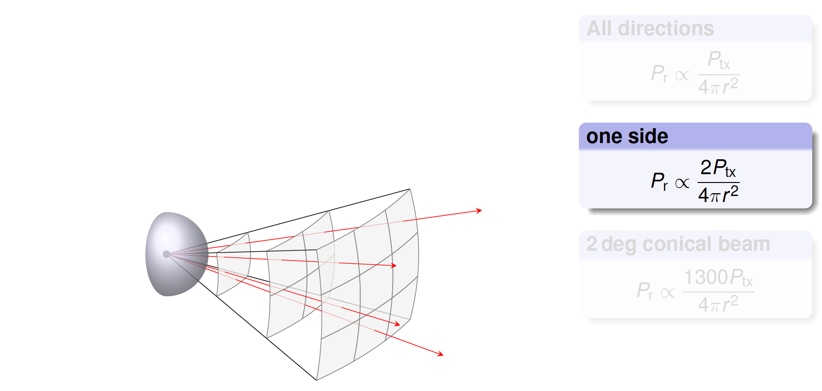
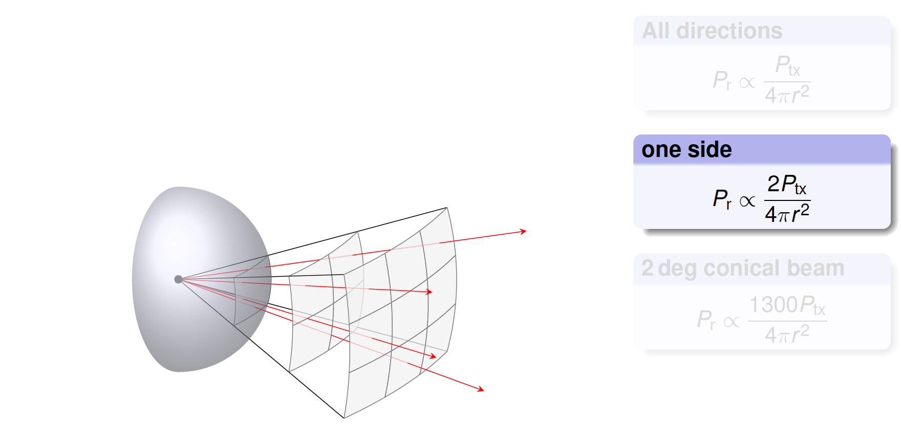
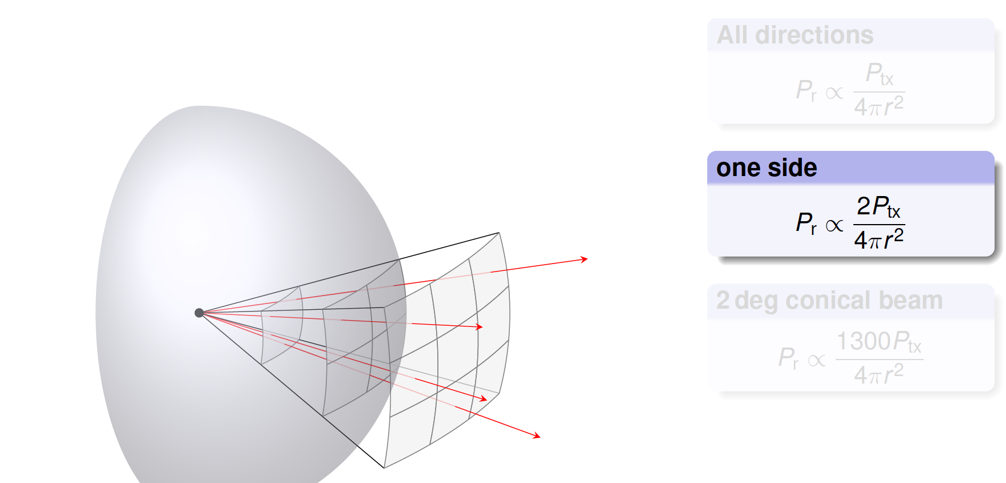
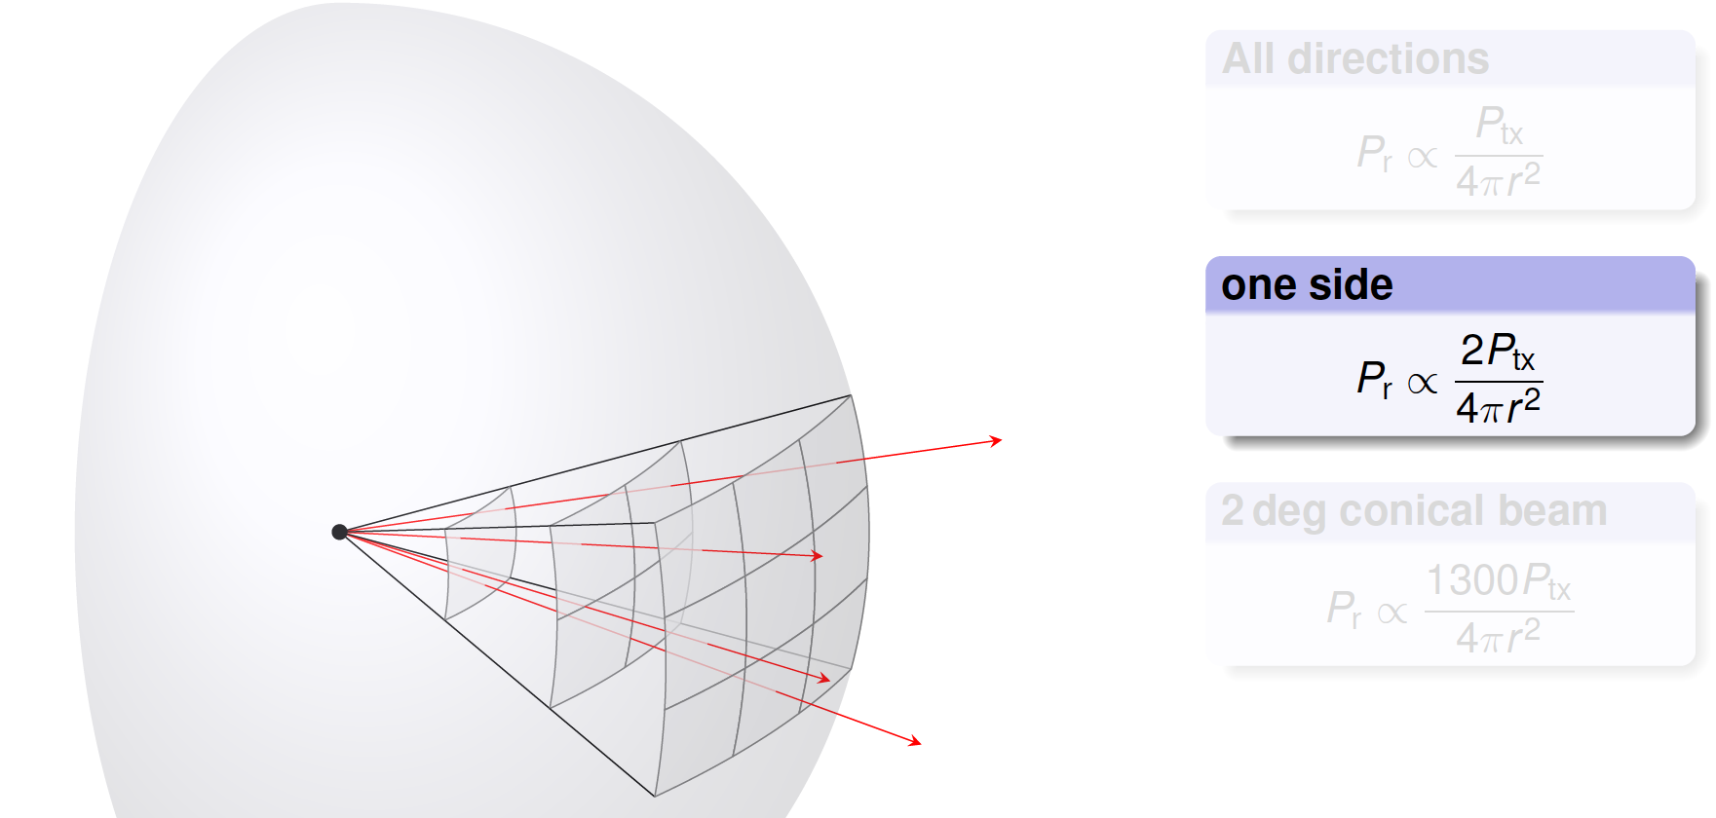
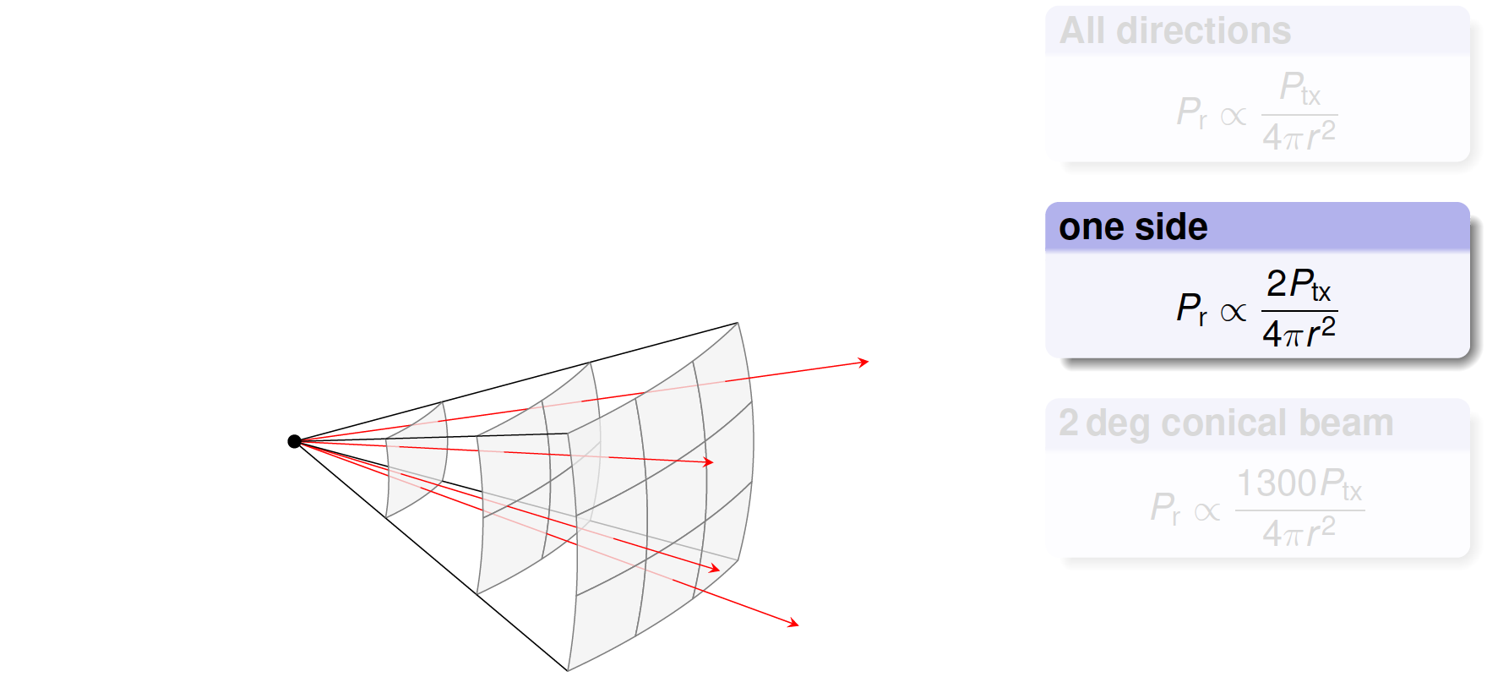
Transmit beam and receive strength

Slide 19
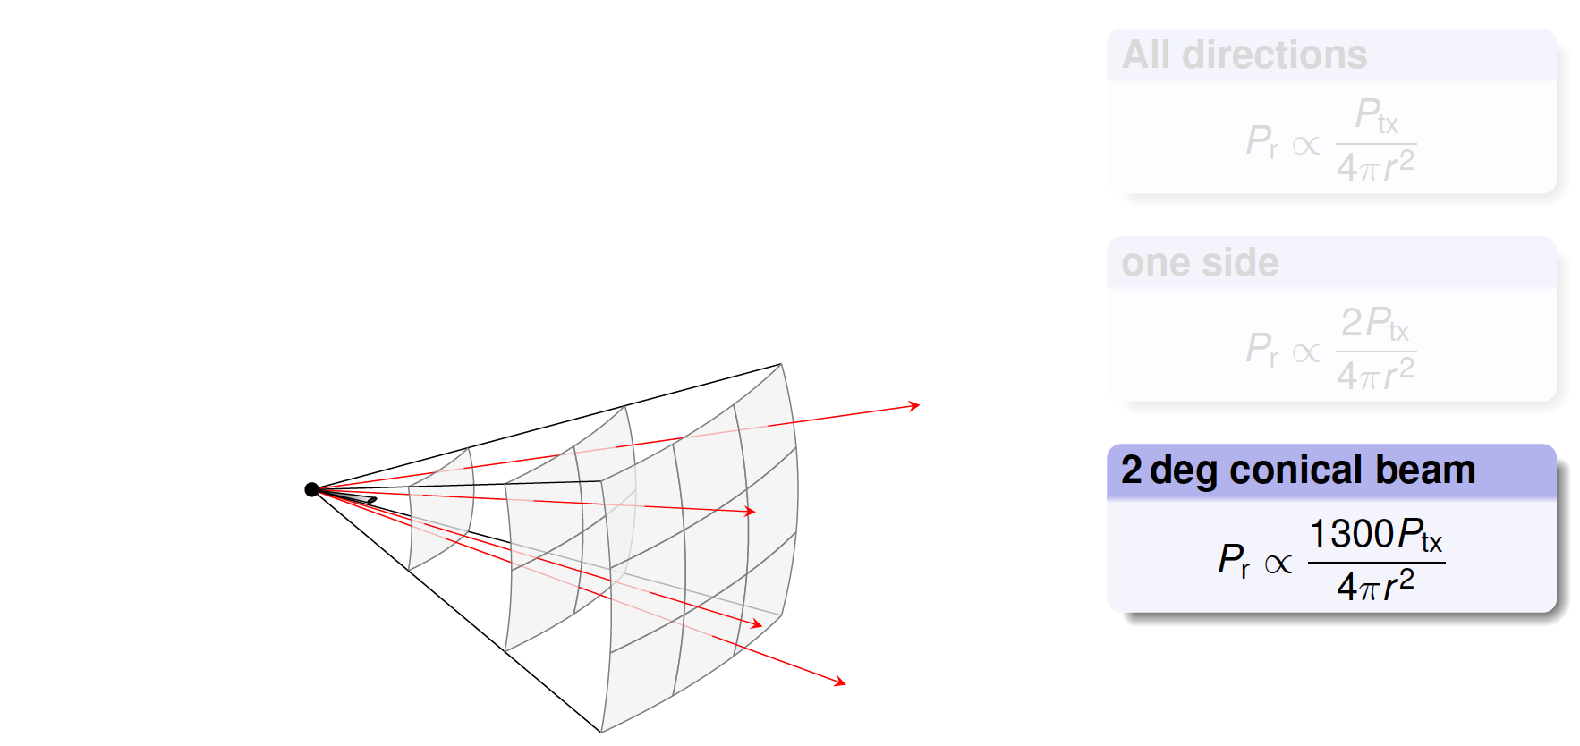

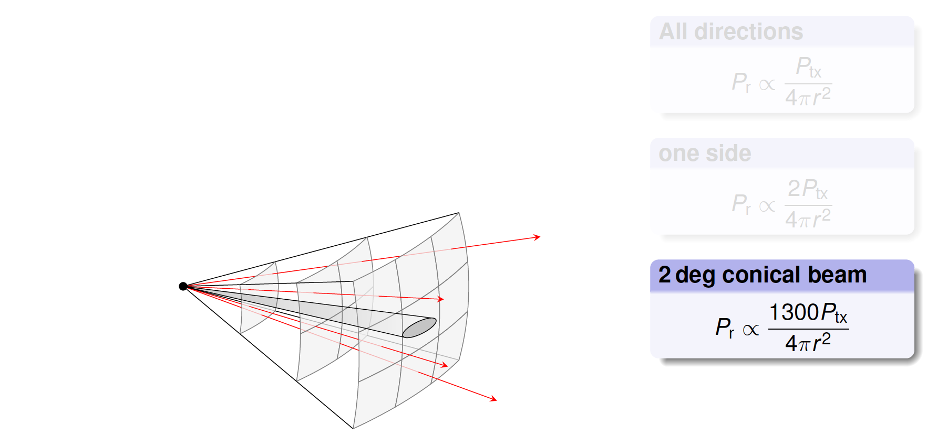
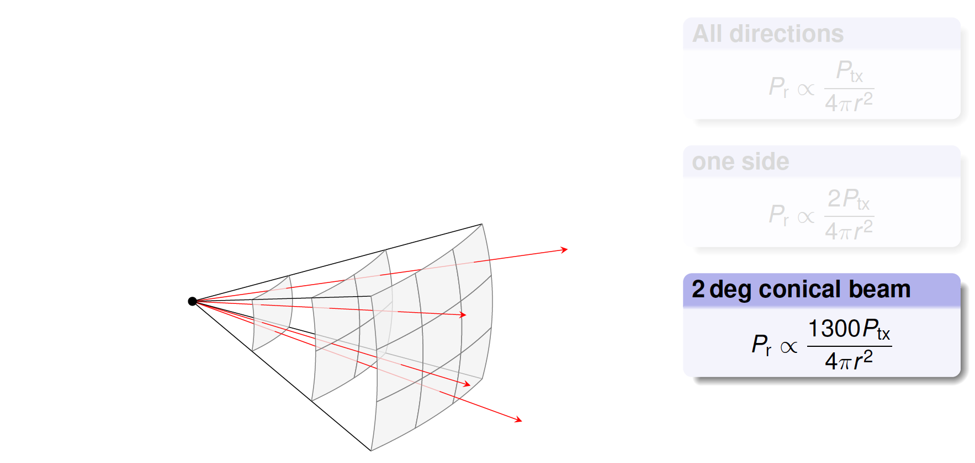
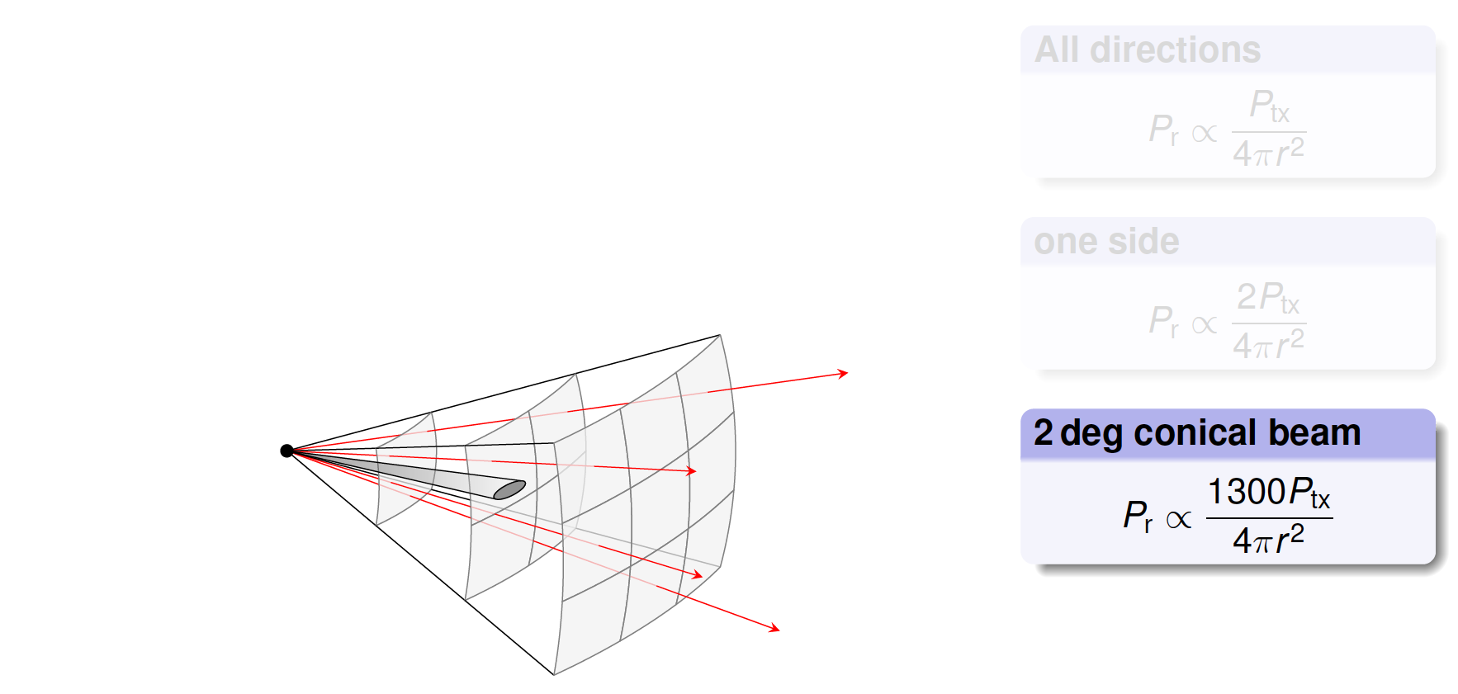
Transmit beam and receive strength

Slide 20

Beamforming and Steering

Slide 21


How does mmWave work?
To address high attenuation, beamforming is used!
Challenge: Beam alignment
Client
AP

Slide 22
How does mmWave work?
Line of sight exists
Client
AP

Slide 23

How does mmWave work?
Line of sight blocked
Client
AP

Slide 24
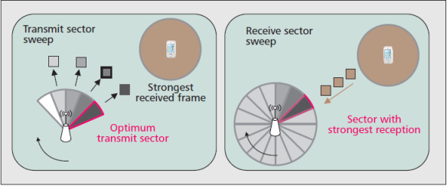
Beamforming Training
Still quite a challenging problem especially under mobility scenarios!

Slide 25
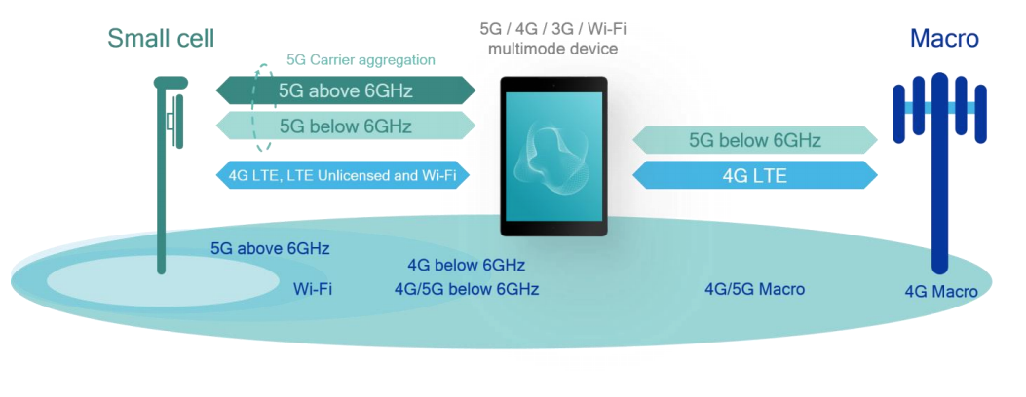
Spectrum Sharing: Multi-connectivity

Slide 26
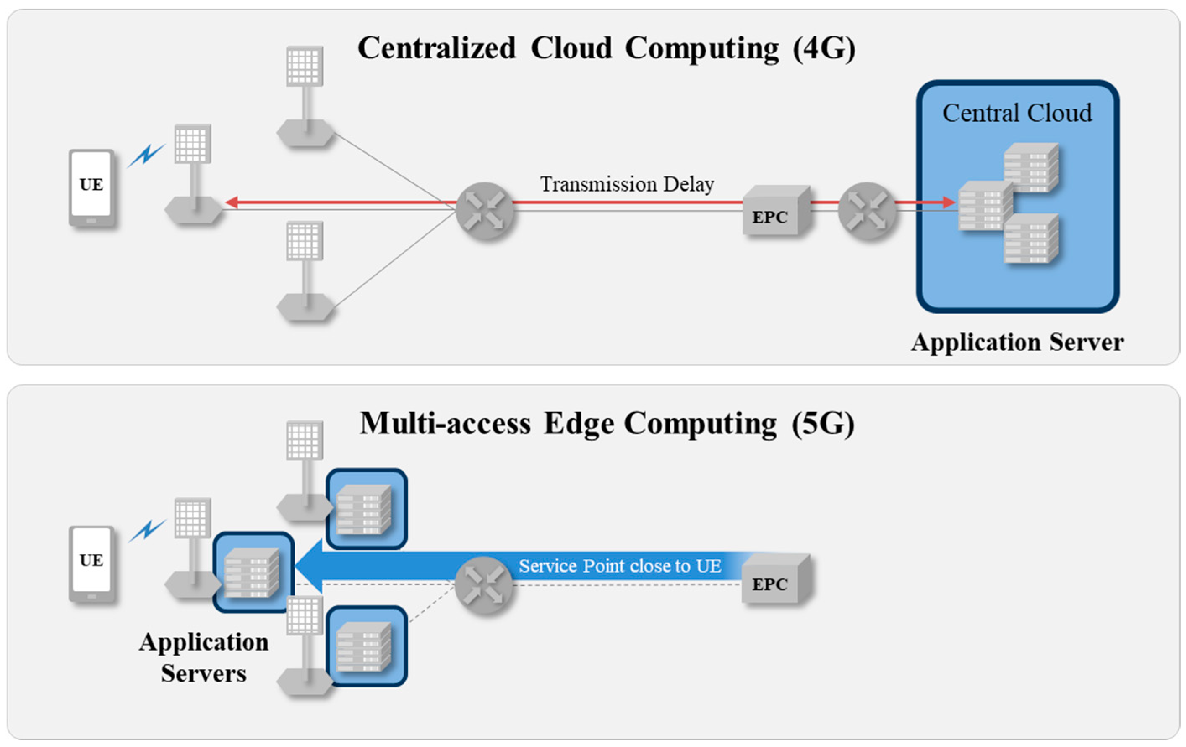
Ultra high reliability and Low Latency

Slide 27
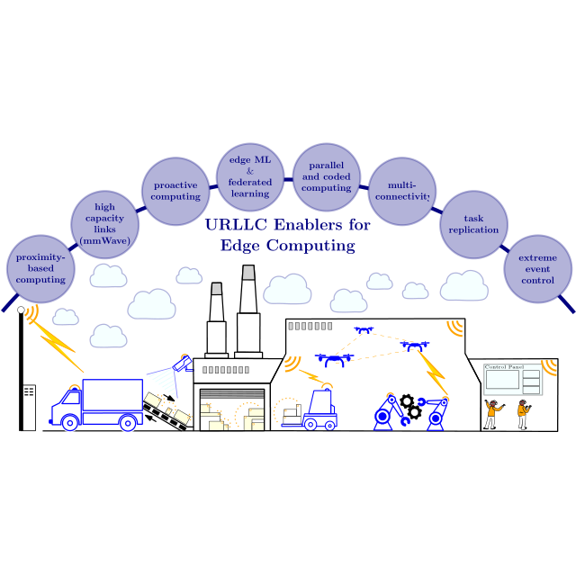
Ultra high reliability and Low Latency

Slide 28
Summary and Conclusion
5G is a paradigm shift in the networking ecosystem: Network as a Programmable Platform
Flexible software based architecture to support many different applications with diverse requirements
Several techologies are proposed: network function virtualization, network slicing, edge computing, mmwave, etc…
Does this flexibility and virtualization comes at a cost?

