Slide 1
Motion Planning
IN5060 - Simulation

Slide 2
Introduction
Motion planning plans the state sequence of the robot without conflict between the start and goal.
It includes Path planning and Trajectory planning.
  Path planning: based on path constraints (such as obstacles)
  Trajectory planning: based on kinematics, dynamics constraints and path sequence.
More information in the following repository:
  https://github.com/ai-winter/matlab_motion_planning/blob/master/README.md

Slide 3
Search-based Planning
A*: A Formal Basis for the heuristic Determination of Minimum Cost Paths
JPS: Online Graph Pruning for Pathfinding On Grid Maps
Lifelong Planning A*: Lifelong Planning A*
D*: Optimal and Efficient Path Planning for Partially-Known Environments
D* Lite: D* Lite
Theta*: Theta*: Any-Angle Path Planning on Grids
Lazy Theta*: Lazy Theta*: Any-Angle Path Planning and Path Length Analysis in 3D

Slide 4
Sample-based Planning
RRT: Rapidly-Exploring Random Trees: A New Tool for Path Planning
RRT-Connect: RRT-Connect: An Efficient Approach to Single-Query Path Planning
RRT* Planning A*: Sampling-based algorithms for optimal motion planning
Informed RRT*: Optimal Sampling-based Path Planning Focused via Direct Sampling of an Admissible Ellipsoidal heuristic

Slide 5
More algorithms
Evolutionary-based planning
ACO: Ant Colony Optimization: A new Meta-Heuristic
Local Planning
DWA: The Dynamic Window Approach to Collision Avoidance

Slide 6
Quick Start Up
To start simulation, open ./simulation_global.mlx or ./simulation_local.mlx and select the algorithm
  For a complete view on the file structure, check the repository
Configure the Start and Finish point on the map.
Select an algorithm among the pool of available ones
  See earlier slides

Slide 7
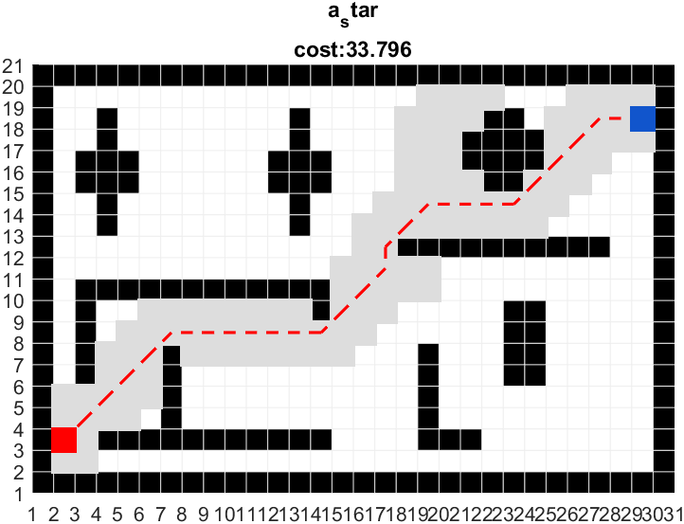
Example (A*)

Slide 8
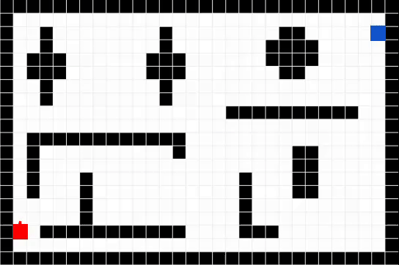
Example (DWA) - Interactive

Slide 9
Evaluation
Available variables
  path: path coordinates from the starting to the finish point
  cost: associated cost value – can be modified (source code)
Cost functions
  Distance
  Time
  …

Slide 10
Your task
Just like C or Java, Matlab is not inherently a simulator of any kind.
The Motion Planning examples comprise algorithms of various kind, and only some of these are iterative in nature. Most of them are algorithms that are design to operate on graphs. Since squared fields can be represented as graphs, they can solve the given problem, but it may not be optimally suited.
Your task is to
Make the motion planning examples work in 3D
Define a scenario inspired by real life
Make interesting observation that arise when you compare several of the give algorithms under different conditions.
Use basic statistics to compare different situations and summarize the performance of several algorithms
Must include Dijkstra and A*
Compare several 3D maps, compare different start and end position, or compare a map that changes while the path is being walked (requiring recomputation).
The main metric to compare is «cost». You could also look at
  path length in squares traveled
  required recomputations (when paths change while moving)

