Slide 1

Experimental Design and Analysis
IN5060: Quantitative Performance Analysis

Slide 2
How to
Design a proper set of experiments for measurement.
Estimate the contribution of each alternative to the performance.
Check if the alternatives are significantly different.
Isolate the measurement errors.
Develop a model that best describes the data obtained.
Check if the model is adequate.

Slide 3
Example
Personal workstation design
  Processor: AMD Ryzen 3,5,9 or Intel Core i5, i7, i9.
  RAM size: 8G, 16GB, or 32GB bytes
  Storage: 512GB, 1TB, 2TB
  Workload: Gaming, managerial, or scientific.

Slide 4
Terminology
Response Variable: Outcome. E.g., throughput, response time
Factors (predictors): Variables that affect the response variable. E.g., CPU type, RAM size, etc...
Levels (treatment): The values that a factor can assume, E.g., RAM size has three levels: 8G, 16GB, or 32GB bytes
Primary Factors: The factors whose effects need to be quantified. E.g., CPU type, RAM size only, etc…
Secondary Factors: Factors whose impact need not be quantified. E.g., the workloads.
Replication: Repetition of all or some experiments.

Slide 5
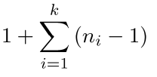

Experimental Design
The number of experiments, the factor level and number of replications for each experiment.
Simple Designs: Vary one factor at a time
  Not statistically efficient.
  Wrong conclusions if the factors have interaction.
Full Factorial Design: All combinations
  Can find the effect of all factors.
  Too much time and money.

Slide 6
How to choose the factors?
Domain knowledge is needed to define the primary/secondary factors
System limitations: controllable parameters, number of repetitions, etc…
Assume you want to measure the performance of a oprational 4G network, what factors can you control?

Slide 7
Statistical Significance
Dunn’s test is used to identify significant difference between the means of two or more distributions for a given confidence interval
Null Hypothesis: There is no significant difference between the two distributions
Alternative Hypothesis: There is significant difference between the two distributions.
Calculating the p-value: The p-value associated with each pairwise comparison is a measure of the statistical significance of the difference between the groups being compared. It tells you whether the observed difference between the groups is likely to be due to random chance or if it is statistically significant.

Slide 8
Statistical Significance
Interpretating the Dunn’s test
If the p-value is less than a specified significance level (α) (usually 0.05, 0.01 or 0.001), you can declare the difference to be statistically significant and reject the test's null hypothesis.
If the p-value is greater than the significance level, you fail to reject the null hypothesis, indicating that there is insufficient evidence to conclude a significant difference between the groups.
The lower the p-value, the more significant the difference is!

Slide 9
Modelling: Simple Linear Regression
Regression Model: Predict a response for a given set of predictor variables.
Response Variable: Estimated variable
Predictor Variables: Variables used to predict the response. predictors or factors
Linear Regression Models: Response is a linear function of predictors.
Simple Linear Regression Models: Only one predictor

Slide 10
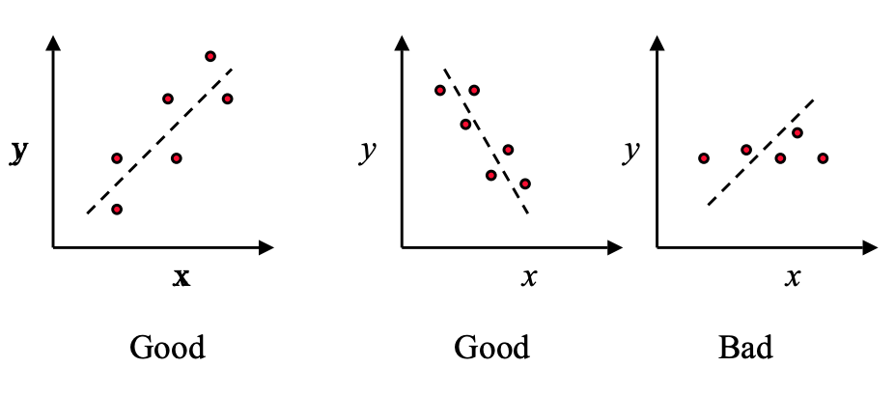
What is a good model?
Check visiually first how your data looks

Slide 11
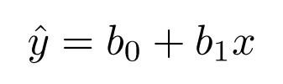


A simple good model
Choose the line that minimizes the sum of squares of the errors
where, is the predicted response when the predictor variable is x.
The parameter b₀ and b₁ are fixed regression parameters to be determined from the data.
Given n observation pairs {(x₁, y₁), …, (x_{n}, y_{n})}, the estimated response for the i^{th} observation is:

Slide 12

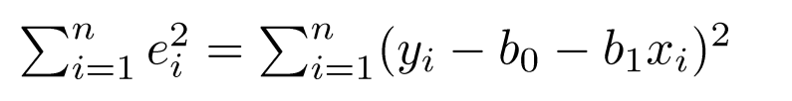
Minimizing the error
The error is:
The best linear model minimizes the sum of squared errors (SSE):

Slide 13
Common Mistakes in Experimentation
The variation due to experimental error is ignored.
Important parameters are not controlled.
Effects of different factors are not isolated
Simple one-factor-at-a-time designs are used
Interactions are ignored
Too many experiments are conducted
Remember the noise in real world measurements! We need STATISTICS ☺

Slide 14
Quantitative Performance Analysis
Real-world examples

Slide 15
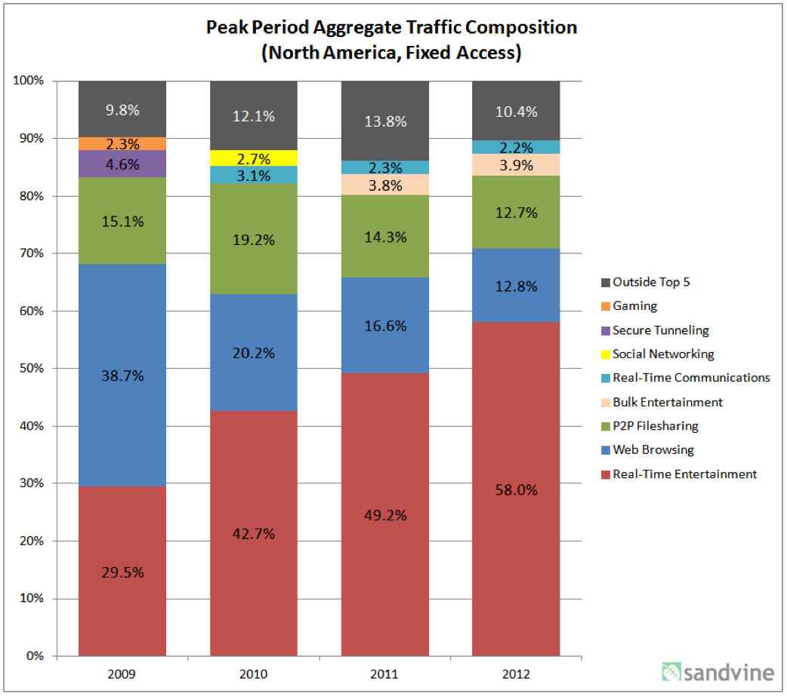
Measurement example
Development of traffic shares over time
A graph using percentages to express the share of application types on the Internet
no absolute values, only percentages
color as well as order allows easy recognition of types, as well as appearance of new types

Slide 16
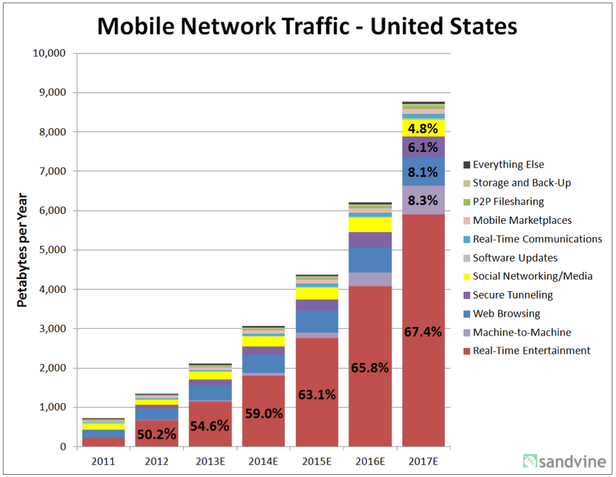
Measurement example
Development of absolute mobile traffic over time
A graph using absolute value to communicate the rapid growth of mobile traffic
percentages provided as text in graph
color as well as order allows easy recognition of types, as well as appearance of new types
note ”E” for estimates

Slide 17

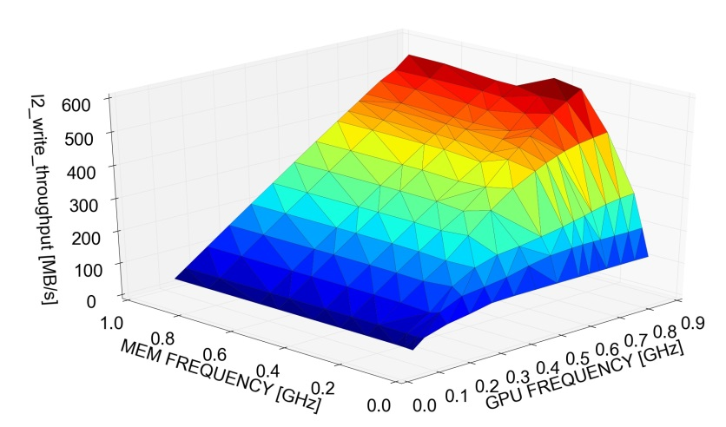
Measurement example
NVidia Tegra K1
impact of frequency on throughput
note: 4 dimensions in the presentation
additional dimension can be used to add information or to add expressiveness to one or more of the dimensions
Notes:
17

Slide 18
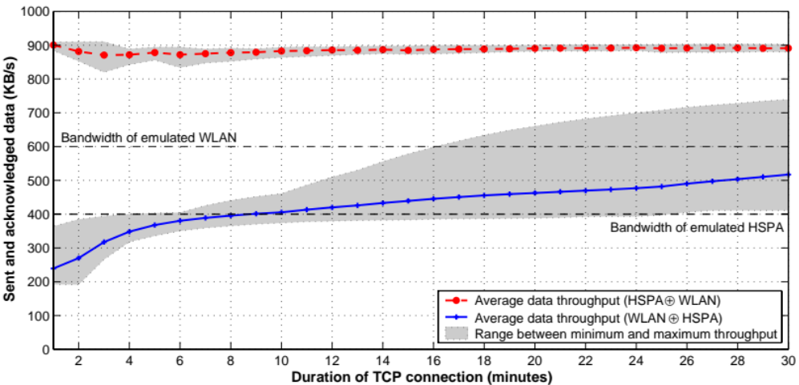
Measurement example
Linux TCP’s ability to recover from out-of-order delivery of packets
2D graph studying values for the average bandwidth of very long-lived TCP flows whose packets are alternately sent over 2 very different paths
details of short-term TCP behaviour are completely hidden
smoothness achieved by averaging
shaded areas illustrate uncertainty (range from min to max average throughput)

Slide 19
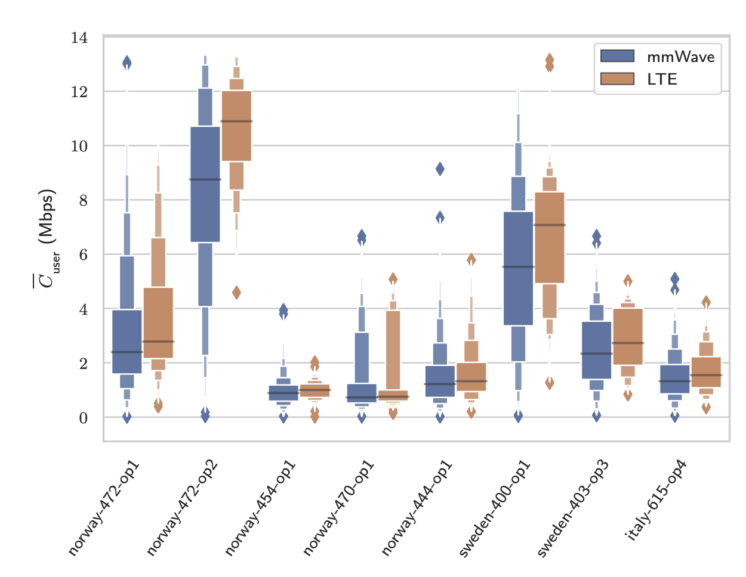
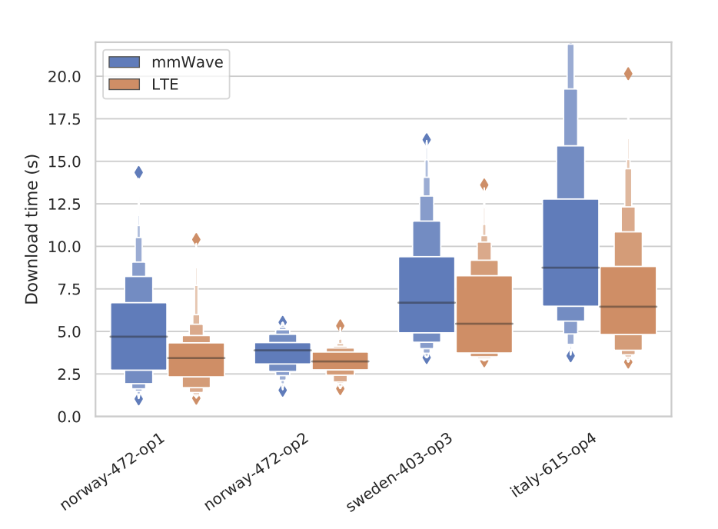
Measurement example
Investigation of the current operator SPEPs (used in 4G LTE networks) under mmWave-like dynamics using MONROE testbed
Different colors highlight the different settings
Boxplots display the first two letter values (the median and quartiles); letter-value plots display further letter values therefore more suitable for large datasets.

Slide 20
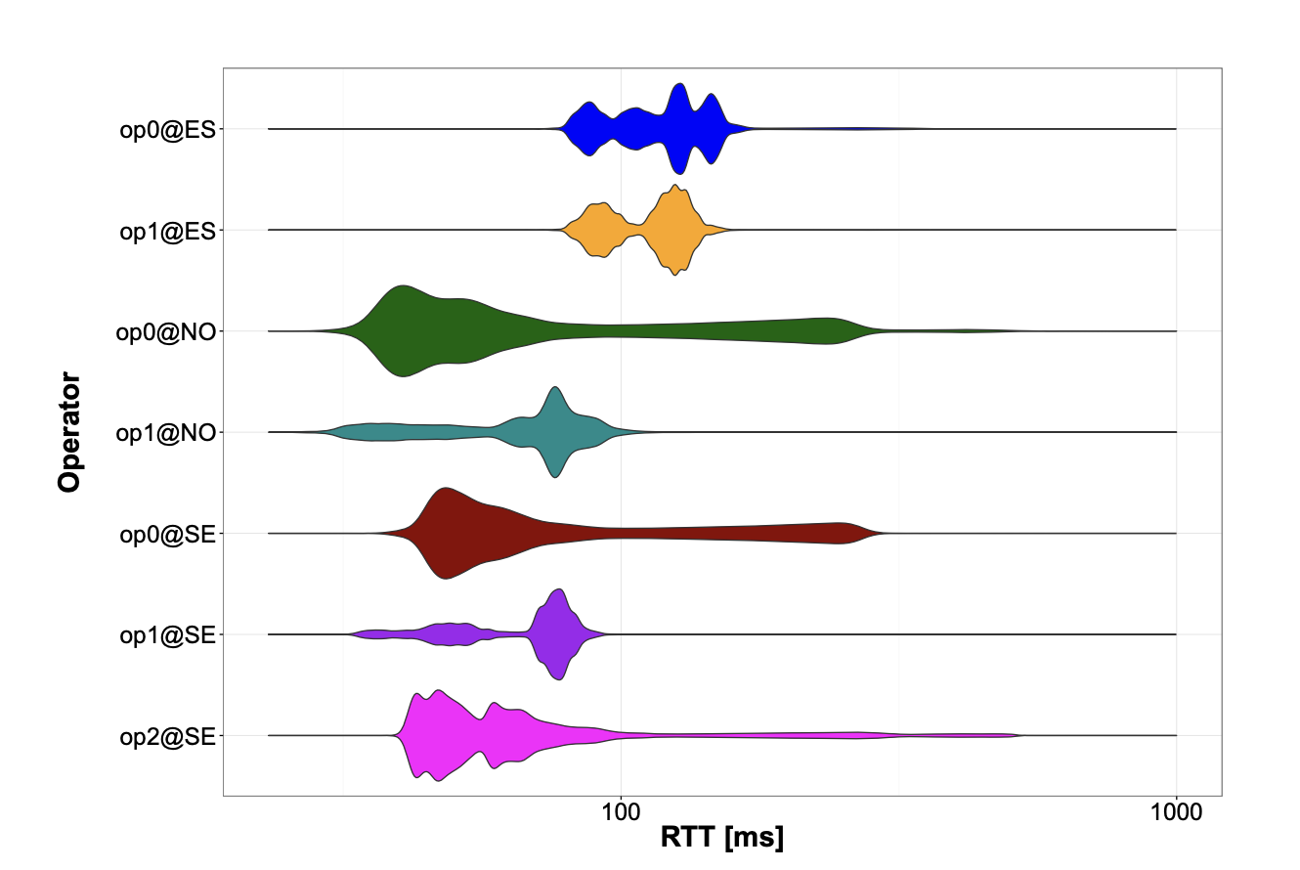
Measurement example
Investigation of latency for 4G LTE networks using MONROE testbed
Different colors highlight the different settings
Violin plots are similar to box plots, except that they also show the probability density of the data at different values.

Slide 21
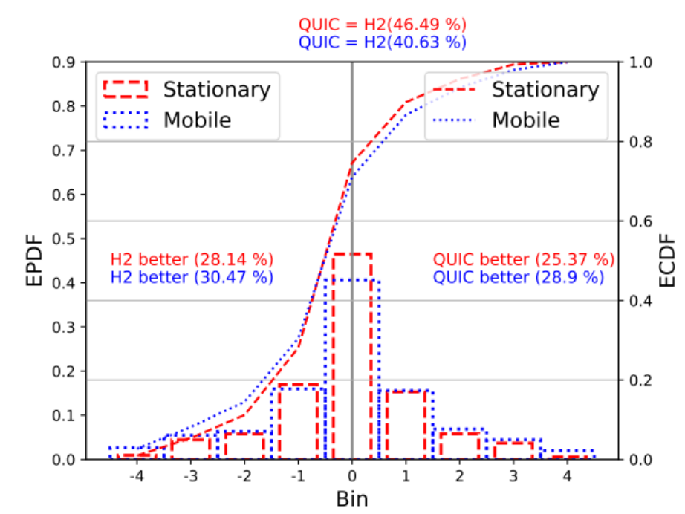
Measurement example
Performance comparison of HTTP2 and QUIC over 4G networks under stationary and mobile scenarios
Color together with pattern is used to differentiate different settings
Empirical PDF is presented together with empirical CDF
The bins are used to illustrate the relative difference levels

Slide 22
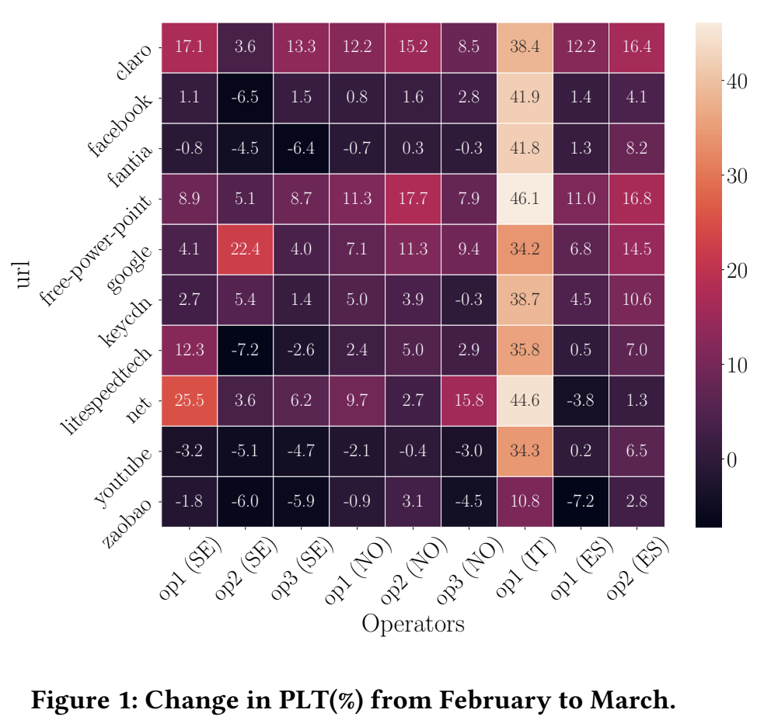
Measurement example
The impact of COVID-19 on the web performance over mobile networks
2D matrix form together with heatmap
The heatmap together with values in it provide more information
highly aggregated data
concept of certainty (e.g. confidence intervals) gets lost

Slide 23
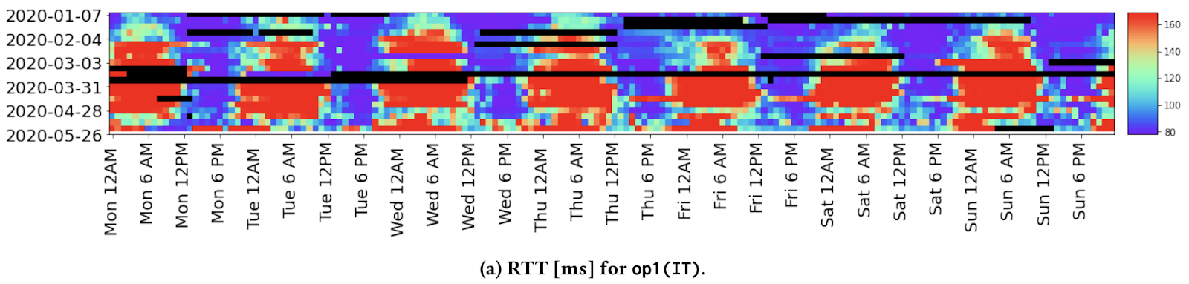
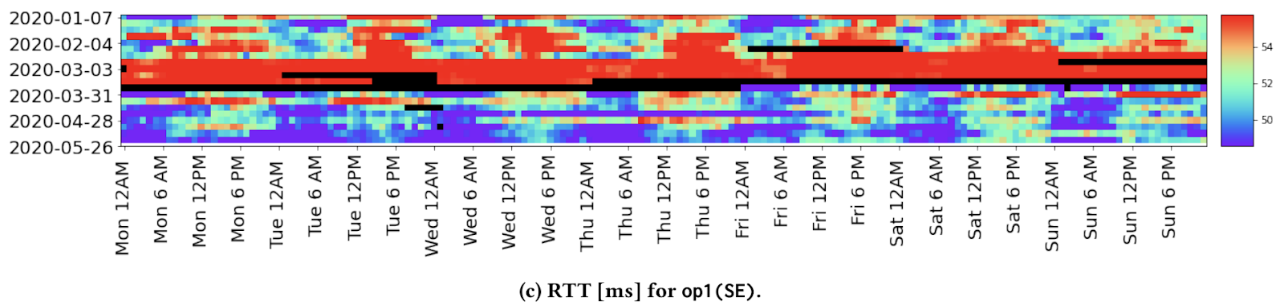
Measurement example
The impact of COVID-19 on the performance of mobile networks
2D information (date vs time of the dat) together with heatmap
Diurnal pattern comparison
Visual patterns are visible, but details are hidden

Slide 24
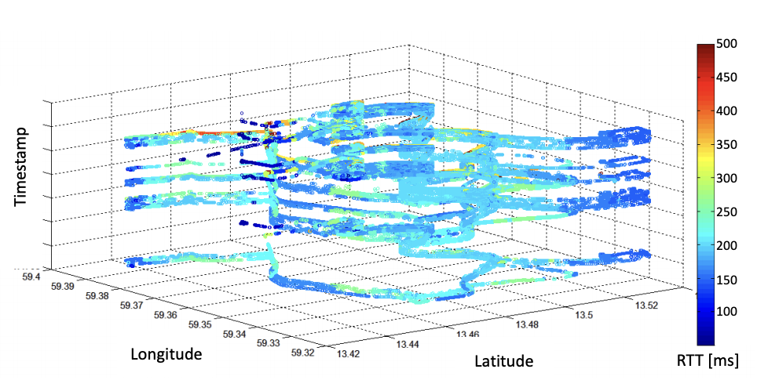
Measurement example
Investigation of latency over multiple trips under mobility for mobile networks
3D information together with heatmap
Multiple laps are shown using the Y-axis offset based on relative timestamps to visually show the different trips
Potentially have the map to visualize the location as well

Slide 25
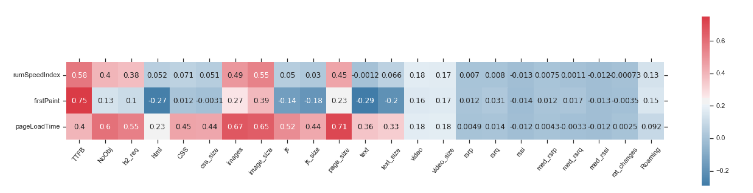
Measurement example (with some ML flavour)
The impact of different browsing features on the web quality of experience
Spearman’s correlation matrix
Heatmap has negative and positive values

