Slide 1

IN5060
Quantitative Performance Analysis
User studies

Slide 2
Why user studies?
Just because something is technically possible doesn’t mean it improves human experiences.
  8K video on a 2015 iPhone?
You cannot be sure that a new technology can rely on old assumptions.
  in games, higher frame rates are good for fluid gameplay
  but the actual reason is that processing loops are tied to frame rate, so higher frame rate leads to faster rendering
You cannot be sure that your own intuition holds for the majority of humankind.
  timed text must scroll from right to left, language-independent
  Powerpoint menus should be at the top of the window, independent of OS style guide and screen aspect ratio

Slide 3
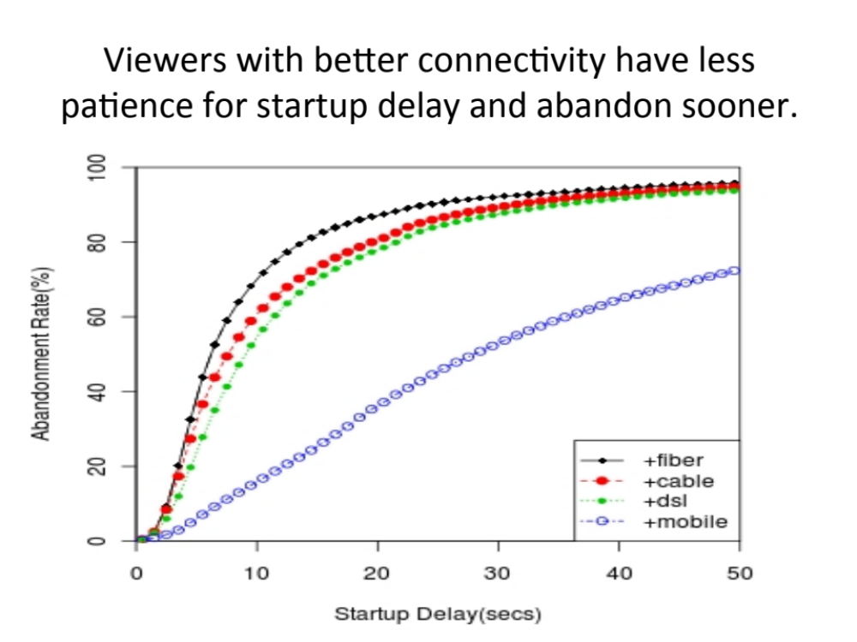
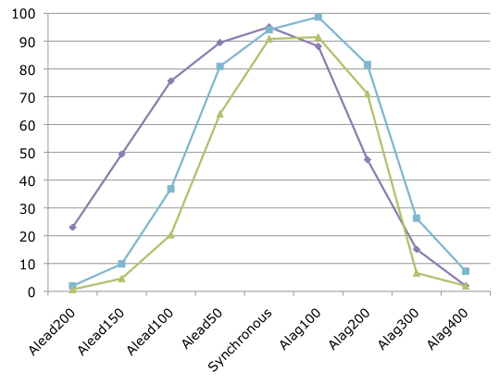
Why user studies?
Creating objective models
Called QoE estimation or QoE prediction
Evaluate new products or version without new user studies
Measurable
Comparable
QoE: Quality of Experience
A measure of users’ satisfaction
Term is very generic
QoE can express the distribution of a population’s satisfaction with a product
QoE can express the percentile of a population that is satisfied with a parameter combination
Surely airline seating targets a satisfaction percentile of 50 ...

Slide 4
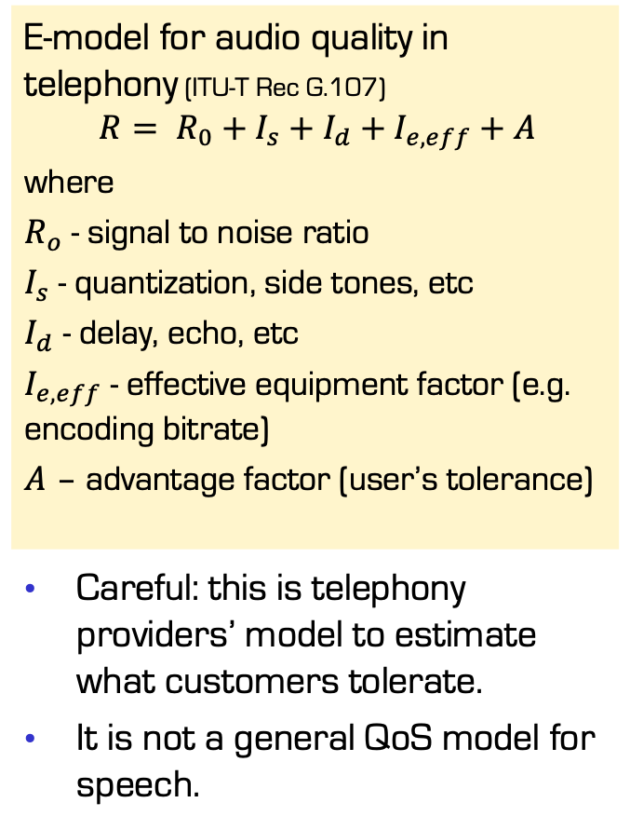
Why user studies?
Creating objective models
Called QoE estimation or QoE prediction
Evaluate new products or version without new user studies
Measurable
Comparable
Desirable model features
Simple
Linear dependencies
One-dimensional Euclidean result
E-model for audio quality in telephony (ITU-T Rec G.107)
$$R= R_{0}+I_{s}+I_{d}+I_{e,eff}+A$$
where
$R_{o}$ - signal to noise ratio
$I_{s}$ - quantization, side tones, etc
$I_{d}$ - delay, echo, etc
$I_{e,eff}$ - effective equipment factor (e.g. encoding bitrate)
$A$ – advantage factor (user’s tolerance)
Careful: this is telephony providers’ model to estimate what customers tolerate.
It is not a general QoS model for speech.

Slide 5
Why user studies?
Creating objective models
Called QoE estimation or QoE prediction
Evaluate new products or version without new user studies
Measurable
Comparable
Desirable model features
Simple
Linear dependencies
One-dimensional Euclidean result
Situation- and content-independent
QoE computable from QoS
QoS: Quality of Service
A measure of observed system states
Typically multi-dimensional, several metrics
Usual in networks
  Latency in ms
  Jitter in ms
  Packet loss rate in %
  Bandwidth in Mbps
Usual in clouds
  Uptime in %
  CPUs in #
  Storage in TB
  ...

Slide 6
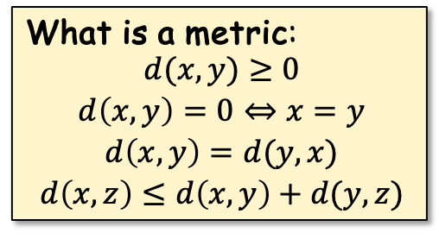
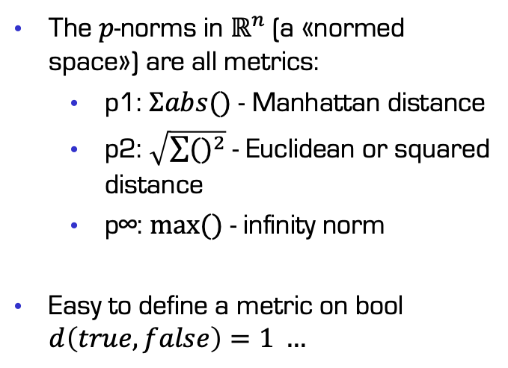
Why user studies?
QoS: Quality of Service
A measure of observed system states
Typically multi-dimensional, several metrics
Usual in networks
  Latency in ms
  Jitter in ms
  Packet loss rate in %
  Bandwidth in Mbps
Usual in clouds
  Uptime in %
  CPUs in #
  Storage in TB/year
  ...
What is a metric:
$$\begin{matrix}\begin{aligned}d(x,y)≥0 \\ d\left(x,y\right)=0⇔x=y\end{aligned} \\ d\left(x,y\right)=d(y,x) \\ d\left(x,z\right)≤d\left(x,y\right)+d(y,z)\end{matrix}$$
The $p$-norms in $ℝ^{n}$(a «normed space») are all metrics:
  p1: $Σabs()$ - Manhattan distance
  p2: $\sqrt{\sum{{()}^{2}}}$ - Euclidean or squared distance
  p∞: $max⁡()$ - infinity norm
Easy to define a metric on bool $d\left(true,false\right)=1 …$

Slide 7
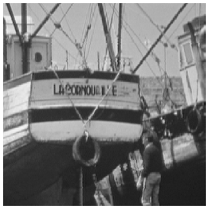
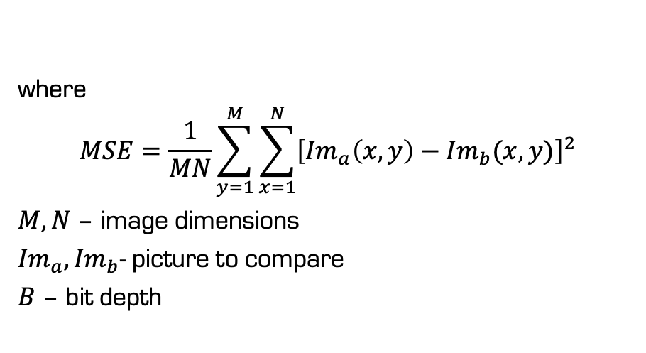
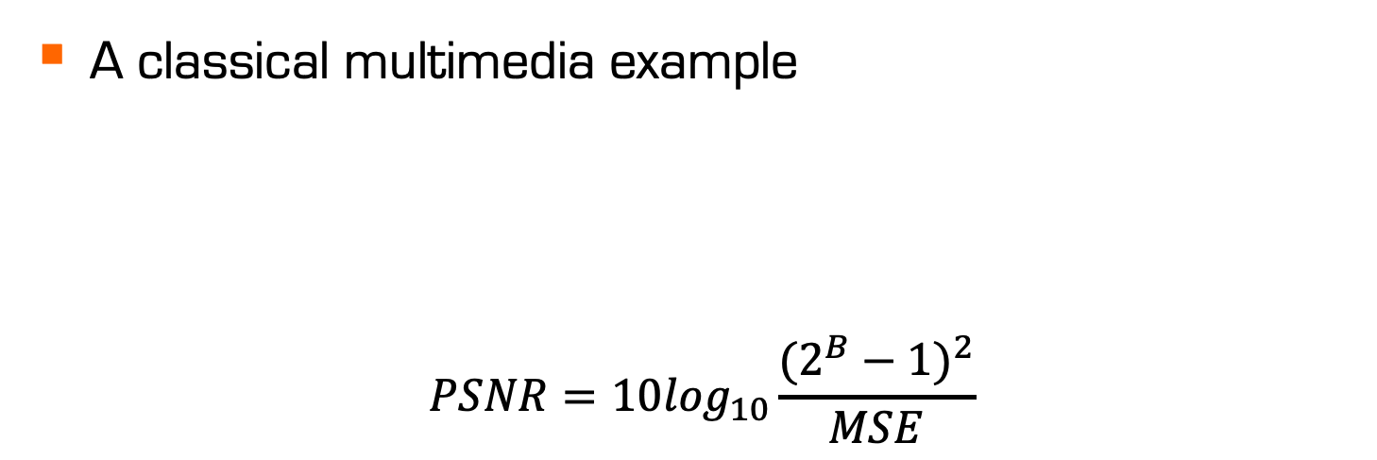
Why user studies?
A classical multimedia example
$$PSNR=10\log_{10}\frac{{(2^{B}−1)}^{2}}{MSE}$$
Peak Signal-to-Noise Ratio
A prevalent video quality metric
where
$$MSE=\frac{1}{MN}\sum_{y=1}^{M}{\sum_{x=1}^{N}{{\left[{Im}_{a}\left(x,y\right)−{Im}_{b}(x,y)\right]}^{2}}}$$
$M,N$ – image dimensions
${Im}_{a},{Im}_{b}$- picture to compare
$B$ – bit depth
Good quality estimate for sending analogue video from broadcast towers to analogue TVs

Slide 8
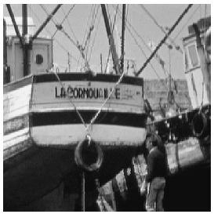

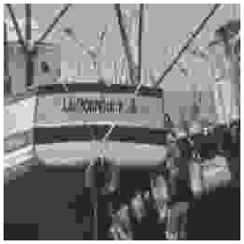
Why user studies?
Reference
Example from
Prof. Touradj Ebrahimi,
ACM MM'09 keynote
PSNR = 24.9 dB
PSNR = 24.9 dB
PSNR = 24.9 dB

Slide 9
Why user studies?
Peak Signal-to-Noise Ratio
A prevalent video quality metric
In addition to this:
several different PSNR computations for color images
different PSNR for different color spaces (RGB,YUV)
visible influence of the encoding format
These problems hurt all metrics that are based on PSNR
Improved by image quality metrics such as
SSIM variants
rate distortion metrics

Slide 10
Why user studies?
Peak Signal-to-Noise Ratio
A prevalent video quality metric
In addition to this:
several different PSNR computations for color images
different PSNR for different color spaces (RGB,YUV)
visible influence of the encoding format
Takeaway 1:
Never believe a statement where PSNR is used for Internet video quality estimation
These problems hurt all metrics that are based on PSNR
Improved by image quality metrics such as
SSIM variants
rate distortion metrics
Takeaway 2:
Never reuse any QoE estimator in a new context without verifying that is works for this by conducting new user studies

Slide 11
Quality assessment methods
most of these are described and named in Recommendations (standards) of the ITU

Slide 12
Methods
Single Stimulus methods
  ACR: Absolute Category Rating
    each sample separately, no reference
    rating on 5-point Likert scale
      possibly named categories: intolerable … excellent
      possibly numbered categories: 1 … 5
    video sample should be 8-12 seconds long
  ACR-HR: Absolute Category Rating with Hidden Reference
    start like ACR
    calculate ratings as differences between reference rating and sample rating
  SSCQE: Single Stimulus Continuous Quality Evaluation
    watch a single (long) sample with quality that varies over time
    use a slider (0-100) for continuous rating
1--5
1--5
0--100

Slide 13
Methods
Double Stimulus methods
  DSCQS: Double Stimulus Continuous Quality Scale
    watch unimpaired reference and impaired sample in random order
    repeat watching as long as desired
    rate quality of both on continuous scale 1-5
  DSIS: Double Stimulus Impairment Scale / DCR: Degradation Category Rating
    watch unimpaired reference followed by impaired sample
    use categories to rate
    (impairment imperceptible … impairment very annoying)
  PC: Pair Comparison
    watch two impaired samples
    rate which one was better
    randomness is extremely important
1--5
1--5
left -- right

Slide 14
Methods
Other methods
  SDSCE: Simultaneous Double Stimulus for Continuous Evaluation
    double stimulus method where two samples are shown side-by-side
    rating on continuous scale 0-100
  SAMVIQ: Subjective Assessment Methodology for Video Quality
    explicit reference, hidden reference, up to 10 measured samples
    participant may repeat watching, last score stands
    continuous scale 0-100
0--100
0--100

Slide 15
Methods
Pair Comparison
  Very robust to untrained participants
  Requires a much larger study
  Results can be converted to an interval scale
    by counting for each example how often is was «better»
    by taking the percentage or fraction of A or B answers

Slide 16
Types
Categorial ratings
  Categorical ratings may be ordinal
    ordinal means that they can be ordered
      e.g.: strongly disagree, disagree, neutral, agree, strongly agree
    It is very advantageous if
    (a) values can be assigned to categories, and
    (b) the distances between neighbouring values are the same (equidistance)
  But they don’t have to be ordinal
    For example
      red, green, blue
      child, adult
      Africa, America, Asia, Australia, Europe
    They may not have any ordering
    You can only check if participants’ selections are different with statistical relevance

Slide 17
Types
Continuous ratings
  Training definitely required
  Often implemented using sliders, gauges, bars, ...
  With 0 ... 100 range, fractions are not relevant
ITU’s categorical ratings
  Understood as interval variables
  Careful with the named categories
    Users must be trained to understand the categories as equidistant
  Usually associated with numbers: a Likert scale
    5-point Likert: 1 ... 5 (neutral -> good) or -2 ... 2 (bad -> good)
    Sometimes 7-point Likert
    Implicitly understood as linear, can be combined with labels «best» and «worst» but preferable not terms for every value

Slide 18
Types
Not trivial to translate between them
  Continuous tends to avoid extremes, Categorical doesn’t.
  Before translation
    Calibration: study the same examples with the same population but getting both ratings
    Perform regression to fit a non-linear function
    (typically a 2nd degree polynom)

Slide 19
User studies and human memory
“Influence of Primacy, Recency and Peak effects on the Game Experience Questionnaire”
paper by Saeed Shafiee (Simula) et al.

Slide 20
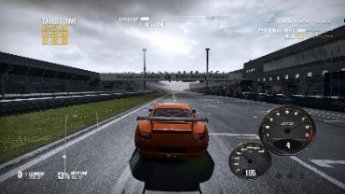
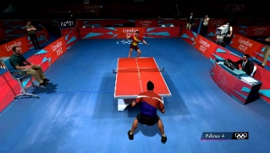
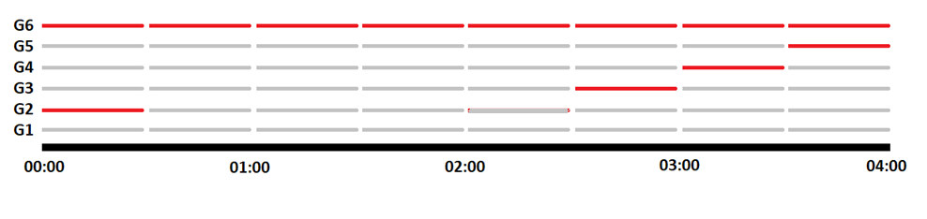
Example: delay in cloud games
“Influence of Primacy, Recency and Peak effects on the Game Experience Questionnaire”
Always delayed reference
30 second phase: 0ms delay (gray), 300ms delay (red)
6 different
conditions
Never delayed reference
Notes:
Need for Speed 2 --- Tabletennis

Slide 21
Example: delay in cloud games
 | not at all | slightly | moderately | fairly | extremely
I felt content
I felt skilful
I was interested in the game's story
I thought it was fun
I was fully occupied with the game
I felt happy
It gave me a bad mood
I thought about other things
I found it tiresome
I felt competent
I thought it was hard
It was aesthetically pleasing
I forgot everything around me
I felt good
I was good at it
“Influence of Primacy, Recency and Peak effects on the Game Experience Questionnaire”
GEQ – game experience
questionnaire
  33 Questions
  Assessing seven aspects of
  gaming QoE
  Peak Effect
  Very popular and widely used
  Standard: ITU-T P.Game
Additional questions
  How do you rate the overall
  quality of your gaming
  experience?
  The game has responded as
  expected to my inputs.
  I had control over the game.

Slide 22
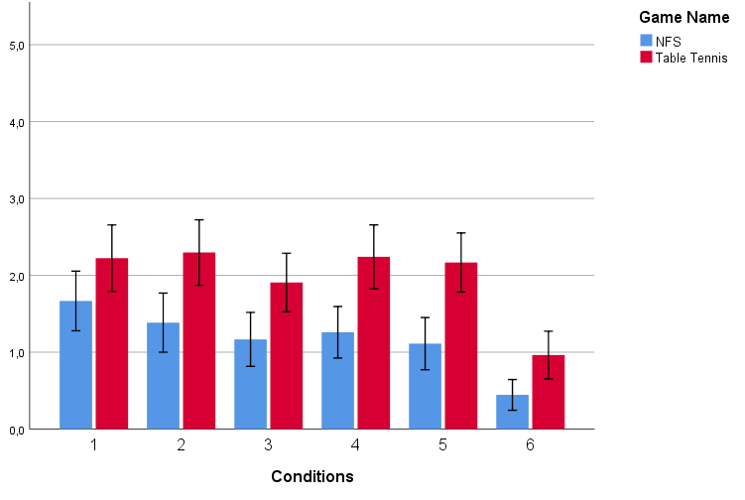
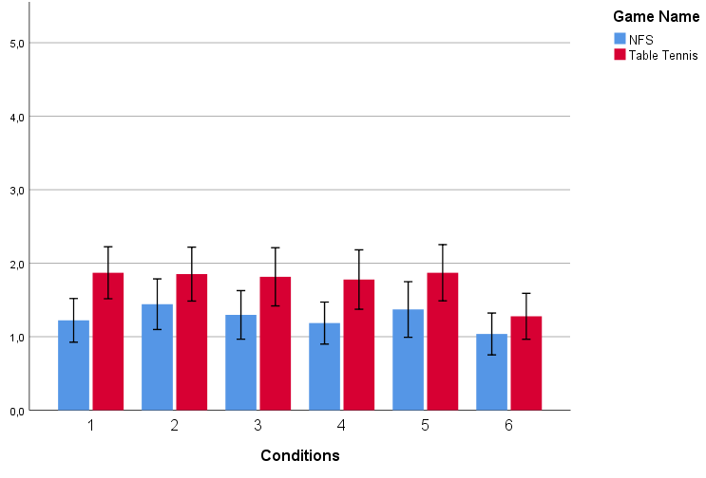
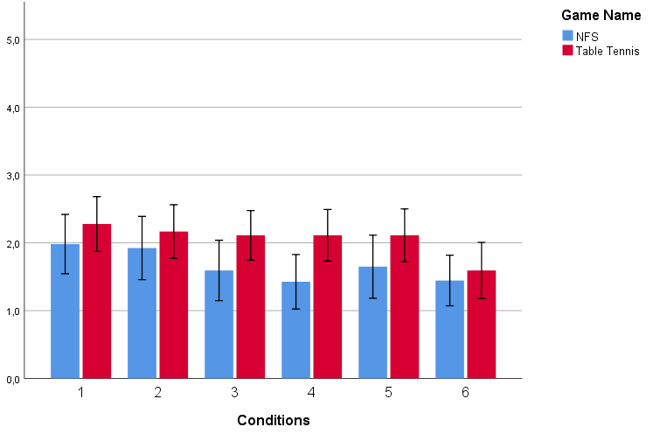
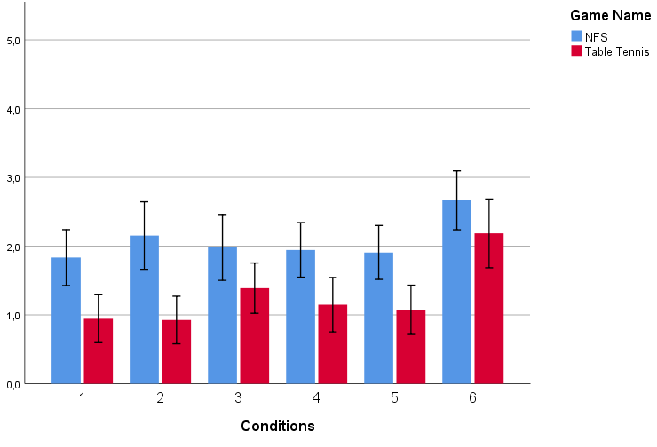
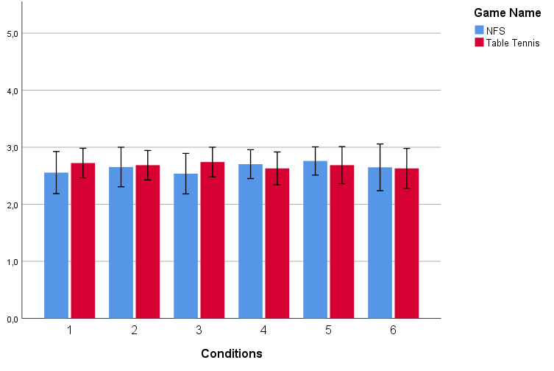
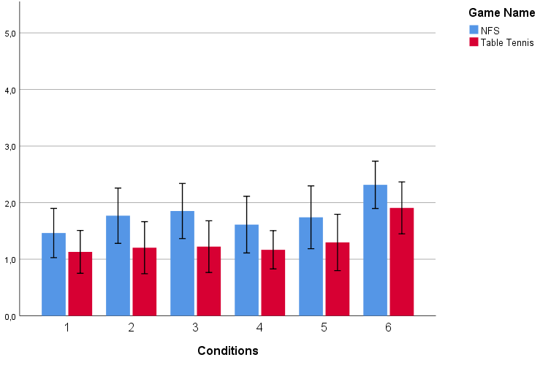
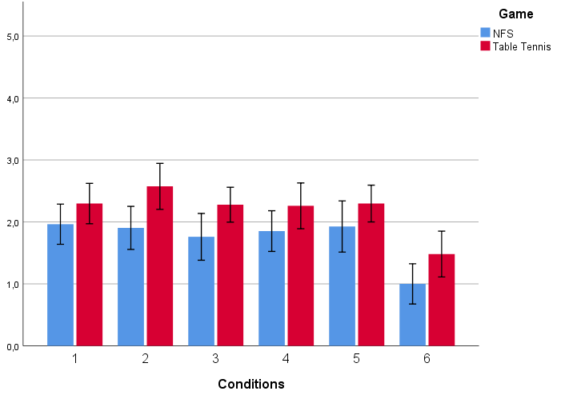
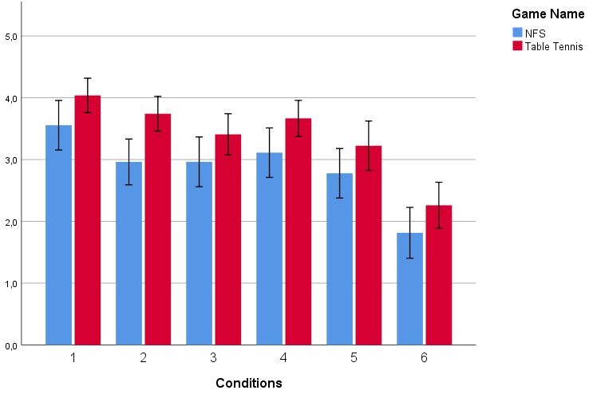
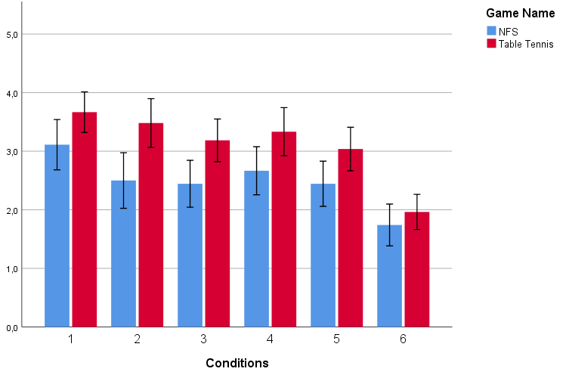
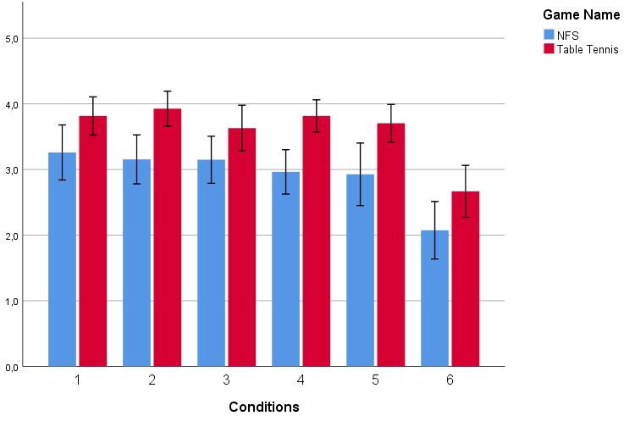
Example: delay in cloud games
“Influence of Primacy, Recency and Peak effects on the Game Experience Questionnaire”
Competence
Sensory and Imaginative Immersion
Flow
Tension
Challenge
Mean Score
Mean Score
Mean Score
Mean Score
Mean Score
Negative Affect
Positive Affect
Responsiveness
Controllability
Overall Gaming Quality
Mean Score
Mean Score
Mean Score
Mean Score
Mean Score
Notes:
Games: Need for Speed 2 + Table Tennis
G1 is worst-case reference, G6 is best-case reference
Primacy: start of show, recency: end of show, peak: anywhere
Need for speed (Blue) shows >95% confidence in differences for Flow
NfS & TT have >95% confidence differences in responsiveness and controllability

Slide 23
Example: delay in cloud games
“Influence of Primacy, Recency and Peak effects on the Game Experience Questionnaire”
Responsiveness
NFS & TT have >95% confidence differences
Mean Score
Notes:
Games: Need for Speed 2 + Table Tennis
G1 is worst-case reference, G6 is best-case reference
Primacy: start of show, recency: end of show, peak: anywhere
Need for speed (Blue) shows >95% confidence in differences for Flow
NfS & TT have >95% confidence differences in responsiveness and controllability

Slide 24
Example: delay in cloud games
“Influence of Primacy, Recency and Peak effects on the Game Experience Questionnaire”
Flow
NFS has >95%
confidence differences
Mean Score
Notes:
Games: Need for Speed 2 + Table Tennis
G1 is worst-case reference, G6 is best-case reference
Primacy: start of show, recency: end of show, peak: anywhere
Need for speed (Blue) shows >95% confidence in differences for Flow
NfS & TT have >95% confidence differences in responsiveness and controllability

Slide 25
How tolerant are video users to startup delay?
paper at IMC 2012 by
Ramesh K. Sitaraman
(UMass Amherst & Akamai) and
S. Shunmuga Krishnan (Akamai)

Slide 26
Main result
Slides by Prof. Ramesh Sitaranam, Umass, Amherst (shown with permission)
“Video Stream Quality Impacts Viewer Behavior: Inferring Causality using Quasi-Experimental Designs”, S. S. Krishnan and R. Sitaraman, ACM Internet Measurement Conference (IMC), Boston, MA, Nov 2012

Slide 27
Data set
One of the most extensive data sets to that date
analyzed data from a widely deployed Akamai client-side plug-in
  10 days
  12 content providers
  23 million views
  216 million minutes of video played
  102.000 videos
  1431 TB of video bytes
  3 continents
  VoD only

Slide 28
Flickering in video streaming
by Pengpeng Ni (Simula) et al., 2011

Slide 29

Image-based metrics can fail badly:
Flickering

Slide 30
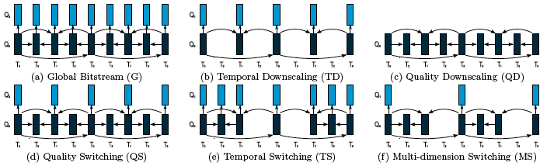
Layer fluctuation in scalable video streaming
Temporal Switching (TS) : Bit-rate adaptation in temporal dimension
Quality Switching (QS) : Bit-rate adaptation in spatial dimension
Multi-dimension Switching (MS): combines the above two switching

Slide 31



3 origins of flicker
Flicker arises from recurrent changes in spatial or temporal quality, some so rapid that the human visual system only perceives fluctuations within the video.
Noise flicker
Blur flicker
Motion flicker
Compression scaling
Resolution scaling
Frame rate scaling
Notes:
When layer switching become visible, we call it an artifact. Now artifacts refer to any visible errors caused by compression, transmission or decoding.
Excessive removal of information
Excessive reduction of quality
Missing or incorrectly assembled packets
The flicker artifact arises from layer adaptations taking place during ongoing sessions. Distinguish between three types of flicker:

Slide 32
Assessment of video adaptation strategies
To cope with the bandwidth fluctuation, which scalability dimension is generally preferable for video adaptation?
Within each dimension, which scaling pattern generates the least annoying flicker effect?
Is it possible to control the annoyance of flicker effects?
How is subjective video quality related to other factors, such as content, devices?

Slide 33
  We create several subjective tests
Previous Findings
  Human perception of video quality are content and context dependent
  There is no general preference order of scaling dimensions
  High frequency may cause flicker effect that is regarded as worse than constant low image quality
  In mobile scenario, frame rates above 12 fps do not cause noticeable visual artifacts
  In HDTV scenario, a frame rate of 12 fps does generate noticeable motion jerkiness
Challenges of subjective tests:
  Efficient and reliable experimental design that avoids fatigue and learning effect

Slide 34
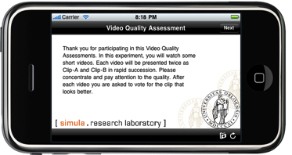

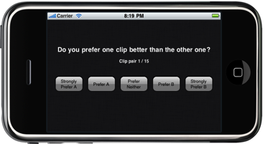
Subjective field study for pre-testing
IPhone application tool for audiovisual quality assessment
  Automate test procedure, user-friendly interface, easy to operate
  Robust design, considering potential interruption during the test
  Suitable for field study, can be easily applied in different scenarios
Our flicker effect study
  Location: In the library of the Oslo university
  24 paid participants, students with different education (few IT)
  Test was divided into 10 experimental units, each lasting about 10 minutes
  Participants were free to choose any number of the 10 experiment units

Slide 35
Video content selection
Spatial Information
Controlling content dependency
only long-distance shots
no or slow camera movement
Temporal Information

Slide 36
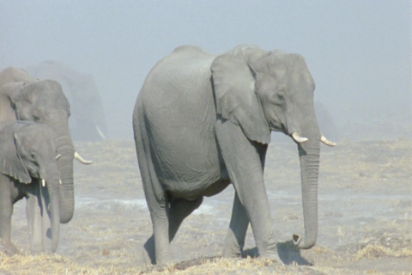
Noise flicker example
Noise flicker
Amplitude: QP24 – QP40
Frequency: 10f / 3 Hz

Slide 37

Blurriness flicker example
Blur flicker
Amplitude: 480x320px – 120x80px
Frequency: 15f / 2 Hz

Slide 38
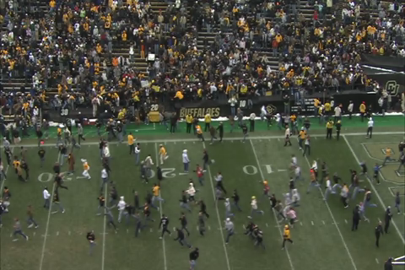
Motion flicker example
Motion flicker
Amplitude: 30fps – 3fps
Frequency: 6f / 5 Hz

Slide 39
How to describe different layer fluctuations?
Layer fluctuation pattern
  Frequency: The time interval it takes for a video sequence return to its previous status
  Amplitude: The quality difference between the two layers being switched
  Dimension: Spatial or temporal, artifact type
Layer Frequency and Amplitude are the interesting factors in our subjective test
Notes:
Current technologies provided us adaptation mechanisms for streaming multimedia in heterogeneous environments. For example, scalable video is an attractive video adaptation technique. A scalable video stream can be truncated into several different sub streams and all of the sub streams are still decodable. But the decoded video of the sub stream have different image quality, frame rate, and frame size. The different truncation pattern results in different kinds of quality impairments. There is no robust quality metric that can tell us which pattern is in general perceived better by our user than the other.
However, it has been reported that current known objective metric fails in accurately predicting human's perception.

Slide 40
How to describe different layer fluctuations?
Layer fluctuation pattern
  Frequency: The time interval it takes for a video sequence to return to its previous status
  Amplitude: The quality difference between the two layers being switched
  Dimension: Spatial or temporal, artifact type
Layer Frequency and Amplitude are the interesting factors in our subjective test
Notes:
Current technologies provided us adaptation mechanisms for streaming multimedia in heterogeneous environments. For example, scalable video is an attractive video adaptation technique. A scalable video stream can be truncated into several different sub streams and all of the sub streams are still decodable. But the decoded video of the sub stream have different image quality, frame rate, and frame size. The different truncation pattern results in different kinds of quality impairments. There is no robust quality metric that can tell us which pattern is in general perceived better by our user than the other.
However, it has been reported that current known objective metric fails in accurately predicting human's perception.

Slide 41
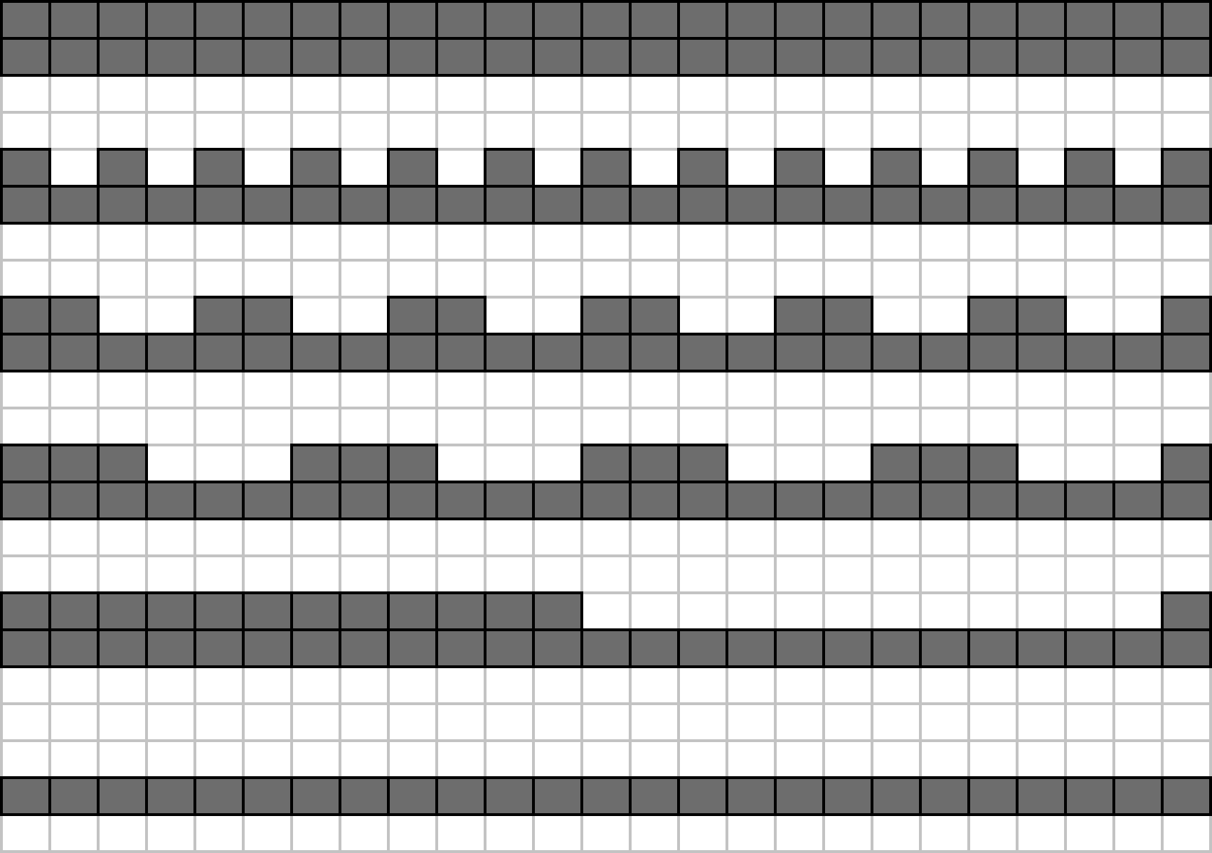
Layer fluctuation pattern in Spatial dimension
Full bit stream, Q_{H}
F =1/2, A = Q_{H}-Q_{L}
F = 1/4 , A = Q_{H}-Q_{L}
F = 1/6 , A = Q_{H}-Q_{L}
F = 1/24 , A = Q_{H}-Q_{L}
Sub stream Q_{L}
Bandwidth consumption in all of these patterns is the same, due to the same amplitude.

Slide 42
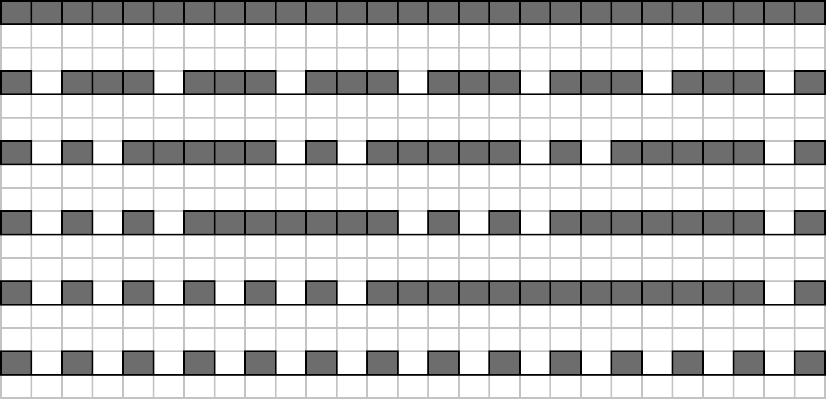
Layer fluctuation pattern in Temporal dimension
Full bit stream, 30fps
F =1/4, A = 30-15fps
F = 1/8 , A = 30-15fps
F = 1/12 , A = 30-15fps
F = 1/24 , A = 30-15fps
Sub stream 15fps
Although the average bit-rate is the same, the visual experience of different patterns may not be identical.

Slide 43
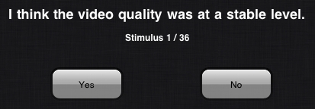
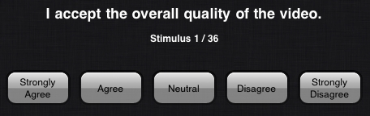
Method
Participants
28 paid, voluntary participants
9 females, 19 males
Age 19 – 41 years (mean 24)
Self-reported normal hearing,
and normal/corrected vision
Procedure
Field study at university library
Presented on iPod touch devices
- Resolution 480x320
- Frame rate 30 fps
12 sec video duration
Random presentations
Optional number of blocks
Notes:
Semi-controlled environment
Full-factorial design in the sense that all period levels and all amplitude levels, were cross-paired.
Such a design results in a lot of trials, so we let participants decide when they’d had enough.
Divided study into blocks according to flicker type. Each block covered all possible combinations of content, period levels and amplitude levels.
Within each block, all trials were fully randomised. No single participant would watch the videos in the same order.
For each trial they would watch a video, then give two responses. One relating to the stability of the quality (first screen-shot) and one relating to the acceptability of the quality (second screen-shot). Measured on 5-point Likert scale.

Slide 44
Test procedure
We use the Single Stimulus (SS) method to collect responses from subjects
  Each test stimulus is displayed only once
Each stimulus lasts for 12 seconds
based on previous study about memory effect
Two responses collected after each stimulus
Stimulus 1
Stimulus 2
vote
12 seconds
0.5 s
0.5 s
  I think the video quality was at a stable level: Yes or No
  I accept the overall quality of the video: 5-likert scale
Strongly Agree
Neutral
Strongly Disagree

Slide 45
Design & Analysis
Repeated measures
Friedman’s Chi-square test
Stimuli blocked by flicker and amplitude
Responses to stability measure converted to binomial scores
Quality ratings converted to ordinal scores ranging from -2 (least acceptable) to 2 (most acceptable)
  we can assume ORDER between scores
  we cannot assume equidistance between scores
Results for experimental stimuli assessed relative to control stimuli of constant high or low quality
Notes:
Repeated-measures, participants provide responses to all stimuli. As opposed to a comparison study where you might look at a difference between two groups.
Data are not on an interval scale, the difference between strongly agree and agree is not necessarily the same as the difference between agree and neutral. Non-parametric.

Slide 46
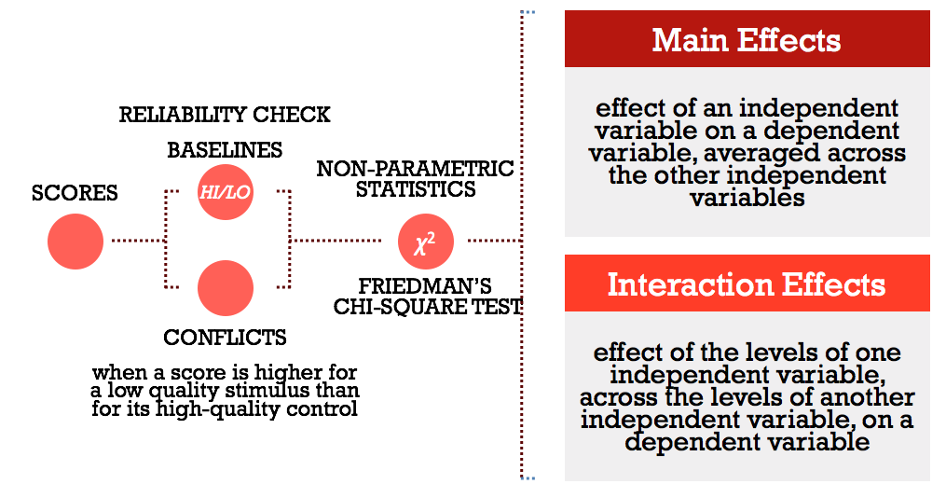
Analysis
Notes:
Conflicts: instances where participants have provided an incorrect response or where they have become tired or bored and given the same response over and over.
Independent variable: content, period or amplitude.
Dependent variable: perception of stability or acceptance of quality

Slide 47
Stability scores - Period
I think the video quality was at a stable level: Yes or No
Perceived quality stability across period levels for
Noise flicker
Perceived quality stability across period levels for
Blur flicker
Perceived quality stability across period levels for
Motion flicker

Slide 48
Stability scores - Amplitude
I think the video quality was at a stable level: Yes or No
Perceived quality stability across amplitude levels for
Noise flicker
Perceived quality stability across amplitude levels for
Blur flicker
Perceived quality stability across amplitude levels for
Motion flicker

Slide 49
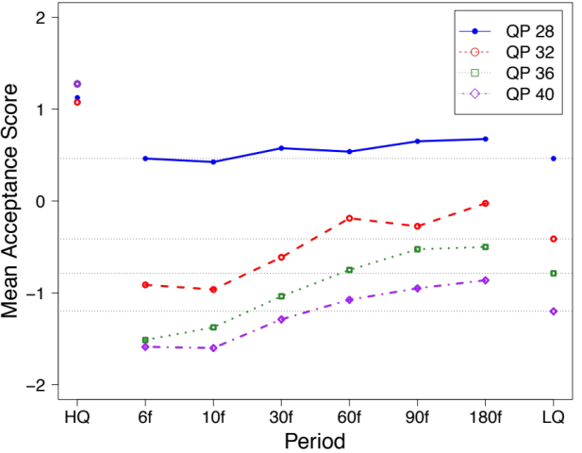
Video quality
I accept the overall quality of the video: 5-likert scale
Constant high quality references
Constant low quality reference, QP28
Not investigated here:
relation between qualities
Noise
L1 | QP24
L0 | QP28, QP32, QP36, QP40
Period | 1/5s, 1/3s, 1s, 2s, 3s, 6s
Content | 4 mid/long distance shots

Slide 50

Acceptance - Noise flicker
I accept the overall quality of the video: 5-likert scale

Slide 51
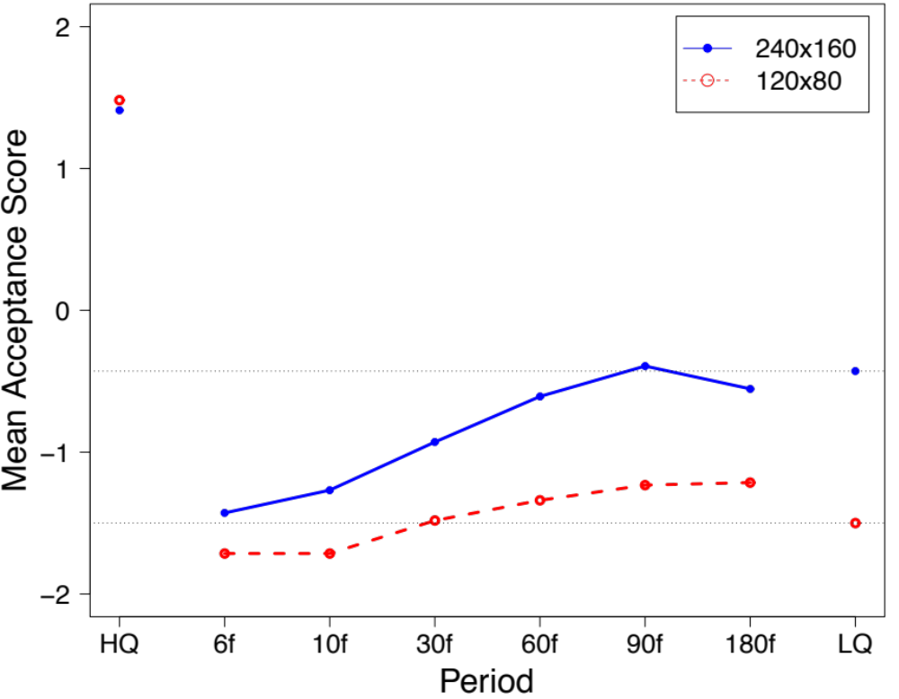
Acceptance – Blur flicker
I accept the overall quality of the video: 5-likert scale

Slide 52
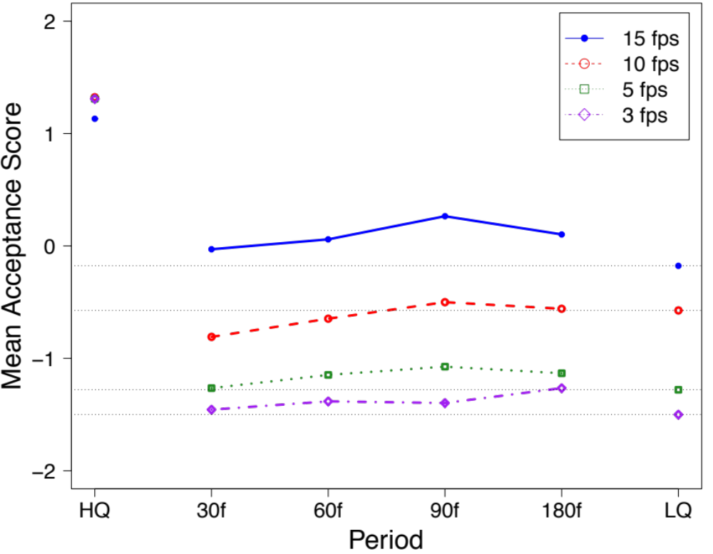
Acceptance – Motion flicker
I accept the overall quality of the video: 5-likert scale

Slide 53
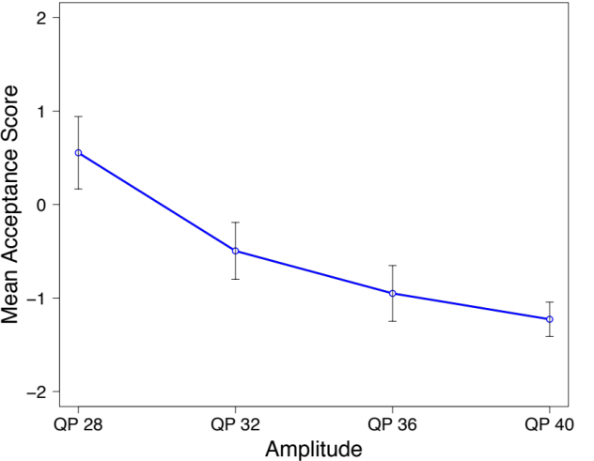
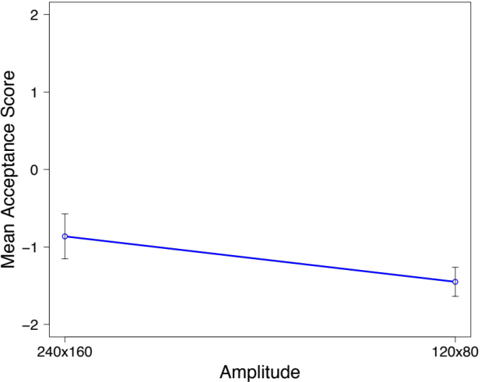
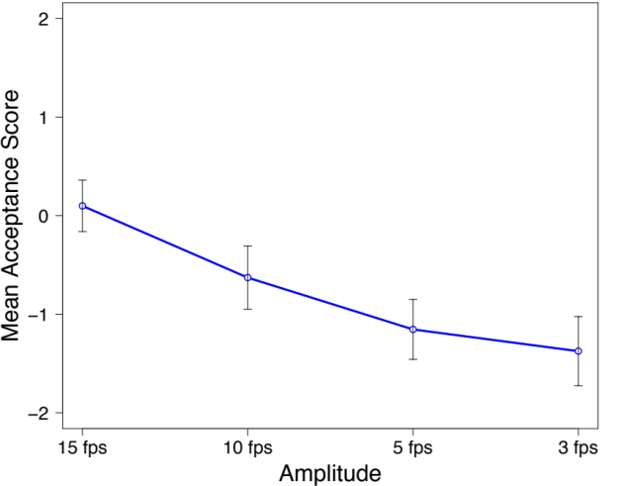
Acceptance
I accept the overall quality of the video: 5-likert scale
Noise
Blur
Motion

Slide 54
Conclusions
With longer flicker frequencies (high periods), acceptance of video quality increases in the spatial dimension
Amplitude (quality difference) has larger effect than frequency, both for stability and acceptance
For noise flicker, large quality differences are rated more acceptable with less frequent quality shifts.
For blur flicker, improved acceptance with less frequent shifts is more pronounced for the smallest quality difference.
The flicker effect varies across contents, particularly for motion flicker.
The three types of flicker have different influences on stability and quality acceptance scores. Scores are generally lower for blur flicker.

Slide 55

Friedman’s ${Chi}^{2}$ (or $Χ^{2}$) test

Slide 56
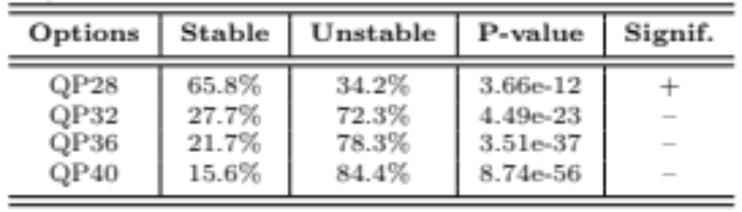
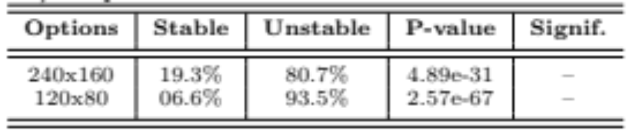
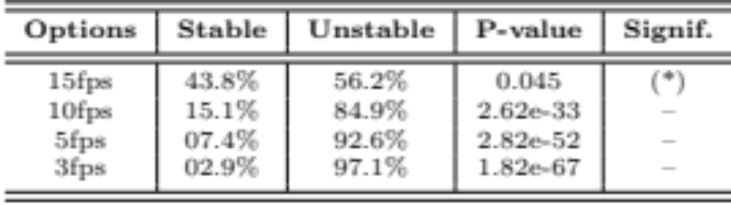
Significance of results
I think the video quality was at a stable level: Yes or No
noise
blur
+ | stable, significant
- | unstable, significant
(*) | not significant
motion

Slide 57

Friedman’s $Χ^{2}$ test
This is a test to verify the relevance of categorical data
where you cannot compute distances between the possible values of the responses
Examples:
  did you like it / not like it
  did it look red / green / blue
  was is stable / unstable

Slide 58
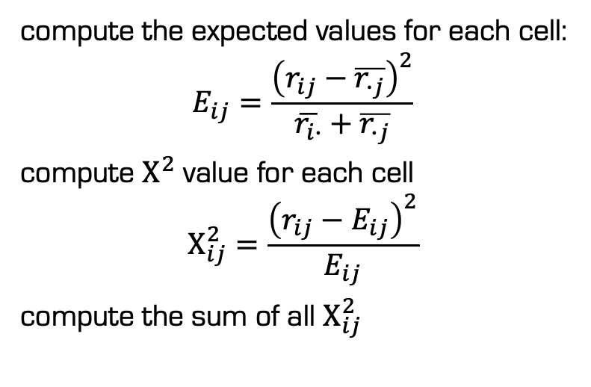
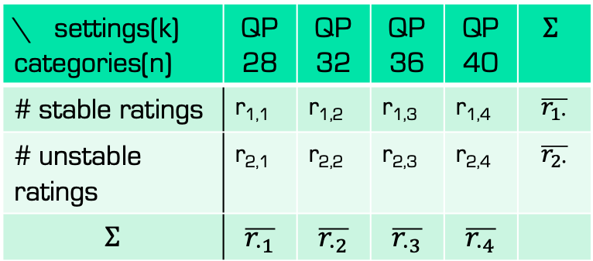
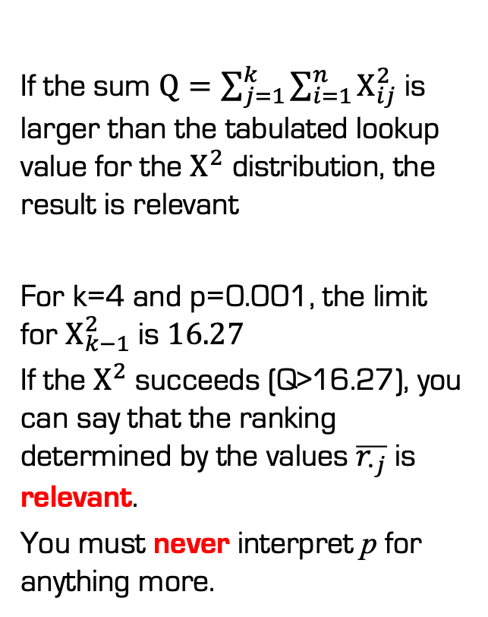
Noise flicker example – single relevance test
\ settings(k) categories(n) | QP28 | QP32 | QP36 | QP40 | $$Σ$$
# stable ratings | r_{1,1} | r_{1,2} | r_{1,3} | r_{1,4} | $$\overline{r_{1∙}}$$
# unstable ratings | r_{2,1} | r_{2,2} | r_{2,3} | r_{2,4} | $$\overline{r_{2∙}}$$
$$Σ$$ | $$\overline{r_{∙1}}$$ | $$\overline{r_{∙2}}$$ | $$\overline{r_{∙3}}$$ | $$\overline{r_{∙4}}$$
total number or
percentages of counts
If the sum $Q=\sum_{j=1}^{k}{\sum_{i=1}^{n}{Χ_{ij}^{2}}}$ is larger than the tabulated lookup value for the $Χ^{2}$ distribution, the result is relevant
For k=4 and p=0.001, the limit for $Χ_{k−1}^{2}$ is $16.27$
If the $Χ^{2}$ succeeds (Q>16.27), you can say that the ranking determined by the values $\overline{r_{∙j}}$ is relevant.
You must never interpret p for anything more.
compute the expected values for each cell:
$$E_{ij}=\frac{{\left(r_{ij}−\overline{r_{∙j}}\right)}^{2}}{\overline{r_{i∙}}+\overline{r_{∙j}}}$$
compute $Χ^{2}$ value for each cell
$$Χ_{ij}^{2}=\frac{{\left(r_{ij}−E_{ij}\right)}^{2}}{E_{ij}}$$
compute the sum of all $Χ_{ij}^{2}$

Slide 59
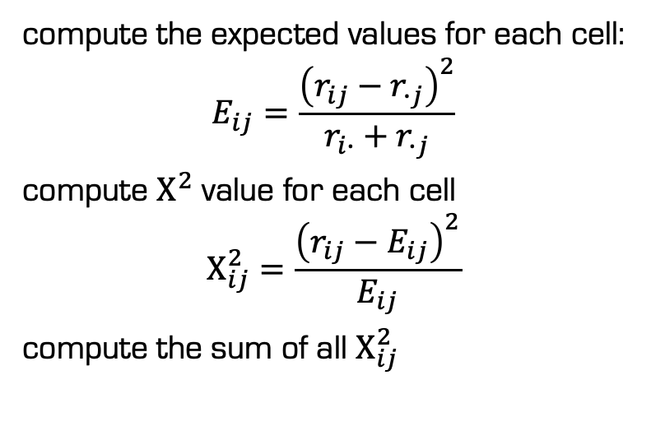
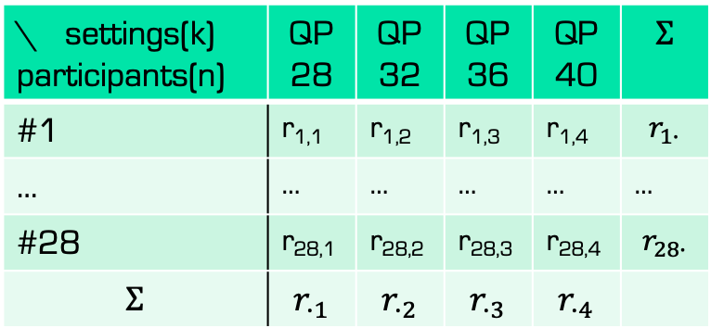
Noise flicker example – separate relevance tests
\ settings(k) participants(n) | QP28 | QP32 | QP36 | QP40 | $$Σ$$
#1 | r_{1,1} | r_{1,2} | r_{1,3} | r_{1,4} | $$r_{1∙}$$
… | … | … | … | … | …
#28 | r_{28,1} | r_{28,2} | r_{28,3} | r_{28,4} | $$r_{28∙}$$
$$Σ$$ | $$r_{∙1}$$ | $$r_{∙2}$$ | $$r_{∙3}$$ | $$r_{∙4}$$
ranks for quality ratings
(how often was it stable)
average if equal
If the sum $Q=\sum_{j=1}^{k}{\sum_{i=1}^{n}{Χ_{ij}^{2}}}$ is larger than the tabulated lookup value for the $Χ^{2}$ distribution, the result is relevant
For k=4 and p=0.001, the limit for $Χ_{k−1}^{2}$ is $16.27$
If the $Χ^{2}$ succeeds (Q>16.27), you can say that the ranking determined by the values $\overline{r_{∙j}}$ is relevant.
You must never interpret p for anything more.
compute the expected values for each cell:
$$E_{ij}=\frac{{\left(r_{ij}−r_{∙j}\right)}^{2}}{r_{i∙}+r_{∙j}}$$
compute $Χ^{2}$ value for each cell
$$Χ_{ij}^{2}=\frac{{\left(r_{ij}−E_{ij}\right)}^{2}}{E_{ij}}$$
compute the sum of all $Χ_{ij}^{2}$

Slide 60
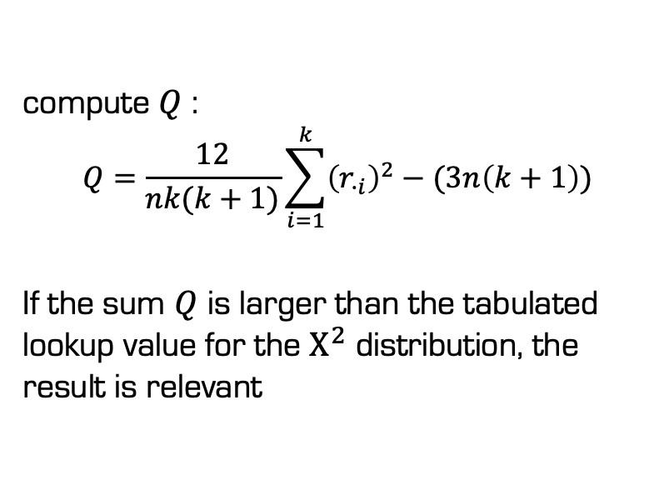
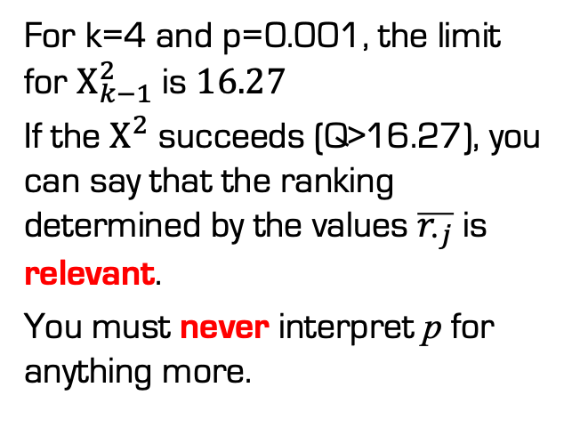
Noise flicker example – separate relevance tests
\ settings(k) participants(n) | QP28 | QP32 | QP36 | QP40 | $$Σ$$
#1 | r_{1,1} | r_{1,2} | r_{1,3} | r_{1,4} | $$r_{1∙}$$
… | … | … | … | … | …
#28 | r_{28,1} | r_{28,2} | r_{28,3} | r_{28,4} | $$r_{28∙}$$
$$Σ$$ | $$r_{∙1}$$ | $$r_{∙2}$$ | $$r_{∙3}$$ | $$r_{∙4}$$
ranks for quality ratings
(how often was it stable)
average if equal
compute $Q$ :
$$Q=\frac{12}{nk(k+1)}\sum_{i=1}^{k}{{\left(r_{∙i}\right)}^{2}−(3n\left(k+1\right))}$$
If the sum $Q$ is larger than the tabulated lookup value for the $Χ^{2}$ distribution, the result is relevant
For k=4 and p=0.001, the limit for $Χ_{k−1}^{2}$ is $16.27$
If the $Χ^{2}$ succeeds (Q>16.27), you can say that the ranking determined by the values $\overline{r_{∙j}}$ is relevant.
You must never interpret p for anything more.

Slide 61

Relevance tables for $Χ^{2}$
https://people.richland.edu/james/lecture/m170/tbl-chi.html
Some tools, like SPSS, can compute the result from the tables

