Slide 1
Department of Informatics
Networks and Distributed Systems (ND) group
INF 5060/9060
Quantitative Performance Analysis
Özgü Alay
Carsten Griwodz

Slide 2


Why do we need statistics?
1. Noise, noise, noise, noise, noise!
445 446 397 226
388 3445 188 1002
47762 432 54 12
98 345 2245 8839
77492 472 565 999
1 34 882 545 4022
827 572 597 364
2. Aggregate data into meaningful information.
“Impossible things usually don’t happen.”
  - Sam Treiman, Princeton University
Statistics helps us quantify “usually.”

Slide 3
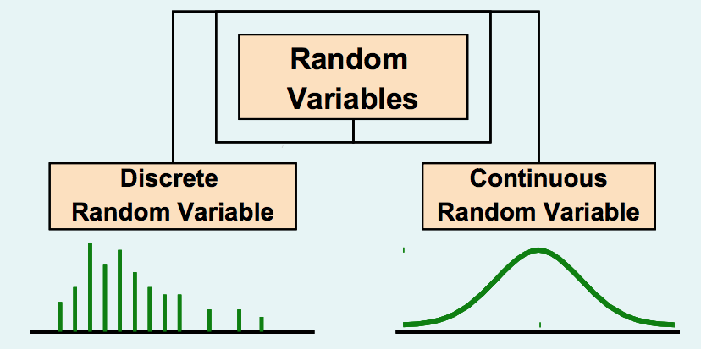
Basic Probability and Statistics Concepts
Independent Events:
  One event does not affect the other
  Knowing probability of one event does not change estimate of another
Random Variable:
  A variable is called a random variable if it takes one of a specified set of values with a specified probability

Slide 4
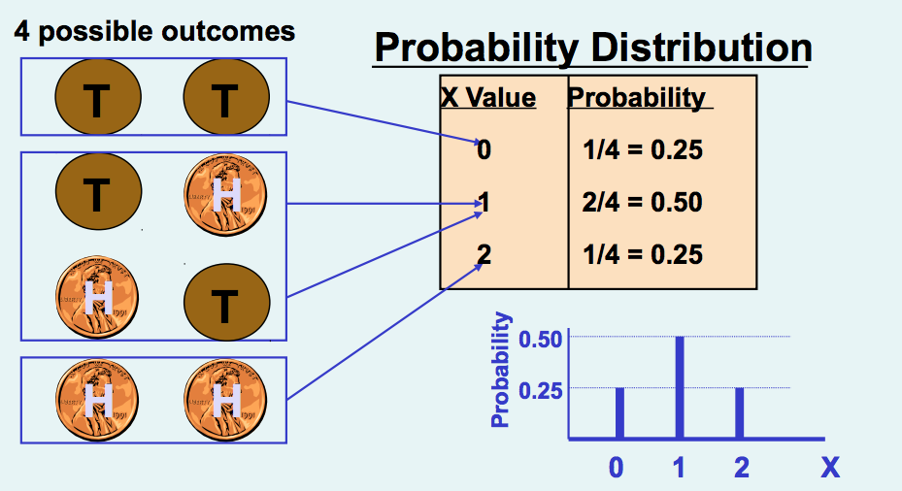
Example of a Discrete Random Variable Probability Distribution
Experiment: Toss 2 Coins. Let X = # heads

Slide 5
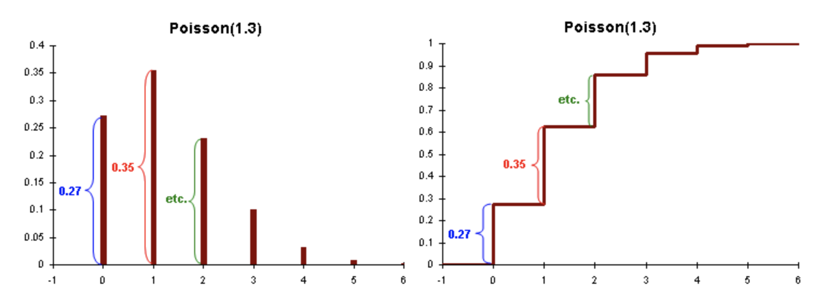
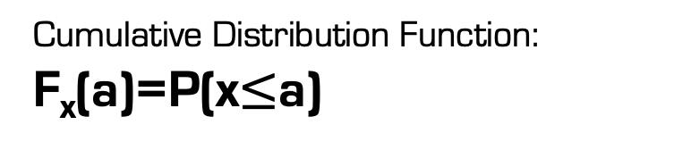
Histogram and Cumulative Distribition Function
Histogram: f(x_{i})= p_{i}.
Cumulative Distribution Function: F_{x}(a)=P(x$≤$a)
Histogram
Cumulative Distribution Function (CDF)

Slide 6
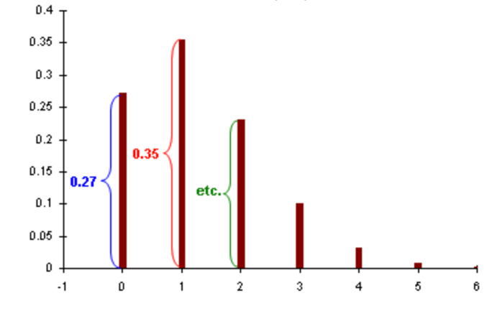
Histogram and Cumulative Distribition Function
Histogram: f(x_{i})= p_{i}.
Cumulative Distribution Function: F_{x}(a)=P(x$≤$a)
Histogram
Cumulative Distribution Function (CDF)

Slide 7

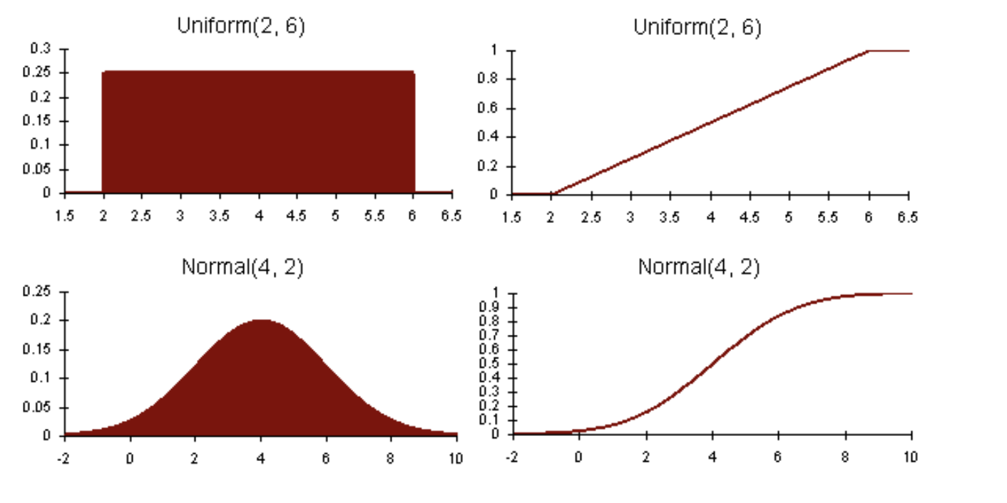
Continuous Random Variable Probability Density Function
      The probability density function, pdf, as .
      The cumulative distribution function, cdf, as .

Slide 8
Indices of central tendency
Summarizing Data by a Single Number
Mean – sum all observations, divide by number
Median – sort in increasing order, take middle
Mode – plot histogram and take largest bucket
Mean can be affected by outliers, while median or mode ignore lots of info
Mean has additive properties (mean of a sum is the sum of the means), but not median or mode

Slide 9
Relationship Between Mean, Median, Mode
mean
median
mode
modes
hist(x)
hist(x)
mean
median
no mode
hist(x)
(a)
mean
median
(b)
mode
mode
(c)
hist(x)
median
hist(x)
median
mean
mean
(d)
(d)

Slide 10
Summarizing Variability
“Then there is the man who drowned crossing a stream
with an average depth of six inches.” – W.I.E. Gates
Summarizing by a single number is rarely enough
→ need statement about variability
Frequency
Frequency
mean
mean
Response Time
Response Time
  If two systems have same mean, tend to prefer one with less variability

Slide 11
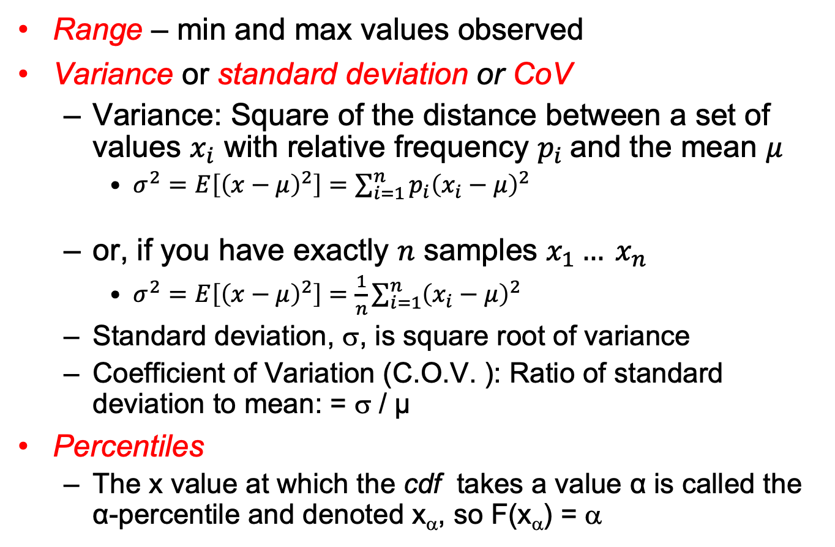
Indices of Dispersion
Range – min and max values observed
Variance or standard deviation or CoV
  Variance: Square of the distance between a set of values $x_{i}$ with relative frequency $p_{i}$and the mean $μ$
    $σ^{2}=E\left[{\left(x−μ\right)}^{2}\right]=\sum_{i=1}^{n}{p_{i}{\left(x_{i}−μ\right)}^{2}}$
  or, if you have exactly $n$ samples $x_{1}… x_{n}$
    $σ^{2}=E\left[{\left(x−μ\right)}^{2}\right]=\frac{1}{n}\sum_{i=1}^{n}{{\left(x_{i}−μ\right)}^{2}}$
  Standard deviation, σ, is square root of variance
  Coefficient of Variation (C.O.V. ): Ratio of standard deviation to mean: = σ / µ
Percentiles
  The x value at which the cdf takes a value α is called the α-percentile and denoted x_{α}, so F(x_{α}) = α
Notes:
This variance formula only if the distance between your X-values is not constant. If you have nothing else than a set of samples X, you divide by the number of samples N instead.
If you have a really large dataset and you must compute the variance from a subset of them, you must divide by N-1 instead. This is called sample variance.
Standard deviation is in the same unit as the original measurements. It is therefore easier to interpret when you want to illustrate, for example, the mean and dispersion side-by-side.

Slide 12
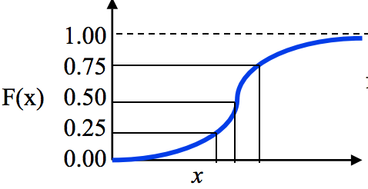
Indices of Dispersion
10- and 90-percentiles
(Semi-)interquartile range (SIQR)
  Q1, Q2 and Q3

Slide 13
Determining Distribution of Data
Additional summary information could be the distribution of the data
  Ex: Disk I/O mean 13, variance 48. Ok. Perhaps more useful to say data is uniformly distributed between 1 and 25.
  Plus, distribution useful for later simulation or analytic modeling
How do determine distribution?
  Plot histogram
For more formal testing: statistical comparison of
CDF (Komolgorov-Smirnov test ) or PDF (Chi-square test)
The Art of Computer Systems Performance Analysis, pp. 460-465

Slide 14
Comparing Systems Using Sample Data
“Statistics are like alienists – they will testify for
either side.” – Fiorello La Guardia
The word “sample” comes from the same root word as “example”
Similarly, one sample does not prove a theory, but rather is an example
Basically, a definite statement cannot be made about characteristics of all systems
Instead, make probabilistic statement about range of most systems
  Confidence intervals

Slide 15
Sample versus Population
Say we generate 1-million random numbers
  mean μ and stddev σ.
  μ is population mean
Put them in an urn draw sample of n
  Sample {x₁, x₂, …, x_{n}} has mean $\overline{x}$, stddev s
$\overline{x}$is likely different than μ!
  With many samples, $\overline{x_{1}}≠\overline{x_{2}}≠…$
Typically, μ is not known and may be impossible to know
  Instead, get estimate of μ from $\overline{x_{1}}$, $\overline{x_{2}}$, …
Notes:
It is hard to find the real mean of the data (population mean), requires infinitely many experiments, we rather get samples and derive statistics.
Each sample mean is an estimate of the population mean.

Slide 16
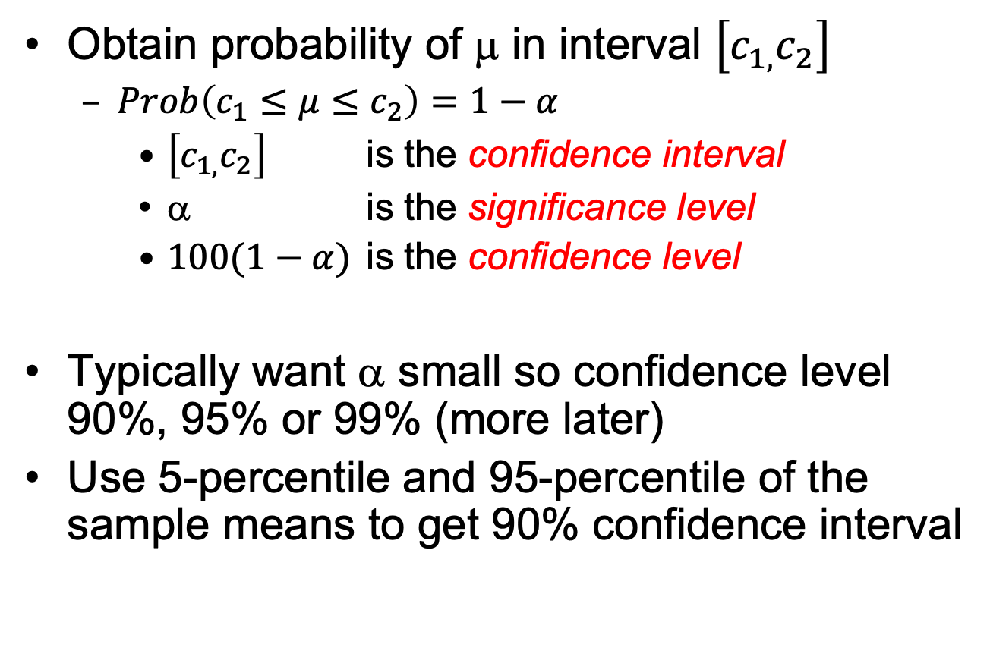
Confidence Interval for the Mean
Obtain probability of μ in interval $\left[c_{1,}c_{2}\right]$
  $Prob\left(c_{1}≤μ≤c_{2}\right)=1−α$
    $\left[c_{1,}c_{2}\right]$ is the confidence interval
    α is the significance level
    $100(1−α)$ is the confidence level
Typically want α small so confidence level 90%, 95% or 99% (more later)
Use 5-percentile and 95-percentile of the sample means to get 90% confidence interval
Notes:
So, perfectly finding the mean by sampling is impossible … but perhaps we can approximate its value with a certain confidence?

Slide 17
Meaning of Confidence Interval
For a 90% confidence level, if we take 100 samples and construct the confidence interval for each sample, the interval would include the population mean in 90 cases.
μ
f(x)
Sample Includes μ?
1 yes
2 yes
No
… ...
Total yes >100(1-α)

Slide 18

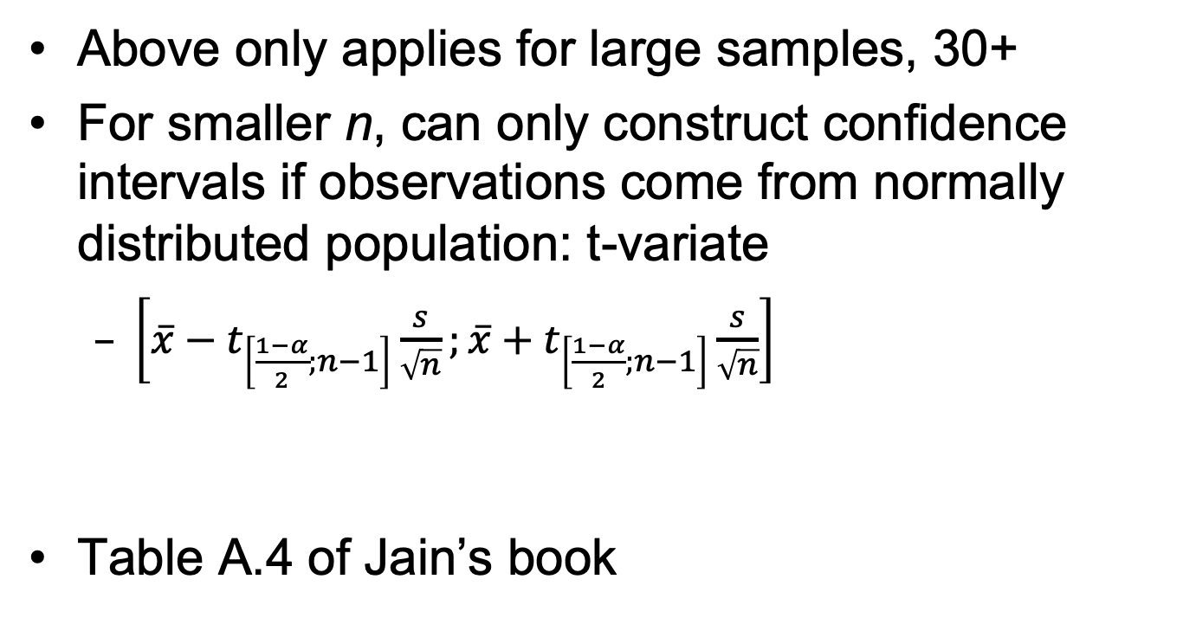

What if n not large?
Above only applies for large samples, 30+
For smaller n, can only construct confidence intervals if observations come from normally distributed population: t-variate
  $\left[\overline{x}−t_{\left[\frac{1−α}{2};n−1\right]}\frac{s}{\sqrt{n}};\overline{x}+t_{\left[\frac{1−α}{2};n−1\right]}\frac{s}{\sqrt{n}}\right]$
Table A.4 of Jain’s book
$\overline{x}$: sampled mean
s: sampled standard deviation
n: number of samples
$t_{\left[\frac{1−α}{2};n−1\right]}$: tabulated value of the t distribution

Slide 19
What Confidence Level to Use?
Often see 90% or 95% (or even 99%), but…
Example:
  Lottery ticket $1, pays $5 million
  Chance of winning is 10⁻⁷ (1 in 10 million)
  To win with 90% confidence, need 9 million tickets
    No one would buy that many tickets!
  So, most people happy with 0.01% confidence

