Slide 1
Performance in distributed systems
Real-world examples

Slide 2
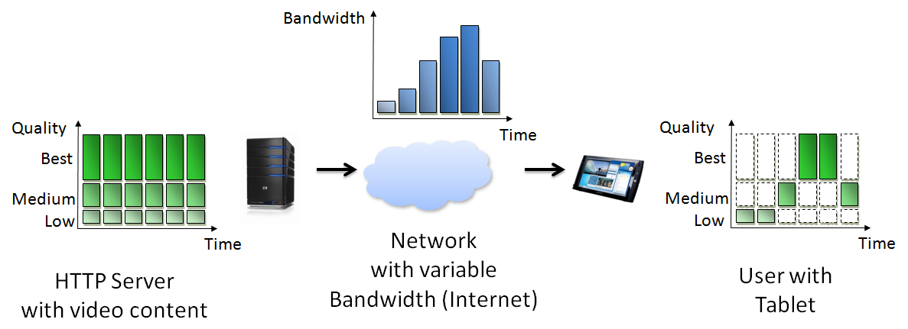
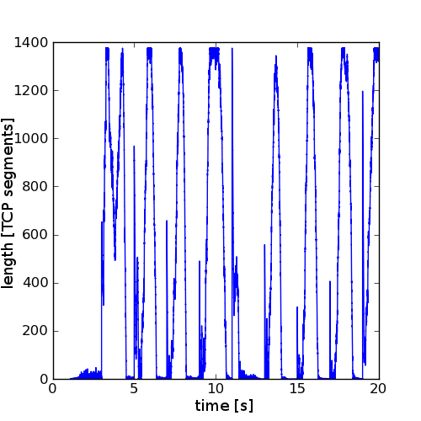
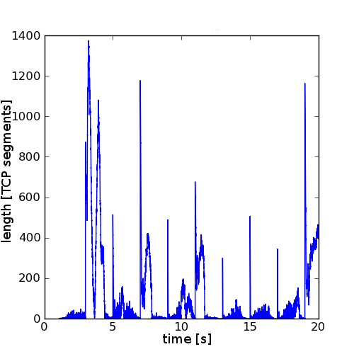
Emulation study
Investigation of router queue
length development in
DASH streaming for different
TCP Congestion Control algorithms
CUBIC
Vegas
Simple 2D graph
showing an independent
parameter X (time) and
a dependent parameter
Y (queue length)
does illustrate the unstable
queue length for CUBIC, but no actual distribution
not a quantifiable result, but anecdotal

Slide 3
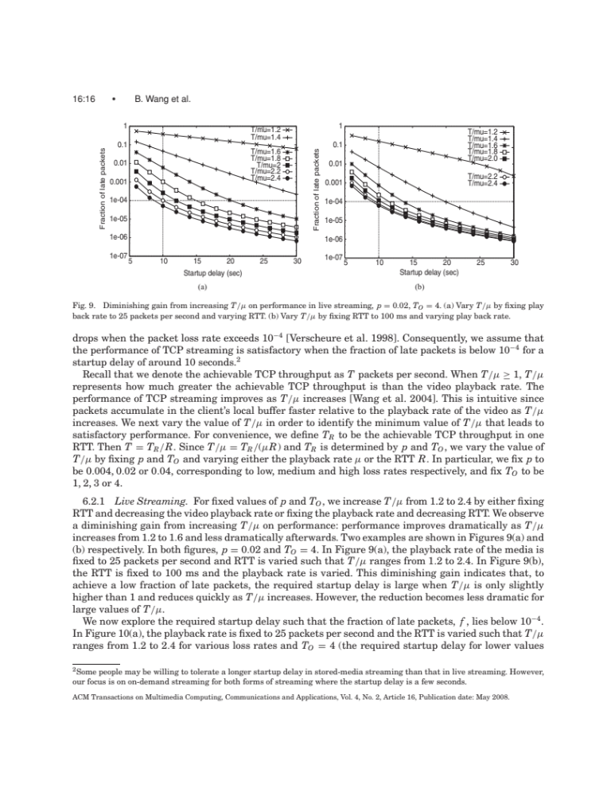
Analytical performance study
Analytical performance study to discover a relation between streaming (video) over TCP and the likelihood of stalling
Analytical graph provides
deterministic, repeatable results
symbols distinguish
conditions
Y-axis is logarithmic to
expose differences at when
very few packets are late
note that each point is a computation with different parameters

Slide 4
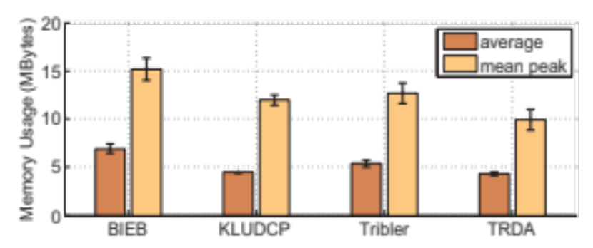
Simulation study
Investigation of memory requirements for several DASH streaming algorithms
Block diagram is suitable
when X-axis values have no
metric relation (no measure of any distance between them)
block diagram is also better if X-values have an order but no metric relation!
2D graph merges 2 questions into 1 graph: average memory use and average peak memory use (average of peaks of several simulation runs) – this does not scale to many questions
standard deviation is added for each of the averages
Notes:
Used in:
“Implementation and user-centric comparison of a novel adaptation logic for DASH with SVC”,
Sieber, C., Hossfeld, T., Zinner, T., Tran-Gia, P., & Timmerer, C, Workshops of IFIP Symposium on Integrated Network Management (IM 2013), pp. 1318-1323, 2013

Slide 5
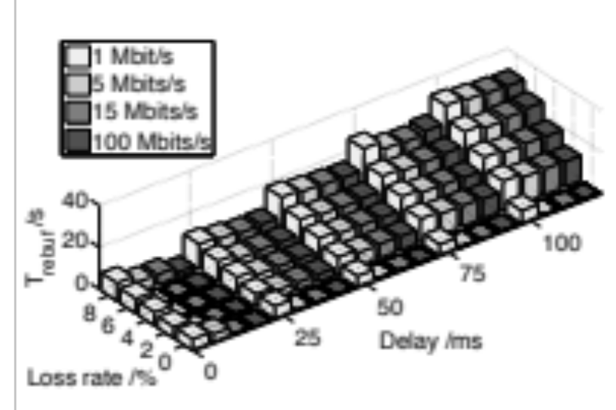
Emulation example
Some HTTP adaptive video streaming strategies can fails when packet loss is high and network delay is high as well. How long are the cumulative waiting times?
3D block diagram
3 independent variables shown
4D information (X, Y, Z, color)
3 independent variables (loss rate, delay, network capacity)
1 dependent variable (rebuffering time)
visually attractive
tolerances (confidence intervals etc.) cannot be expressed
absolute height cannot be ascertained by reader for all conditions
does not scale to many network capacities
Notes:
Used in:
“Measuring the quality of experience of HTTP video streaming”,
Mok, R. K. P., Chan, E. W. W., & Chang, R. K. C., Workshops of IFIP Symposium on Integrated Network Management (IM 2011), pp. 485-492, 2011

Slide 6
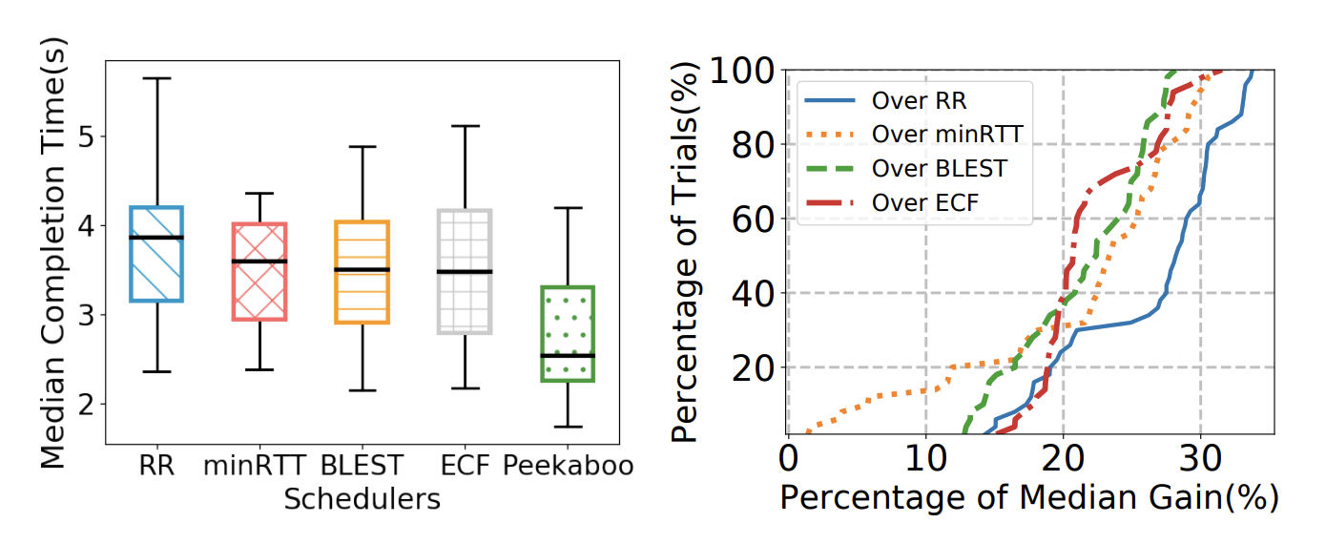
Emulation example
How will a learning-based multipath scheduler (Peekaboo) improve the completion time over heterogenous networks?
Boxplots and CDFs
Boxplots provide the statistical information both on the lower and upper percentiles
CDF of the gain illustrates the distribution of the gain
Quantifies both the basic characteristics of schedulers as well as the how well the proposed scheduler performs compared to others
Notes:
Used in:
“Measuring the quality of experience of HTTP video streaming”,
Mok, R. K. P., Chan, E. W. W., & Chang, R. K. C., Workshops of IFIP Symposium on Integrated Network Management (IM 2011), pp. 485-492, 2011

Slide 7
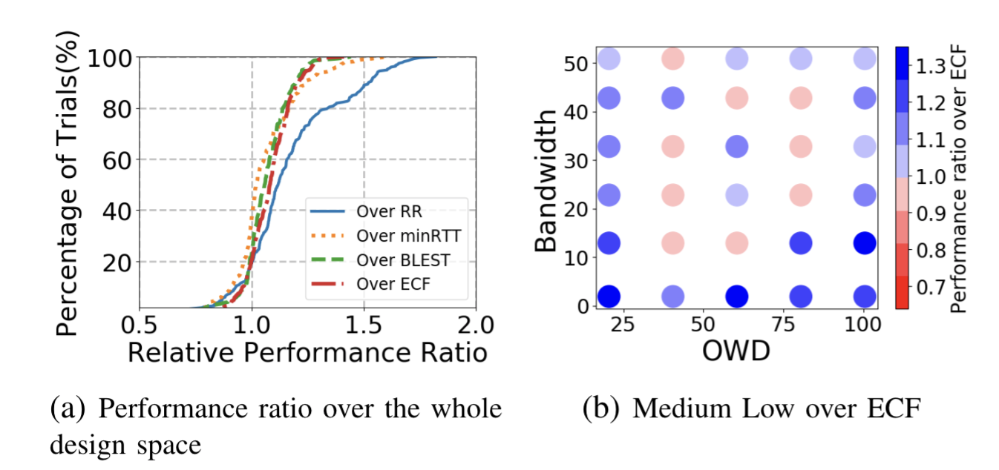
Emulation example
How will a learning-based multipath scheduler (Peekaboo) improve the completion time over heterogenous networks?
One-way delay
Design space exploration
Emulations are often done over a design space of variables
CDF of the gain illustrates the distribution of the gain but it does not tell where the gain comes from
A heatmap over a design space can show where the gains come from
Quantifies both the basic characteristics of gains as well as the where the gains (if any) coming from

Slide 8
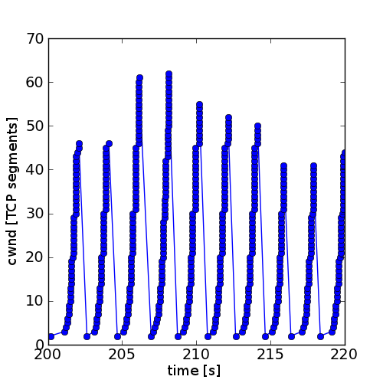
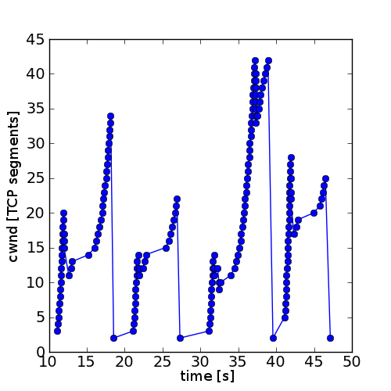
Emulation study
CUBIC
Investigation of sender’s congestion window size in the same study.
Video segments have a duration of 2 seconds (top) and 10 seconds (bottom), the algorithm attempts to choose a quality that can be downloaded in 1 second.
Simple 2D graph showing an
independent parameter X (time) and
a dependent Y (congestion window size)
serves to illustrate that CUBIC is incapable of maintaining its congestion window between 2-second DASH segments, but enters TCP slow start
not a quantifiable result, but anecdotal

Slide 9
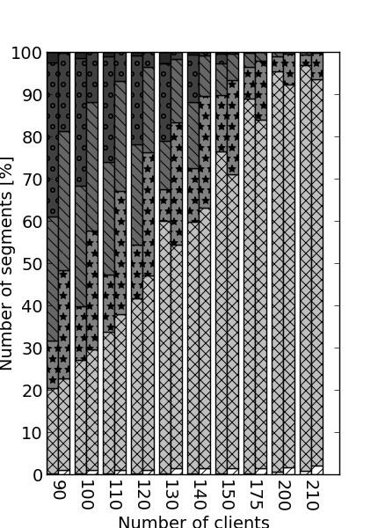
Emulation study
Investigation of the distribution of video quality in the same study.
Segments 2-sec. (left in each column) and 10-sec. (right). Patterns indicate qualities (0 stall, 5 best).
Shows the shares of qualities for entire film.
Graph with 3 dimensions (X and
segment duration independent,
Y dependent)
quite problematic
  hard to distinguish qualities, patterns are not easily enough recognized
  quality 1 is dominant, no visual comparison of the others
  change of order between left and right remains hidden

Slide 10
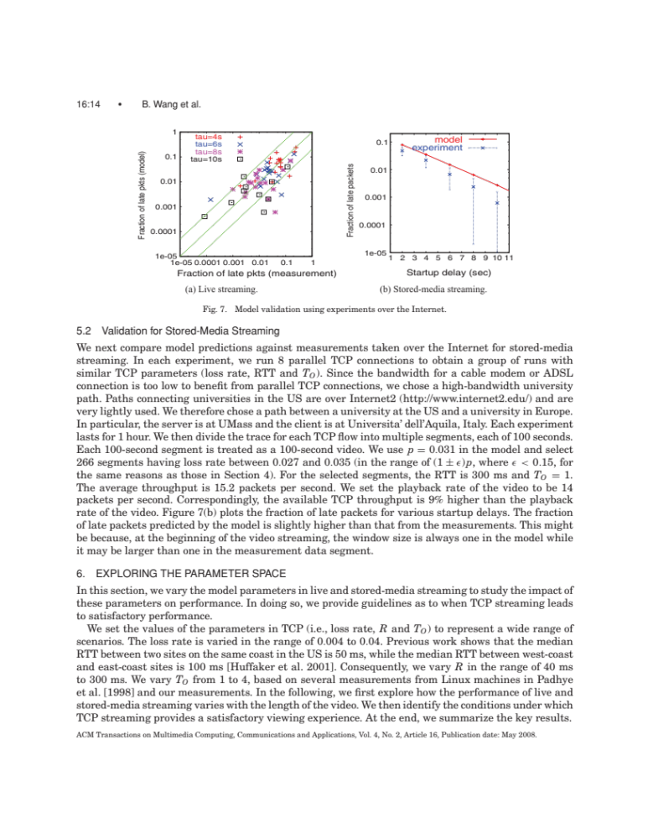
Combined study
Performance study to discover a relation between streaming (video) over TCP and the likelihood of stalling – model validated by ns-2 simulation (“experiment”)
Simulation
symbols distinguish
model and simulation
Y-axis is logarithmic
simulation is not deterministic,
and error bars show the
95% confidence interval
for the simulation, each point with error bars is derived from the results of 1000 simulation runs

Slide 11
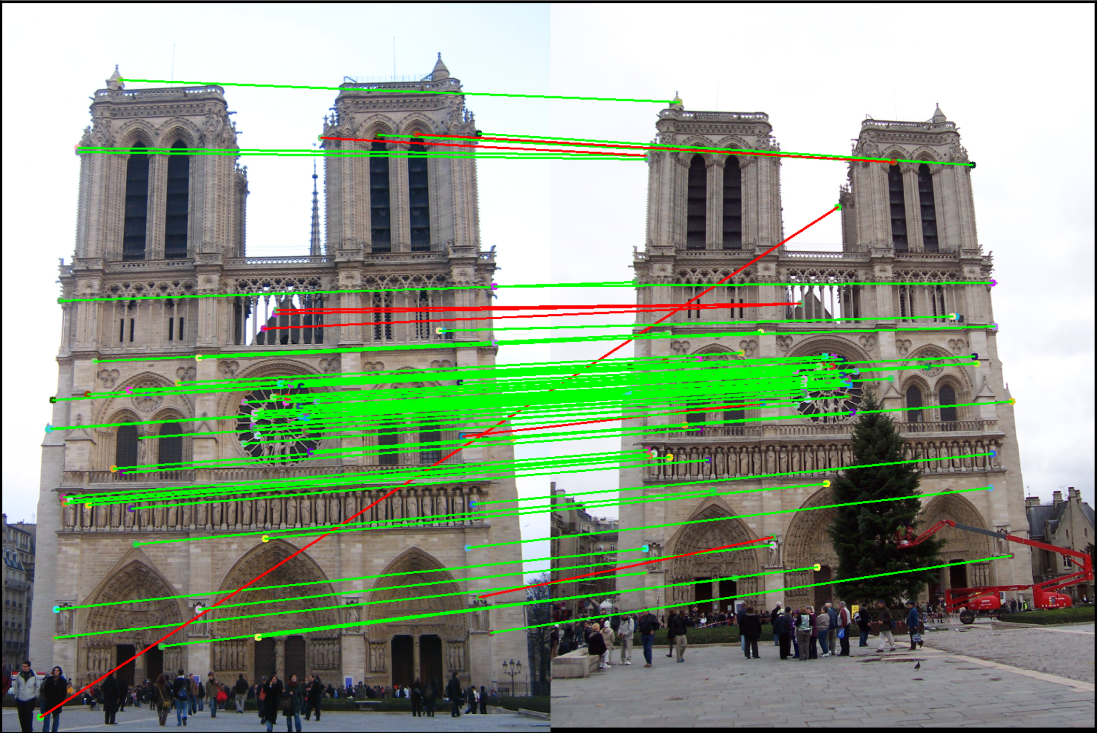
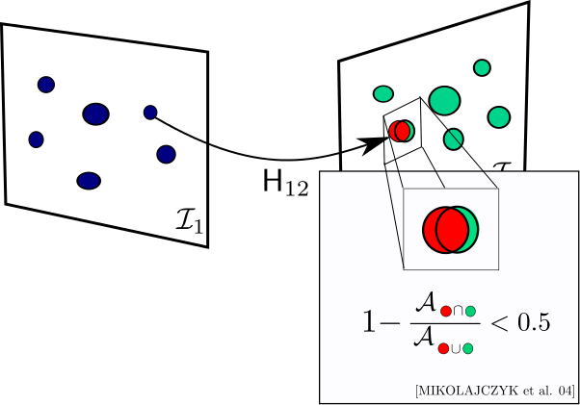
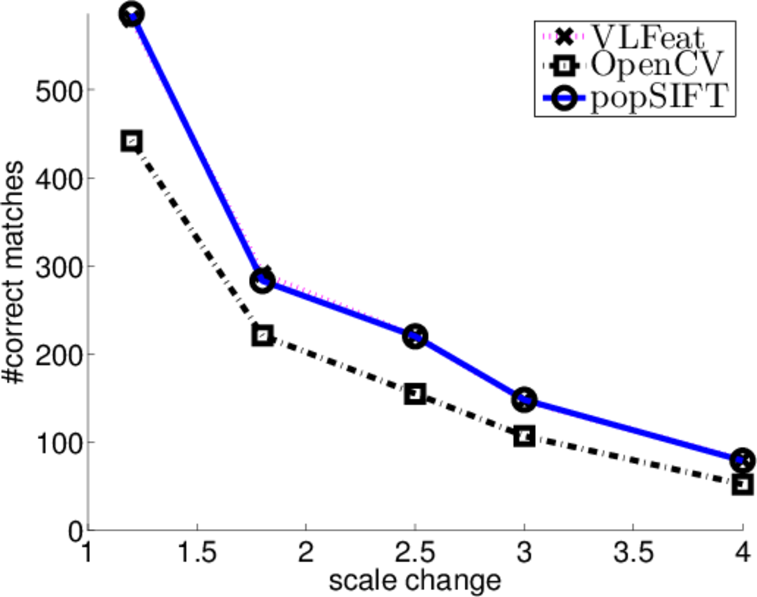
Emulation example
Comparing the performance of the 3 implementations of the algorithm “Scale-Invariant Feature Transform” (SIFT)
Very simple 2D plot, relating only to a set of very specific image pairs
100% deterministic and repeatable, no point in expressing errors
definition ahead of time: boolean condition that defines “match” (adopted from an independent study that developed a good comparison method)

Slide 12
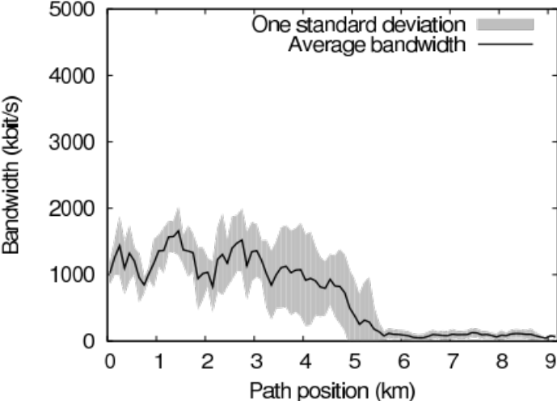
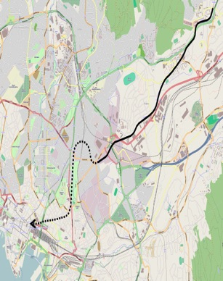
Emulation example
Documenting the repeatability of bandwidth measurement on a typical commuter path
Map shows the subway route from
Stovner to Oslo S
graph shows the measured bandwidth by distance from Stovner
figure does not represent any specific measurement run, the measurements have been collected, and the graph shows both the average bandwidth and 1 standard deviation
not only anecdotal but valid for predictions

Slide 13
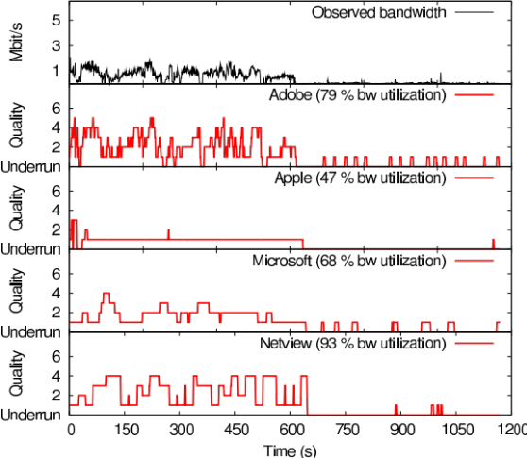
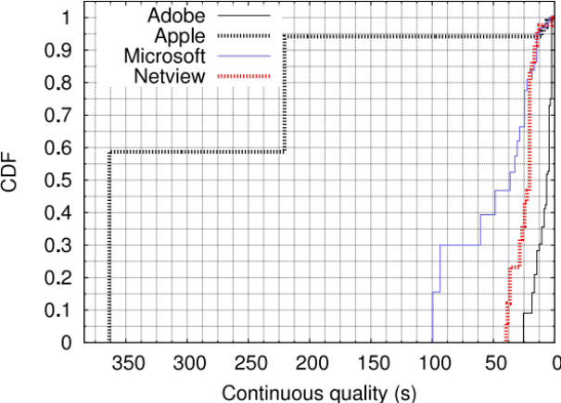
Emulation example
Comparing the bandwidth efficiency and stability of several HTTP Adaptive Streaming methods
Upper graph shows quality
development over time
by itself, it has only
anecdotal value
Lower graph shows CDF of quality changes
Apple HLS is most stable (a desirable property)
but upper graph exposes that the price for this is very low quality

