Slide 1
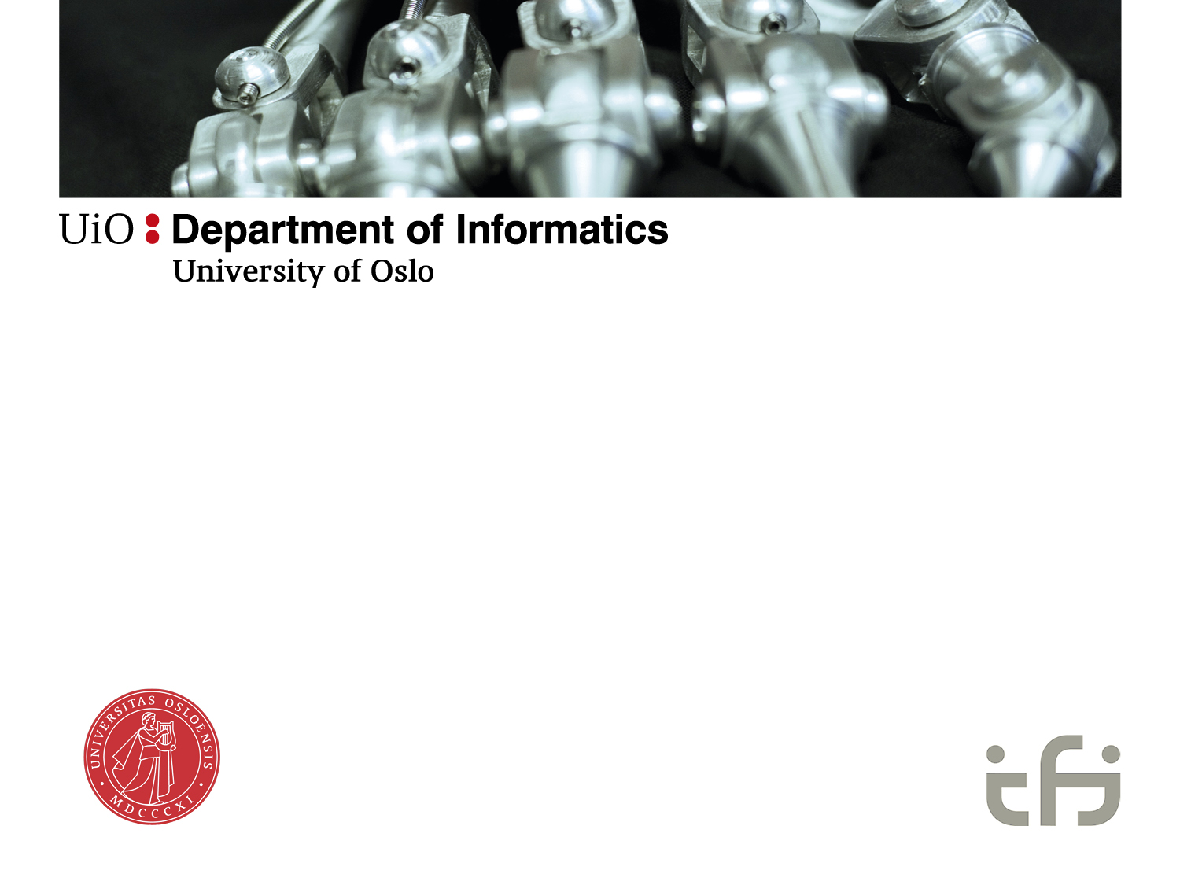
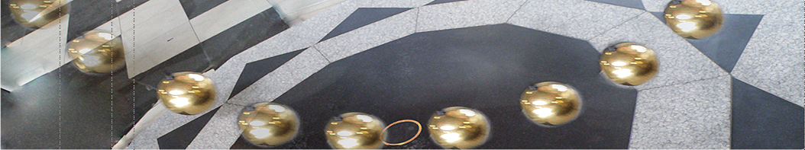
Socio-technical perspectives:
Assemblage Theory
Ole Hanseth

Slide 2
Alternative perspectives/theories
Actor-Network Theory (ANT)
  Actants, translation, alignement
Agential Realism (Sociomateriality)
  Inseparable entanglement, agential cut, performativity («becoming,»)
Critical Realism
  Emergence, mechanisms, triggers
Assembalge Theory

Slide 3
Ontology for IS (theories)
Understanding the emergence and evolution of platform ecosystems and information infrastructures
Requirements:
  socio-technical relations
  Multi-level (zooming in and out)
  Processes/dynamics

Slide 4
Alternative ontologies
 | Sosio-tech | Multi-level | Process
Critical Realism ANT | + ++ | + ++ | + +
Sociomateriality/Agential Realism | + | 0 | --
Assemblage Theory | ++ | ++ | ++

Slide 5
Case
TAVI: Transcatheter Aortic Valve Implantation
Aortic Stenosis

Slide 6
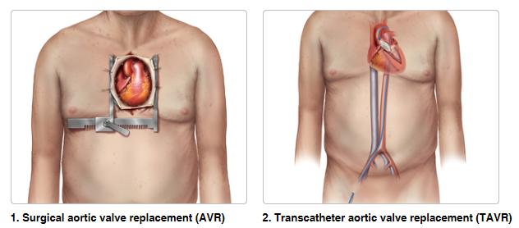
Two treatment options since 2007
TAVR = TAVI, a minimally invasive alternative for the inoperable patients, first feasibility studies in 2002, CE-mark in 2007
http://newheartvalve.com/
Notes:
Surgical aortic valve replacement is safe and improves symptoms along with survival. However, up to 1/3 of patients with aortic valve stenosis cannot complete the procedure due to frailty
Aortic valve replacement is most frequently done through an incision made by cutting through the sternum. Once the pericardium has been opened, the patient is put on the heart-lung machine. This machine takes over the task of breathing for the patient and pumping their blood around while the surgeon replaces the heart valve. Once the patient is on bypass, a cut is made in the aorta and a crossclamp applied. The surgeon then removes the patient's diseased aortic valve and a mechanical or tissue valve is put in its place. Once the valve is in place and the aorta has been closed, the patient is taken off the heart-lung machine.

Slide 7
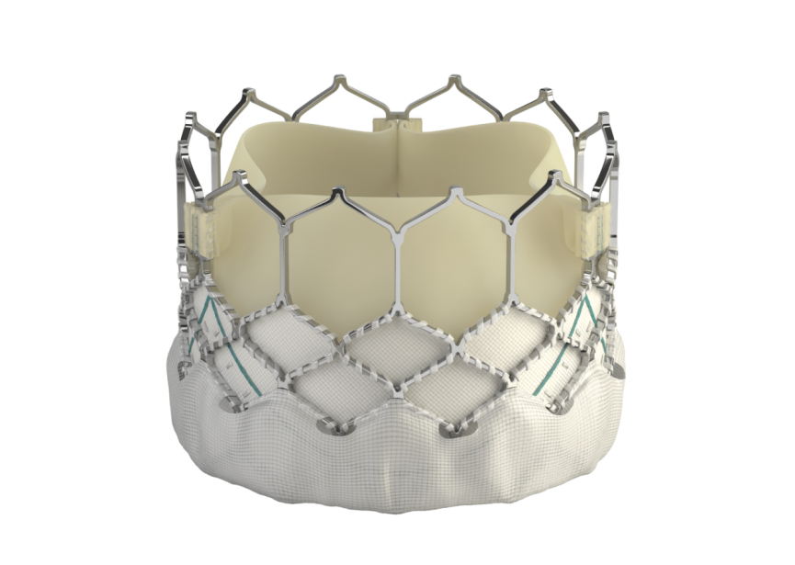
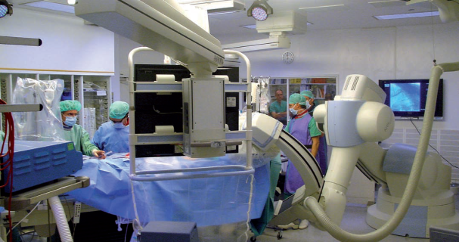
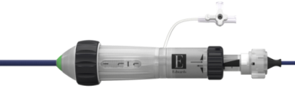
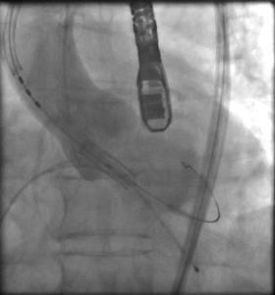
Technologies in use for doing TAVI
Fine control of valve positioning
Numerous computers and
applications: EPR, PACS, ..
https://www.youtube.com/watch?v=X1Uk9Jvbut0
http://edwards.com/
Notes:
Performing TAVI requires a close collaboration between the cardiologist and cardiac surgeons, and prior to any procedure the TAVI team evaluates what sort of procedure is most appropriate for the patient. Depending on the physical conditions of the patient the valves may be inserted through four access points. The transfemoral is the least invasive (termed peripheral), whereas the three others (termed central) are performed by the surgeons in close collaboration with the cardiologists.
Image 2: Access points
In the example of a central access procedure we can observe the relevance of spaces and objects in signifying authority of either of the groups. The cardiac surgeons would stand by the patient’s upper part of the body and the cardiologists at the lower. But they do not remain there as they move in and out of the activity spaces, with or without words, asking for confirmation or giving it, indicating that another group is responsible for the patient during certain tasks. The practitioner ‘in charge’ is the one holding the delivery catheter closest to the patients’ body, and this legitimates their right to make the expert decision.
Knowing what type of TAVI procedure it is, the cardiologists and surgeons know approximately when to arrive at the site, when to get dressed, where to stand, when to start doing their part of the procedure and so on. Naturally, there are smaller details as requests from one practitioner to another to change some detail of a piece of equipment, hand more tissues or check something in the patient’s data, which are communicated clearly and directed at specific persons. There are also discussions between the cardiologists and cardiac surgeons about for example the rate of heart fibrillation, positioning of the valve or its navigation through the body.
Image 3: A fluoroscopy x-ray machine during a TAVI procedure.
However, because in every procedure the moments and activities of the practitioners are clear although not always explicated, breaches of these, whether vocalized or performed, are very noticeable. In a transapical (central access) procedure the surgeons are handling the catheters to the heart via the incisions at the chest, often with the aid of a fluoroscopy x-ray machine. Cardiologists usually stand beside and observe or help with handing the equipment to the surgeons. However, in a few instances, the insertion of the catheter or the placing of a wire into its right position in the heart was particularly challenging. A cardiologist then stepped in with just a short sentence, took the catheter out of the hands of the surgeon and completed the activity. It was obvious by this unspoken prospect, that this cardiologist was considered the master in handling catheters, and therefore had the authority to interfere. However most of these challenges have been anticipated; that a part of the specific procedure is less difficult to one group, or that in order to solve an expected issue another group will be stepping in. These decisions were instantiated in the physical layout of the room, but also reflect historical continuation of which community is experts in handling a particular technology. There is an additional expectation that there is a jurisdictional balance between the groups, because they are working at the IVC. When the cardiologists have performed TAVIs in their department, the surgeons were not present at all, apart from in the planning phase of the procedures. In this simple sense, the physical location of the procedure defines who the expert department is. To solidify this distribution even more, in this arrangement the organization of procedures outside of the operation room changes. Although the collective TAVI meetings are still held, the patients would no longer be chosen from the same pool, but the department takes responsibility for a patient before, during and after the TAVI procedure.
To sum up, the practitioners at our main site have now been doing TAVI procedures for five years and operated hundreds of patients. To understand expertise in relation to doing TAVI we cannot reduce it to an individual endeavour, but also need to consider how matters such as the valves, the catheters and the room are parts of different heterogeneous arrangements, are historically conditioned and represent partly competing regimes of expertise.
The TAVI segment of the market is estimated to reach $2 billion by 2015. (source: symmetis..com)
Vise til settlement Medtronic og Edwards
Individual tasks/skills
Crimping the valve, preparing the intro system
Operating the introduction system
Positioning the valve
Checking that everything is OK (e.g. leakages)
But also team collaboration and coordination
Simpler, safer, more efficient procedures (for instance, coordination of valve crimping and preparing the patient)

Slide 8
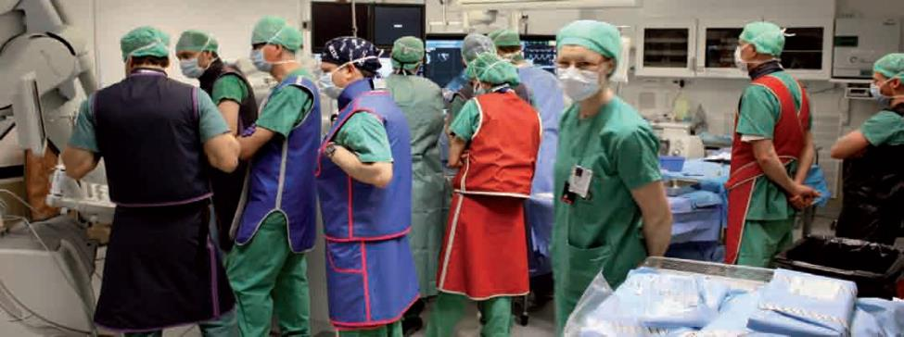
Procedures performed by TAVI teams
Notes:
TAVI is about recombining knowing in practice from many different fields
Cardiologists (handling catheters)
Cardiac surgeons (operating on heart valves), and no experience with using catheters
Anaesthesiologists (providing anaesthetics)
Anaesthesia and operation nurses
Radiographers (imaging), “crimping nurses” preparing the valve
TAVI means that they become novices again by operating in a new environment (new procedure and in some cases a new type of OR), and that they need to learn new skills to accomplish their tasks

Slide 9
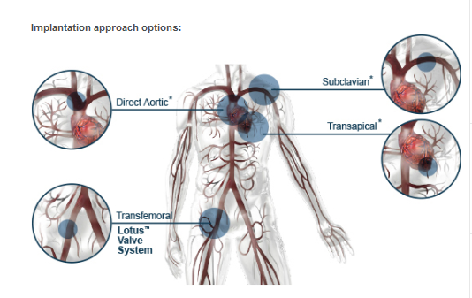
Valve can be inserted through four access points
http://bostonscientific.com/
Notes:
The valve can be inserted through four different access points. The transfemoral access point is at the patient’s leg and the remaining three are at the patient’s chest; the transfemoral access point procedures are carried out by cardiologists and the remaining three by cardiac surgeons. These are termed the ‘peripheral access’ and ‘central access’ points, respectively.

Slide 10
Overall process, TAVI as infrastructure
Organizing at national and regional level
Admission, examination and diagnosing (incl international experts), preparation for surgery, surgery, intensive care, discharge, follow up
Complex information infrastructure
  Digital instruments, general and specialized image analysis tools, EPR, ….

Slide 11
Assemblage theory
Manuel DeLanda “A New Philosophy of Society: Assemblage Theory and Social Complexity” (2006)
Gilles Deleuze
Non-essentialist, realist process ontology
Assemblage/agencement
  Arrangement/act of arranging

Slide 12
AT: Key concepts
Properties, capacities (to interact/affect & being affected), tendencies
  Relations of exteriority
Two dimensions:
  Material – expressive (like ANT)
  Stabilizing (territorializing, coding) – destabilizing (de-territorializing, de-coding)
Emergence, thresholds, non-linearity, path-dependency, critical junctures, path creation
Upward & downward causality (whole-part interactions)

Slide 13
TAVI analysis
Socio-technical relations
Multi-level interactions
  Upward: emergence and evolution of arch/gov configurations
  Downward: arch/gov shaping of TAVI evolution (practices)
Tensions: Stabilizing and de-stabilizing processes

Slide 14
TAVI: assemblages of assemblages, capacities
Local
  Valves, catheters, imaging instruments, individual doctors and nurses
  Surgery theatre: team, patient, equipment and facilities
  Hospital: Pre-, per- and post-operative practices
National
  Funding, regulation, organizing at national level
Global
  Vendors, patents, international conferences, professional associations and so forth

Slide 15
How TAVI has evolved over time
Technological improvements
Individual and team skills improved
Medical knowledge advanced
Changes in ways of organising activities
In sum this leads to:
  Number of team members reduced
  Speed of the procedure reduced
  Patient volume increased
  Inclusion criteria changed (lower risk patients)
  Movement from transapical to transfemoral (50/50 to 90/10)
Stabilizing and de-stabilizing processes
Convergence and divergence

Slide 16
Example 1: New improved technology changes hospital practices
Valves, catheters, introducer systems, imaging instruments and so forth
  De-stabilization of vendor assemblage based on accumulation of medical knowledge and experience
  De-stabilizing hospital practices

Slide 17
Example 2: Accidents with different outcomes
Patients dying during procedure in 3 different hospitals, but with different outcomes:
  Site 1: Temporary destabilisation, but no changes
  Site 2: Temporary destabilisation – minimalist approach chosen
  Site 3: Temporary destabilisation – focus on the importance of involving different specialities leading to focus on the team and importance of using hybrid room
  In site 3 we also find that the accident leads to a de-stabilisation of the global assemblage because the vendor changed their practices

Slide 18
Example 3: Split into surgical and cardiological procedure
De-stabilizing processes:
  Learning
  Reduces risk levels
Stabilization: learning, institutionalization
«competition»

Slide 19
To understand TAVI it is important to study the connections
global
New valve
Patient dies
Split at IVC
Accumulated
events
Incident
Reduce no. of
team members
Patient dies
local

Slide 20
Conclusion
TAVI: builds upon a complex information infrastructure
TAVI as Infrastructure => holistic approach
Assemblage theory is a useful lens
  For understanding the multi-level evolution of global high-tech patient care (dynamic, sociomaterial complexity)
  Because it helps us identify critical (=infrastructural) elements shaping the evolution
    Architecture: facilities, …
    Aims and strategies
    Governance: Organizing, management, funding, regulation, degree of conflict,..

