Slide 1
IN5230 - Mandatory Task 2

Slide 2

Deadline for delivery
October 14th @ 08:00.
Each group submits a report.
Image is borrowed from Internet!

Slide 3
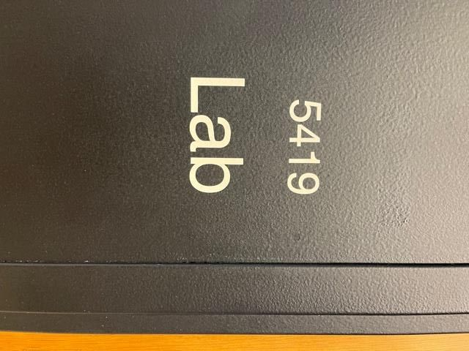
Electro-Magnetic Interface (EMI)
Provided Materials
  EMxpert Scanner
  Demo Board
  Laptop

Slide 4
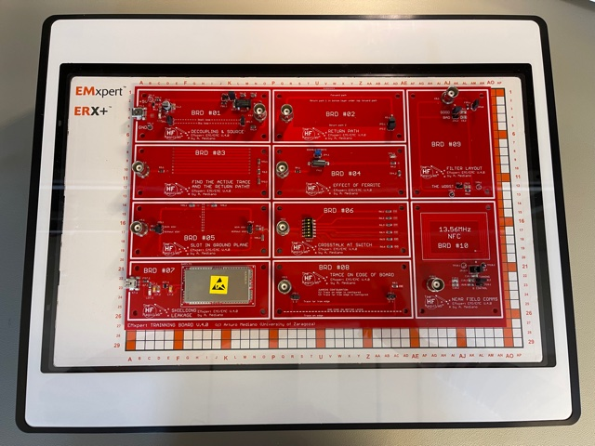
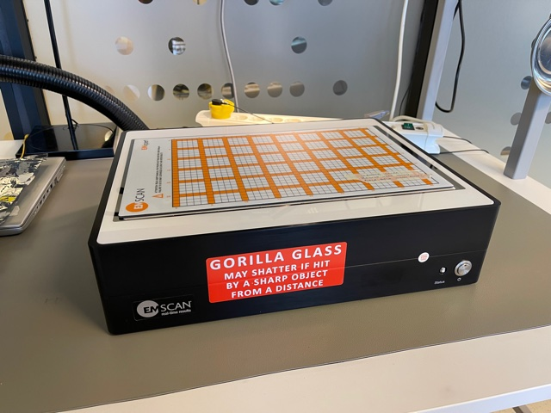
EMxpert Scanner
A1

Slide 5
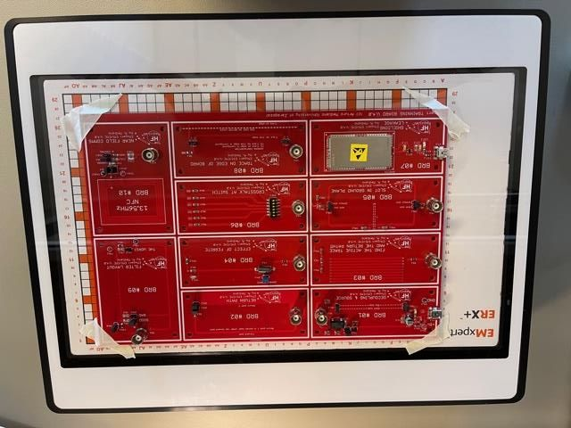
EMxpert Scanner
Paper tape for fixing the board on the scanner.

Slide 6
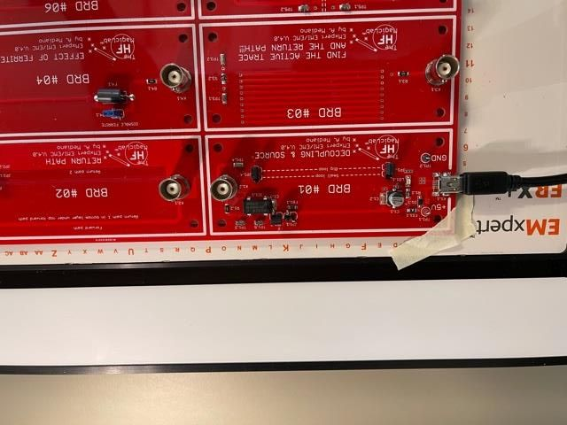
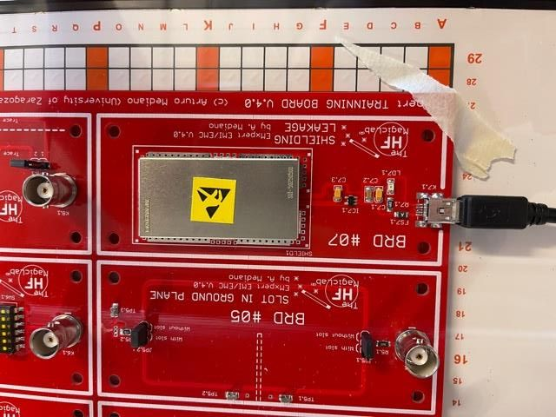
EMxpert Scanner
USB Charger for powering up the boards.

Slide 7
Laptop
Username: stoy, Password: stoystoy
C:\IN5230stud/2026
  GroupN_user1_user2
EMxpert64 Program

Slide 8
Scanning Type
Spectral Scan
  Scanning the PCB at some locations in a wide frequency range.
Spatial Scan
  Scanning a selection of locations at a certain frequency.

Slide 9
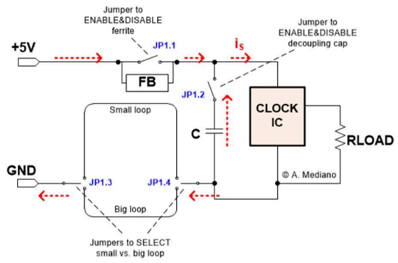
BRD#01
Protecting the power supply from EM field generated by the IC clock by:
  Decoupling capacitor
  Small loop
  Ferrite Bead*
* FB suppresses high-frequency electronic noise in electronic circuits.

Slide 10
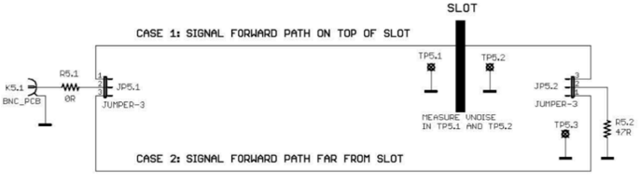
BRD#05
Routing the signal over the slot on the ground plane is dangerous!
High frequency signal tries to return in the same direction as the forward path.
Notes:
Low Frequency signal selects the shortest path.

Slide 11
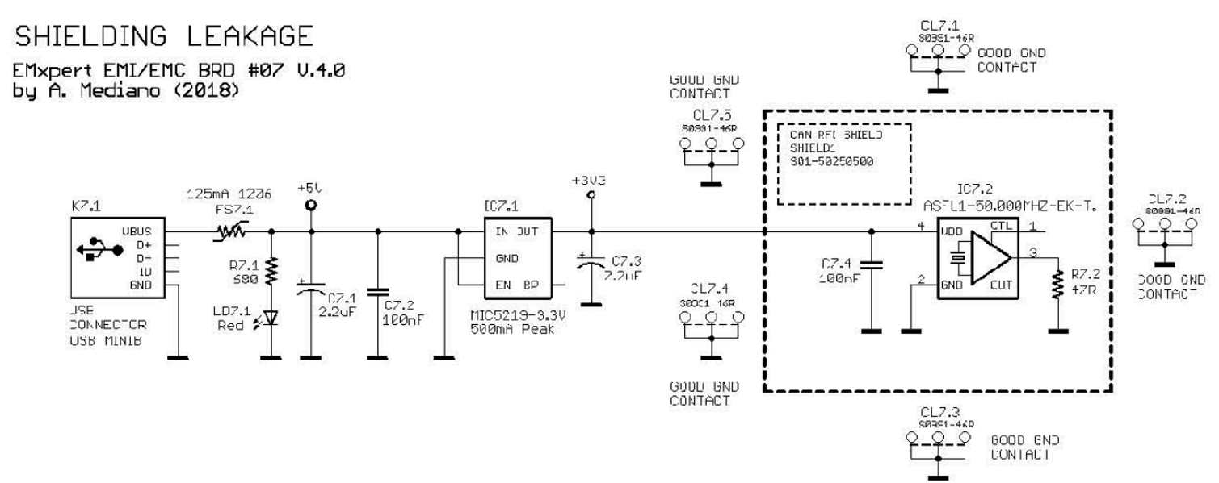
BRD#07
Shielding reduces the EMI!

Slide 12
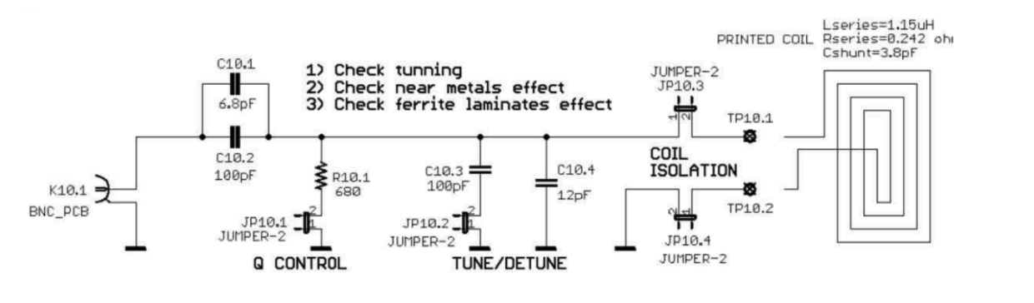
BRD#10
Testing the performance of the NFC antenna by EM scanner.

Slide 13
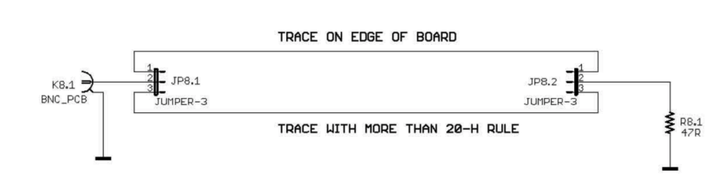
BRD#08, PhD
Critical signal near the edge of the board is not a good option causing fringing effect.

Slide 14
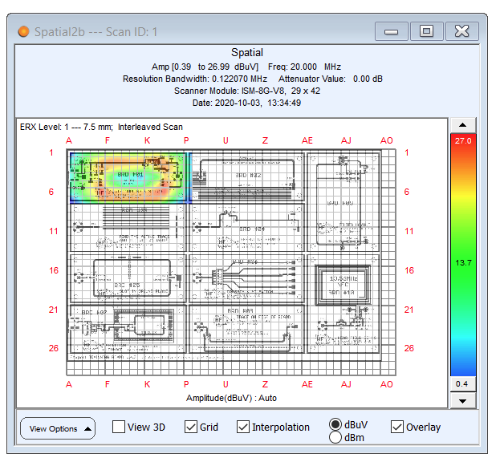
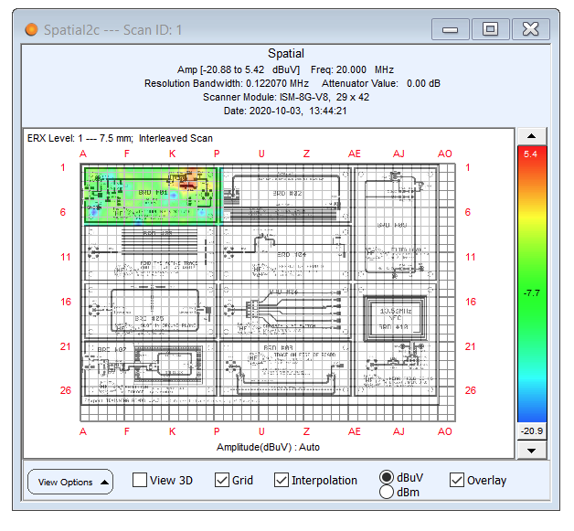
Scaling

Slide 15
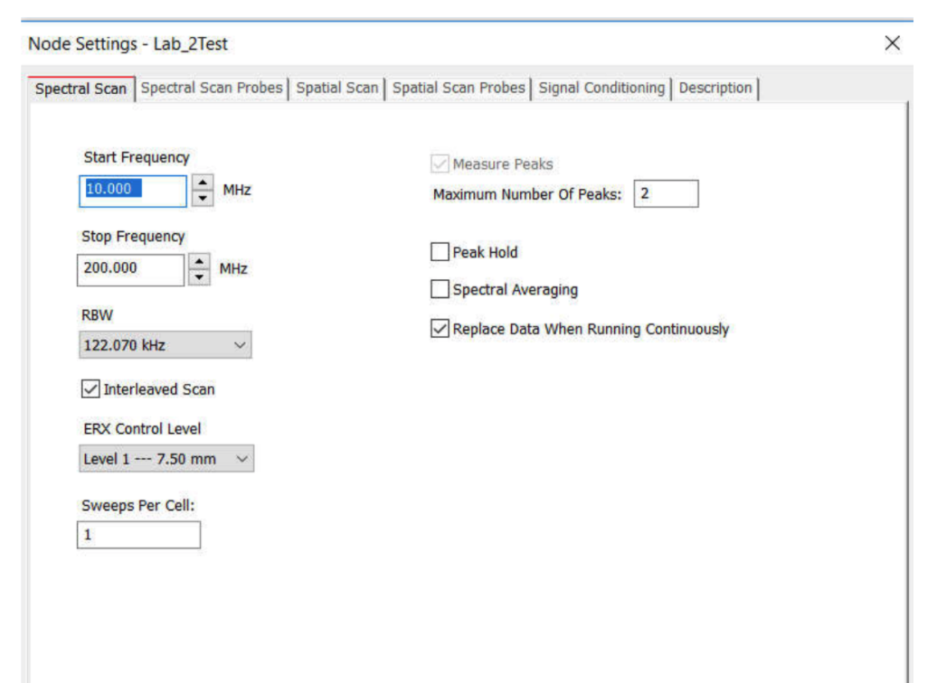
Project Setting
Spectral Scan
  Scanning the PCB at some locations in a wide frequency range.
  Start frequency = 10MHz, Stop frequency = 200MHz, and RBW=122.070 kHz
  Enable Interleaved Scan

Slide 16
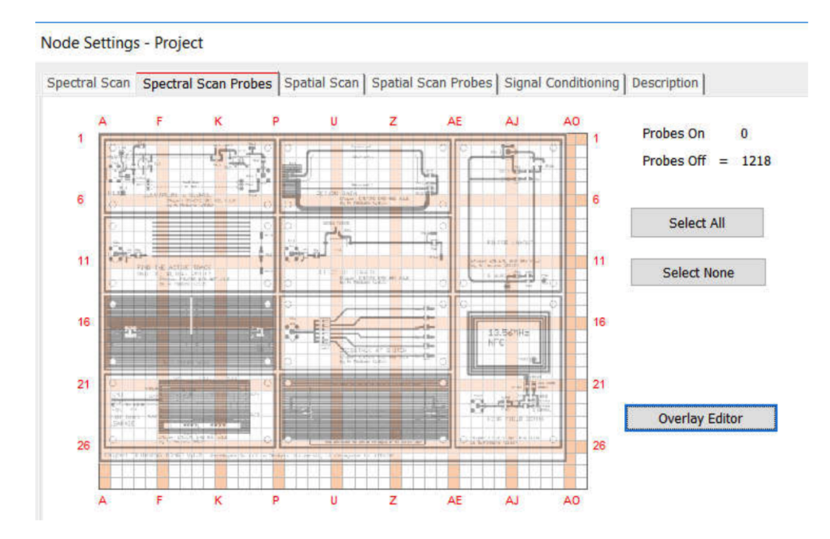
Project Setting
Spectral Scan Probes
  Select None and set Overlay editor and browse the image from: ‘C:\EMSCAN\IN5230 DemoCard\DemoBoardGerb’
  Adjust the image.

Slide 17
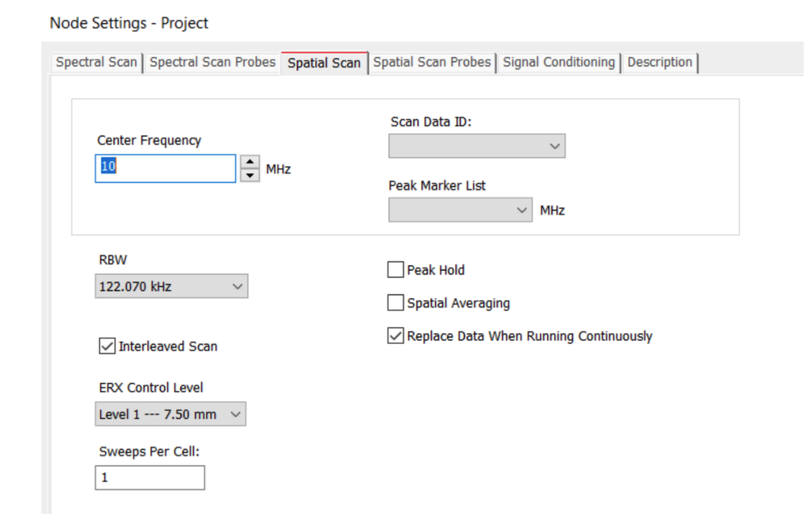
Project Setting
Spatial Scan
  Scanning a selection of locations at a certain frequency.
  Set Center frequency = 20MHz.
  Enable Interleaved Scan

Slide 18
Project Setting
Spatial Scan Probes
  The same as Spectral Scan Probes.

Slide 19
Project Setting
Leave the Signal Conditioning section as it is.
Use the Description Tab to change the name of the project.
Create a new node for each exercise
  project → right click → add node → module
  change the module name to the exercise name
Add a new simulation within each exercise module
  exercise 1 → add node → Spectral/Special

Slide 20
Enjoy 😊

