Slide 1
IN5230 – Fall 2026
Electronic noise –
Estimates and countermeasures
Mandatory lab 3 : Component noise with LTspice

Slide 2
Mandatory 3: Purpose and tools
Purpose: Get experience with component noise simulation
Technology: 350nm CMOS from AMS (Austria Microsystems)
  Requires model-file
Simulation tool: LTspice
  Simulation modes: .tran, .noise, .ac
  Use our own transistor symbols (that show W, L and model)
Can be done on private PC

Slide 3
Mandatory 3
Send report by email to farnazsa@ifi.uio.no.
Deadlines:
  Final Report – 08:00 Friday 11th of November,
  Check the amplifiers before 21st of October!! (Last slide)
Assessment: Approved / Not approved.
  Reports are submitted on an individual basis.
  The reports should contain the schematics that are used, simulation results, text EXPLAINING what has been done as well as an analysis of the results.
  Put up a summary table and comment at the end of each task when relevant.
  USE WHITE/LIGHT BACKGROUND for the plots!
  Avoid yellow curves.

Slide 4

Mandatory 3

Slide 5
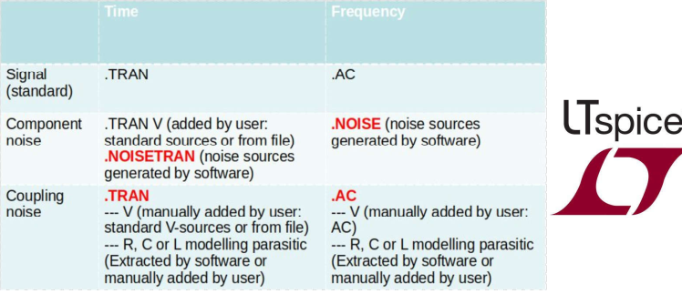
Simulation modes

Slide 6
Preparing CMOS model for mandatory 3
Using transistor models for an integrated circuit: 0.35m CMOS from AMS (Austria Micro Systems)
Preparation
Include transistor model card
Include symbols
Set correct model for transistors in schematic
Set correct length and width for transistors in schematic

Slide 7
Preparing CMOS model for mandatory 3
Generally, transistor models can be included as:
  A model in the standard library file,
  As a private library file. (Must include link (as text) in schematic)
  or
  As entire model as «text» in the schematic
  ⇒ You may first try the first alternative and replace <program files>/LTC/LTspiveIV/lib/cmp/standard.mos with our own file. If that does not work, place the model-file in the same folder as your design and add a link in the schematic.

Slide 8
Preparing CMOS model for mandatory 3
2. Transistor symbols
  We use our own transistor symbols (that show widths, lengths etc.). They must be on the same directory as we have our schematics (nmos4.asy, pmos4.asy)
Correct transistor model:
  Change the transistor model name for NMOS transistors to MODN and for PMOS to MODP

Slide 9
Preparing CMOS model for mandatory 3
4. Change transistor width and length
  Set the correct transistor sizes in each transistor. In figures the transistor sizes are often given in Width/Length. Remember to add «u» or «μ» after the numbers to give correct value. If not, the sizes will be interpreted as meters (with no warning). Right click on the component to change height and width.

Slide 10
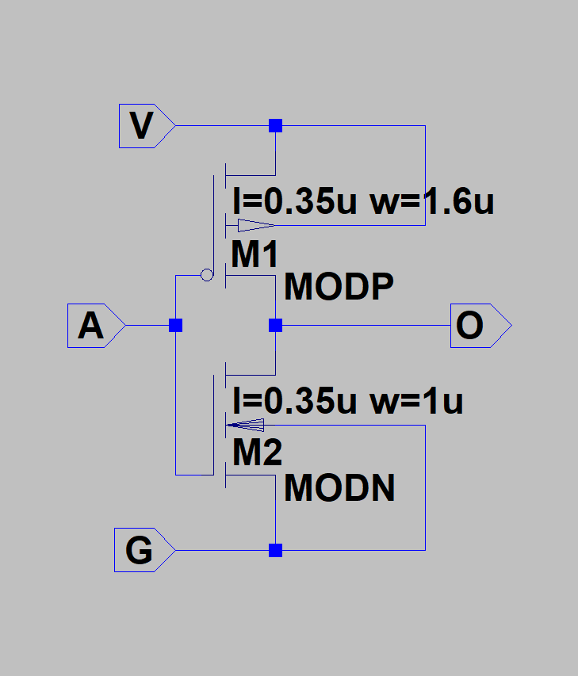
Inverter transistor example
PMOS: Outgoing arrow connected to high supply
NMOS: Incoming arrow connected to low potential

Slide 11
LTspice: .NOISE analysis
.NOISE is used to simulate component noise in the frequency-domain. The simulator includes by itself noise for all components in the schematic.

Slide 12
LTspice: .NOISE analysis
Example: .NOISE V(out) V1 dec 200 1m 1G
Out : Name of network node
V1 : Name of source instance. May be voltage or current
Dec: Type of sweep (decade, octave, linear or list)
200: Number of points per decade/octave
1m: Start frequency (1m = 1 milli Hz, 1Meg = 1 Mega Hz)
1G: Stop frequency

Slide 13
LTspice: .NOISE analysis
Simulation results:
  Onoise: Total coupling noise at node «V(out)»
  Gain: Gain from V1 to V(out).
  Inoise: Equivalent input noise at V1. Noise at output divided by gain.
  Noise contributions from all other component noise contributing elements.

Slide 14
LTspice: .NOISE analysis
Spot/integrated noise
  The simulation shows the spot noise at each frequency
  Integrated noise can be found by:
    Right clicking on the selected signal. NB: this gives the noise for the entire simulated frequency range.
    Use the .meas function
    Warning! For integrating inoise, don’t use frequency regions where gain < 1.

Slide 15
LTspice: .MEAS – measure and save
.MEAS directive is used to measure and save some variables in the spice «Output log» (right click →View→Spice Output Log
Examples (AC – for AC simulation – NOISE for noise simulation):
.MEAS AC Smax MAX MAG(V(out))
.MEAS AC BW TARG MAG(V(out)) VAL=Smax/SQRT(2) FALL=1
.MEAS AC GBW WHEN MAG(V(out))=MAG(V(in))
.MEAS NOISE N_R1 FIND V(r1) AT 10k
.MEAS NOISE Ni10k100k INTEG V(inoise) TRIG AT=1k TARG AT=100k

Slide 16
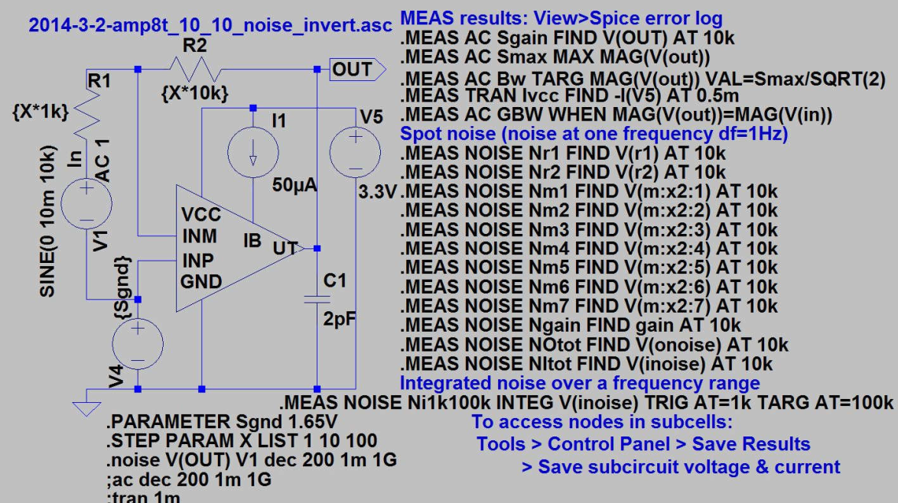

Slide 17
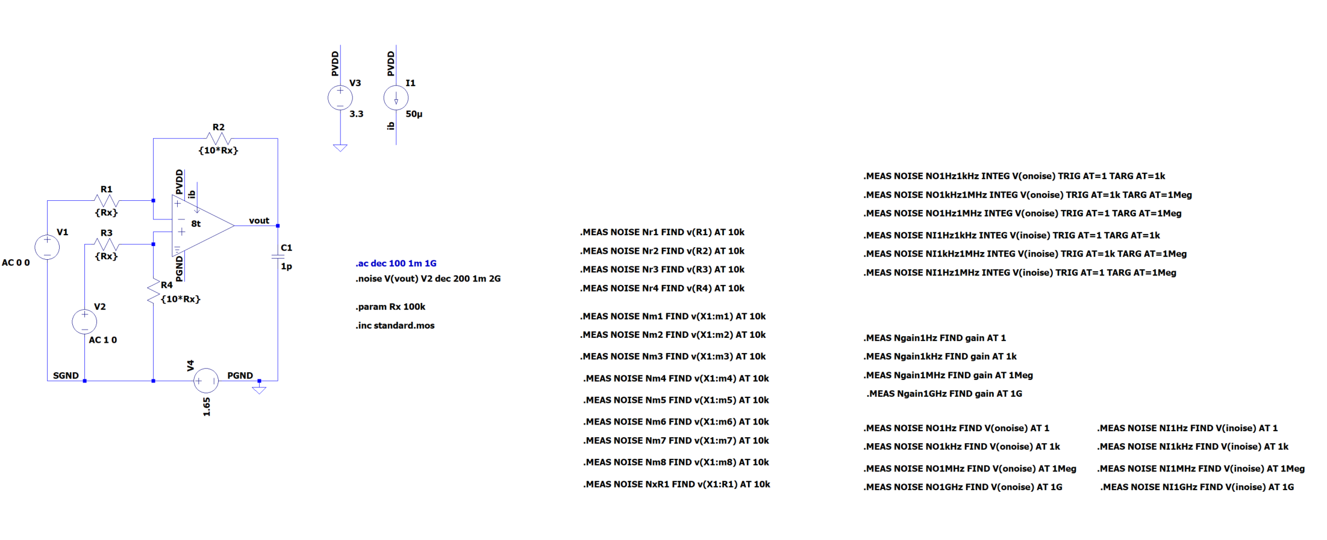

Slide 18
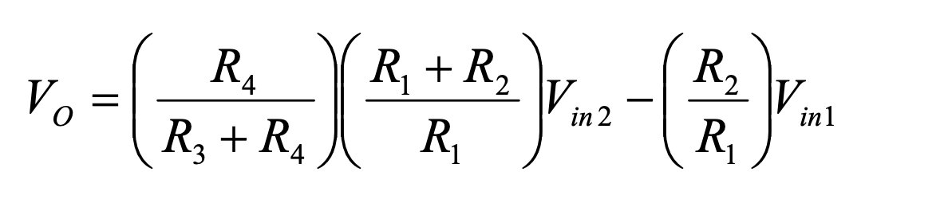
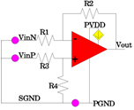
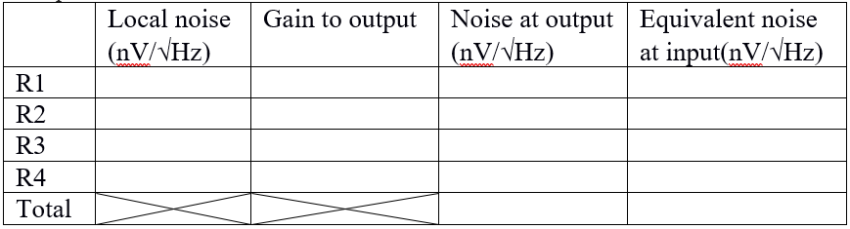
Task1: Ideal Amplifier
Studying the performance of the ideal amplifier in a resistive feedback loop
Copy the amplifier symbol from the "Educational" area. Include “.lib opamp.sub” on the schematic
Opamp settings: Gain = 100k and GBW = 10Meg

Slide 19
Task1: Ideal Amplifier
Fill out the table based both on hand calculations and simulations
Disadvantage/advantage of small/large R? (Hint: Noise ⇔Power)

Slide 20
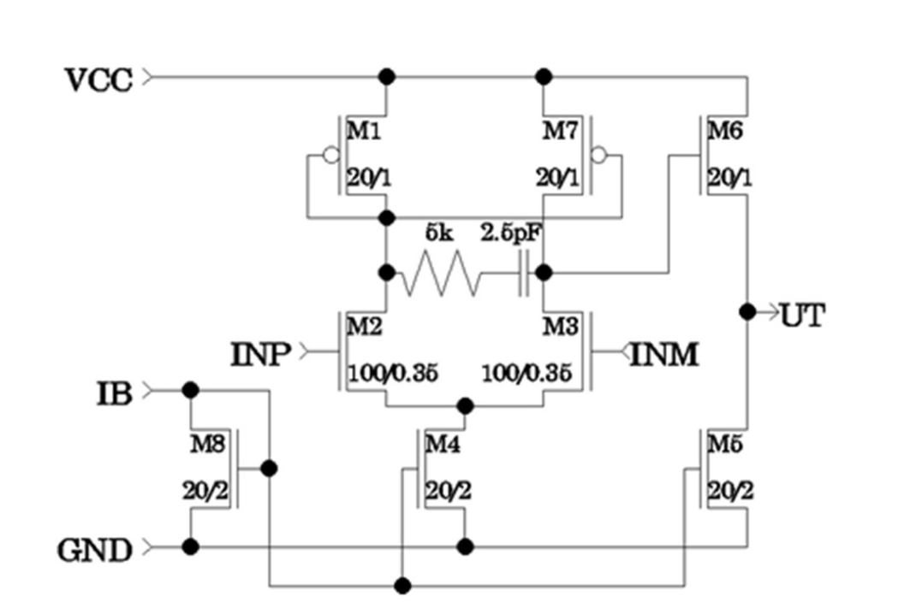
Task2: Simple CMOS Amplifier
.ac analysis for the open loop circuit without the feedback
Perform the .ac analysis for the resistive network of task 1 when you replace the ideal amplifier by this amplifier

Slide 21
Task2: Simple CMOS Amplifier
c) Finding the spot noise (.noise) at 1Hz, 1kHz, 1MHz, and 1GHz and integrated noise for the areas of 1Hz-1kHz, 1kHz-1MHz, and 1Hz-1MHz
d) Repeat the task 1 with this amplifier
  Find the 6 strongest noise sources

Slide 22
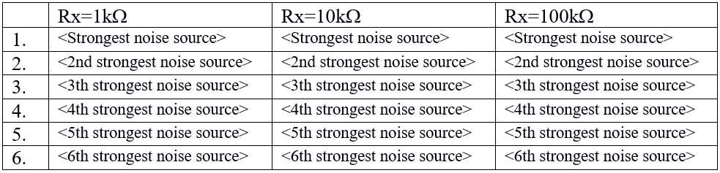
Task2: Simple CMOS Amplifier
Fill out the table above with the identity and contributions within each cell. (Use the same transistor indexing as in previous figure.)
Hint: In the rightmost column the resistors will be dominating while in the leftmost column amplifier transistors will dominate.

Slide 23
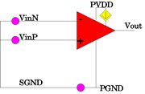
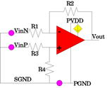
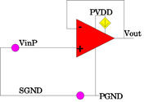
Task 3. Open loop, 10x gain and closed loop
In this task you shall find the spot noise (.noise) at 1MHz and the integrated noise from 1 Hz to 1 MHz at output and the positive equivalent input.
Find this for open loop, for 10x, as well as a follower. Present your results in a table.
The small pink circles are voltage sources. The voltage sources between SGND and PGND is a 1.65V DC source.

Slide 24
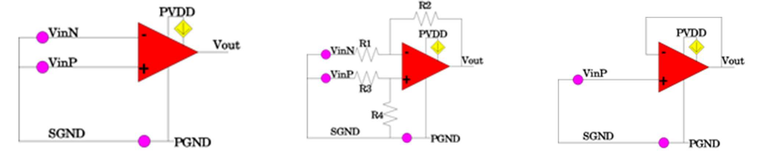
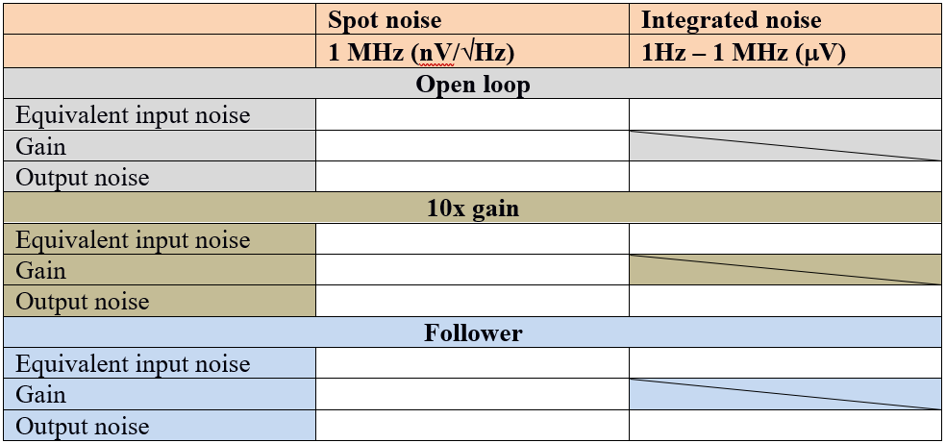
Task3: Open loop, 10x gain and closed loop
Fining spot noise and integrated noise for three different structures

Slide 25
Task 3. Open loop, 10x gain and closed loop
Comment: Here you will find that the follower (gain=1) and open loop (large gain) has the same equivalent input noise. Does that mean they are equally good? Will their gain influence on the noise contributions from subsequent circuitry?

Slide 26
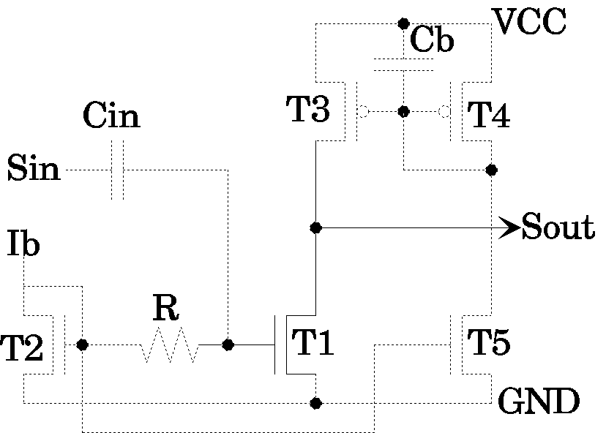
Task 4. Common source input stage - RF

Slide 27

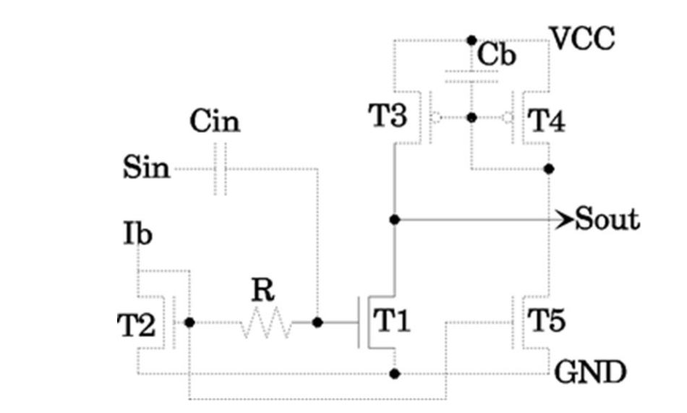
Task4: Common Source Amplifier- RF
Finding Cin as the signal is not muted by more than 10%. (R = 1k and Ib = 10uA)
Finding the range for R as its contribution on the output noise is <10%.

Slide 28
Task4: Common Source Amplifier- RF
c) What is the role of Cb?
d) Doubling the Wn, Ln, Wp, Lp.
e) Increasing the Ib.

Slide 29
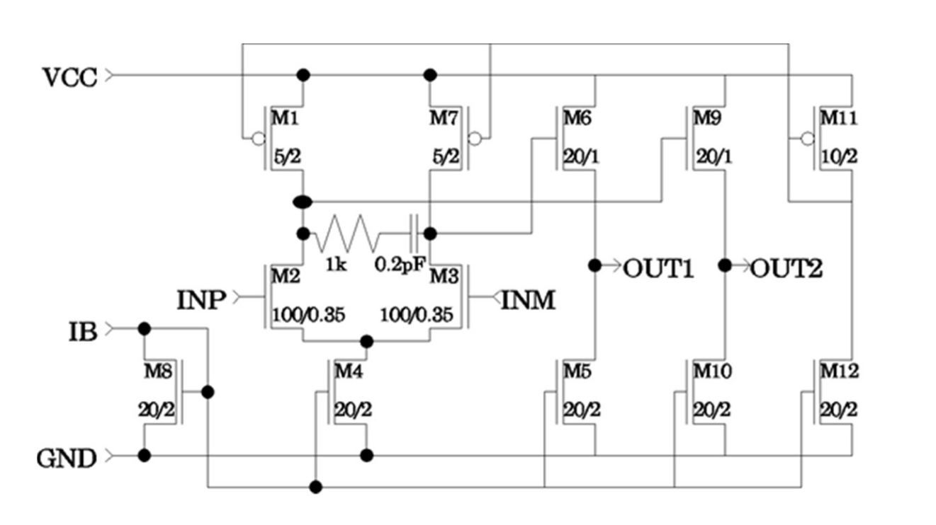
Task 5: CMOS Amplifier with Differential Input and Output
Finding the gain for each input, and differential input, finding the output noise and equivalent input noise.
Look at the effect of noise on the power supply, VCC (.AC)
  M2 and M3 are identical
  W_M2 = W_M3+ 0.1W_M3
Specify the power consumption variation

Slide 30
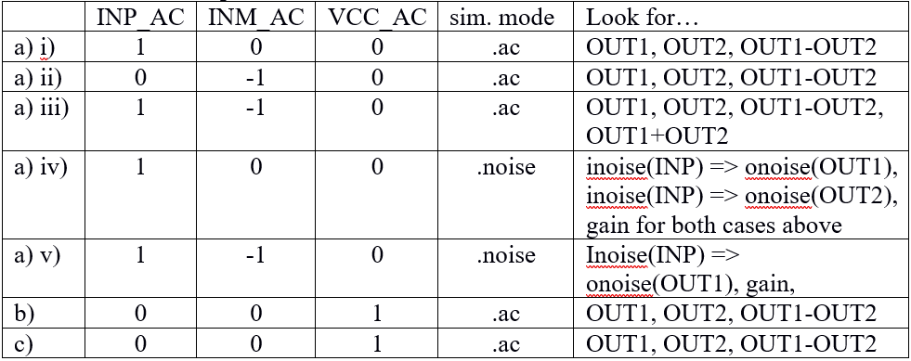
Task 5: CMOS Amplifier with Differential Input and Output
Simulation setup:
  In all cases the DC’s are: INP & INM = 1.65V, VCC=3.3V
  AC values as given below

Slide 31
Task 5: CMOS Amplifier with Differential Input and Output
Note:
  Output difference has to be calculated by the simulator. Method: Select a signal among those available. Plot it in the result window. Click on the name and edit the name from say «V(out1)» to «V(out1)-V(out2)».

Slide 32
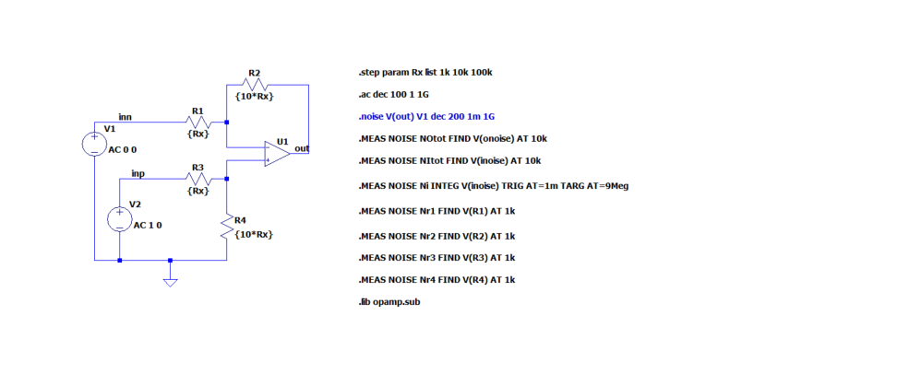
Example: How to plot .MEAS data

Slide 33
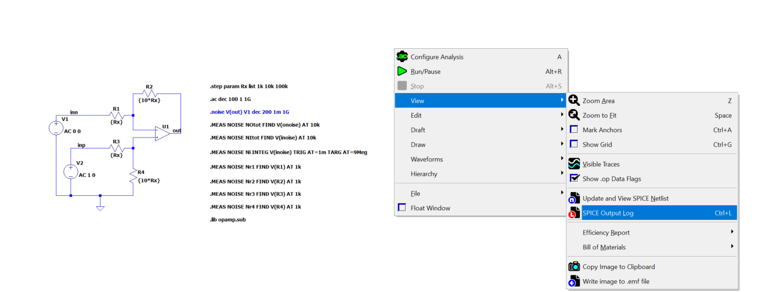
Example: How to plot .MEAS data

Slide 34
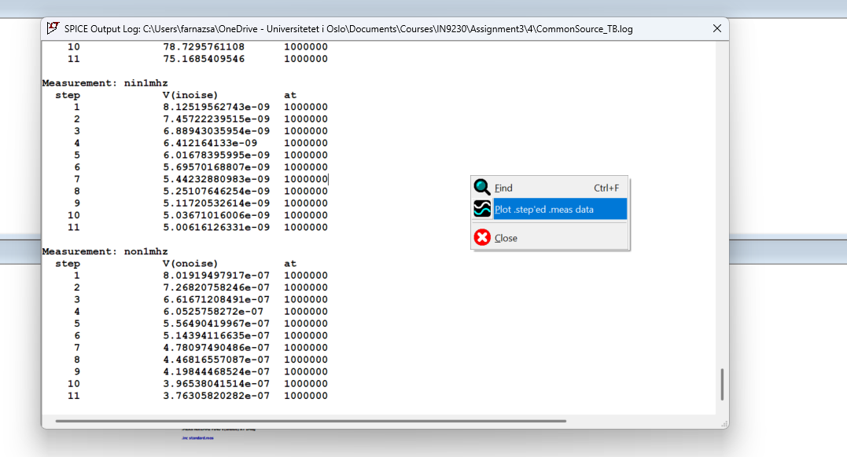
Example: How to plot .MEAS data

Slide 35
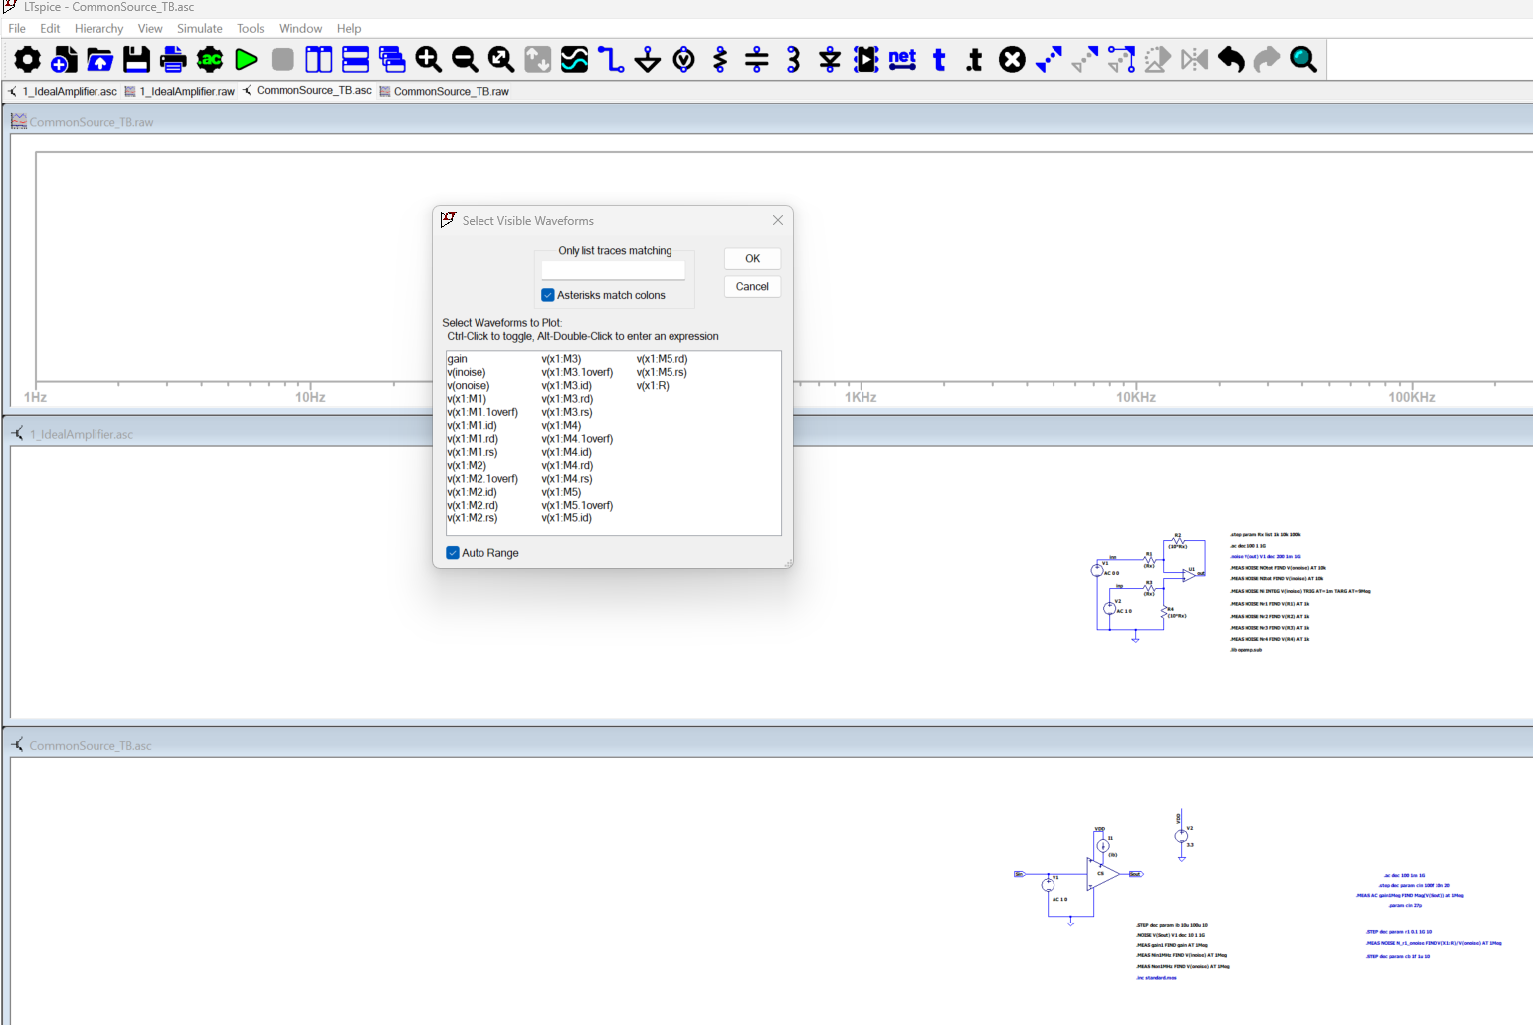
Example: How to plot .MEAS data

Slide 36
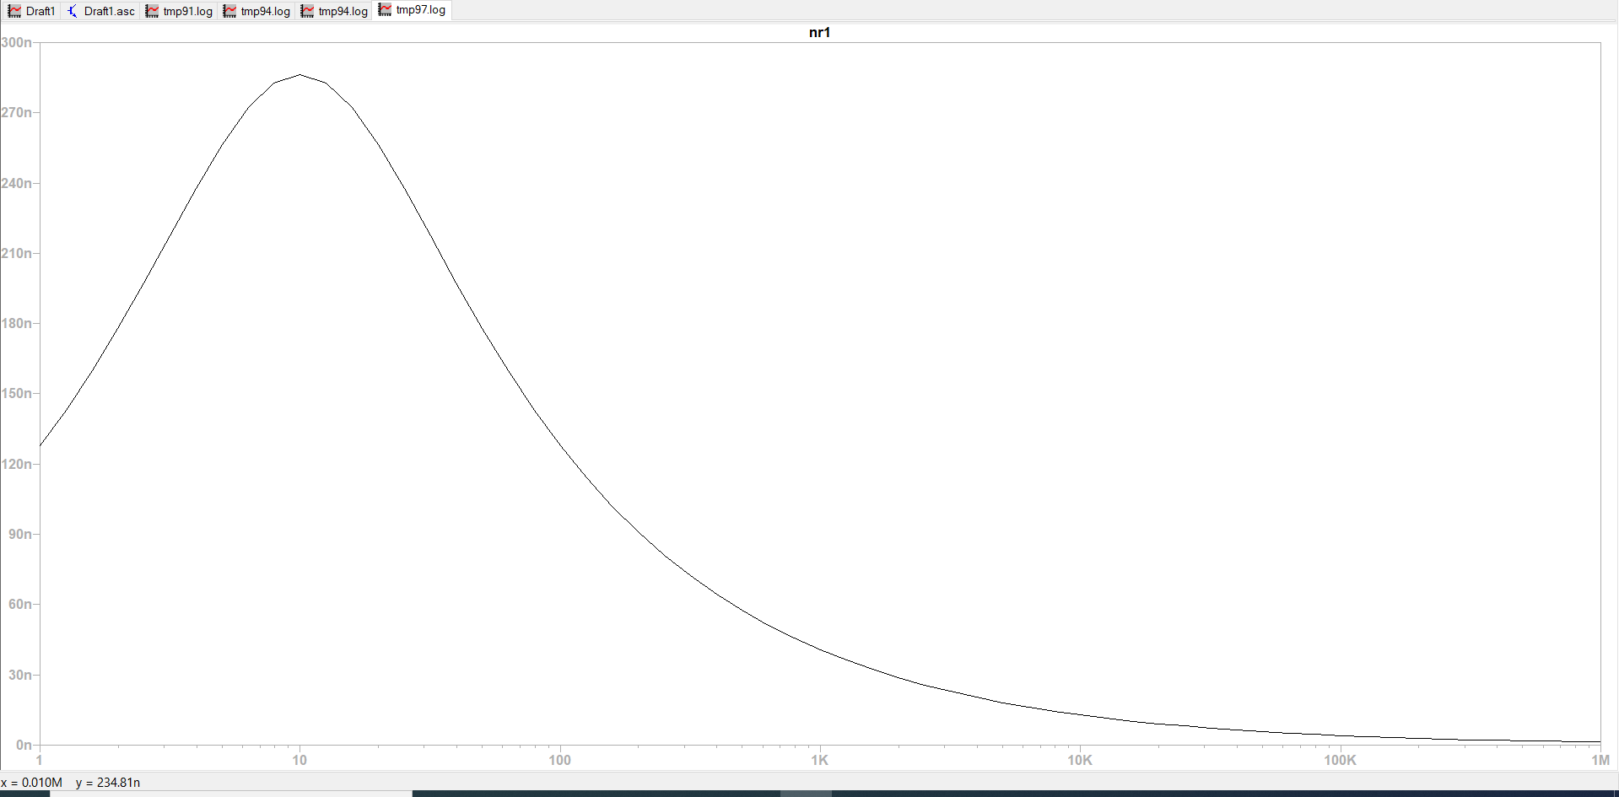
Example: How to plot .MEAS data
R1 (ohm)

Slide 37
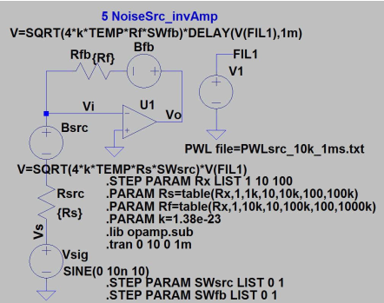
Transient component noise simulation

Slide 38
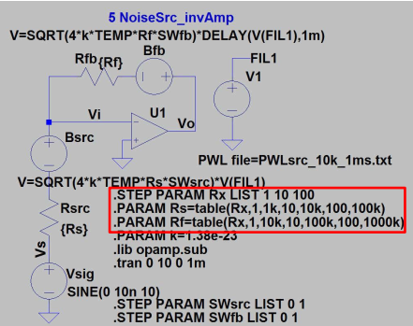
Transient component noise simulation

Slide 39
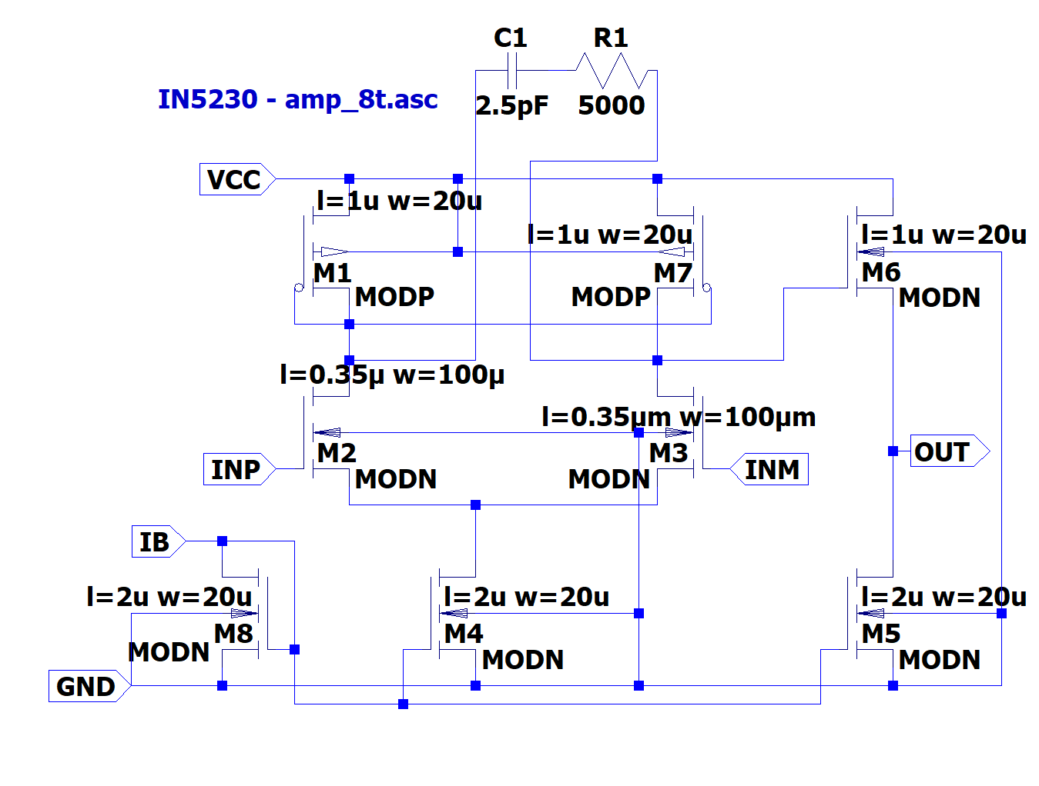
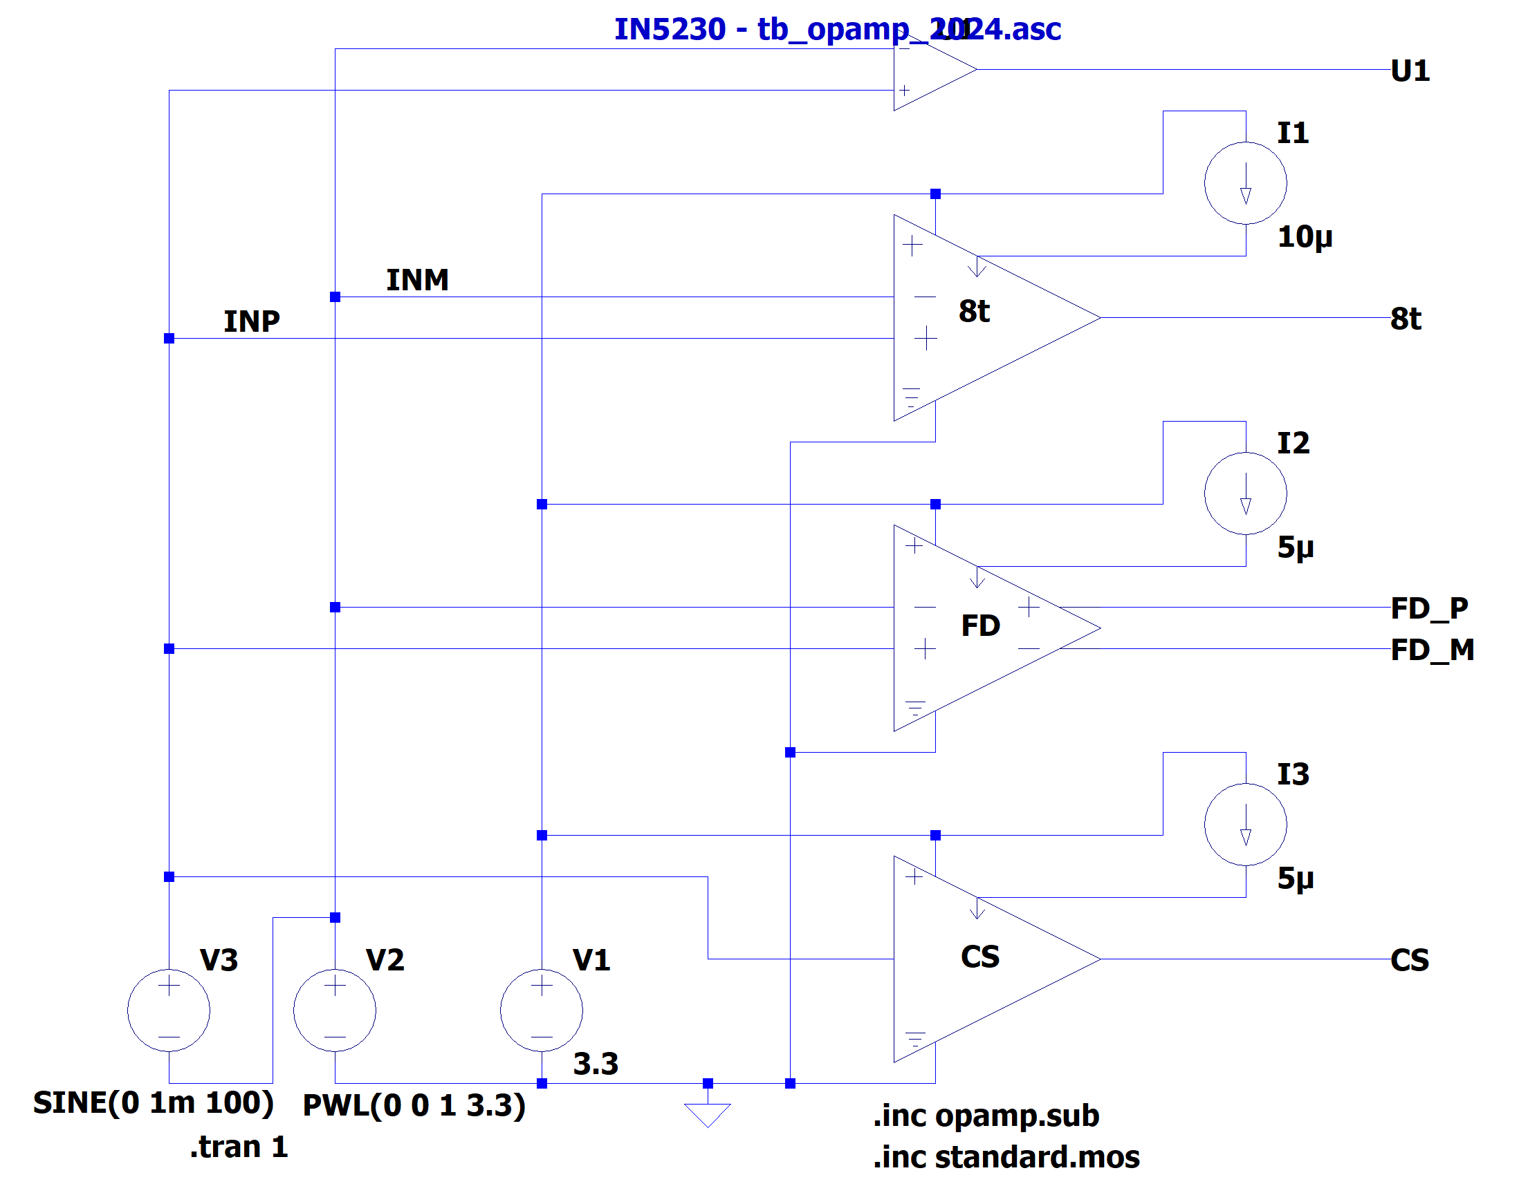
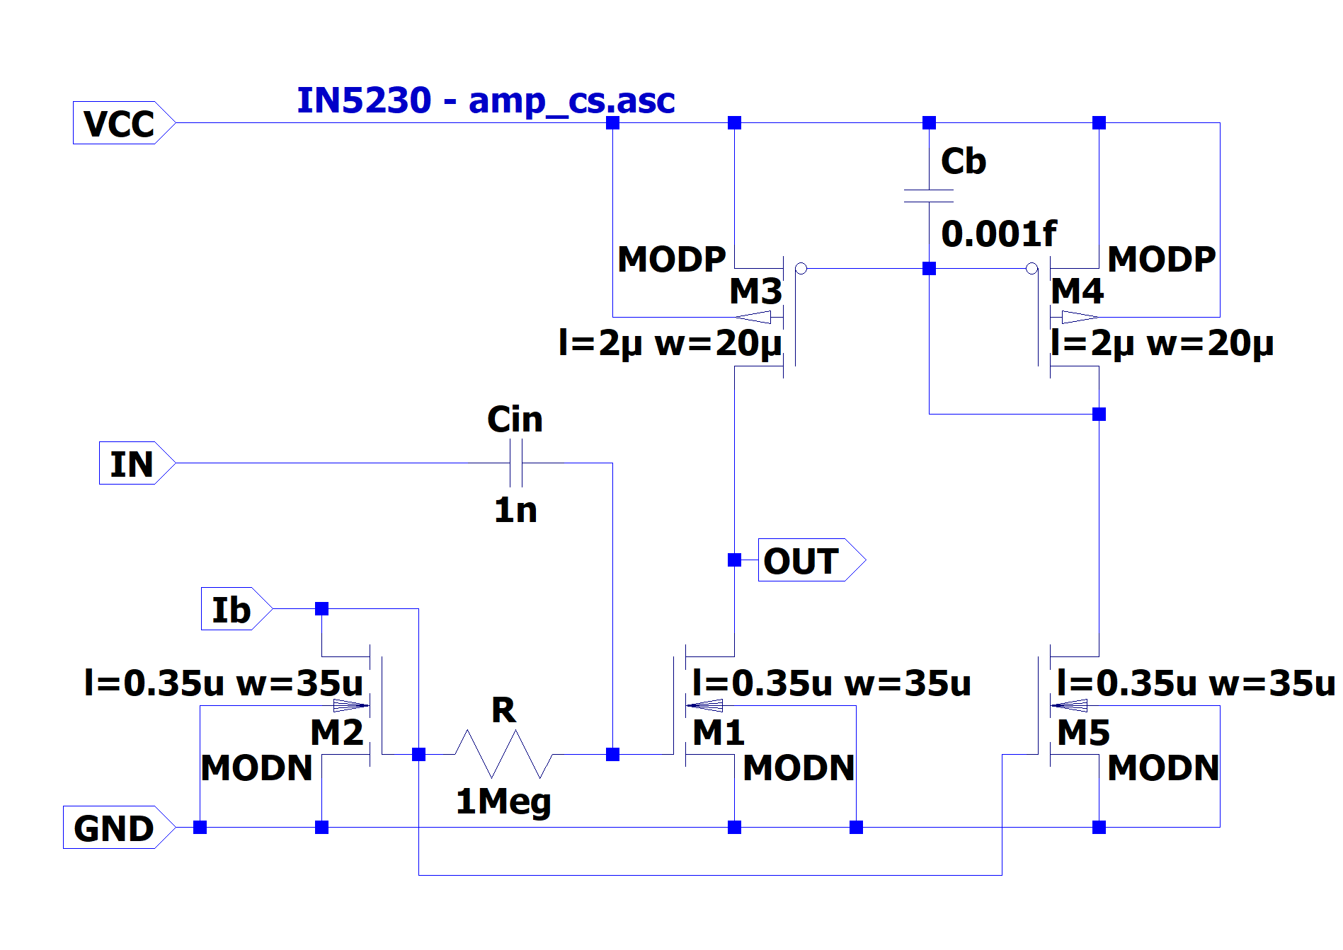
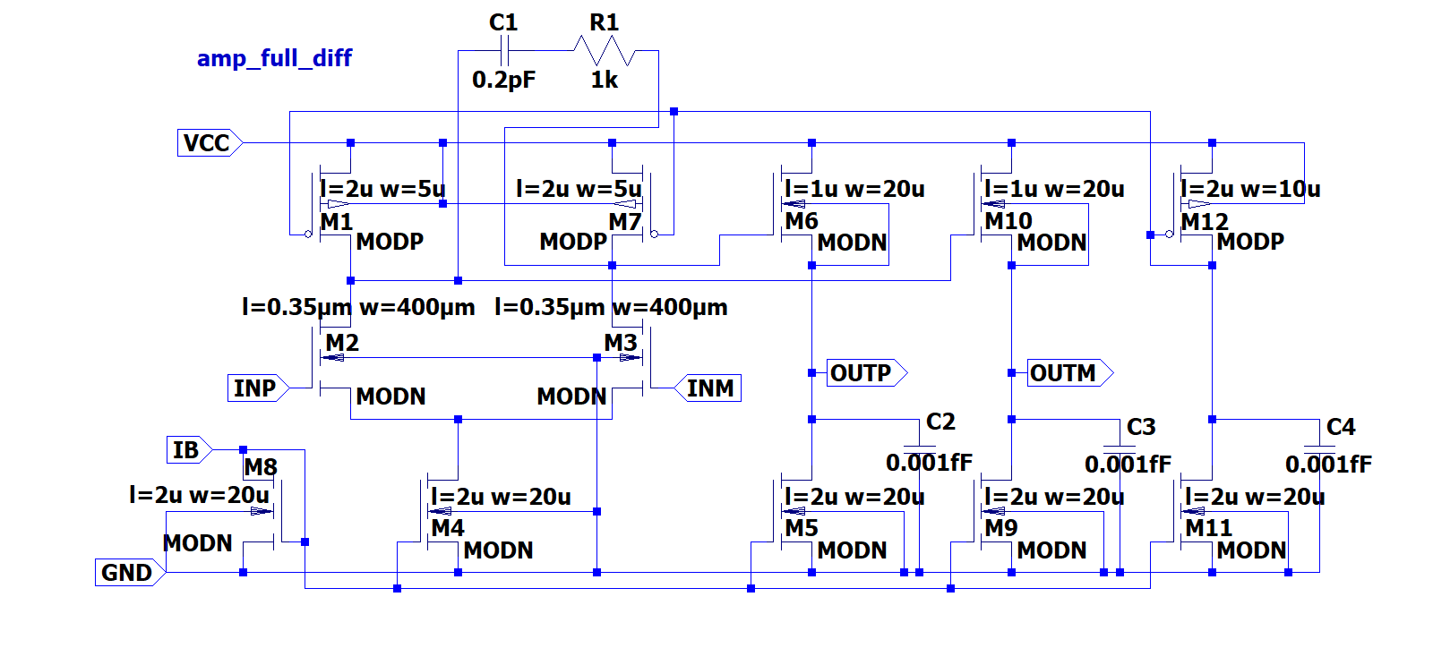
2024 - schematics

Slide 40
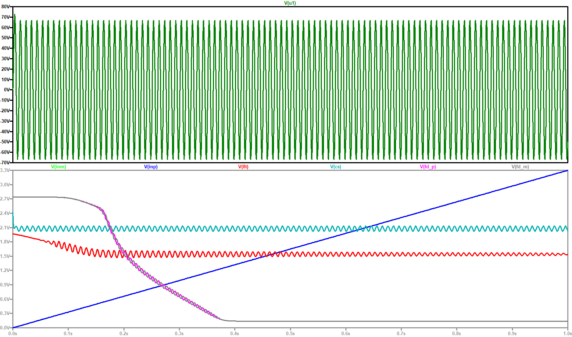
Testbench: tb_opamp_2024.asc
Run the simulations on tb_opamp_2024.asc
Input: Ramp with small sinus
Make sure you see the shown plots.

