Slide 1
Advanced Topics in Artificial Intelligence for Intelligent Systems (IN5490): Classification
Fall 2018
Enrique Garcia Ceja (enriqug@ifi.uio.no)

Slide 2
Machine learning taxonomy.
Supervised learning.
Classification.
Imbalanced data.
Random over/under sampling.
SMOTE.
Cost-sensitive classification.
Semi-supervised learning.
Self-learning.
Multi-view learning.
Co-Training.
Stacked generalization.
Data representations.
Multi-user evaluation.
Baseline classifiers.

Slide 3
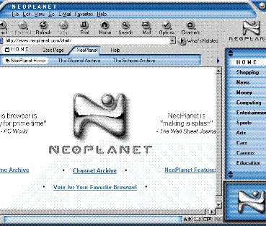
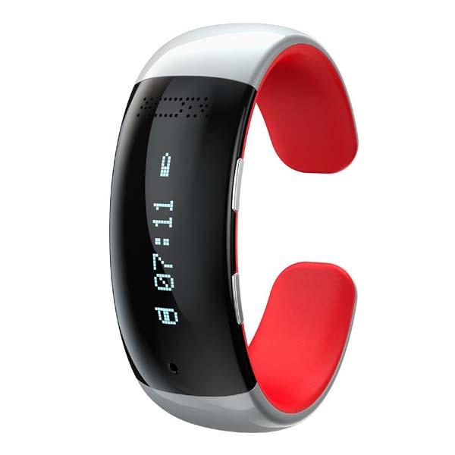
Big amounts of data
With the advent of information technologies the amount of data that is generated everyday is growing at a fast pace.
Trying to extract information and knowledge from that vast cumulus of data is a time consuming (if not impossible) task to do by hand.

Slide 4
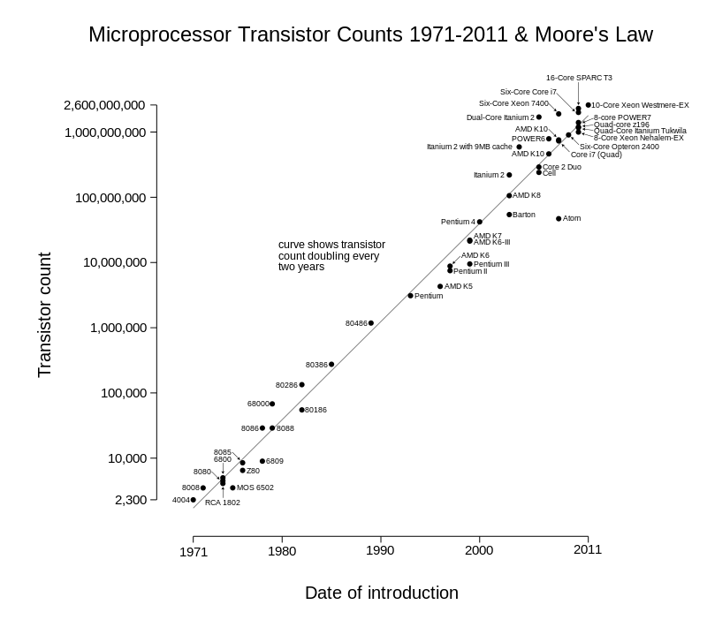
Given that the computational power of machines has been increasing in the last years, it would be desirable to use that power to process that huge amounts of data to extract knowledge from it.
By Wgsimon - Own work, CC BY-SA 3.0, https://commons.wikimedia.org/w/index.php?curid=15193542

Slide 5
Machine learning can be thought of (but not limited to), as a set of computational algorithms that automatically find interesting patterns and relationships from data.
“The basic principle of machine learning is the automatic modeling of underlying processes that have generated the collected data.” (I. Kononenko and M. Kukar, 2007).

Slide 6
Learning
(I. Kononenko and M. Kukar., 2007) defined learning as “any modification of the system that improves its performance in some problem solving task.”
The result of learning is knowledge that the system can use to solve new problems. An algorithm infers the properties of a given set of data and that information allows it to make predictions about other data that it might see in the future.
This is possible because almost all nonrandom data contains patterns which allows a machine to generalize (T. Segaran, 2007).

Slide 7
ML taxonomy
Machine learning
Supervised
Unsupervised
Reinforcement learning
Semi-supervised
Regression
Classification
Clustering
Associations

Slide 8
Supervised learning
In supervised learning, the algorithms are presented with a set of classified instances from which they learn a way of classifying unseen instances. When the attribute to be predicted is numeric rather than nominal it is called regression.
Training data
Algorithm
Model
prediction

Slide 9
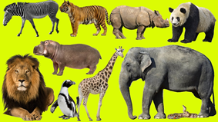
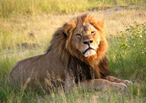
Classification
zebra
tiger
rhino
panda
Algorithm
Model
lion
hippo
elephant
lion
penguin
giraffe
snake

Slide 10
Remember: garbage in, garbage out
Algorithm

Slide 11
Algorithm

Slide 12
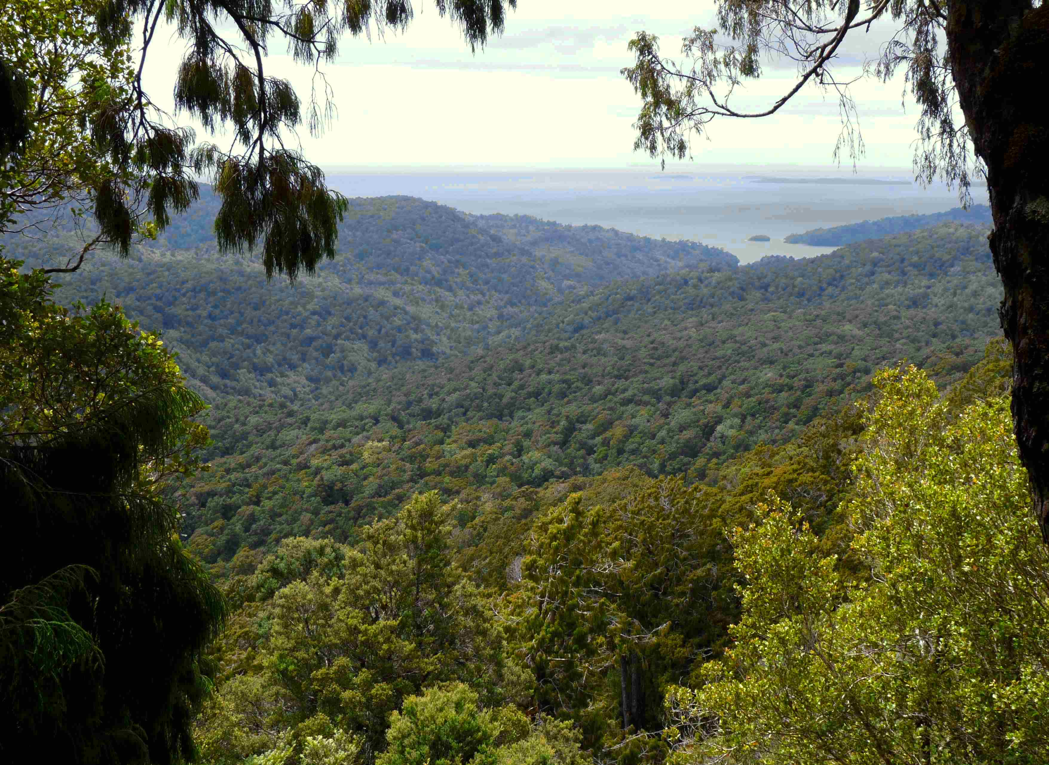
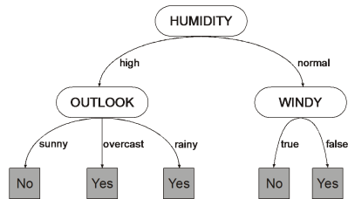
The resulting model is also called the hypothesis.
Given a model space and an optimality criterion, a model satisfying this criterion is sought.
Optimal tree!

Slide 13
Some criteria:
Maximizing the prediction accuracy
Minimizing the hypothesis’ size
Maximizing the hypothesis fitness to the input data
Maximizing the hypothesis interpretability
Minimizing the time complexity of prediction

Slide 14
Imbalanced data
Random over/under sampling
SMOTE
Cost sensitive classification

Slide 15
You trained a model to predict cancer from image data using a state of the art Hierarchical siamese CNN with dynamic kernel activations…

Slide 16
Your model has an accuracy of 99.9%

Slide 17
But… WTH!?

Slide 18
By looking at the confusion matrix you realize that the model does not detect any of the positive examples.

Slide 19
After plotting your class distribution you see that you have thousands of negative examples but just a couple of positives.
negatives
positives

Slide 20
Classifiers try to reduce the overall error so they can be biased towards the majority class.
# Negatives = 998
# Positives = 2
By always predicting a negative class the accuracy will be 99.8% !!

Slide 21
Your dataset is imbalanced.
Now what??

Slide 22
What can you do?
Collect more data (difficult in many domains)
Delete data from the majority class
Create synthetic data
Adapt your learning algorithm (cost sensitive classification)

Slide 23
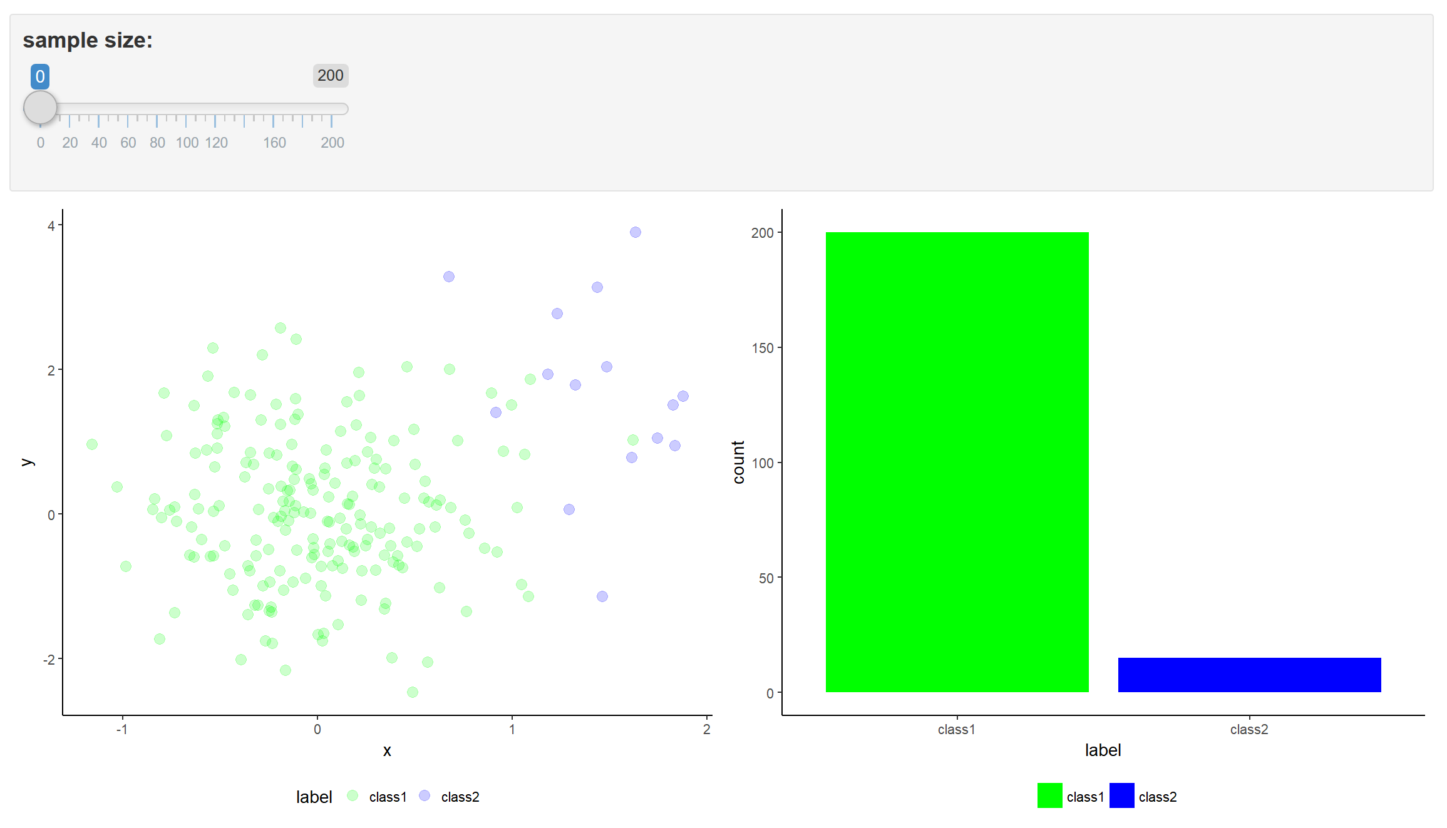
Random over/under sampling
Random oversampling: randomly duplicate data points from the minority class.
Random undersampling: randomly delete data points from the majority class.
Demo

Slide 24
Problems with these approaches:
Loss of information (in the case of under sampling)
Overfitting and fixed boundaries (over sampling)

Slide 25
SMOTE
Synthetic Minority Over-sampling Technique (Chawla).
Creates new data points from the minority class.
Operates in the feature space.

Slide 26
Main steps:
Take the difference between a sample point and one of its nearest neighbors.
Multiply the difference by a random number between 0 and 1 and add it to the feature vector.
This causes the selection of a random point along the line segment between two specific features.
synthetic point
a nearest neighbor
sample point

Slide 27
SMOTE DEMO

Slide 28
Danger of information injection and overfitting
Do not create synthetic points on the entire dataset before splitting into train/test sets.
Perform the preprocessing just on the training data!!
For k-fold cross validation, you have to do it for each fold (just on the training set).

Slide 29
For images:
Augment training data by applying image transformations: rotate, scale, shift, etc.
Keras provides functionalities for data augmentation: https://blog.keras.io/building-powerful-image-classification-models-using-very-little-data.html

Slide 30
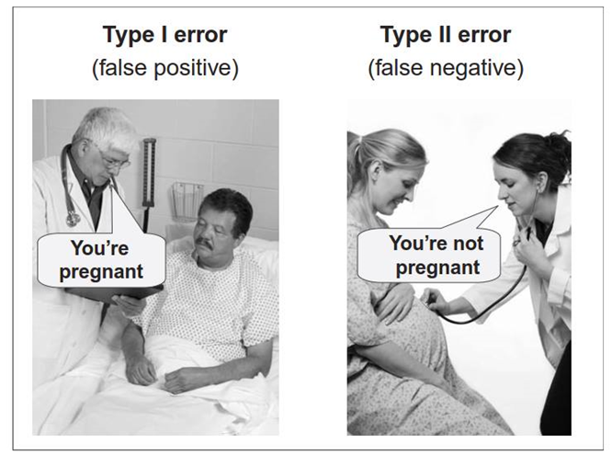
Cost-sensitive classification
Based on the classifier predicted probabilities.
Binary case: predict positive if probability is > 0.5
Probability threshold can be changed using a cost matrix:
Classify as positive if: probability of positive > $\frac{\text{µ}}{\text{µ}+\text{ʎ }}$
TP: true positives
0 | ʎ
µ | 0
FN: false negatives
FP: false positives
TN: true negatives

Slide 31
Cost-sensitive classification
Credit dataset.

Slide 32
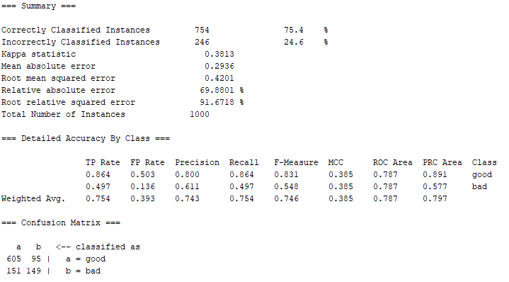
Cost-sensitive classification with Weka
Naïve Bayes.
TP
FN
FP
TN

Slide 33
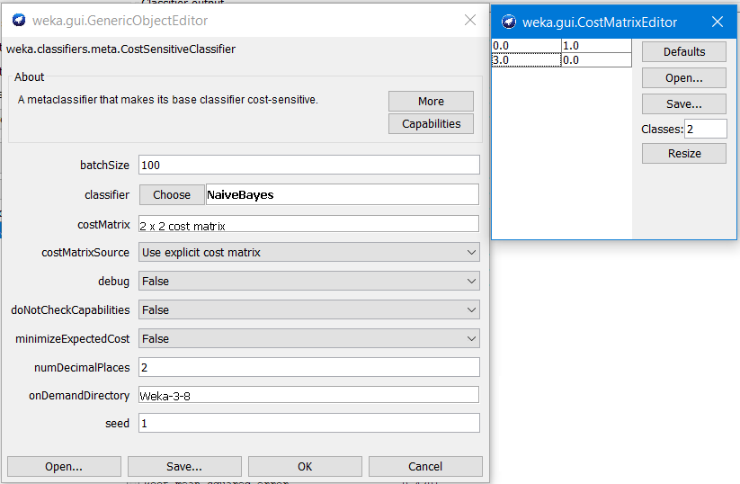
Cost-sensitive classification with Weka
Cost-sensitive classifier with Naïve Bayes.
$$\frac{\text{µ}}{\text{µ}+\text{ʎ }}=\frac{\text{3}}{\text{3}+\text{1} }=0.75$$
Cost of misclassifications changed from 1.0 to 3.0
FP will be more severely penalized.

Slide 34
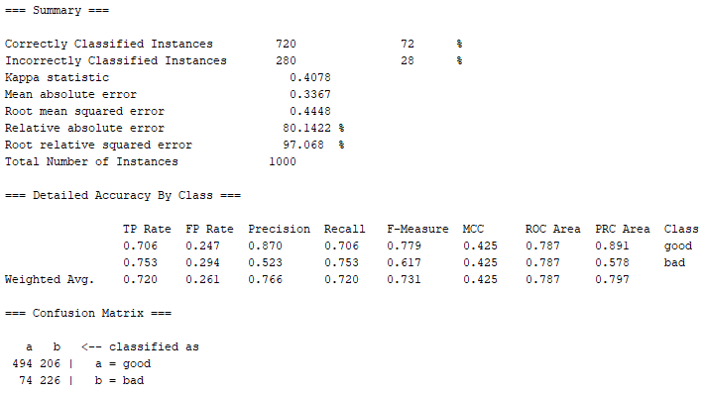
Cost-sensitive classification with Weka
Cost-sensitive classifier with Naïve Bayes.
But also TP reduced
FPs reduced

Slide 35
Assign class weights
In Keras you can assign class weights.
fit() function in keras has a class_weight parameter (see https://keras.io/models/model/).
class_weight = {0: 1.,
1: 9.}
Optional dictionary mapping class indices (integers) to a weight (float) value, used for weighting the loss function (during training only). This can be useful to tell the model to "pay more attention" to samples from an under-represented class.
max_v = number of points with majority class
weight_minority = max_v / (# of minority points)
weight_majority = max_v / max_v = 1
This is just one way to compute class weights

Slide 36
Tools
Python imbalanced-learn library: https://github.com/scikit-learn-contrib/imbalanced-learn
Weka also has oversampling methods and a cost sensitive meta classifier: https://weka.wikispaces.com/CostSensitiveClassifier

Slide 37
Performance metrics
Most of the time accuracy will not be enough to assess performance.
accuracy $=\frac{TP+TN}{P+N}$
$sensitivity=\frac{TP}{P}$
precision$=\frac{TP}{TP+FP}$
Percentage of correctly classified instances.
The proportion of positives that are correctly identified as such.
Equivalently, it is the fraction of relevant instances among the selected ones.
Matthews correlation coefficient (takes into account imbalance)

Slide 38
Supporting materials: imbalanced data
Chawla, N. V., Bowyer, K. W., Hall, L. O., & Kegelmeyer, W. P. (2002). SMOTE: synthetic minority over-sampling technique. Journal of artificial intelligence research, 16, 321-357.
Kotsiantis, S., Kanellopoulos, D., & Pintelas, P. (2006). Handling imbalanced datasets: A review. GESTS International Transactions on Computer Science and Engineering, 30(1), 25-36.
Python imbalanced-learn library: https://github.com/scikit-learn-contrib/imbalanced-learn
Weka also has oversampling methods and a cost sensitive meta classifier: https://weka.wikispaces.com/CostSensitiveClassifier
Cost-sensitive classification video: https://www.youtube.com/watch?v=l9muPldOG30
Performance metrics: https://en.wikipedia.org/wiki/Sensitivity_and_specificity

Slide 39
Semi-supervised learning (SSL)
labeled
unlabaled
Suitable when just a small proportion of the training data is labeled.
These algorithms try to learn also from the unlabeled data.

Slide 40
Semi-supervised learning (SSL)
Suitable for datasets with:
Small amounts of labeled data
Large amounts of unlabeled data (labeling requires effort)
High certainty in labels

Slide 41
Semi-supervised learning (SSL)
100%
labeled
supervised
partially supervised
semi-supervised
0
unsupervised
0
100% certainty
Image: (Biecek, 2012)

Slide 42
Semi-supervised learning (SSL)
Traditional supervised learning is limited to using labeled data.
SSL also uses unlabeled data to learn.
Let (x,y) be a labeled instance and (x,ø) be an unlabeled instance.
L: a set of n labaled instances.
U: a set of m unlabeled instances.
n << m
SSL tries to use L U U to learn a predictive model.

Slide 43
SSL: Self-learning
L: labeled instances
U: unlabeled instances
Self-learning: a model uses the unlabeled data
to improve itself.
Procedure:
Train a model f with L
y’ = f(x) where x ∈ U
L = L ∪ (x,y’)
Repeat

Slide 44
Self-learning ‘improvements’
Just add instances with the most confident predictions.
Perform the procedure with batches of instances instead of one instance at a time.
Re-assess previous predictions.

Slide 45
SSL is not always guaranteed to work! Performance may also degrade due to noisy instances. Remember: garbage in, garbage out!
40

Slide 46
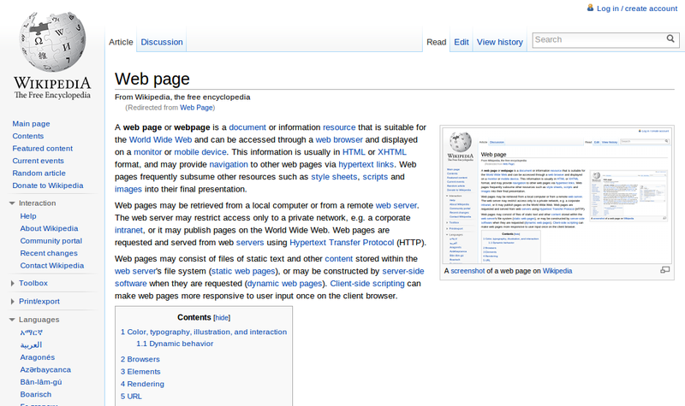
Multi-view learning
Sometimes, an observation can be represented by two independent sets of features or ‘views’.
For example a webpage can be characterized by its content but also by the links’ text pointing to it.
This view redundance can be used for semi-supervised learning!

Slide 47
Multi-view learning
Conventional algorithms ‘concatenate’ all views.
This approach might cause overfitting with small training sets.
Not physically meaningful since each view has specific statistical properties.

Slide 48
Multi-view learning
Multi-view learning takes advantage of all views to jointly optimize and exploit the redundant views of the same input data to improve performance.

Slide 49
Multi-view learning
Co-Training (Blum, A., & Mitchell, T.) is a type of semi-supervised algorithm.
Two classifiers work together to enlarge the training set L and increase performance.

Slide 50
Co-training algorithm
Some implementations use independent L for each view.

Slide 51
Co-training algorithm
Assumptions
A feature split into two views exists.
Each feature split (view) is sufficient to train a good classifier.
The views are conditionally independent given the class.

Slide 52
Co-training algorithm
How to combine the results?
Multiply output probabilities.
Choose the class with maximum probability among the two models.
Train a single model after the last iteration.

Slide 53
Tri-training
Tri-training (Zhou and Li)
Use three learners. If two agree, the data is used to teach the third learner.

Slide 54
From Co-training to tri-training
One sees light,
and the other one sees dark
but they always work together
to enlarge the training set.
Sometimes they disagree,
so they keep independent labeled sets
but at the end, they always become friends.
Sometimes they make mistakes
and they will propagate
causing the overall performance to degrade.
Fortunately, they met a new learner
and whenever they agree,
the data point is shared with it.
Now the three train together
predict together
and will live forever.
By Enrique Garcia Ceja

Slide 55
Supporting materials: SSL, multi-view learning and co-training.
Blum, A., & Mitchell, T. (1998, July). Combining labeled and unlabeled data with co-training. In Proceedings of the eleventh annual conference on Computational learning theory (pp. 92-100). ACM.
Zhou, Z. H., & Li, M. (2005). Tri-training: Exploiting unlabeled data using three classifiers. IEEE Transactions on knowledge and Data Engineering, 17(11), 1529-1541.
Chapelle, O., Scholkopf, B., & Zien, A. (2009). Semi-supervised learning (chapelle, o. et al., eds.; 2006)[book reviews]. IEEE Transactions on Neural Networks, 20(3), 542-542.

Slide 56
Stacked Generalization

Slide 57
tacked generalization
Proposed by (Wolpert, 1992).
Combines a set of powerful learners by stacking their outputs.
Many of the Kaggle’s winning solutions use some type of stacking.

Slide 58
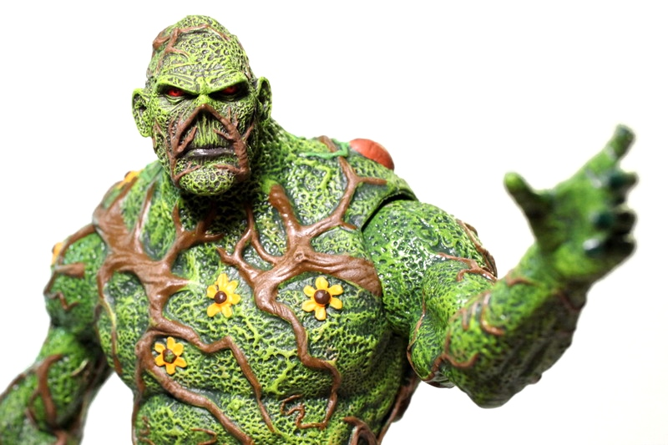
tacked generalization
SVM
LSTM RNN
Random Forest
Super Learner
Notes:
Iron man: https://www.flickr.com/photos/o_o--so/8675784958

Slide 59
tacked generalization
First, train a set of first-level learners.
Use the outputs of the first-level learners to train a meta-learner.

Slide 60
tacked generalization
Procedure:

Slide 61
tacked generalization
D’
Use D’ to train the meta-learner
Predictions of first-level learners
p₁
p_{L}
M
y
n
n
n,L
n

Slide 62
tacked generalization
Steps 2 and 3 can lead to overfitting.
To avoid this, use k-fold cross validation within these steps.
After D’ has been generated, retrain all first-level learners with all data from D.

Slide 63
tacked generalization
Performance can increase by adding confidence information about predictions (Ting & Witten).
Where k is the number of classes.
Probs are the averaged output probabilities from each learner L.
D’
p₁
p_{L}
p_{robs}
M
y
n
n
n,k
n,L
n

Slide 64
Supporting materials: stacked generalization
Zhou, Z. H. (2012). Ensemble methods: foundations and algorithms. Chapman and Hall/CRC.
Wolpert, D. H. (1992). Stacked generalization. Neural networks, 5(2), 241-259.

Slide 65
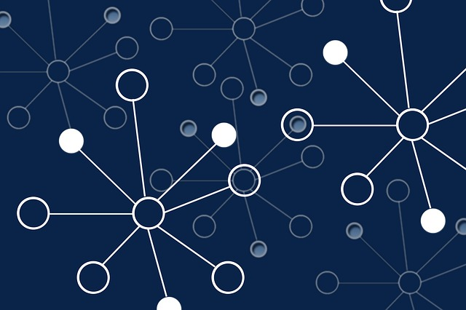
Data representations

Slide 66
Selecting a data representation is crucial.
Invest time thinking about the possibilities.
Each representation provides a different perspective/view (information).
Predictive models will depend on the type of representation.

Slide 67
Feature vectors
Efficient.
Most of the ML models support this type of representation.
Time/Frequency/etc. domain.
Require feature engineering.
Substantial information can be lost.
They are static (no temporal information).
5
0
2
3
10
7
3
0

Slide 68
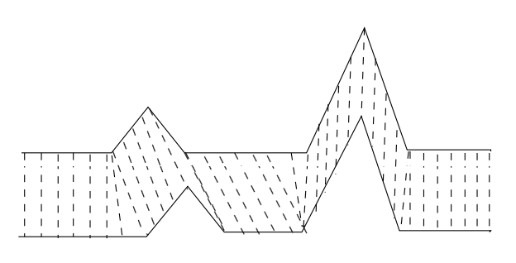
Time series
Preserve temporal patterns.
Not many models support or are efficient when handling raw time series data.
Euclidean distance often provides state of the art results for classification tasks.
Dynamic time warping (Rabiner & Juang, 1993) works on time series by aligning them on time.
Shapelets (Ye & Keogh, 2009) provide interpretable results and are more efficient than the previous ones at prediction time.
LSTM RNNs.
Computationally expensive.

Slide 69
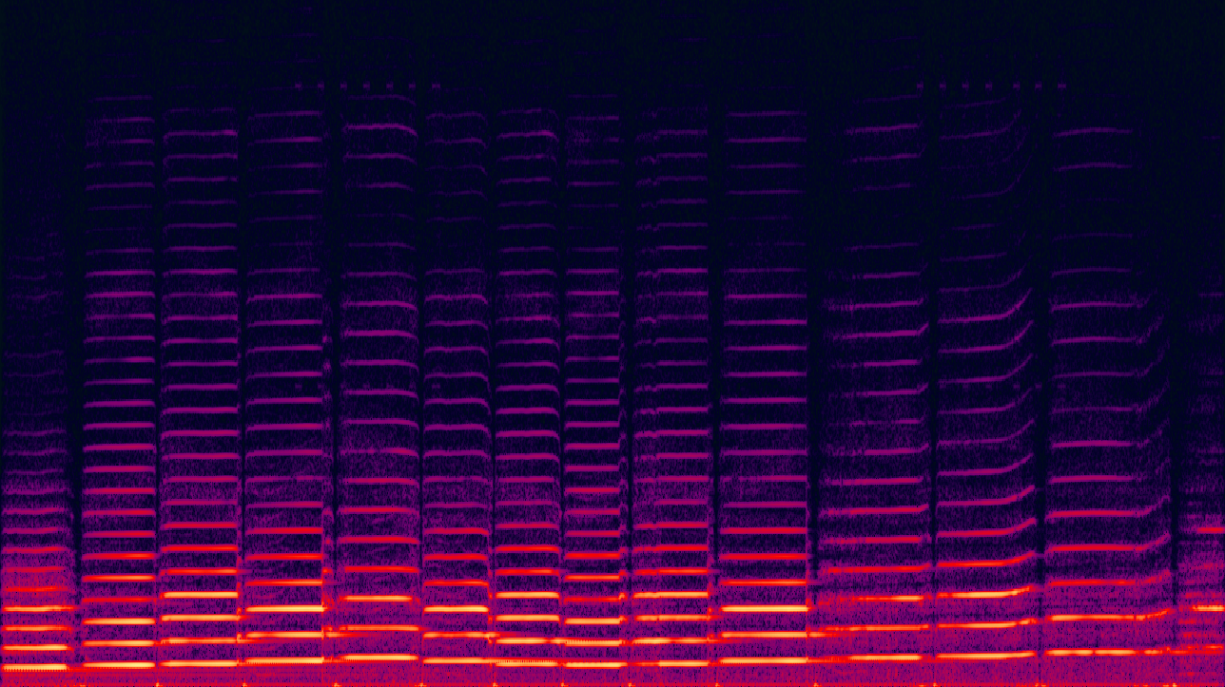
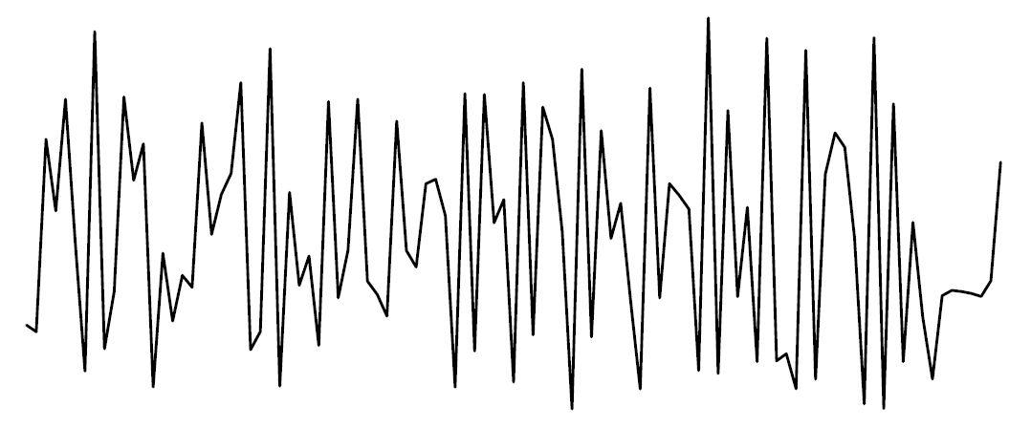
Images
Provide spatial information.
Efficient methods: Convolutional Neural Networks CNNs.
Multiple dimensions (RGB).
Time series data can be converted into images (spectrogram, recurrence plots, etc.).
Violin spectrogram
Recurrence plot

Slide 70
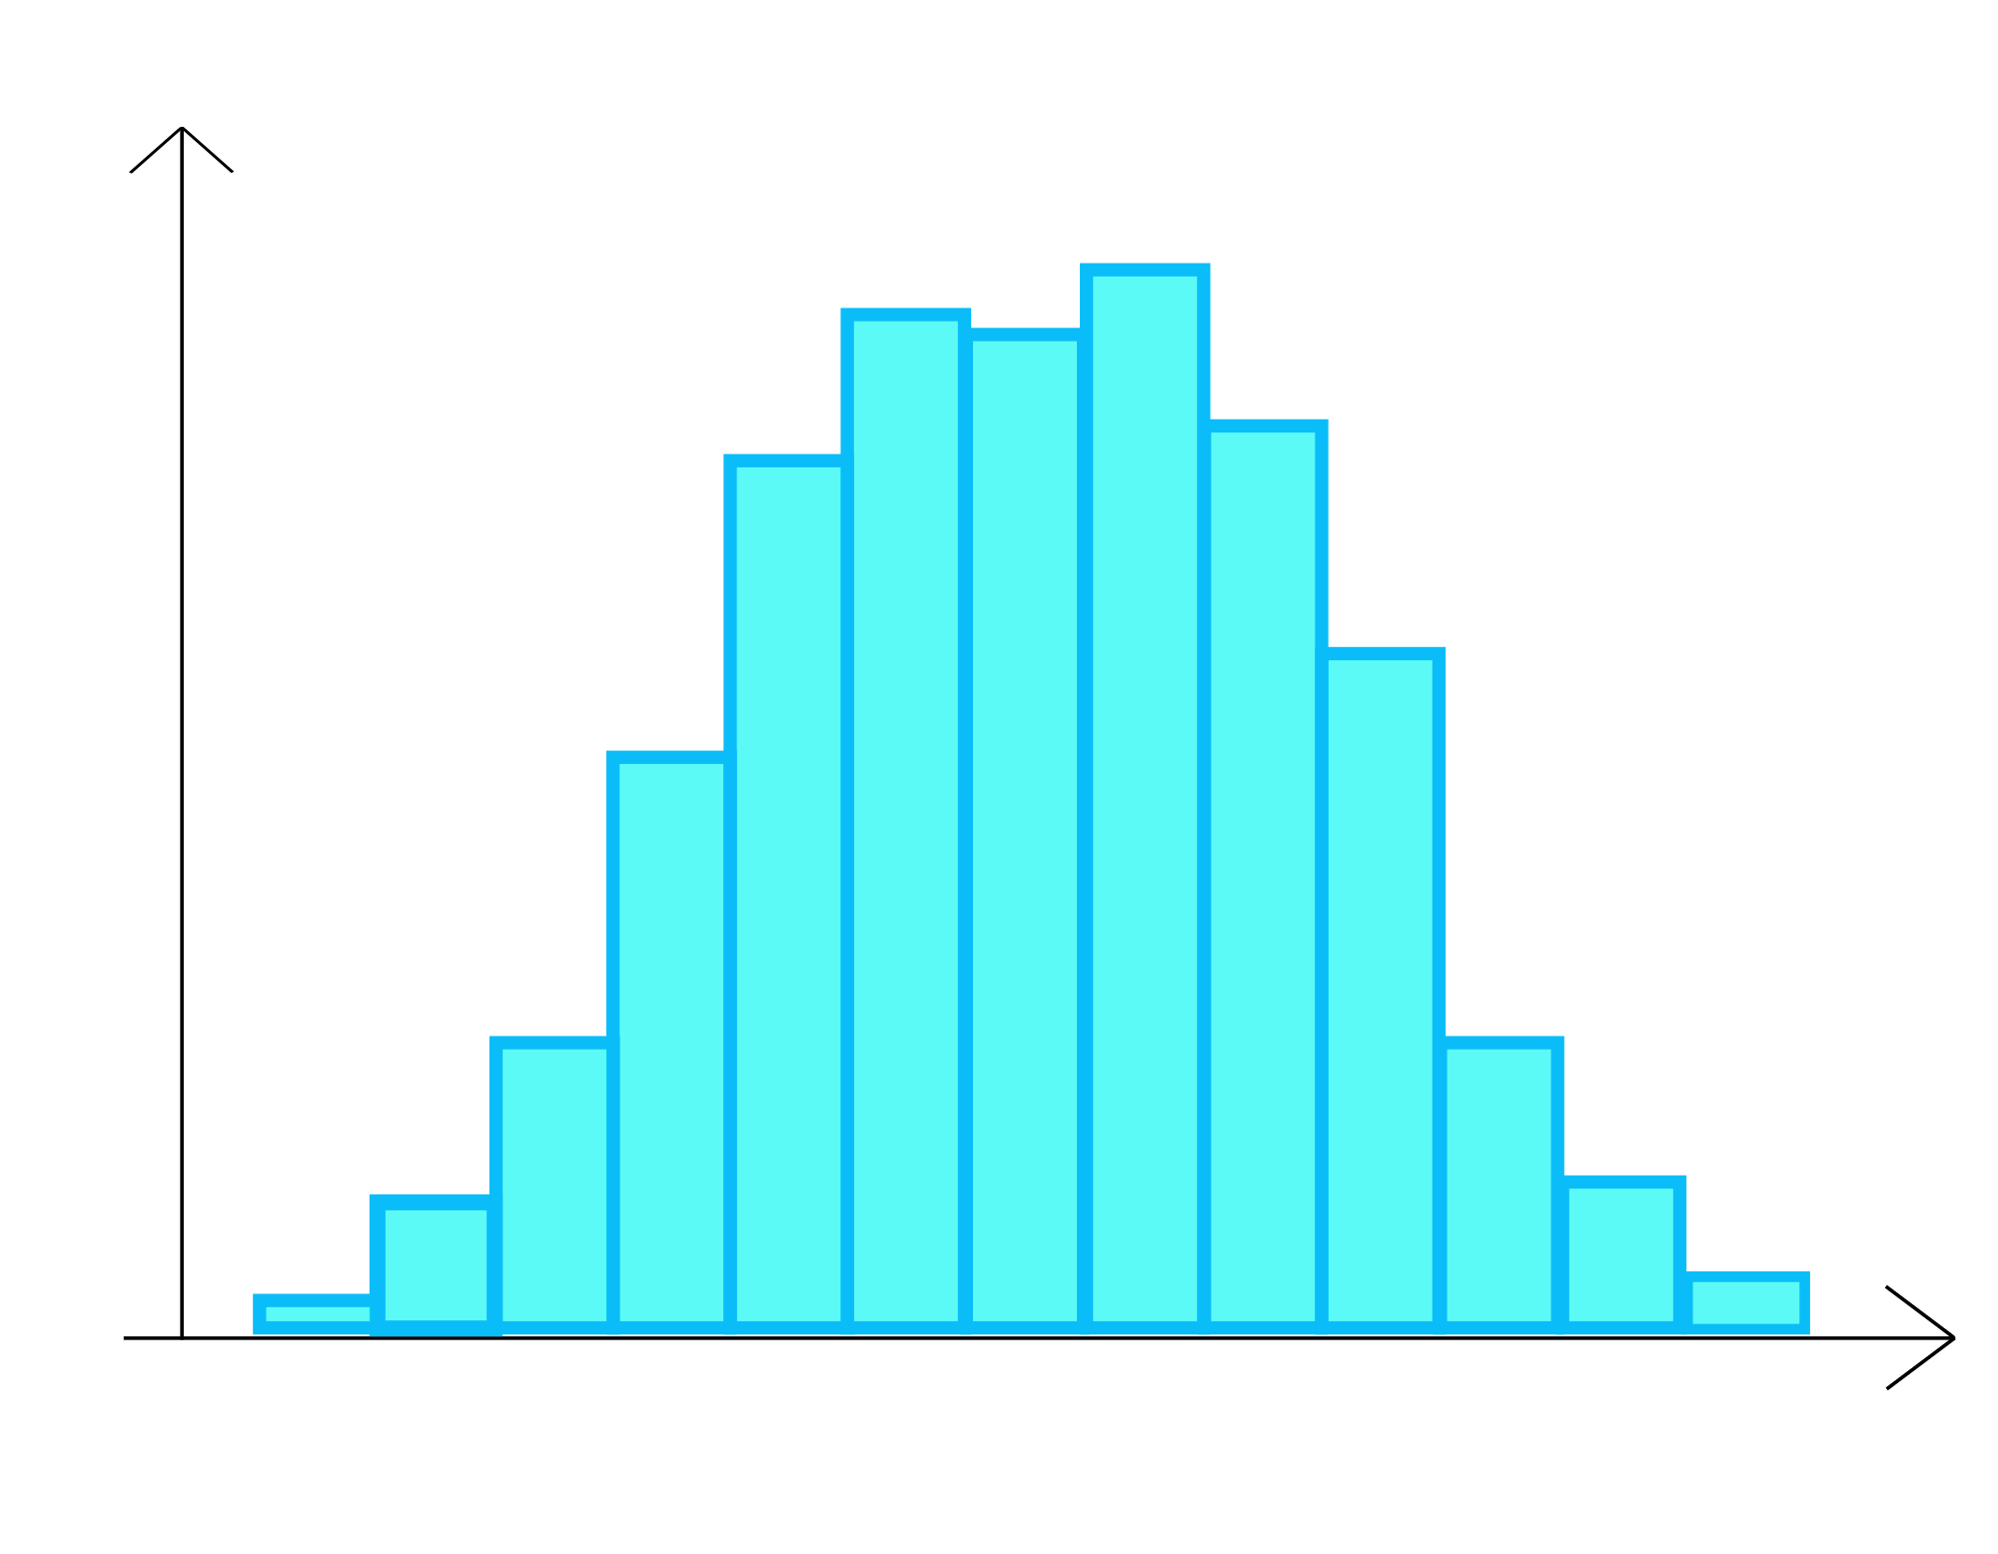
Bag-of-words
Commonly used in Natural Language Processing.
Also used in computer vision.
Time series data can be converted into a Bag-of-Words representation by using vector quantization.
The bag of words (word distribution) can be used as features to train classification models.
Temporal information is lost.
document
Bag of words
(words distribution)

Slide 71
Graph
Able to capture relationships between entities.
Edges can be weighted.
For the document example, words can be nodes and edges can represent connections between adjacent words.
Adjacency matrix entries can be used as features.
Statistics can be computed: closeness centrality, betweenness centrality, inbound, outbound edges, etc.

Slide 72
Combining representations
It is possible to combine different representations by using, e.g., stacking.
5
0
2
3
SVM
Stacking
CNN
prediction
LSTM

Slide 73
Multi-user evaluation
Evaluate classification models in multi-user settings.

Slide 74
Behavior differences
Users are unique.
Possess different characteristics and behaviors.
Attributes: age, gender, height, etc.

Slide 75
Multi-user scenarios
Speech recognition
Hand gesture recognition
Activity recognition
Facial expression recognition

Slide 76
Evaluation types
Mixed models
General models (user-independent models)
Personal models (user-dependent)

Slide 77
Mixed models
Do not make distinction between users.
Training/testing sets generated independently of users.
Some data points of the same user can be in both training and testing sets.
Performance results may not be representative of how the system will perform in real life.
Using a mixed model in multi-user scenarios is not a good idea to assess performance.

Slide 78
Personal models (user-dependent)
Are trained with data just from the same user.
In general, their performance is the best.
They require more data for each particular user.
Prone to overfitting.

Slide 79
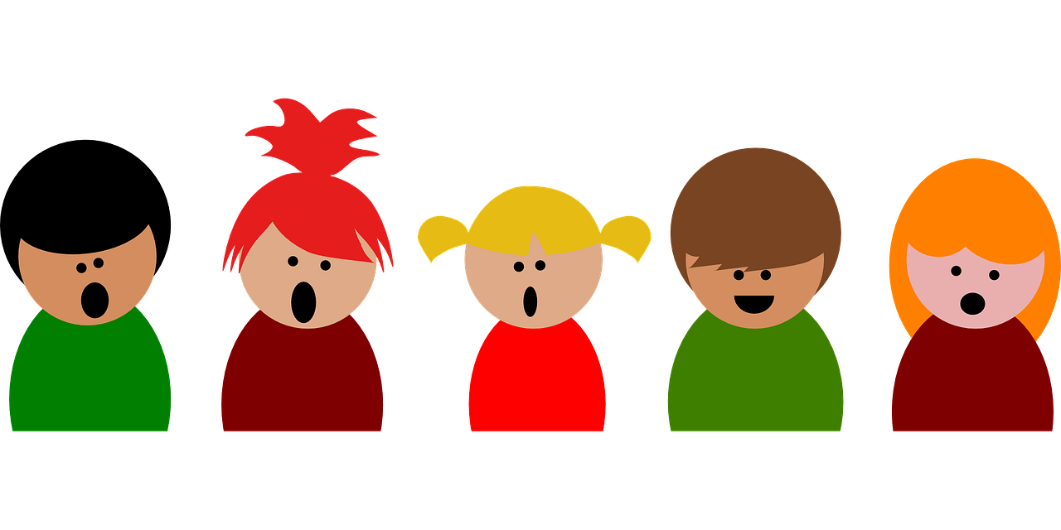
General models (user-independent models)
Are not trained with data from the target user.
Can be used right away to make predictions.
Performance can be low for some users.
Leave one user out validation
Test set
Train set

Slide 80
Supporting materials: Multi-user evaluation
Lockhart, J. W., & Weiss, G. M. (2014, April). The benefits of personalized smartphone-based activity recognition models. In Proceedings of the 2014 SIAM international conference on data mining (pp. 614-622). Society for Industrial and Applied Mathematics.
Rokni, S. A., Nourollahi, M., & Ghasemzadeh, H. (2018). Personalized Human Activity Recognition Using Convolutional Neural Networks. arXiv preprint arXiv:1801.08252.

Slide 81
Baseline classifiers
Machine learning is not the answer to every problem.
You can solve many problems with simple heuristics.
Assess whether or not machine learning has a benefit.

Slide 82
Baseline classifiers
Predict the most frequent class.
Predict according to class distributions.
Predict uniformly at random.
Predict the average value.
Predict next observations as the value of the previous one.

Slide 83
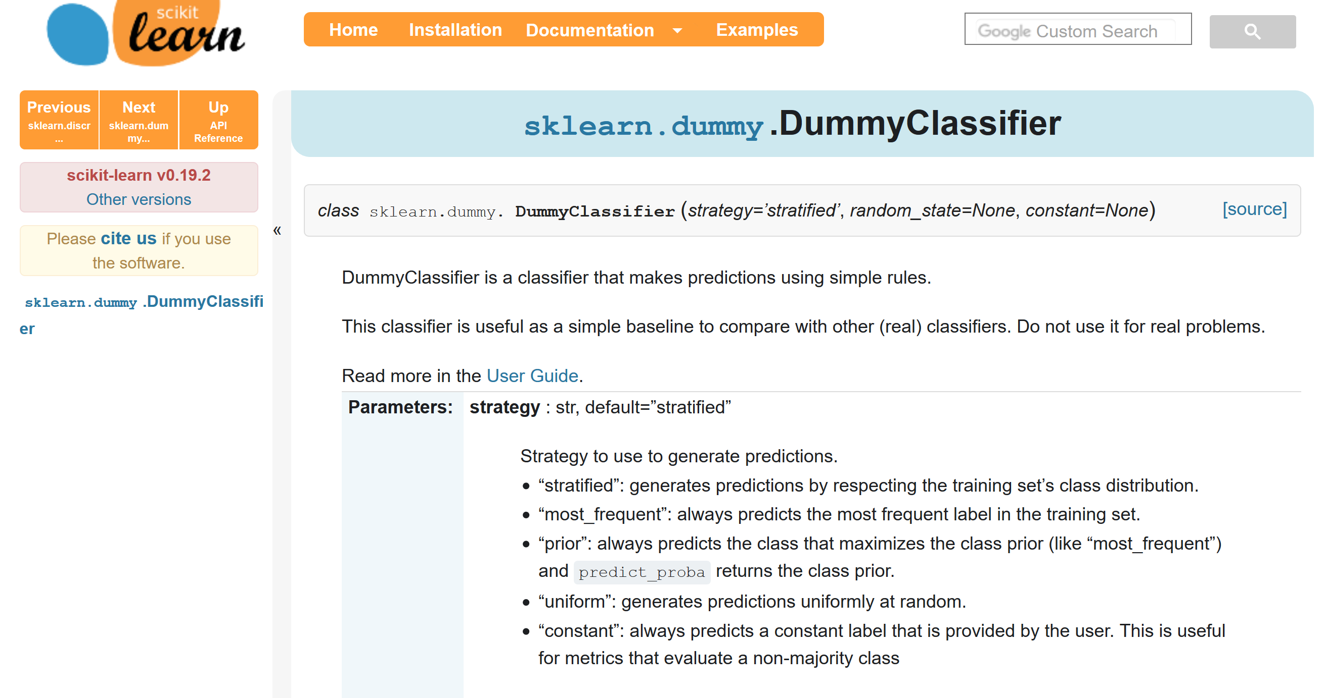
Supporting materials: Multi-user evaluation
Scikit learn dummy classifier: http://scikit-learn.org/stable/modules/generated/sklearn.dummy.DummyClassifier.html

Slide 84
QUESTIONS?
Machine learning taxonomy.
Supervised learning.
Classification.
Imbalanced data.
Random over/under sampling.
SMOTE.
Cost-sensitive classification.
Semi-supervised learning.
Self-learning.
Multi-view learning.
Co-Training.
Stacked generalization.
Data representations.
Multi-user evaluation.
Baseline classifiers

Slide 85
References
I. Kononenko and M. Kukar. Machine Learning and Data Mining. Horwood Publishing, 2007.
T. Segaran. Programming Collective Intelligence: Building Smart Web 2.0 Applications. Oreilly Series. O'Reilly Media, 2007.
Jenkins, A. L., Singer, J., Conner, B. T., Calhoun, S., & Diamond, G. (2014). Risk for Suicidal Ideation and Attempt among a Primary Care Sample of Adolescents Engaging in Nonsuicidal Self‐Injury. Suicide and life-threatening behavior, 44(6), 616-628.
Dinsha, D. and Manikandaprabu, N., 2014. Breast tumor segmentation and classification using SVM and Bayesian from thermogram images. Unique Journal of Engineering and Advanced Sciences, 2(2), pp.147-151.
Chawla, N. V., Bowyer, K. W., Hall, L. O., & Kegelmeyer, W. P. (2002). SMOTE: synthetic minority over-sampling technique. Journal of artificial intelligence research, 16, 321-357.
law Biecek, P., Szczurek, E., Vingron, M., & Tiuryn, J. The R Package bgmm: Mixture Modeling with Uncertain Knowledge.
Blum, A., & Mitchell, T. (1998, July). Combining labeled and unlabeled data with co-training. In Proceedings of the eleventh annual conference on Computational learning theory (pp. 92-100). ACM.
Zhou, Z. H., & Li, M. (2005). Tri-training: Exploiting unlabeled data using three classifiers. IEEE Transactions on knowledge and Data Engineering, 17(11), 1529-1541.
Wolpert, D. H. (1992). Stacked generalization. Neural networks, 5(2), 241-259.
Ting, K. M., & Witten, I. H. (1999). Issues in stacked generalization. Journal of artificial intelligence research, 10, 271-289.
Rabiner, L. R., & Juang, B. H. (1993). Fundamentals of speech recognition (Vol. 14). Englewood Cliffs: PTR Prentice Hall.
Ye, L., & Keogh, E. (2009, June). Time series shapelets: a new primitive for data mining. In Proceedings of the 15th ACM SIGKDD international conference on Knowledge discovery and data mining (pp. 947-956). ACM.

