Slide 1


INTERACTION WITH AI and autonomous systems – MoDULE 2
Session 1, 2024
Asbjørn Følstad, SINTEF

Slide 2
Five sessions
Sept. 26: Discover
Oct. 3: Define
Oct 10: Develop
Oct 17: [to be announced]
Oct 24: Deliver
Interaction with AI – module 2

Slide 3
Amershi, S., Weld, D., Vorvoreanu, M., Fourney, A., Nushi, B., Collisson, P., ... & Teevan, J. (2019). Guidelines for human-AI interaction. In Proceedings of the 2019 CHI Conference on Human Factors in Computing Systems (paper no. 3). ACM.
Bender, E. M., Gebru, T., McMillan-Major, A., & Mitchell, M. (2021). On the dangers of stochastic parrots: Can language models be too big?. In Proceedings of the 2021 ACM Conference on Fairness, Accountability, and Transparency (pp. 610-623). ACM
Kocielnik, R., Amershi, S., & Bennett, P. N. (2019). Will you accept an imperfect AI?: Exploring designs for adjusting end-user expectations of AI systems. In Proceedings of the 2019 CHI Conference on Human Factors in Computing Systems (paper no. 411). ACM.
Yang, Q., Steinfeld, A., Rosé, C., & Zimmerman, J. (2020). Re-examining whether, why, and how Human-AI Interaction is uniquely difficult to design. In Proceedings of the 2020 CHI conference on human factors in computing systems (Paper no. 164).
Følstad, A., & Brandtzæg, P. B. (2017). Chatbots and the new world of HCI. interactions, 24(4), 38-42.
Skjuve, M., Følstad, A., Fostervold, K. I., & Brandtzaeg, P. B. (2021). My chatbot companion-a study of human-chatbot relationships. International Journal of Human-Computer Studies, 149, 102601.
Skjuve, M., Brandtzaeg, P. B., Følstad, A. (2024) Why do people use ChatGPT. First Monday.
Bommasani, R. et al. (2021). On the opportunities and risks of foundation models. arXiv preprint arXiv:2108.07258.
Eloundou, T., Manning, S., Mishkin, P., & Rock, D. (2023). GPTs are GPTs: An early look at the labor market impact potential of large language models. arXiv preprint arXiv:2303.10130.
Noy, S., & Zhang, W. (2023). Experimental evidence on the productivity effects of generative artificial intelligence. Science, 381(6654), 187-192.
Literature

Slide 4
Individual assignment
Building on and extending the individual assignment in Module 1. Startup today – finish October 24)
Interim reports
(Oct. 24)
Building on and extending the group assignment in Module 1. Startup today – finish October 24)
+ Design task (startup today – present October 24, include in mid-term report as Appendix 1)
Group assignment

Slide 5
Interim report - individual assignment
Three topics:
Characteristics of AI-infused systems.
Human-AI interaction design.
Conversational user interfaces to large language models
Language: English or Norwegian.
Target pages new content: 5-6
Min. articles referenced 4.
Aim to address these three topics in the lectures

Slide 6
Interim report – group assignment
Content (target 6-9 pages)
(New) Front page
A description of the group, who you are - names.
A description of the topic of “interaction with AI” you are interested in.
A description of the user group and context of use you are interested in.
(new) Background section: Position your work relative to existing knowledge and practice
The 1-3 questions that you want to address (can change and evolve)
(updated) Method section – overall approach / process, data collection methods
(new) Findings (progress, initial outcomes)
(updated) Minimum six references to literature.
Appendix – approx. 1 page
Appendix 1: Module 2 design task – briefly describe the process and outcome. Detail reflections and lessons learnt.
Brief status on the group task – each group say a few words

Slide 7
Group 1. DeepFake
How do AI-generated images influence people’s ability to separate real content from fake content online?
How can misinformation or deepfake content on social media negatively affect someone's beliefs or decisions?
What are the positive and negative ways AI-generated content can be utilized, and how can these opposing uses shape society?
Group 4 – How to organize student life
How are students structuring their daily–life?
Could AI be used to effectively organize a student’s chaotic life?
Can AI make improvements on students motivation?
Group 5 – Keenious - (CTRL + ALT + ELITE)
How do users interact with the system when searching for articles?
How satisfied are users with current functionality?
Missing features or extensions to enhance user experience?
Group 2. “The use of chatbots in coding”TeamGPT
What motivates students to incorporate AI assistants in programming work?
How do students differ in prompt design using different Coding assistants?
Group 3 Picture Generators/plagiarism RAJHA
How well do text to picture generators work in the early stages of the design process?
How do we define plagiarism when using AI text to images in personal work?
Can text to image generators replace manual work for sketching and drawing in a design process?

Slide 8
Group 6 – NeuroDivergent
What challenges do students with ADHD face in their everyday student life?
Can technologies aid them in these challenges?
Are there technologies that hinder them in reaching their goals?
Group 8 – Journalister og AI
I hvilken grad stoler journalister på innspill fra en KI-drevet språkmodell, og hvordan håndterer de eventuelle feil eller upresis informasjon generert av systemet?
Dette spørsmålet åpner opp for å utforske en viktig fallgruve, nemlig tillit og ansvar når journalister bruker KI i sitt arbeid.
Ved å ta utgangspunkt i dette, kan vi grave dypere i hvordan journalister vurderer og verifiserer KI-generert innhold.
Group 7 – Speech to Text
How do you use speech-to-text in your coursework or team projects, and what impact does it have on your productivity?
Which specific features of speech-to-text technology would you like to improve to better fit academic or collaborative tasks?
What features or integrations with other tools (e.g., Google Docs, MS Teams) would encourage you to start using speech-to-text?
Group 9 – EvaluBots (questions rephrased for brevity)
How do group teachers and lecturers use AI to evaluate assignments? (if at all?)
  Tools? Impact on assessment process?
How do students use AI in their assignments? (if at all?)
  Opinions on use? Implications? Ethics?
How does subject matter influence use of AI for evaluation?

Slide 9
Module 2 design task
Sept 26
Oct 3
Oct 10
Oct 17
Design prototype AI system, relevant for your groupwork topic.
… using the double diamond design process
… and any AI support of your choice
At all but the last lecture of Module 2, you will receive tips and guidance for your process
At the final lecture, you will present your prototype.
Oct 24
Discover
Define
Develop
Deliver

Slide 10
Module 2 design task – AI support
Process support
Large language models
Image, audio, video generation
Code generation
… for ideation, detailing, implementation
Platforms for implementation
Configurable GPTs or similar
  Character.ai
  OpenAI GPT (subscription required)
Chatbot platforms
  BotPress
Any other method or platform
As an alternative implementation, you can also present a mock-up prototype, showing how existing AI services could be included
First week: Discover
Use ChatGPT or Google Gemini for brainstorming and ideation
Generate content for inspiration
Familiarize yourself with one or more possible platforms for implementation

Slide 11
Module 2 design task:
Example based on Group 4
topic (student organizer)

Slide 12
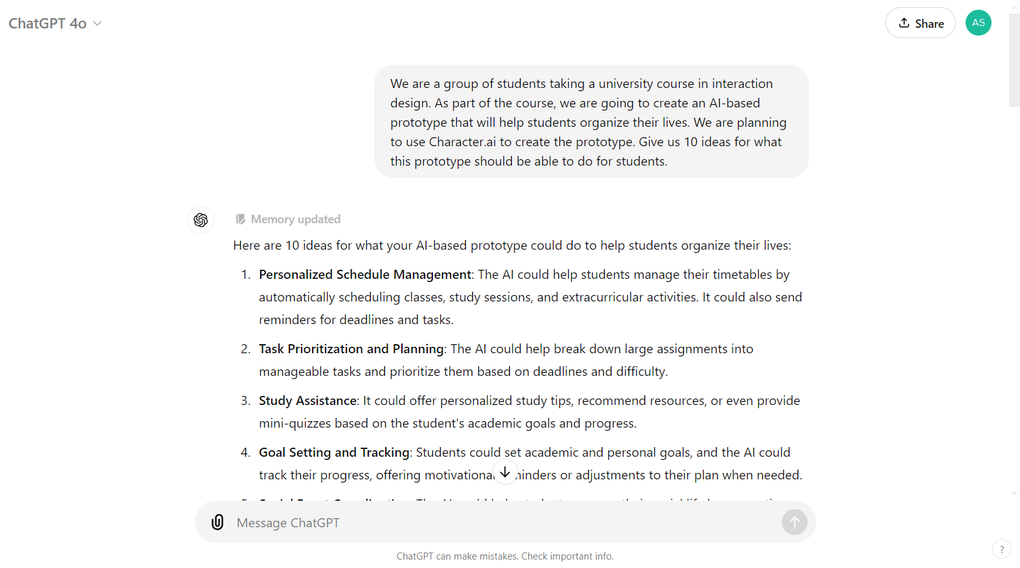

Slide 13
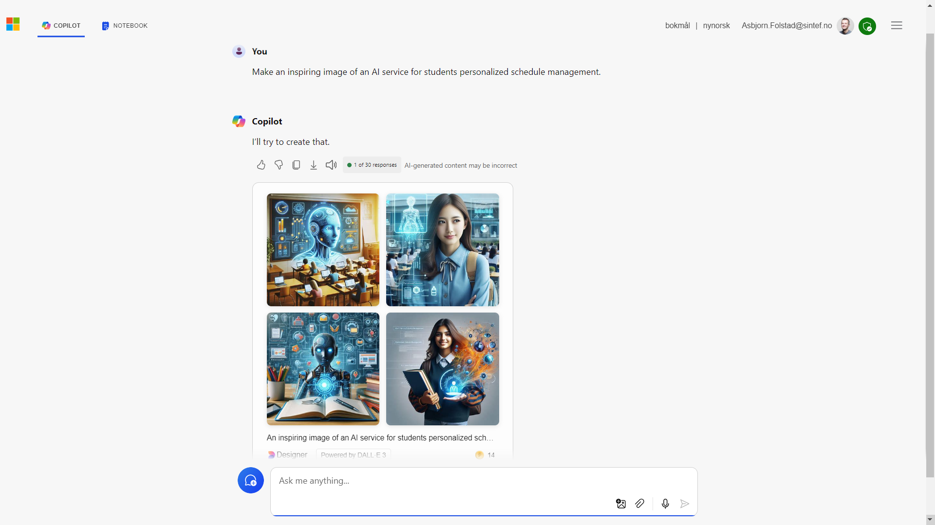

Slide 14
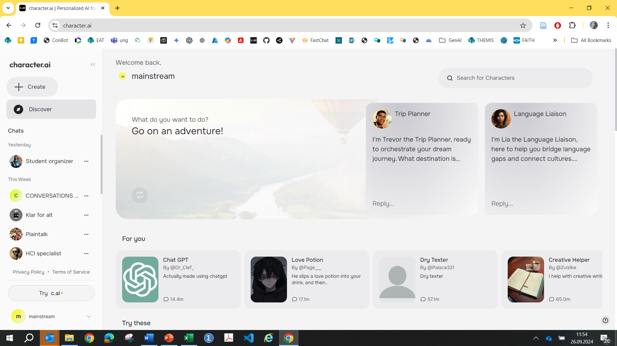

Slide 15
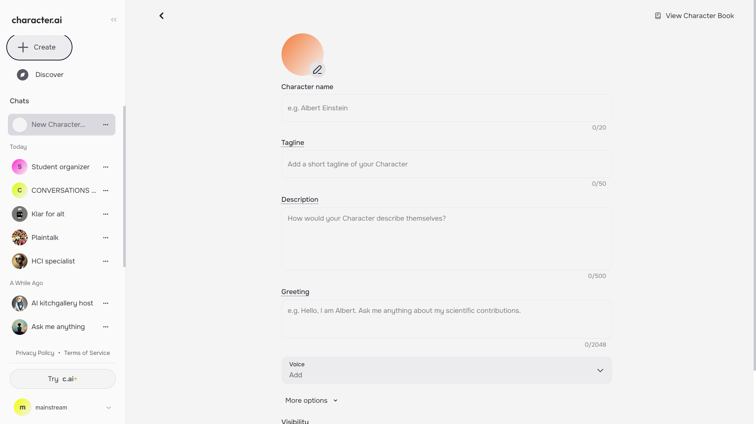

Slide 16
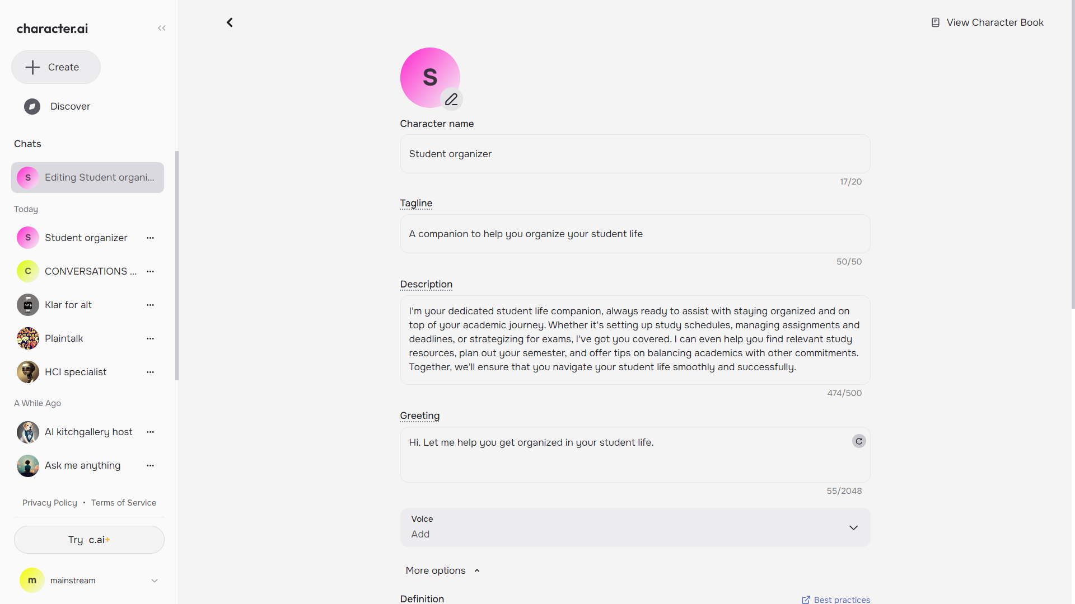

Slide 17
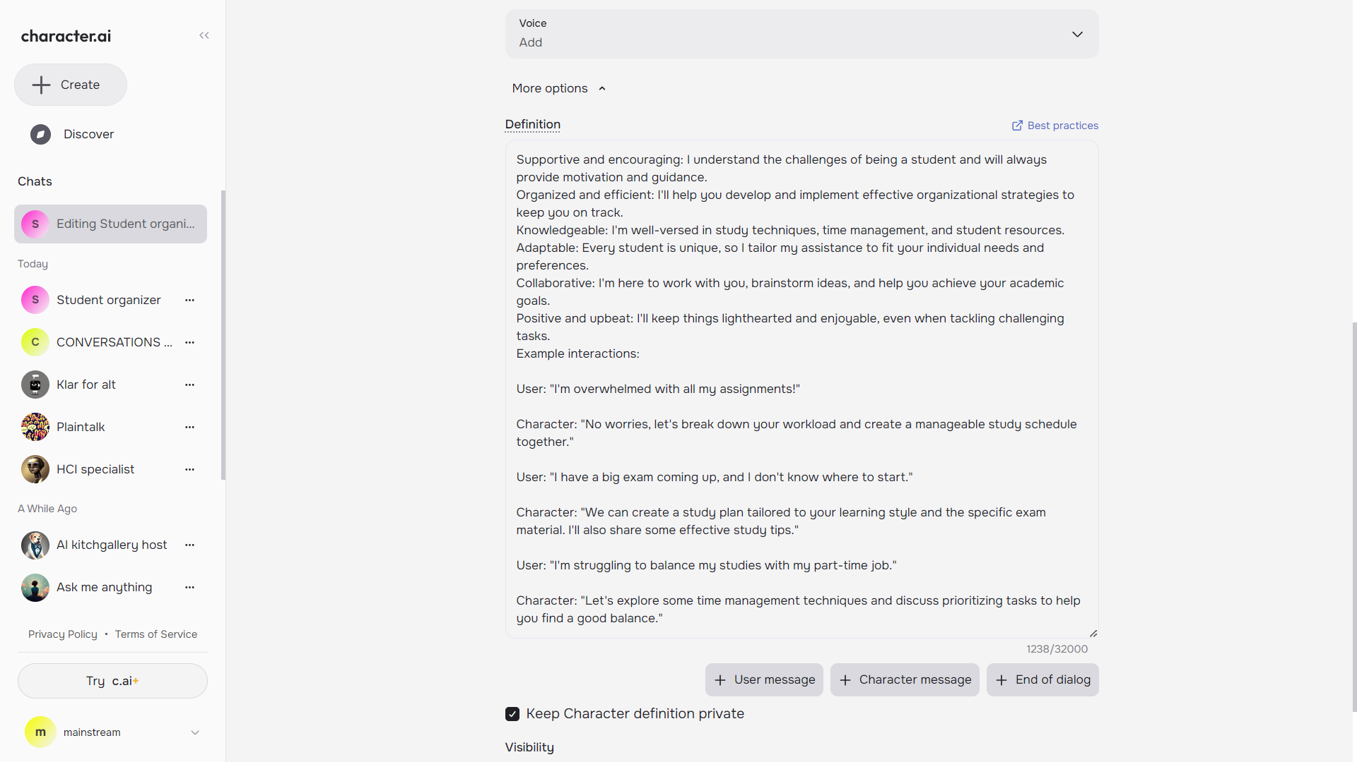

Slide 18
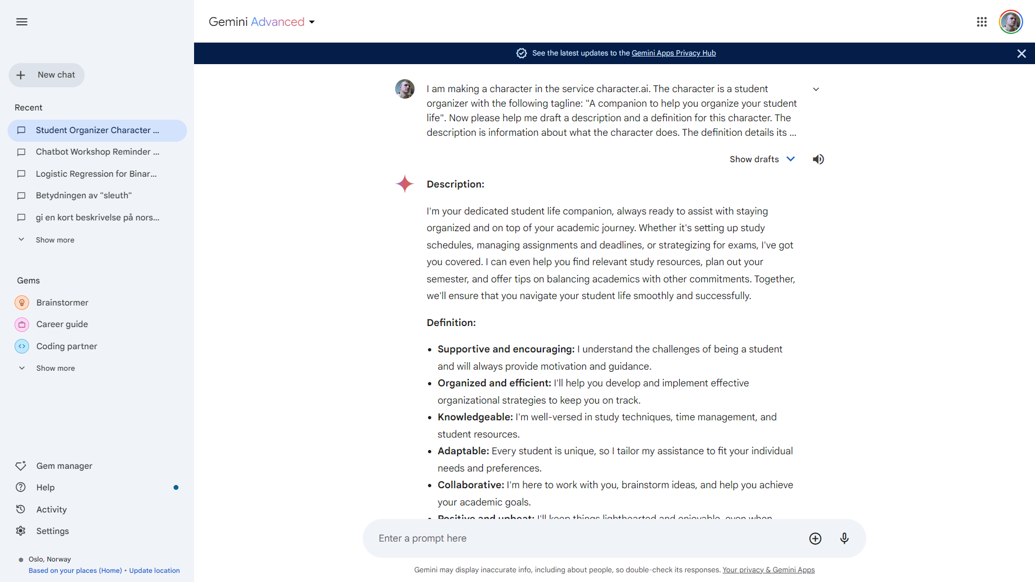

Slide 19
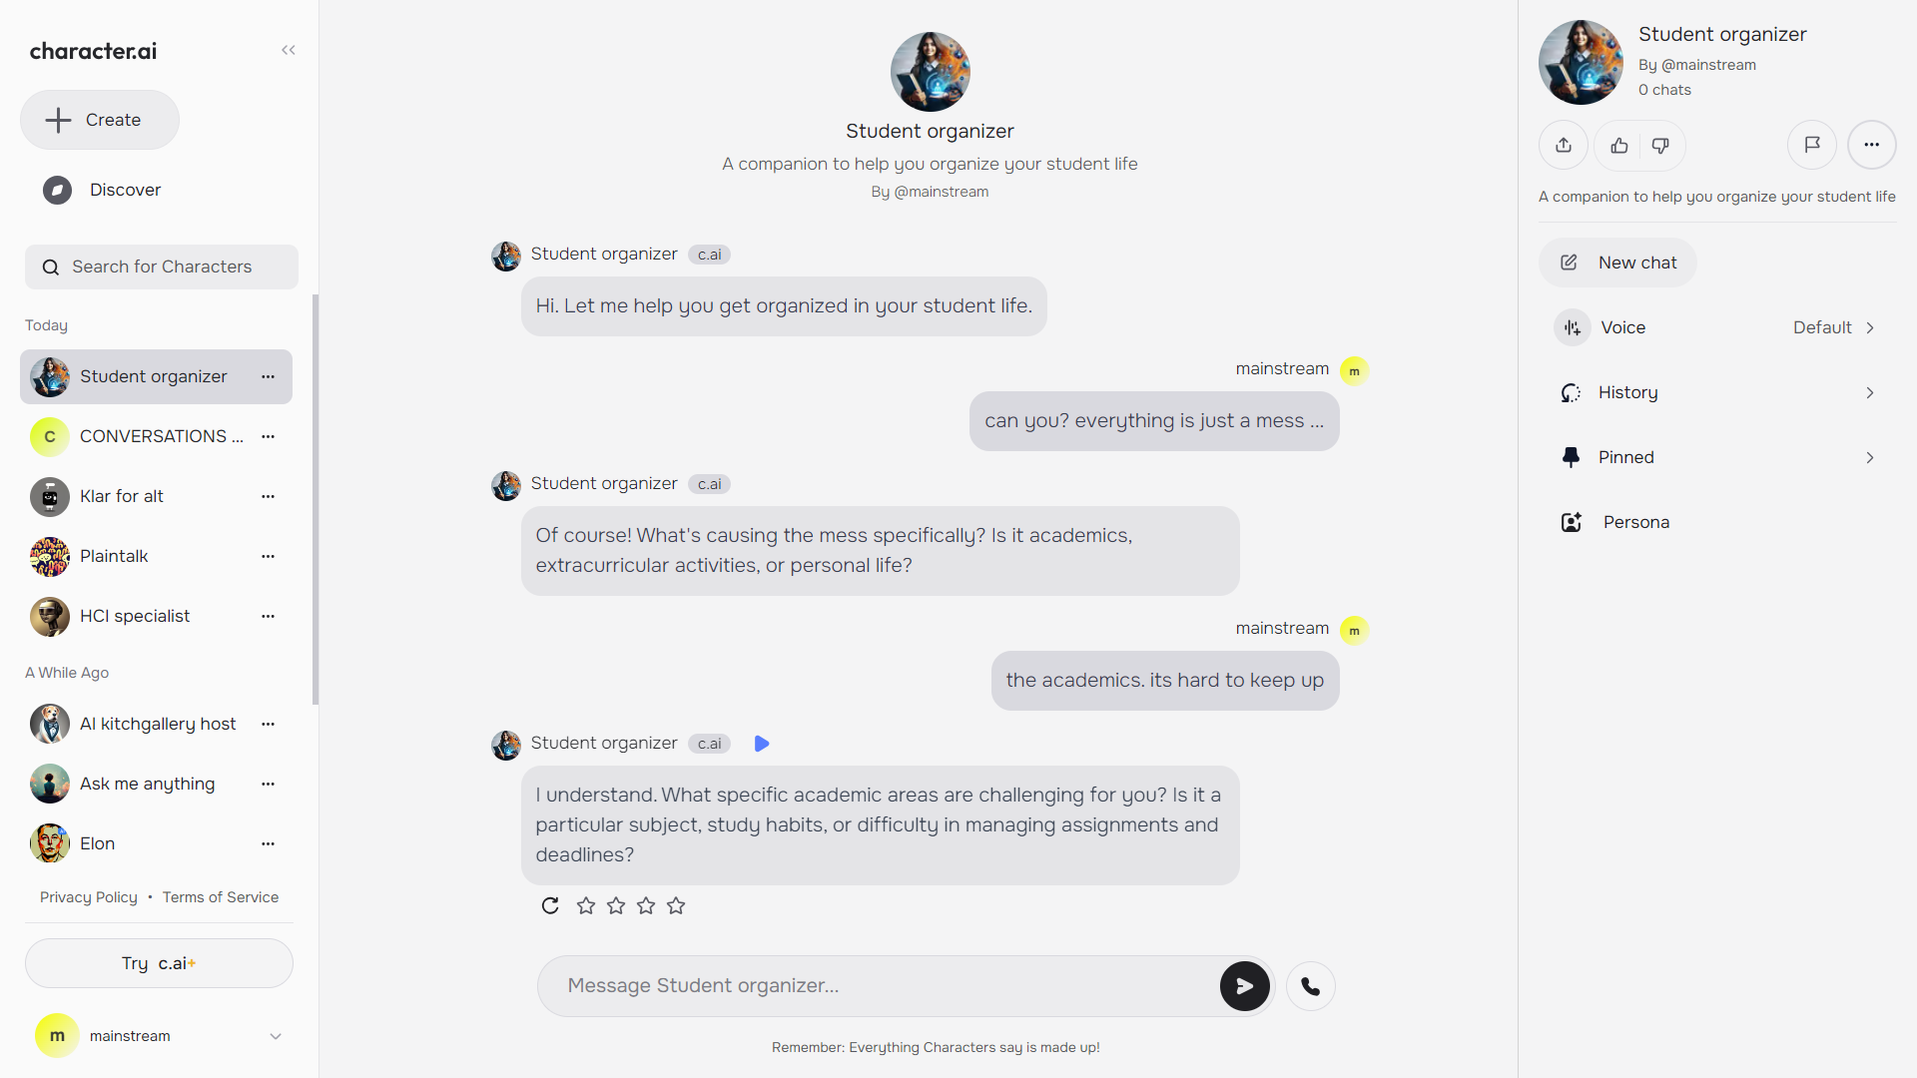

Slide 20
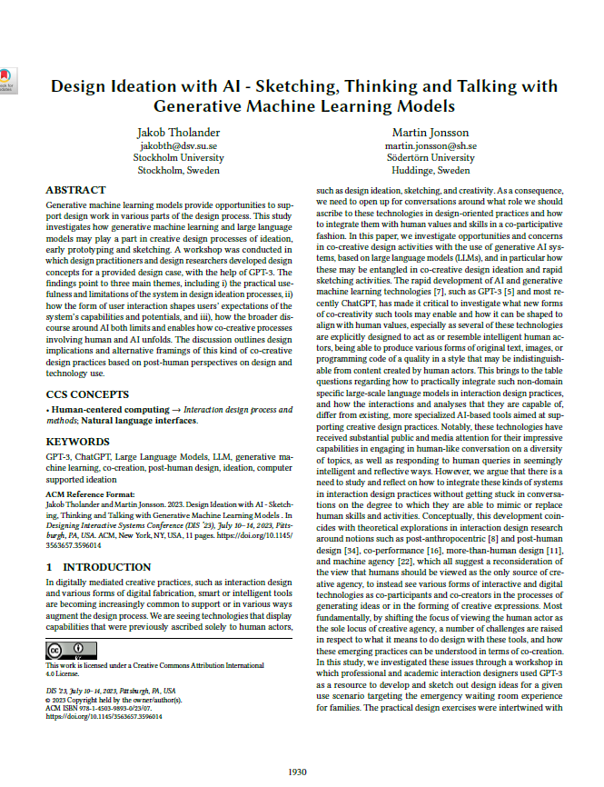
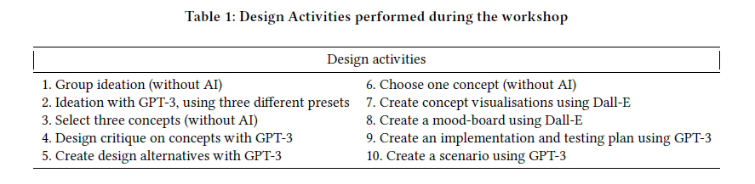
DIS ’23 paper for additional guidance
Tholander, J., & Jonsson, M. (2023). Design ideation with AI-sketching, thinking and talking with generative machine learning models. In Proceedings of the 2023 ACM designing interactive systems conference – DIS ‘23 (pp. 1930-1940). New York, NY: ACM

Slide 21
End 1

