Slide 1


INTERACTION WITH AI and autonomous systems – MoDULE 2
Session 2, 2024
Asbjørn Følstad, SINTEF

Slide 2
Five sessions
Sept. 26: Discover
Oct. 3: Define
Oct 10: Develop
Oct 17: [to be announced]
Oct 24: Deliver
Interaction with AI – module 2

Slide 3
Module 2 design task
Sept 26
Oct 3
Oct 10
Oct 17
Design prototype AI system, relevant for your groupwork topic.
… using the double diamond design process
… and any AI support of your choice
At all but the last lecture of Module 2, you will receive tips and guidance for your process
At the final lecture, you will present your prototype.
Oct 24
Discover
Define
Develop
Deliver

Slide 4
Module 2 design task – AI support
Process support
Large language models
Image, audio, video generation
Code generation
… for ideation, detailing, implementation
Platforms for implementation
Configurable GPTs or similar
  Google AI Studio
  Character.ai
  OpenAI GPT (subscription required)
Chatbot platforms
  BotPress
Any other method or platform
As an alternative implementation, you can also present a mock-up prototype, showing how existing AI services could be included
First week: Discover
Use ChatGPT or Google Gemini for brainstorming and ideation
Generate content for inspiration
Familiarize yourself with one or more possible platforms for implementation

Slide 5
Module 2 design task
Oct 3
Oct 10
Second week: Define
Use ChatGPT or Google Gemini for critiquing your ideas and initial concepts
Continue to generate content for inspiration – including generation of example dialogues
Examine match between ideas /initial concepts and support in your AI platform of choice
Discover
Define
Develop
Deliver

Slide 6
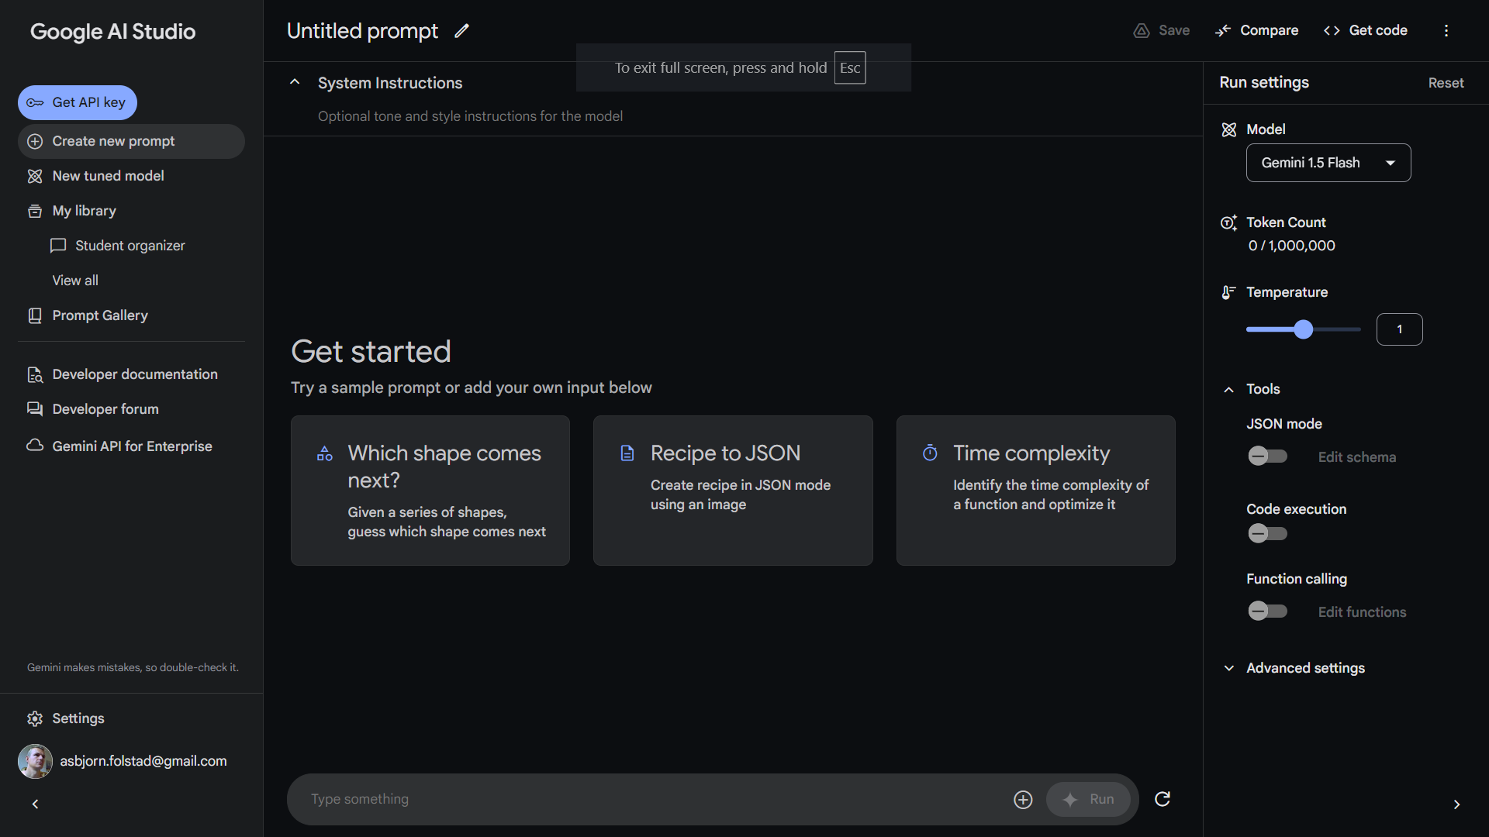
Module 2 design task
Yet another suggestion for AI platform: Google AI Studio:
Second week: Define
Use ChatGPT or Google Gemini for critiquing your ideas and initial concepts
Continue to generate content for inspiration – including generation of example dialogues
Examine match between ideas /initial concepts and support in your AI platform of choice
For more suggestions on AI platform and process support, see presentation from first lecture in Module 1.

Slide 7
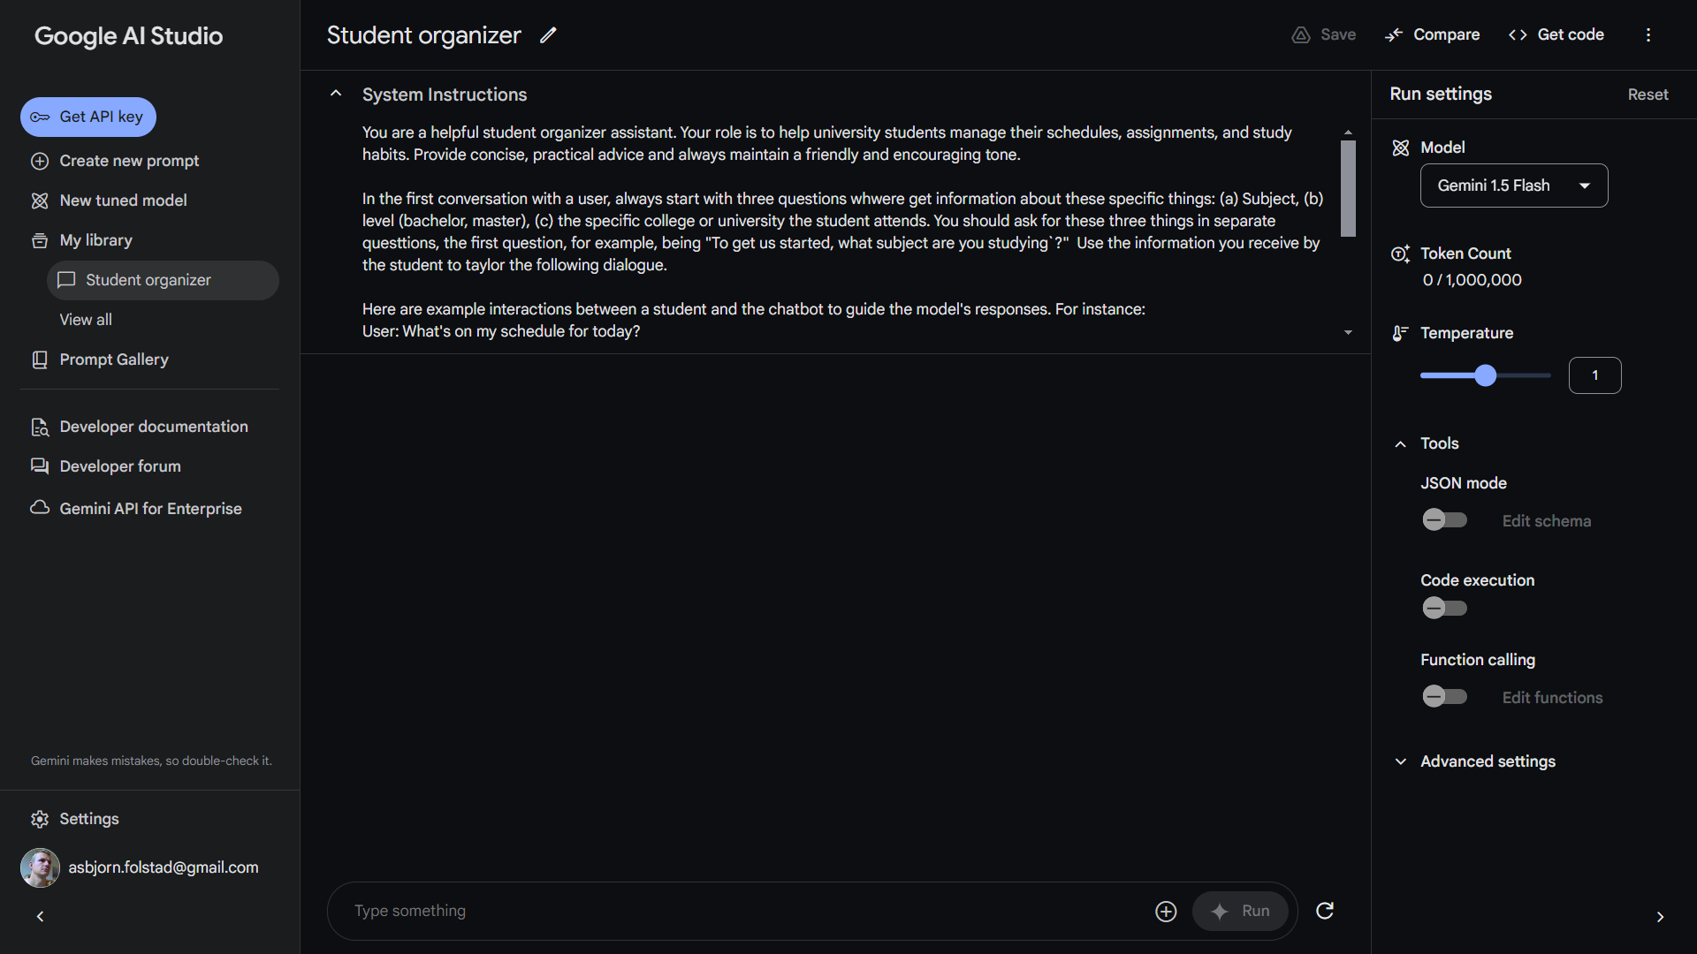

Slide 8
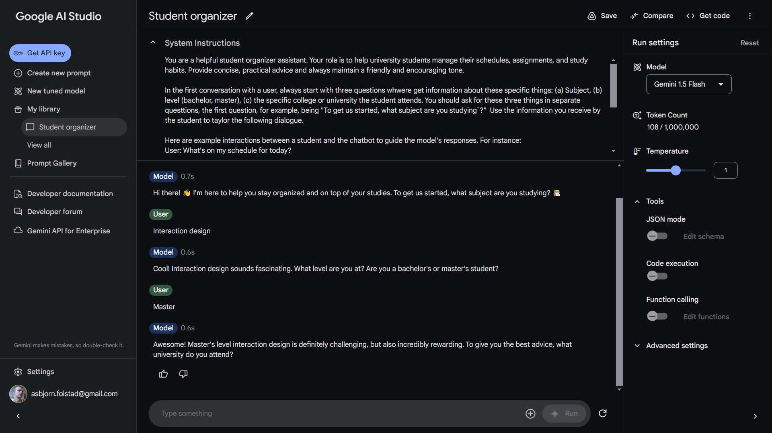

Slide 9
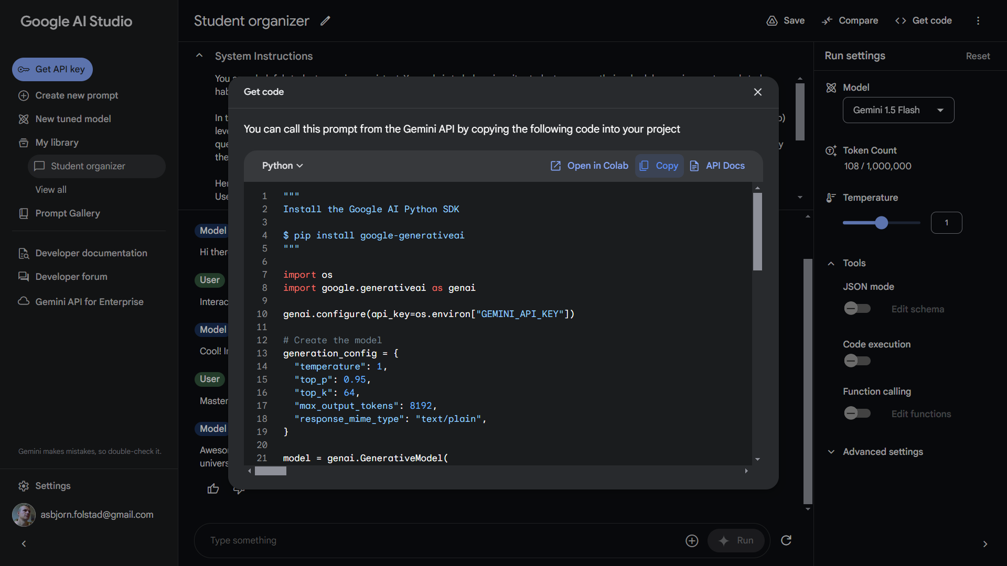

Slide 10
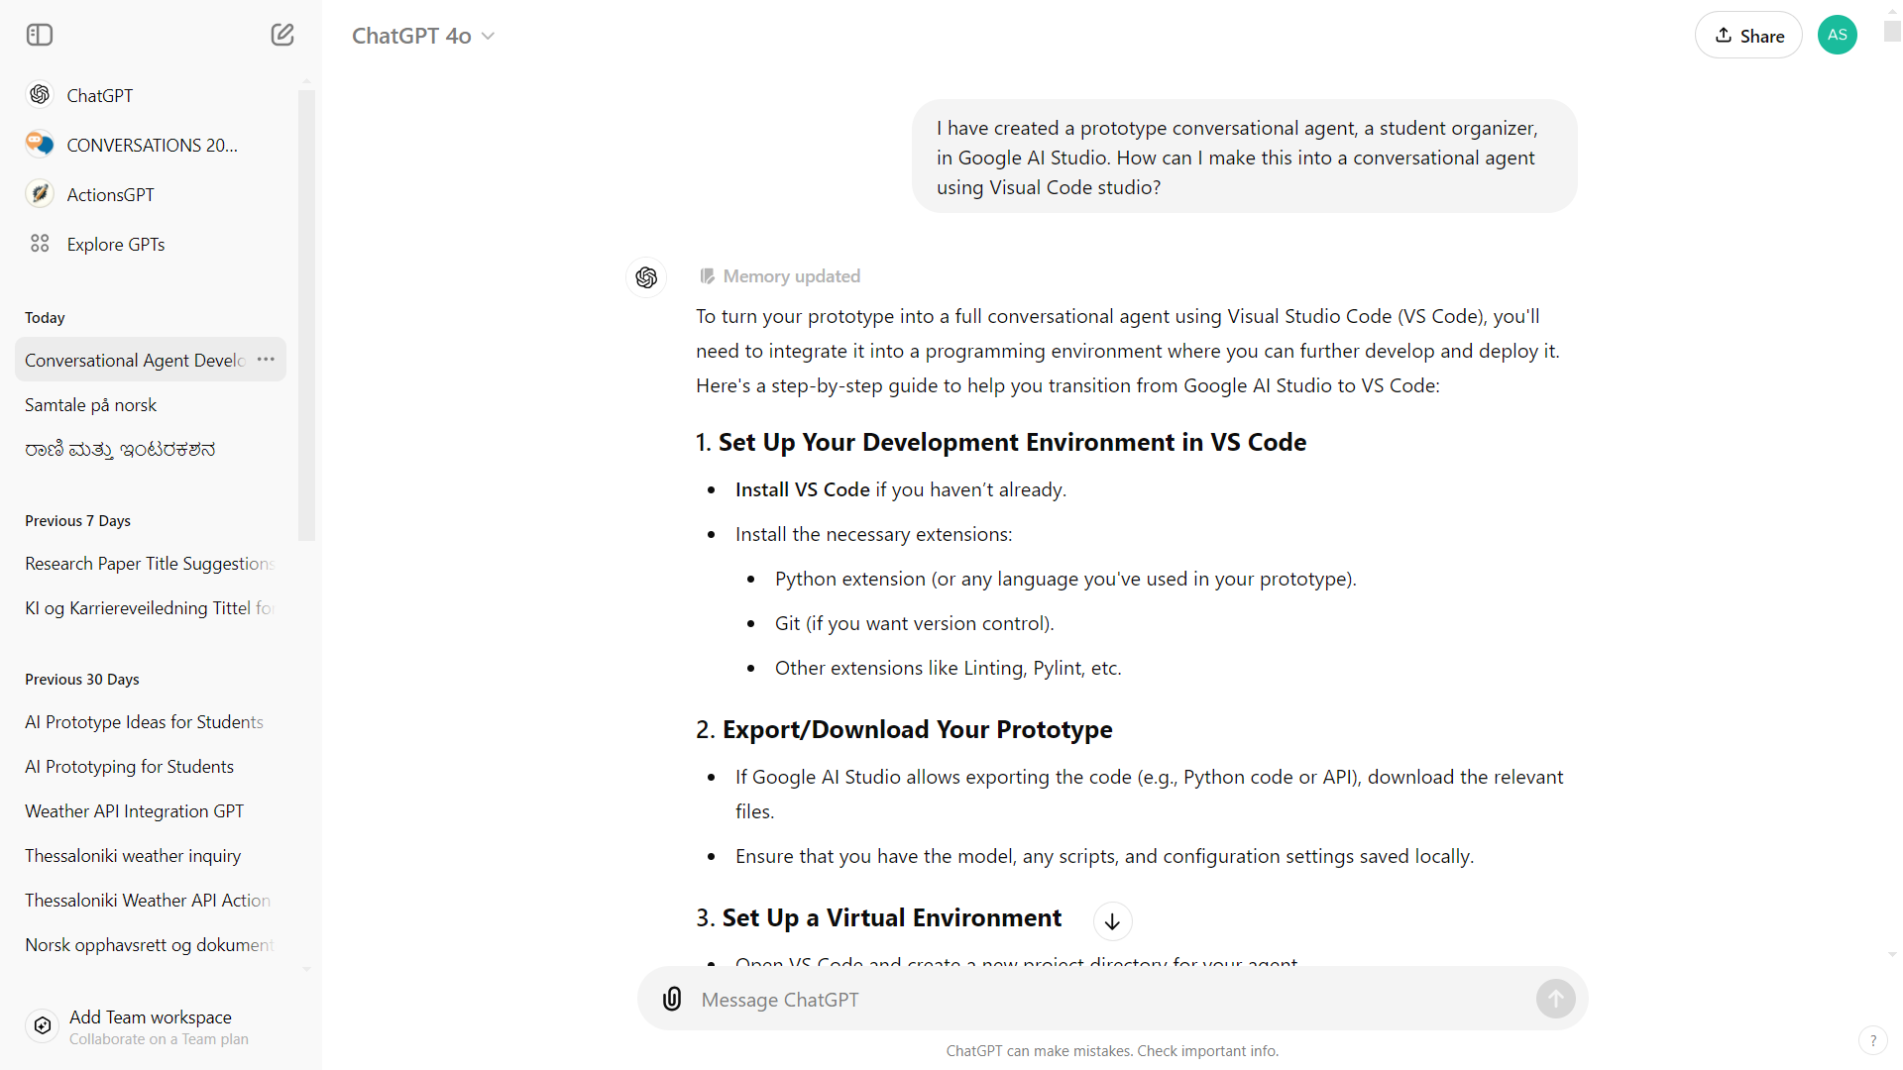

Slide 11


Slide 12
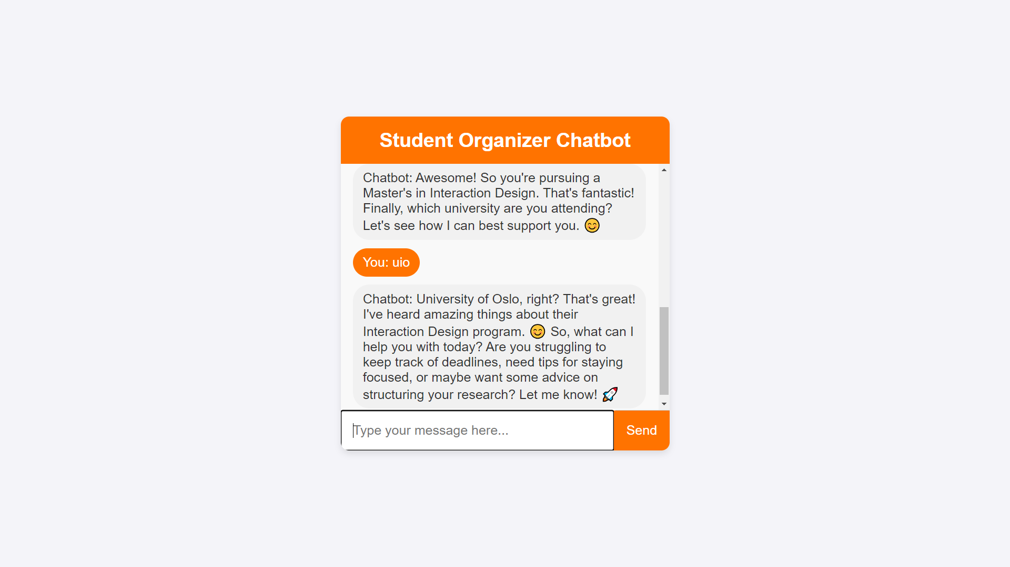

Slide 13
Creativity support from
large language models –
what to expect and how to benefit

Slide 14
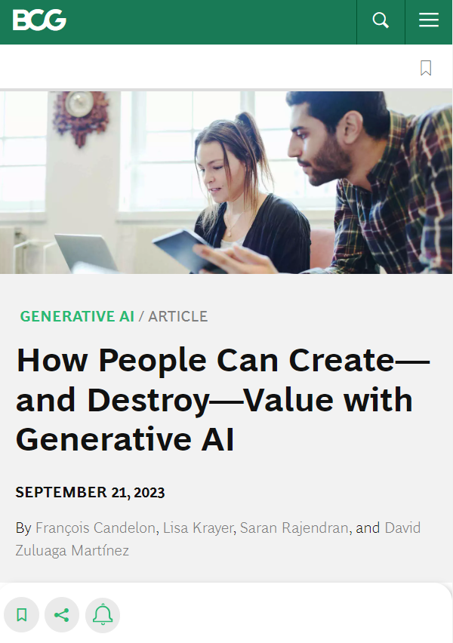
Study: Generative AI to support creativity and business problem solving
>750 junior consultants
Two types of task:
- Creative (i.e. creative product innovation) – scored 1-10.
- Business problem solving (e.g. business decision) – scored 0 or 1
Three conditions
- Use ChatGPT after 30 minute training
- Use ChatGPT after no training
- Not use ChatGPT
All also conduct introductory benchmark task
https://www.bcg.com/publications/2023/how-people-create-and-destroy-value-with-gen-ai
Notes:
Creative:
You are working for a footwear company in the unit developing new products. Generate ideas for a new shoe aimed at a specific market or sport that is underserved. Be creative and give at least ten ideas.
Come up with a list of steps needed to launch the product. Be concise but comprehensive.
Use your best knowledge to segment the footwear market by users. Develop a marketing slogan for each segment you are targeting.
Suggest three ways of testing whether your marketing slogan works well with the customers you have identified.
Write marketing copy for a press release of the product.
Business problem solving:
The CEO, Harold Van Muylders, of Kleding (a fictitious company) would like to understand the performance of the company’s three brands (Kleding Man, Kleding Woman, and Kleding Kids) to uncover deeper issues. Please find attached interviews from company insiders. In addition, the attached excel sheet provides financial data broken down by brands.
Using this information, if the CEO must pick one brand to focus on and invest in to drive revenue growth in the company, what brand should that be? What is the rationale for this choice? Please support your views with data and/or interview quotations

Slide 15
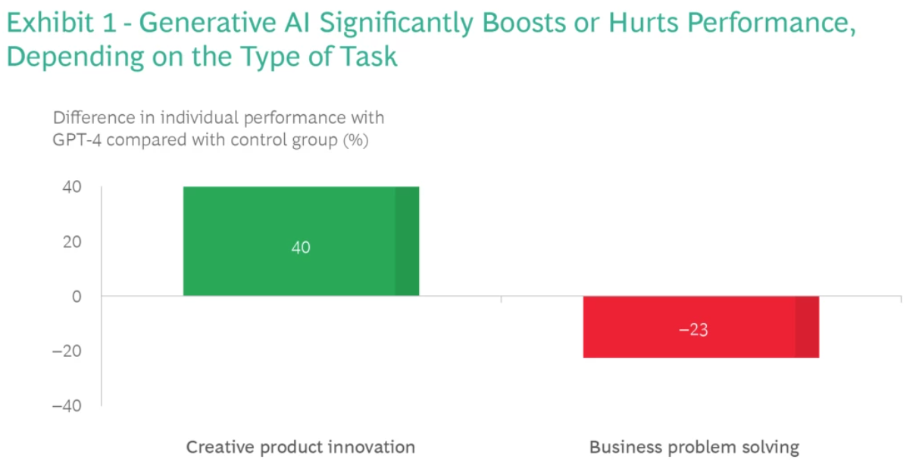
https://www.bcg.com/publications/2023/how-people-create-and-destroy-value-with-gen-ai

Slide 16
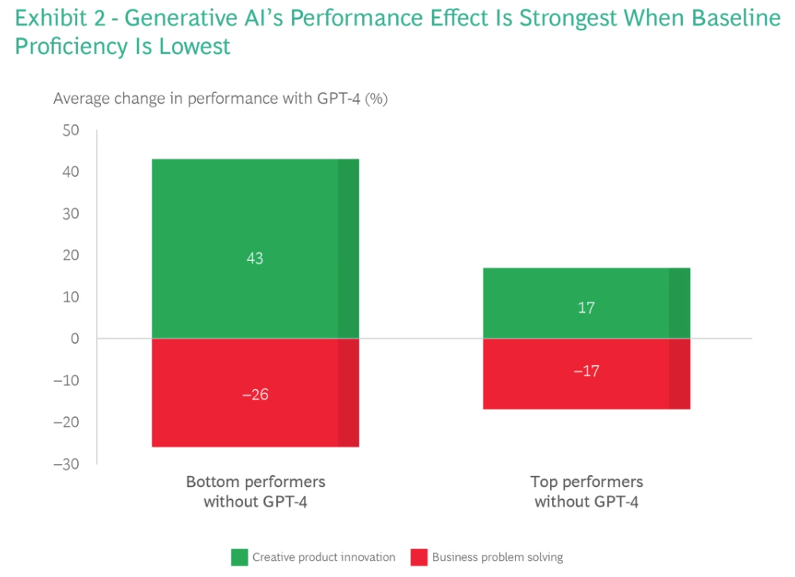
https://www.bcg.com/publications/2023/how-people-create-and-destroy-value-with-gen-ai

Slide 17
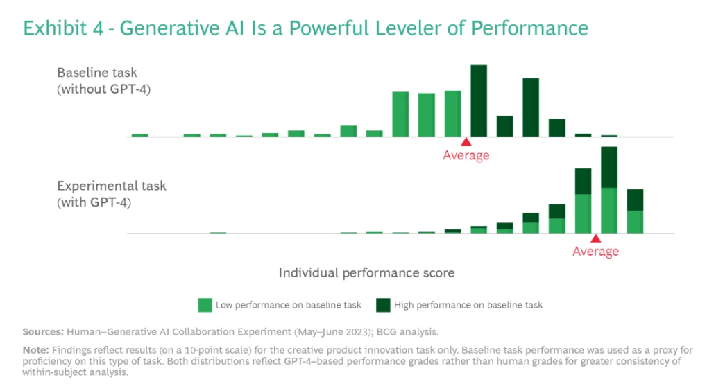
https://www.bcg.com/publications/2023/how-people-create-and-destroy-value-with-gen-ai

Slide 18
A seeming creativity boost! Any challenges or limitations?
https://www.bcg.com/publications/2023/how-people-create-and-destroy-value-with-gen-ai

Slide 19
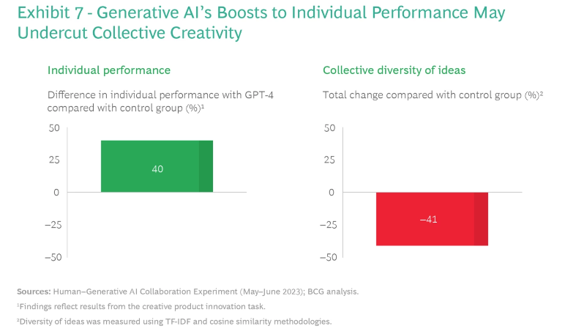
https://www.bcg.com/publications/2023/how-people-create-and-destroy-value-with-gen-ai

Slide 20
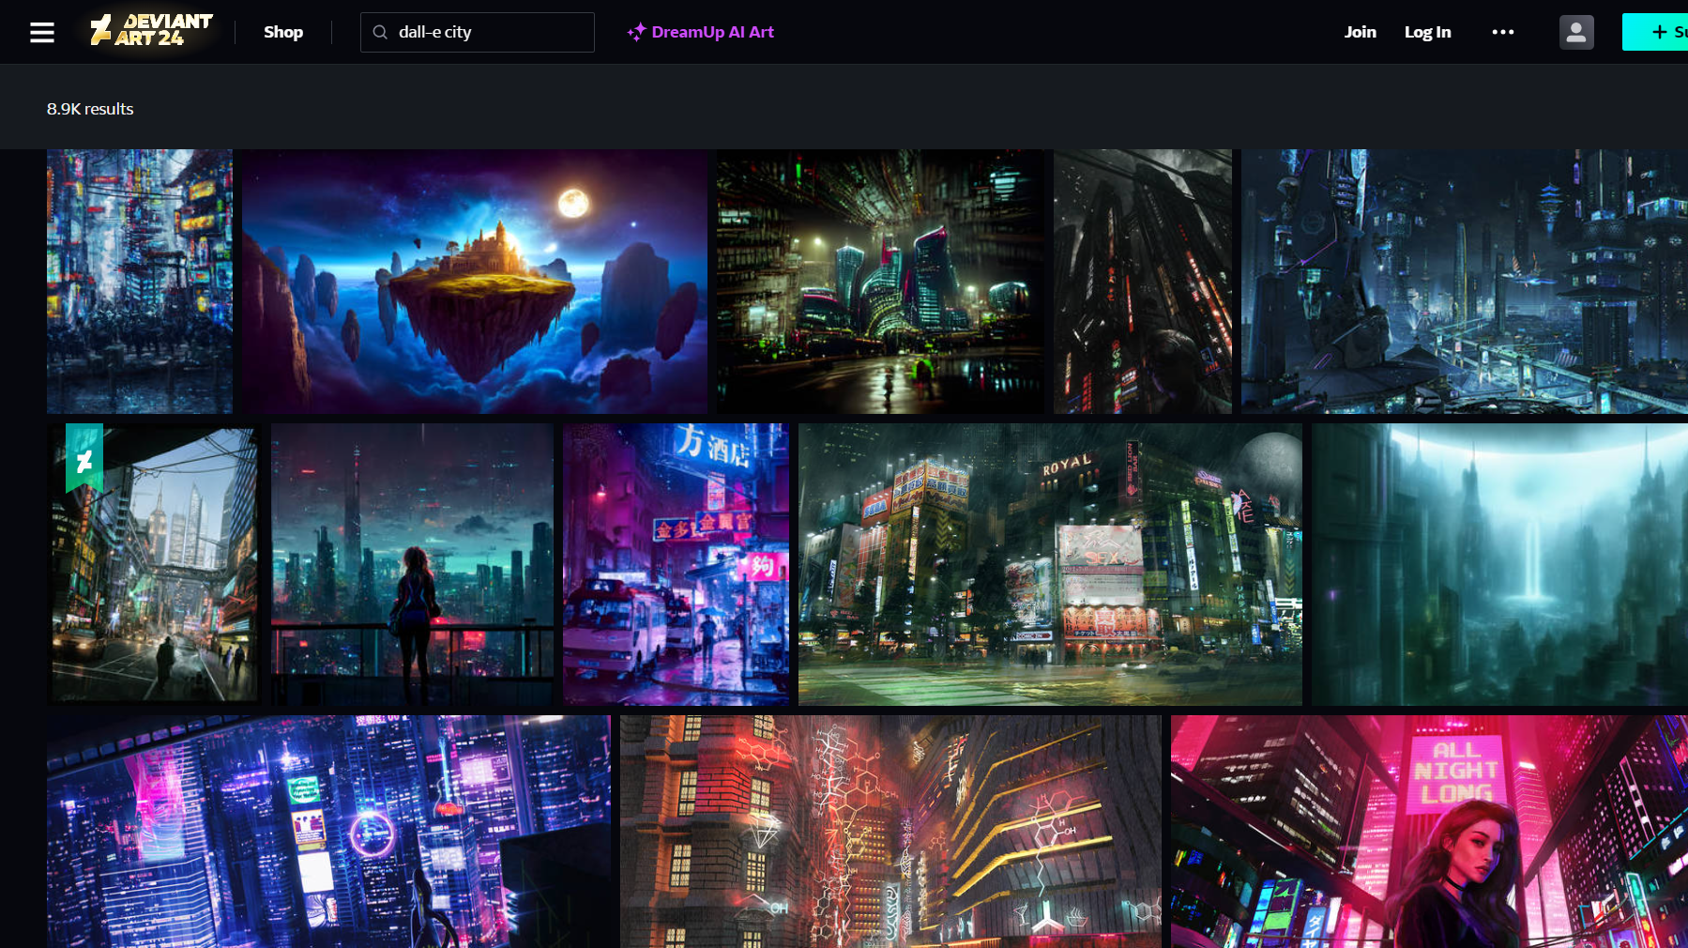
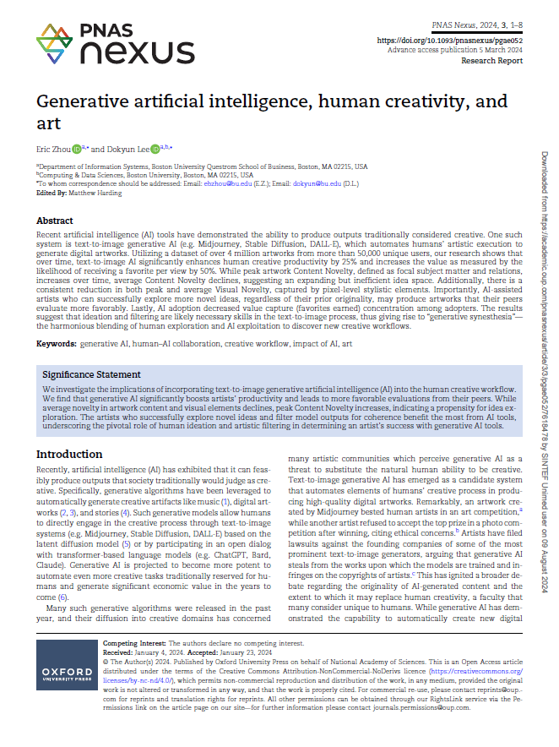
Studie av 4M kunstverk av 50K kunstnere, på nettsted tilsvarende DeviantArt
Fokus på kunstnere som tar i bruk GenAI – identifisert ved tags (5,8 K av 50K kunstnere)
Resultater:
Økt produktivitet
Økt sannsynlighet for favoritt
Innholdsmessig nyhetsverdi: Økt toppnivå, redusert gjennomsnitt
Visuell nyhetsverdi: Redusert toppnivå og gjennomsnitt
Konklusjon: Evne til ideskaping og filtrering viktig for vellykket menneske-maskin samarbeid for visuell kunst -> behov for nye kreative arbeidsprosesser
Diskusjon 1
20
Zhou, E., & Lee, D. (2023). Generative ai, human creativity, and art. PNAS Nexus, 3(3) https://doi.org/10.1093/pnasnexus/pgae052

Slide 21
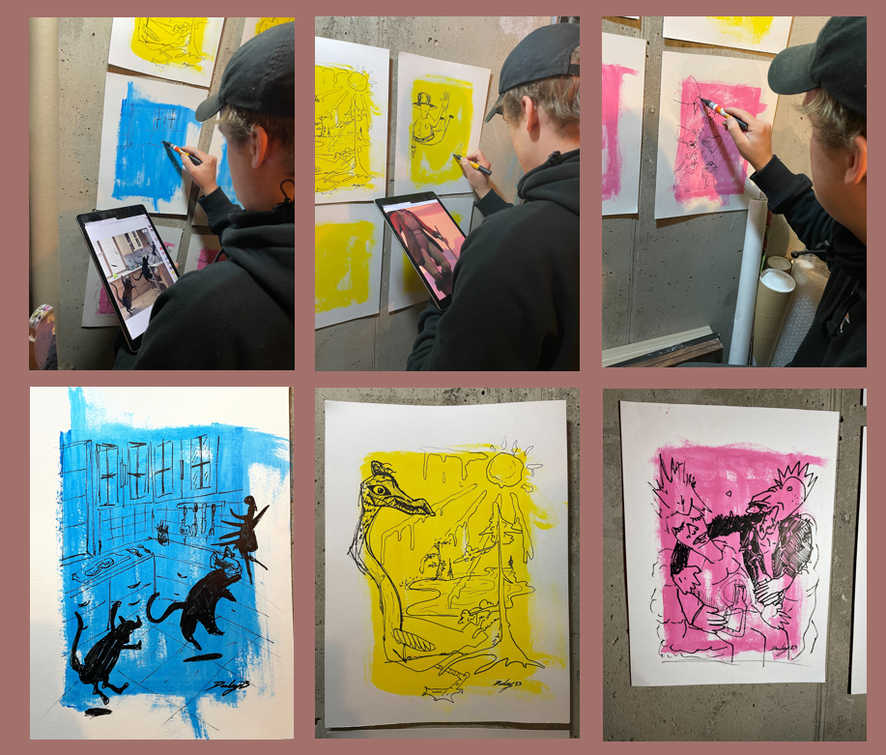
Sustainable creativity boost seems to require human-machine collaboration – with the machine inspiring and supporting engaged and creative humans.
From UiO Honours student project, by Søren Hunskaar, Fartein Badhwar Valen-Sendstad, Benedict Leander Skålevik Parton, Sol Strøm Jensen

Slide 22
AI infused systems and
the challenge of designing them

Slide 23
"Systems that have features harnessing AI capabilities that are directly exposed to the end user."
AI-infused systems
Amershi, S., Weld, D., Vorvoreanu, M., Fourney, A., Nushi, B., Collisson, P., ... & Teevan, J. (2019). Guidelines for human-AI interaction. In Proceedings of the 2019 CHI Conference on Human Factors in Computing Systems (paper no. 3). ACM.

Slide 24
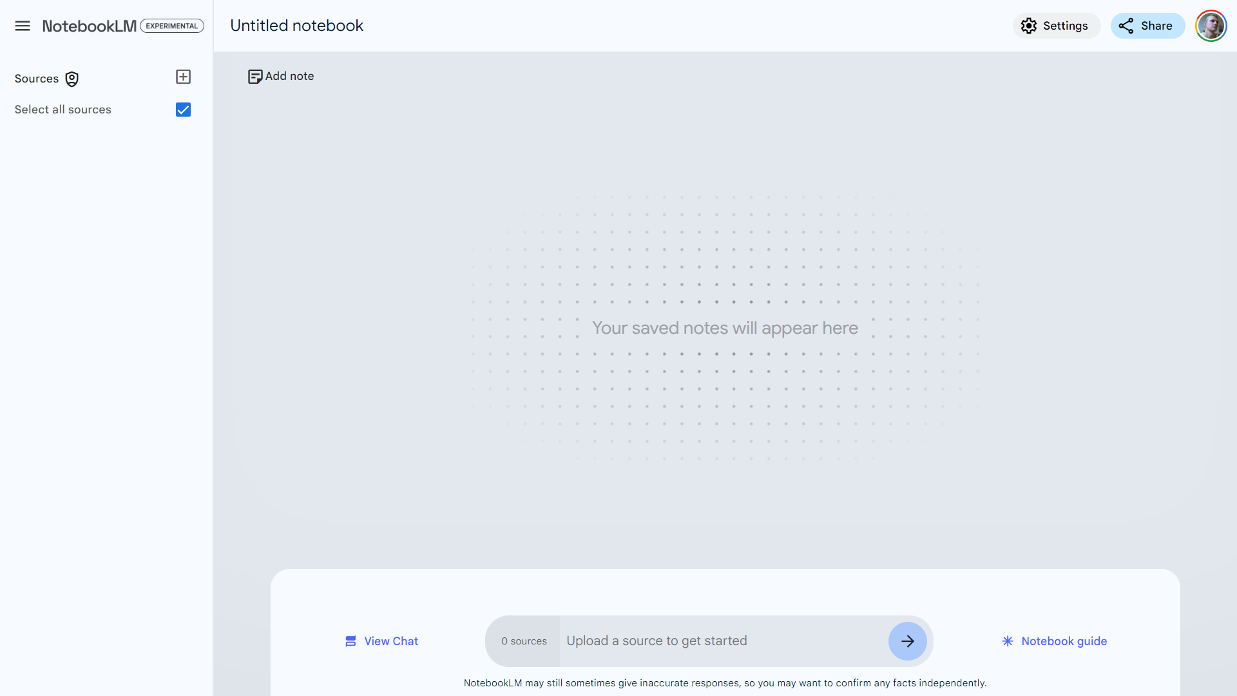
Favourite example – from 2024

Slide 25
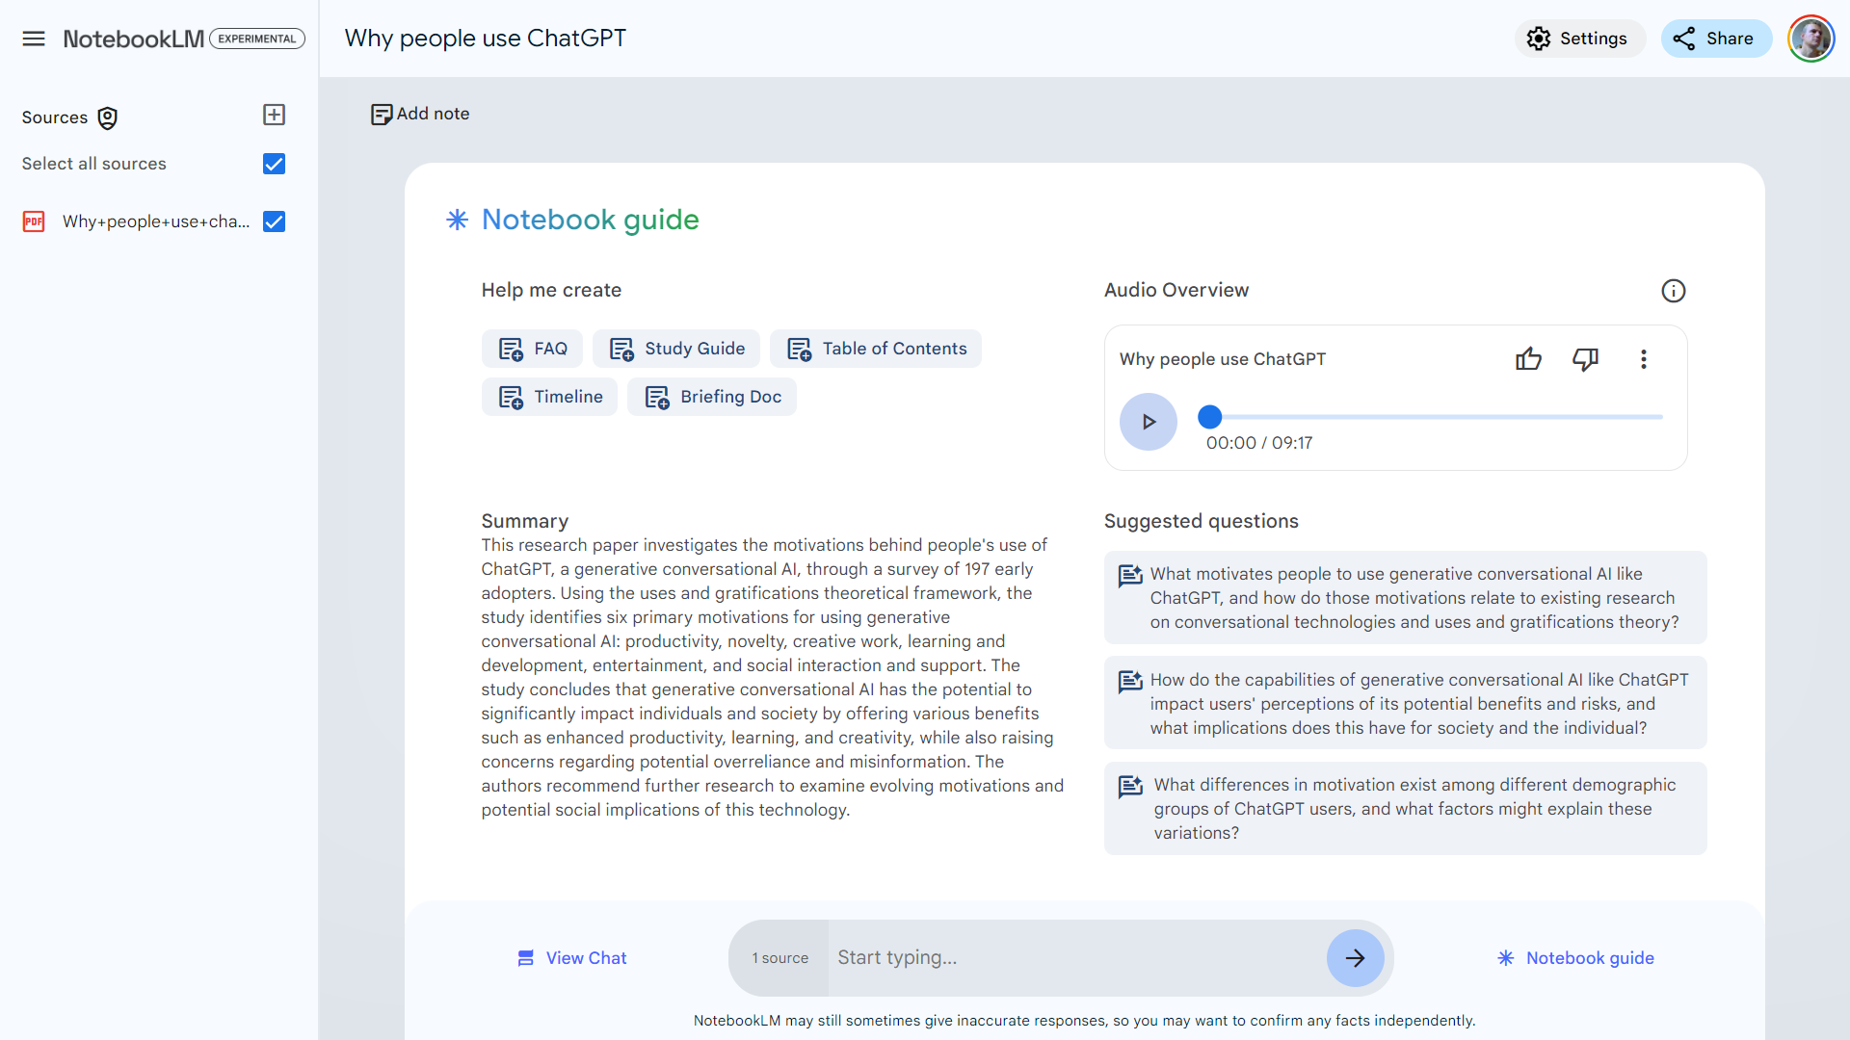

Slide 26
Individual assignment – task 1:
Characteristics of AI-infused systems
AI-infused systems are ' systems that have features harnessing AI capabilities that are directly exposed to the end user' (Amershi et al., 2019).
Drawing on the lectures of Module 2 and three of the mandatory articles (Amershi et al. (2019), Kocielnik et al. (2019), Yang et al., (2020)). Identify and describe key characteristics of AI-infused systems.
Identify one AI-infused system which you know well, that exemplifies some of the above key characteristics. Discuss the implications of these characteristics for the example system, in particular how users are affected by these characteristics.
What are the characteristics of AI-infused systems?
Identify one system and use this to exemplify

Slide 27
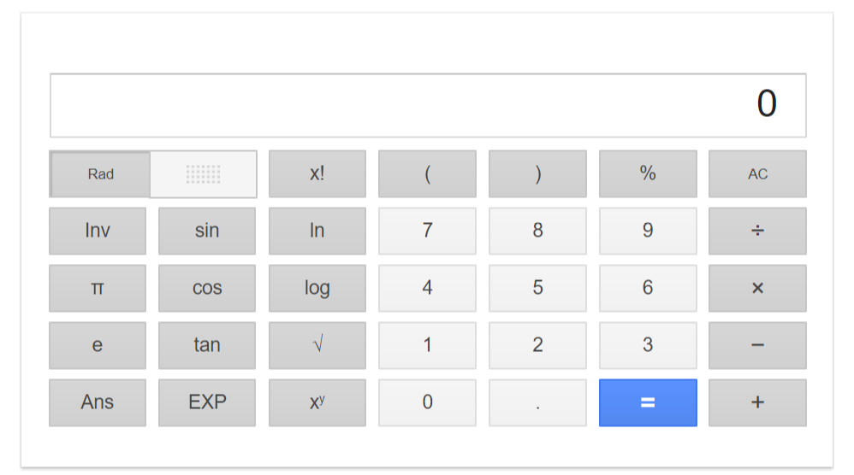
VS.

Slide 28
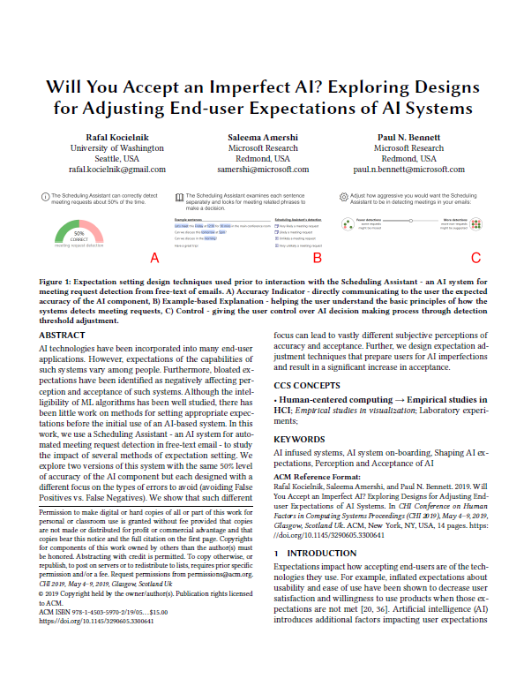
Kocielnik et al. (2019)
Probabilistic – almost always operate at less than perfect accuracy
Impacted by user actions – such as user-generated content
Transparency issues – how to mitigate? e.g. by showing decision rules

Slide 29
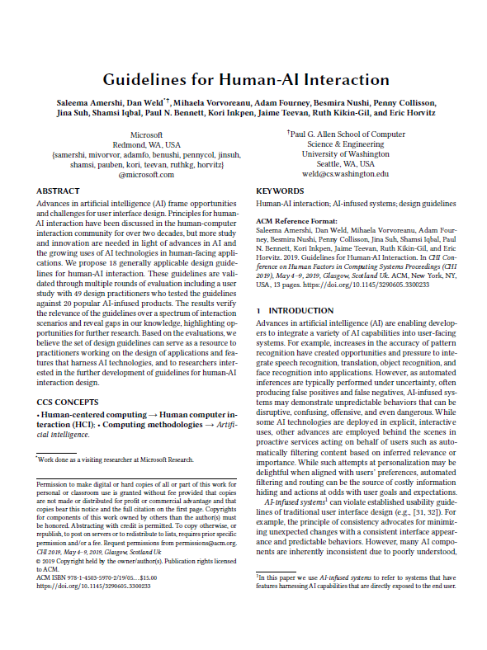
Amershi et al. (2019)
Definition of AI-infused systems: Systems that have features harnessing AI capabilities that are directly exposed to the end user
Uncertainty -> errors common, both false positives and negatives
Inconsistency -> sensitive to context and small changes in input
Behind the scenes personalization (e.g. automated filtering) -> potentially undesired information hiding

Slide 30
Learning | Improving | Black box | Fuelled by large data sets
Dynamic
Mistakes inevitable
Opaque
Data gathering through interaction
VS.

Slide 31
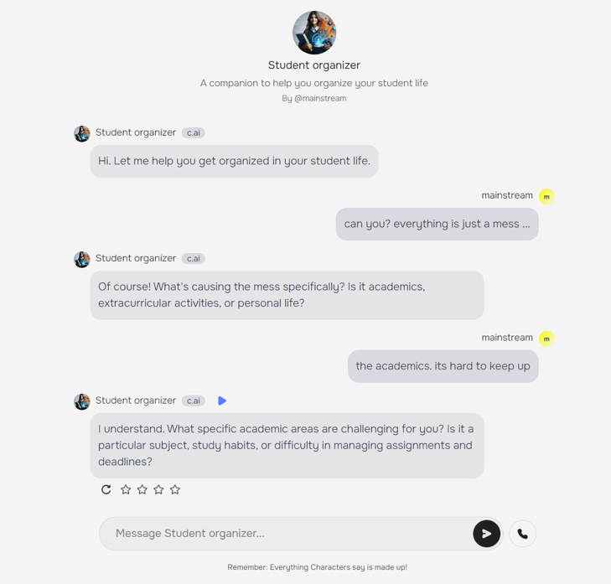
Consider …
your design tasks in module two – where you are to apply an AI platform to developd a prototype solution related to your group assignment
... here represented by the example of the previous lecture
Challenges in human-centred design of AI

Slide 32
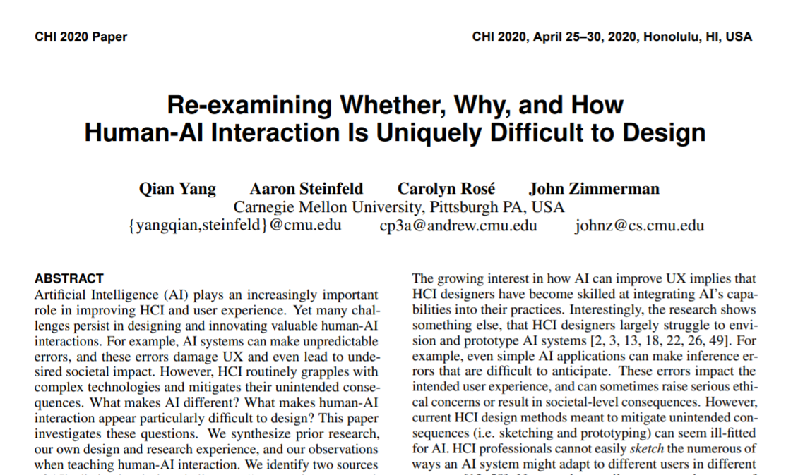
Challenges in human-centred design of AI

Slide 33
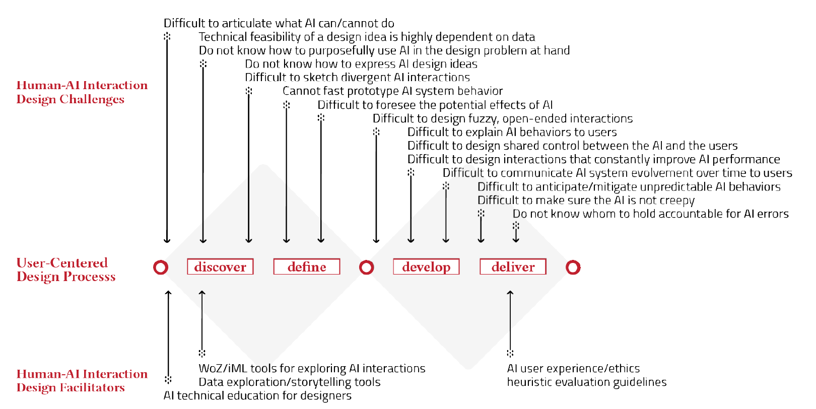
Challenges in human-centred design of AI
Yang, Q., Steinfeld, A., Rosé, C., & Zimmerman, J. (2020). Re-examining Whether, Why, and How Human-AI Interaction Is Uniquely Difficult to Design. In Proceedings of the 2020 CHI conference on human factors in computing systems (Paper no. 164).

Slide 34
"To understand AI’s capabilities, to a great extent, is to understand this gap between what the data appear to promise and the AI system built from that data can concretely achieve.
Challenges in human-centred design of AI
Capability uncertainty, due to limited understanding of opportunities with AI-systems
(How to sketch?)
Output complexity, due to adaptive character of AI-systems
(How to prototype?)
Yang, Q., Steinfeld, A., Rosé, C., & Zimmerman, J. (2020). Re-examining Whether, Why, and How Human-AI Interaction Is Uniquely Difficult to Design. In Proceedings of the 2020 CHI conference on human factors in computing systems (Paper no. 164).
Consider: Capability uncertainty in services based on generative AI?

Slide 35
"The system outputs that entail most design complexities are those that cannot be simulated. Consider Siri as an example. […] the relationship between Siri’s in- and outputs follow complex patterns that cannot be concisely described. As a result, rule-based simulators cannot meaningfully simulate Siri’s utterances nor can a human wizard.
Challenges in human-centred design of AI
Capability uncertainty, due to limited understanding of opportunities with AI-systems
(How to sketch?)
Output complexity, due to adaptive character of AI-systems
(How to prototype?)
Yang, Q., Steinfeld, A., Rosé, C., & Zimmerman, J. (2020). Re-examining Whether, Why, and How Human-AI Interaction Is Uniquely Difficult to Design. In Proceedings of the 2020 CHI conference on human factors in computing systems (Paper no. 164).
Consider: Output complexity in services based on generative AI?

Slide 36
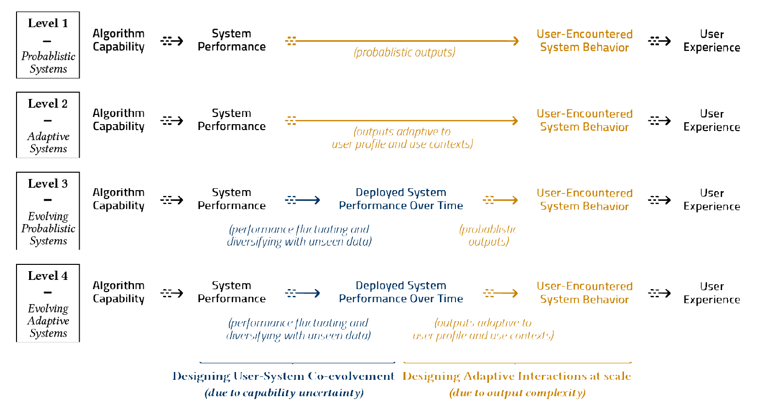
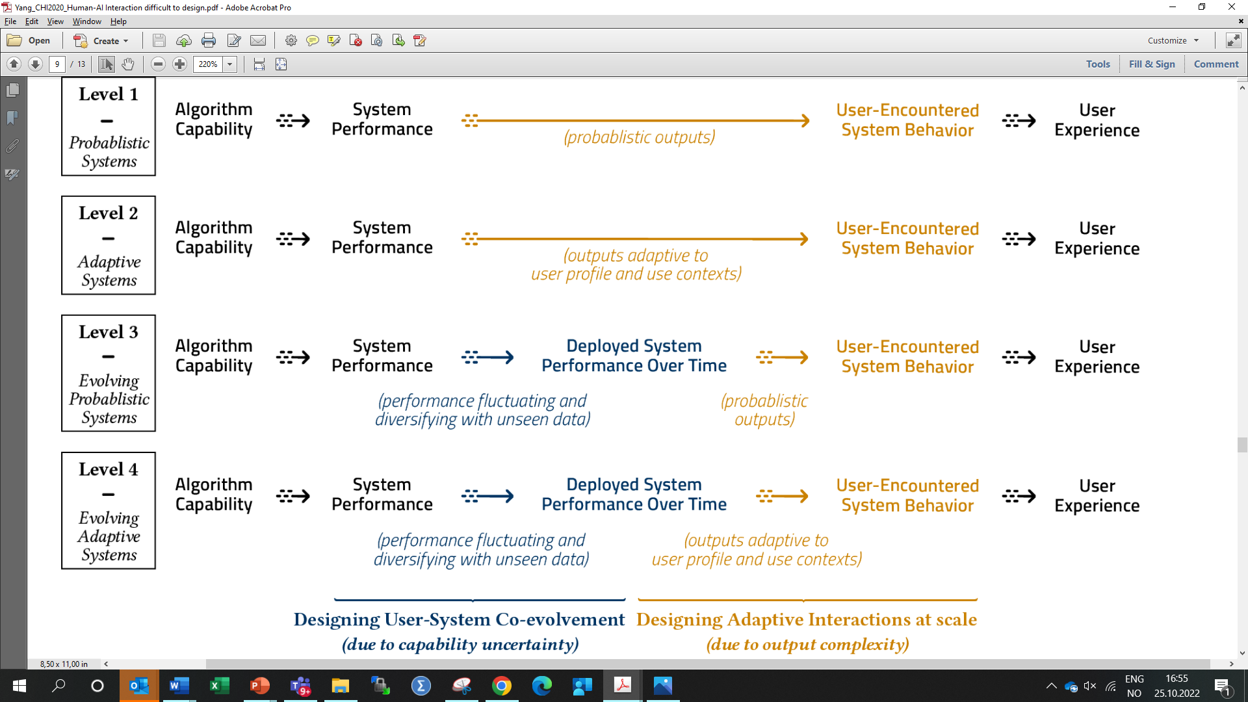
Yang, Q., Steinfeld, A., Rosé, C., & Zimmerman, J. (2020). Re-examining Whether, Why, and How Human-AI Interaction Is Uniquely Difficult to Design. In Proceedings of the 2020 CHI conference on human factors in computing systems (Paper no. 164).

Slide 37

Limited dataset basis for AI.
No adaptation to user context
-> Low capability uncertainty
-> Low output complexity
Image: https://commons.wikimedia.org/wiki/File:Face_Recognition_3252983.png
Yang, Q., Steinfeld, A., Rosé, C., & Zimmerman, J. (2020). Re-examining Whether, Why, and How Human-AI Interaction Is Uniquely Difficult to Design. In Proceedings of the 2020 CHI conference on human factors in computing systems (Paper no. 164).

Slide 38
Evolving dataset basis for AI.
Adaptation to user context
-> High capability uncertainty
-> High output complexity
Yang, Q., Steinfeld, A., Rosé, C., & Zimmerman, J. (2020). Re-examining Whether, Why, and How Human-AI Interaction Is Uniquely Difficult to Design. In Proceedings of the 2020 CHI conference on human factors in computing systems (Paper no. 164).

Slide 39
Identify root challenges. Understand the difference between prototyping in the lab and real world implementations
Articulating the contributions and limits of emergent design methods/tools/processes. Apply available support for prototyping and mock-ups, but understand the limitations of these
Provide new insights for future research. Consider AI design tasks as opportunities for gathering insights to be used in future projects.
Challenges in human-centred design of AI
Recommendations on process
Yang, Q., Steinfeld, A., Rosé, C., & Zimmerman, J. (2020). Re-examining Whether, Why, and How Human-AI Interaction Is Uniquely Difficult to Design. In Proceedings of the 2020 CHI conference on human factors in computing systems (Paper no. 164).

Slide 40
End 2

