Slide 1
Lecture 14 – Course recap
TEK4500
04.12.2023
Håkon Jacobsen
hakon.jacobsen@its.uio.no

Slide 2
Agenda
Recap of course
Q&A
Go through exam from 2023 and 2022 (offline)

Slide 3

What is cryptography?
Alice
Bob
M
Adversary
Security goals:
Data privacy: adversary should not be able to read message M
Data integrity: adversary should not be able to modify message M
Data authenticity: message M really originated from Alice

Slide 4
What is cryptography?
Alice
Bob
M
M'
Adversary
Security goals:
Data privacy: adversary should not be able to read message M
Data integrity: adversary should not be able to modify message M
Data authenticity: message M really originated from Alice

Slide 5
Ideal solution: secure channels
But how to build?
Alice
Bob
M
Adversary
Security goals:
Data privacy: adversary should not be able to read message M ✓
Data integrity: adversary should not be able to modify message M ✓
Data authenticity: message M really originated from Alice ✓

Slide 6


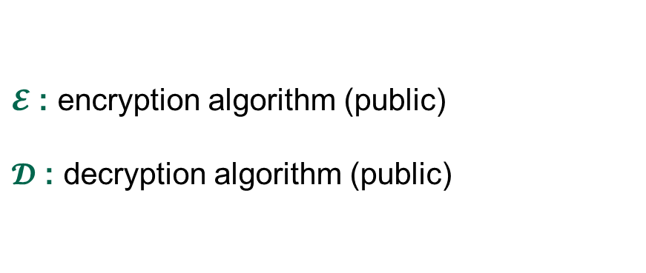
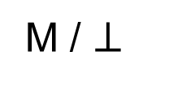
Creating secure channels: encryption schemes
Alice
Bob
K
K
$$ℰ$$
C
$$𝒟$$
M
M / $⊥$
Adversary
$𝓔$ : encryption algorithm (public)
$𝓓$ : decryption algorithm (public)
K : encryption / decryption key (secret)

Slide 7
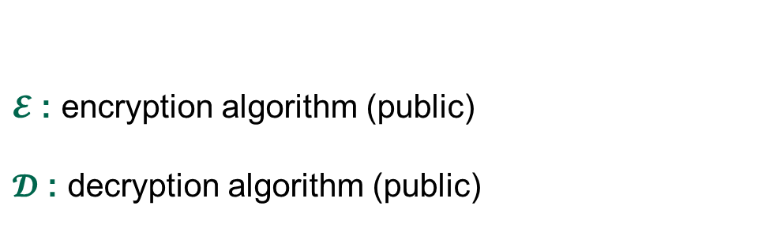
Creating secure channels: encryption schemes
Alice
Bob
K_{e}
K_{d}
$$ℰ$$
C
$$𝒟$$
M
M / $⊥$
Adversary
$𝓔$ : encryption algorithm (public)
$𝓓$ : decryption algorithm (public)
K_{e} : encryption key (public)
K_{d} : decryption key (secret)

Slide 8
Basic goals of cryptography
AEAD
IND-CPA, IND-CCA
UF-CMA
 | Message privacy | Message integrity / authentication
Symmetric keys | Symmetric encryption | Message authentication codes (MAC)
Asymmetric keys | Asymmetric encryption (public-key encryption) | Digital signatures
PRNG
PRNG
Key exchange
IND-CPA, IND-CCA
UF-CMA
Unkeyed primitives
Hash functions
TRNG
Collision resistance, one-wayness
Enough
min-entropy

Slide 9
Basic goals of cryptography
ChaCha20 (stream cipher)
Encrypt-then-MAC
AES-GCM
AES-CCM
AES-OCB
AES-CTR, AES-CTR$
AES-CBC$
CBC-MAC, CMAC,
HMAC
 | Message privacy | Message integrity / authentication
Symmetric keys | Symmetric encryption | Message authentication codes (MAC)
Asymmetric keys | Asymmetric encryption (public-key encryption) | Digital signatures
ChaCha20
CTR mode
PRNG
Key exchange
Diffie-Hellman
ElGamal, Padded RSA
Schnorr, ECDSA, Hashed RSA
Unkeyed primitives
Hash functions
TRNG
SHA2-256, SHA2-512
SHA3-256, SHA3-512
Ring-oscillators, lava lamps
quantum effects,
mouse wiggling…

Slide 10



Constructions and relations
GCM++, CCM, OCB++
TRNG
PRNG
Stream cipher
CTR
CTR
Symmetric-key encryption
PRF
AE
AEAD
CBC$
EtM
AES
Feistel
Thm.
PRP
MAC schemes
CBC-MAC, CMAC, PMAC
Protocols
TLS, SSH, IPsec, What's App
Davies-Mayer
HMAC
SHA2
Hash functions
Public-key encryption
Merkle-
Damgård
Key exchange
ElGamal
Schnorr, ECDSA
Diffie-Hellman
$$\left(Z_{p}^{∗} , .⋅.\right)$$
$$\left(E\left(F_{p}\right),+\right)$$
Kyber
Digital signatures
One-Way Trapdoor
functions
$$\left(Z_{N}^{∗} , ⋅\right)$$
RSA
Dilithium
PKI
digital certificates
Learning With Errors

Slide 11
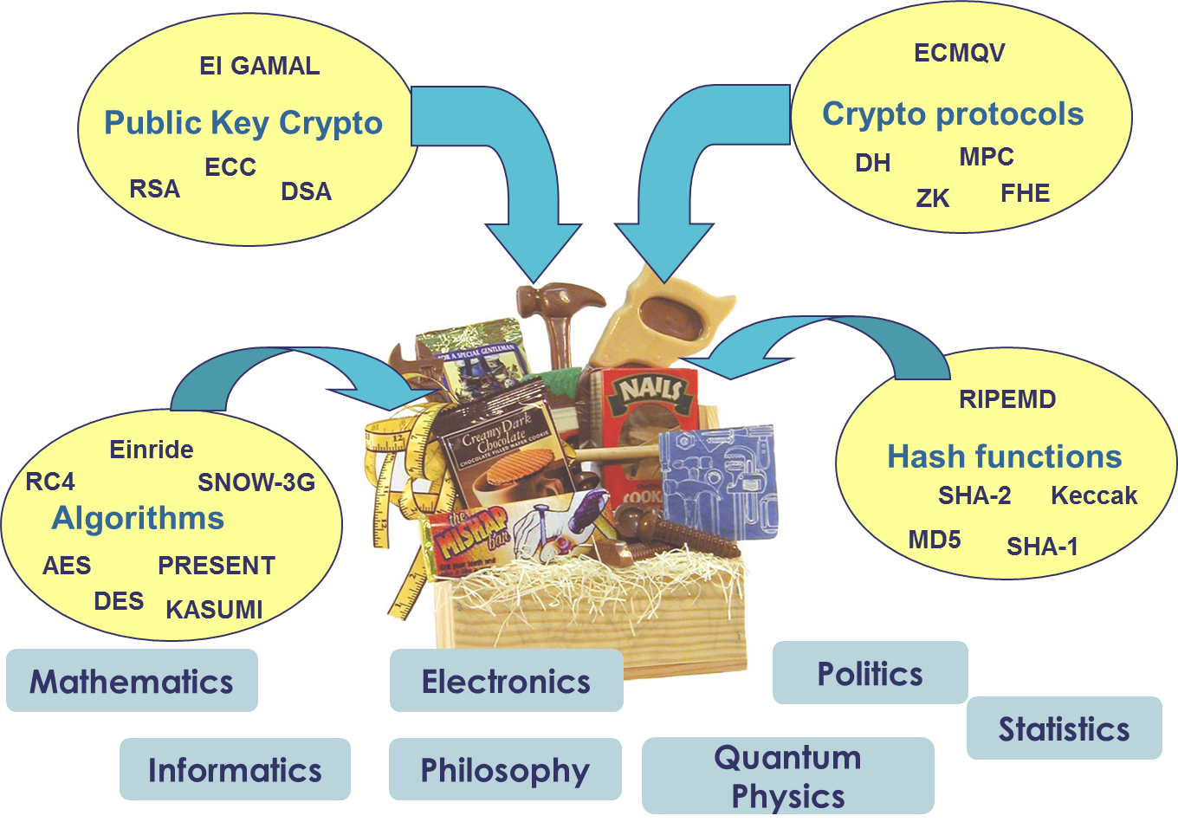
The crypto toolbox

Slide 12
Exam
Tuesday December 16, 15:00-19:00 (4 hours)
Digital, on-campus (Silurveien 2, Sal 4D)
Closed-book
I will make a round approximately 2 hours into the exam for possible question
https://www.uio.no/studier/emner/matnat/its/TEK4500/h24/eksamen/index.html

Slide 13
Course evaluation
All students should have received a link to a course evaluation form by email
Please submit your feedback to help improve the course!

