Slide 1
Lecture 3 – Symmetric encryption, IND-CPA,
CTR, CBC
TEK4500
11.09.2024
Håkon Jacobsen
hakon.jacobsen@its.uio.no

Slide 2
Basic goals of cryptography
 | Message privacy | Message integrity / authentication
Symmetric keys | Symmetric encryption | Message authentication codes (MAC)
Asymmetric keys | Asymmetric encryption (a.k.a. public-key encryption) | Digital signatures

Slide 3

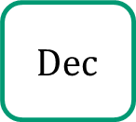
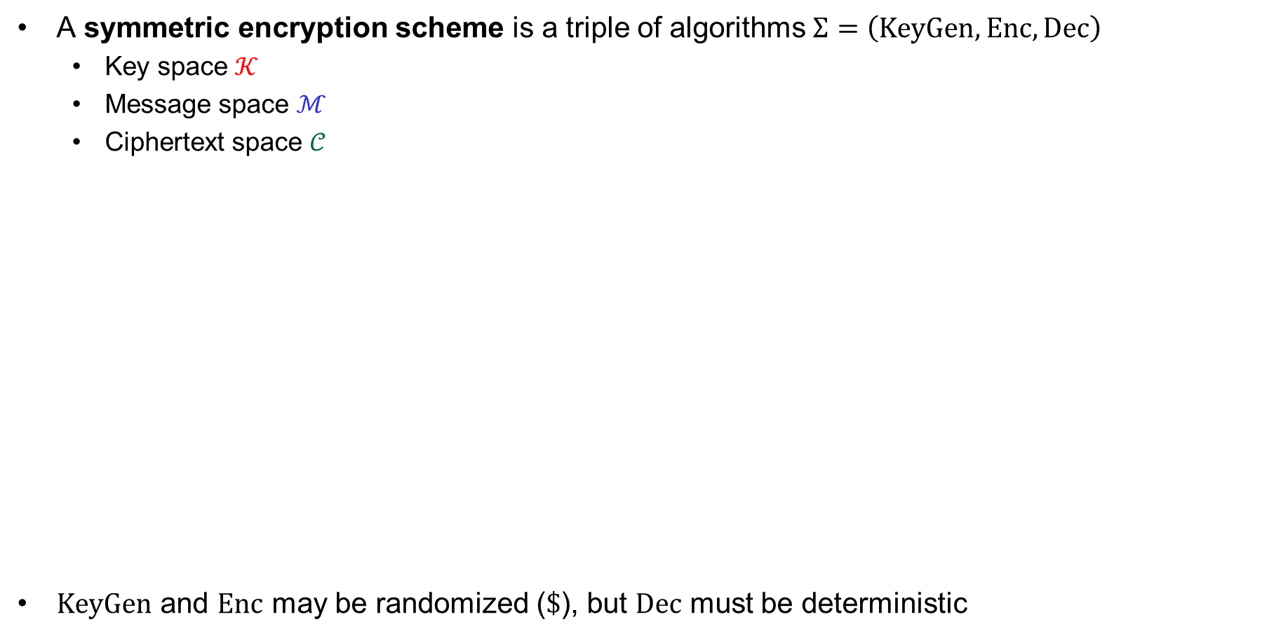

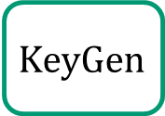

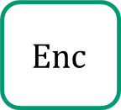

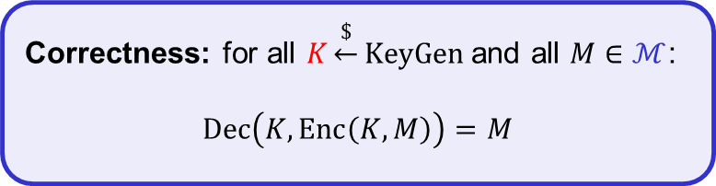

Encryption schemes – syntax
A symmetric encryption scheme is a triple of algorithms $Σ=\left(KeyGen, Enc, Dec\right)$
  Key space $𝒦$
  Message space $ℳ$
  Ciphertext space $𝒞$
$KeyGen$ and $Enc$ may be randomized ($\$$), but $Dec$ must be deterministic
Correctness: for all $K\underset{←}{\$}KeyGen$ and all $M∈ℳ$:
$$Dec\left(K, Enc\left(K, M\right)\right)=M$$
$$KeyGen$$
$$\$$$
$K$
$$\$$$
$$C$$
$$Dec$$
$$Enc$$
$$M$$
$M$
Adversary
Notes:
Delivery of K outside the "responsibility" of encryption scheme

Slide 4
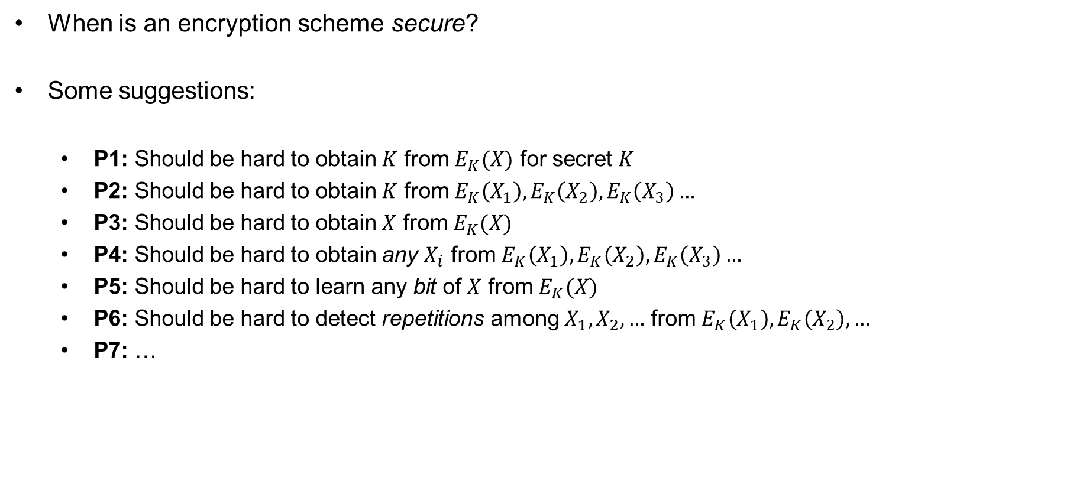
Symmetric encryption – security definition
When is an encryption scheme secure?
Some suggestions:
  P1: Should be hard to obtain $K$ from $E_{K}(X)$ for secret $K$
  P2: Should be hard to obtain $K$ from $E_{K}\left(X_{1}\right),E_{K}\left(X_{2}\right),E_{K}\left(X_{3}\right)…$
  P3: Should be hard to obtain $X$ from $E_{K}(X)$
  P4: Should be hard to obtain any $X_{i}$ from $E_{K}\left(X_{1}\right),E_{K}\left(X_{2}\right),E_{K}\left(X_{3}\right)…$
  P5: Should be hard to learn any bit of $X$ from $E_{K}(X)$
  P6: Should be hard to detect repetitions among $X_{1},X_{2},…$ from $E_{K}\left(X_{1}\right),E_{K}\left(X_{2}\right), …$
  P7: …
Not possible for block ciphers!

Slide 5













Electronic Code Book (ECB) mode
Block cipher: $ℰ :𝒦×{\left\{0,1\right\}}^{n}→{\left\{0,1\right\}}^{n}$
$$M$$
$${ M}_{1}$$
$${ M}_{2}$$
$${ M}_{3}$$
$${ M}_{4}$$
$${ ℰ}_{K}$$
$${ ℰ}_{K}$$
$${ ℰ}_{K}$$
$${ ℰ}_{K}$$
$C_{1}$
$${ C}_{2}$$
$${ C}_{3}$$
$C_{4}$

Slide 6

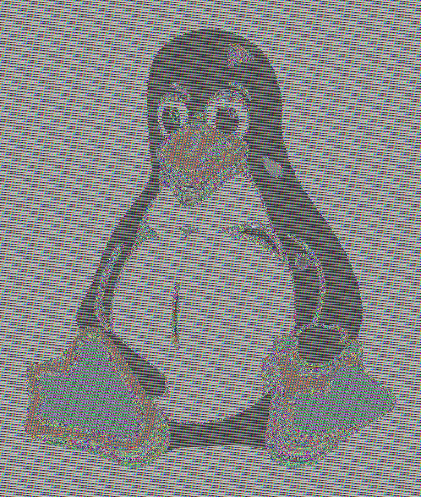

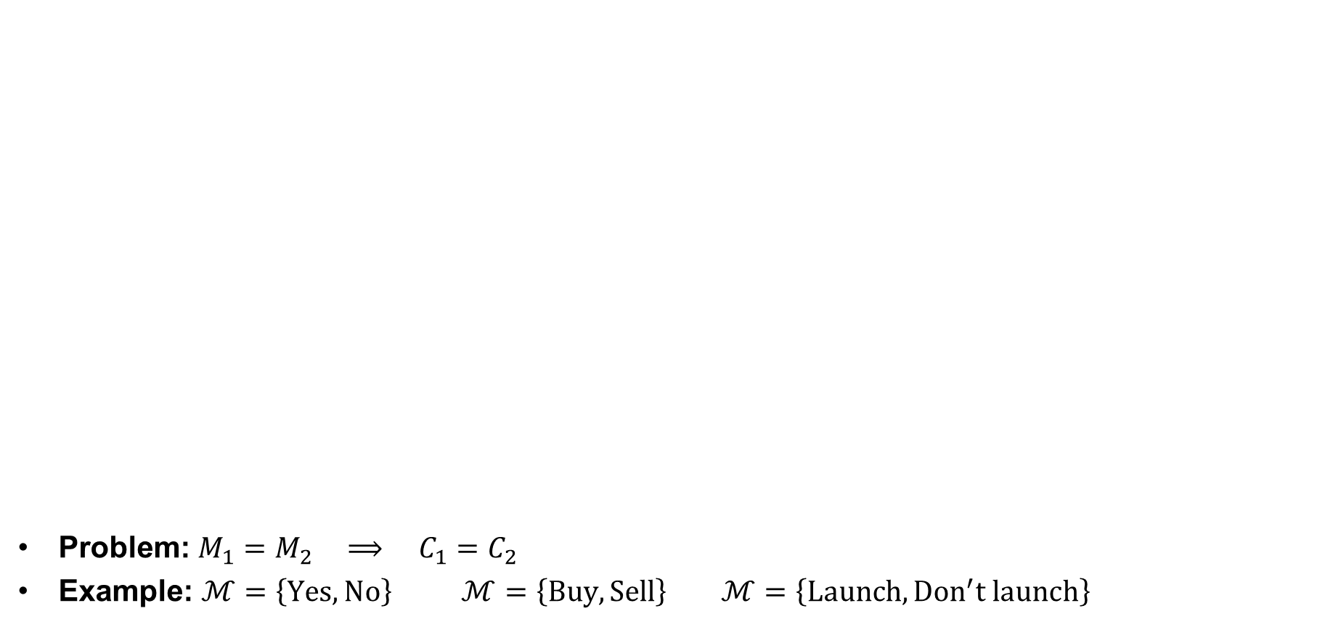
ECB problem
Problem: $M_{1}=M_{2} ⟹ C_{1}=C_{2}$
Example: $ℳ=\left\{Yes, No\right\}$ $ℳ=\left\{Buy, Sell\right\}$ $ℳ=\left\{Launch, {Don}^{′}t launch\right\}$
Plaintext
ECB encrypted
Properly encrypted

Slide 7






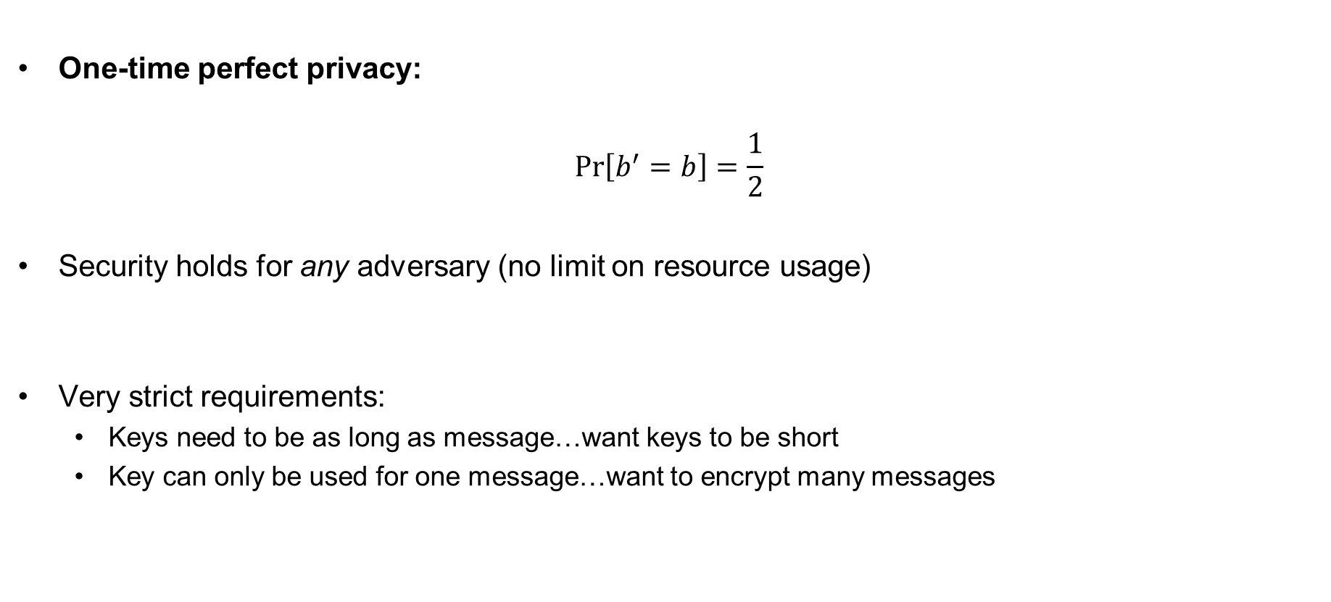

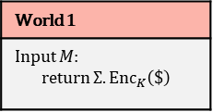

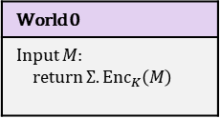

Perfect privacy
One-time perfect privacy:
$$Pr\left[b^{′}=b\right]=\frac{1}{2}$$
Security holds for any adversary (no limit on resource usage)
Very strict requirements:
  Keys need to be as long as message…want keys to be short
  Key can only be used for one message…want to encrypt many messages
computational
World 0
Input $M$: return $Σ.{Enc}_{K}\left(M\right)$
World 1
Input $M$: return $Σ.{Enc}_{K}\left(\$\right)$
$$b$$
$$± ε$$
$$M$$
$$M$$
$$C$$
$$C$$
resource bounded
I’m in World $b′$
✓
✓

Slide 8

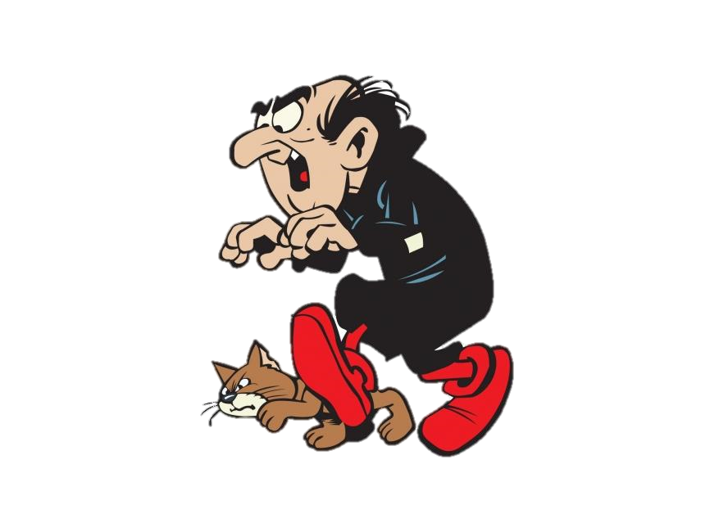
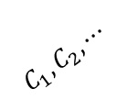
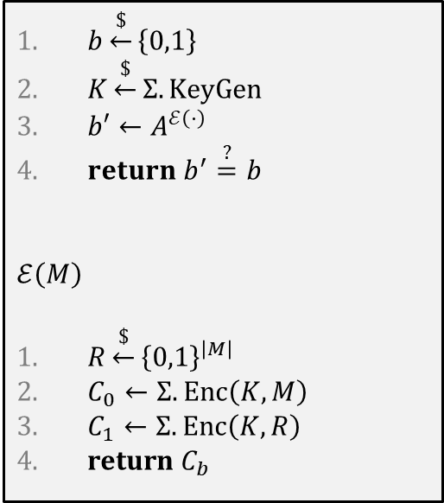
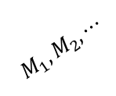


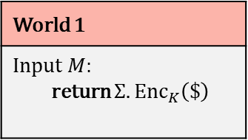
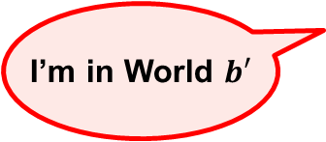
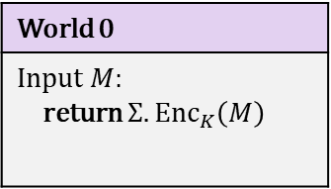

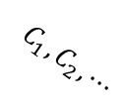
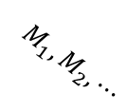
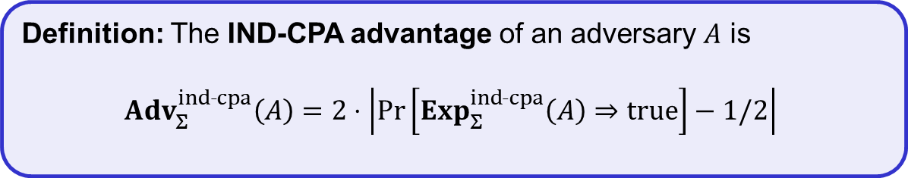
IND-CPA – indistinguishability against chosen-plaintext attacks
$$Exp_{Σ}^{ind­­˗cpa}\left(A\right)$$
World 0
Input $M$: return $Σ.{Enc}_{K}\left(M\right)$
World 1
Input $M$: return $Σ.{Enc}_{K}\left(\$\right)$
$b\underset{←}{\$}\left\{0,1\right\}$
$K\underset{←}{\$}Σ.KeyGen$
$b′←A^{ℰ\left(⋅\right)}$
$return b^{′}\overset{?}{=}b$
$$ℰ\left(M\right)$$
$R\underset{←}{\$}{\left\{0,1\right\}}^{\left|M\right|}$
$C_{0}←Σ.Enc\left(K, M\right)$
$C_{1}←Σ.Enc\left(K, R\right)$
return $C_{b}$
$$b=0$$
$$b=1$$
$$M_{1}, M_{2}, ⋯$$
$$M_{1}, M_{2}, ⋯$$
$$C_{1}, C_{2}, ⋯$$
$$C_{1}, C_{2}, ⋯$$
I’m in World $b′$
Definition: The IND-CPA advantage of an adversary $A$ is
$${Adv}_{Σ}^{ind­˗cpa}\left(A\right)=2⋅\left|\operatorname{Pr}\left[Exp_{Σ}^{ind˗cpa}\left(A\right)⇒true\right]−1/2\right|$$

Slide 9
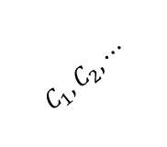

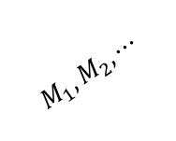
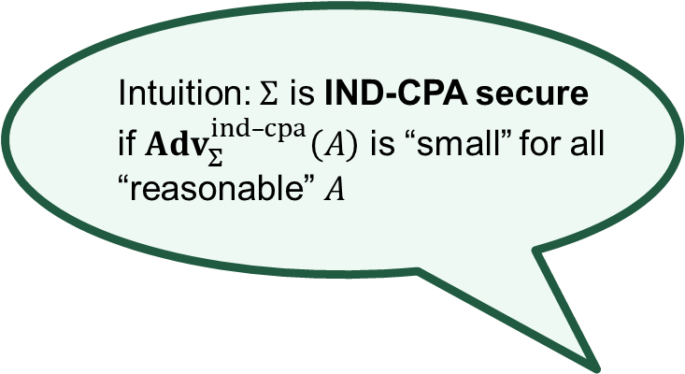
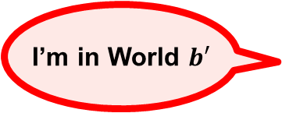
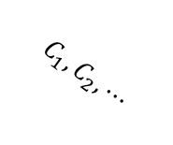

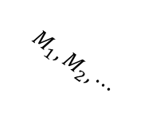
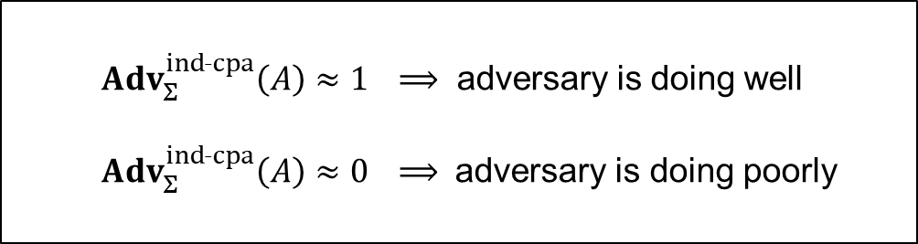
IND-CPA – indistinguishability against chosen-plaintext attacks
$$Exp_{Σ}^{ind­­˗cpa}\left(A\right)$$
World 0
Input $M$: return $Σ.{Enc}_{K}\left(M\right)$
World 1
Input $M$: return $Σ.{Enc}_{K}\left(\$\right)$
$b\underset{←}{\$}\left\{0,1\right\}$
$K\underset{←}{\$}Σ.KeyGen$
$b′←A^{ℰ\left(⋅\right)}$
$return b^{′}\overset{?}{=}b$
$$ℰ\left(M\right)$$
$R\underset{←}{\$}{\left\{0,1\right\}}^{\left|M\right|}$
$C_{0}←Σ.Enc\left(K, M\right)$
$C_{1}←Σ.Enc\left(K, R\right)$
return $C_{b}$
Intuition: $Σ$ is IND-CPA secure
if ${Adv}_{Σ}^{ind­–cpa}\left(A\right)$ is “small” for all
“reasonable” $A$
${Adv}_{Σ}^{ind˗cpa}\left(A\right)≈1$ $⟹$ adversary is doing well
${Adv}_{Σ}^{ind˗cpa}\left(A\right)≈0$ $⟹$ adversary is doing poorly
$$M_{1}, M_{2}, ⋯$$
$$M_{1}, M_{2}, ⋯$$
$$C_{1}, C_{2}, ⋯$$
$$C_{1}, C_{2}, ⋯$$
I’m in World $b′$
Definition: The IND-CPA advantage of an adversary $A$ is
$${Adv}_{Σ}^{ind­˗cpa}\left(A\right)=2⋅\left|\operatorname{Pr}\left[Exp_{Σ}^{ind˗cpa}\left(A\right)⇒true\right]−1/2\right|$$

Slide 10


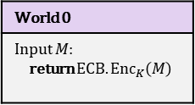



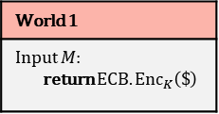





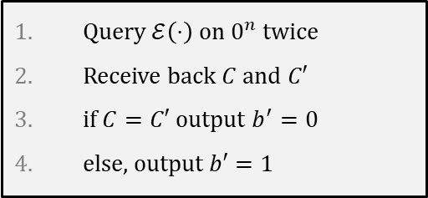





Example: IND-CPA insecurity of ECB mode
$$\text{Adversary} A$$
Query $ℰ\left(⋅\right)$ on $0^{n}$ twice
Receive back $C$ and $C′$
if $C=C′$ output $b^{′}=0$
else, output $b′=1$
World 0
Input $M$: return $ECB.{Enc}_{K}\left(M\right)$
World 1
Input $M$: return $ECB.{Enc}_{K}\left(\$\right)$
$$b$$
$$0^{n}, 0^{n}$$
$$0^{n}, 0^{n}$$
$$C,C$$
$$C, C′$$
I’m in World $b′$
$$\operatorname{Pr}\left[{Exp}_{ECB}^{ind–cpa}\left(A\right)⇒true\right]$$
$$= \operatorname{Pr}\left[b^{′}=b\right]$$
$= \operatorname{Pr}\left[b^{′}=0 ∣ b=0\right]⋅1/2 + \operatorname{Pr}\left[b^{′}=1 ∣ b=1\right]⋅1/2$
$= \operatorname{Pr}\left[C=C′ ∣ b=0\right]⋅1/ 2$
$\left(1−Pr\left[b^{′}=0 ∣ b=1\right] \right)⋅1/ 2$
$$+ ⋯$$
$$= 1/2$$
$\left(1−Pr\left[C=C′ ∣ b=1\right] \right)⋅1/ 2$
$$+ ⋯$$
$$= 1/2 + \left(1 −{ 2}^{−n}\right) ⋅1/2$$
$$= 1 − \frac{1}{2^{n+1}}$$

Slide 11



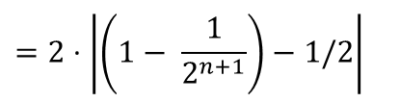

Example: IND-CPA insecurity of ECB mode
$$\text{Adversary} A$$
Query $ℰ\left(⋅\right)$ on $0^{n}$ twice
Receive back $C$ and $C′$
if $C=C′$ output $b^{′}=0$
else, output $b′=1$
World 0
Input $M$: return $ECB.{Enc}_{K}\left(M\right)$
World 1
Input $M$: return $ECB.{Enc}_{K}\left(\$\right)$
$$b$$
$$0^{n}, 0^{n}$$
$$0^{n}, 0^{n}$$
$$C,C$$
$$C, C′$$
I’m in World $b′$
$$\operatorname{Pr}\left[{Exp}_{ECB}^{ind–cpa}\left(A\right)⇒true\right]$$
$$1 − \frac{1}{2^{n+1}}$$
$$= \operatorname{Pr}\left[b^{′}=b\right]$$
$${Adv}_{ECB}^{ind­–cpa}\left(A\right)=2⋅\left|\operatorname{Pr}\left[Exp_{Σ}^{ind–cpa}\left(A\right)⇒true\right]−1/2\right|$$
$$=2⋅\left|\left(1− \frac{1}{2^{n+1}}\right)−1/2\right|$$
$$= 1−\frac{1}{2^{n}}$$
$$≈ 1$$

Slide 12
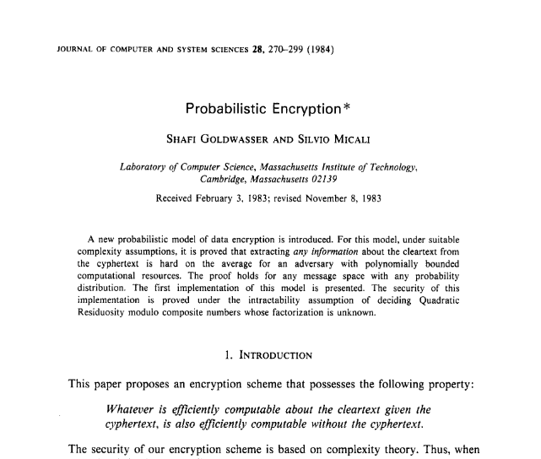
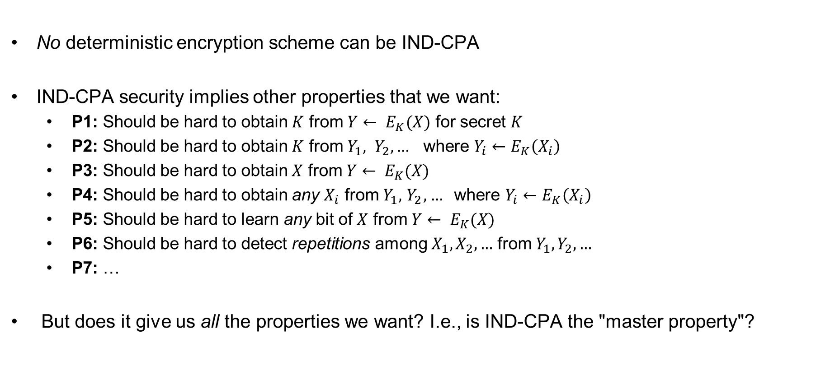
Consequences of the definition
No deterministic encryption scheme can be IND-CPA
IND-CPA security implies other properties that we want:
  P1: Should be hard to obtain $K$ from ${Y← E}_{K}(X)$ for secret $K$
  P2: Should be hard to obtain $K$ from $Y_{1}, Y_{2}, …$ where $Y_{i}←E_{K}\left(X_{i}\right)$
  P3: Should be hard to obtain $X$ from ${Y← E}_{K}(X)$
  P4: Should be hard to obtain any $X_{i}$ from $Y_{1}, { Y}_{2}, …$where $Y_{i}←E_{K}\left(X_{i}\right)$
  P5: Should be hard to learn any bit of $X$ from ${Y← E}_{K}(X)$
  P6: Should be hard to detect repetitions among $X_{1}, X_{2},…$ from $Y_{1}, Y_{2}, …$
  P7: …
But does it give us all the properties we want? I.e., is IND-CPA the "master property"?

Slide 13
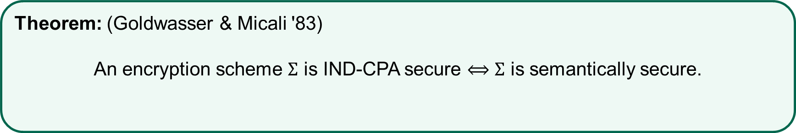
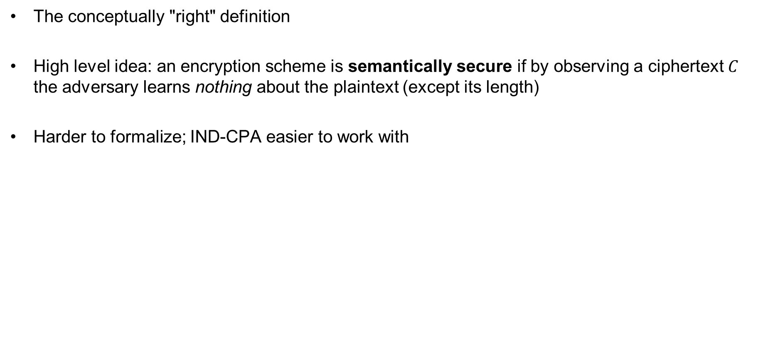
Semantic security
The conceptually "right" definition
High level idea: an encryption scheme is semantically secure if by observing a ciphertext $C$ the adversary learns nothing about the plaintext (except its length)
Harder to formalize; IND-CPA easier to work with
Theorem: (Goldwasser & Micali '83)
An encryption scheme $Σ$ is IND-CPA secure $⟺$ $Σ$ is semantically secure.

Slide 14
Length-leaking attacks
Wikipedia pages
  Each page has a unique size
Google maps
  World regions have unique "fingerprints" based on length of data (based on map tiles)
Variable-bitrate encoding
  Can e.g., fingerprint movies streamed over Netflix
To combat length-leaking attacks: message padding
  Can be expensive
  Supported in TLS, but seldom used
  Used by TOR

Slide 15


Constructing symmetric
encryption schemes

Slide 16


How to achieve non-deterministic encryption?
Randomized encryption
  Coins flipped internally by the algorithm
Nonce-based encryption
  Encryption scheme itself is deterministic
  Non-determinism injected from the outside
Plaintext
Ciphertext
$$M$$
$$M′$$

Slide 17





CTR$ mode
pick randomly
ctr
ctr+1
ctr+2
ctr+3
$${ ℰ}_{K}$$
$${ ℰ}_{K}$$
$${ ℰ}_{K}$$
keystream
$$M$$
=
ctr
$$C$$

Slide 18
CTR$ mode
pick randomly
ctr
ctr+1
ctr+2
ctr+3
$${ ℰ}_{K}$$
$${ ℰ}_{K}$$
$${ ℰ}_{K}$$
keystream
$$M$$
=
ctr
$$C$$

Slide 19


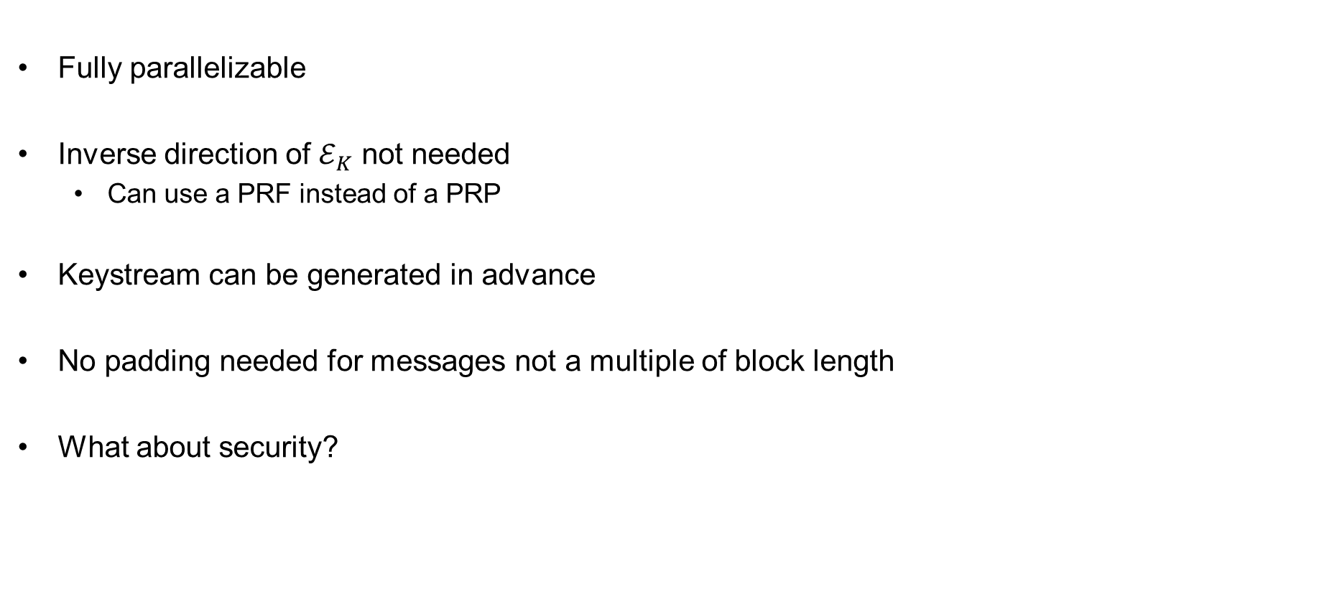



CTR properties
Fully parallelizable
Inverse direction of $ℰ_{K}$ not needed
  Can use a PRF instead of a PRP
Keystream can be generated in advance
No padding needed for messages not a multiple of block length
What about security?
pick randomly
ctr
ctr+1
ctr+2
ctr+3
$${ ℰ}_{K}$$
$${ ℰ}_{K}$$
$${ ℰ}_{K}$$
keystream
$$M$$
=
ctr
$$C$$

Slide 20
Modern approach to cryptography
Trying to make cryptography more a science than an art
Focus on formal definitions of security (and insecurity)
Clearly stated assumptions
Analysis supported by mathematical proofs

Slide 21
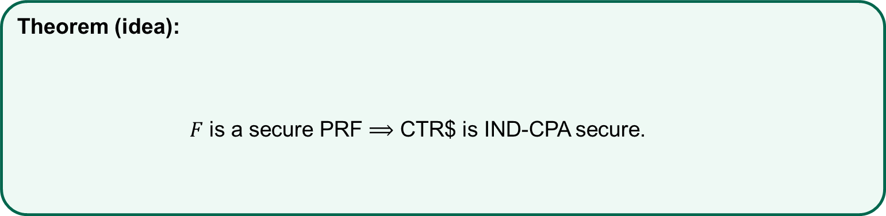
Security of CTR$
Theorem (idea):
$F$ is a secure PRF $⟹$ CTR$ is IND-CPA secure.

Slide 22
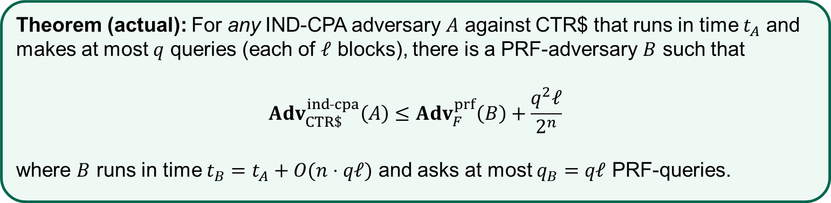
Security of CTR$
Theorem (actual): For any IND-CPA adversary $A$ against CTR$ that runs in time $t_{A}$ and makes at most $q$ queries (each of $ℓ$ blocks), there is a PRF-adversary $B$ such that
$${Adv}_{CTR\$}^{ind­˗cpa}\left(A\right)≤{Adv}_{F}^{prf}\left(B\right)+\frac{q^{2}ℓ}{2^{n}}$$
where $B$ runs in time $t_{B}=t_{A}+O(n⋅qℓ)$ and asks at most $q_{B}=qℓ$ PRF-queries.

Slide 23

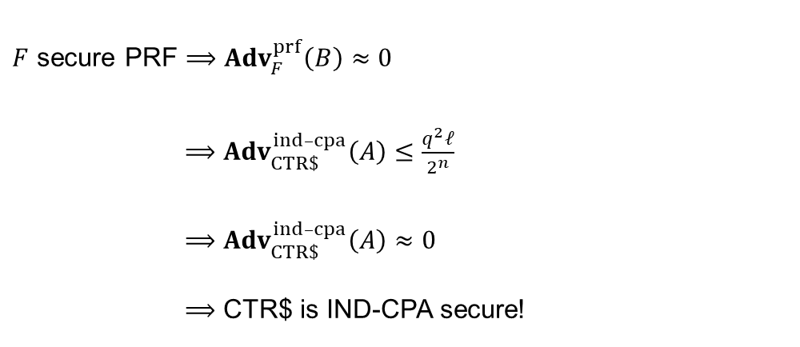

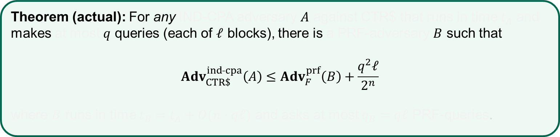
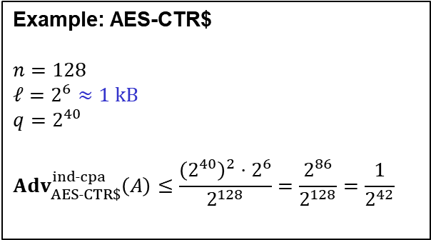
Security of CTR$
Theorem (actual): For any IND-CPA adversary $A$ against CTR$ that runs in time $t_{A}$ and makes at most $q$ queries (each of $ℓ$ blocks), there is a PRF-adversary $B$ such that
$${Adv}_{CTR\$}^{ind­˗cpa}\left(A\right)≤{Adv}_{F}^{prf}\left(B\right)+\frac{q^{2}ℓ}{2^{n}}$$
where $B$ runs in time $t_{B}=t_{A}+O(n⋅qℓ)$ and asks at most $q_{B}=qℓ$ PRF-queries.
$F$ secure PRF $⟹$ ${Adv}_{F}^{prf}\left(B\right)≈0$
$⟹$ ${Adv}_{CTR\$}^{ind­–cpa}\left(A\right)≤\frac{q^{2}ℓ}{2^{n}}$
$⟹$ ${Adv}_{CTR\$}^{ind­–cpa}\left(A\right)≈0$
$⟹$ CTR$ is IND-CPA secure!
Example: AES-CTR$
$$n=128$$
$ℓ=2^{6}≈1 kB$
$$q=2^{40}$$
$${Adv}_{AES˗CTR\$}^{ind­˗cpa}\left(A\right)≤\frac{{\left(2^{40}\right)}^{2}⋅2^{6}}{2^{128}}=\frac{2^{86}}{2^{128}}=\frac{1}{2^{42}}$$
$$≈70 TB$$
$$\left(q^{2}ℓ≪2^{n}\right)$$

Slide 24
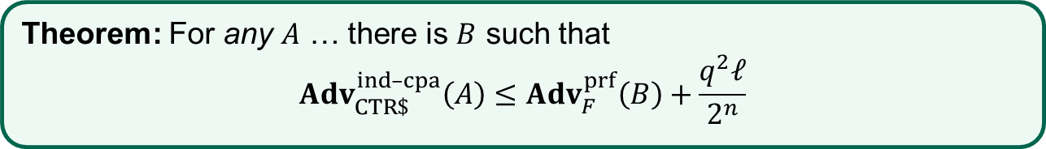



Security of CTR$ – proof
Theorem: For any $A$ … there is $B$ such that
$${Adv}_{CTR\$}^{ind­–cpa}\left(A\right)≤{Adv}_{F}^{prf}\left(B\right)+\frac{q^{2}ℓ}{2^{n}}$$
$$M$$
$$M[1]$$ | $$M[2]$$ | $$M[3]$$ | $$⋯$$ | $$M[ℓ]$$
$$F_{K}(X+1)$$ | $$F_{K}(X+2)$$ | $$F_{K}(X+3)$$ | $$⋯$$ | $$F_{K}(X+ℓ)$$
$$=$$
$$C[1]$$ | $$C[2]$$ | $$C[3]$$ | $$⋯$$ | $$C\left[ℓ\right]$$
$$C$$

Slide 25




Security of CTR$ – proof
Theorem: For any $A$ … there is $B$ such that
$${Adv}_{CTR\$}^{ind­–cpa}\left(A\right)≤{Adv}_{F}^{prf}\left(B\right)+\frac{q^{2}ℓ}{2^{n}}$$
$$M$$
$$M[1]$$ | $$M[2]$$ | $$M[3]$$ | $$⋯$$ | $$M[ℓ]$$
$$ρ(X+1)$$ | $$ρ(X+2)$$ | $$ρ(X+3)$$ | $$⋯$$ | $$ρ(X+ℓ)$$
$$=$$
$$C[1]$$ | $$C[2]$$ | $$C[3]$$ | $$⋯$$ | $$C\left[ℓ\right]$$
$$C$$
$$ρ\underset{←}{\$}Func[n,n]$$
$≈F_{K}$ by PRF-security

Slide 26

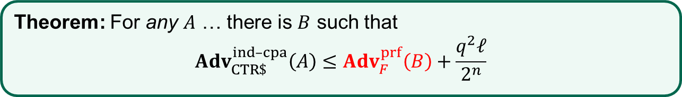

Security of CTR$ – proof
Theorem: For any $A$ … there is $B$ such that
$${Adv}_{CTR\$}^{ind­–cpa}\left(A\right)≤{Adv}_{F}^{prf}\left(B\right)+\frac{q^{2}ℓ}{2^{n}}$$
$$M$$
$$M[1]$$ | $$M[2]$$ | $$M[3]$$ | $$⋯$$ | $$M[ℓ]$$
$$ρ(X+1)$$ | $$ρ(X+2)$$ | $$ρ(X+3)$$ | $$⋯$$ | $$ρ(X+ℓ)$$
$$=$$
$$C[1]$$ | $$C[2]$$ | $$C[3]$$ | $$⋯$$ | $$C\left[ℓ\right]$$
$$C$$
$$ρ\underset{←}{\$}Func[n,n]$$
$≈F_{K}$ by PRF-security

Slide 27





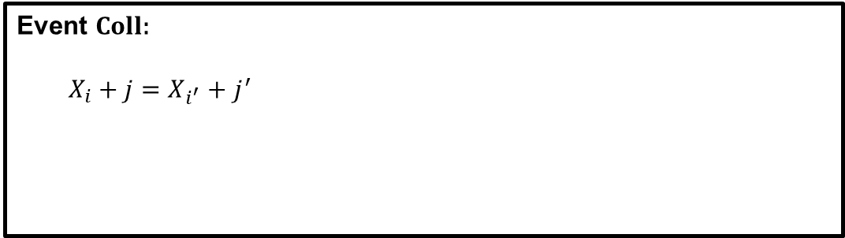
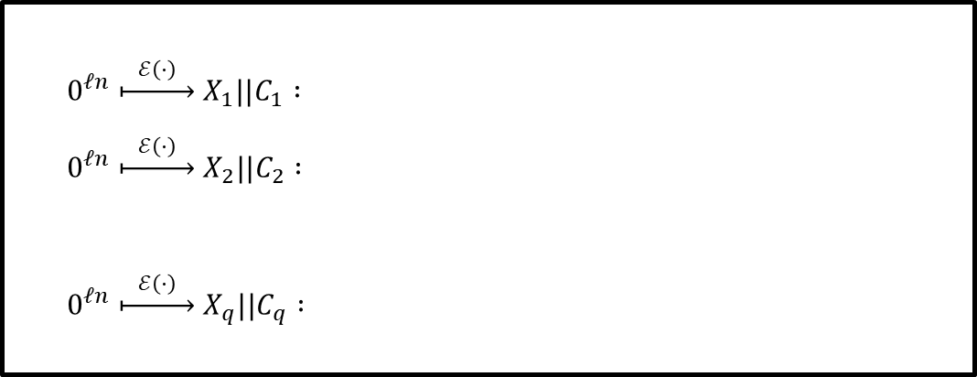


Security of CTR$ – proof
$0^{ℓn} \underset{↦}{ ℰ\left(⋅\right) } X_{1}||C_{1} :$
$0^{ℓn} \underset{↦}{ ℰ\left(⋅\right) } X_{2}||C_{2} :$
$0^{ℓn} \underset{↦}{ ℰ\left(⋅\right) } X_{q}||C_{q} :$
Theorem: For any $A$ … there is $B$ such that
$${Adv}_{CTR\$}^{ind­–cpa}\left(A\right)≤{Adv}_{F}^{prf}\left(B\right)+\frac{q^{2}ℓ}{2^{n}}$$
$\begin{matrix}X_{1} & X_{1}+1 & X_{1}+2\end{matrix} \begin{matrix}⋯ & X_{1}+ℓ\end{matrix}$
$\begin{matrix}X_{2} & X_{2}+1 & X_{2}+2\end{matrix} \begin{matrix}⋯ & X_{2}+ℓ\end{matrix}$
$$M$$
$\begin{matrix}X_{q} & X_{q}+1 & X_{q}+2\end{matrix} \begin{matrix}⋯ & X_{q}+ℓ\end{matrix}$
$$M[1]$$ | $$M[2]$$ | $$M[3]$$ | $$⋯$$ | $$M[ℓ]$$
OTP
$$ρ(X+1)$$ | $$ρ(X+2)$$ | $$ρ(X+3)$$ | $$⋯$$ | $$ρ(X+ℓ)$$
$$=$$
Event $Coll$:
$X_{i}+j=X_{i^{′}}+j^{′}$
$$⟹ ρ\left(X_{i}+j\right)=ρ\left(X_{i^{′}}+j^{′}\right)=\tilde{K}$$
$$C[1]$$ | $$C[2]$$ | $$C[3]$$ | $$⋯$$ | $$C\left[ℓ\right]$$
$$⟹ C_{i}\left[j\right]=C_{i^{′}}\left[j^{′}\right]=\left(\tilde{K}⊕0^{n}\right)$$
$$C$$
$$ρ\underset{←}{\$}Func[n,n]$$
$≈F_{K}$ by PRF-security

Slide 28






Security of CTR$ – proof
$0$ $1$ $…$
$$ℓ$$
$$2^{n}−1$$
$$X_{2}, X_{2}+1,…$$
$$X_{1}, X_{1}+1,…$$
$$Pr\left[Coll\right]=Pr\left[Coll_{1}∨Coll_{2}∨⋯∨Coll_{q}\right]$$
$$≤Pr\left[Coll_{1}\right]+Pr\left[Coll_{2}\right]+…+Pr\left[Coll_{q}\right]$$
$$≤ 0$$

Slide 29


Security of CTR$ – proof
$0$ $1$ $…$
$$ℓ$$
$$2^{n}−1$$
$$X_{2}, X_{2}+1,…$$
$$X_{1}, X_{1}+1,…$$
$$Pr\left[Coll\right]=Pr\left[Coll_{1}∨Coll_{2}∨⋯∨Coll_{q}\right]$$
$$≤Pr\left[Coll_{1}\right]+Pr\left[Coll_{2}\right]+…+Pr\left[Coll_{q}\right]$$
$$≤ 0$$
$$+ \frac{2ℓ}{2^{n}}$$

Slide 30


Security of CTR$ – proof
$0$ $1$ $…$
$$ℓ$$
$$ℓ$$
$$2^{n}−1$$
$$X_{3}, X_{3}+1,…$$
$$X_{1}, X_{1}+1,…$$
$$X_{3}, X_{3}+1,…$$
$$X_{2}, X_{2}+1,…$$
$$Pr\left[Coll\right]=Pr\left[Coll_{1}∨Coll_{2}∨⋯∨Coll_{q}\right]$$
$$≤Pr\left[Coll_{1}\right]+Pr\left[Coll_{2}\right]+…+Pr\left[Coll_{q}\right]$$
$$≤ 0$$
$$+ \frac{2ℓ}{2^{n}}$$
$$+ \frac{2⋅2ℓ}{2^{n}}$$

Slide 31





Security of CTR$ – proof
$0$ $1$ $…$
$$ℓ$$
$$ℓ$$
$$ℓ$$
$$2^{n}−1$$
$$X_{1}, X_{1}+1,…$$
$$X_{3}, X_{3}+1,…$$
$$X_{4}, X_{4}+1,…$$
$$X_{2}, X_{2}+1,…$$
$$X_{4}, X_{4}+1,…$$
$$X_{4}, X_{4}+1,…$$
$$Pr\left[Coll\right]=Pr\left[Coll_{1}∨Coll_{2}∨⋯∨Coll_{q}\right]$$
$$≤Pr\left[Coll_{1}\right]+Pr\left[Coll_{2}\right]+…+Pr\left[Coll_{q}\right]$$
$$≤ 0$$
$$+ \frac{2ℓ}{2^{n}}$$
$$+ \frac{2⋅2ℓ}{2^{n}}$$
$$+ \frac{3⋅2ℓ}{2^{n}}$$

Slide 32




Security of CTR$ – proof
$0$ $1$ $…$
$$ℓ$$
$$ℓ$$
$$ℓ$$
$$ℓ$$
$$2^{n}−1$$
$$X_{1}, X_{1}+1,…$$
$$X_{3}, X_{3}+1,…$$
$$X_{4}, X_{4}+1,…$$
$$X_{2}, X_{2}+1,…$$
$$Pr\left[Coll\right]=Pr\left[Coll_{1}∨Coll_{2}∨⋯∨Coll_{q}\right]$$
$$≤Pr\left[Coll_{1}\right]+Pr\left[Coll_{2}\right]+…+Pr\left[Coll_{q}\right]$$
$$≤ 0$$
$$+ \frac{2ℓ}{2^{n}}$$
$$+ \frac{2⋅2ℓ}{2^{n}}$$
$$+ \frac{3⋅2ℓ}{2^{n}}$$
$$+ ⋯ + \frac{(q−1)⋅2ℓ}{2^{n}}$$
$$= \frac{2ℓ}{2^{n}}⋅\left(1+2+3+⋯+\left(q−1\right)\right)$$
$$≤\frac{q^{2}ℓ}{2^{n}}$$
$$\frac{q(q−1)}{2}$$

Slide 33
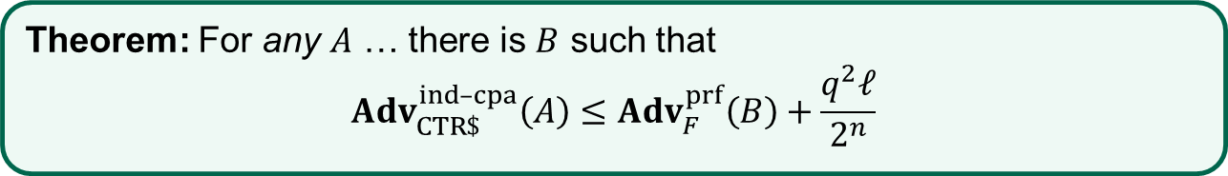
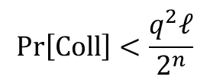
Security of CTR$ – proof
Theorem: For any $A$ … there is $B$ such that
$${Adv}_{CTR\$}^{ind­–cpa}\left(A\right)≤{Adv}_{F}^{prf}\left(B\right)+\frac{q^{2}ℓ}{2^{n}}$$
$$M$$
$$M[1]$$ | $$M[2]$$ | $$M[3]$$ | $$⋯$$ | $$M[ℓ]$$
$$Pr\left[Coll\right]<\frac{q^{2}ℓ}{2^{n}}$$
$$ρ(X+1)$$ | $$ρ(X+2)$$ | $$ρ(X+3)$$ | $$⋯$$ | $$ρ(X+ℓ)$$
$$=$$
$$C[1]$$ | $$C[2]$$ | $$C[3]$$ | $$⋯$$ | $$C\left[ℓ\right]$$
$$C$$
$$ρ\underset{←}{\$}Func[n,n]$$
$≈F_{K}$ by PRF-security

Slide 34
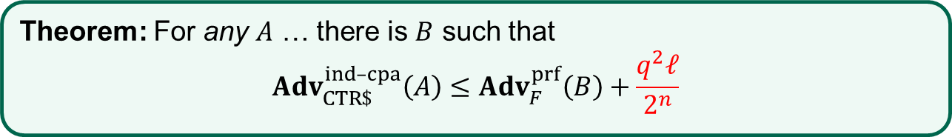
Security of CTR$ – proof
Theorem: For any $A$ … there is $B$ such that
$${Adv}_{CTR\$}^{ind­–cpa}\left(A\right)≤{Adv}_{F}^{prf}\left(B\right)+\frac{q^{2}ℓ}{2^{n}}$$
$$M$$
$$M[1]$$ | $$M[2]$$ | $$M[3]$$ | $$⋯$$ | $$M[ℓ]$$
$$Pr\left[Coll\right]<\frac{q^{2}ℓ}{2^{n}}$$
$$ρ(X+1)$$ | $$ρ(X+2)$$ | $$ρ(X+3)$$ | $$⋯$$ | $$ρ(X+ℓ)$$
$$=$$
$$C[1]$$ | $$C[2]$$ | $$C[3]$$ | $$⋯$$ | $$C\left[ℓ\right]$$
$$C$$
$$ρ\underset{←}{\$}Func[n,n]$$
$≈F_{K}$ by PRF-security

Slide 35


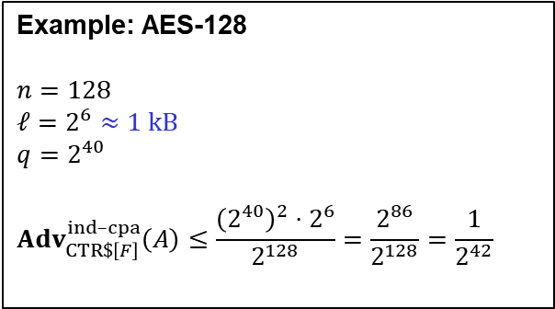






Nonce-based encryption
$$Enc :𝒦×ℳ→𝒞$$
$$\$$$
$$M$$
$$Enc$$
$$C$$
$$Enc\left(K,M\right)={Enc}_{K}\left(M\right)$$
$$K$$
Randomized
"number used once" =
Nonce
$$Enc :𝒦×𝒩×ℳ→𝒞$$
$$N$$
$$Enc$$
$$Enc\left(K, N, M\right)=Enc_{K}\left(N, M\right)={Enc}_{K}^{N}\left(M\right)$$
$$M$$
$$C$$
$$K$$
Nonce-based
How to create the nonce?
Randomly (also called IV-based)
Counter
Combination
Deterministic

Slide 36


CTR$ vs. (nonce-based) CTR
Probabilistic
Nonce-based
$$CTR\$.Enc\left(K,M\right)$$
$ctr\underset{←}{\$}{\left\{0,1\right\}}^{n}$ for $i=1, …, ℓ$ do $C_{i}←ℰ_{K}\left(ctr+i\right)⊕M_{i}$ return $ctr||C_{1}||⋯||C_{ℓ}$
$$CTR.Enc\left(K,N,M\right)$$
$ctr←N\underset{←}{\$}$ for $i=1, …, ℓ$ do $C_{i}←ℰ_{K}\left(ctr+i\right)⊕M_{i}$ return $ctr||C_{1}||⋯||C_{ℓ}$
vs.
Notes:
Careful: if $N$ is selected as a counter N = 0, 1, 2, 3, … for each new message, then we get ctr collisions if the messages are longer than one block
(the first message will have ctr values 0 + 1, 0 + 2, 0 + 3, …, the second message will have 1 + 1, 1 + 2, 1 + 3, which yields a collision in block 2 of M1 with block 1 of M2, collision in block 3 of M1 with block 2 of M2, and so on)
Hence N should continue from what the previous ctr ended up at. This requires state!

Slide 37


Nonce-based CTR – IND-CPA security
Theorem (CTR$): For any IND-CPA adversary $A$ against CTR$ that runs in time $t_{A}$ and asks at most $q$ queries (each of $ℓ$ blocks), there is a PRF-adversary $B$ such that
$${Adv}_{CTR\$}^{ind­–cpa}\left(A\right)≤{Adv}_{F}^{prf}\left(B\right)+\frac{q^{2}ℓ}{2^{n}}$$
where $B$ runs in time $t_{B}=t_{A}+O(n⋅qℓ)$ and asks at most $q_{B}=qℓ$ PRF-queries.
vs.
Theorem (CTR): For any IND-CPA adversary $A$ against CTR that runs in time $t_{A}$
and asks at most $q$ queries (each of $ℓ$ blocks), there is a PRF-adversary $B$ such that
$${Adv}_{CTR}^{ind­–cpa}\left(A\right)≤{Adv}_{F}^{prf}\left(B\right)$$
where $B$ runs in time $t_{B}=t_{A}+O(n⋅qℓ)$ and asks at most $q_{B}=qℓ$ PRF-queries.

Slide 38














CBC$ – Cipher Block Chaining mode
pick randomly
$$IV$$
$${ M}_{1}$$
$${ M}_{2}$$
$${ M}_{3}$$
$M_{4}$
$${ ℰ}_{K}$$
$${ ℰ}_{K}$$
$${ ℰ}_{K}$$
$${ ℰ}_{K}$$
$${ C}_{0}$$
$${ C}_{1}$$
$${ C}_{2}$$
$$C_{3}$$
$${ C}_{4}$$

Slide 39

















CBC$ – Cipher Block Chaining mode
pick randomly
$$IV$$
$${ M}_{1}$$
$${ M}_{2}$$
$${ M}_{3}$$
$${ M}_{4}$$
$${ M}_{1}$$
$${ M}_{2}$$
$${ M}_{3}$$
$${ M}_{4}$$
$${ ℰ}_{K}$$
$${ ℰ}_{K}$$
$${ ℰ}_{K}$$
$${ ℰ}_{K}$$
$${ ℰ}_{K}^{˗1}$$
$${ ℰ}_{K}^{˗1}$$
$${ ℰ}_{K}^{˗1}$$
$${ ℰ}_{K}^{˗1}$$
$${ C}_{0}$$
$${ C}_{1}$$
$${ C}_{2}$$
$${ C}_{3}$$
$${ C}_{4}$$
$$C_{0}$$
$${ C}_{1}$$
$${ C}_{2}$$
$${ C}_{3}$$
$${ C}_{4}$$

Slide 40














CBC
Theorem: IND-CPA secure for random IV
(assuming $ℰ$ is a good block cipher)
Not IND-CPA secure for nonce-based IV
  (exercise: show this)
Not parallelizable; cannot precompute values
Inverse of block cipher needed for decryption
Padding needed for messages not a multiple of block length
…historically one of the most used modes-of-operation
pick randomly
$$IV$$
$${ M}_{1}$$
$${ M}_{2}$$
$${ M}_{3}$$
$${ M}_{4}$$
$${ ℰ}_{K}$$
$${ ℰ}_{K}$$
$${ ℰ}_{K}$$
$${ ℰ}_{K}$$
$${ C}_{0}$$
$${ C}_{1}$$
$${ C}_{2}$$
$${ C}_{3}$$
$${ C}_{4}$$

Slide 41




IND-CPA – Indistinguishability against chosen-plaintext attacks
World 0
Input $M$: return $Σ.Enc\left(K, M\right)$
World 1
Input $M$: return $Σ.Enc\left(K, \$\right)$
I’m in World $b′$

Slide 42



IND-CCA – Indistinguishability against chosen-ciphertext attacks
World 0
Input $M$: return $Σ.Enc\left(K, M\right)$ Input $C$: return $Σ.Dec\left(K,C\right)$
World 1
Input $M$: return $Σ.Enc\left(K, \$\right)$ Input $C$: return $Σ.Dec\left(K,C\right)$
I’m in World $b′$
Restriction: not allowed to query $Enc\left(K,⋅\right)$ and then give result to $Dec\left(K,⋅\right)$ (unmodified)

Slide 43
IND-CCA
None of the schemes we have looked at today are IND-CCA secure
  Attacks are easy to demonstrate (exercise)
New techniques are needed
Next week: message authentication codes

