Slide 1
Lecture 5 – Authenticated encryption
TEK4500
25.09.2024
Håkon Jacobsen
hakon.jacobsen@its.uio.no

Slide 2
Basic goals of cryptography
 | Message privacy | Message integrity / authentication
Symmetric keys | Symmetric encryption | Message authentication codes (MAC)
Asymmetric keys | Asymmetric encryption (a.k.a. public-key encryption) | Digital signatures

Slide 3

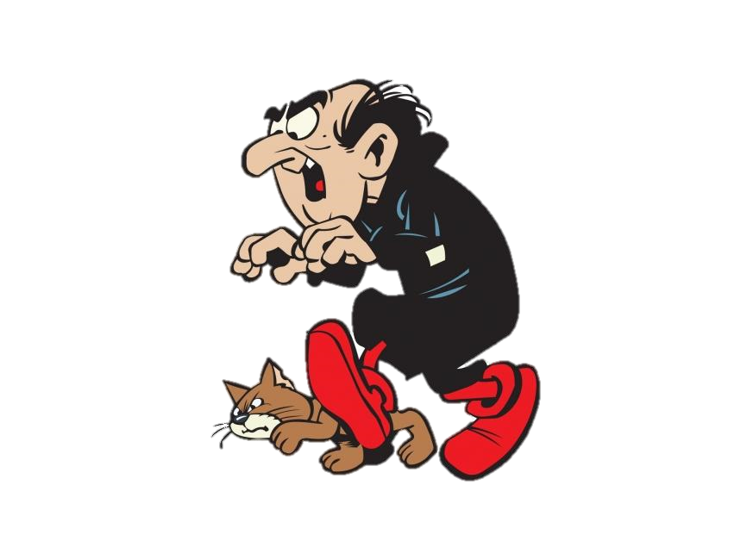
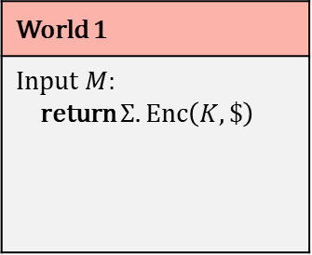
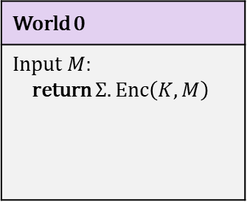

IND-CPA – Indistinguishability against chosen-plaintext attacks
World 0
Input $M$: return $Σ.Enc\left(K, M\right)$
World 1
Input $M$: return $Σ.Enc\left(K, \$\right)$
I’m in World $b′$

Slide 4





Chosen-plaintext attacks
Public Internet
Google Search (internal)
C
M

Slide 5
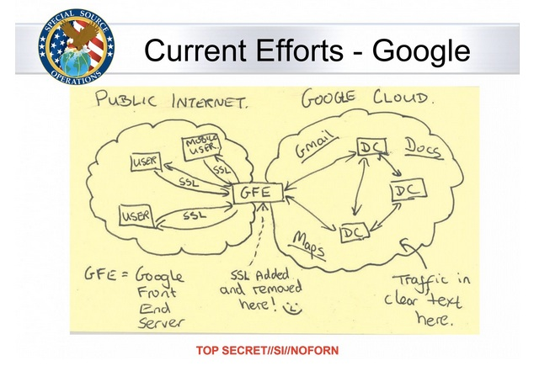
Chosen-plaintext attacks

Slide 6
IND-CPA – Indistinguishability against chosen-plaintext attacks
World 0
Input $M$: return $Σ.Enc\left(K, M\right)$
World 1
Input $M$: return $Σ.Enc\left(K, \$\right)$
I’m in World $b′$

Slide 7
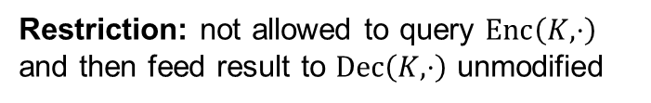
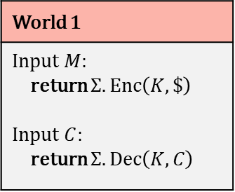
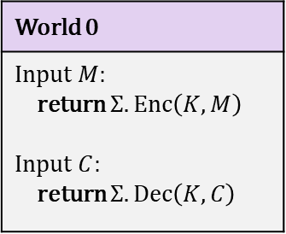
IND-CCA – Indistinguishability against chosen-ciphertext attacks
World 0
Input $M$: return $Σ.Enc\left(K, M\right)$ Input $C$: return $Σ.Dec\left(K,C\right)$
World 1
Input $M$: return $Σ.Enc\left(K, \$\right)$ Input $C$: return $Σ.Dec\left(K,C\right)$
I’m in World $b′$
Restriction: not allowed to query $Enc\left(K,⋅\right)$ and then feed result to $Dec\left(K,⋅\right)$ unmodified

Slide 8
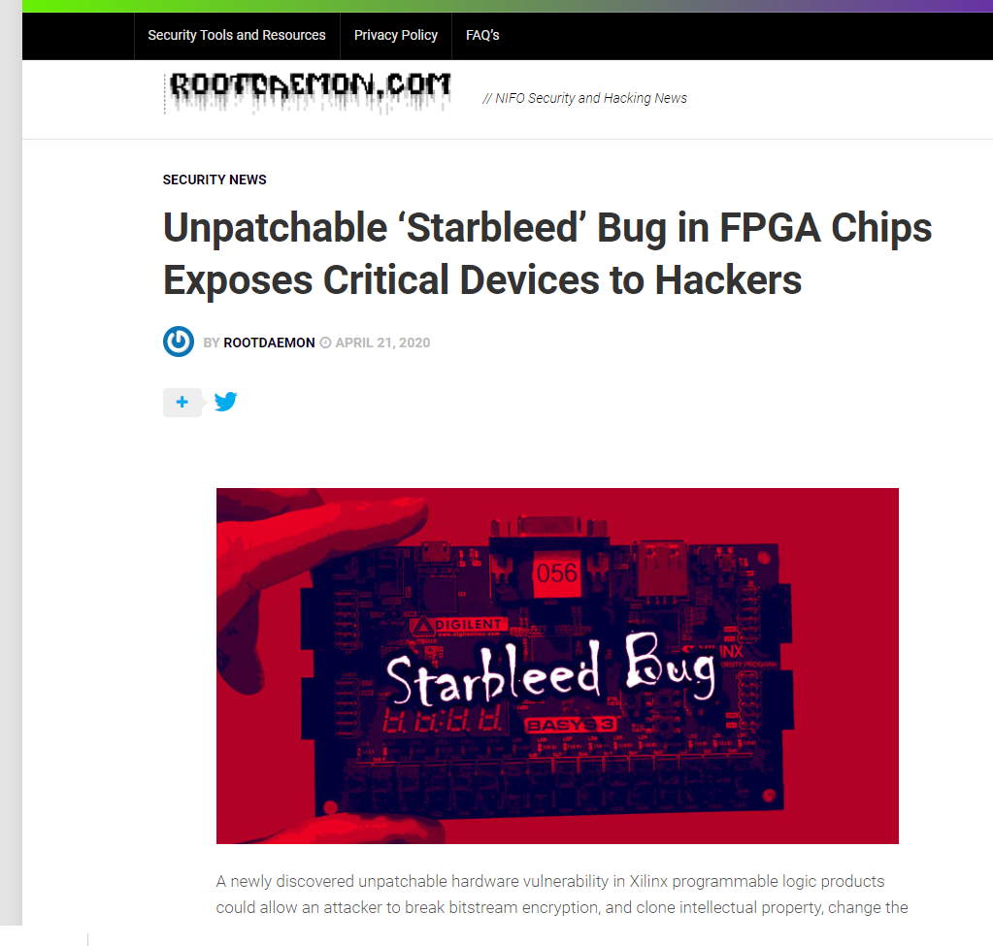
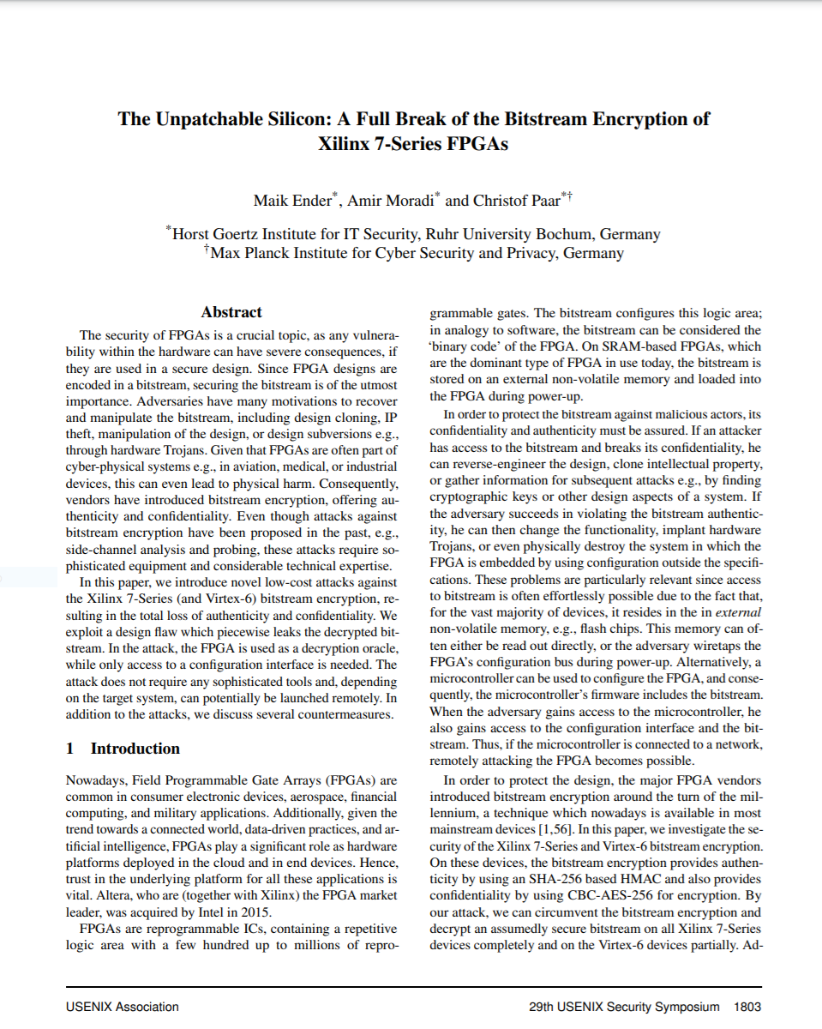
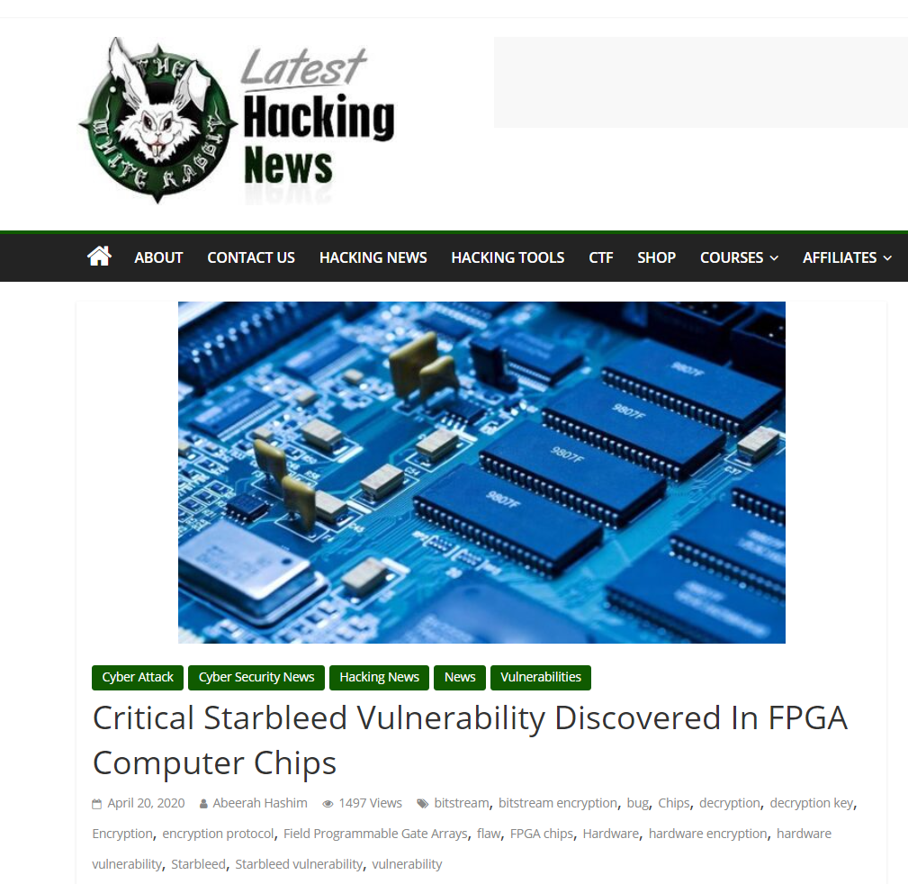
Xilinx FPGA – Starbleed attack

Slide 9


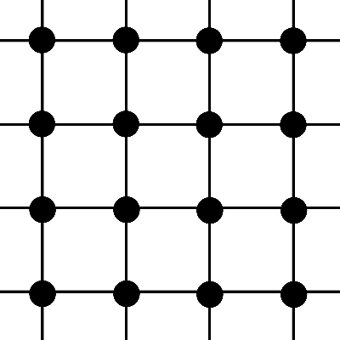
FPGA – Field Programmable Gate Array
Bitstream
Configure

Slide 10
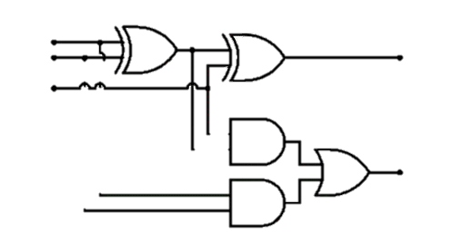
FPGA – Field Programmable Gate Array
Bitstream

Slide 11
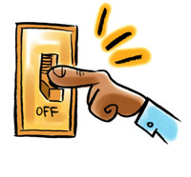
FPGA – Field Programmable Gate Array
Bitstream design typically a business secret
(or even a national/military secret)
Bitstream
FPGA applications:
  Aerospace and avionics
  Digital signal processors
  Defense and military
  Medical devices
  General hardware accelerators
  (e.g. cryptography)

Slide 12

FPGA – Field Programmable Gate Array
Bitstream
Decrypt bitstream with K
Configure
K

Slide 13
FPGA – Field Programmable Gate Array
Bitstream
Decrypt bitstream with K
K

Slide 14
Xilinx Starbleed attack
Bitstream
Decrypt bitstream with K
⋯ | ⋯ | ⋯
K_{MAC} | ⋯ | ⋯
⋯ | WRITE WBSTAR | 0x00000000
 |  | MAC TAG
Header
K
WBSTAR: 0x000000
AES-CBC encrypted
WBSTAR = Warm-Boot Start-address

Slide 15



Xilinx Starbleed attack
Bitstream
Decrypt bitstream with K
⋯ | ⋯ | ⋯
K_{MAC} | ⋯ | ⋯
⋯ | WRITE WBSTAR
 |  | BAD TAG
Reboot
K
Configure
WBSTAR: 0x23d001
AES-CBC decrypt

Slide 16
Xilinx Starbleed attack
Bitstream
“Read out WBSTAR”
Decrypt bitstream with K
Configure
K
WBSTAR: 0x23d001
0x23d001

Slide 17
Xilinx Starbleed attack
Bitstream
“Read out WBSTAR”
Decrypt bitstream with K
⋯ | ⋯ | ⋯
K_{MAC} | ⋯ | ⋯
⋯ | WRITE WBSTAR
 |  | BAD TAG
K
WBSTAR: 0x23d001

Slide 18
Xilinx Starbleed attack
Bitstream
“Read out WBSTAR”
Decrypt bitstream with K
Configure
⋯ | ⋯ | ⋯
K_{MAC} | ⋯ | ⋯
⋯ | WRITE WBSTAR
 |  | BAD TAG
Reboot
K
Configure
WBSTAR: 0xff0015
WBSTAR: 0x23d001
0xff0015
AES-CBC decrypt

Slide 19
Xilinx Starbleed attack
Bitstream
“Read out WBSTAR”
Decrypt bitstream with K
⋯ | ⋯ | ⋯
K_{MAC} | ⋯ | ⋯
⋯ | WRITE WBSTAR
 |  | BAD TAG
Reboot
K
Configure
WBSTAR: 0x6391dd
0x6391dd

Slide 20
Xilinx Starbleed attack
Bitstream
“Read out WBSTAR”
Decrypt bitstream with K
⋯ | ⋯ | ⋯
K_{MAC} | ⋯ | ⋯
⋯ | WRITE WBSTAR
 |  | BAD TAG
Reboot
K
Configure
WBSTAR: 0xba11c0
0xba11c0

Slide 21
Xilinx Starbleed attack
Bitstream
“Read out WBSTAR”
Decrypt bitstream with K
⋯ | ⋯ | ⋯
K_{MAC} | ⋯ | ⋯
⋯ | WRITE WBSTAR
 |  | BAD TAG
Reboot
K
Configure
WBSTAR: 0x833ad7
0x833ad7

Slide 22
Xilinx Starbleed attack
Bitstream
“Read out WBSTAR”
Decrypt bitstream with K
⋯ | ⋯ | ⋯
K_{MAC} | ⋯ | ⋯
⋯ | WRITE WBSTAR
 |  | BAD TAG
Reboot
K
Configure
WBSTAR: 0xfe4115
0xfe4115
Time to fully decrypt bitstream: 26 hours

Slide 23
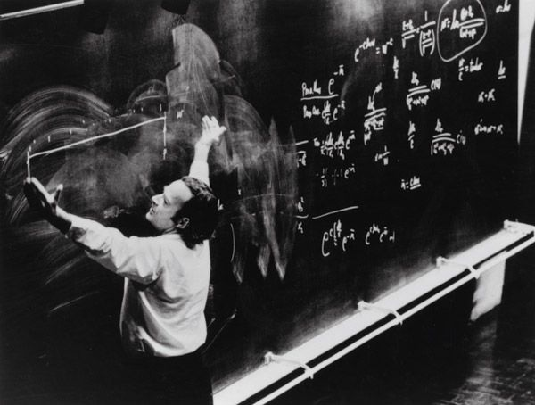
Authenticated encryption

Slide 24
Authenticated encryption
Authenticated encryption: privacy and integrity from a single primitive:
Syntactically (almost) the same as a normal encryption scheme

Slide 25






Authenticated encryption – syntax
$$Enc :𝒦×ℳ→𝒞$$
$$Enc(K,M)={Enc}_{K}\left(M\right)=C$$
$$Dec :𝒦×𝒞→ℳ$$
$$∪\left\{⊥\right\}$$
$$Dec\left(K, C\right)=Dec_{K}\left(C\right)=M$$
$$/ ⊥$$

Slide 26

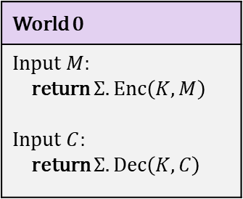
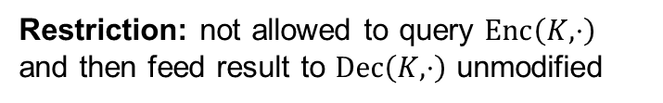
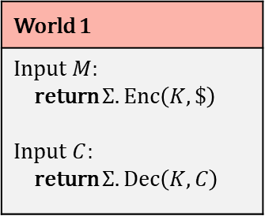
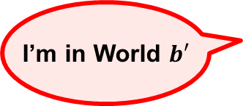
Authenticated encryption – security
World 0
Input $M$: return $Σ.Enc\left(K, M\right)$ Input $C$: return $Σ.Dec\left(K,C\right)$
World 1
Input $M$: return $Σ.Enc\left(K, \$\right)$ Input $C$: return $Σ.Dec\left(K,C\right)$
I’m in World $b′$
Restriction: not allowed to query $Enc\left(K,⋅\right)$ and then feed result to $Dec\left(K,⋅\right)$ unmodified

Slide 27
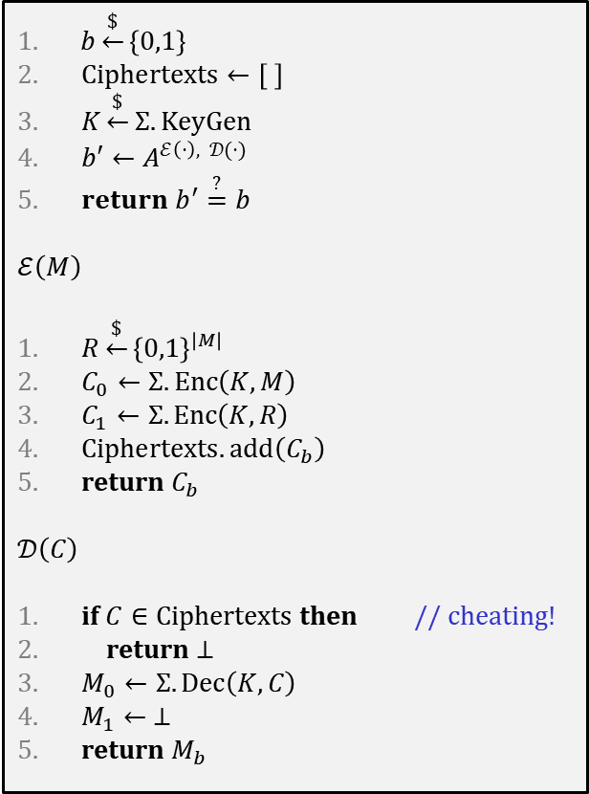

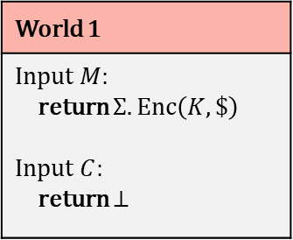
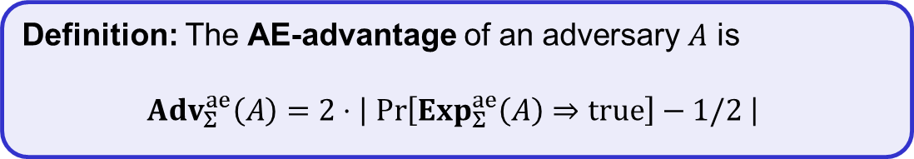
Authenticated encryption – security
$$Exp_{Σ}^{ae}\left(A\right)$$
World 0
Input $M$: return $Σ.Enc\left(K, M\right)$ Input $C$: return $Σ.Dec\left(K,C\right)$
World 1
Input $M$: return $Σ.Enc\left(K, \$\right)$ Input $C$: return $⊥$
$b\underset{←}{\$}\left\{0,1\right\}$
$Ciphertexts←\left[ \right]$
$K\underset{←}{\$}Σ.KeyGen$
$b′←A^{ℰ\left(⋅\right), 𝒟(⋅)}$
$return b^{′}\overset{?}{=}b$
$$ℰ\left(M\right)$$
$R\underset{←}{\$}{\left\{0,1\right\}}^{\left|M\right| }$
$C_{0}←Σ.Enc\left(K, M\right)$
$C_{1}←Σ.Enc\left(K, R\right)$
$Ciphertexts.add\left(C_{b}\right)$
return $C_{b}$
$$𝒟\left(C\right)$$
if $C∈Ciphertexts$ then // cheating!
return $⊥$
$M_{0}←Σ.Dec\left(K, C\right)$
$M_{1}← ⊥$
return $M_{b}$
I’m in World $b′$
Restriction: not allowed to query $Enc\left(K,⋅\right)$ and then feed result to $Dec\left(K,⋅\right)$ unmodified
Definition: The AE-advantage of an adversary $A$ is
$${Adv}_{Σ}^{ae}\left(A\right)=2⋅\left|\operatorname{Pr}\left[Exp_{Σ}^{ae}\left(A\right)⇒true\right]−1/2 \right|$$

Slide 28
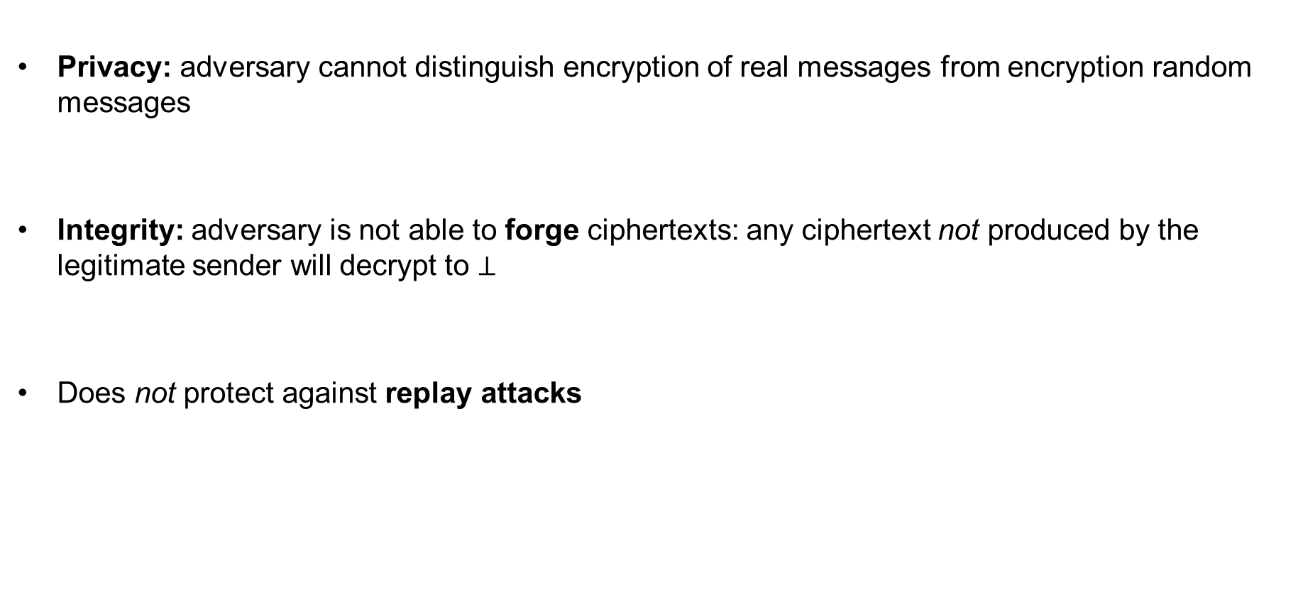
AE security definition – implications
Privacy: adversary cannot distinguish encryption of real messages from encryption random messages
Integrity: adversary is not able to forge ciphertexts: any ciphertext not produced by the legitimate sender will decrypt to $⊥$
Does not protect against replay attacks

Slide 29



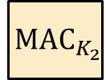
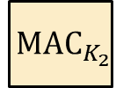

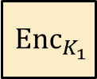
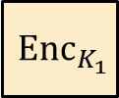






Generic composition: AE from Encryption + MAC
MAC-then-Encrypt (MtE)
Encrypt-and-MAC (E&M)
Encrypt-then-MAC (EtM)
$$M$$
$$M$$
$$M$$
$${ Enc}_{K_{1}}$$
$${ MAC}_{K_{2}}$$
$${ Enc}_{K_{1}}$$
$${ MAC}_{K_{2}}$$
$${ Enc}_{K_{1}}$$
$${ MAC}_{K_{2}}$$
$$C$$
$$C$$
$$T$$
$$C$$
$$T$$
Used in TLS 1.2
Used in SSH
Used in IPsec

Slide 30

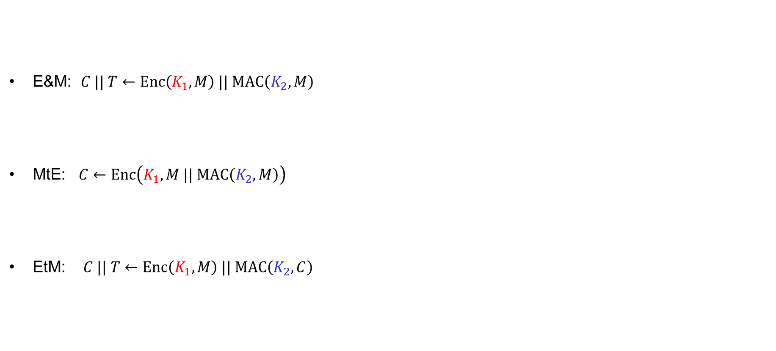



Generic composition: AE secure?
E&M: $C || T←Enc\left(K_{1}, M\right) || MAC\left(K_{2}, M\right)$
MtE: $C←Enc\left(K_{1}, M || MAC\left(K_{2}, M\right)\right)$
EtM: $C || T←Enc\left(K_{1}, M\right) || MAC\left(K_{2}, C\right)$
IND-CPA secure
UF-CMA secure
$$MAC\left(K_{2}, M\right)$$
✗
$$Enc\left(K_{1}, M\right) || M || T$$
AE secure?
✗
$$0000 || C$$
$$Enc\left(K_{1}, M || …\right)$$
✓

Slide 31

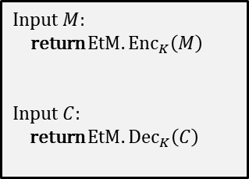


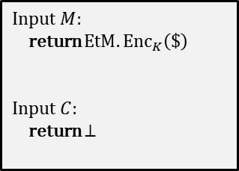
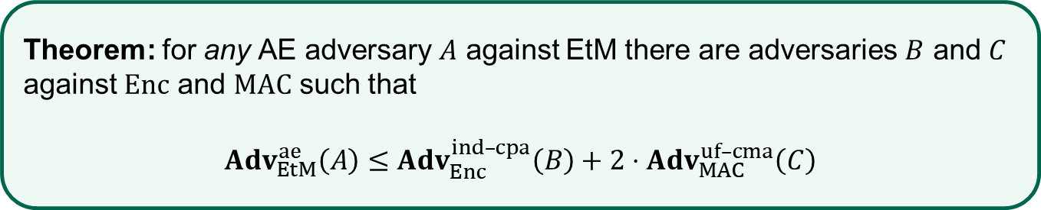

EtM – security
Theorem: for any AE adversary $A$ against EtM there are adversaries $B$ and $C$ against $Enc$ and $MAC$ such that
$Adv_{EtM}^{ae}\left(A\right)≤$ $Adv_{Enc}^{ind–cpa}\left(B\right)+2⋅Adv_{MAC}^{uf–cma}\left(C\right)$
Proof sketch:
$$\text{World}\text{ 0}$$
$$\text{World} \text{1}$$
Input $M$:
return $EtM.{Enc}_{K}\left(M\right)$
Input $C$:
return $EtM.{Dec}_{K}\left(C\right)$
IND-CPA
Input $M$:
return $EtM.{Enc}_{K}\left(\$\right)$
Input $C$:
return $⊥$
$$≈$$
$$≈$$
UF-CMA

Slide 32
CCA-attacks – revisited
MtE used in Starbleed attack
Gave rise to (partial) decryption oracle
Attack would not have been possible
with an AE secure scheme
Bitstream
“Read out WBSTAR”
Decrypt bitstream with K
⋯ | ⋯ | ⋯
K_{MAC} | ⋯ | ⋯
⋯ | WRITE WBSTAR
 |  | BAD TAG
K
Configure
WBSTAR: 0x833ad7
AES-CBC
0x833ad7

Slide 33


AEAD – Authenticated Encryption with Associated Data

Slide 34


AEAD – AE with associated data (AD)
AD – data that can't be encrypted but still need integrity protection
  Headers in protocols
  Configuration data
  Metadata
Integrity protected
Dst address
Src address
Payload
Tag
$$AD$$
$$M$$
Authenticated
Encrypted
Privacy protected
Notes:
Example: Filenames of (encrypted) files on disk

Slide 35








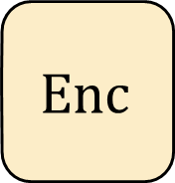
Authenticated encryption w/associated data (AEAD) – syntax
$$Enc :𝒦×ℳ→𝒞$$
$$Enc\left(K, M\right)=Enc_{K}\left(M\right)=C$$
$$Enc$$
$$\$$$
$$A$$
$$M$$
$$C$$
$$Dec :𝒦×𝒞→ℳ∪\left\{⊥\right\}$$
$$K$$
$$Dec\left(K, C\right)={Dec}_{K}\left(C\right)=M/⊥$$

Slide 36



Authenticated encryption w/associated data (AEAD) – syntax
$$Enc :𝒦×𝒜×ℳ→𝒞$$
$$Enc\left(K, A,M\right)=Enc_{K}\left(A,M\right)={Enc}_{K}^{A}\left(M\right)=C$$
$$N$$
$$Enc$$
$$\$$$
$$A$$
$$M$$
$$C$$
$$Dec :𝒦×𝒜×𝒞→ℳ∪\left\{⊥\right\}$$
$$K$$
$$Dec\left(K, A, C\right)={Dec}_{K}\left(A, C\right)={Dec}_{K}^{A}\left(C\right)=M/⊥$$

Slide 37
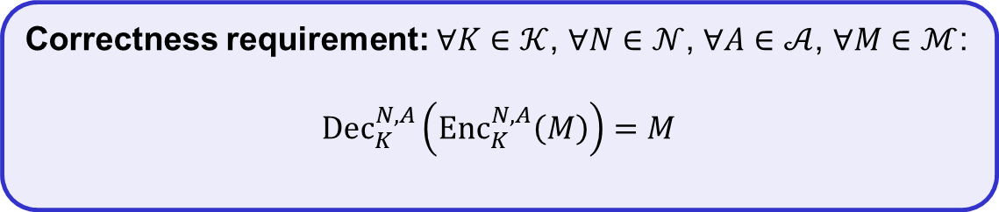

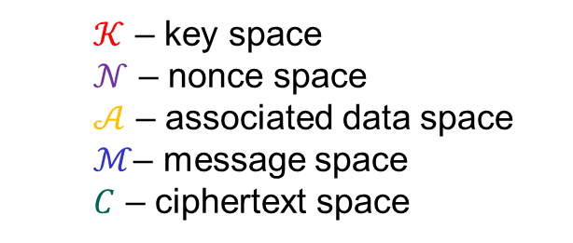
Authenticated encryption w/associated data (AEAD) – syntax
$$Enc :𝒦×𝒩×𝒜×ℳ→𝒞$$
$$Enc\left(K, N, A,M\right)={Enc}_{K}^{N}\left(A,M\right)={Enc}_{K}^{N,A}\left(M\right)=C$$
$$N$$
$$Enc$$
$$A$$
$$M$$
$$C$$
$$Dec :𝒦×𝒩×𝒜×𝒞→ℳ∪\left\{⊥\right\}$$
$$K$$
$$Dec\left(K, N, A,C\right)={Dec}_{K}^{N}\left(A, C\right)={Dec}_{K}^{N,A}\left(C\right)=M/⊥$$
  $𝒦$ – key space
  $𝒩$ – nonce space
  $𝒜$ – associated data space
  $ℳ$– message space
  $C$ – ciphertext space
Correctness requirement: $∀K∈𝒦$, $∀N∈𝒩$, $∀A∈𝒜$, $∀M∈ℳ$:
$${Dec}_{K}^{N,A}\left({Enc}_{K}^{N,A}\left(M\right)\right)=M$$

Slide 38
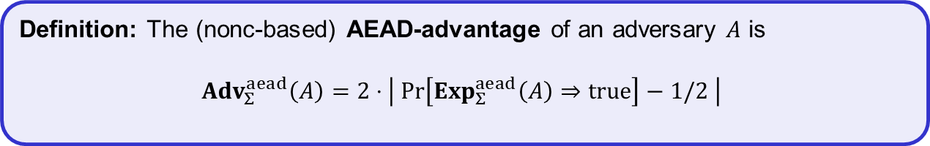
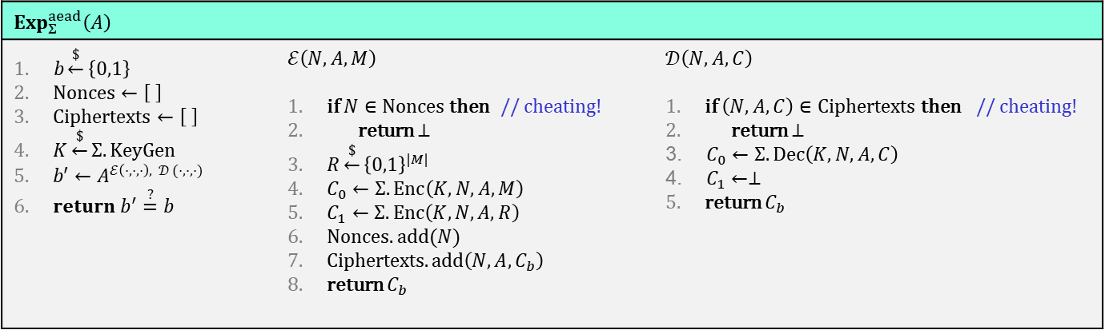
AEAD security (nonce-based)
$$Exp_{Σ}^{aead}\left(A\right)$$
$b\underset{←}{\$}\left\{0,1\right\}$ $Nonces←\left[ \right]$ $Ciphertexts←\left[ \right]$ $K\underset{←}{\$}Σ.KeyGen$ $b′←A^{ℰ\left(⋅,⋅,⋅\right), 𝒟 (⋅,⋅,⋅)}$ $return b^{′}\overset{?}{=}b$ | $$ℰ\left(N, A,M\right)$$ if $N∈Nonces$ then // cheating! return $⊥$ $R\underset{←}{\$}{\left\{0,1\right\}}^{|M|}$ $C_{0}←Σ.Enc\left(K, N, A,M\right)$ $C_{1}←Σ.Enc\left(K, N, A,R\right)$ $Nonces.add(N)$ Ciphertexts$.add\left({N,A,C}_{b}\right)$ return $C_{b}$ | $$𝒟\left(N, A, C\right)$$ if $\left(N,A,C\right)∈Ciphertexts$ then // cheating! return $⊥$ $C_{0}←Σ.Dec\left(K, N, A,C\right)$ $C_{1}←⊥$ return $C_{b}$
Definition: The (nonc-based) AEAD-advantage of an adversary $A$ is
$${Adv}_{Σ}^{aead}\left(A\right)=2⋅\left| \operatorname{Pr}\left[Exp_{Σ}^{aead}\left(A\right)⇒true\right]−1/2 \right|$$

Slide 39
Constructing AEAD schemes

Slide 40


























GCM – Galois/Counter Mode
ctr+1
ctr+2
ctr+3
$${ E}_{K}$$
$${ E}_{K}$$
$${ E}_{K}$$
$${ M}_{1}$$
$${ M}_{2}$$
$${ M}_{3}$$
$${ A}_{1}$$
$${ A}_{2}$$
$${ C}_{1}$$
$${ C}_{2}$$
$${ C}_{3}$$
$$\left|A\right|+\left|C\right|$$
$$⋇$$
$$⋇$$
$$⋇$$
$$⋇$$
$$⋇$$
$$⋇$$
$$H$$
$$H$$
$$H$$
$$H$$
$$H$$
$$H$$
$$S$$
$$T$$

Slide 41







GCM – Galois/Counter Mode
CTR-mode
ctr+1
ctr+2
ctr+3
$$ctr←N||0^{31}1$$
$${ E}_{K}$$
$${ E}_{K}$$
$${ E}_{K}$$
$${ M}_{1}$$
$${ M}_{2}$$
$${ M}_{3}$$
$${ A}_{1}$$
$${ A}_{2}$$
$${ C}_{1}$$
$${ C}_{2}$$
$${ C}_{3}$$
$$\left|A\right|+\left|C\right|$$
$$⋇$$
$$⋇$$
$$⋇$$
$$⋇$$
$$⋇$$
$$⋇$$
$$H$$
$$H$$
$$H$$
$$H$$
$$H$$
$$H$$
$$S$$
$$T$$

Slide 42













GCM – Galois/Counter Mode
ctr+1
ctr+2
ctr+3
$H←E_{K}\left(0^{128}\right)$
$${ E}_{K}$$
$${ E}_{K}$$
$${ E}_{K}$$
$$S←E_{K}(N||0^{31}1)$$
$${ M}_{1}$$
$${ M}_{2}$$
$${ M}_{3}$$
GMAC
$${ A}_{1}$$
$${ A}_{2}$$
$${ C}_{1}$$
$${ C}_{2}$$
$${ C}_{3}$$
$$\left|A\right|+\left|C\right|$$
$$⋇$$
$$⋇$$
$$⋇$$
$$⋇$$
$$⋇$$
$$⋇$$
$$H$$
$$H$$
$$H$$
$$H$$
$$H$$
$$H$$
$$A_{1}H$$
$$A_{1}H^{2}+A_{2}H$$
$$A_{1}H^{3}+A_{2}H^{2}+C_{1}H$$
$$S$$
$$A_{1}H^{4}+A_{2}H^{3}+C_{1}H^{2}+C_{2}H$$
$$A_{1}H^{6}+A_{2}H^{5}+C_{1}H^{4}+C_{2}H^{3}+C_{3}H^{2}+LH+S=$$
$$T$$
$$A_{1}H^{5}+A_{2}H^{4}+C_{1}H^{3}+C_{2}H^{2}+C_{3}H$$

Slide 43

GCM – Galois/Counter Mode
ctr+1
ctr+2
ctr+3
$$ctr←N||0^{31}1$$
$H←E_{K}\left(0^{128}\right)$
$${ E}_{K}$$
$${ E}_{K}$$
$${ E}_{K}$$
$$S←E_{K}(N||0^{31}1)$$
$${ M}_{1}$$
$${ M}_{2}$$
$${ M}_{3}$$
$${ A}_{1}$$
$${ A}_{2}$$
$${ C}_{1}$$
$${ C}_{2}$$
$${ C}_{3}$$
$$\left|A\right|+\left|C\right|$$
$$⋇$$
$$⋇$$
$$⋇$$
$$⋇$$
$$⋇$$
$$⋇$$
$$H$$
$$H$$
$$H$$
$$H$$
$$H$$
$$H$$
$$S$$
$$T$$

Slide 44



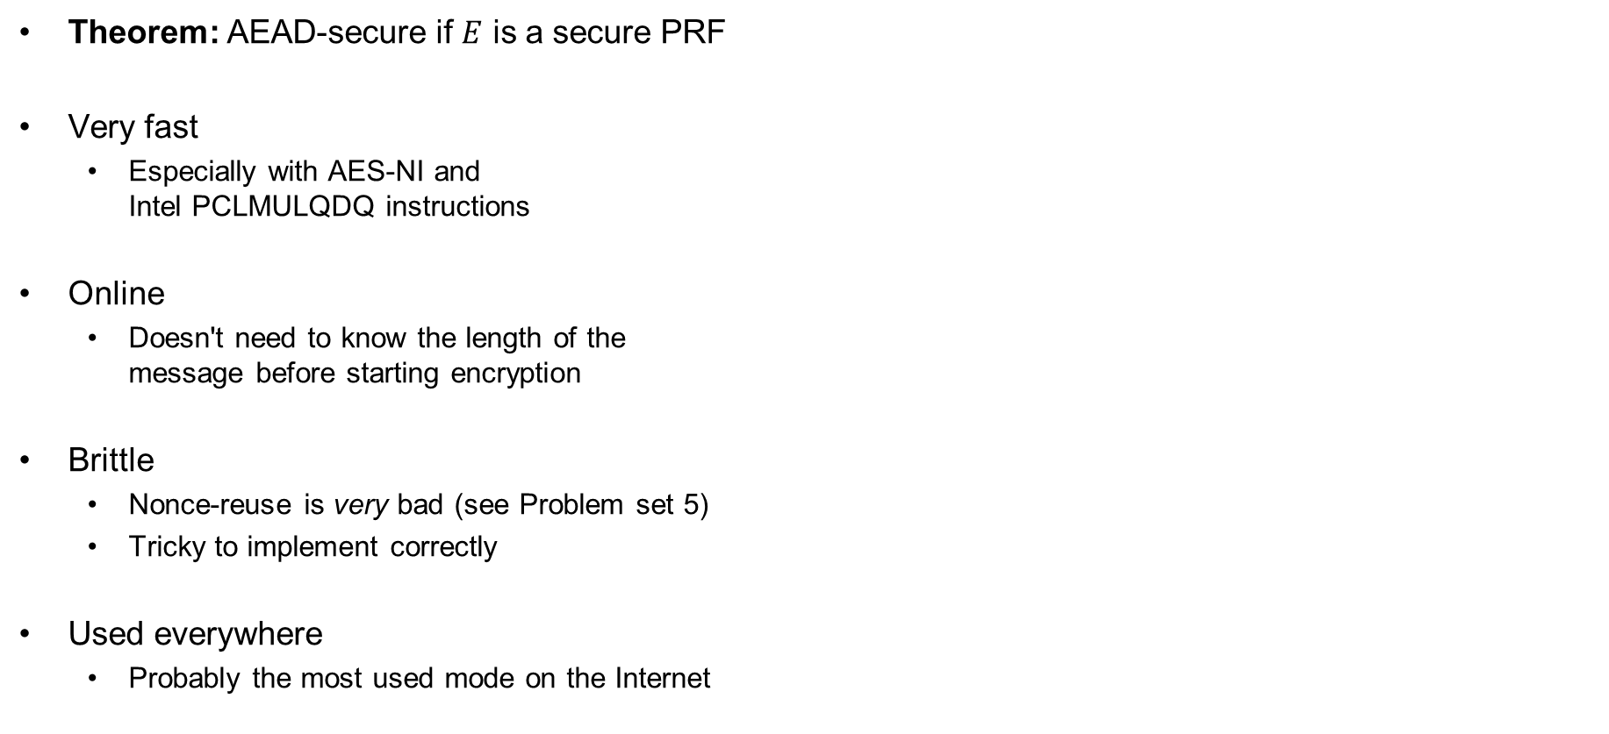


GCM – properties
Theorem: AEAD-secure if $E$ is a secure PRF
Very fast
  Especially with AES-NI and
  Intel PCLMULQDQ instructions
Online
  Doesn't need to know the length of the
  message before starting encryption
Brittle
  Nonce-reuse is very bad (see Problem set 5)
  Tricky to implement correctly
Used everywhere
  Probably the most used mode on the Internet
$ctr←N||0^{31}1$
$H←E_{K}\left(0^{128}\right)$
$$S←E_{K}(N||0^{31}1)$$
ctr+1
ctr+2
ctr+3
$${ E}_{K}$$
$${ E}_{K}$$
$${ E}_{K}$$
$${ M}_{1}$$
$${ M}_{2}$$
$${ M}_{3}$$
$${ A}_{1}$$
$${ A}_{2}$$
$${ C}_{1}$$
$${ C}_{2}$$
$${ C}_{3}$$
$$\left|A\right|+\left|C\right|$$
$$⋇$$
$$⋇$$
$$⋇$$
$$⋇$$
$$⋇$$
$$⋇$$
$$H$$
$$H$$
$$H$$
$$H$$
$$H$$
$$H$$
$$S$$
$$T$$

Slide 45

Ideal solution: secure channels
Internet
How to build?
Alice
Bob
M
Adversary
Security goals:
Data privacy: adversary should not be able to read message M ✓
Data integrity: adversary should not be able to modify message M ✓
Data authenticity: message M really originated from Alice ✓

Slide 46
Ideal solution: secure channels
AES-GCM?
Internet
Alice
Bob
M
Adversary
Security goals:
Data privacy: adversary should not be able to read message M ✓
Data integrity: adversary should not be able to modify message M ✓
Data authenticity: message M really originated from Alice ✓

Slide 47



AES-GCM = secure channel?
"Send Bob $10"
AES-GCM
AES-GCM
+10
AES-GCM
+10
AES-GCM
+10

Slide 48



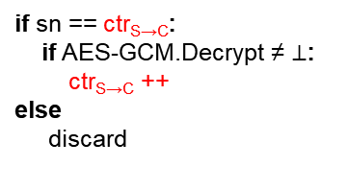
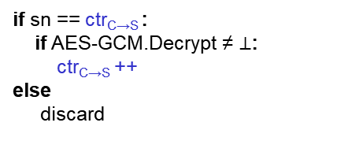
Secure channels – TLS / IPsec
increment
ctr_{C→S} = 103
ctr_{S→C} = 395
AD
ctr_{C→S} = 103
ctr_{S→C} = 395
104
105
104
AES-GCM
105
396
398
397
398
396
397
398
sn = 103
data
if sn == ctr_{S→C}:
if AES-GCM.Decrypt ≠ $⊥$:
ctr_{S→C} ++
else
discard
sn = 395
data
if sn == ctr_{C→S} :
if AES-GCM.Decrypt ≠ $⊥$:
ctr_{C→S} ++
else
discard
increment
sn = 396
data
sn = 397
data
sn = 104
data
sn = 103
data
103 < ctr_{C→S}
Notes:
Why can't the attacker just change sn to 105? Because of AES-GCM!

Slide 49


























OCBv3 – Offset Codebook Mode
$${ A}_{1}$$
$${ A}_{2}$$
$${ M}_{1}$$
$${ M}_{2}$$
$${ M}_{3}$$
$$M_{1}⊕M_{2}⊕M_{3}$$
$$Δ_{1}$$
$$Δ_{2}$$
$$Δ_{3}$$
$$Δ_{4}$$
$$Δ_{5}$$
$$Δ_{6}$$
$${ E}_{K}$$
$${ E}_{K}$$
$${ E}_{K}$$
$${ E}_{K}$$
$${ E}_{K}$$
$${ E}_{K}$$
$$Δ_{3}$$
$$Δ_{4}$$
$$Δ_{5}$$
Auth
Auth
$${ C}_{1}$$
$${ C}_{2}$$
$${ C}_{3}$$
$$T$$
$Δ_{i}$ - derived from 96-bit nonce $N$

Slide 50
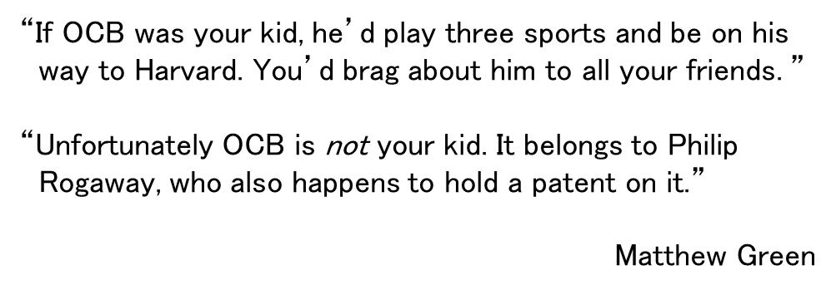
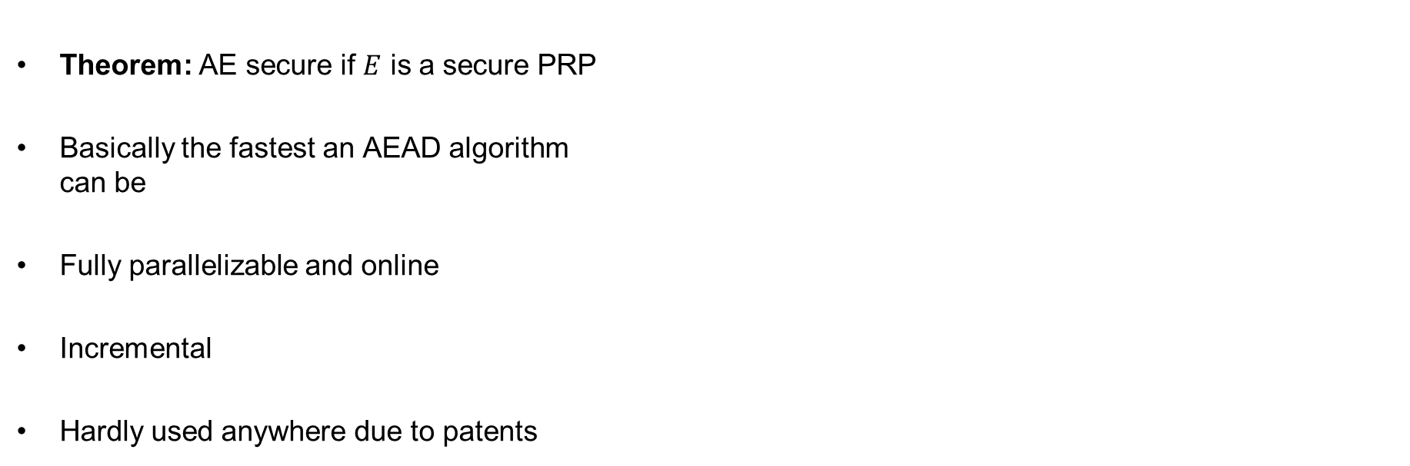


OCBv3 – properties
Theorem: AE secure if $E$ is a secure PRP
Basically the fastest an AEAD algorithm
can be
Fully parallelizable and online
Incremental
Hardly used anywhere due to patents
“If OCB was your kid, he’d play three sports and be on his
way to Harvard. You’d brag about him to all your friends. ”
“Unfortunately OCB is not your kid. It belongs to Philip
Rogaway, who also happens to hold a patent on it.”
Matthew Green
$${ A}_{1}$$
$${ A}_{2}$$
$${ M}_{1}$$
$${ M}_{2}$$
$${ M}_{3}$$
$$M_{1}⊕M_{2}⊕M_{3}$$
$$Δ_{1}$$
$$Δ_{2}$$
$$Δ_{3}$$
$$Δ_{4}$$
$$Δ_{5}$$
$$Δ_{6}$$
$${ E}_{K}$$
$${ E}_{K}$$
$${ E}_{K}$$
$${ E}_{K}$$
$${ E}_{K}$$
$${ E}_{K}$$
$$Δ_{3}$$
$$Δ_{4}$$
$$Δ_{5}$$
Auth
Auth
$${ C}_{1}$$
$${ C}_{2}$$
$${ C}_{3}$$
$$T$$

Slide 51














CCM – Counter Mode with CBC-MAC
$${ E}_{K}$$
$${ E}_{K}$$
$${ E}_{K}$$
$${ E}_{K}$$
$${ E}_{K}$$
$$T$$
$$IV$$
$${ A}_{1}$$
$${ M}_{1}$$
$${ M}_{2}$$
$${ M}_{3}$$
ctr+1
$${ E}_{K}$$
ctr+2
$${ E}_{K}$$
ctr+3
$${ E}_{K}$$
ctr
$${ E}_{K}$$
$${ C}_{1}$$
$${ C}_{2}$$
$${ C}_{3}$$
$${ C}_{T}$$

Slide 52








CCM – Counter Mode with CBC-MAC
$${ E}_{K}$$
$${ E}_{K}$$
$${ E}_{K}$$
$${ E}_{K}$$
$${ E}_{K}$$
$$T$$
CTR-mode
$$IV$$
$${ A}_{1}$$
$${ M}_{1}$$
$${ M}_{2}$$
$${ M}_{3}$$
ctr+1
$${ E}_{K}$$
ctr+2
$${ E}_{K}$$
ctr+3
$${ E}_{K}$$
ctr
$${ E}_{K}$$
$${ C}_{1}$$
$${ C}_{2}$$
$${ C}_{3}$$
$${ C}_{T}$$
ctr $←F_{1}||N|| 0^{16}$

Slide 53




CCM – Counter Mode with CBC-MAC
CBC-MAC
$${ E}_{K}$$
$${ E}_{K}$$
$${ E}_{K}$$
$${ E}_{K}$$
$${ E}_{K}$$
$$T$$
$$IV$$
$${ A}_{1}$$
$${ M}_{1}$$
$${ M}_{2}$$
$${ M}_{3}$$
ctr+1
$${ E}_{K}$$
ctr+2
$${ E}_{K}$$
ctr+3
$${ E}_{K}$$
ctr
$${ E}_{K}$$
$${ C}_{1}$$
$${ C}_{2}$$
$${ C}_{3}$$
$${ C}_{T}$$

Slide 54


CCM – Counter Mode with CBC-MAC
CBC-MAC
$\left|A+M\right|$-
$${ E}_{K}$$
$${ E}_{K}$$
$${ E}_{K}$$
$${ E}_{K}$$
$${ E}_{K}$$
$$T$$
$$IV$$
$${ A}_{1}$$
$${ M}_{1}$$
$${ M}_{2}$$
$${ M}_{3}$$
ctr+1
$${ E}_{K}$$
ctr+2
$${ E}_{K}$$
ctr+3
$${ E}_{K}$$
ctr
$${ E}_{K}$$
$${ C}_{1}$$
$${ C}_{2}$$
$${ C}_{3}$$
$${ C}_{T}$$
$$IV←F_{2}||N|| {len}_{16}\left(AD+M\right)$$

Slide 55

CCM – Counter Mode with CBC-MAC
≈ ECBC-MAC
$${ E}_{K}$$
$${ E}_{K}$$
$${ E}_{K}$$
$${ E}_{K}$$
$${ E}_{K}$$
$$T$$
$$IV$$
$${ A}_{1}$$
$${ M}_{1}$$
$${ M}_{2}$$
$${ M}_{3}$$
ctr+1
$${ E}_{K}$$
ctr+2
$${ E}_{K}$$
ctr+3
$${ E}_{K}$$
ctr
$${ E}_{K}$$
$${ C}_{1}$$
$${ C}_{2}$$
$${ C}_{3}$$
$${ C}_{T}$$
$$IV←F_{2}||N|| {len}_{16}\left(AD+M\right)$$

Slide 56
CCM – Counter Mode with CBC-MAC
$${ E}_{K}$$
$${ E}_{K}$$
$${ E}_{K}$$
$${ E}_{K}$$
$${ E}_{K}$$
$$T$$
$$IV$$
$${ A}_{1}$$
$${ M}_{1}$$
$${ M}_{2}$$
$${ M}_{3}$$
ctr+1
$${ E}_{K}$$
ctr+2
$${ E}_{K}$$
ctr+3
$${ E}_{K}$$
ctr
$${ E}_{K}$$
$${ C}_{1}$$
$${ C}_{2}$$
$${ C}_{3}$$
$${ C}_{T}$$
ctr $←F_{1}||N|| 0^{16}$
$$IV←F_{2}||N|| {len}_{16}\left(AD+M\right)$$

Slide 57

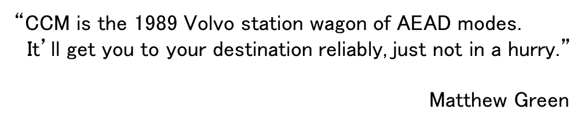
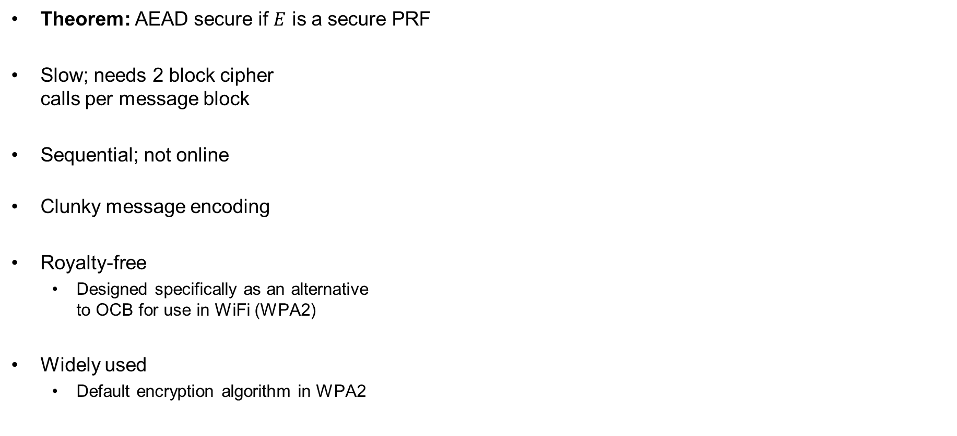





CCM – properties
Theorem: AEAD secure if $E$ is a secure PRF
Slow; needs 2 block cipher
calls per message block
Sequential; not online
Clunky message encoding
Royalty-free
  Designed specifically as an alternative
  to OCB for use in WiFi (WPA2)
Widely used
  Default encryption algorithm in WPA2
“CCM is the 1989 Volvo station wagon of AEAD modes.
It’ll get you to your destination reliably, just not in a hurry.”
Matthew Green
$${ E}_{K}$$
$${ E}_{K}$$
$${ E}_{K}$$
$${ E}_{K}$$
$${ E}_{K}$$
$$T$$
$$IV$$
$${ A}_{1}$$
$${ M}_{1}$$
$${ M}_{2}$$
$${ M}_{3}$$
ctr+1
$${ E}_{K}$$
ctr+2
$${ E}_{K}$$
ctr+3
$${ E}_{K}$$
ctr
$${ E}_{K}$$
$$ctr←F_{1}||N|| 0^{16}$$
$${ C}_{1}$$
$${ C}_{2}$$
$${ C}_{3}$$
$${ C}_{T}$$
$$IV←F_{2}||N|| {len}_{16}\left(AD+M\right)$$

Slide 58
Summary
Authenticated encryption: privacy + intergrity in one primitive
AEAD: AE + associated data: data that gets integrity protection, but not privacy protection
(e.g. protocol headers)
AEAD examples:
  GCM
  CCM
  OCB
AEAD is not a secure channel!
  Does not provide replay protection
  Secure channels from AEAD: add counters/nonces/timers
Next week: hash functions

