Slide 1
Lecture 7 – Randomness, entropy,
TRNG/PRNGs, stream ciphers
TEK4500
9.10.2024
Håkon Jacobsen
hakon.jacobsen@its.uio.no

Slide 2
Midterm exam
Available on Canvas today (Wednesday, October 9)
Due: two weeks later (Thursday, October 24, 23:59)
Take-home exam
Individual: collaboration is not allowed
Mandatory: need to pass in order to be eligible for the exam
All sources allowed (save for explicitly searching for the solution)
Submission: Canvas (file type = PDF; strongly prefer if you use provided LaTex template)
Start early! The assignment may be more challenging than you expect

Slide 3
Outline
How to generate (lots) of randomness?
PRNGs
  Stream ciphers
Randomness – what is it?
  Entropy
TRNGs
Key derivation

Slide 4



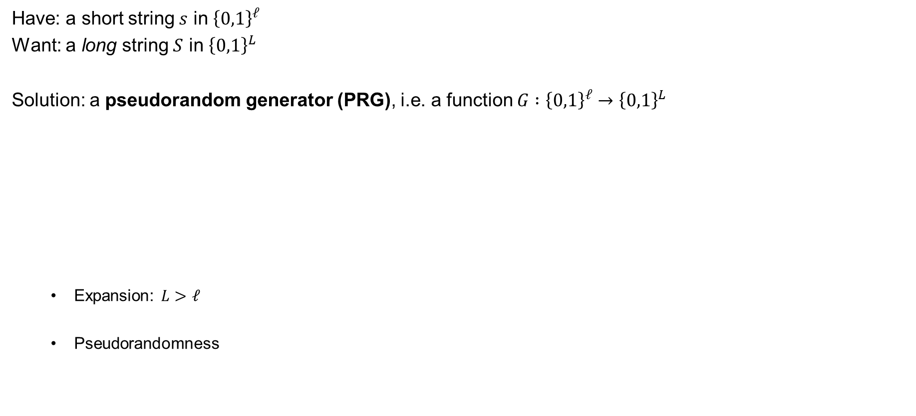
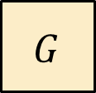

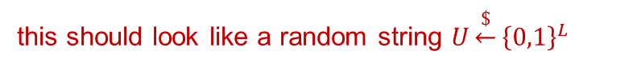
Pseudorandom generators (PRG) – syntax
Have: a short string $s$ in ${\left\{0,1\right\}}^{ℓ}$
Want: a long string $S$ in ${\left\{0,1\right\}}^{L}$
Solution: a pseudorandom generator (PRG), i.e. a function $G :{\left\{0,1\right\}}^{ℓ}→{\left\{0,1\right\}}^{L}$
  Expansion: $L>ℓ$
  Pseudorandomness
(uniform and independently distributed)
(uniform and independently distributed)
$$ℓ$$
$$L$$
$$G$$
$$s$$
$$G\left(s\right)$$
this should look like a random string $U\underset{←}{\$}{\left\{0,1\right\}}^{L}$
$$≫$$

Slide 5

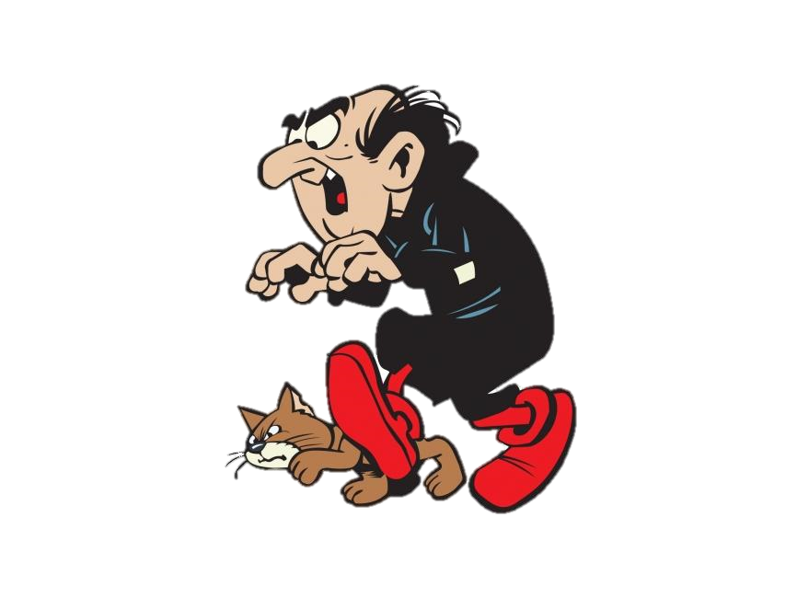
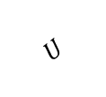
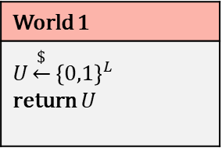
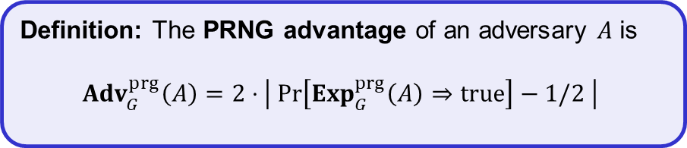
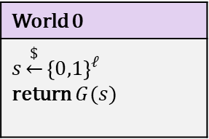
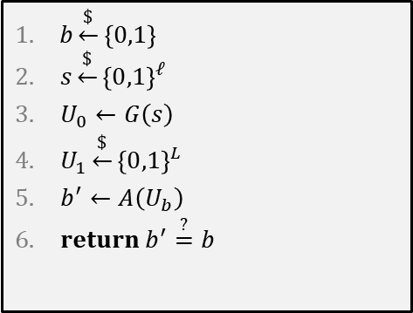
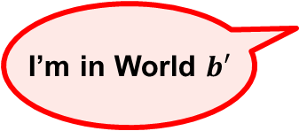
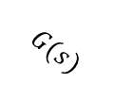

PRNG – security definition
$$Exp_{G}^{prg}\left(A\right)$$
World 0
$$s\underset{←}{\$}{\left\{0,1\right\}}^{ℓ}$$ return $G(s)$
World 1
$$U\underset{←}{\$}{\left\{0,1\right\}}^{L}$$ return $U$
$b\underset{←}{\$}\left\{0,1\right\}$
$s\underset{←}{\$}{\left\{0,1\right\}}^{ℓ}$
$U_{0}←G\left(s\right)$
$U_{1}\underset{←}{\$}{\left\{0,1\right\}}^{L}$
$b^{′}←A\left(U_{b}\right)$
$return b^{′}\overset{?}{=}b$
$$G(s)$$
$$U$$
I’m in World $b′$
Definition: The PRNG advantage of an adversary $A$ is
$${Adv}_{G}^{prg}\left(A\right)=2⋅\left|\operatorname{Pr}\left[Exp_{G}^{prg}\left(A\right)⇒true\right]−1/2 \right|$$

Slide 6






Pseudorandomness
$$G(s)$$
PRNG sec.
$${\left\{0,1\right\}}^{ℓ}$$
$$≈$$
$${\left\{0,1\right\}}^{L}$$
$${\left\{0,1\right\}}^{L}$$

Slide 7










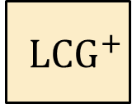
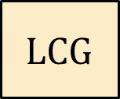

Linear Congruential Generator
$a$, $b$, $M$ are public
$$aX_{2}+b$$
$$aX_{1}+b$$
$$X_{n}←aX_{n−1}+b \left(\operatorname{mod}{M}\right)$$
$$aX_{0}+b$$
Completely insecure!
$$LCG$$
$$X_{0}$$
$$X_{1} X_{2} X_{3} ⋯ X_{ℓ}$$
(Learning $X_{1}$ reveals all other $X_{2}$, $X_{3}$, $…$ )
$${ LCG}^{+}$$
$$X_{0}$$
$$Y_{1} Y_{2} Y_{3} ⋯ Y_{ℓ}$$
Still completely insecure!
$$Y_{i}←top 32 bits of X_{i}$$
(Learning a few $Y_{i}$ reveals all other $Y_{j}$ )

Slide 8








Creating PRNGs – CTR-mode
pick randomly
ctr
ctr+1
ctr+2
ctr+3
ctr+4
ctr+5
$${ E}_{K}$$
$${ E}_{K}$$
$${ E}_{K}$$
$${ E}_{K}$$
$${ E}_{K}$$
$$⋯$$
keystream
$$M$$
=
$$C_{0}$$
$$C$$

Slide 9




Stream ciphers
Security requirement: For all $N$ the function $G^{N}(⋅)$ is a secure PRG
$$N$$
not IND-CPA secure!
$$G$$
$$s$$
$$S$$
$$M$$
=
$$C$$
$$Enc :𝒦×𝒩×ℳ→𝒞$$
$$Enc_{K}^{N}\left(M\right)=N || G^{N}\left(K\right)⊕M$$
Stream cipher

Slide 10




Stream ciphers – CTR-mode
Stream cipher
PRNG
Nonce
Seed / key
ctr
ctr+1
ctr+2
ctr+3
ctr+4
ctr+5
$${ E}_{K}$$
$${ E}_{K}$$
$${ E}_{K}$$
$${ E}_{K}$$
$${ E}_{K}$$
$$⋯$$
keystream
$$M$$
=
$$C_{0}$$
$$C$$

Slide 11

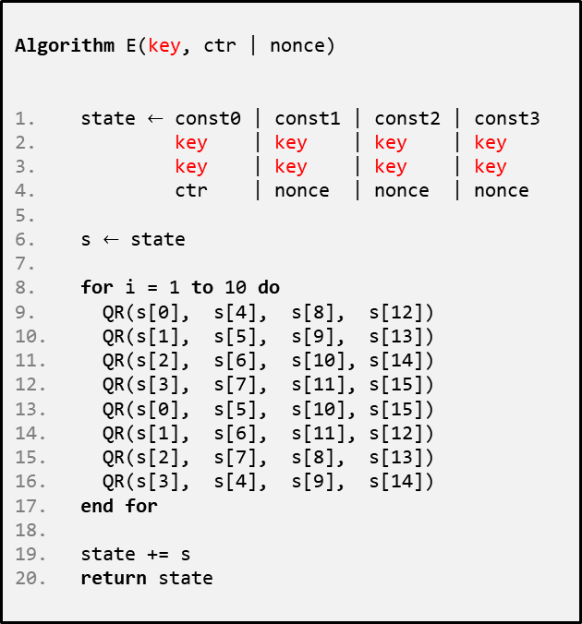


ChaCha20
$$E :{\left\{0,1\right\}}^{256}×{\left\{0,1\right\}}^{128}→{\left\{0,1\right\}}^{512}$$
Algorithm E(key, ctr | nonce)
state $←$ const0 | const1 | const2 | const3
$←$ key | key | key | key
$←$ key | key | key | key
$←$ ctr | nonce | nonce | nonce
s $←$ state
for i = 1 to 10 do
QR(s[0], s[4], s[8], s[12])
QR(s[1], s[5], s[9], s[13])
QR(s[2], s[6], s[10], s[14])
QR(s[3], s[7], s[11], s[15])
QR(s[0], s[5], s[10], s[15])
QR(s[1], s[6], s[11], s[12])
QR(s[2], s[7], s[8], s[13])
QR(s[3], s[4], s[9], s[14])
end for
state += s
return state
Algorithm QR(a, b, c , d)
a += b; d ^= a; d <<<= 16;
c += d; b ^= c; b <<<= 12;
a += b; d ^= a; d <<<= 8;
c += d; b ^= c; b <<<= 7;
ChaCha20:
1|nonce
2|nonce
3|nonce
4|nonce
$${ E}_{K}$$
$${ E}_{K}$$
$${ E}_{K}$$
$${ E}_{K}$$
$$⋯$$
keystream
0
1
2
3
s =
4
5
6
7
8
9
10
11
12
13
14
15

Slide 12
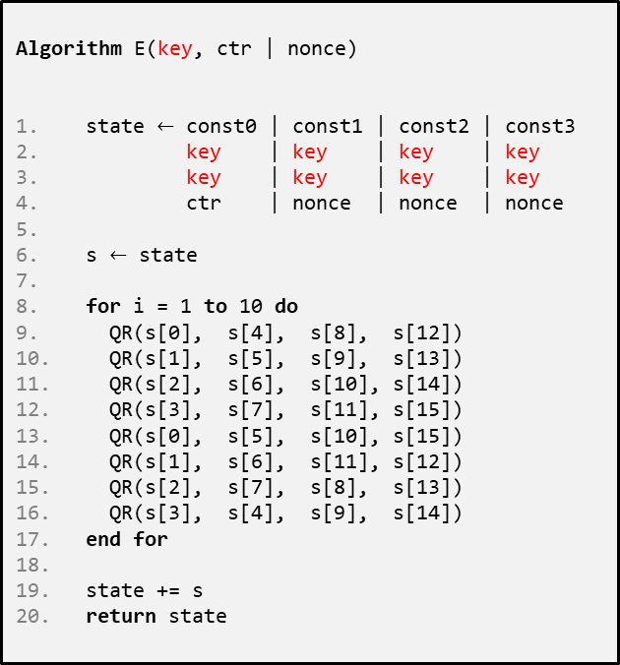
ChaCha20
Extremely simple
  only ARX operations (add-rotate-xor)
Very fast in SW
  no HW support required
  faster than AES(-CTR) without AES-NI instructions
Constant time – no tables
No key-setup, no subkeys
Often combined with the MAC Poly1305 to create an AEAD
Designed by Daniel J. Bernstein
Algorithm E(key, ctr | nonce)
state $←$ const0 | const1 | const2 | const3
$←$ key | key | key | key
$←$ key | key | key | key
$←$ ctr | nonce | nonce | nonce
s $←$ state
for i = 1 to 10 do
QR(s[0], s[4], s[8], s[12])
QR(s[1], s[5], s[9], s[13])
QR(s[2], s[6], s[10], s[14])
QR(s[3], s[7], s[11], s[15])
QR(s[0], s[5], s[10], s[15])
QR(s[1], s[6], s[11], s[12])
QR(s[2], s[7], s[8], s[13])
QR(s[3], s[4], s[9], s[14])
end for
state += s
return state

Slide 13

Randomness

Slide 14
Statistical tests
What does that even mean?
Suggestions:
  A random string should have roughly 50% zeros and ones (how much can you deviate?)
  A continuous run of zeros (or ones) shouldn't be too long (how long?)
  ≈ 25% of 2-bit substrings should be 00, 25% should be 01, …
  ≈ 12.5% of 3-bit substrings should be 000, 12.5% should be 001, ….
  A random string should not be compressible (related to Kolmogorov-complexity)
  …
Is this a random string?
10101001110101100010010001111100001010100000000101001111111001110111101
00000000000000000000000000000000001111111111111111111111111111111111111111
What about this?
Our answer: question not valid!

Slide 15
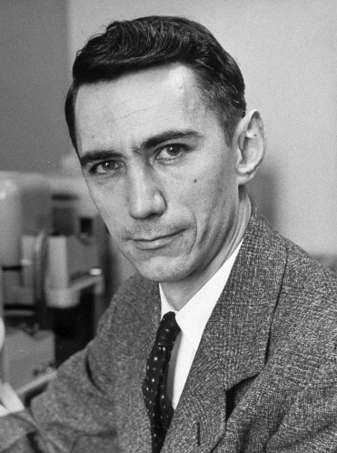


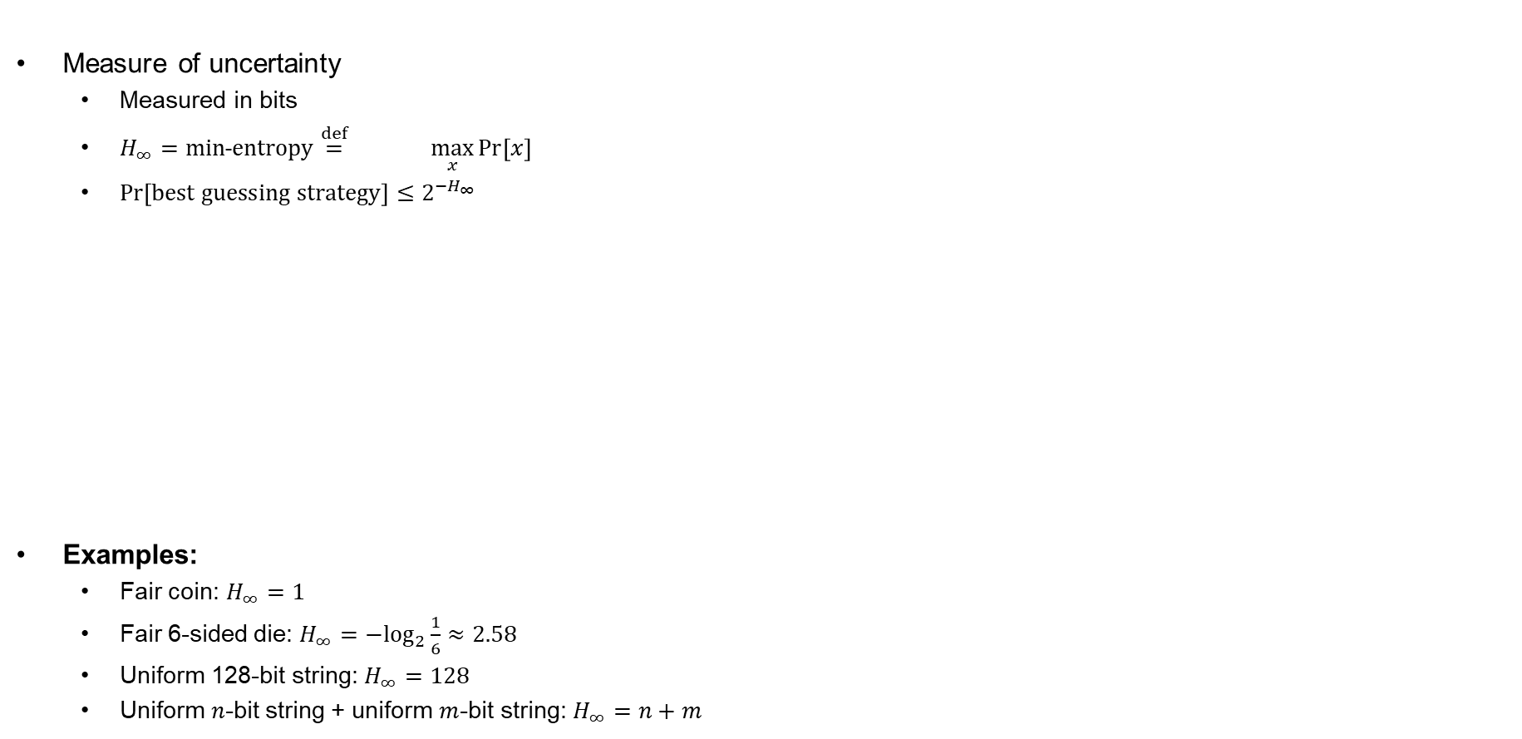



Entropy
Measure of uncertainty
  Measured in bits
  $H_{∞}=min˗entropy\overset{def}{=} \max_{x}{\operatorname{Pr}\left[x\right]}$
  $\operatorname{Pr}\left[best guessing strategy\right]≤2^{−H_{∞}}$
Examples:
  Fair coin: $H_{∞}=1$
  Fair 6-sided die: $H_{∞}={−log}_{2}{\frac{1}{6}}≈2.58$
  Uniform 128-bit string: $H_{∞}=128$
  Uniform $n$-bit string + uniform $m$-bit string: $H_{∞}=n+m$
$$\log_{2}\left(\max_{x}{\operatorname{Pr}{[x]}}\right)$$
$$−$$
$$H_{∞}=−\log_{2}{\frac{1}{4}=2}$$
$$H_{∞}=−\log_{2}{\frac{1}{2}=1}$$
$$H_{∞}=−\log_{2}{1=0}$$
Claude Shannon

Slide 16
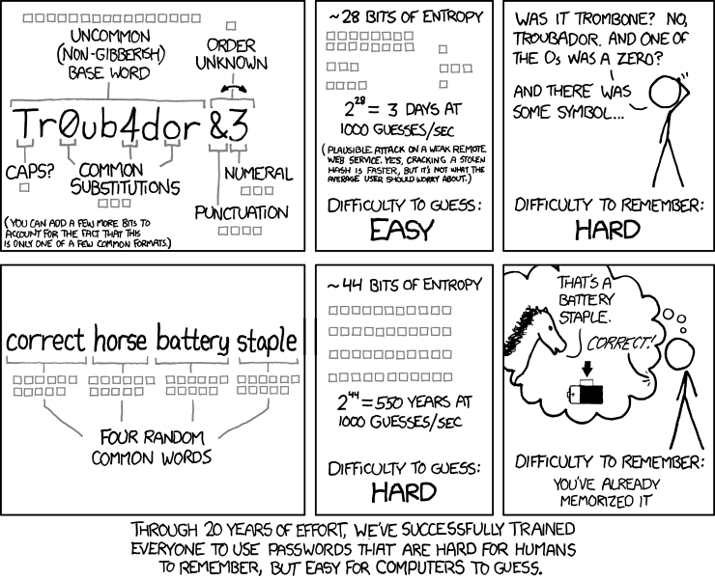
Password strength
https://xkcd.com/936
Notes:
Uncommon word list of size 65000 = 16 bits
0,a,o transformations $≈$ 3-4 bits
Capitalize or not = 1 bit
Unknown order of trailing number odd special character = 1 bit
Number $≈$ 3 bits
Special character = 3 bits
Unknown punctuation $≈$ 4 bits
Total = 16 + 3 + 1 +1 + 3 + 4 = 28 bits
Four random words from words list of size 2048 (11 bits) = 11 + 11 + 11 + 11 = 44 bits

Slide 17
High entropy = good keys?
Have a (long) string X with 128 bits of min-entropy
Want 128 bits for AES key Y. How to choose?
X
10011011 11101111 10101100 01100100 11101000 11111000 10100111 00110001 11000111 01001110 11011000 10101010 01001001 00001001 10100011 01000010 01011001 10011001 01100000 01101001 11001000 00111101 01011111 11000101 00001000 00010001 11010011 10010010 11000100 00000111 11000001 11011010 01100110 11000110 11011011 00101100 01100110 11100101 01100000 00100001 10000010 11110011 01111111 11000110 10110110 10101001 01011100 11001101 00111101 01110011 01000010 11010001 11111110 00110011 11010110 01110100 00010100 01101011 00000101 01101011 01101000 11000110 10110010 10010000 11010111 01011000 11111101 00011001 01100110 01011001 01011110 10100000 00110010 01100010 00001011 00011011 10100000 10001001 11010100 10100010 01100011 00001110 11110011 01010111 01111101 00010101 00010000 00110000 01111000 11111100 11100001 01111110 00100111 11110010 01101111 10000001 11100111 01001110 00011000 01010000 10110011 00111010 10000110 10101010 00110010 00100111 10101111 01010110 10101110 11101111 10110010 00101110 11011011 10000100 10001011 11111001 01110001 10111110 01000000 11001111 10010111 01100001 01101101 11100101 11011111 01000010 00111111 11000100
Y

Slide 18
High entropy = good keys?
Have a (long) string X with 128 bits of min-entropy
Want 128 bits for AES key Y. How to choose?
Bits of X may be biased and dependent
Want to "concentrate" the entropy in X into a string Y of only 128 bits
Bits of Y should be non-biased and independent
X
00000000 00000000 00000000 00000000
00000000 00000000 00000000 00000000
00000000 00000000 00000000 00000000
00000000 00000000 00000000 00000000
01011001 10011001 01100000 01101001 11001000 00111101 01011111 11000101 00001000 00010001 11010011 10010010 11000100 00000111 11000001 11011010 01100110 11000110 11011011 00101100 01100110 11100101 01100000 00100001 10000010 11110011 01111111 11000110 10110110 10101001 01011100 11001101 00111101 01110011 01000010 11010001 11111110 00110011 11010110 01110100 00010100 01101011 00000101 01101011 01101000 11000110 10110010 10010000 11010111 01011000 11111101 00011001 01100110 01011001 01011110 10100000 00110010 01100010 00001011 00011011 10100000 10001001 11010100 10100010 01100011 00001110 11110011 01010111 01111101 00010101 00010000 00110000 01111000 11111100 11100001 01111110 00100111 11110010 01101111 10000001 11100111 01001110 00011000 01010000 10110011 00111010 10000110 10101010 00110010 00100111 10101111 01010110 10101110 11101111 10110010 00101110 11011011 10000100 10001011 11111001 01110001 10111110 01000000 11001111 10010111 01100001 01101101 11100101 11011111 01000010 00111111 11000100
Y

Slide 19
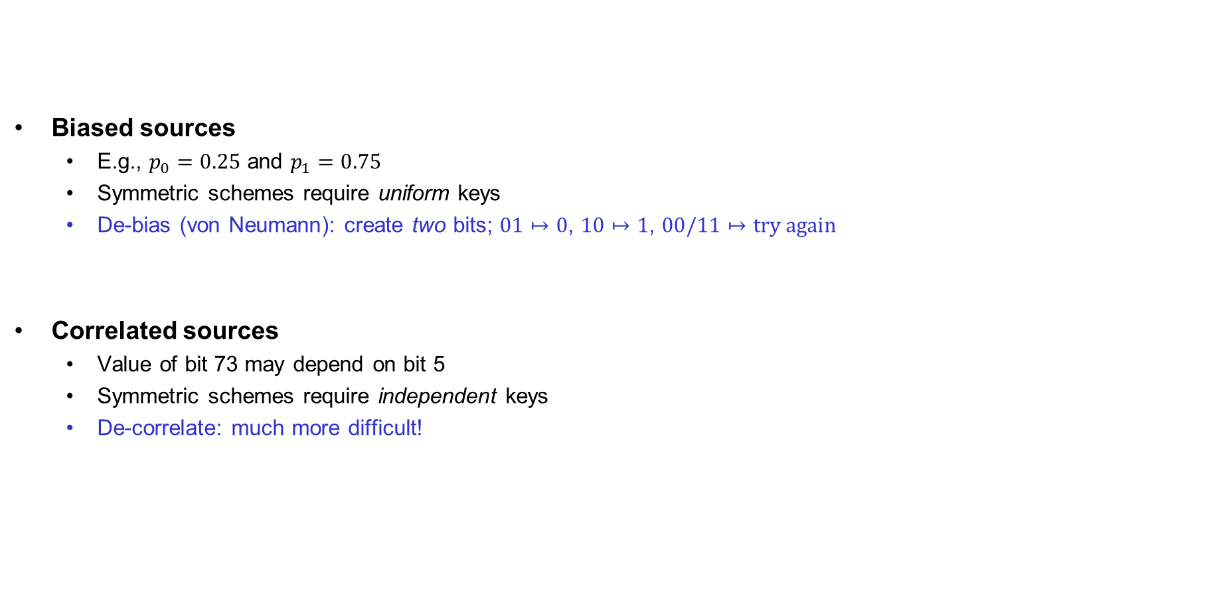
Problems with TRNGs
…and slow!
Biased sources
  E.g., $p_{0}=0.25$ and $p_{1}=0.75$
  Symmetric schemes require uniform keys
  De-bias (von Neumann): create two bits; $01↦0$, $10↦1$, $00/11↦try again$
Correlated sources
  Value of bit 73 may depend on bit 5
  Symmetric schemes require independent keys
  De-correlate: much more difficult!
(in practice: hash with SHA2-256)
(in practice: hash with SHA2-256)

Slide 20
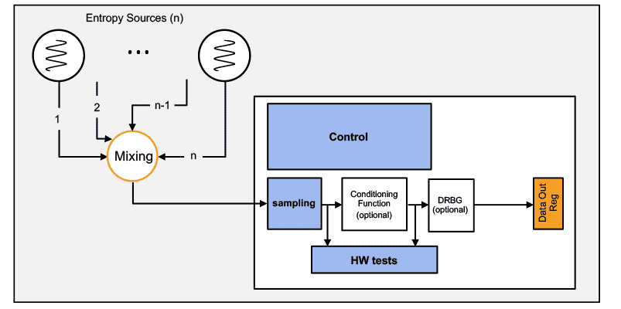
Random generators
Common design:
  TRNG generates random bits with high entropy
  Short uniform seed extracted from random bits
  PRNG expands seed to “infinite” length
Examples:
  /dev/urandom
  CryptGenRandom
  Intel RDRAND
Debian OpenSSL RNG bug
  // MD_Update(&m,buf,j);
  Only 32,767 possibilities for seed ≈ 15 bits of entropy

Slide 21
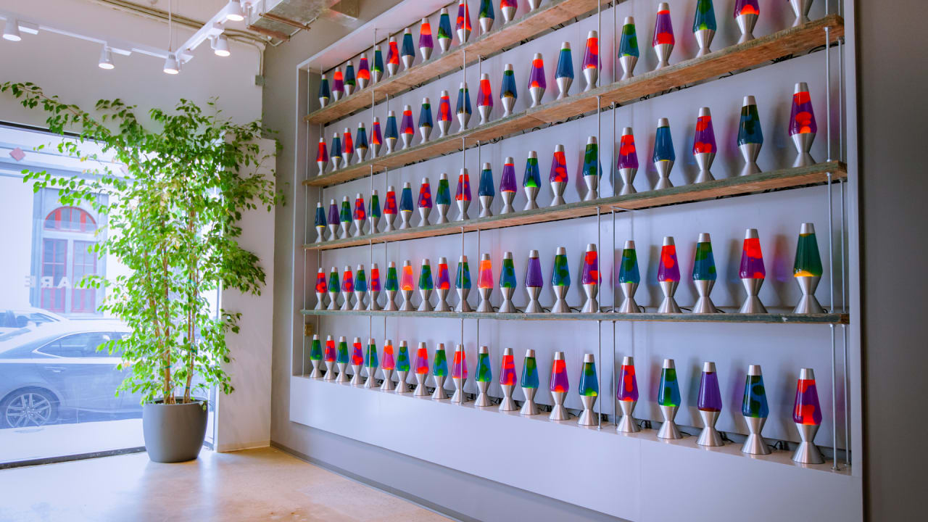
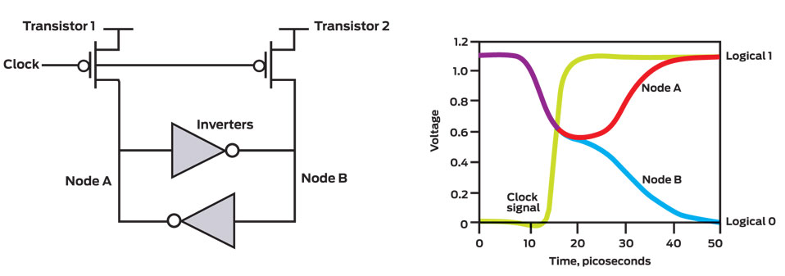
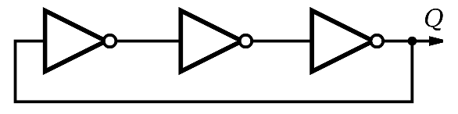
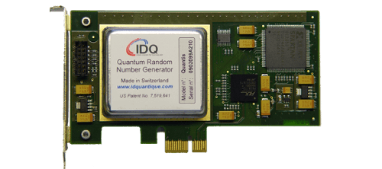

TRNG
Thermal noise
Entropy sources
https://www.cloudflare.com/learning/ssl/lava-lamp-encryption/
Ring oscillators
Quantum magic
(radioactive decay, quantum tunneling, etc…)

Slide 22

Ring-oscillators
Shot noise
Thermal agitation
Clock
sample
sample
sample

Slide 23
Ring-oscillators
Clock
sample
sample
sample

Slide 24
Key derivation functions (KDF)
Applications typically need many keys
  Traffic encryption keys (send + receive)
  Traffic MAC keys (send + receive)
  Data storage keys
  …
KDF: transform a source of keying material into one or more pseudorandom keys
Common paradigm: extract-then-expand
  Extract: compress high-entropy input key material into short uniform key with high entropy
  Expand: expand short key into many using a PRNG

Slide 25

















Recap: HMAC
$$K_{1}$$
$$M_{1}$$
$$M_{2}$$
$$M_{t}||pad$$
$$h$$
$$h$$
$$h$$
$$⋯$$
$$h$$
$$IV$$
$$T′$$
$$K_{2}$$
$$T^{′}||pad$$
$$h$$
$$h$$
$$IV$$
$$T$$
$${HMAC}_{K}\left(M\right)=H\left( K⊕opad || H\left(K⊕ipad || M\right)\right)$$

Slide 26
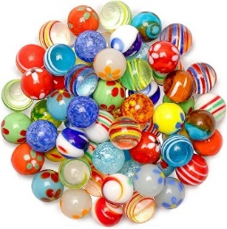



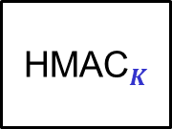








HKDF – HMAC-based KDF
Entropy
$$1$$
$$2$$
$$3$$
salt
HMAC$S$
HMAC$K$
HMAC$K$
HMAC$K$
$$⋯$$
$$K$$
$${ K}_{1}$$
$${ K}_{2}$$
$${ K}_{3}$$
Extract
Expand

Slide 27
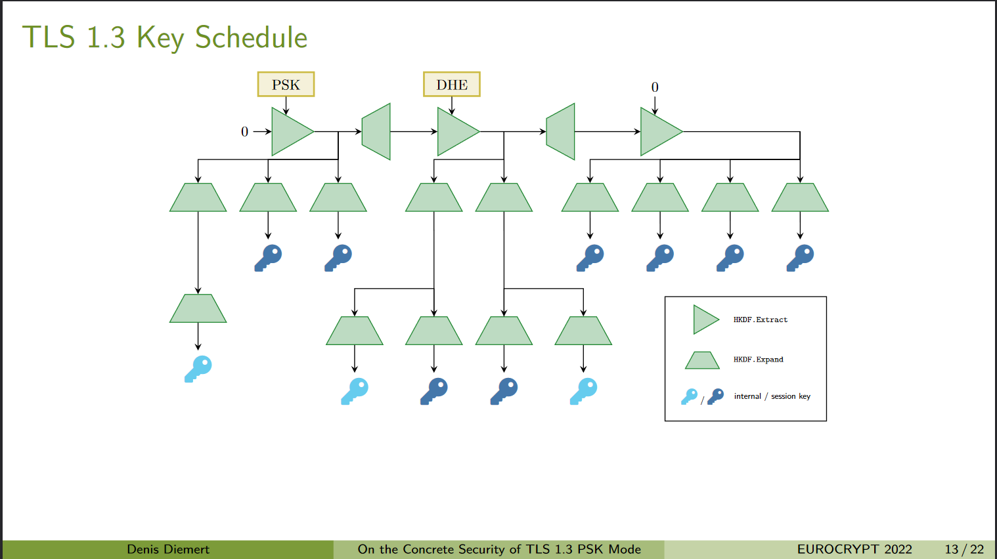
Key derivations in practice

Slide 28
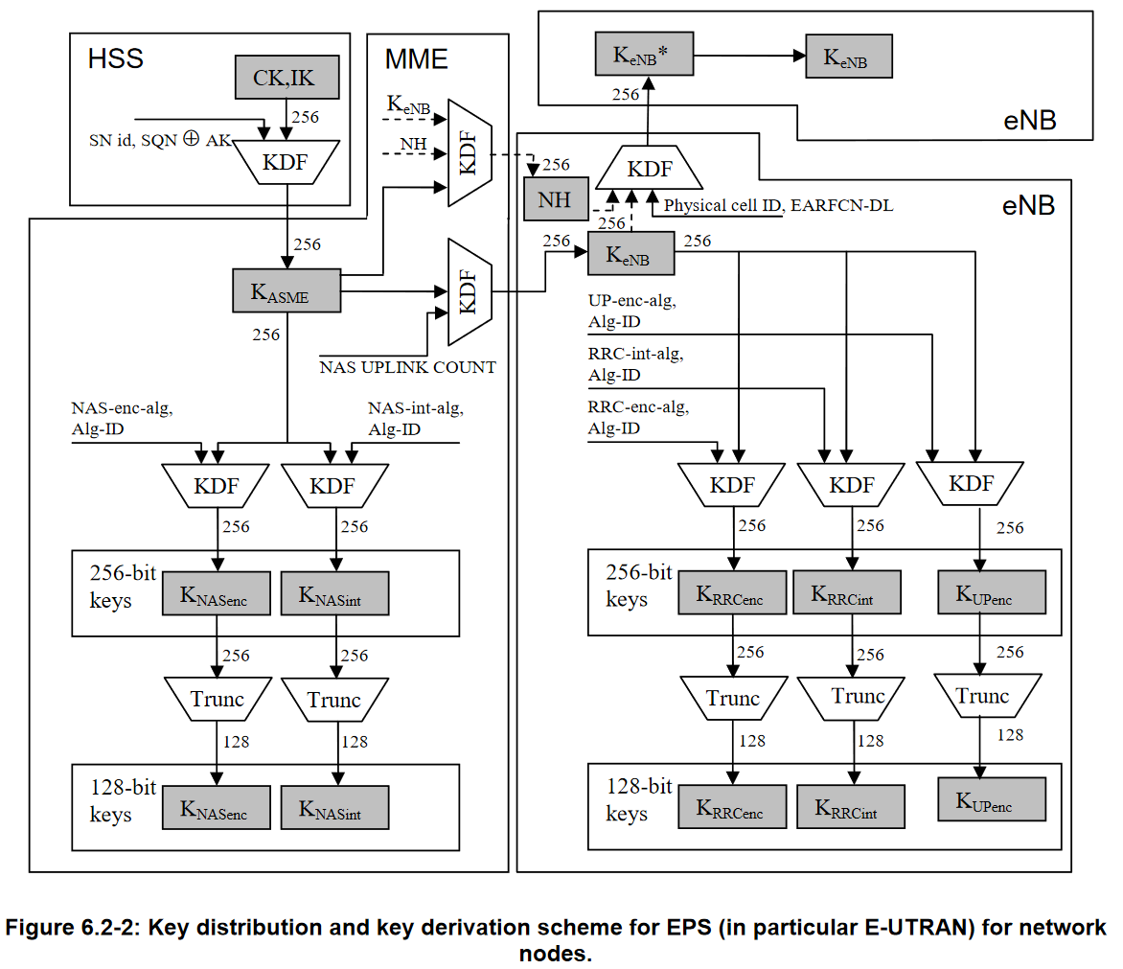
LTE key derivation

Slide 29

End of PART 1
(symmetric Crypto)

Slide 30
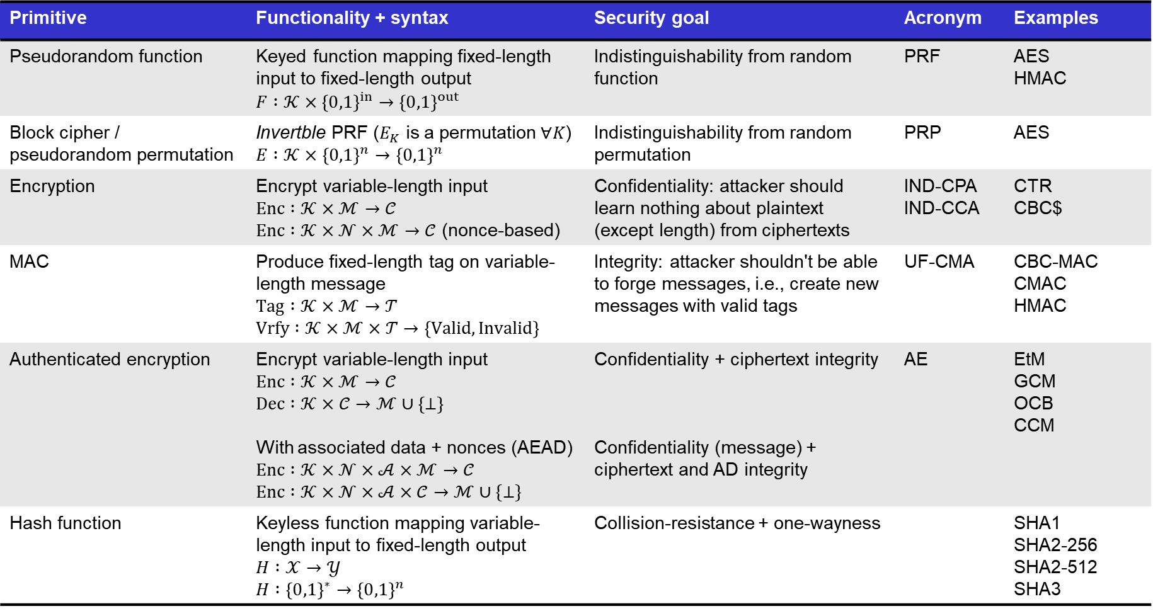
Summary of symmetric cryptography
Primitive | Functionality + syntax | Security goal | Acronym | Examples
Pseudorandom function | Keyed function mapping fixed-length input to fixed-length output $$F :𝒦×{\left\{0,1\right\}}^{in}→{\left\{0,1\right\}}^{out}$$ | Indistinguishability from random function | PRF | AES HMAC
Block cipher / pseudorandom permutation | Invertble PRF ($E_{K}$ is a permutation $∀K$) $$E :𝒦×{\left\{0,1\right\}}^{n}→{\left\{0,1\right\}}^{n}$$ | Indistinguishability from random permutation | PRP | AES
Encryption | Encrypt variable-length input $$Enc :𝒦×ℳ→𝒞$$ $Enc :𝒦×𝒩×ℳ→𝒞$ (nonce-based) | Confidentiality: attacker should learn nothing about plaintext (except length) from ciphertexts | IND-CPA IND-CCA | CTR CBC$
MAC | Produce fixed-length tag on variable-length message $$Tag :𝒦×ℳ→𝒯$$ $$Vrfy :𝒦×ℳ×𝒯→\left\{Valid, Invalid\right\}$$ | Integrity: attacker shouldn't be able to forge messages, i.e., create new messages with valid tags | UF-CMA | CBC-MAC CMAC HMAC
Authenticated encryption | Encrypt variable-length input $Enc :𝒦×ℳ→𝒞$ $$Dec :𝒦×𝒞→ℳ∪\left\{⊥\right\}$$ With associated data + nonces (AEAD) $$Enc :𝒦×𝒩×𝒜×ℳ→𝒞$$ $$Enc :𝒦×𝒩×𝒜×𝒞→ℳ∪\{⊥\}$$ | Confidentiality + ciphertext integrity Confidentiality (message) + ciphertext and AD integrity | AE | EtM GCM OCB CCM
Hash function | Keyless function mapping variable-length input to fixed-length output $H :𝒳→𝒴$ $$H :{\left\{0,1\right\}}^{∗}→{\left\{0,1\right\}}^{n}$$ | Collision-resistance + one-wayness |  | SHA1 SHA2-256 SHA2-512 SHA3

Slide 31
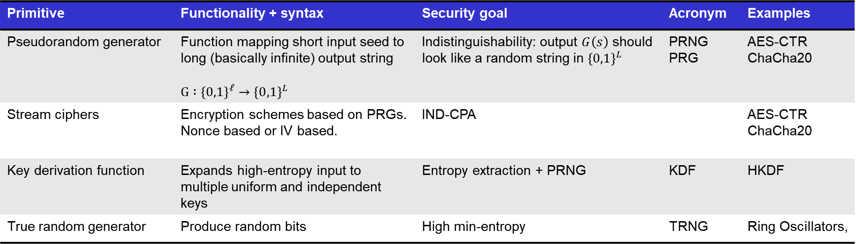
Summary of symmetric cryptography
Primitive | Functionality + syntax | Security goal | Acronym | Examples
Pseudorandom generator | Function mapping short input seed to long (basically infinite) output string $$G :{\left\{0,1\right\}}^{ℓ}→{\left\{0,1\right\}}^{L}$$ | Indistinguishability: output $G\left(s\right)$ should look like a random string in ${\left\{0,1\right\}}^{L}$ | PRNG PRG | AES-CTR ChaCha20
Stream ciphers | Encryption schemes based on PRGs. Nonce based or IV based. | IND-CPA |  | AES-CTR ChaCha20
Key derivation function | Expands high-entropy input to multiple uniform and independent keys | Entropy extraction + PRNG | KDF | HKDF
True random generator | Produce random bits | High min-entropy | TRNG | Ring Oscillators,

