Slide 1
Lecture 8 – Group theory,
Diffie-Hellman key exchange
TEK4500
16.10.2024
Håkon Jacobsen
hakon.jacobsen@its.uio.no

Slide 2



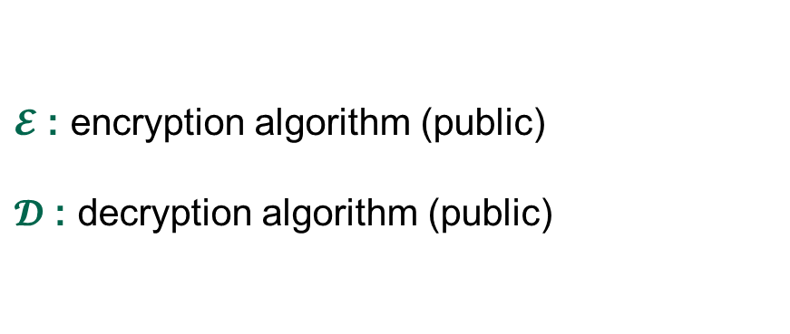
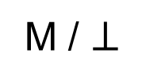
Creating secure channels: encryption schemes
Internet
Alice
Bob
K
K
$$ℰ$$
C
$$𝒟$$
M
M / $⊥$
Adversary
$𝓔$ : encryption algorithm (public)
$𝓓$ : decryption algorithm (public)
K : encryption / decryption key (secret)

Slide 3
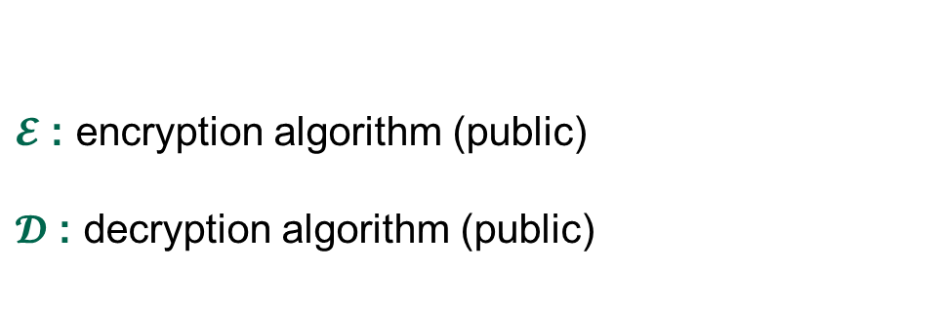
Creating secure channels: encryption schemes
Internet
Alice
Bob
K_{e}
K_{d}
$$ℰ$$
C
$$𝒟$$
M
M / $⊥$
Adversary
$𝓔$ : encryption algorithm (public)
$𝓓$ : decryption algorithm (public)
K_{e} : encryption key (public)
K_{d} : decryption key (secret)

Slide 4
Basic goals of cryptography
 | Message privacy | Message integrity / authentication
Symmetric keys | Symmetric encryption | Message authentication codes (MAC)
Asymmetric keys | Asymmetric encryption (a.k.a. public-key encryption) | Digital signatures
Key exchange

Slide 5






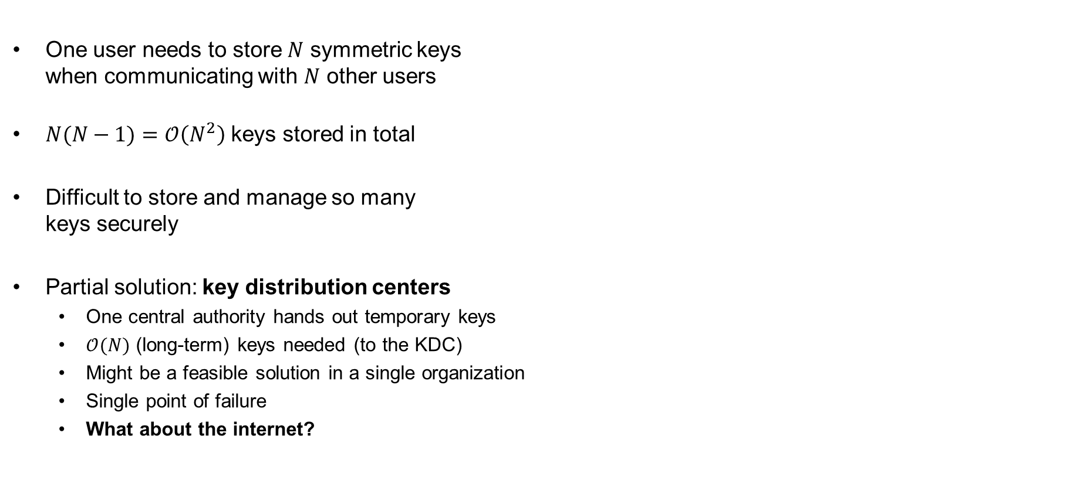
Symmetric key distribution problem
One user needs to store $N$ symmetric keys
when communicating with $N$ other users
$N(N−1)=𝒪\left(N^{2}\right)$ keys stored in total
Difficult to store and manage so many
keys securely
Partial solution: key distribution centers
  One central authority hands out temporary keys
  $𝒪(N)$ (long-term) keys needed (to the KDC)
  Might be a feasible solution in a single organization
  Single point of failure
  What about the internet?

Slide 6

The public-key revolution

Slide 7

















Diffie-Hellman key exchange – idea
AES-GCM++
$$K$$
$$K$$

Slide 8
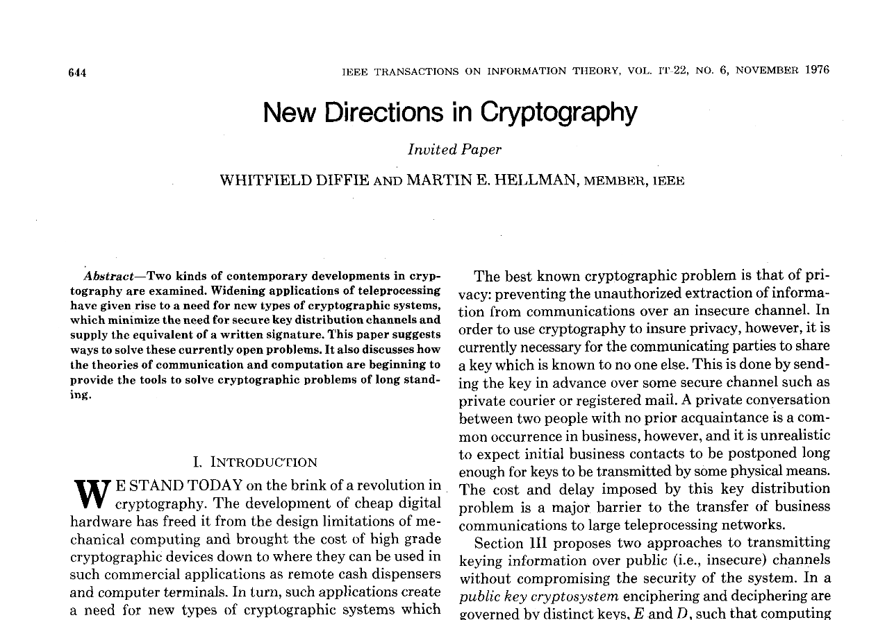
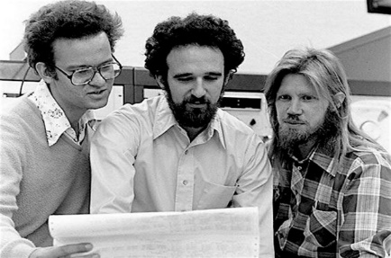
Diffie-Hellman key exchange
Discovered in the 1970's
Allows two parties to establish a shared secret
without ever having met
Diffie & Hellman paper also introduced:
  Public-key encryption
  Digital signatures
Ralph Merkle
Whitfield Diffie
Martin Hellman

Slide 9
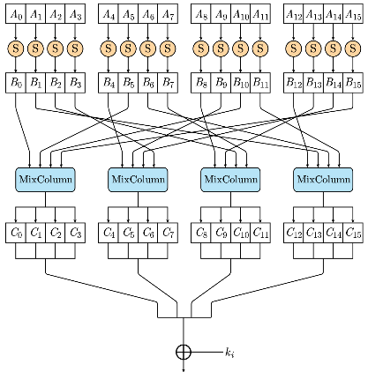
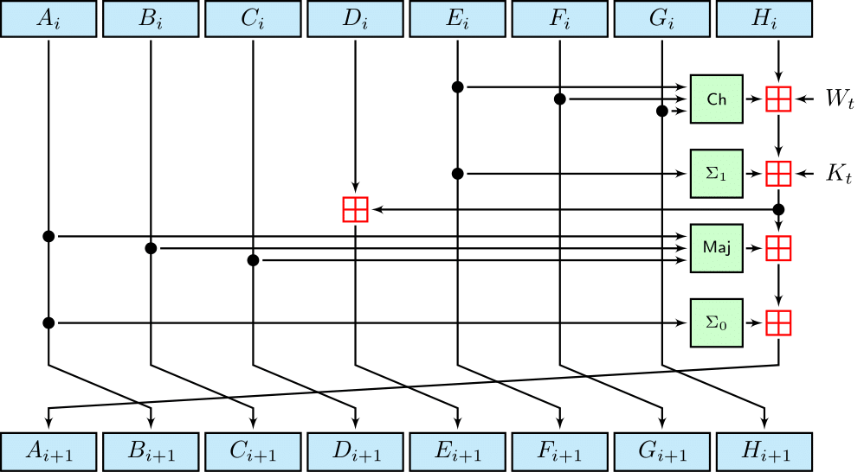
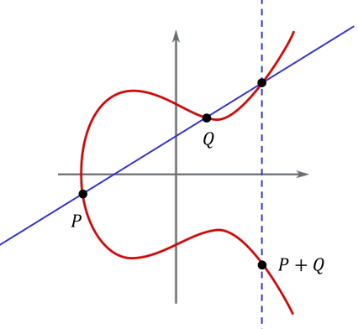
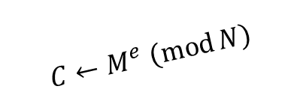

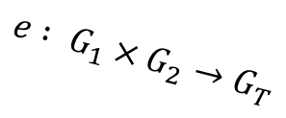

A different kind of primitives
Symmetric crypto boils down to a few primitives
  Block ciphers and hash functions
  Why are these considered secure?
    Lots and lots of cryptanalysis (well-studied!)
    Artificial and man-made
Want asymmetric crypto to be based on a few well-studied primitives too
Candidates come from a different place:
  Hard mathematical problems
  Good candidates: discrete logarithms, factoring
    Much more algebraic structure
SHA2-256
AES
$$Z_{n}^{∗}≃Z_{p_{1}}^{∗}×Z_{p_{2}}^{∗}×⋯×Z_{p_{t}}^{∗}$$
$$C←M^{e} \left(\operatorname{mod}{N}\right)$$
$$e : G_{1}×G_{2}→G_{T}$$
$$y^{2}=x^{3}−5x+2$$

Slide 10
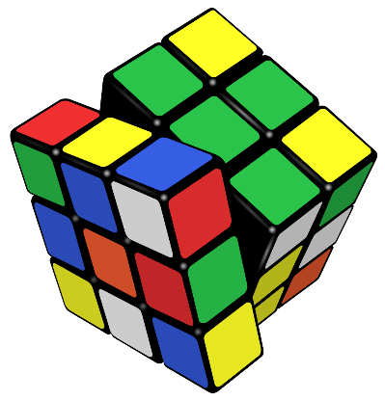
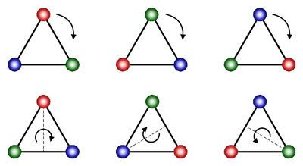




$$Z_{10}$$
$$Z_{5}$$
$$Z_{2}$$
$$0$$
Group theory + number theory

Slide 11










Preliminaries
(integers)
$$Z=\left\{…, −2, −1, 0, 1, 2, 3, …\right\}$$
An integer $p>1$ is prime if it's only divisible by $1$ and $p$
(reals)
$R=$ the real numbers
$R^{∗}=R∖\{0\}$
(integers “mod $n$”)
$$Z_{n}=\left\{0, 1, 2, …, n−1\right\}$$
(integers “mod $p$”)
$$Z_{p}=\left\{0, 1, 2, …, p−1\right\}$$
$p$ prime
$$Z_{p}^{∗}=Z_{p}∖\left\{0\right\}$$
Examples:
$$Z_{11}=\left\{0, 1, 2, 3, 4, 5, 6, 7, 8, 9, 10\right\}$$
$$Z_{11}^{∗}=\left\{1, 2, 3, 4, 5, 6, 7, 8, 9, 10\right\}$$

Slide 12

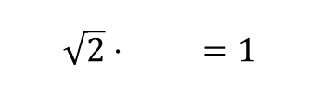



















Groups – motivation
Groups
$$Z$$
$$\left(R^{∗}, .⋅\right)$$
$$\left(Z,+\right)$$
$$\left(R,+\right)$$
$$R^{∗}$$
$$R$$
Associativity
$$\left(1+2\right)+3=1+\left(2+3\right)$$
$$\left(\sqrt{2}+e\right)+π=\sqrt{2}+\left(e+π\right)$$
$$\left(\sqrt{2}⋅e\right)⋅π=\sqrt{2}⋅\left(e⋅π\right)$$
Identity
$$6+0=6$$
$$\sqrt{2}+0=\sqrt{2}$$
$$\sqrt{2}⋅1=\sqrt{2}$$
$$0$$
$$0$$
$$1$$
$$\frac{1}{\sqrt{2}}$$
$$\sqrt{2}⋅\frac{1}{3\sqrt{2}}=1$$
$$\left(−\sqrt{2}\right)$$
Inverses
$$6+(−6)=0$$
$$\sqrt{2} + =0$$
$$\left(−6\right)$$

Slide 13
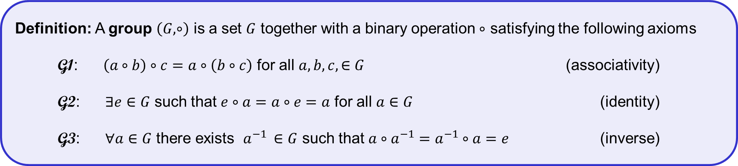
Groups – definition
Definition: A group $\left(G, ∘\right)$ is a set $G$ together with a binary operation $∘$ satisfying the following axioms
G1: $\left(a∘b\right)∘c=a∘\left(b∘c\right)$ for all $a,b,c,∈G$ (associativity)
G2: $∃e∈G$ such that $e∘a=a∘e=a$ for all $a∈G$ (identity)
G3: $∀a∈G$ there exists $a^{−1 }∈G$ such that $a∘a^{−1}=a^{−1}∘a=e$ (inverse)
A group is abelian/commutative if $a∘b=b∘a$ for all $a,b∈G$
The order of a group is the number of elements in $G$, denoted $\left|G\right|$

Slide 14


















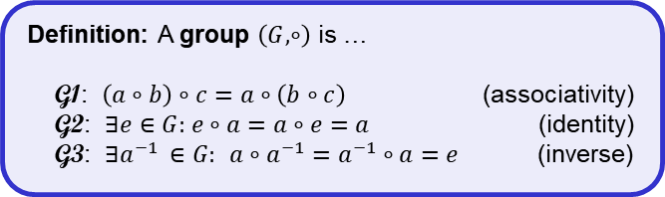









































































Examples
Definition: A group $\left(G, ∘\right)$ is …
G1: $\left(a∘b\right)∘c=a∘\left(b∘c\right)$ (associativity)
G2: $∃e∈G:$ $e∘a=a∘e=a$ (identity)
G3: $∃a^{−1 }∈G:$ $a∘a^{−1}=a^{−1}∘a=e$ (inverse)
Groups
Not groups
$$\left(Z,+\right)$$
$$e=0$$
$${"2}^{−1}"=−2$$
$$\left(Z, ⋅\right)$$
$$2^{−1}= ?$$
$$\left(Z,−\right)$$
$$\left(1−2\right)−3≠1−(2−3)$$
$$\left(R,+\right)$$
$$e=0$$
$${"π}^{−1}"=−π$$
$$\left(R^{∗},⋅\right)$$
$$e=1$$
$$π^{−1}=1/π$$
$$\left(R, ⋅\right)$$
$$0⋅x=1?$$
$$\left(Z_{6},+_{6}\right)$$
$$e=0$$
$${"2}^{−1}"=4 : 2+4=6≡0 mod⁡6$$
$$\left(Z_{n},{ ⋅}_{n}\right)$$
$$2x=1 \left(\operatorname{mod}{6}\right)?$$
$$\left(Z_{p}^{∗},{ ⋅}_{p}\right)$$
$$e=1$$
$$\left(Z_{p},{ ⋅}_{p}\right)$$
$${"3}^{−1}"=x: 3⋅x≡1 mod⁡p$$
$$\left(Z_{2}×Z_{2},+_{2×2}\right)$$
$$≅$$
$$\left(G, .∘ \right)$$
$$\left(Z_{4},+_{4}\right)$$
$$\left(G, .⋆ \right)$$
$$\left(G, .∘ \right)$$
$$\left(Z_{3},+_{3}\right)$$
$$∘$$
$$e$$
$$a$$
$$b$$
$$c$$
$$+_{4}$$
$$0$$
$$1$$
$$2$$
$$3$$
$$⋆$$
$$e$$
$$a$$
$$b$$
$$c$$
$$∘$$
$$e$$
$$a$$
$$b$$
$$+_{3}$$
$$0$$
$$1$$
$$2$$
$$e$$
$$e$$
$$a$$
$$b$$
$$c$$
$$0$$
$$0$$
$$1$$
$$2$$
$$3$$
$$e$$
$$e$$
$$a$$
$$b$$
$$c$$
$$e$$
$$e$$
$$a$$
$$b$$
$$0$$
$$0$$
$$1$$
$$2$$
$$a$$
$$a$$
$$b$$
$$c$$
$$e$$
$$1$$
$$1$$
$$2$$
$$3$$
$$0$$
$$a$$
$$a$$
$$e$$
$$c$$
$$b$$
$$a$$
$$a$$
$$b$$
$$e$$
$$1$$
$$1$$
$$2$$
$$0$$
$$b$$
$$b$$
$$c$$
$$e$$
$$a$$
$$2$$
$$2$$
$$3$$
$$0$$
$$1$$
$$b$$
$$b$$
$$c$$
$$e$$
$$a$$
$$b$$
$$b$$
$$e$$
$$a$$
$$2$$
$$2$$
$$0$$
$$1$$
$$c$$
$$c$$
$$e$$
$$a$$
$$b$$
$$3$$
$$3$$
$$0$$
$$1$$
$$2$$
$$c$$
$$c$$
$$b$$
$$a$$
$$e$$

Slide 15













More groups
$$σ_{5}∘σ_{2}=σ_{4}$$
$$≠$$
$$σ_{2}∘σ_{5}=σ_{6}$$
$$σ_{4}∘σ_{4}=σ_{1}$$
$$σ_{1}$$
$$σ_{2}$$
$$σ_{3}$$
$$σ_{3}∘σ_{2}=σ_{1}$$
$$D_{3}=\left\{σ_{1},σ_{2},…,σ_{6}\right\}$$
$$σ_{4}$$
$$σ_{5}$$
$$σ_{6}$$
$\left(D_{3}, ∘\right)$ is a group

Slide 16















Group exponentation
$15$
$$g^{0}\overset{def}{=}e$$
$$\left(Z,+\right):$$
$${"3}^{15}"=3+3+3+⋯+3=15⋅3$$
$n$
$$g^{n}\overset{def}{=}g∘g∘⋯∘g$$
$$g^{−n}\overset{def}{=}{\left(g^{−1}\right)}^{n}$$
Multiplicative notation
$n$
$m$
$$\left(G,⋆\right) : a⋆b=ab$$
$a⋆a⋆⋯a=a^{n}$
Fact:
$$g^{n}∘g^{m}$$
$$=g∘⋯∘g∘g∘⋯∘g$$
$$=g^{n+m}$$
$n+m$
just notation!
Additive notation
Fact:
$${\left(g^{n}\right)}^{m}=g^{nm}={\left(g^{m}\right)}^{n}$$
$$\left(G,⋆\right) : a⋆b=a+b$$
$a⋆a⋆⋯a=n⋅a$

Slide 17





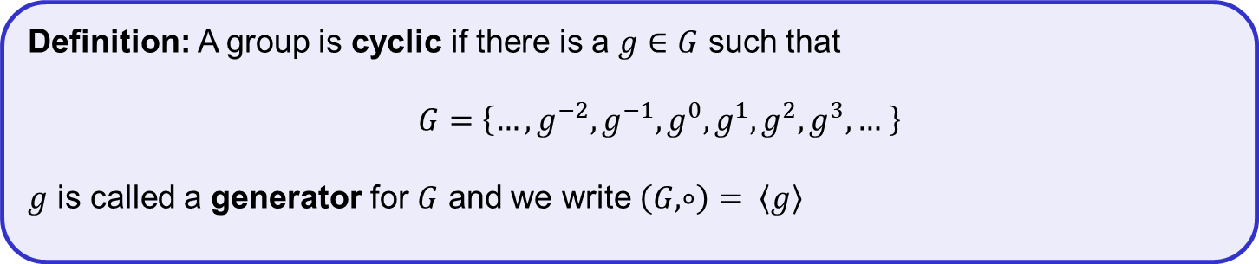

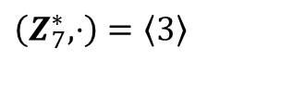









Cyclic groups
Definition: A group is cyclic if there is a $g∈G$ such that
$G=\left\{…,g^{−2},g^{−1},g^{0},g^{1},g^{2},g^{3},… \right\}$
$g$ is called a generator for $G$ and we write $\left(G, ∘\right)= \left\langle g\right\rangle$
Examples:
Not cyclic groups:
$$\left(Z, +\right)=〈1〉$$
$$=〈−1〉$$
$$\left(R, +\right)$$
$$\left(R^{∗}, ⋅\right)$$
$$\left(Z_{n}, +_{n}\right)=〈1〉$$
$$\left(G, ⋆ \right)$$
$\left(Z_{7}^{∗}, ⋅\right)=\left\langle 3\right\rangle$
$$=\left\{3^{0},3^{1},3^{2},3^{3},3^{4},3^{5}\right\}=\left\{1, 3, 2, 6, 4, 5\right\}$$
$$∘$$
$$e$$
$$a$$
$$b$$
$$c$$
$$=\left\langle 5\right\rangle$$
$$=\left\{5^{0},5^{1},5^{2},5^{3},5^{4},5^{5}\right\}=\left\{1, 5, 4, 6, 2, 3\right\}$$
$$e$$
$$e$$
$$a$$
$$b$$
$$c$$
$$≠\left\langle 2\right\rangle$$
$$=\left\{2^{0},2^{1},2^{2},2^{3},2^{4},2^{5}\right\}=\left\{1, 2, 4, 1, 2, 4\right\}=\left\{1, 2, 4\right\}$$
$$a$$
$$a$$
$$b$$
$$c$$
$$e$$
$$b$$
$$b$$
$$c$$
$$e$$
$$a$$
Fact: $\left(Z_{p}^{∗}, ⋅\right)$ is cyclic for all primes $p$
$$c$$
$$c$$
$$e$$
$$a$$
$$b$$

Slide 18








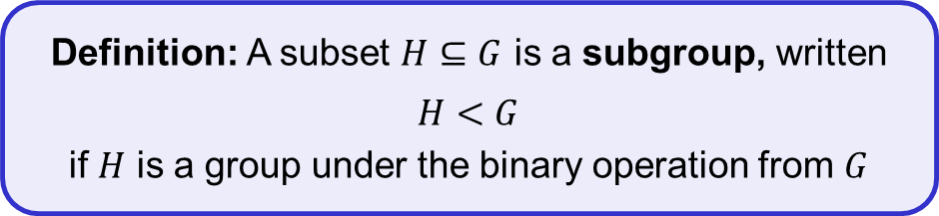










Subgroups
Definition: A subset $H⊆G$ is a subgroup, written
$H<G$
if $H$ is a group under the binary operation from $G$
$$G$$
$$H$$
$$x^{−1}$$
$$x∘y$$
$$y$$
$$x$$
Examples:
positive real numbers
$$e$$
$\left\{e\right\}<G$ (for all groups)
$$\left(R_{>0}, ⋅\right)<\left(R^{∗}, ⋅\right)$$
$G<G$ (for all groups)
$$\left(\left\{1,−1\right\},⋅\right)<\left(R^{∗}, ⋅\right)$$
$\left\langle 5\right\rangle =\left\{0, 5, 10,…,35\right\}$
$$2Z=\left\{…,−2, 0, 2, 4, 6,…\right\}<\left(Z,+\right)$$
$$\left\langle 20\right\rangle <$$
$$\left\langle 10\right\rangle <$$
$$\left\langle 5\right\rangle <$$
$$\left(Z_{40}, +\right)$$
$\left\langle 10\right\rangle =\left\{0, 10, 20, 30\right\}$
$$3Z=\left\{…,−3, 0, 3, 6, 9,…\right\}<\left(Z,+\right)$$
$\left\langle 20\right\rangle =\left\{0, 20\right\}$

Slide 19













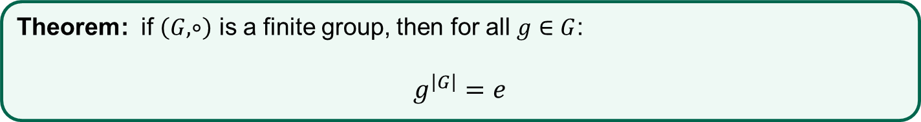






Cyclic groups
Theorem: if $\left(G,∘\right)$ is a finite group, then for all $g∈G$:
$$g^{\left|G\right|}=e$$
Proof (finite cyclic groups):
$$G$$
$$\left|G\right|=\left|〈g〉\right|=n$$
$$e$$
$$g^{1}$$
$$g^{2}$$
$$g^{3}$$
$$⋯$$
$$g^{n−1}$$
$$g^{n}$$
$$g^{n+1}$$
$$g^{n+2}$$
$$⋯$$
$$g^{3}=e$$
$$g^{4}=g$$
$$g^{5}=g^{2}$$
$$g^{6}=g^{3}=e, …$$
$$g^{n}=g^{3}$$
$${⟹ g}^{n−3}=e$$
${⟹ g}^{j}=e$ $j<n$
contradiction!
Theorem: $g^{i}=g^{i \left(\operatorname{mod}{n}\right)}=g^{i \left(\operatorname{mod}{ \left|G\right|}\right)}$
Theorem (Lagrange’s theorem): if $H<G$ then $\left|H\right|$ divides $\left|G\right|$

Slide 20


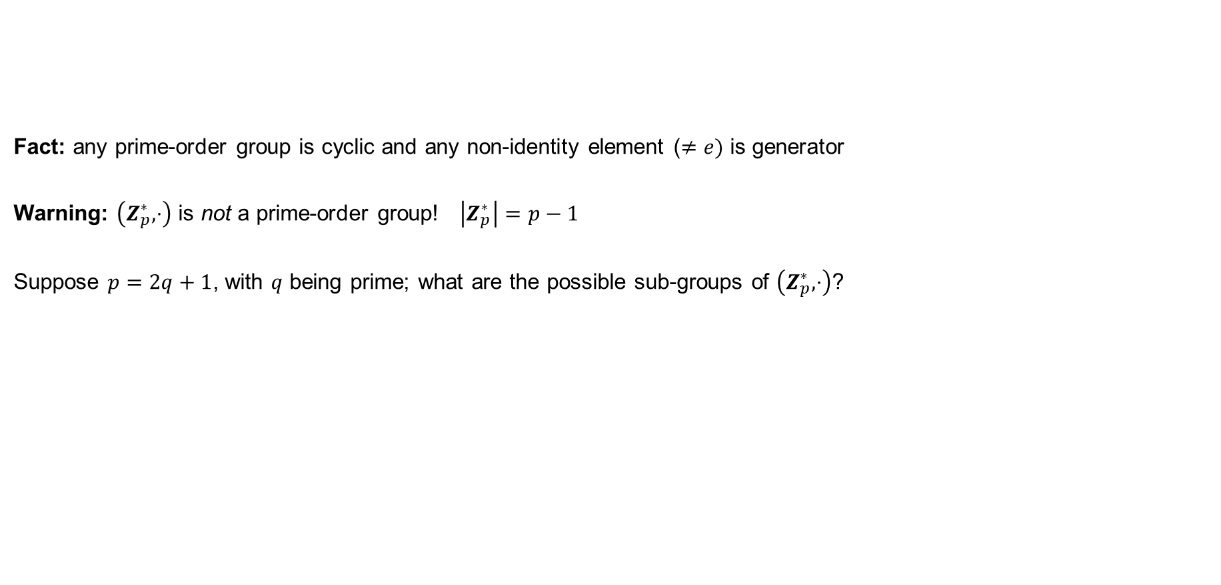




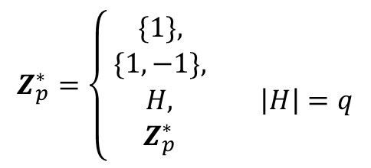

Groups of prime order
Fact: any prime-order group is cyclic and any non-identity element ($≠e)$ is generator
Warning: $\left(Z_{p}^{∗},⋅\right)$ is not a prime-order group! $\left|Z_{p}^{∗}\right|=p−1$
Suppose $p=2q+1$, with $q$ being prime; what are the possible sub-groups of $\left(Z_{p}^{∗},⋅\right)$?
Theorem (Lagrange's theorem): if $H<G$ then $\left|H\right|$ divides $\left|G\right|$
$$\left|Z_{p}^{∗}\right|=p−1=2q$$
Example:
$$Z_{11}^{∗}$$
$$=\left\{1, 2, 3, 4, 5, 6, 7, 8, 9, 10\right\}$$
$$\left\{1\right\}<Z_{11}^{∗}$$
$$Z_{p}^{∗}=\left\{\begin{aligned}\{1\}, \\ \{1,−1\}, \\ \begin{matrix}H, & \left|H\right|=q\end{matrix} \\ Z_{p}^{∗} \end{aligned}\right.$$
$$11=2⋅5+1$$
$$\left\{1,−1\right\}=\{1,10\}<Z_{11}^{∗}$$
$$H=\left\langle 3\right\rangle =\left\langle 4\right\rangle =\left\langle 5\right\rangle =\left\langle 9\right\rangle =\{1, 3, 4, 5, 9\}<Z_{11}^{∗}$$
$$Z_{11}^{∗}<Z_{11}^{∗}$$

Slide 21

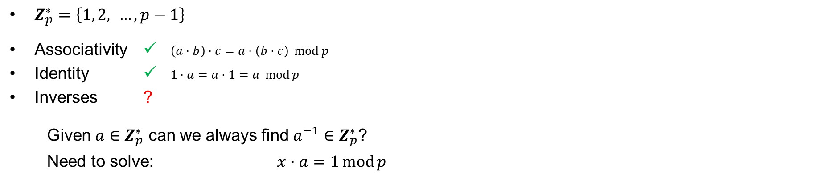
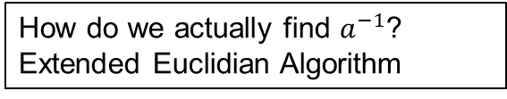




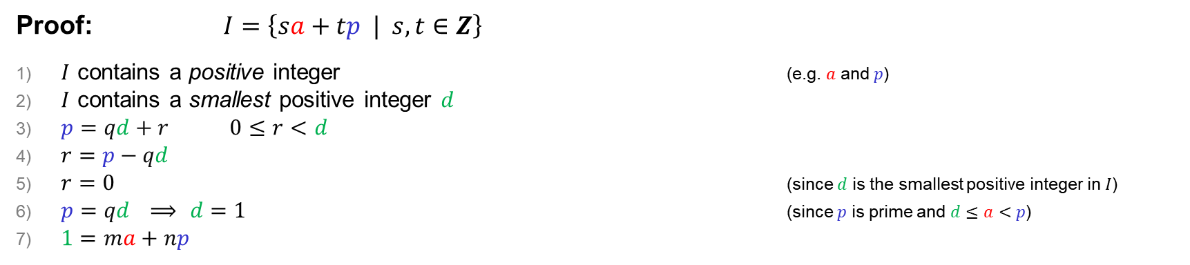
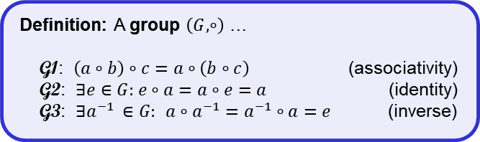


Why is $\left(Z_{p}^{∗},⋅\right)$ a group?
$Z_{p}^{∗}=\left\{1, 2, …, p−1\right\}$
Associativity ✓ $\left(a⋅b\right)⋅c=a⋅\left(b⋅c\right)\operatorname{mod}{p}$
Identity ✓ $1⋅a=a⋅1=a\operatorname{mod}{p}$
Inverses ?
Given $a∈Z_{p}^{∗}$ can we always find $a^{−1}∈Z_{p}^{∗}$?
Need to solve: $x⋅a=1\operatorname{mod}{p}$
Definition: A group $\left(G, ∘\right)$ …
G1: $\left(a∘b\right)∘c=a∘\left(b∘c\right)$ (associativity)
G2: $∃e∈G:$ $e∘a=a∘e=a$ (identity)
G3: $∃a^{−1 }∈G:$ $a∘a^{−1}=a^{−1}∘a=e$ (inverse)
How do we actually find $a^{−1}$?
Extended Euclidian Algorithm
Claim: $∃m,n∈Z$ such that $ma+np=1$
$$⟹ ma=1−np$$
$$=1\operatorname{mod}{p}$$
$$⟹ m=a^{−1}∈Z_{p}^{∗}$$
Proof: $I=\left\{sa+tp | s, t∈Z\right\}$
$I$ contains a positive integer (e.g. $a$ and $p$)
$I$ contains a smallest positive integer $d$
$p=qd+r$ $0≤r<d$
$r=p−qd$
$r=0$ (since $d$ is the smallest positive integer in $I$)
$p=qd$ $⟹$ $d=1$ (since $p$ is prime and $d≤a<p$)
$1=ma+np$
Non-constructive
$=ma+np$
$$=p−q\left(ma+np\right)$$
$$=−qma+\left(1−qn\right)p$$
$$∈I$$
Q.E.D

Slide 22
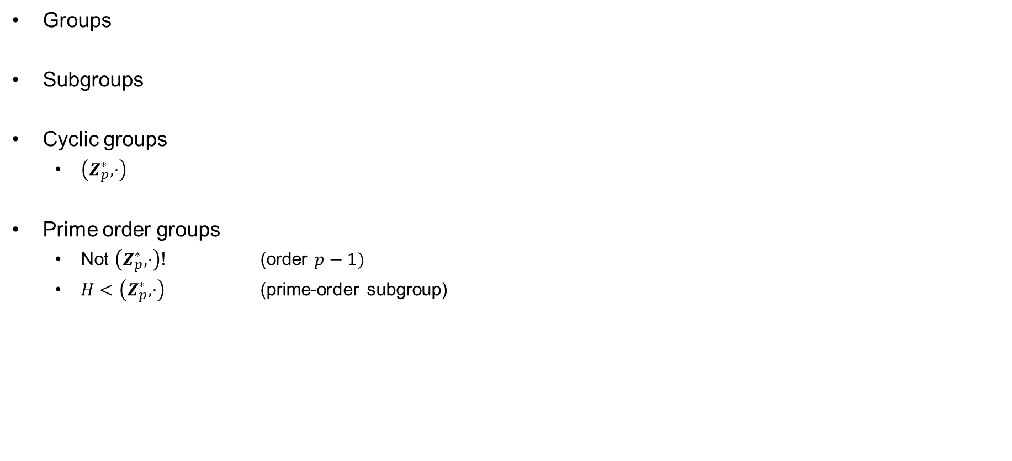
Before the break
Groups
Subgroups
Cyclic groups
  $\left(Z_{p}^{∗},⋅\right)$
Prime order groups
  Not $\left(Z_{p}^{∗},⋅\right)$! (order $p−1)$
  $H<\left(Z_{p}^{∗},⋅\right)$ (prime-order subgroup)

Slide 23












Diffie-Hellman
public
$$G=〈g〉$$
$$A=g^{a}$$
$$a\underset{←}{\$}\left\{1, …, \left|G\right|\right\}$$
$$B=g^{b}$$
$$b\underset{←}{\$}\left\{1, …, \left|G\right|\right\}$$
$$Z←B^{a}$$
$$={(g^{b})}^{a} =g^{ab}$$
$$Z′←A^{b}$$
$${=\left(g^{a}\right)}^{b}=g^{ab}$$
Claim: $Z=Z′$

Slide 24











Diffie-Hellman – example
$$Z_{1019}^{∗}=〈2〉$$
$$299$$
$$403\underset{←}{\$}\left\{1, …, 1018\right\}$$
$$72$$
$$901\underset{←}{\$}\left\{1, …, 1018\right\}$$
$$299←2^{403} mod⁡1019$$
$$72←2^{901} mod 1019$$
$Z←{72}^{403}\operatorname{mod}{1019}$
$$≡526$$
$$Z^{′}←{299}^{901}\operatorname{mod}{1019}$$
$$≡526$$

Slide 25

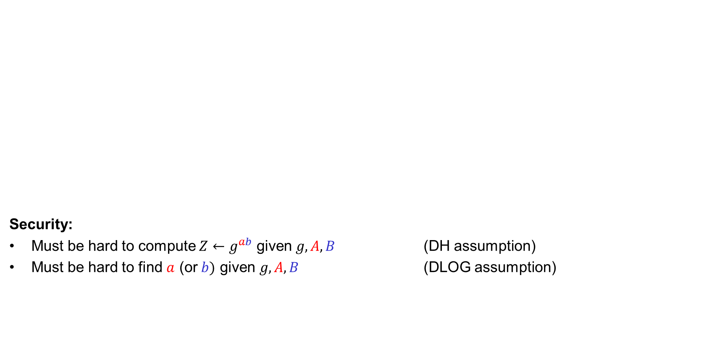


Diffie-Hellman
public
Security:
Must be hard to compute $Z←g^{ab}$ given $g, A, B$ (DH assumption)
Must be hard to find $a$ (or $b)$ given $g, A, B$ (DLOG assumption)
$$G=〈g〉$$
$$A=g^{a}$$
$$a\underset{←}{\$}\left\{1, …, \left|G\right|\right\}$$
$$B=g^{b}$$
$$b\underset{←}{\$}\left\{1, …, \left|G\right|\right\}$$
$$Z←B^{a}$$
$$={(g^{b})}^{a} =g^{ab}$$
$$Z′←A^{b}$$
$${=\left(g^{a}\right)}^{b}=g^{ab}$$
Doesn't work: $A∘B$
$$=g^{a}∘g^{b}=g^{a+b}≠g^{ab}$$

Slide 26



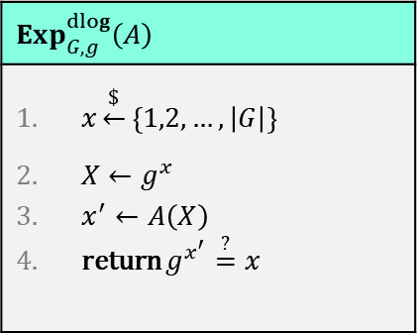

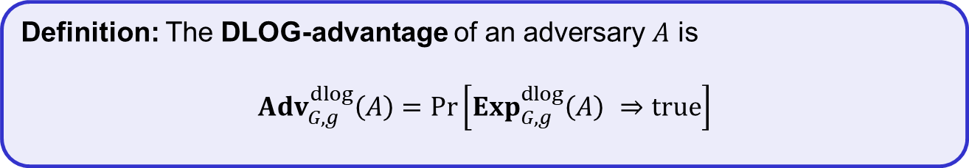



Discrete logarithm (DLOG) problem
public
$$Exp_{G,g}^{dlog}\left(A\right)$$
$x\underset{←}{\$}\left\{1,2,…,\left|G\right|\right\}$ $X←g^{x}$ $x^{′}←A\left(X\right)$ return $g^{x^{′}}\overset{?}{=}x$
$$G=\left\langle g\right\rangle$$
$${ x}^{′}$$
Challenger
$$X$$
$$x\underset{←}{\$}\left\{1,2,…,\left|G\right|\right\}$$
$$X←g^{x}$$
Adversary wins if $g^{x^{′}}=X$
In other words: $x^{′}=\log_{g}{X}$
Definition: The DLOG-advantage of an adversary $A$ is
$${Adv}_{G,g}^{dlog}\left(A\right)=\operatorname{Pr}\left[Exp_{G,g}^{dlog}\left(A\right) ⇒true\right]$$

Slide 27


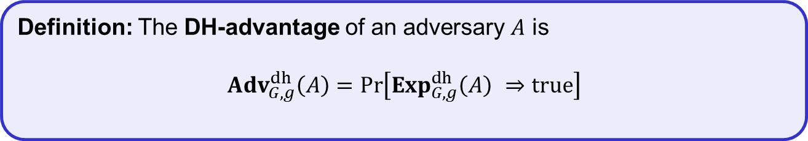

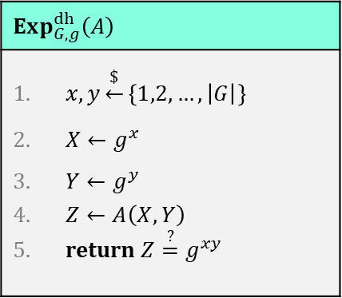


Diffie-Hellman (DH) problem
public
$$Exp_{G,g}^{dh}\left(A\right)$$
$x,y\underset{←}{\$}\left\{1,2,…,\left|G\right|\right\}$ $X←g^{x}$ $Y←g^{y}$ $Z←A\left(X,Y\right)$ return $Z\overset{?}{=}g^{xy}$
$$G=\left\langle g\right\rangle$$
$Z$
Challenger
$$X, Y$$
$$x,y\underset{←}{\$}\left\{1,2,…,\left|G\right|\right\}$$
$$X←g^{x}$$
$$Y←g^{y}$$
Adversary wins if $Z=g^{xy}$
Definition: The DH-advantage of an adversary $A$ is
$${Adv}_{G,g}^{dh}\left(A\right)=\operatorname{Pr}\left[Exp_{G,g}^{dh}\left(A\right) ⇒true\right]$$

Slide 28
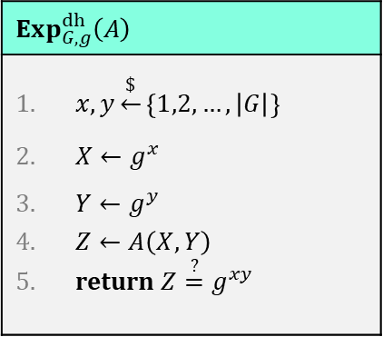

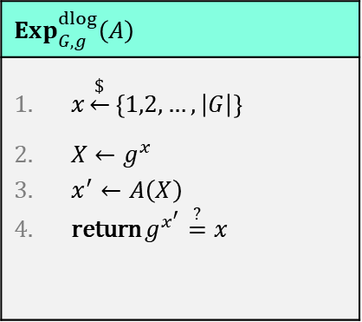



DLOG vs. DH
$$Exp_{G,g}^{dlog}\left(A\right)$$
$x\underset{←}{\$}\left\{1,2,…,\left|G\right|\right\}$ $X←g^{x}$ $x^{′}←A\left(X\right)$ return $g^{x^{′}}\overset{?}{=}x$
$$Exp_{G,g}^{dh}\left(A\right)$$
$x,y\underset{←}{\$}\left\{1,2,…,\left|G\right|\right\}$ $X←g^{x}$ $Y←g^{y}$ $Z←A\left(X,Y\right)$ return $Z\overset{?}{=}g^{xy}$
DLOG security $\overset{?}{⟹}$ DH security
DLOG security $⟸$ DH security
$$⇕$$
DLOG insecurity $⟹$ DH insecurity

Slide 29
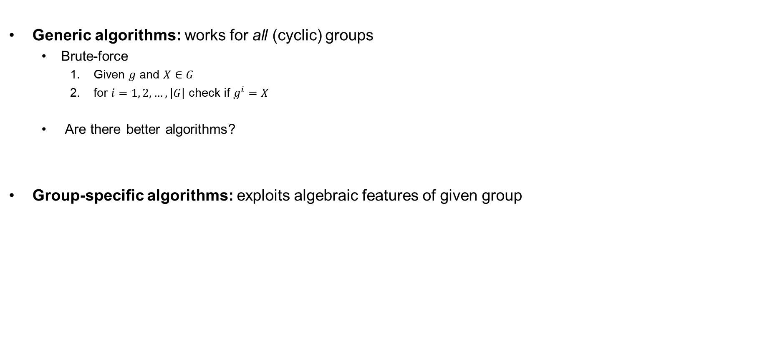
Algorithms for solving DLOG
Generic algorithms: works for all (cyclic) groups
  Brute-force
    Given $g$ and $X∈G$
    for $i=1, 2, …, \left|G\right|$ check if $g^{i}=X$
  Are there better algorithms?
Group-specific algorithms: exploits algebraic features of given group
run time: $𝒪\left(\left|G\right|\right)=\left(2^{n}\right)$, assuming $\left|G\right|≈2^{n}$

Slide 30




































Solving DLOG: the baby-step giant-step algorithm
Given:
$$X←g^{x}$$
$$n←\left\lceil \sqrt{\left|G\right|}\right\rceil$$
$$Y←g^{n}$$
Find: $x$
$$𝒪\left(\sqrt{\left|G\right|}\right)$$
$$g^{0}$$
$$g^{1}$$
$$g^{2}$$
$$g^{3}$$
$$g^{4}$$
Look for $i, j$ such that:
$$g^{n}$$
$$Y^{0},Y^{1},…,Y^{n}$$
$$Y^{0}$$
$$Xg^{i}=Y^{j}$$
$$Y^{n}$$
$$Y^{1}$$
$$X =Y^{j}g^{−i}$$
$${Xg}^{0},{Xg}^{1},…,{Xg}^{n}$$
$$g^{2n}$$
$$X =g^{nj}g^{−i}$$
$$Y^{2}$$
$$\tilde{𝒪}\left(\sqrt{\left|G\right|}\right)$$
$$g^{x} =g^{nj}g^{−i}$$
$$Xg^{n}$$
$$g^{x} =g^{nj−i}$$
$$Y^{j}$$
$$Y^{3}$$
$$Xg^{i}$$
$$g^{3n}$$
$$Xg^{3}$$
$$x =nj−i$$
$$Xg^{2}$$
Time + memory: $\tilde{𝒪}\left(\sqrt{\left|G\right|}\right)$
$$Xg^{1}$$
$$X$$

Slide 31

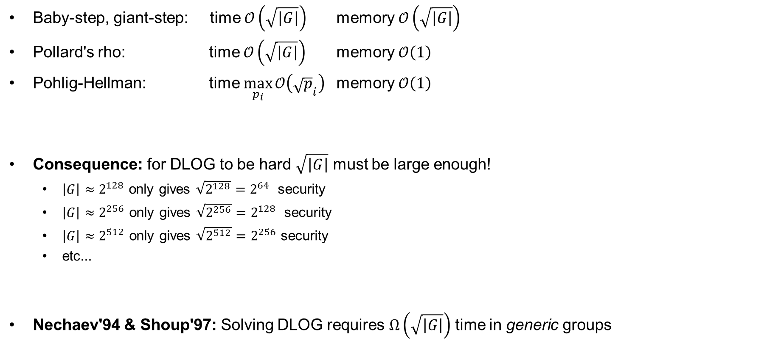

Generic algorithms for solving DLOG
Baby-step, giant-step: time $𝒪\left(\sqrt{\left|G\right|}\right)$ memory $𝒪\left(\sqrt{\left|G\right|}\right)$
Pollard's rho: time $𝒪\left(\sqrt{\left|G\right|}\right)$ memory $𝒪\left(1\right)$
Pohlig-Hellman: time $\max_{p_{i}}{𝒪\left({\sqrt{p}}_{i}\right)}$ memory $𝒪\left(1\right)$
Consequence: for DLOG to be hard $\sqrt{\left|G\right|}$ must be large enough!
  $\left|G\right|≈2^{128}$ only gives $\sqrt{2^{128}}=2^{64}$ security
  $\left|G\right|≈2^{256}$ only gives $\sqrt{2^{256}}=2^{128}$ security
  $\left|G\right|≈2^{512}$ only gives $\sqrt{2^{512}}=2^{256}$ security
  etc...
Nechaev'94 & Shoup'97: Solving DLOG requires $Ω\left(\sqrt{\left|G\right|}\right)$ time in generic groups
One of the $p_{i}$ must be large enough!
$$p_{1}^{e_{1}}p_{2}^{e_{2}}⋯p_{t}^{e_{t}}$$

Slide 32
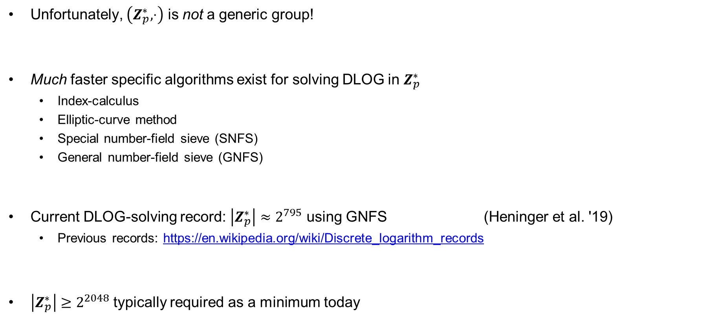
Non-generic algorithms for DLOG
Unfortunately, $\left(Z_{p}^{∗}, ⋅\right)$ is not a generic group!
Much faster specific algorithms exist for solving DLOG in $Z_{p}^{∗}$
  Index-calculus
  Elliptic-curve method
  Special number-field sieve (SNFS)
  General number-field sieve (GNFS)
Current DLOG-solving record: $\left|Z_{p}^{∗}\right|≈2^{795}$ using GNFS (Heninger et al. '19)
  Previous records: https://en.wikipedia.org/wiki/Discrete_logarithm_records
$\left|Z_{p}^{∗}\right|≥2^{2048}$ typically required as a minimum today
exceptionally complicated algorithms, requiring very advanced mathematics!

Slide 33
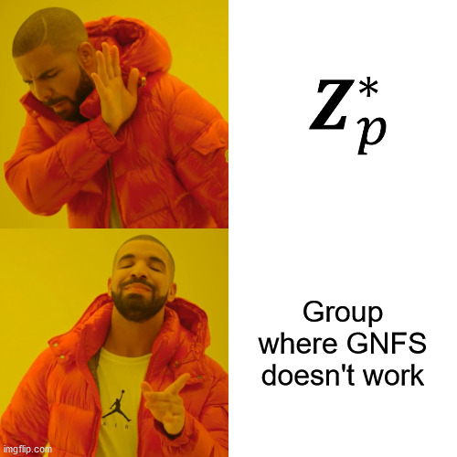

Next week: better alternatives to $Z_{p}^{∗}$?

