Slide 1
Lecture 2 – Block ciphers,
PRFs/PRPs, AES
TEK4500
27.08.2025
Håkon Jacobsen
hakon.jacobsen@its.uio.no

Slide 2

Ideal solution: secure channels
Internet
But how to build?
Alice
Bob
M
Adversary
Security goals:
Data privacy: adversary should not be able to read message M ✓
Data integrity: adversary should not be able to modify message M ✓
Data authenticity: message M really originated from Alice ✓

Slide 3
Basic goals of cryptography
 | Message privacy | Message integrity / authentication
Symmetric keys | Symmetric encryption | Message authentication codes (MAC)
Asymmetric keys | Asymmetric encryption (a.k.a. public-key encryption) | Digital signatures

Slide 4

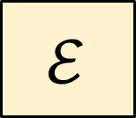



Encryption schemes
Plaintext
$$ℳ$$
$$ℰ$$
$$\$$$
$$𝒦$$
Key
Ciphertext
$$𝒞$$

Slide 5

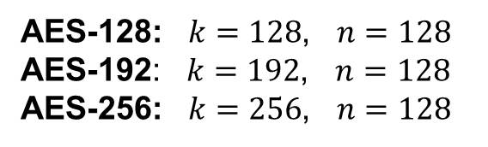




Block ciphers
Plaintext
$${\left\{0,1\right\}}^{n}$$
$$128$$
$$ℰ$$
$${\left\{0,1\right\}}^{k}$$
Key
AES
$$128$$
Ciphertext
$${\left\{0,1\right\}}^{n}$$
AES-128: $k=128$, $n=128$
AES-192: $k=192$, $n=128$
AES-256: $k=256$, $n=128$

Slide 6








Block cipher applications
Encryption of messages of 128 bits (block length)
However: we actually want to encrypt messages of arbitrary length!
  Splitting the message into multiple 128 bit blocks (like above) is not secure!
  A mode-of-operation is needed (covered later in the course)
Correct viewpoint: block ciphers are not encryption schemes!
  Block ciphers are primitives used to construct other things
$$K$$
$$E_{K}\left(X_{1}\right)$$
$$K$$
$$E_{K}\left(X_{2}\right)$$
$$E_{K}\left(X_{3}\right)$$
$$⋮$$

Slide 7
Block cipher applications
The “work horse” of crypto
Can be used to build:
  Encryption of arbitrary length messages (including stream ciphers)
  Message authentication codes
  Authenticated encryption
  Hash functions
  Pseudorandom generators (PRNGs)
  Key derivation functions
  One-time tokens

Slide 8
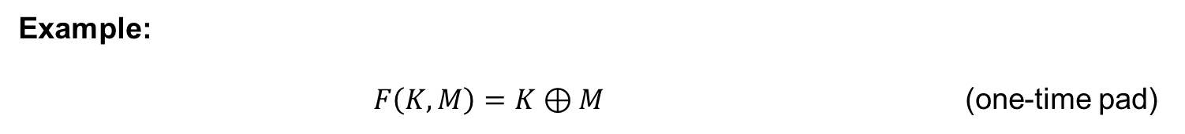
Principles for designing block ciphers
Claude Shannon, “Communication Theory of Secrecy Systems”(1949):
  Diffusion: plaintext spread over large parts of the ciphertext
  Confusion: a complex relation between plaintext, key and ciphertext
Example:
$F\left(K,M\right)=K⊕M$ (one-time pad)
Is this a good block cipher?

Slide 9
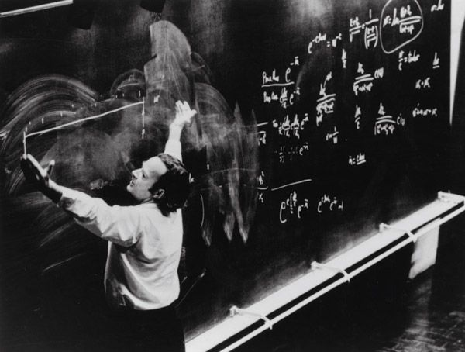
Defining block cipher security

Slide 10
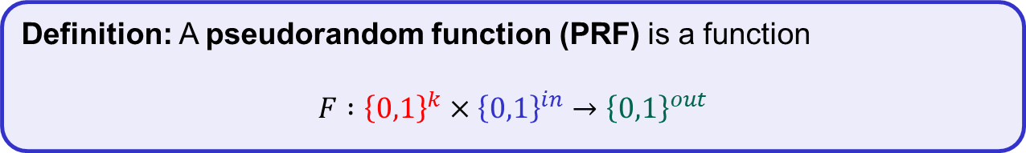
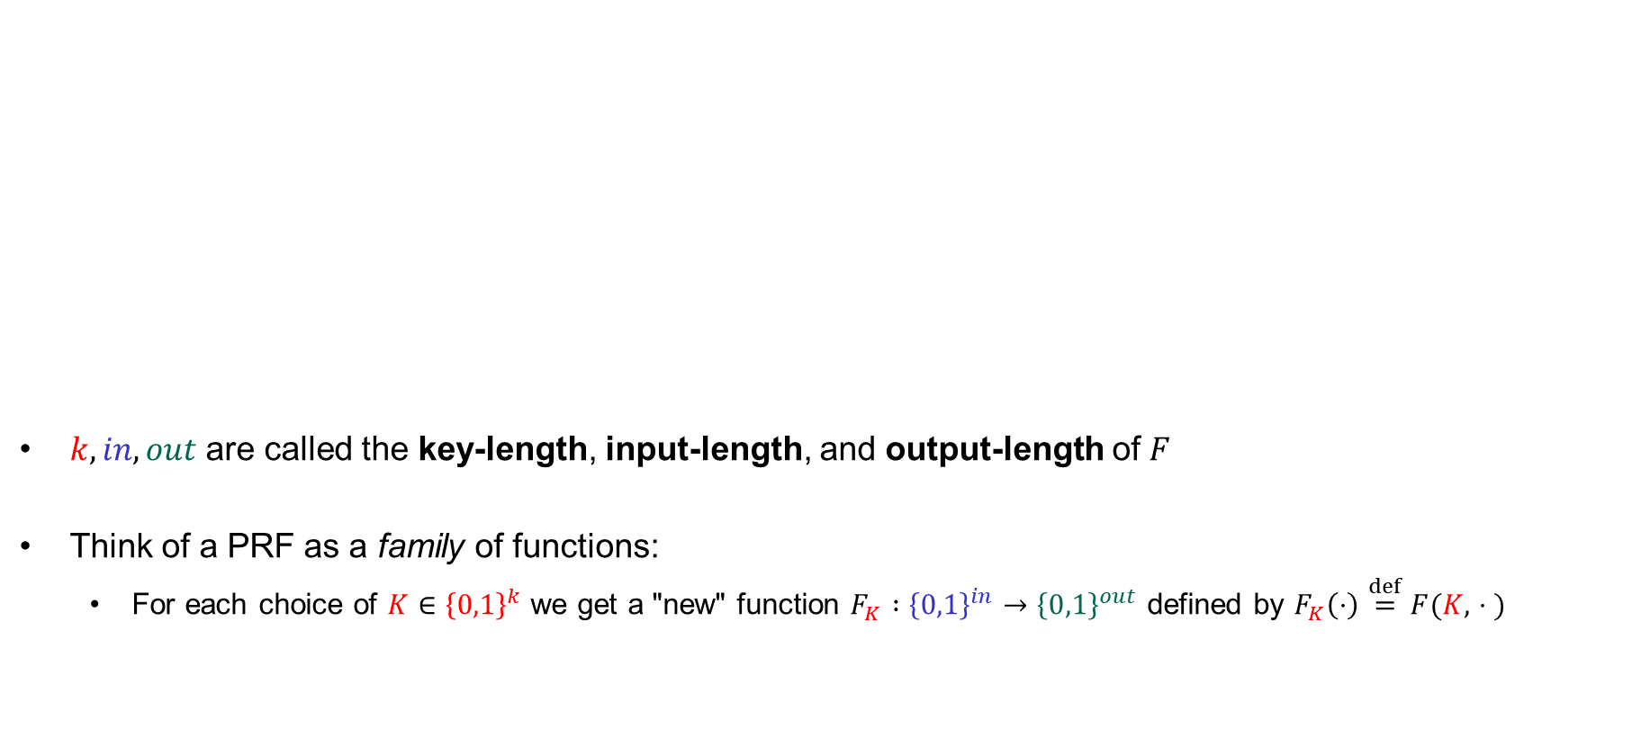
Pseudorandom functions (PRFs)
$k, in, out$ are called the key-length, input-length, and output-length of $F$
Think of a PRF as a family of functions:
  For each choice of $K∈{\left\{0,1\right\}}^{k}$ we get a "new" function $F_{K} :{\left\{0,1\right\}}^{in}→{\left\{0,1\right\}}^{out}$ defined by $F_{K}\left(⋅\right)\overset{def}{=}F(K, ∙⋅ )$
Definition: A pseudorandom function (PRF) is a function
$$F :{\left\{0,1\right\}}^{k}×{\left\{0,1\right\}}^{in}→{\left\{0,1\right\}}^{out}$$

Slide 11


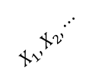
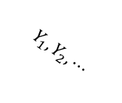
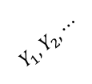

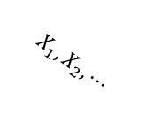


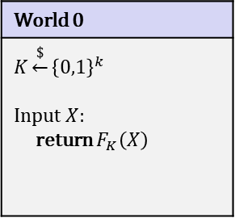

PRF – security
World 0
$$K\underset{←}{\$}{\left\{0,1\right\}}^{k}$$ Input $X$: return $F_{K}\left(X\right)$
$b$
World 1
Random function
?
$$b=0$$
$$b=1$$
$$\tilde{F}\left(⋅\right)$$
$$X_{1}, X_{2}, ⋯$$
$$X_{1}, X_{2}, ⋯$$
$$Y_{1}, Y_{2}, ⋯$$
$$Y_{1}, Y_{2}, ⋯$$

Slide 12









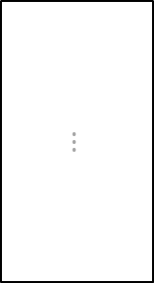







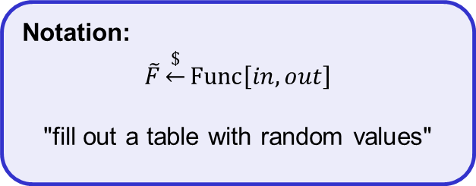
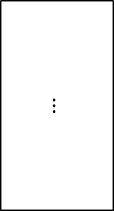

Random functions
$$\tilde{F }:{\left\{0,1\right\}}^{in}→{\left\{0,1\right\}}^{out}$$
$in=4$, $out=5$
$$X$$
$$\tilde{F}\left(X\right)$$
What is $\tilde{F}\left(0000\right)$?
$$0000$$
$$10001$$
Notation:
$$\tilde{F}\underset{←}{\$}Func\left[in,out\right]$$
"fill out a table with random values"
$$0010$$
$$11100$$
What is $\tilde{F}\left(0010\right)$?
$$0011$$
$$00010$$
$$⋮$$
$$⋮$$
$$2^{4}$$
$$1111$$
$$00111$$
$$5$$

Slide 13

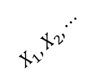

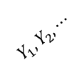

PRF – security
World 0
$$K\underset{←}{\$}{\left\{0,1\right\}}^{k}$$ Input $X$: return $F_{K}\left(X\right)$
$b$
World 1
Random function
$$b=1$$
$$\tilde{F}\left(⋅\right)$$
$$X_{1}, X_{2}, ⋯$$
$$Y_{1}, Y_{2}, ⋯$$

Slide 14


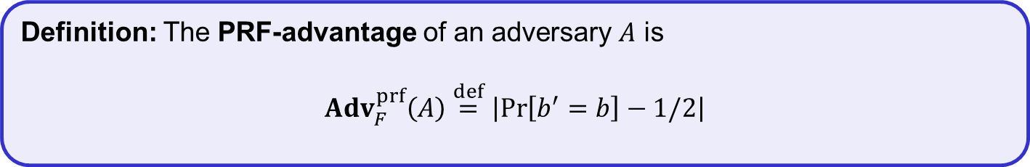
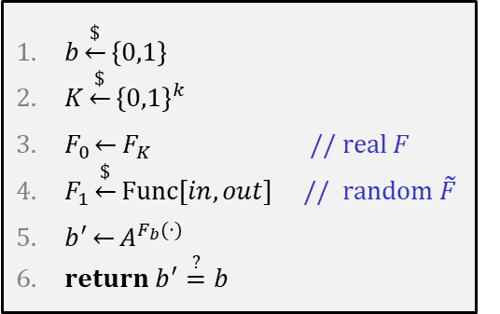

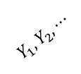

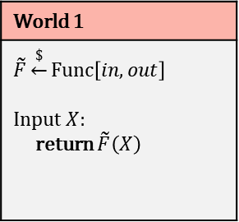
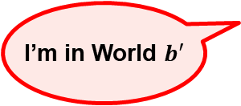
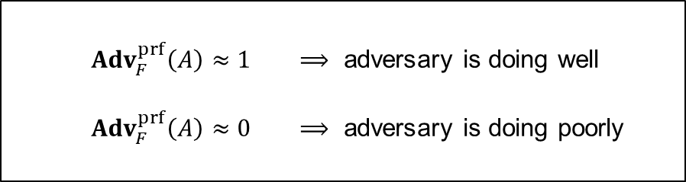

PRF – security
$$Exp_{F}^{prf}\left(A\right)$$
$$A=$$
World 0
$$K\underset{←}{\$}{\left\{0,1\right\}}^{k}$$ Input $X$: return $F_{K}\left(X\right)$
$b$
World 1
$$\tilde{F}\underset{←}{\$}Func\left[in,out\right]$$ Input $X$: return $\tilde{F}\left(X\right)$
$b\underset{←}{\$}\left\{0,1\right\}$
$K\underset{←}{\$}{\left\{0,1\right\}}^{k}$
$F_{0}\underset{←}{}F_{K}$ // real $F$
$F_{1}\underset{←}{\$}Func\left[in, out\right]$ // random $\tilde{F}$
$b^{′}\underset{←}{}A^{F_{b}(⋅)}$
$return b^{′}\overset{?}{=}b$
$$b=0$$
$$b=1$$
$$X_{1}, X_{2}, ⋯$$
${Adv}_{F}^{prf}\left(A\right)≈1$ $⟹$ adversary is doing well
${Adv}_{F}^{prf}\left(A\right)≈0$ $⟹$ adversary is doing poorly
$$/2$$
$$Y_{1}, Y_{2}, ⋯$$
I’m in World $b′$
Definition: The PRF-advantage of an adversary $A$ is
$${Adv}_{F}^{prf}\left(A\right)\overset{def}{=}\left|\operatorname{Pr}\left[b^{′}=b\right]−1/2\right|$$

Slide 15
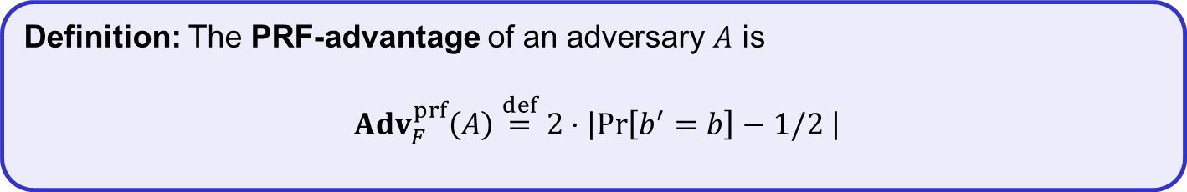
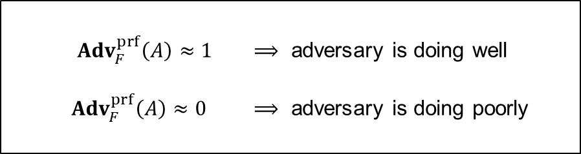
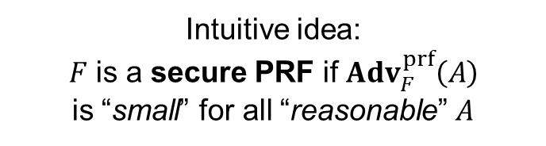
PRF – security
$$Exp_{F}^{prf}\left(A\right)$$
$$A=$$
World 0
$$K\underset{←}{\$}{\left\{0,1\right\}}^{k}$$ Input $X$: return $F_{K}\left(X\right)$
$b$
World 1
$$\tilde{F}\underset{←}{\$}Func\left[in,out\right]$$ Input $X$: return $\tilde{F}\left(X\right)$
$b\underset{←}{\$}\left\{0,1\right\}$
$K\underset{←}{\$}{\left\{0,1\right\}}^{k}$
$F_{0}\underset{←}{}F_{K}$ // real $F$
$F_{1}\underset{←}{\$}Func\left[in, out\right]$ // random $\tilde{F}$
$b^{′}\underset{←}{}A^{F_{b}(⋅)}$
$return b^{′}\overset{?}{=}b$
$$b=0$$
$$b=1$$
Intuitive idea:
$F$ is a secure PRF if ${Adv}_{F}^{prf}\left(A\right)$
is “small” for all “reasonable” $A$
${Adv}_{F}^{prf}\left(A\right)≈1$ $⟹$ adversary is doing well
${Adv}_{F}^{prf}\left(A\right)≈0$ $⟹$ adversary is doing poorly
${Adv}_{F}^{prf}\left(A\right)≈1$ $⟹$ adversary is doing well
${Adv}_{F}^{prf}\left(A\right)≈0$ $⟹$ adversary is doing poorly
$$/2$$
I’m in World $b′$
Definition: The PRF-advantage of an adversary $A$ is
$${Adv}_{F}^{prf}\left(A\right)\overset{def}{=}2⋅\left|\operatorname{Pr}\left[b^{′}=b\right]−1/2 \right|$$

Slide 16

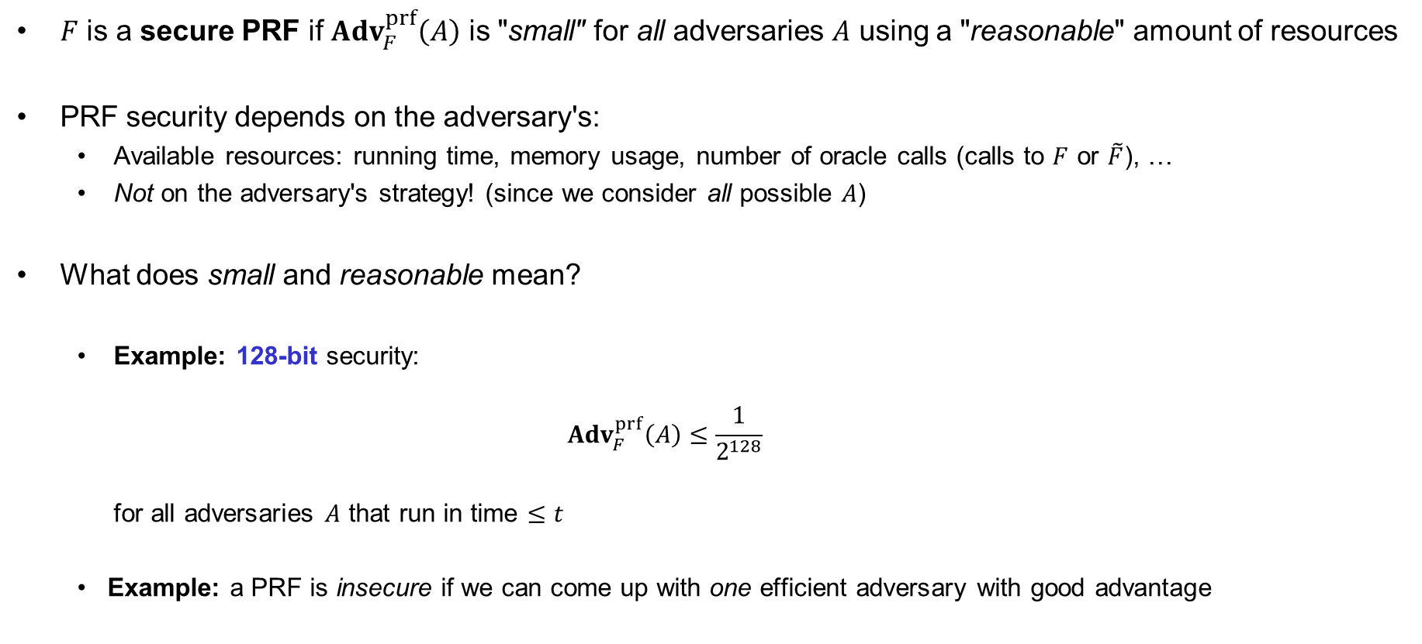


Understanding "advantage"
$F$ is a secure PRF if ${Adv}_{F}^{prf}\left(A\right)$ is "small" for all adversaries $A$ using a "reasonable" amount of resources
PRF security depends on the adversary's:
  Available resources: running time, memory usage, number of oracle calls (calls to $F$ or $\tilde{F}$), …
  Not on the adversary's strategy! (since we consider all possible $A$)
What does small and reasonable mean?
  Example: 128-bit security:
  ${Adv}_{F}^{prf}\left(A\right)≤\frac{1}{2^{128}}$
  for all adversaries $A$ that run in time $≤t$
  Example: a PRF is insecure if we can come up with one efficient adversary with good advantage
$$t$$
$$2^{80}$$
$$=2^{−48}≈0.000000000000001$$
$$≈2^{80}$$

Slide 17


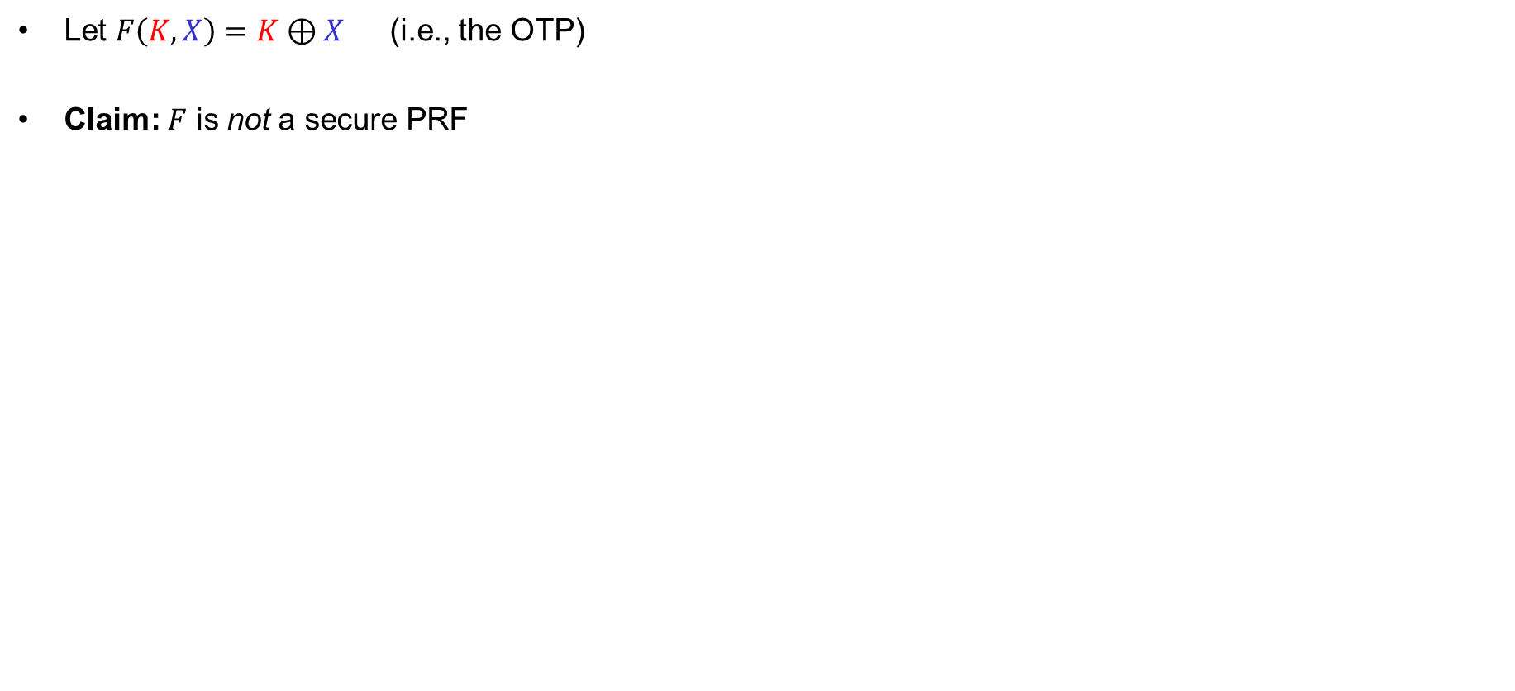


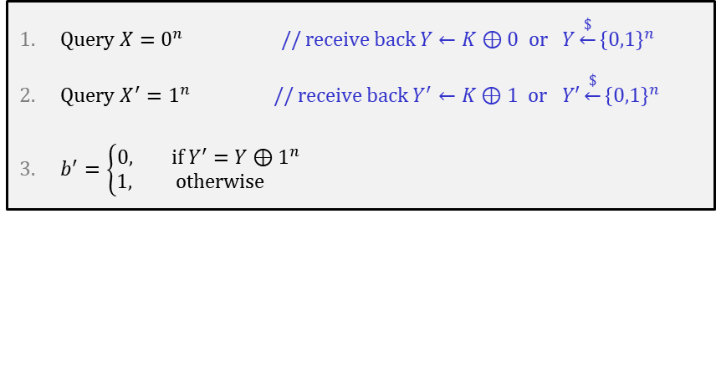
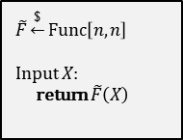

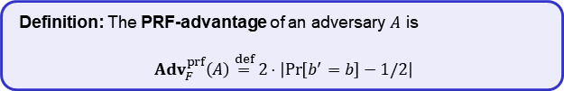


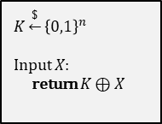
Example
Let $F\left(K, X\right)=K⊕X$ (i.e., the OTP)
Claim: $F$ is not a secure PRF
$$\text{World}\text{ 0}$$
$$\text{World} \text{1}$$
$$K\underset{←}{\$}{\left\{0,1\right\}}^{n}$$
Input $X$:
return $K⊕X$
$b$
$$\tilde{F}\underset{←}{\$}Func\left[n,n\right]$$
Input $X$:
return $\tilde{F}\left(X\right)$
$$A$$
Query $X=0^{n}$ // receive back $Y←K⊕0$ or $Y\underset{←}{\$}{\left\{0,1\right\}}^{n}$
Query $X^{′}=1^{n}$ // receive back $Y^{′}←K⊕1$ or $Y′\underset{←}{\$}{\left\{0,1\right\}}^{n}$
$b^{′}=\left\{\begin{aligned}0, if Y^{′}=Y⊕1^{n} \\ &1, otherwise \end{aligned}\right.$
$$X^{′}$$
$$X$$
$$X$$
$$X^{′}$$
$$Y^{′}$$
$$Y$$
$$Y$$
$$Y^{′}$$
I’m in World $b′$
Definition: The PRF-advantage of an adversary $A$ is
$${Adv}_{F}^{prf}\left(A\right)\overset{def}{=}2⋅\left|\operatorname{Pr}\left[b^{′}=b\right]−1/2\right|$$
$$\operatorname{Pr}\left[b^{′}=b\right] =$$
$$= \operatorname{Pr}\left[b^{′}=0 ∣ b=0\right]⋅\operatorname{Pr}\left[ b=0\right]+\operatorname{Pr}\left[b^{′}=1 ∣ b=1\right]⋅\operatorname{Pr}\left[ b=1\right]$$
$$= \operatorname{Pr}\left[b^{′}=0 ∣ b=0\right]⋅1/2 +\operatorname{Pr}\left[b^{′}=1 ∣ b=1\right]⋅1/ 2$$
$$= Pr\left[Y^{′}=Y⊕1^{n}∣b=0\right]{⋅1/2} + ⋯$$
$$= 1⋅1/2 + ⋯$$
Notes:
0^n = 0000…0 (n bits)
1^n = 1111…1 (n bits)

Slide 18





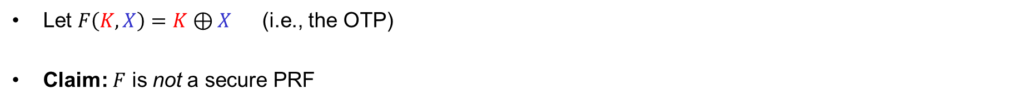
Example
Let $F\left(K, X\right)=K⊕X$ (i.e., the OTP)
Claim: $F$ is not a secure PRF
$$\text{World}\text{ 0}$$
$$\text{World} \text{1}$$
$$K\underset{←}{\$}{\left\{0,1\right\}}^{n}$$
Input $X$:
return $K⊕X$
$b$
$$\tilde{F}\underset{←}{\$}Func\left[n,n\right]$$
Input $X$:
return $\tilde{F}\left(X\right)$
$$A$$
Query $X=0^{n}$ // receive back $Y←K⊕0$ or $Y\underset{←}{\$}{\left\{0,1\right\}}^{n}$
Query $X^{′}=1^{n}$ // receive back $Y^{′}←K⊕1$ or $Y′\underset{←}{\$}{\left\{0,1\right\}}^{n}$
$b^{′}=\left\{\begin{aligned}0, if Y^{′}=Y⊕1^{n} \\ &1, otherwise \end{aligned}\right.$
$$X^{′}$$
$$X$$
$$Y$$
$$Y^{′}$$
$$Y$$
$$Y^{′}$$
$$X$$
$$X^{′}$$
I’m in World $b′$
Definition: The PRF-advantage of an adversary $A$ is
$${Adv}_{F}^{prf}\left(A\right)\overset{def}{=}2⋅\left|\operatorname{Pr}\left[b^{′}=b\right]−1/2\right|$$
$$\operatorname{Pr}\left[b^{′}=b\right] =$$
$$= \operatorname{Pr}\left[b^{′}=0 ∣ b=0\right]⋅\operatorname{Pr}\left[ b=0\right]+\operatorname{Pr}\left[b^{′}=1 ∣ b=1\right]⋅\operatorname{Pr}\left[ b=1\right]$$
$$= \operatorname{Pr}\left[b^{′}=0 ∣ b=0\right]⋅1/2 +\operatorname{Pr}\left[b^{′}=1 ∣ b=1\right]⋅1/ 2$$
$$= Pr\left[Y^{′}=Y⊕1^{n}∣b=0\right]{⋅1/2} +\left(1−Pr\left[b^{′}=0 ∣ b=1\right]\right)⋅1/2$$
$$= 1⋅1/2 + ⋯$$
$$\left(1−Pr\left[Y^{′}=Y⊕1^{n} ∣ b=1\right]\right)⋅1/2$$
$$= 1/2 +\left(1−\frac{1}{2^{n}}\right)⋅1/2$$
$$= 1−\frac{1}{2^{n+1}}$$

Slide 19






Example
Let $F\left(K, X\right)=K⊕X$ (i.e., the OTP)
Claim: $F$ is not a secure PRF
$$\text{World}\text{ 0}$$
$$\text{World} \text{1}$$
$$K\underset{←}{\$}{\left\{0,1\right\}}^{n}$$
Input $X$:
return $K⊕X$
$b$
$$\tilde{F}\underset{←}{\$}Func\left[n,n\right]$$
Input $X$:
return $\tilde{F}\left(X\right)$
$$A$$
Query $X=0^{n}$ // receive back $Y←K⊕0$ or $Y\underset{←}{\$}{\left\{0,1\right\}}^{n}$
Query $X^{′}=1^{n}$ // receive back $Y^{′}←K⊕1$ or $Y′\underset{←}{\$}{\left\{0,1\right\}}^{n}$
$b^{′}=\left\{\begin{aligned}0, if Y^{′}=Y⊕1^{n} \\ &1, otherwise \end{aligned}\right.$
I’m in World $b′$
Definition: The PRF-advantage of an adversary $A$ is
$${Adv}_{F}^{prf}\left(A\right)\overset{def}{=}2⋅\left|\operatorname{Pr}\left[b^{′}=b\right]−1/2\right|$$
$$\operatorname{Pr}\left[b^{′}=b\right] =$$
$$1−\frac{1}{2^{n+1}}$$
$${Adv}_{F}^{prf}\left(A\right)=2⋅\left|\operatorname{Pr}\left[b^{′}=b\right]−\frac{1}{2}\right|$$
$$= 2⋅\left|\left(1−\frac{1}{2^{n+1}}\right)−\frac{1}{2}\right|$$
$$= 1−2^{−n}$$
$$≈ 1$$

Slide 20
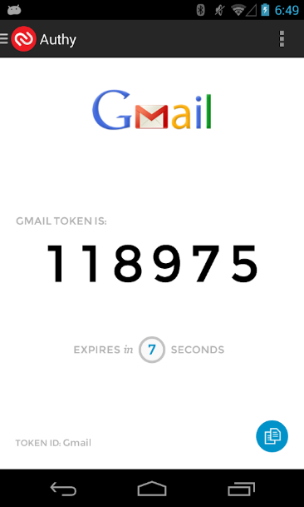

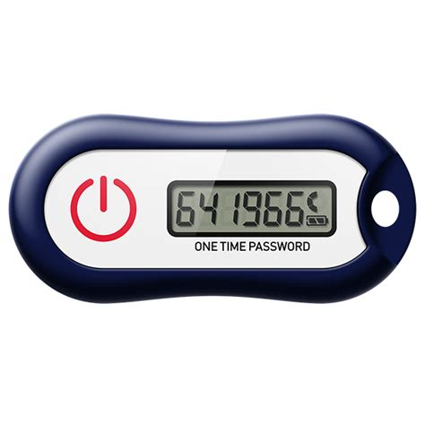


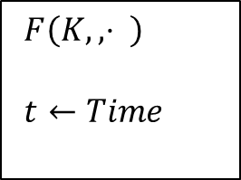

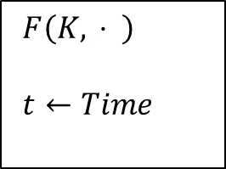






PRF applications: one-time tokens
PRF
$F\left(K, ,⋅ \right)$
$t←Time$
$F\left(K,, ⋅ \right)$
$t←Time$
$$⋮$$
$$OTT\overset{?}{=}F\left(K,t−2\right)$$
$$OTT\overset{?}{=}F\left(K,t−1\right)$$
$$641966←F\left(K,t\right)$$
$$OTT=641966$$
$$OTT\overset{?}{=}F\left(K,t\right)$$
$$OTT\overset{?}{=}F\left(K,t+1\right)$$
$$OTT\overset{?}{=}F\left(K,t+2\right)$$
$$⋮$$

Slide 21


Constructing block ciphers

Slide 22
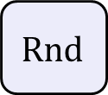





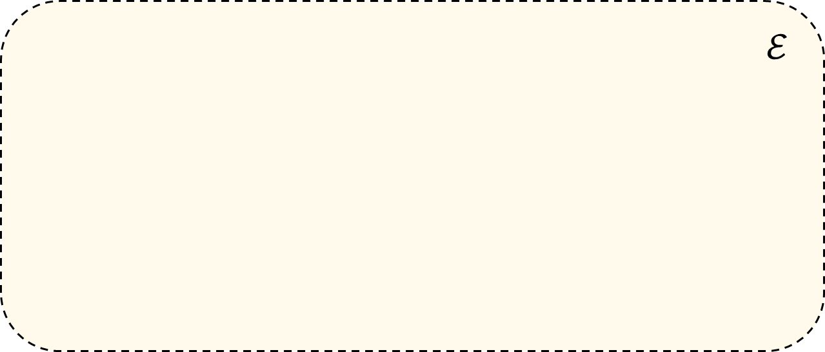









Block ciphers
$K$
$$ℰ$$
$$M$$
Key expansion
$$C$$
$n$ bits
$$K_{1}$$
$$K_{2}$$
$$K_{3}$$
$$K_{R}$$
$n$ bits
$$Rnd$$
$$Rnd$$
$$Rnd$$
$$Rnd$$
$$⋯$$
Rnd = round function (iterated $R$ times)
AES-128/192/256: $R=10/12/14$

Slide 23
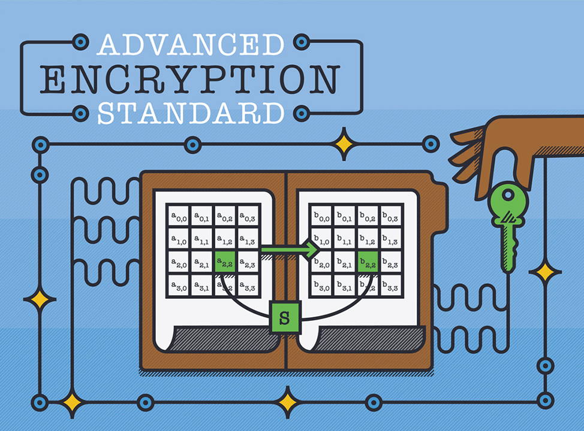
Advanced Encryption Standard
Notes:
https://formaestudio.com/rijndaelinspector/archivos/Rijndael_Animation_v4_eng-html5.html

Slide 24
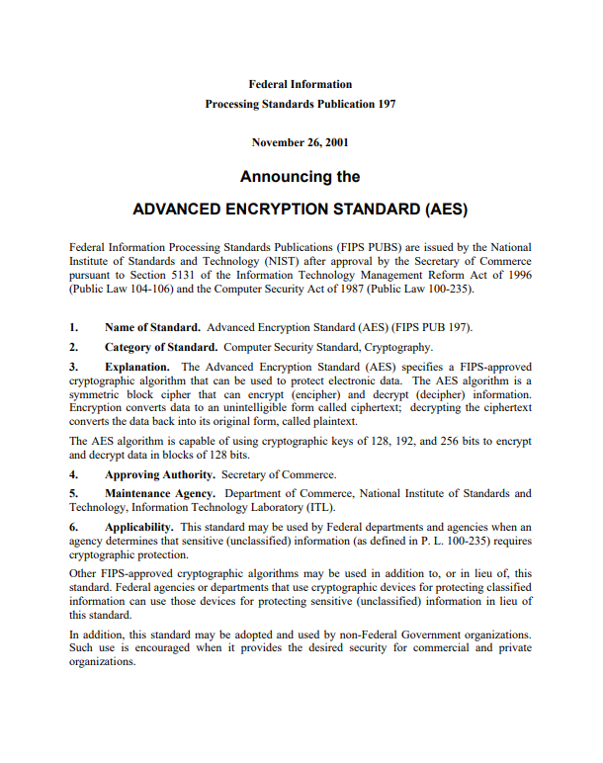
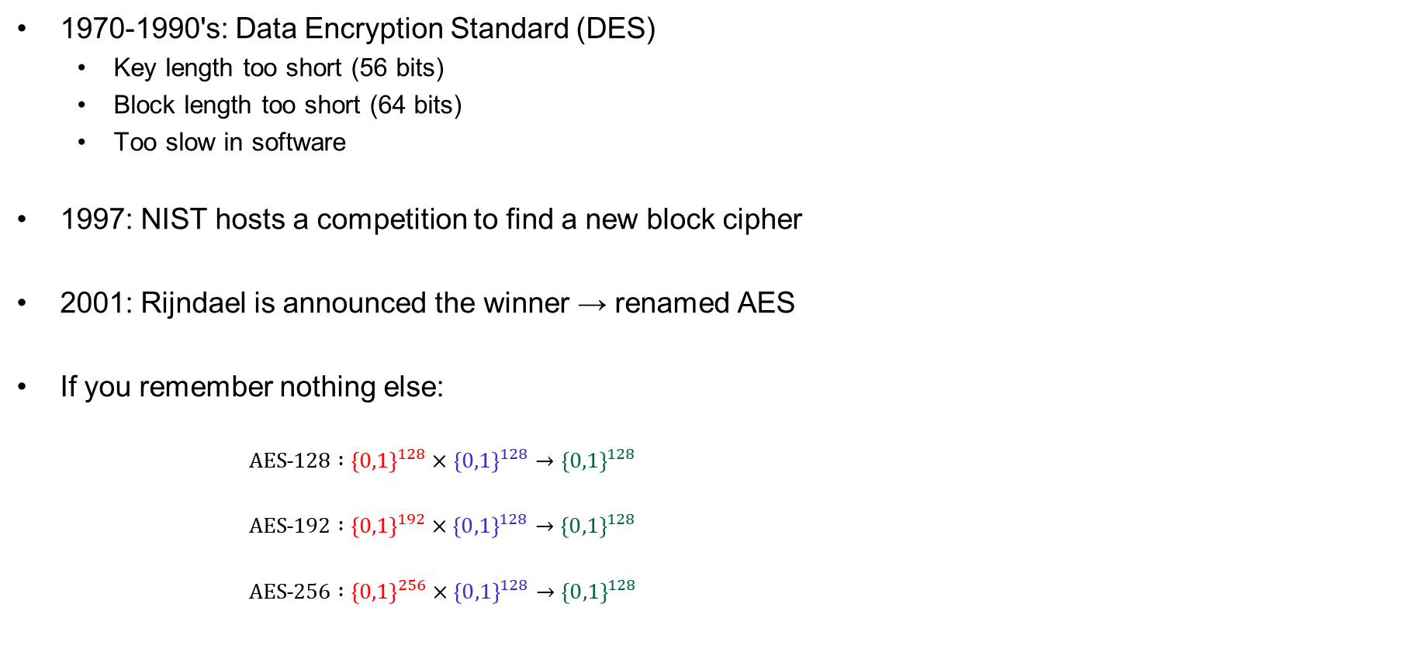
AES – history
1970-1990's: Data Encryption Standard (DES)
  Key length too short (56 bits)
  Block length too short (64 bits)
  Too slow in software
1997: NIST hosts a competition to find a new block cipher
2001: Rijndael is announced the winner → renamed AES
If you remember nothing else:
  $AES˗128 :{\left\{0,1\right\}}^{128}×{\left\{0,1\right\}}^{128}→{\left\{0,1\right\}}^{128}$
  $AES˗192 :{\left\{0,1\right\}}^{192}×{\left\{0,1\right\}}^{128}→{\left\{0,1\right\}}^{128}$
  $AES˗256 :{\left\{0,1\right\}}^{256}×{\left\{0,1\right\}}^{128}→{\left\{0,1\right\}}^{128}$
Notes:
https://formaestudio.com/rijndaelinspector/archivos/Rijndael_Animation_v4_eng-html5.html

Slide 25













AES-128
128
$$K$$
128
128
128
128
128
$${ K}_{0}$$
$${ K}_{1}$$
$${ K}_{2}$$
$$⋯$$
$$K_{9}$$
$$K_{10}$$
input
SubBytes
ShiftRow
MixColumn
SubBytes
ShiftRow
MixColumn
SubBytes
ShiftRow
output
$$⊕$$
$$⊕$$
$$⊕$$
$$⋯$$
$$⊕$$
$$⊕$$
10 rounds
Notes:
https://formaestudio.com/rijndaelinspector/archivos/Rijndael_Animation_v4_eng-html5.html

Slide 26
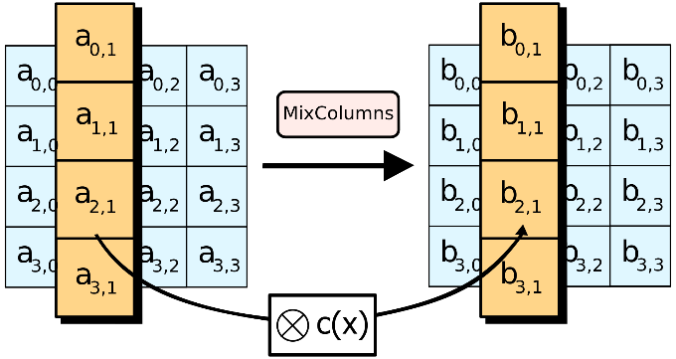
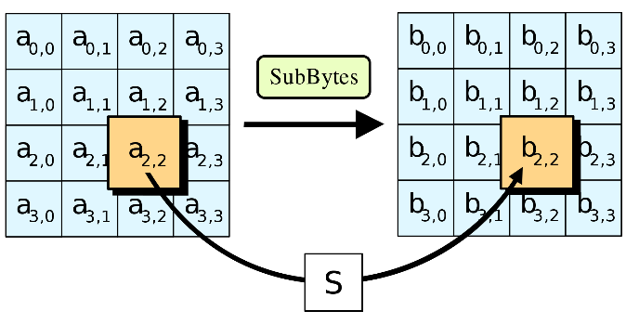
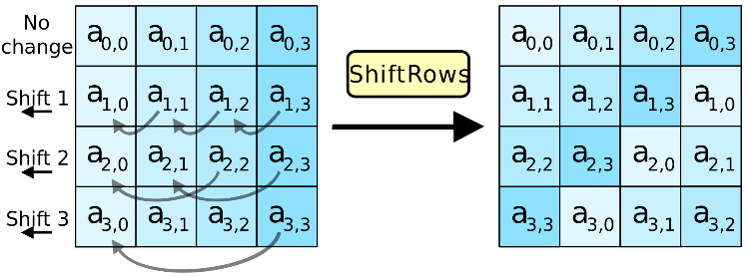
AES round function
SubBytes
ShiftRow
MixColumn
Notes:
https://formaestudio.com/rijndaelinspector/archivos/Rijndael_Animation_v4_eng-html5.html

Slide 27
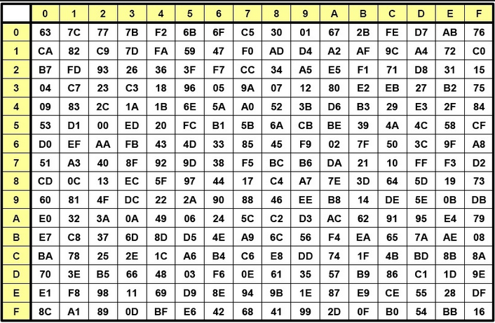


AES round function - SubBytes
SubBytes
ShiftRow
MixColumn
$a_{2,2}=$ 8A
$b_{2,2}=$ 7E
Notes:
https://formaestudio.com/rijndaelinspector/archivos/Rijndael_Animation_v4_eng-html5.html

Slide 28
AES round function - ShiftRows
SubBytes
ShiftRow
MixColumn
Notes:
https://formaestudio.com/rijndaelinspector/archivos/Rijndael_Animation_v4_eng-html5.html

Slide 29


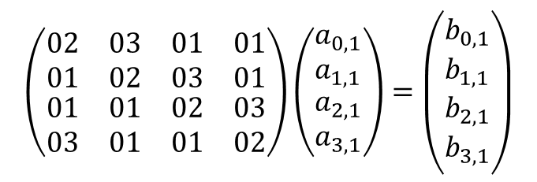

AES round function - MixColumns
$$a_{1}$$
$$b_{1}$$
$$Ma_{1}=b_{1}$$
$$\left(\begin{matrix}\begin{matrix}02 & 03 \\ 01 & 02\end{matrix} & \begin{matrix}01 & 01 \\ 03 & 01\end{matrix} \\ \begin{matrix}01 & 01 \\ 03 & 01\end{matrix} & \begin{matrix}02 & 03 \\ 01 & 02\end{matrix}\end{matrix}\right)\left(\begin{matrix}a_{0,1} \\ a_{1,1} \\ \begin{matrix}a_{2,1} \\ a_{3,1}\end{matrix}\end{matrix}\right)=\left(\begin{matrix}b_{0,1} \\ b_{1,1} \\ \begin{matrix}b_{2,1} \\ b_{3,1}\end{matrix}\end{matrix}\right)$$
SubBytes
ShiftRow
MixColumn
$$1⋅a_{0,1}+2⋅a_{1,1}+3⋅a_{2,1}+1⋅a_{3,1}=b_{1,1}$$
$$a_{0,1}⊕2⋇a_{1,1}⊕3⋇a_{2,1}⊕a_{3,1}=b_{1,1}$$
Notes:
https://formaestudio.com/rijndaelinspector/archivos/Rijndael_Animation_v4_eng-html5.html

Slide 30







AES-128
128
$$K$$
128
128
128
128
128
$$K_{0}$$
$$K_{1}$$
$$K_{2}$$
$$K_{9}$$
$$K_{10}$$
input
SubBytes
ShiftRow
MixColumn
SubBytes
ShiftRow
MixColumn
SubBytes
ShiftRow
output
$$⊕$$
$$⊕$$
$$⊕$$
$$⋯$$
$$⊕$$
$$⊕$$
10 rounds
Notes:
https://formaestudio.com/rijndaelinspector/archivos/Rijndael_Animation_v4_eng-html5.html

Slide 31
AES performance
AES is reasonably efficient in software
  Table-based implementation very fast (but not secure!)
  Difficult to implement AES both fast and securely (in SW)
Intel introduced dedicated AES instructions into their CPUs (AES-NI):
  aesenc, aesenclast: do one round of AES in one cycle
  aeskeygenassist: do AES key expansion
  aesdec, aesdeclast: do one round of AES decryption in one cycle
  aesimc: do AES inverser MixColumns
  Now standard in all modern CPUs
 | Throughput (my laptop)
AES-128 (in software) | 0.27 GB/s
AES-128 (w/AES-NI) | 3.45 GB/s
Notes:
https://formaestudio.com/rijndaelinspector/archivos/Rijndael_Animation_v4_eng-html5.html

Slide 32
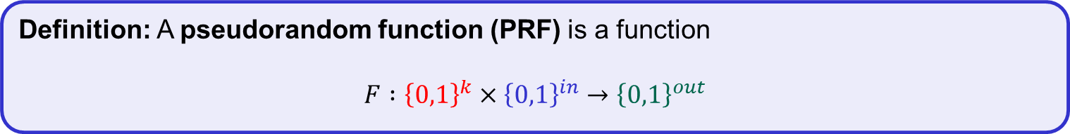
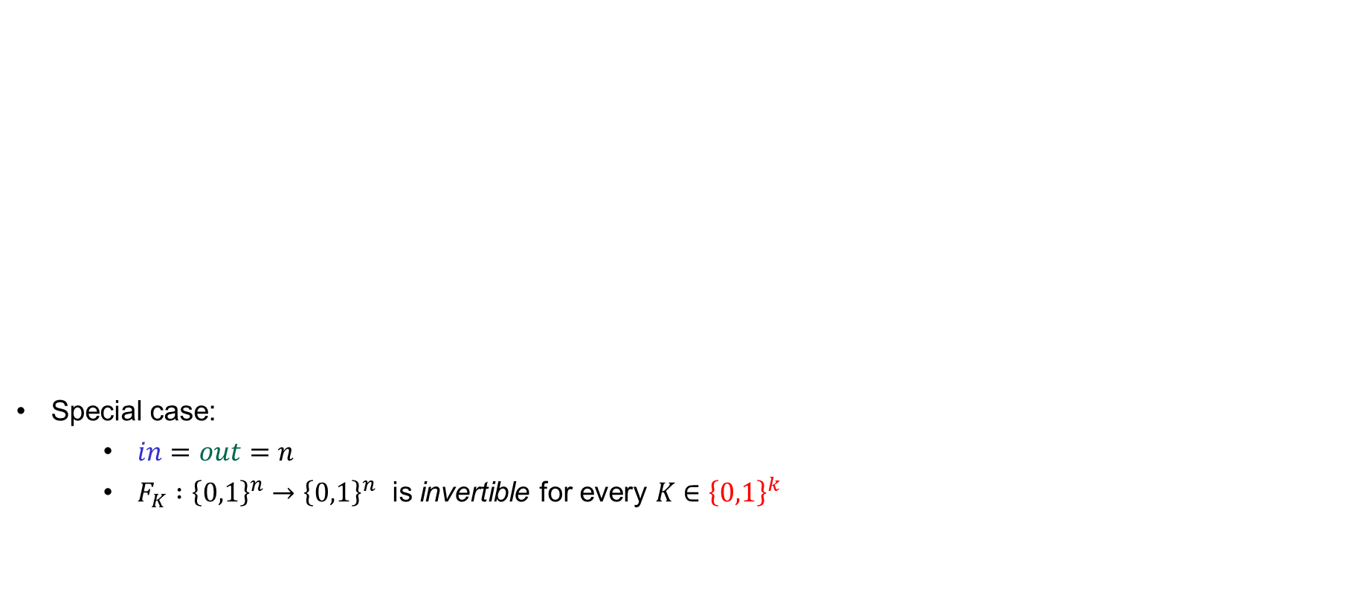
Block ciphers, a.k.a. pseudorandom permutations (PRP)
Special case:
  $in=out=n$
  $F_{K} :{\left\{0,1\right\}}^{n}→{\left\{0,1\right\}}^{n}$ is invertible for every $K∈{\left\{0,1\right\}}^{k}$
Definition: A pseudorandom function (PRF) is a function
$$F :{\left\{0,1\right\}}^{k}×{\left\{0,1\right\}}^{in}→{\left\{0,1\right\}}^{out}$$
Definition: A block cipher, or pseudorandom permutation (PRP), is a PRF where:

Slide 33
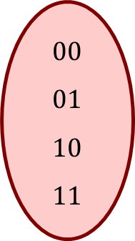
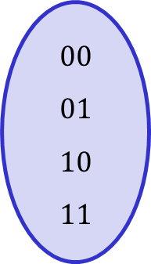
Permutations vs. functions
$$E_{K}$$
$$F_{K}$$
$$00 \\ 01 \\ 10 \\ 11$$
$$00 \\ 01 \\ 10 \\ 11$$
$$00 \\ 01 \\ 10 \\ 11$$
$$00 \\ 01 \\ 10 \\ 11$$
Permutation
Not a permutation

Slide 34




Permutations vs. functions
$$E^{−1}$$
$$E_{K}$$
$$F_{K}$$
$$00 \\ 01 \\ 10 \\ 11$$
$$00 \\ 01 \\ 10 \\ 11$$
$$00 \\ 01 \\ 10 \\ 11$$
$$00 \\ 01 \\ 10 \\ 11$$
Permutation
Not a permutation
Important:
${E : \left\{0,1\right\}}^{k}×{\left\{0,1\right\}}^{n}→{\left\{0,1\right\}}^{n}$ is not a permutation (but a block cipher)
$E_{K} :{\left\{0,1\right\}}^{n}→{\left\{0,1\right\}}^{n}$ is a permutation

Slide 35




PRF – security
$$Exp_{F}^{prf}\left(A\right)$$
$b\underset{←}{\$}\left\{0,1\right\}$ $K\underset{←}{\$}{\left\{0,1\right\}}^{k}$ $F_{0}\underset{←}{}F_{K}$ $F_{1}\underset{←}{\$}Func\left[in, out\right]$ $b^{′}\underset{←}{}A^{F_{b}(⋅)}$ $return b^{′}\overset{?}{=}b$
$$A=$$
World 0
$$K\underset{←}{\$}{\left\{0,1\right\}}^{k}$$ Input $X$: return $F_{K}\left(X\right)$
$b$
World 1
$$\tilde{F}\underset{←}{\$}Func\left[in,out\right]$$ Input $X$: return $\tilde{F}\left(X\right)$
I’m in World $b′$
Definition: The PRF-advantage of an adversary $A$ is
$${Adv}_{F}^{prf}\left(A\right)\overset{def}{=}2⋅\left| \operatorname{Pr}\left[b^{′}=b\right]−1/2 \right|$$

Slide 36






PRF PRP – security
$$prp$$
$$Exp_{F}^{prf} \left(A\right)$$
$b\underset{←}{\$}\left\{0,1\right\}$ $K\underset{←}{\$}{\left\{0,1\right\}}^{k}$ $F_{0}\underset{←}{}F_{K}$ $F_{1}\underset{←}{\$}Func\left[in, out\right]$ $b^{′}\underset{←}{}A^{F_{b}(⋅)}$ $return b^{′}\overset{?}{=}b$
$$A=$$
World 0
$$K\underset{←}{\$}{\left\{0,1\right\}}^{k}$$ Input $X$: return $F_{K}\left(X\right)$
$b$
World 1
$$\tilde{F}\underset{←}{\$}Func\left[in,out\right]$$ Input $X$: return $\tilde{F}\left(X\right)$
$$Perm\left[n\right]$$
$$Perm\left[n\right]$$
I’m in World $b′$
Definition: The PRP-advantage of an adversary $A$ is
$${Adv}_{F}^{prf}\left(A\right)\overset{def}{=}2⋅\left|\operatorname{Pr}\left[b^{′}=b\right]−1/2 \right|$$
$$prp$$

Slide 37













PRP security $⟹$ PRF security
PRP/PRF Switching Lemma: Let $E$ be a PRP. For all $A$ making exactly $q$ oracle queries:
$${Adv}_{E}^{prf}\left(A\right)≤{Adv}_{E}^{prp}\left(A\right)+\frac{q^{2}}{2^{n}}$$
Proof sketch:
all outputs from PRF oracle are distinct
$$\operatorname{Pr}\left[b^{′}=b\right]$$
$$=$$
$$\operatorname{Pr}\left[b^{′}=b∣dist \right]\operatorname{Pr}\left[dist \right]+\operatorname{Pr}\left[b^{′}=b∣\overline{dist} \right]\operatorname{Pr}\left[ \overline{dist} \right]$$
$$≤$$
$$\operatorname{Pr}\left[b^{′}=b∣dist \right]+\operatorname{Pr}\left[ \overline{dist} \right]$$
$$\operatorname{Pr}\left[ \overline{dist} \right]=\operatorname{Pr}{[Y_{1}∨Y_{2}∨⋯∨Y_{q}]}$$
$$≤\operatorname{Pr}\left[Y_{1}\right]+\operatorname{Pr}\left[Y_{2}\right]+\operatorname{Pr}\left[Y_{3}\right]+⋯+\operatorname{Pr}\left[Y_{q}\right]$$
$$≤ \frac{0}{2^{n}}$$
$$+\frac{1}{2^{n}}$$
$$+\frac{2}{2^{n}}$$
$$+⋯+\frac{q−1}{2^{n}}$$
$$= \frac{q\left(q−1\right)}{2⋅2^{n}}$$
event that $i$-th output from PRF oracle collides with previous output
$$<\frac{q^{2}}{2^{n+1}}$$

Slide 38






















PRP security $⟹$ PRF security
PRP/PRF Switching Lemma: Let $E$ be a PRP. For all $A$ making exactly $q$ oracle queries:
$${Adv}_{E}^{prf}\left(A\right)≤{Adv}_{E}^{prp}\left(A\right)+\frac{q^{2}}{2^{n}}$$
Proof sketch:
all outputs from PRF oracle are distinct
$${Adv}_{E}^{prf}\left(A\right)$$
$$\overset{def}{=}$$
$$($$
$$)$$
$$2⋅$$
$$=$$
$$\operatorname{Pr}\left[b^{′}=b∣dist \right]\operatorname{Pr}\left[dist \right]+\operatorname{Pr}\left[b^{′}=b∣\overline{dist} \right]\operatorname{Pr}\left[ \overline{dist} \right]$$
$$− 1$$
$$\operatorname{Pr}\left[b^{′}=b\right]$$
$$− 1$$
$$2⋅$$
$$($$
$$)$$
$$≤$$
$$\operatorname{Pr}\left[b^{′}=b∣dist \right]+\operatorname{Pr}\left[ \overline{dist} \right]$$
$$2⋅$$
$$− 1$$
$$\operatorname{Pr}\left[b^{′}=b∣dist \right] + \frac{q^{2}}{2^{n+1}}$$
$$≤$$
$2⋅$
$$− 1$$
$$2⋅$$
$${Adv}_{E}^{prp}\left(A\right) + \frac{q^{2}}{2^{n}}$$
$$=$$

Slide 39


Attacking block ciphers

Slide 40
Attacks on block ciphers
Brute force attacks: search through every possible key in the key space
  Generic: works for all block ciphers
  Not practical for large key spaces
Specialized attacks: try to exploit the concrete details of the block cipher
  Differential cryptanalysis ('90, but known by the designers of DES and NSA since mid '70 )
  Linear cryptanalysis ('92)
  AES designed to resist both
Implementation attacks: vulnerabilities due to implementation characteristics
  Power draw
  Timing
  Cache misses

Slide 41
Summary
Block ciphers are very important primitives (building blocks) – not encryption schemes!
Correct abstraction: block ciphers = PRPs
Right security notion for PRFs/PRPs:
indistinguishability from random function/permutation
Concrete block cipher designs: DES, AES, …
Next week: how to create encryption schemes from block ciphers

Slide 42












PRF security – an equivalent view
$$Func\left[in, out\right]$$
$$\left|Func\left[in,out\right]\right|=$$
# bitstrings of length $2^{in}⋅out$
$$=2^{\left(2^{in}⋅out\right)}$$
$$\tilde{F}(X)$$
$$101…111$$
$$001…001$$
$$111…100$$
$$101…000$$
$$⋮$$
$$001…001$$
$$G\left(X\right)=1^{out}$$
Example:
$$\left|Func\left[3,2\right]\right|=$$
$$2^{2^{3}⋅2}$$
$$F\left(X\right)=1010⋯$$
$$2^{in}$$
$$V\left(X\right)=X⊕17$$
$$=2^{16}$$
$$=65536$$
$$H\left(X\right)=0^{out}$$
$$\tilde{F}$$
$$out$$
- Bits to specify one function: $2^{in}⋅out$
- Each distinct bitstring of length $2^{in}⋅out$
represents a unique function

Slide 43








PRF security – an equivalent view
$$Func\left[128, 128\right]$$
$$\left|Func\left[in,out\right]\right|=$$
# bitstrings of length $2^{in}⋅out$
$$=2^{\left(2^{in}⋅out\right)}$$
$$\tilde{F}(X)$$
$$101…111$$
$$001…001$$
$$111…100$$
$$101…000$$
$$⋮$$
$$001…001$$
$$G\left(X\right)=1^{128}$$
Example:
$$\left|Func\left[3,2\right]\right|=$$
$$2^{2^{3}⋅2}$$
$$F\left(X\right)=1010⋯$$
$$2^{128}$$
$$V\left(X\right)=X⊕17$$
$$=2^{16}$$
$$=65536$$
$$H\left(X\right)=0^{128}$$
$$\tilde{F}$$
$$128$$
$$AES$$
$$\left|Func\left[128,128\right]\right|=$$
$$2^{2^{128}⋅128}$$
$${AES}_{00…}\left(X\right)$$
$${AES}_{101…}\left(X\right)$$
- Bits to specify one function: $2^{in}⋅out$
$$\left|AES\right|=$$
$$2^{128}$$
$${AES}_{11…}\left(X\right)$$
- Each distinct bitstring of length $2^{in}⋅out$
represents a unique function

Slide 44

PRF security – an equivalent view
$$Func\left[128, 128\right]$$
$$\left|Func\left[in,out\right]\right|=$$
# bitstrings of length $2^{in}⋅out$
$$=2^{\left(2^{in}⋅out\right)}$$
$$\tilde{F}(X)$$
$$101…111$$
$$001…001$$
$$111…100$$
$$101…000$$
$$⋮$$
$$001…001$$
$$G\left(X\right)=1^{128}$$
Example:
$$\left|Func\left[3,2\right]\right|=$$
$$2^{2^{3}⋅2}$$
$$F\left(X\right)=1010⋯$$
$$2^{128}$$
$$V\left(X\right)=X⊕17$$
$$=2^{16}$$
$$=65536$$
$$H\left(X\right)=0^{128}$$
$$\tilde{F}$$
$$128$$
$$\left|Func\left[128,128\right]\right|=$$
$$2^{2^{128}⋅128}$$
- Bits to specify one function: $2^{in}⋅out$
$$\left|AES\right|=$$
$$2^{128}$$
$$AES$$
- Each distinct bitstring of length $2^{in}⋅out$
represents a unique function

Slide 45

Block ciphers – security
$$\left|Func\left[128,128\right]\right|=$$
$$2^{2^{128}⋅128}$$
$$Func\left[128, 128\right]$$
$$G\left(X\right)=1^{128}$$
$$F\left(X\right)=1010⋯$$
$$V\left(X\right)=X⊕17$$
$$H\left(X\right)=0^{128}$$
$$\tilde{F}$$
$$\left|AES\right|=$$
$$2^{128}$$
$$AES$$

Slide 46







Block ciphers – security
$$\left|Func\left[128,128\right]\right|=$$
$$2^{2^{128}⋅128}$$
$$Func\left[128, 128\right]$$
$$\left|Perm\left[128\right]\right|=$$
$$2^{128}!$$
$$Perm\left[128\right]$$
$$G\left(X\right)=\overline{X}$$
$$F\left(X\right)=X$$
$$V\left(X\right)=X⊕17$$
$$H\left(X\right)=00…0$$
$$\left|AES\right|=$$
$$2^{128}$$
$$AES$$

