Slide 1
Lecture 10 – Diffie-Hellman III,
PKE, KEM, ElGamal, Noise
TEK4500
22.10.2025
Håkon Jacobsen
hakon.jacobsen@its.uio.no

Slide 2

Conspiracies…

Slide 3

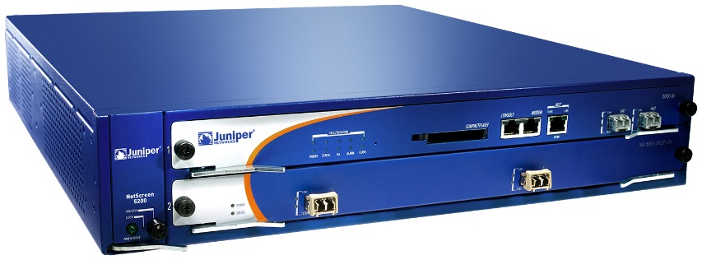
Juniper Networks
Juniper Networks: big manufacturer of network equipment (routers, VPNs, firewalls, etc.)
  Major customers: telcos, banks, US DoD
2015:
Hackers obtained access to source code repository
Only made one change:
--- Qx = 2c55e5e45edf713dc43475effe8813a60326a64d9ba3d2e39cb639b0f3b0ad10
+++ Qx = 9585320eeaf81044f20d55030a035b11bece81c785e6c933e4a8a131f6578107
IMPORTANT JUNIPER SECURITY ANNOUNCEMENT
During a recent internal code review, Juniper discovered unauthorized code in ScreenOS that could allow a knowledgeable attacker to gain administrative access to NetScreen® devices and to decrypt VPN connections.

Slide 4
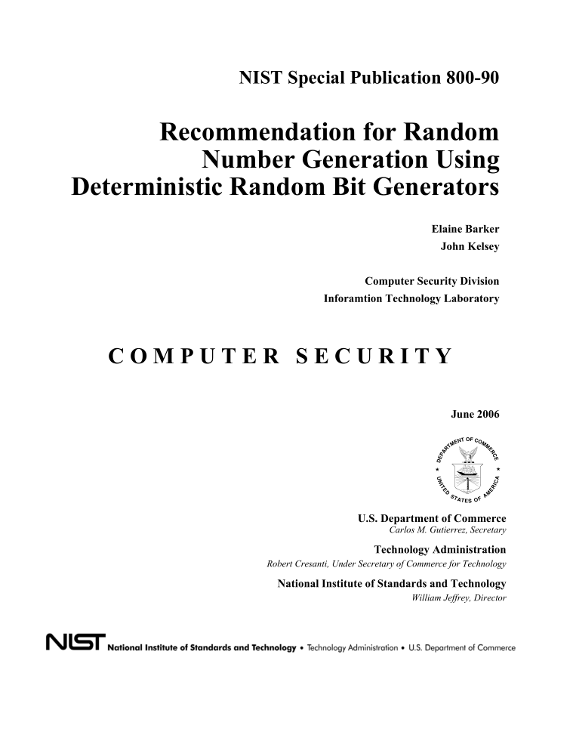
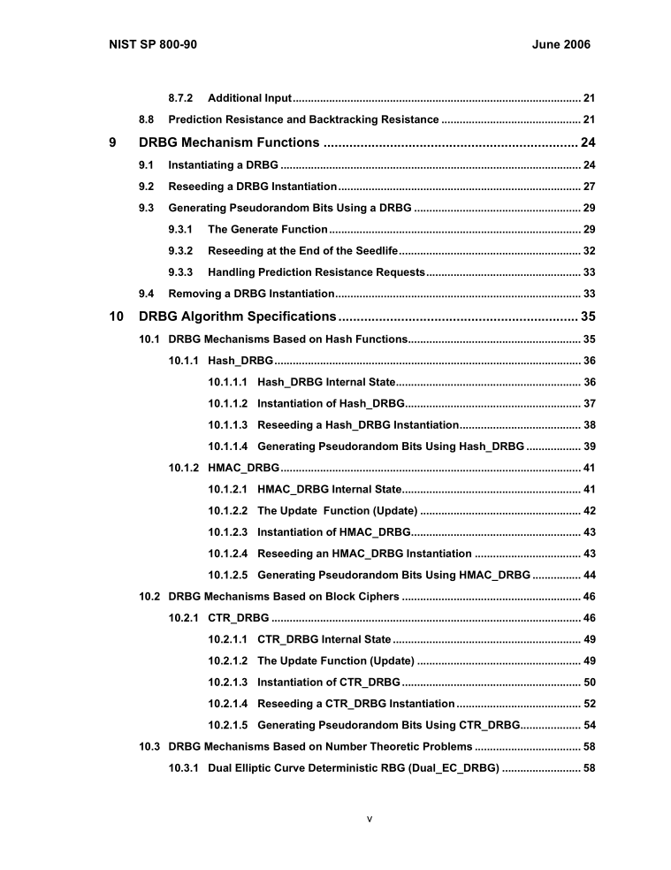
PRNG standardization

Slide 5
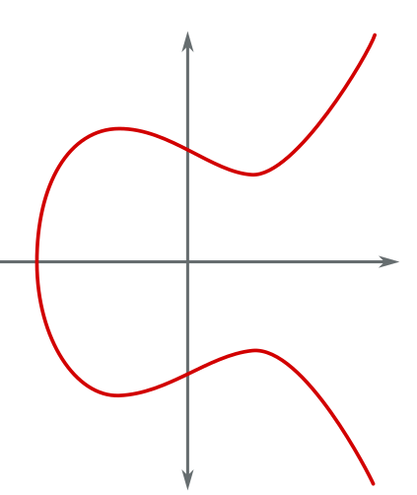
Elliptic curves summary
$P=(x,y)$ point on elliptic curve
$x$ and $y$ are elements in $Z_{p}$
Points $P$ and $Q$ can be added to get another point $P+Q$
Special case: add $P$ to itself $n$ times
$nP=P+P+…+P$
DLOG problem: given $P$ and $nP$, find $n$ (for secret $n$)
$$y$$
$$P$$
$$x$$
$$Q$$

Slide 6






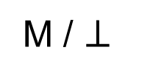
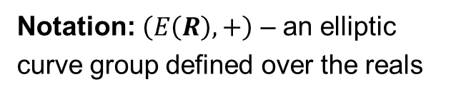



PRNG
$$G\left(s_{0}\right)$$
$$G\left(s_{1}\right)$$
$$G\left(s_{2}\right)$$
$${ s}_{0}$$
$${ s}_{1}$$
$${ s}_{2}$$
$$s_{3}$$
$$F\left(s_{0}\right)$$
$$F\left(s_{1}\right)$$
$$F\left(s_{2}\right)$$
$$⋯$$
$${ R}_{0}$$
$${ R}_{1}$$
$${ R}_{2}$$

Slide 7

















Dual EC DRBG
$P,Q:$public points on an elliptic curve
$x\left(⋅\right) :$x-coordinate of elliptic curve point (256 bits)
$$x\left(s_{0}Q\right)$$
$$x\left(s_{1}Q\right)$$
$$x\left(s_{2}Q\right)$$
256 bit
$${ s}_{0}$$
$${ s}_{1}$$
$${ s}_{2}$$
$$s_{0}P$$
$$x\left(s_{1}P\right)$$
$$x\left(s_{2}P\right)$$
$$⋯$$
$$x\left(s_{0}Q\right)$$
$$r_{0}$$
$$r_{1}$$
$$r_{2}$$
keep 240 bits

Slide 8






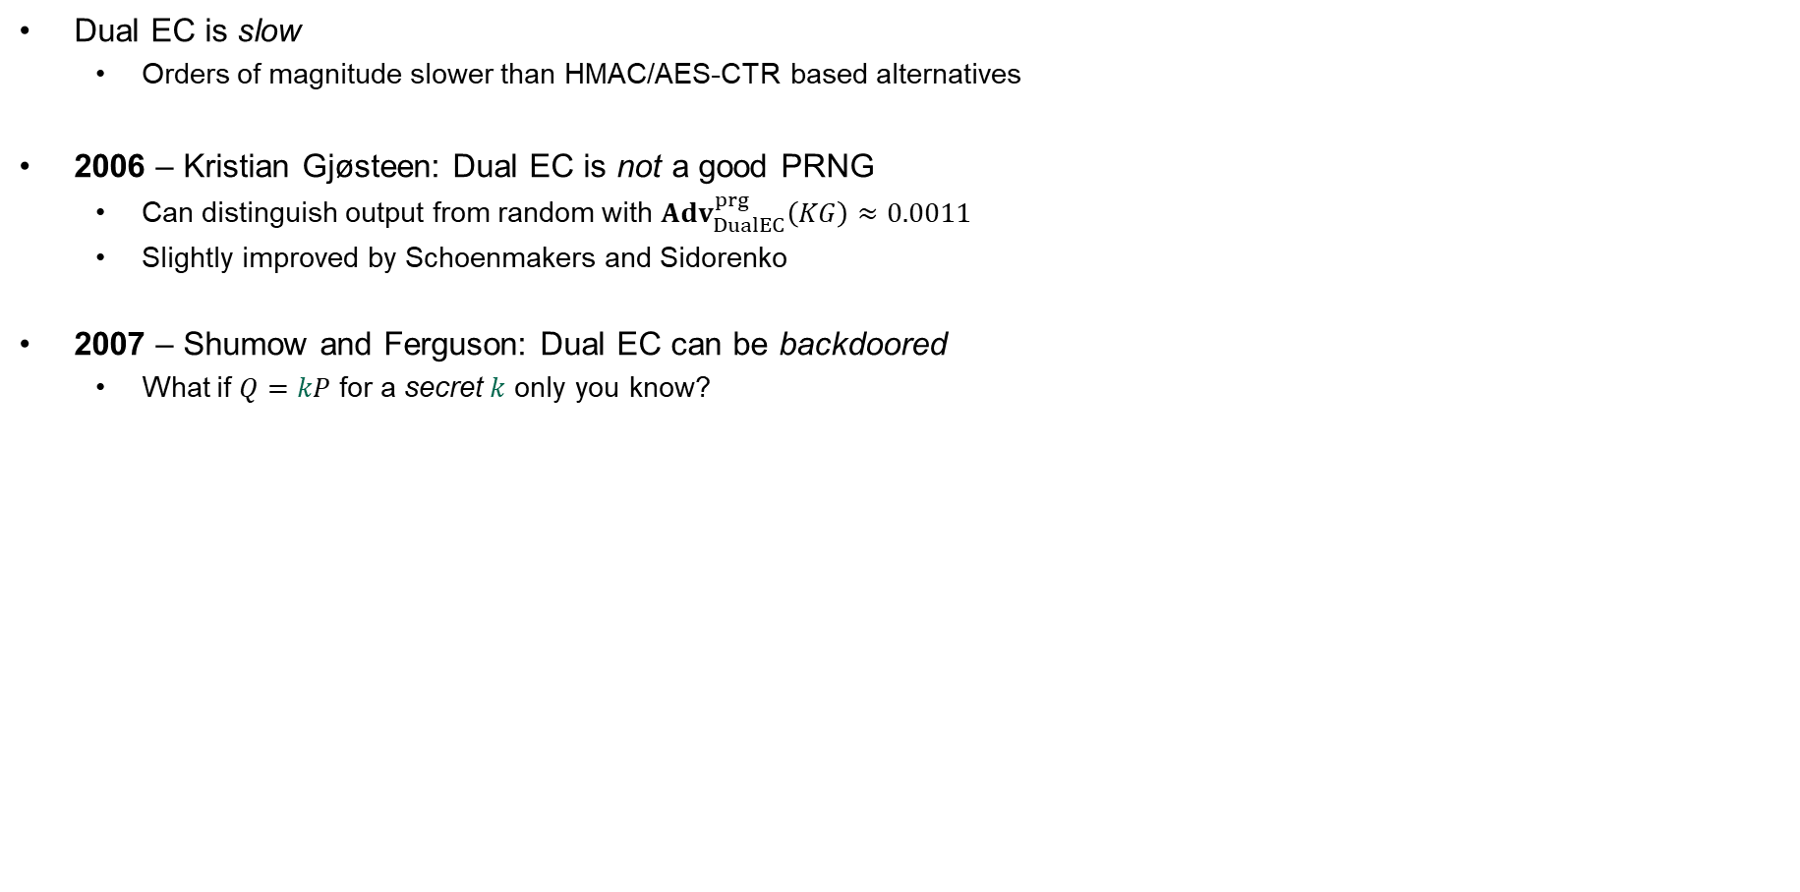








Dual EC DRBG – something's fishy
Dual EC is slow
  Orders of magnitude slower than HMAC/AES-CTR based alternatives
2006 – Kristian Gjøsteen: Dual EC is not a good PRNG
  Can distinguish output from random with ${Adv}_{DualEC}^{prg}\left(KG\right)≈0.0011$
  Slightly improved by Schoenmakers and Sidorenko
2007 – Shumow and Ferguson: Dual EC can be backdoored
  What if $Q=kP$ for a secret $k$ only you know?
$$x\left(s_{0}Q\right)$$
$$x\left(s_{1}Q\right)$$
$$x\left(s_{2}Q\right)$$
$${ s}_{0}$$
$${ s}_{1}$$
$${ s}_{2}$$
$$s_{0}P$$
$$x\left(s_{1}P\right)$$
$$x\left(s_{2}P\right)$$
$$⋯$$
$$x\left(s_{0}Q\right)$$
$$r_{0}$$
$$r_{1}$$
$$r_{2}$$

Slide 9













Dual EC DRBG
$P,Q:$public points on an elliptic curve
$$Q=kP$$
$x\left(⋅\right) :$x-coordinate (256 bits)
$$x\left(s_{0}Q\right)$$
$$x\left(s_{1}Q\right)$$
$$x\left(s_{2}Q\right)$$
256 bit
$${ s}_{0}$$
$${ s}_{1}$$
$${ s}_{2}$$
$$s_{0}P$$
$$x\left(s_{1}P\right)$$
$$x\left(s_{2}P\right)$$
$$⋯$$
$$x\left(s_{0}Q\right)$$
$$r_{0}$$
$$r_{1}$$
$$r_{2}$$
keep 240 bits
$${ R}_{0}$$
$${ R}_{1}$$
$${ R}_{2}$$
$${kR}_{0}$$
$$= k⋅\left(s_{0}P\right)$$
$$= s_{0}⋅\left(kP\right)$$
$$= s_{0}Q$$
$$\underset{→}{x\left(⋅\right)}{ s}_{1}$$

Slide 10
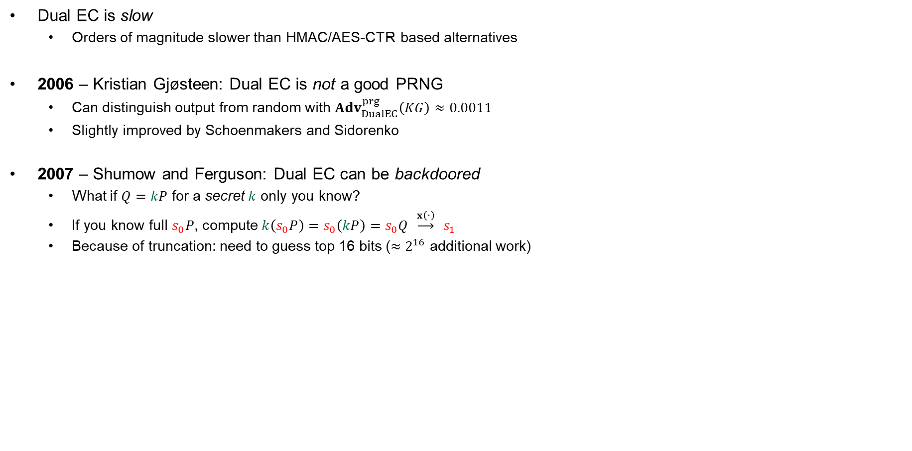
Dual EC DRBG – something's fishy
Dual EC is slow
  Orders of magnitude slower than HMAC/AES-CTR based alternatives
2006 – Kristian Gjøsteen: Dual EC is not a good PRNG
  Can distinguish output from random with ${Adv}_{DualEC}^{prg}\left(KG\right)≈0.0011$
  Slightly improved by Schoenmakers and Sidorenko
2007 – Shumow and Ferguson: Dual EC can be backdoored
  What if $Q=kP$ for a secret $k$ only you know?
  If you know full $s_{0}P$, compute $k\left(s_{0}P\right)=s_{0}\left(kP\right)=s_{0}Q \underset{→}{x\left(⋅\right)} s_{1}$
  Because of truncation: need to guess top 16 bits (${≈2}^{16}$ additional work)
$$x\left(s_{0}Q\right)$$
$$x\left(s_{1}Q\right)$$
$$x\left(s_{2}Q\right)$$
$${ s}_{0}$$
$${ s}_{1}$$
$${ s}_{2}$$
$$s_{0}P$$
$$x\left(s_{1}P\right)$$
$$x\left(s_{2}P\right)$$
$$⋯$$
$$x\left(s_{0}Q\right)$$
$$r_{0}$$
$$r_{1}$$
$$r_{2}$$

Slide 11
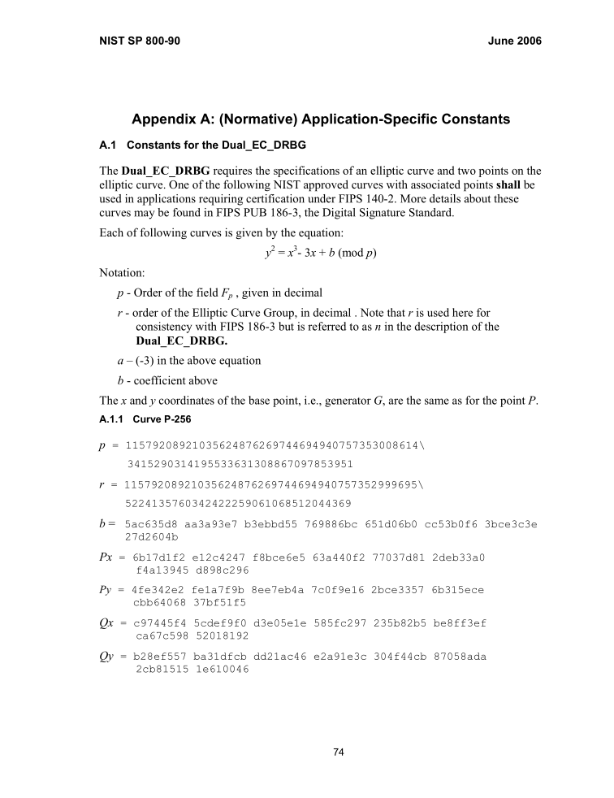
Where does $Q$ (and $P$) come from?
From: John Kelsey [mailto:john.kelsey@nist.gov]
Sent: Wednesday, October 27, 2004 11:17 AM
To: Don Johnson
Subject: Minding our Ps and Qs in Dual_EC
Do you know where Q comes from in Dual_EC_DRBG?
Thanks,
-Joh
----------------------------------------------------------------
Subject: RE: Minding our Ps and Qs in Dual_EC
From: "Don Johnson" <DJohnson@cygnacom.com>
Date: Wed, October 27, 2004 11:42 am
To: "John Kelsey" <john.kelsey@nist.gov>
John,
P=G.
Q is (in essence) the public key for some random private key.
It could also be generated like a(nother) canonical G, but NSA kyboshed
this idea, and I was not allowed to publicly discuss it, just in case you
may think of going there.
Don B. Johnson

Slide 12
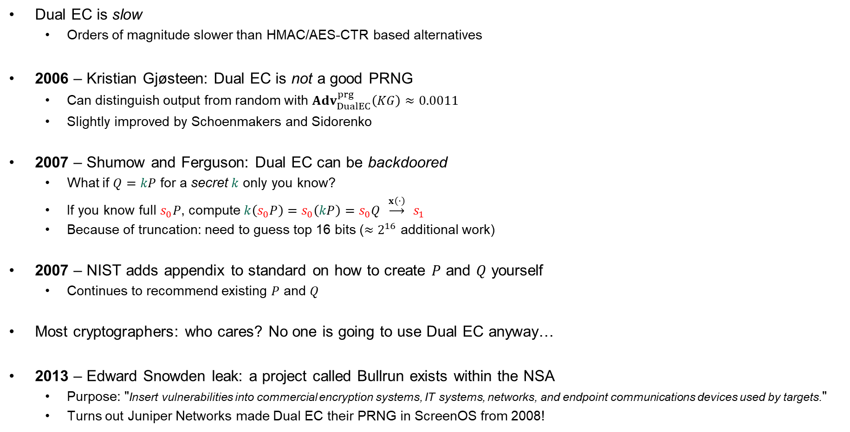
Dual EC DRBG – something's fishy
Dual EC is slow
  Orders of magnitude slower than HMAC/AES-CTR based alternatives
2006 – Kristian Gjøsteen: Dual EC is not a good PRNG
  Can distinguish output from random with ${Adv}_{DualEC}^{prg}\left(KG\right)≈0.0011$
  Slightly improved by Schoenmakers and Sidorenko
2007 – Shumow and Ferguson: Dual EC can be backdoored
  What if $Q=kP$ for a secret $k$ only you know?
  If you know full $s_{0}P$, compute $k\left(s_{0}P\right)=s_{0}\left(kP\right)=s_{0}Q \underset{→}{x\left(⋅\right)} s_{1}$
  Because of truncation: need to guess top 16 bits (${≈2}^{16}$ additional work)
2007 – NIST adds appendix to standard on how to create $P$ and $Q$ yourself
  Continues to recommend existing $P$ and $Q$
Most cryptographers: who cares? No one is going to use Dual EC anyway…
2013 – Edward Snowden leak: a project called Bullrun exists within the NSA
  Purpose: "Insert vulnerabilities into commercial encryption systems, IT systems, networks, and endpoint communications devices used by targets."
  Turns out Juniper Networks made Dual EC their PRNG in ScreenOS from 2008!
$$x\left(s_{0}Q\right)$$
$$x\left(s_{1}Q\right)$$
$$x\left(s_{2}Q\right)$$
$${ s}_{0}$$
$${ s}_{1}$$
$${ s}_{2}$$
$$s_{0}P$$
$$x\left(s_{1}P\right)$$
$$x\left(s_{2}P\right)$$
$$⋯$$
$$x\left(s_{0}Q\right)$$
$$r_{0}$$
$$r_{1}$$
$$r_{2}$$

Slide 13
Juniper PRNG
ScreenOS does make use of the Dual_EC_DRBG standard,
but is designed to not use Dual_EC_DBRG as its primary random number generator. ScreenOS uses it in a way that should not be vulnerable to the possible issue that has been brought to light. Instead of using the NIST recommended curve points it uses self-generated basis points and then takes the output as an input to FIPS/ANSI X.9.31 PRNG, which is the random number generator used in ScreenOS cryptographic operations.
Juniper Knowledge Base Article KB28205

Slide 14
Juniper PRNG
ScreenOS v.6.1
ScreenOS v.6.2
char seed[8], key[24], block[8]; // X9.31 vars
int calls_since_reseed;
void prng_reseed(void) {
int index = 0;
char tmp_output[32];
system_rng_generate(tmp_output, 32);
memcpy(seed, tmp_output, 8);
index = 8;
memcpy(key, &tmp_output[index], 24)
index = 32;
}
void prng_generate(char *output ) {
int index = 0;
calls_since_reseed++;
if (calls_since_reseed > 10 000)
prng_reseed();
for (; index < 20; index += 8) {
...
x9_31_generate_block(seed, key, block);
...
memcpy(&output[index], block, 8);
}
}
char seed[8], key[24], block[8]; // X9.31 vars
char output[32];
int calls_since_reseed, index;
void prng_reseed(void) {
index = 0;
dual_ec_generate(output, 32);
memcpy(seed, output, 8);
index = 8;
memcpy(key, &output[index], 24);
index = 32;
}
void prng_generate(void) {
index = 0;
calls_since_reseed++;
prng_reseed();
for (; index < 32; index += 8) {
...
x9_31_generate_block(seed, key, block);
...
memcpy(&output[index], block, 8);
}
}
global shared buffer
global variable
local variable
local buffer
caller-supplied buffer
local variable
only called conditionally
called unconditionally
Dual EC output masked by this
…means this is skipped!
Source: Where did I leave my keys? Lessons from the Juniper Dual EC incident https://dl.acm.org/doi/10.1145/3266291
Notes:
Problem in v6.2:
index is a global variable set to 32 after prng_reseed
so for-loop in prng_generate never runs!
Output in output buffer comes directly from Dual_EC
Changes from 6.1 to 6.2:
replaced an entropy-gathering procedure for (re)seeding the ANS X9.31 PRNG with Dual EC using a custom Q point
modified the X9.31 reseed logic to reseed on every call rather than every 10,000 calls
changed the loop counter in the prng_generate procedure as well as the procedure’s output to be global variables, shared with the reseed procedure, thus ensuring that pseudorandom values are generated by Dual EC, and not X9.31
changed the IKE nonce length from 160 bits to 256 bits
added a nonce pre-generation queue.

Slide 15



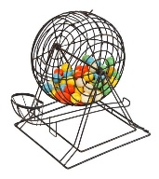








IKEv2 / IPsec
Knowledge of any of these allows deriving traffic encryption key
client nonce,
xG
server nonce,
yG
client authentication
Juniper v6.1: 20 bytes
Juniper v6.2: 32 bytes
server authentication
Dual EC
$$x\left(s_{0}Q\right)$$
$$x\left(s_{1}Q\right)$$
Created by Juniper PRNG
$${ s}_{0}$$
$${ s}_{1}$$
$$s_{0}P$$
$$x\left(s_{1}P\right)$$
$$⋯$$
$$x\left(s_{0}Q\right)$$
$$r_{0}$$
$$r_{1}$$
20 bytes
Notes:
Majority of IKE implementations use nonce sizes of 20 bytes…but not Juniper v6.2 (32 bytes)

Slide 16

Juniper Networks backdoor
Juniper Networks: big manufacturer of network equipment (routers, VPNs, firewalls, etc.)
  Major customers: telcos, banks, US DoD
2015:
Hackers had obtained access to source code repository
Only one change:
--- Qx = 2c55e5e45edf713dc43475effe8813a60326a64d9ba3d2e39cb639b0f3b0ad10
+++ Qx = 9585320eeaf81044f20d55030a035b11bece81c785e6c933e4a8a131f6578107
IMPORTANT JUNIPER SECURITY ANNOUNCEMENT
During a recent internal code review, Juniper discovered unauthorized code in ScreenOS that could allow a knowledgeable attacker to gain administrative access to NetScreen® devices and to decrypt VPN connections.
Juniper created $Q$ (yay! No NSA)
Who dis?

Slide 17
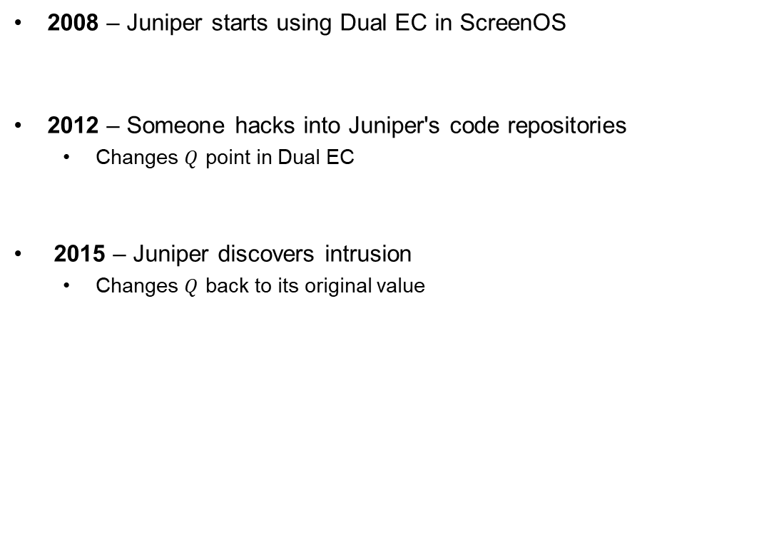
Juniper Networks backdoor
2008 – Juniper starts using Dual EC in ScreenOS
2012 – Someone hacks into Juniper's code repositories
  Changes $Q$ point in Dual EC
2015 – Juniper discovers intrusion
  Changes $Q$ back to its original value

Slide 18
TLS 1.2
Only 28 bytes ☹
client random
server random, yG
xG
Dual EC

Slide 19
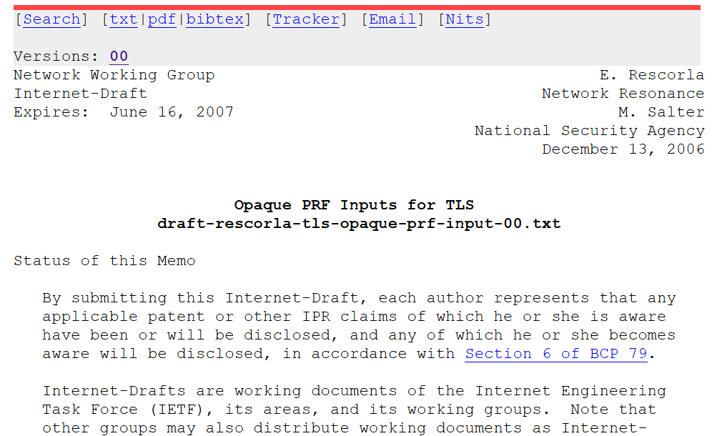
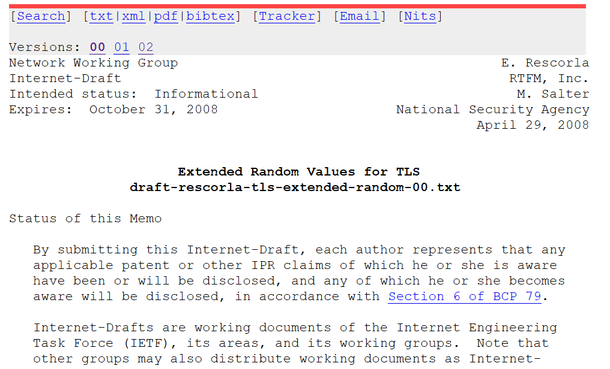
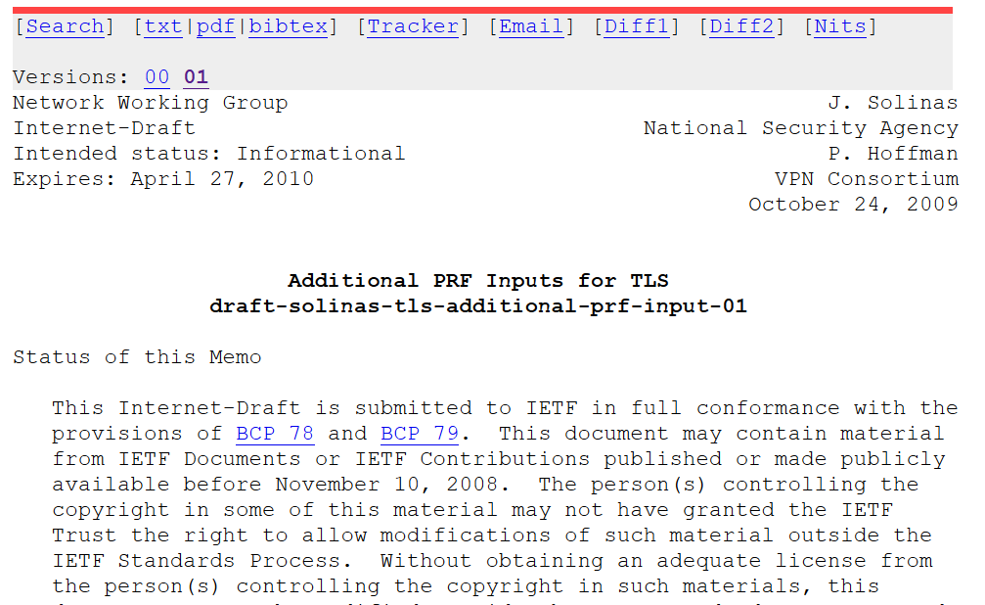
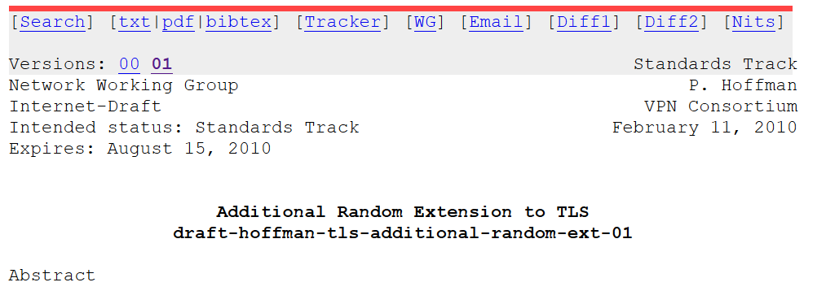
Extended Random
NSA: please make the TLS nonces bigger…for reasons ;-)
Implementing Extended Random makes
exploiting Dual EC 10,000 times easier
No real cryptographic justification exists
for making them longer

Slide 20

RSA Security – BSAFE
Turns out Juniper weren't the only ones using Dual EC
RSA Security
  Big computer and network security company
  Creator of BSAFE cryptographic library
2004 – accepted $10 million from the NSA in order to make Dual EC the default in BSAFE
2014 – adapted the TLS Extended Random extension

Slide 21


Slide 22
Basic goals of cryptography
 | Message privacy | Message integrity / authentication
Symmetric keys | Symmetric encryption | Message authentication codes (MAC)
Asymmetric keys | Asymmetric encryption (a.k.a. public-key encryption) | Digital signatures
(Key exchange)

Slide 23
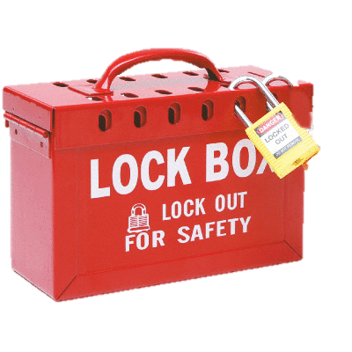







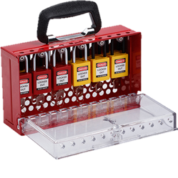
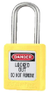


Public-key encryption

Slide 24

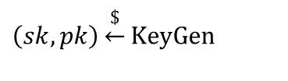



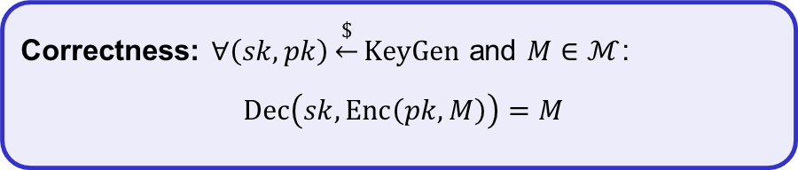
Public-key encryption (PKE) – syntax
A PKE is a tuple $PKE=\left(KeyGen, Enc, Dec\right)$ of algorithms
$$KeyGen :S𝒦×P𝒦$$
$$Enc:P𝒦×ℳ→𝒞$$
$$Dec :S𝒦×𝒞→ℳ∪\left\{⊥\right\}$$
$$\left(sk, pk\right)\underset{←}{\$}KeyGen$$
$$Enc\left(pk,M\right)=C$$
$$Dec\left(sk, C\right)=M/⊥$$
Correctness: $∀\left(sk,pk\right)\underset{←}{\$}KeyGen$ and $M∈ℳ$:
$$Dec\left(sk,Enc\left(pk,M\right)\right)=M$$

Slide 25
Public-key encryption
K
AES-GCM++
K

Slide 26
Basic goals of cryptography
 | Message privacy | Message integrity / authentication
Symmetric keys | Symmetric encryption | Message authentication codes (MAC)
Asymmetric keys | Asymmetric encryption (a.k.a. public-key encryption) | Digital signatures
(Key exchange)
Key Encapsulation
Mechanisms (KEM)

Slide 27

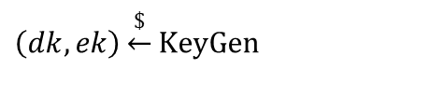








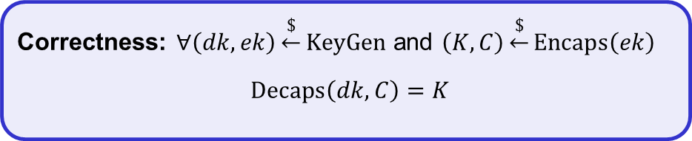
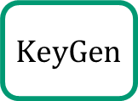
Key Encapsulation Mechanisms (KEM) – syntax
A KEM is a tuple $KEM=\left(KeyGen, Encaps, Decaps\right)$ of algorithms
$$KeyGen :D𝒦×ℰ𝒦$$
$$Encaps:ℰ𝒦→𝒦×𝒞$$
$$Dec :𝒟𝒦×𝒞→𝒦∪\left\{⊥\right\}$$
$$\left(dk, ek\right)\underset{←}{\$}KeyGen$$
$$Encaps\left(ek\right)=(K,C)$$
$$Decaps\left(dk, C\right)=K/⊥$$
Correctness: $∀\left(dk,ek\right)\underset{←}{\$}KeyGen$ and $\left(K,C\right)\underset{←}{\$}Encaps\left(ek\right)$
$$Decaps\left(dk,C\right)=K$$
$$\$$$
$$KeyGen$$
$𝒟𝒦$ – private key space
$ℰ𝒦$ – public key space
$𝒦$ – symmetric key space
$𝒞$ – ciphertext space
$ek$
$dk$
$\left(dk,ek\right)$
$$Encaps$$
$$C$$
$$Decaps$$
$$\$$$
$$K$$
$$K / \left\{⊥\right\}$$
Adversary

Slide 28


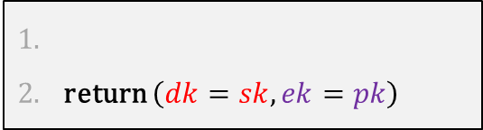





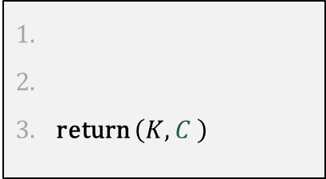



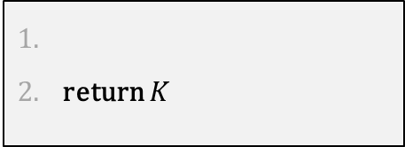

KEM from PKE
$$KEM.KeyGen$$
return $\left(dk=sk,ek=pk\right)$
$$\left(sk,pk\right)\underset{←}{\$}PKE.KeyGen$$
$$pk (=ek)$$
$$KEM.Encaps\left(ek\right)$$
return $\left(K,C \right)$
$$K\underset{←}{\$}ℳ$$
$$\text{K}\text{EM}\text{.}\text{Dec}\left(dk,C\right)$$
$$C←PKE.Enc(ek,K)$$
$$C$$
return $K$
$$K←PKE.Dec(dk,C)$$

Slide 29



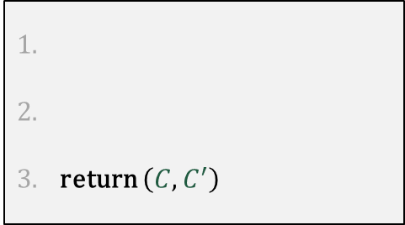




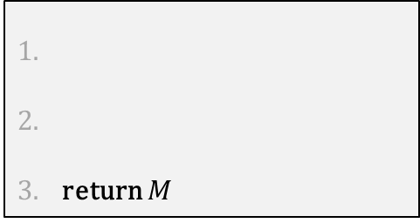


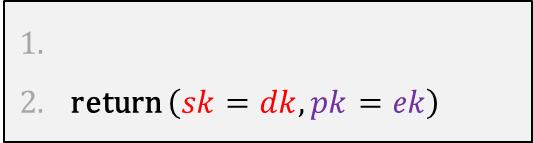


PKE from KEM
$$PKE.KeyGen$$
return $\left(sk=dk,pk=ek\right)$
$$\left(dk,ek\right)\underset{←}{\$}KEM.KeyGen$$
$$M$$
$$pk$$
$$PKE.Enc\left(pk,M\right)$$
$$\text{PKE}\text{.}\text{Dec}\left(sk,\left(C,C′\right)\right)$$
return $\left(C,C^{′}\right)$
$$C$$
return $M$
$$\left(K,C\right)←KEM.Encaps(ek)$$
$$K←KEM.Decaps(sk,C)$$
$$C′←Σ.{Enc}_{K}(M)$$
$$C^{′}$$
$$M←Σ.{Dec}_{K}(C^{′})$$
KEM security is about this part
Symmetric encryption scheme

Slide 30



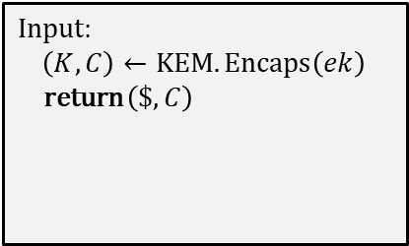
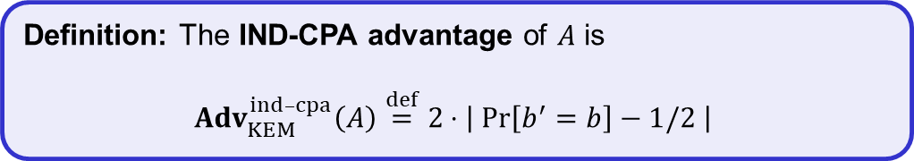




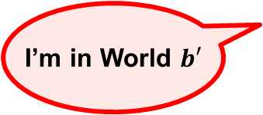

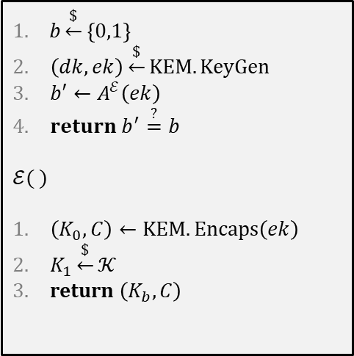
KEM-security: IND-CPA
$$\text{World}\text{ 0}$$
$$\text{World}\text{ 1}$$
$$Exp_{KEM}^{ind­­–cpa}\left(A\right)$$
Input:
$\left(K,C\right)←KEM.Encaps\left(ek\right)$
return $\left(K,C\right)$
$b$
Input:
$\left(K,C\right)←KEM.Encaps\left(ek\right)$
return $\left(\$,C\right)$
$b\underset{←}{\$}\left\{0,1\right\}$
$\left(dk,ek\right)\underset{←}{\$}KEM.KeyGen$
$b′←A^{ℰ}\left(ek\right)$
$return b^{′}\overset{?}{=}b$
$$ℰ( )$$
$\left(K_{0},C\right)←KEM.Encaps\left(ek\right)$
$K_{1}\underset{←}{\$}𝒦$
return $\left(K_{b},C\right)$
$$ek$$
I’m in World $b′$
Definition: The IND-CPA advantage of $A$ is
$${Adv}_{KEM}^{ind­–cpa}\left(A\right)\overset{def}{=}2⋅\left|\operatorname{Pr}\left[b^{′}=b\right]−1/2 \right|$$

Slide 31
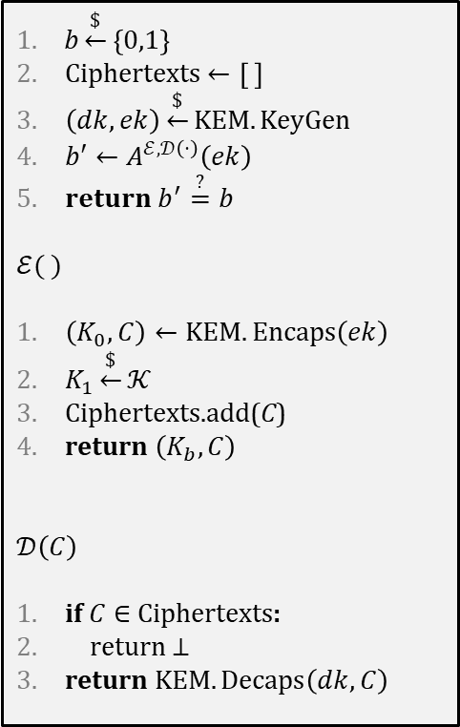
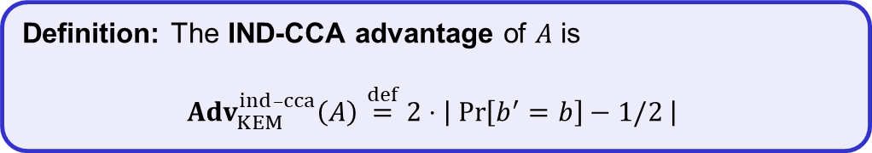

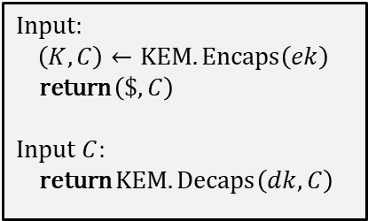

KEM-security: IND-CCA
$$\text{World}\text{ 0}$$
$$\text{World}\text{ 1}$$
$$Exp_{KEM}^{ind­­–cca}\left(A\right)$$
Input:
$\left(K,C\right)←KEM.Encaps\left(ek\right)$
return $\left(K,C\right)$
Input $C$:
return $KEM.Decaps\left(dk,C\right)$
$b$
Input:
$\left(K,C\right)←KEM.Encaps\left(ek\right)$
return $\left(\$,C\right)$
Input $C$:
return $KEM.Decaps\left(dk,C\right)$
$b\underset{←}{\$}\left\{0,1\right\}$
Ciphertexts $←\left[ \right]$
$\left(dk,ek\right)\underset{←}{\$}KEM.KeyGen$
$b′←A^{ℰ,𝒟\left(⋅\right)}\left(ek\right)$
$return b^{′}\overset{?}{=}b$
$$ℰ( )$$
$\left(K_{0},C\right)←KEM.Encaps\left(ek\right)$
$K_{1}\underset{←}{\$}𝒦$
Ciphertexts.add(C)
return $\left(K_{b},C\right)$
$$𝒟\left(C\right)$$
if $C∈$ Ciphertexts:
return $⊥$
return $KEM.Decaps\left(dk,C\right)$
$$ek$$
I’m in World $b′$
Restriction: not allowed to forward output from $Encaps$ query to $Decaps$ query unmodified
Definition: The IND-CCA advantage of $A$ is
$${Adv}_{KEM}^{ind­–cca}\left(A\right)\overset{def}{=}2⋅\left|\operatorname{Pr}\left[b^{′}=b\right]−1/2 \right|$$

Slide 32


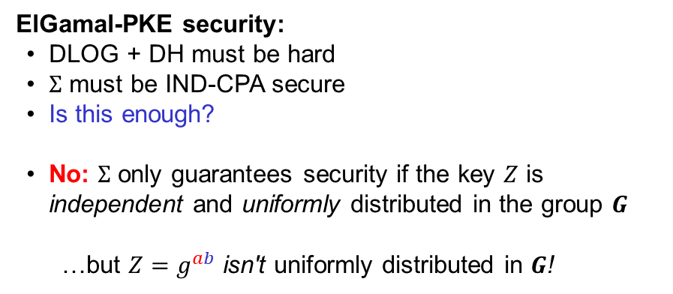





















Diffie-Hellman as a KEM (a.k.a. ElGamal PKE)
$$G=〈g〉$$
$$b\underset{←}{\$}\left\{1, …, \left|G\right|\right\}$$
$$KEM.KeyGen$$
/ $PKE.KeyGen$
$$M$$
$$B$$
$$B←g^{b}$$
$$A$$
$$PKE.Enc$$
$$B$$
$$PKE.Dec$$
$$a\underset{←}{\$}\left\{1, …, \left|G\right|\right\}$$
$$C$$
$$b\underset{←}{\$}\left\{1, …, \left|G\right|\right\}$$
$$KEM.Encaps$$
$$A←g^{a}$$
$$B←g^{b}$$
$$Z←B^{a}=H\left(g^{ab}\right)$$
ElGamal-PKE security:
DLOG + DH must be hard
$Σ$ must be IND-CPA secure
Is this enough?
No: $Σ$ only guarantees security if the key $Z$ is
independent and uniformly distributed in the group $G$
…but ${Z=g}^{ab}$ isn't uniformly distributed in $G$!
$$KEM.Decaps$$
$$Z←A^{b}$$
$$C←Σ.Enc\left(Z , M\right)$$
$$M←Σ. Dec\left(Z , C\right)$$
$$Σ. Enc :G×ℳ→𝒞$$
Actually want:$Σ. Enc :{\left\{0,1\right\}}^{k}×ℳ→𝒞$

Slide 33




Diffie-Hellman as a KEM (a.k.a. ElGamal PKE)
$$H :G→{\left\{0,1\right\}}^{k}$$
$$G=〈g〉$$
$$b\underset{←}{\$}\left\{1, …, \left|G\right|\right\}$$
$$KEM.KeyGen$$
$$KEM.KeyGen$$
/ $PKE.KeyGen$
$$M$$
$$B$$
$$B←g^{b}$$
$$A$$
$$PKE.Enc$$
$$PKE.Dec$$
$$a\underset{←}{\$}\left\{1, …, \left|G\right|\right\}$$
$$C$$
$$KEM.Encaps$$
$$A←g^{a}$$
$$Z←B^{a}=H\left(g^{ab}\right)$$
ElGamal-PKE security:
DLOG + DH must be hard
$Σ$ must be IND-CPA secure
Is this enough?
No: $Σ$ only guarantees security if the key $Z$ is
independent and uniformly distributed in the group $G$
…but ${Z=g}^{ab}$ isn't uniformly distributed in $G$!
$$KEM.Decaps$$
$$Z←A^{b}$$
$$K←H(Z)$$
$$K←H(Z)$$
$$C←Σ.Enc\left(Z , M\right)$$
$$K,$$
$$K,$$
$$M←Σ. Dec\left(Z , C\right)$$
$$Σ. Enc :G×ℳ→𝒞$$
Actually want:$Σ. Enc :{\left\{0,1\right\}}^{k}×ℳ→𝒞$

Slide 34
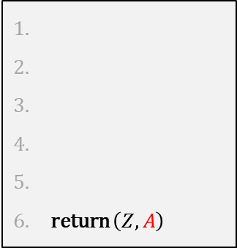


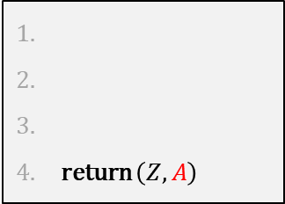

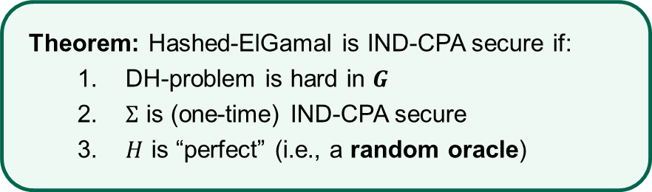
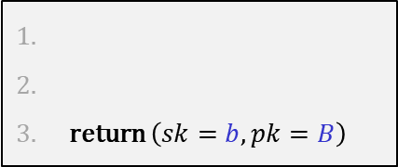

Hashed-ElGamal PKE
$$KeyGen$$
$$H :G→{\left\{0,1\right\}}^{k}$$
return $\left(sk=b,pk=B\right)$
$$G=〈g〉$$
$$b\underset{←}{\$}\left\{1, …, \left|G\right|\right\}$$
$$M$$
$$B$$
$$B←g^{b}$$
$$A$$
$$Enc\left(pk=B,M\right)$$
return $\left(Z,A\right)$
$$C$$
$$a\underset{←}{\$}\left\{1, …, \left|G\right|\right\}$$
$$A←g^{a}$$
$$Dec\left(sk,(A,C)\right)$$
$$Z←B^{a}=H\left(g^{ab}\right)$$
return $\left(Z,A\right)$
$$Z←A^{b}$$
Theorem: Hashed-ElGamal is IND-CPA secure if:
  DH-problem is hard in $G$
  $Σ$ is (one-time) IND-CPA secure
  $H$ is “perfect” (i.e., a random oracle)
$$K←H(Z)$$
$$K←H(Z)$$
$$C←Σ.Enc\left(Z , M\right)$$
$$K,$$
$$K,$$
$$M←Σ. Dec\left(Z , C\right)$$

Slide 35


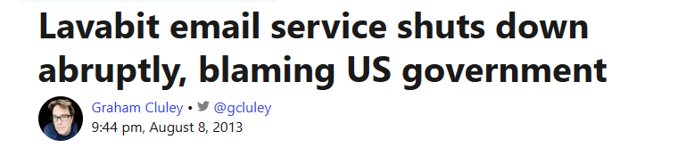
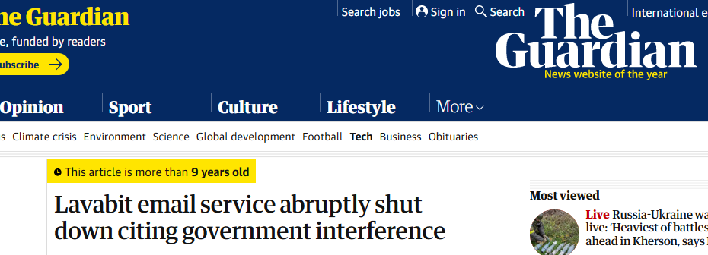
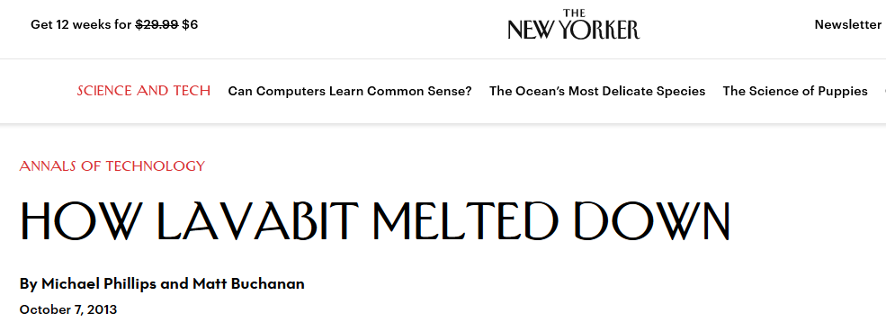
Lavabit

Slide 36









Lavabit and KEMs
$$\left(dk,ek\right)\underset{←}{\$}KEM.KeyGen$$
$$ek$$
lavabit.com
$$C$$
$$\left(K,C\right)←KEM.Encaps(ek)$$
TLS
$$K←KEM.Decaps(dk,C)$$

Slide 37
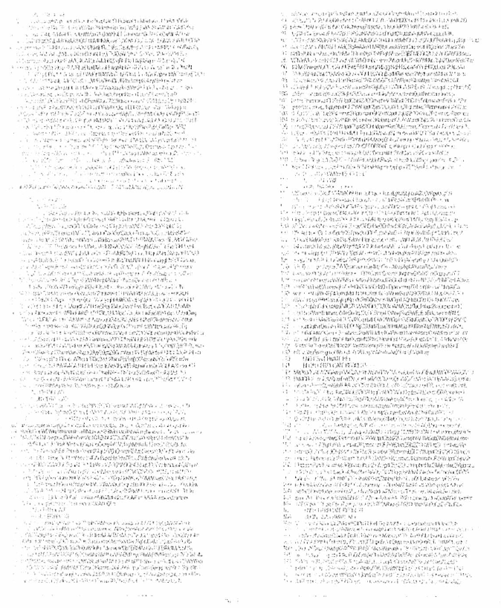
Lavabit

Slide 38
Forward secrecy
What Lavabit's solution lacked was forward secrecy:
But how is this possible?
Definition: A system has forward secrecy if an attacker cannot obtain previously sent data, even if it obtains the parties' long-term keys

Slide 39





KEMs with forward secrecy
$$\left(dk,ek\right)\underset{←}{\$}KEM.KeyGen$$
$$ek$$
$$ek$$
$$\left(dk,ek\right)\underset{←}{\$}KEM.KeyGen$$
TLS
$$\left(K,C\right)←KEM.Encaps(ek)$$
$$C$$
$$K←KEM.Decaps(dk,C)$$

Slide 40
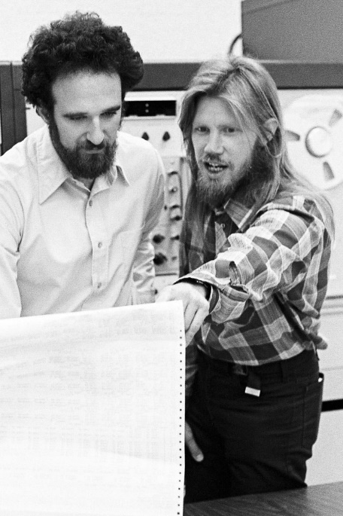

Attacking Diffie-Hellman

Slide 41

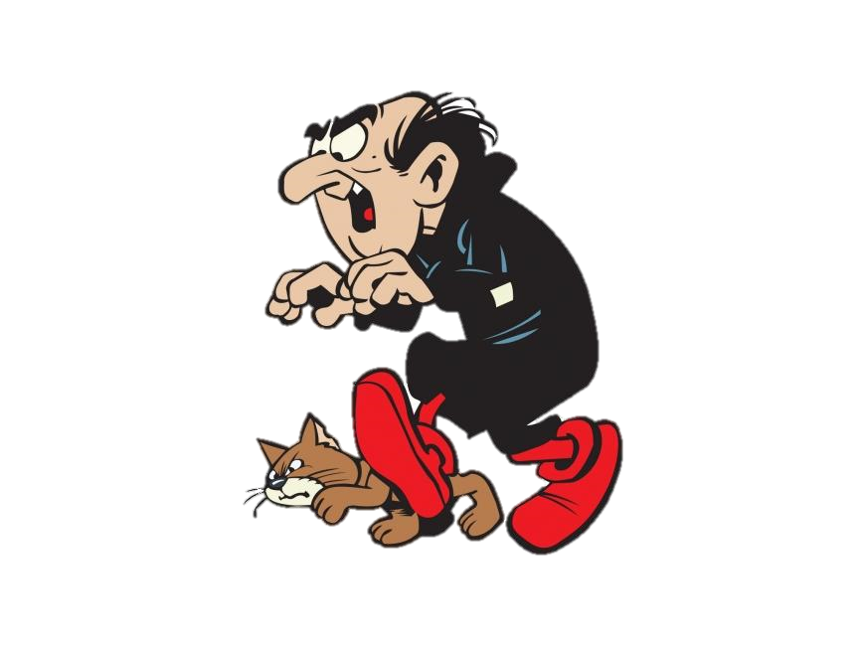







Diffie-Hellman – man-in-the-middle attack
$$G=〈g〉$$
$$A=g^{a}$$
$$a\underset{←}{\$}\left\{1, …, \left|G\right|\right\}$$
$$B=g^{b}$$
$$b\underset{←}{\$}\left\{1, …, \left|G\right|\right\}$$
$$Z←B^{a}=g^{ab}$$
$$Z←A^{b}=g^{ab}$$

Slide 42



Diffie-Hellman – man-in-the-middle attack
$$G=〈g〉$$
$$A=g^{a}$$
$$X=g^{x}$$
$$a\underset{←}{\$}\left\{1, …, \left|G\right|\right\}$$
$$B=g^{b}$$
$$b\underset{←}{\$}\left\{1, …, \left|G\right|\right\}$$
$$Z←B^{a}=g^{ab}$$
$$Z←A^{b}=g^{ab}$$
$$x$$
$$Z^{′}←X^{b}=g^{xb}$$

Slide 43








Diffie-Hellman – man-in-the-middle attack
$$G=〈g〉$$
$$Y=g^{y}$$
$$A=g^{a}$$
$$X=g^{x}$$
$$a\underset{←}{\$}\left\{1, …, \left|G\right|\right\}$$
$$B=g^{b}$$
$$b\underset{←}{\$}\left\{1, …, \left|G\right|\right\}$$
$$Z←B^{a}=g^{ab}$$
$$Z←A^{b}=g^{ab}$$
$$y$$
$$x$$
$$Z′′←Y^{a}=g^{ay}$$
$$Z^{′}←X^{b}=g^{xb}$$
AES-GCM++
AES-GCM++
$$Z^{′′}←A^{y}=g^{ay}$$
$$Z^{′}←B^{x}=g^{xb}$$
$$M$$
$$M$$
$$M$$

Slide 44













Noise-protocol
Long-term key
Long-term key
$$A=g^{a}$$
$$G=〈g〉$$
, $A$, $B$
$$B=g^{b}$$
$$X=g^{x}$$
$$x\underset{←}{\$}\left\{1, …, \left|G\right|\right\}$$
$$Y=g^{y}$$
$$y\underset{←}{\$}\left\{1, …, \left|G\right|\right\}$$
$$K←H\left(X,Y, B^{a},Y^{x}\right)$$
$$K←H\left(X,Y,A^{b},X^{y} \right)$$
$$g^{ab}$$
$$g^{xy}$$
$$g^{ab}$$
$$g^{xy}$$

Slide 45
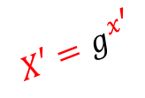







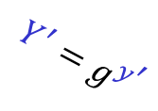
Noise-protocol
Long-term key
Long-term key
$$A=g^{a}$$
$$G=〈g〉$$
, $A$, $B$
$$B=g^{b}$$
$$Y^{′}=g^{y^{′}}$$
$$X=g^{x}$$
$$X′=g^{x^{′}}$$
$$x\underset{←}{\$}\left\{1, …, \left|G\right|\right\}$$
$$Y=g^{y}$$
$$y\underset{←}{\$}\left\{1, …, \left|G\right|\right\}$$
$$K←H\left(X,Y, B^{a},Y^{x}\right)$$
$$K←H\left(X,Y,A^{b},X^{y} \right)$$
$$y^{′}$$
$$x^{′}$$
$$K′←H\left(X,Y^{′}, B^{a},{Y′}^{x}\right)$$
$$K′←H\left(X′,Y,A^{b},{X^{′}}^{y} \right)$$
$$g^{ab}$$
adversary can't compute this due to DH/DLOG problem
Can't compute $K′$ or $K′$!

Slide 46







Noise-protocol
Long-term key
Long-term key
$$A=g^{a}$$
$$G=〈g〉$$
, $A$, $B$
$$B=g^{b}$$
(static)
(static)
$$X=g^{x}$$
$$x\underset{←}{\$}\left\{1, …, \left|G\right|\right\}$$
$$Y=g^{y}$$
$$y\underset{←}{\$}\left\{1, …, \left|G\right|\right\}$$
ephemeral
Many alternatives:
Used inside
$$K←H\left(X,Y, g^{ab},g^{xy} \right)$$
static-static, ephemeral-ephemeral
$$K←H\left(X,Y, g^{ay},g^{xb} \right)$$
static-ephemeral, ephemeral-static
$$K←H\left(X,Y, g^{ay},g^{xb},g^{xy}\right)$$
static-ephemeral, ephemeral-static, ephemeral-ephemeral
$$K←H\left(X,Y, g^{ab},g^{ay},g^{xb},g^{xy}\right)$$
static-static, static-ephemeral, ephemeral-static, ephemeral-ephemeral

Slide 47



Forward secrecy
Long-term key
Long-term key
$$A=g^{a}$$
$$G=〈g〉$$
, $A$, $B$
$$B=g^{b}$$
(static)
(static)
$$X=g^{x}$$
$$x\underset{←}{\$}\left\{1, …, \left|G\right|\right\}$$
$$Y=g^{y}$$
$$y\underset{←}{\$}\left\{1, …, \left|G\right|\right\}$$
AES-GCM++
ephemeral
$$K←H\left(X,Y, g^{ab},g^{xy} \right)$$
$$K←H\left(X,Y, g^{ab},g^{xy} \right)$$
Can't compute!
(Need to solve DH or DLOG problem)

Slide 48
Next week
How to ensure keys are authentic?
Digital signatures
PKI

