Slide 1
Lecture 11 – Digital signatures, UF-CMA,
Schnorr, PKI
TEK4500
29.10.2025
Håkon Jacobsen
hakon.jacobsen@its.uio.no

Slide 2
Basic goals of cryptography
 | Message privacy | Message integrity / authentication
Symmetric keys | Symmetric encryption | Message authentication codes (MAC)
Asymmetric keys | Asymmetric encryption (a.k.a. public-key encryption) | Digital signatures
(Key exchange)
Key Encapsulation
Mechanisms (KEM)

Slide 3

What is cryptography?
Internet
Alice
Bob
M
M'
Adversary
Security goals:
Data privacy: adversary should not be able to read message M
Data integrity: adversary should not be able to modify message M
Data authenticity: message M really originated from Alice

Slide 4
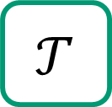
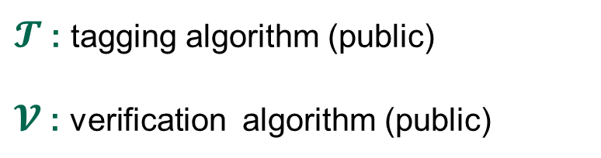

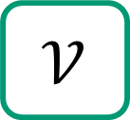
MACs
Internet
Alice
Bob
K
K
$$𝒯$$
M, T
$$𝒱$$
M
M / $⊥$
$𝓣$ : tagging algorithm (public)
$𝓥$ : verification algorithm (public)
K : tagging / verification key (secret)

Slide 5

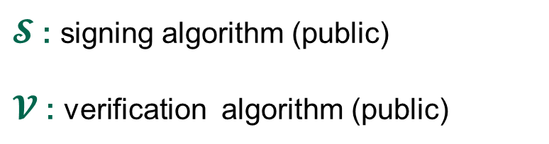
Digital signatures
Internet
Alice
Bob
sk
vk
$$𝒮$$
M, σ
$$𝒱$$
M
M / $⊥$
$𝓢$ : signing algorithm (public)
$𝓥$ : verification algorithm (public)
sk : signing key (secret)
vk : verification key (public)

Slide 6
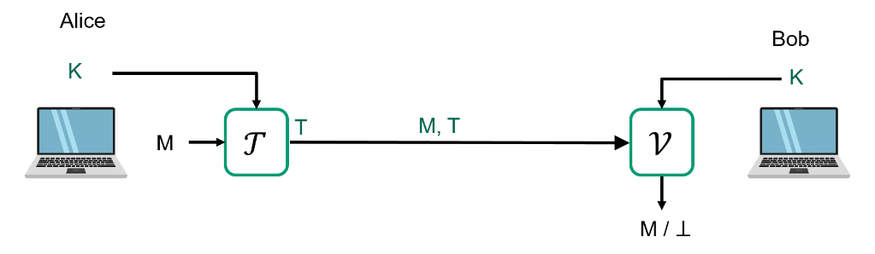
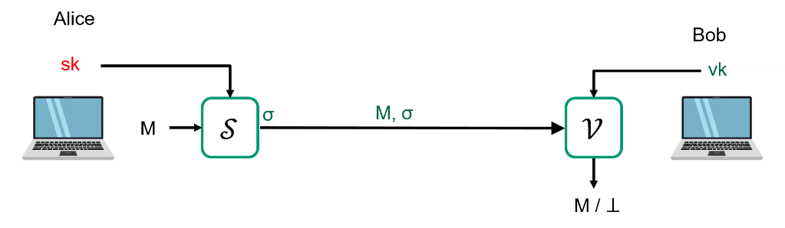
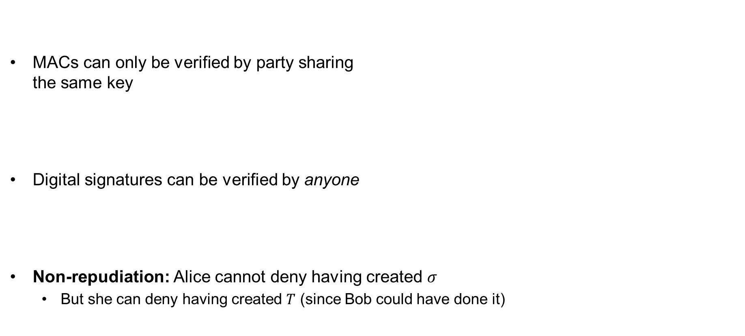
MACs vs. digital signatures
MACs can only be verified by party sharing
the same key
Digital signatures can be verified by anyone
Non-repudiation: Alice cannot deny having created $σ$
  But she can deny having created $T$ (since Bob could have done it)
MAC
Digital signature

Slide 7
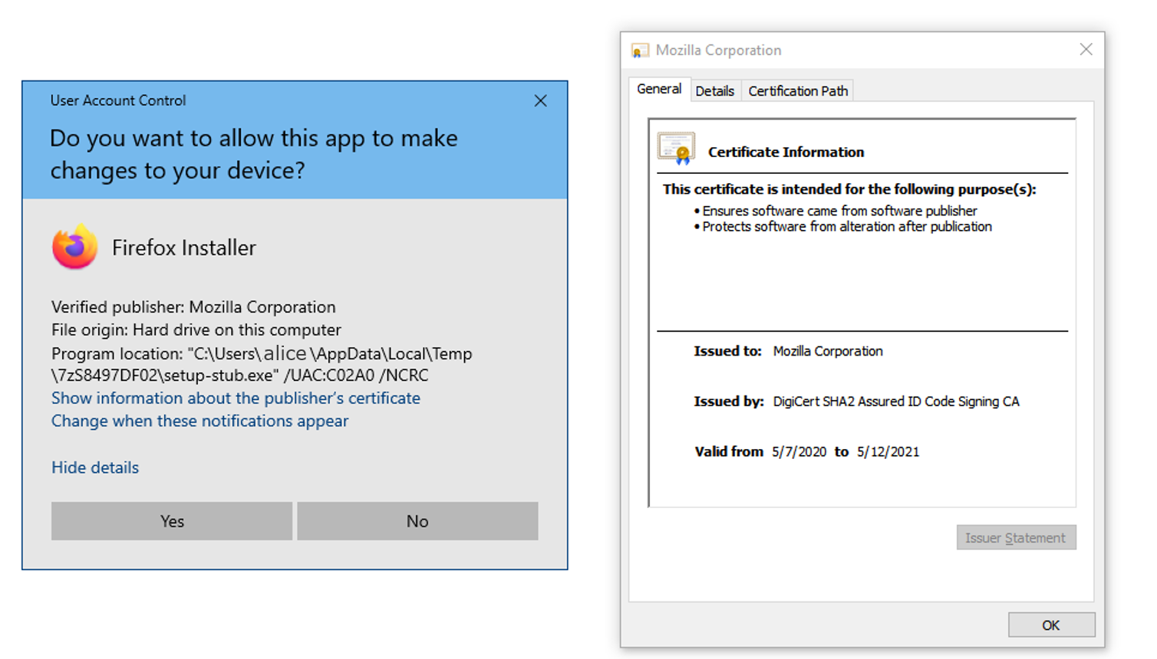
Applications of digital signatures
Electronic document signing
HTTPS / TLS certificates
Software installation
Email sender authentication
Bitcoin

Slide 8
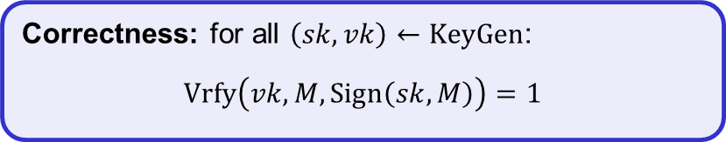
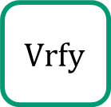







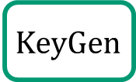








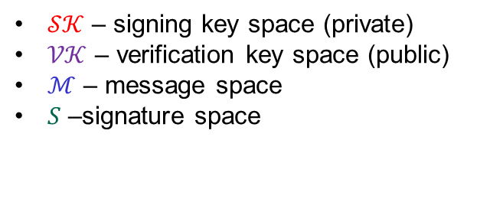
Digital signatures – syntax
A digital signature scheme is a tuple of algorithms $Σ=(KeyGen, Sign, Vrfy)$
$$KeyGen :𝒮𝒦×𝒱𝒦$$
$$Sign :𝒮𝒦×ℳ→𝒮$$
$$Vrfy :𝒱𝒦×ℳ×𝒮→\{0,1\}$$
$$\left(sk, vk\right)\underset{←}{\$}KeyGen$$
$$Sign\left(sk, M\right)={Sign}_{sk}\left(M\right)=σ$$
$$Vrfy\left(vk, M,σ\right)={Vrfy}_{vk}\left(M,σ\right)=1/0$$
$𝒮𝒦$ – signing key space (private)
$𝒱𝒦$ – verification key space (public)
$ℳ$ – message space
$S$ –signature space
Correctness: for all $\left(sk,vk\right)←KeyGen$:
$$Vrfy\left(vk, M, Sign\left(sk, M\right)\right)=1$$
$$KeyGen$$
$$\$$$
$sk$
$vk$
$\left(sk,vk\right)$
$$Sign$$
$$σ$$
$$M, σ$$
$$Vrfy$$
$$M$$
$$1/0$$
Adversary
8

Slide 9
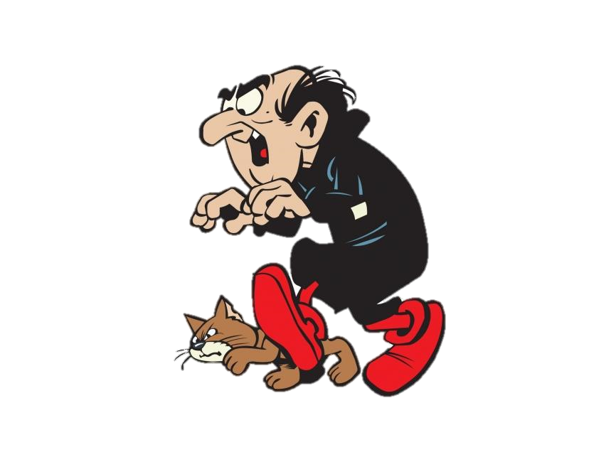
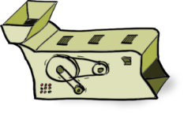
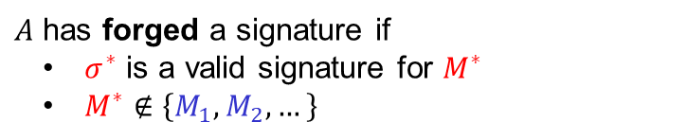
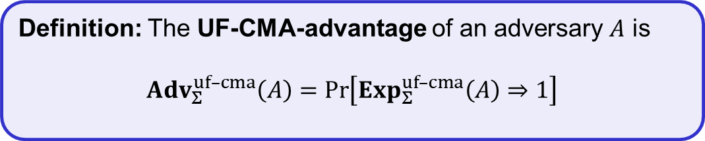

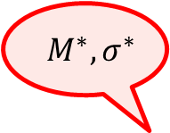


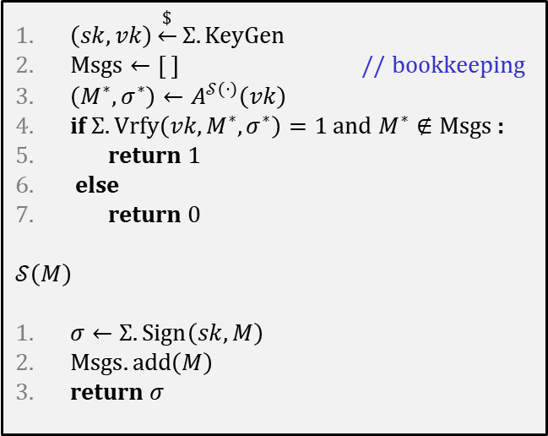
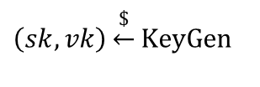

Digital signatures – security: UF-CMA
Challenger
$$Exp_{Σ}^{uf–cma}\left(A\right)$$
$${ M}^{∗}, σ^{∗}$$
$$vk$$
$$\left(sk,vk\right)\underset{←}{\$}KeyGen$$
$\left(sk,vk\right)\underset{←}{\$}Σ.KeyGen$
$Msgs←\left[ \right]$ // bookkeeping
$\left(M^{∗}, σ^{∗}\right)←A^{𝒮\left(⋅\right)}\left(vk\right)$
if $Σ.Vrfy\left(vk, M^{∗}, σ^{∗}\right)=1$ and $M^{∗}∉Msgs$ :
return 1
else
return 0
$$𝒮\left(M\right)$$
$σ←Σ.Sign\left(sk, M\right)$
$Msgs.add\left(M\right)$
return $σ$
$$M_{1},M_{2}, …$$
$$Sign(sk, ⋅)$$
$$σ_{1},σ_{2}, …$$
$A$ has forged a signature if
  $σ^{∗}$ is a valid signature for $M^{∗}$
  $M^{∗}∉\left\{M_{1},M_{2},…\right\}$
Definition: The UF-CMA-advantage of an adversary $A$ is
$${Adv}_{Σ}^{uf–cma}\left(A\right)=\operatorname{Pr}\left[Exp_{Σ}^{uf–cma}\left(A\right)⇒1\right]$$

Slide 10


Designing signature schemes

Slide 11



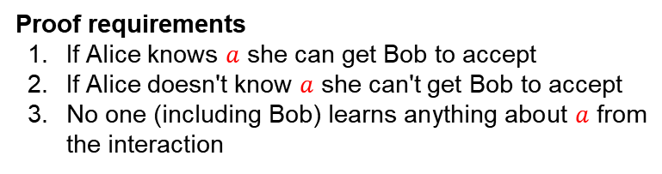


DLOG proof of knowledge
$$A=g^{a}$$
$$\left(G,⋆\right)=\left\langle g\right\rangle$$
$$a$$
Proof requirements
If Alice knows $a$ she can get Bob to accept
If Alice doesn't know $a$ she can't get Bob to accept
No one (including Bob) learns anything about $a$ from the interaction
✓
✓
✗

Slide 12


DLOG proof of knowledge
$$A=g^{a}$$
$$\left(G,⋆\right)=\left\langle g\right\rangle$$
$$a+r \left(mod \left|G\right|\right)$$
$$r\underset{←}{\$}\left\{1, …, \left|G\right|\right\}$$
Proof requirements
If Alice knows $a$ she can get Bob to accept
If Alice doesn't know $a$ she can't get Bob to accept
No one (including Bob) learns anything about $a$ from the interaction
✗
?
✓

Slide 13


DLOG proof of knowledge
$$A=g^{a}$$
$$\left(G,⋆\right)=\left\langle g\right\rangle$$
$$r$$
$$r\underset{←}{\$}\left\{1, …, \left|G\right|\right\}$$
$$a+r \left(mod \left|G\right|\right)$$
Proof requirements
If Alice knows $a$ she can get Bob to accept
If Alice doesn't know $a$ she can't get Bob to accept
No one (including Bob) learns anything about $a$ from the interaction
✓
✓
✗

Slide 14








DLOG proof of knowledge
$$A=g^{a}$$
$$\left(G,⋆\right)=\left\langle g\right\rangle$$
$${R=g}^{r}$$
$$r\underset{←}{\$}\left\{1, …, \left|G\right|\right\}$$
$$a+r \left(mod \left|G\right|\right)$$
$$z$$
accept if $A⋆R\overset{?}{=}g^{z}$
Proof requirements
If Alice knows $a$ she can get Bob to accept
If Alice doesn't know $a$ she can't get Bob to accept
No one (including Bob) learns anything about $a$ from the interaction
✓
$$A⋆R=g^{a}g^{r}=g^{a+r}$$
$${=g}^{z}$$
✗
$$R←{A^{−1}⋆g}^{z}$$
$$⟹$$
$$A⋆R=A⋆A^{−1}⋆g^{z}=g^{z}$$
✓
Notes:
Req. 3 by OTP and DLOG problem

Slide 15










DLOG proof of knowledge
$$A=g^{a}$$
$$\left(G,⋆\right)=\left\langle g\right\rangle$$
$${R=g}^{r}$$
$$r\underset{←}{\$}\left\{1, …, \left|G\right|\right\}$$
$$b$$
$$b\underset{←}{\$}\left\{1, …, \left|G\right|\right\}$$
$$ab+r \left(mod \left|G\right|\right)$$
accept if $A^{b}⋆R\overset{?}{=}g^{z}$
$$z$$
Proof requirements
If Alice knows $a$ she can get Bob to accept
If Alice doesn't know $a$ she can't get Bob to accept
No one (including Bob) learns anything about $a$ from the interaction
✓
$$A^{b}⋆R=g^{ab}g^{r}$$
$$=g^{ab+r}=g^{z}$$
✓
$$R←{A^{−1}⋆g}^{z}$$
$$⟹$$
$$A^{b}⋆R=A^{b}⋆A^{−1}⋆g^{z}≠g^{z}$$
✓
Notes:
Soundness (requirement 2) follows since now Alice cannot pick $z$ before she creates $R$. Once $R$ is chosen and $b$ is received, Alice is forced to find $a$ in order to create the only $z (mod p)$ that equals $ab+r$.
Zero-knowledge (requirement 3) is easy to prove for honest Bob (i.e., one that picks $b$ uniformly at random).
For dishonest Bob it is not so easy. However,

Slide 16



Interactive signature scheme
$$A=g^{a}$$
$$\left(G,⋆\right)=\left\langle g\right\rangle$$
$$M$$
$${R=g}^{r}$$
$$M$$
$$r\underset{←}{\$}\left\{1, …, \left|G\right|\right\}$$
$$b$$
$$b←H(M)$$
$$ab+r \left(mod \left|G\right|\right)$$
accept if $A^{b}⋆R\overset{?}{=}g^{z}$
$$z$$
Proof requirements
If Alice knows $a$ she can get Bob to accept
If Alice doesn't know $a$ she can't get Bob to accept
No one (including Bob) learns anything about $a$ from the interaction
✓
✓
✓

Slide 17




Non-interactive signature scheme
$$A=g^{a}$$
$$\left(G,⋆\right)=\left\langle g\right\rangle$$
$$M$$
$${R=g}^{r}$$
$$r\underset{←}{\$}\left\{1, …, \left|G\right|\right\}$$
$$b$$
$$σ=\left(R,b,z\right)$$
$$ab+r \left(mod \left|G\right|\right)$$
$$b←H(M)$$
accept if $A^{b}⋆R\overset{?}{=}g^{z}$
and $H\left(M\right)=b$
$$z$$
Proof requirements
If Alice knows $a$ she can get Bob to accept
If Alice doesn't know $a$ she can't get Bob to accept
No one (including Bob) learns anything about $a$ from the interaction
✓
✓
✓

Slide 18






Non-interactive signature scheme
$$A=g^{a}$$
$$\left(G,⋆\right)=\left\langle g\right\rangle$$
$$M$$
$$R=A^{−b}⋆g^{z}$$
$${R=g}^{r}$$
$$r\underset{←}{\$}\left\{1, …, \left|G\right|\right\}$$
$$b$$
$$σ=\left(R,b,z\right)$$
$$z$$
$$ab+r \left(mod \left|G\right|\right)$$
$$b←H(M)$$
accept if $A^{b}⋆R\overset{?}{=}g^{z}$
and $H\left(M\right)=b$
$$z$$
Proof requirements
If Alice knows $a$ she can get Bob to accept
If Alice doesn't know $a$ she can't get Bob to accept
No one (including Bob) learns anything about $a$ from the interaction
✓
✗
$$A^{b}⋆R=g^{ab}g^{−ab}⋆g^{z}$$
$$=g^{z}$$
✓

Slide 19




Non-interactive signature scheme
$$A=g^{a}$$
$$\left(G,⋆\right)=\left\langle g\right\rangle$$
$$M$$
$${R=g}^{r}$$
$$r\underset{←}{\$}\left\{1, …, \left|G\right|\right\}$$
$$b$$
$$σ=\left(R,b,z\right)$$
$$σ=\left(R,z\right)$$
$$ab+r \left(mod \left|G\right|\right)$$
$$b←H(A,R,M)$$
$$b←H(M)$$
accept if $A^{b}⋆R\overset{?}{=}g^{z}$
and $H\left(M\right)=b$
$$z$$
Proof requirements
If Alice knows $a$ she can get Bob to accept
If Alice doesn't know $a$ she can't get Bob to accept
No one (including Bob) learns anything about $a$ from the interaction
✓
✓
✓

Slide 20



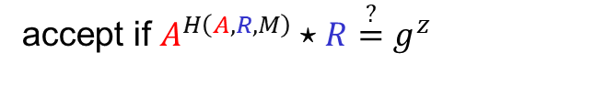
Non-interactive signature scheme
$$A=g^{a}$$
$$\left(G,⋆\right)=\left\langle g\right\rangle$$
$$M$$
$${R=g}^{r}$$
$$r\underset{←}{\$}\left\{1, …, \left|G\right|\right\}$$
$$σ=\left(R,z\right)$$
$$ab+r \left(mod \left|G\right|\right)$$
$$b$$
$$b←H(A,R,M)$$
accept if $A^{H\left(A,R,M\right)}⋆R\overset{?}{=}g^{z}$
$$z$$
Proof requirements
If Alice knows $a$ she can get Bob to accept
If Alice doesn't know $a$ she can't get Bob to accept
No one (including Bob) learns anything about $a$ from the interaction
✓
✓
✓

Slide 21
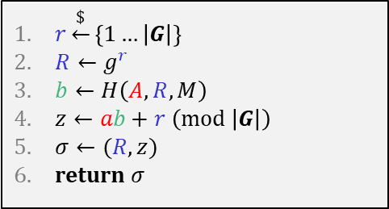
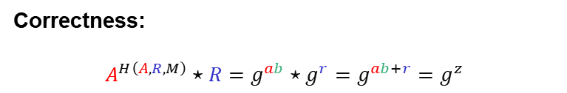

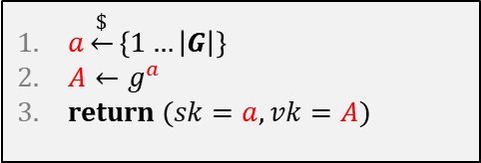
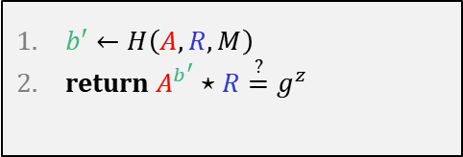


Schnorr signature scheme
$$A=g^{a}$$
$$\left(G,⋆\right)=\left\langle g\right\rangle$$
$$KeyGen$$
$a\underset{←}{\$}\left\{1…\left|G\right|\right\}$
$A←g^{a}$
return $(sk=a, vk=A)$
$$M$$
$${R=g}^{r}$$
$$Verify\left(vk=A,M,σ=(R,z)\right)$$
$$Sign\left(sk=a,M\right)$$
$b′←H\left(A,R,M\right)\underset{←}{\$}$
return $A^{b^{′}}⋆R\overset{?}{=}g^{z}$
$$r\underset{←}{\$}\left\{1, …, \left|G\right|\right\}$$
$$σ=\left(R,b,z\right)$$
$r\underset{←}{\$}\left\{1…\left|G\right|\right\}$
$R←g^{r}$
$b←H\left(A,R,M\right)$
$z←ab+r \left(mod \left|G\right|\right)$
$σ←(R,z)$
return $σ$
$$ab+r \left(mod \left|G\right|\right)$$
$$b←H(A,R,M)$$
$$z$$
Proof requirements
If Alice knows $a$ she can get Bob to accept
If Alice doesn't know $a$ she can't get Bob to accept
No one (including Bob) learns anything about $a$ from the interaction
✓
Correctness:
$$A^{H\left(A,R,M\right)}⋆R=g^{ab}⋆g^{r}=g^{ab+r}=g^{z}$$
✓
✓
Notes:
Many variations and optimizations for Schnorr scheme (see https://crypto.stackexchange.com/questions/34863/ec-schnorr-signature-multiple-standard/#50202)
For example, it possible to define the signature simply as $(b,z)$ (i.e., we don't send $R$). During verification we instead recompu check that $A^{b}$

Slide 22

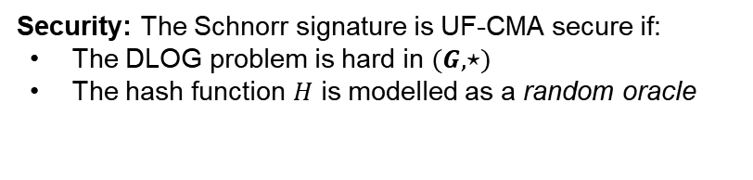
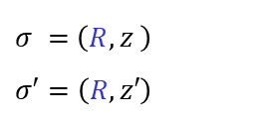


Schnorr signature scheme
$$A=g^{a}$$
$$\left(G,⋆\right)=\left\langle g\right\rangle$$
$$KeyGen$$
$a\underset{←}{\$}\left\{1…\left|G\right|\right\}$
$A←g^{a}$
return $(sk=a, vk=A)$
$$M$$
$${R=g}^{r}$$
$$Verify\left(vk=A,M,σ=(R,z)\right)$$
$$Sign\left(sk=a,M\right)$$
$b′←H\left(A,R,M\right)\underset{←}{\$}$
return $A^{b^{′}}⋆R\overset{?}{=}g^{z}$
$$r\underset{←}{\$}\left\{1, …, \left|G\right|\right\}$$
$$σ=\left(R,b,z\right)$$
$r\underset{←}{\$}\left\{1…\left|G\right|\right\}$
$R←g^{r}$
$b←H\left(A,R,M\right)$
$z←ab+r \left(mod \left|G\right|\right)$
$σ←(R,z)$
return $σ$
$$ab+r \left(mod \left|G\right|\right)$$
$$b←H(A,R,M)$$
$$z$$
  $r$ must be picked new every time!
Proof requirements
If Alice knows $a$ she can get Bob to accept
If Alice doesn't know $a$ she can't get Bob to accept
No one (including Bob) learns anything about $a$ from the interaction
✓
Security: The Schnorr signature is UF-CMA secure if:
The DLOG problem is hard in $(G,⋆)$
The hash function $H$ is modelled as a random oracle
✓
✓
Learned private long-term key!
$$σ =\left(R,z \right)$$
$$σ′=\left(R,z′\right)$$
$$=a⋅(b−b′)$$
$$⟹ a=\left(z−z^{′}\right)⋅{\left(b−b′\right)}^{−1} \operatorname{mod}{ \left|G\right|}$$
$$⟹ z−z^{′}=(ab+r)−(ab^{′}+r)$$
Notes:
Many variations and optimizations for Schnorr scheme (see https://crypto.stackexchange.com/questions/34863/ec-schnorr-signature-multiple-standard/#50202)
For example, it possible to instead define the signature as $(b,z)$ (i.e., send $b$ instead of $R$). During verification we instead compute $R′←A^{−b}⋆g^{z}=g^{−ab}⋆g^{ab+r}=g^{r}$ and check that $H\left(A, R^{′}, M\right)=b$.

Slide 23
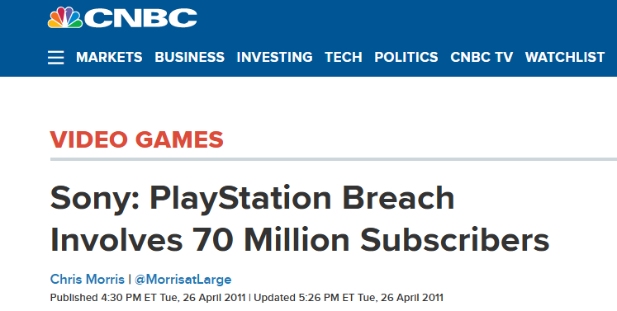
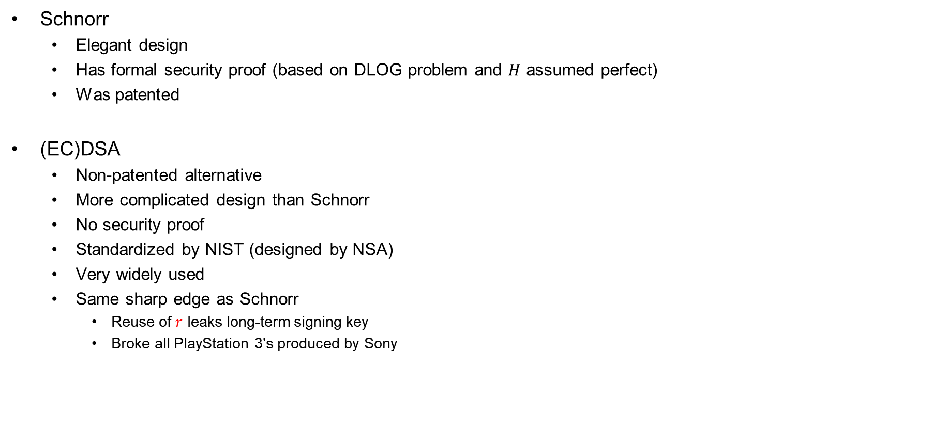
Discrete-log-based signatures
Schnorr
  Elegant design
  Has formal security proof (based on DLOG problem and $H$ assumed perfect)
  Was patented
(EC)DSA
  Non-patented alternative
  More complicated design than Schnorr
  No security proof
  Standardized by NIST (designed by NSA)
  Very widely used
  Same sharp edge as Schnorr
    Reuse of $r$ leaks long-term signing key
    Broke all PlayStation 3's produced by Sony

Slide 24
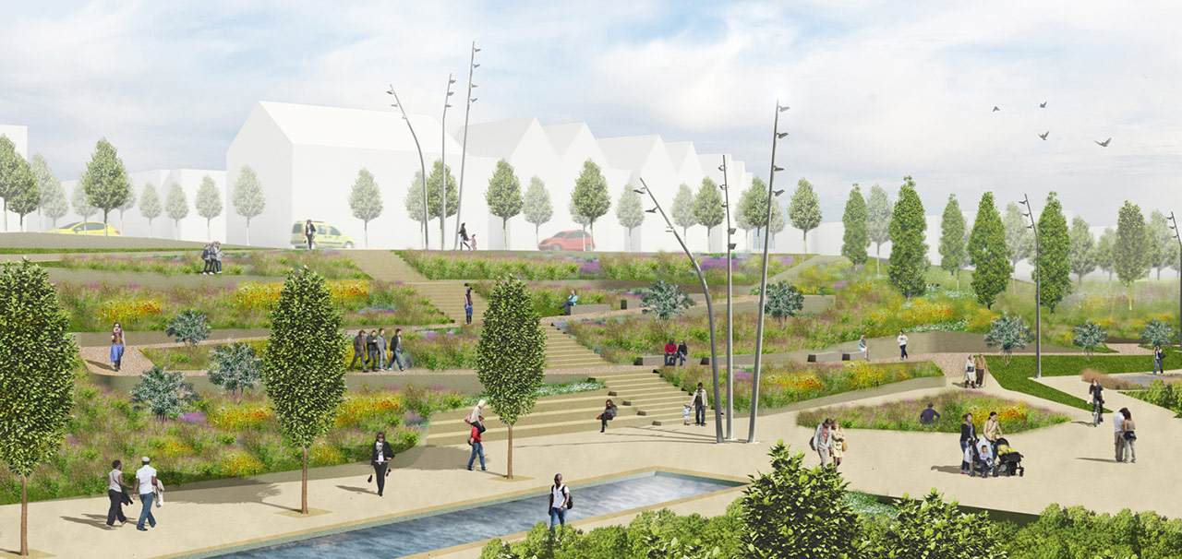
Public-key infrastructure (PKI)

Slide 25





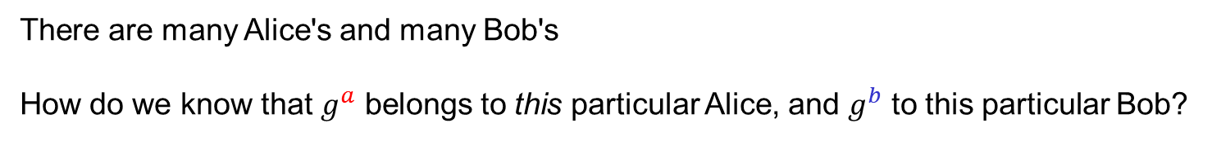
What are identities?
"Alice",
$$g^{a}$$
"Bob",
$$g^{b}$$
$${K←g}^{ab}$$
$${K←g}^{ab}$$
There are many Alice's and many Bob's
How do we know that $g^{a}$ belongs to this particular Alice, and $g^{b}$ to this particular Bob?
Need to bind public keys to entities

Slide 26



Identities on the internet
www.bob.com
"Alice",
$$g^{a}$$
www.bob.com,
$$g^{b}$$
$${K←g}^{ab}$$
$${K←g}^{ab}$$
There are many Alice's and many Bob's
How do we know that $g^{a}$ belongs to this particular Alice, and $g^{b}$ to this particular Bob?
Need to bind public keys to entities
– internet: bind public keys to domain names

Slide 27


Identities on the internet
www.evil.com
$$g^{a}$$
www.bob.com,
$$g^{b}$$
need proof these belong together
$$b\underset{←}{\$}\left\{1, …, \left|G\right|\right\}$$
$${K←g}^{ab}$$
$${K←g}^{ab}$$
There are many Alice's and many Bob's
How do we know that $g^{a}$ belongs to this particular Alice, and $g^{b}$ to this particular Bob?
Need to bind public keys to entities
– internet: bind public keys to domain names

Slide 28







Authenticated key exchange
www.bob.com
$$g^{a}$$
$$\left(sk_{B},vk_{B}\right)$$
$$g^{b}$$
www.bob.com,
$$,vk_{B}$$
if $Vrfy\left(vk_{B},…,σ\right)=1$
$$σ$$
$${K←g}^{ab}$$
$${K←g}^{ab}$$
else
abort
But why should we trust this $vk_{B}$?
Could have been created by the adversary itself

Slide 29
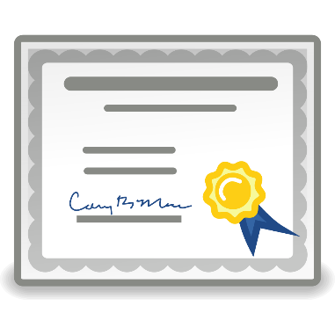
Digital certificates
Digital certificate: a way of binding a public key to an entity
A certificate consists of:
  The public key of the entity
  A bunch of information identifying the entity
    Name
    Address
    Occupation
    URL
    Email-address
    Phone number
    …
  A digital signature on all the above by a certificate authority (CA)

Slide 30
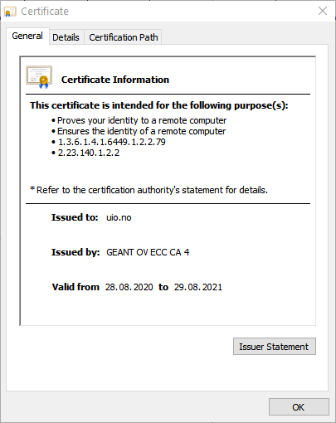
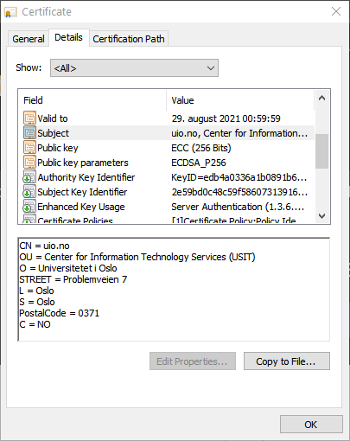
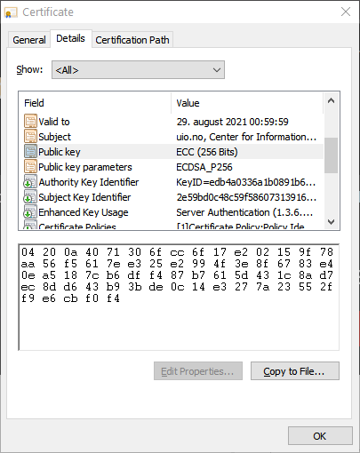
Digital certificates

Slide 31

Certificate authorities (CA)
CA: an issuer of digital certificates
Acts as a trusted third-party, certifying (i.e., signing)
the public keys of other entities
  Verifies the identity of a claimed public-key owner
The basis of a public-key infrastructure (PKI)
Certificate
Authority

Slide 32

















Authenticated key exchange + PKI
www.bob.com
$$vk_{CA}$$
$$g^{a}$$
$$\left(sk_{B},vk_{B}\right)$$
$${ g}^{b},$$
if $Vrfy\left(vk_{B},…,σ\right)=1$
www.bob.com,
$$vk_{B}$$
and $Vrfy\left(vk_{CA},…,σ\right)=1$
$$σ$$
$$σ$$
$${K←g}^{ab}$$
$${K←g}^{ab}$$
$$vk_{CA}$$
else
abort

Slide 33




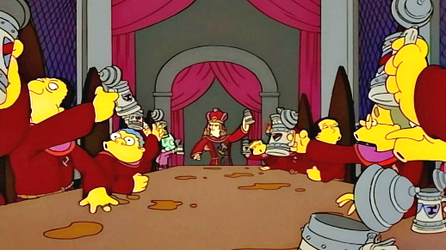

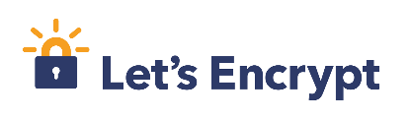
Root CAs
Root CAs: CAs that sign other CAs' public keys
  + only a few root CAs need to be trusted by end-users
  + root CAs can distribute the signing + verification load to smaller CAs
  - single point of failure
  Root CAs for the internet: a few large multinational corporations
  ; private key must be very heavily guarded
Root CA signing key

Slide 34
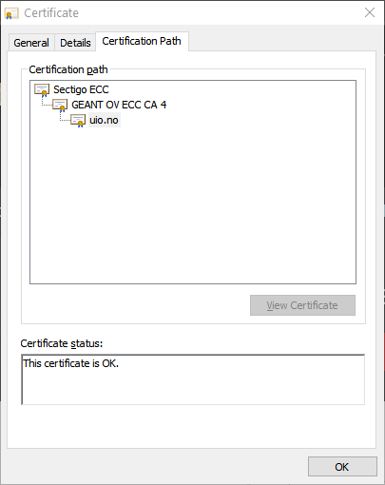
Certificate chains

Slide 35










HTTPS / TLS + PKI
www.bob.com
$$vk_{{CA}_{2}}$$
$$vk_{{CA}_{1}}$$
$$g^{a}$$
$$\left(sk_{B},vk_{B}\right)$$
if $Vrfy\left(vk_{B},…,σ\right)=1$
www.bob.com,
$$g^{b}$$
and $Vrfy\left(vk_{{CA}_{1}},…,σ\right)=1$
$$σ$$
$$vk_{B}$$
and $Vrfy\left(vk_{{CA}_{2}},…,σ\right)=1$
$${K←g}^{ab}$$
$${K←g}^{ab}$$
$$σ$$
$$vk_{{CA}_{1}}$$
else
abort
$$σ$$

Slide 36
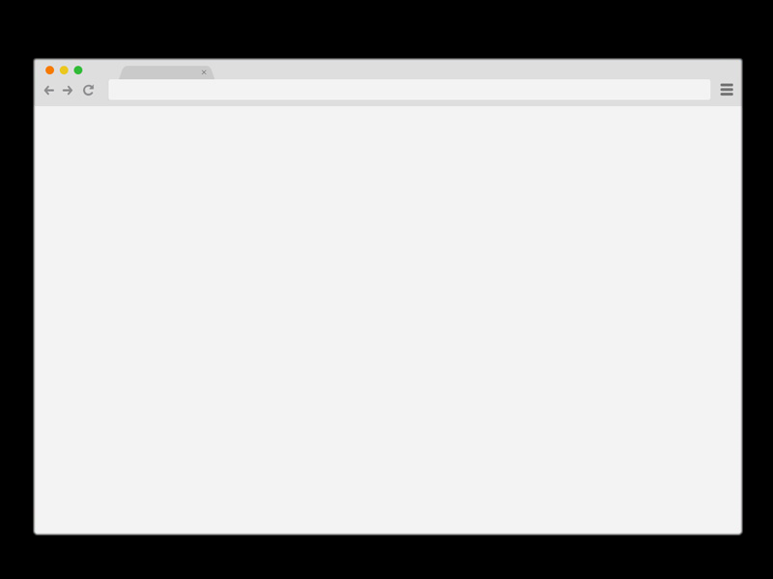

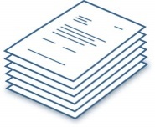





How to get a signed certificate?
4
www.bob.com
www.bob.com
2
$$vk_{B}$$
0x349a5
3
“Put 0x349a5 on your page”
1
Check
5
$$\left(sk_{B},vk_{B}\right)←KeyGen$$
Other validation methods also possible:
Confirmation emails
DNS entries
Physical verification
Passport or driver's license
6
$$←Sign\left(sk_{dc}, vk_{B}, \right)$$
7

Slide 37




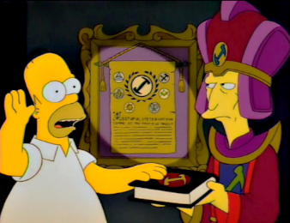
How to become an internet root CA?
Need to prove yourself (trust)worthy to browser and OS vendors
  Microsoft Root Certificate Program
  Mozilla CA Certificate Program
  Apple Root Certificate Program
  Chrome Root CA Program
Lot's of auditing and paperwork
Many formal technical and non-technical security requirements
  CA/Browser forum
  Baseline Requirements v1.7.3

Slide 38
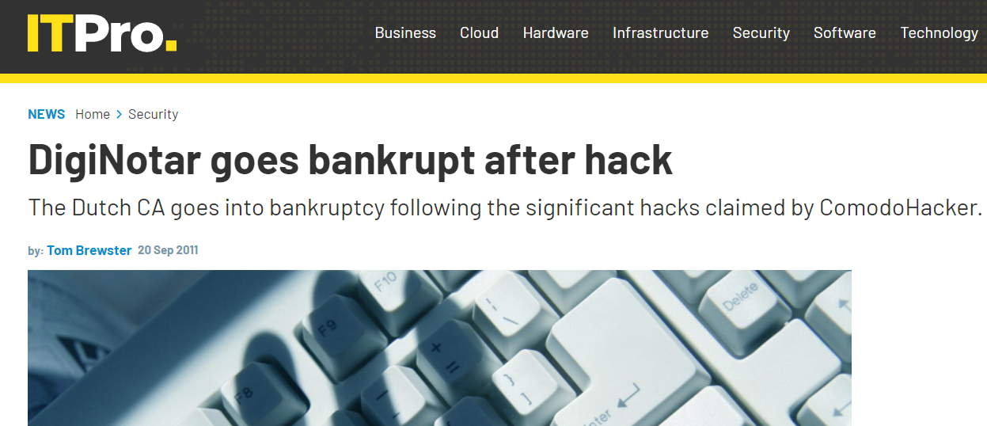
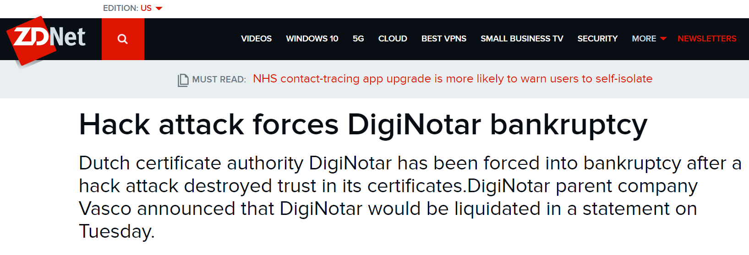
DigiNotar
Dutch root CA
Lost control of their private signing key in 2011
Fraudulent certificates issued for Gmail,
Yahoo!, Mozilla, WordPress, …
30 000 Iranian Gmail users targeted
Triggered the creation of Certificate Transparency

Slide 39







Certificate revocation
www.bob.com
$$g^{a}$$
$$\left(sk_{B},vk_{B}\right)$$
${ g}^{b},$ $σ,$ $vk_{B}$
get CRL
if revoked:
abort
CA

Slide 40
Certificate revocation – OCSP
(Online Certificate Status Protocol)
www.bob.com
$$g^{a}$$
$$\left(sk_{B},vk_{B}\right)$$
${ g}^{b},$ $σ,$ $vk_{B}$
is revoked?
if revoked:
abort
yes
CA

Slide 41
Certificate revocation – OCSP
www.bob.com
$$g^{a}$$
$$\left(sk_{B},vk_{B}\right)$$
${ g}^{b},$ $σ,$ $vk_{B}$
is revoked?
if request timed out:
abort
cert valid
(hard fail)
(soft fail)
CA

Slide 42
Certificate revocation – OCSP
www.bob.com
$$g^{a}$$
$$\left(sk_{B},vk_{B}\right)$$
${ g}^{b},$ $σ,$ $vk_{B}$
is revoked?
if request timed out:
abort
cert valid
yes
(hard fail)
(soft fail)
CA

Slide 43

Certificate revocation – OCSP
embarrassing_stuff.com
$$g^{a}$$
$$\left(sk_{B},vk_{B}\right)$$
${ g}^{b},$ $σ,$ $vk_{B}$
is revoked?
embarrassing_stuff.com
CA

Slide 44


Certificate revocation – OCSP stapling
embarrassing_stuff.com
$$g^{a}$$
$$\left(sk_{B},vk_{B}\right)$$
${ g}^{b},$ $σ,$ $vk_{B}$
“ has not been revoked ”
Valid until November 20
“ has not been revoked ”
Valid until November 20
CA

Slide 45
Certificate revocation – OCSP stapling
embarrassing_stuff.com
$$g^{a}$$
$$\left(sk_{B},vk_{B}\right)$$
${ g}^{b},$ $σ,$ $vk_{B}$
“ has been revoked ”
“ has been revoked ”
if OCSP staple not present:
abort (hard fail)
cert valid (soft fail)
CA

Slide 46
Certificate revocation – OCSP stapling + must_staple
embarrassing_stuff.com
“must include staple”
$$g^{a}$$
$$\left(sk_{B},vk_{B}\right)$$
${ g}^{b},$ $σ,$ $vk_{B}$
“ has been revoked ”
“ has been revoked ”
if OCSP staple not present:
abort (hard fail)
cert valid (soft fail)
CA

Slide 47
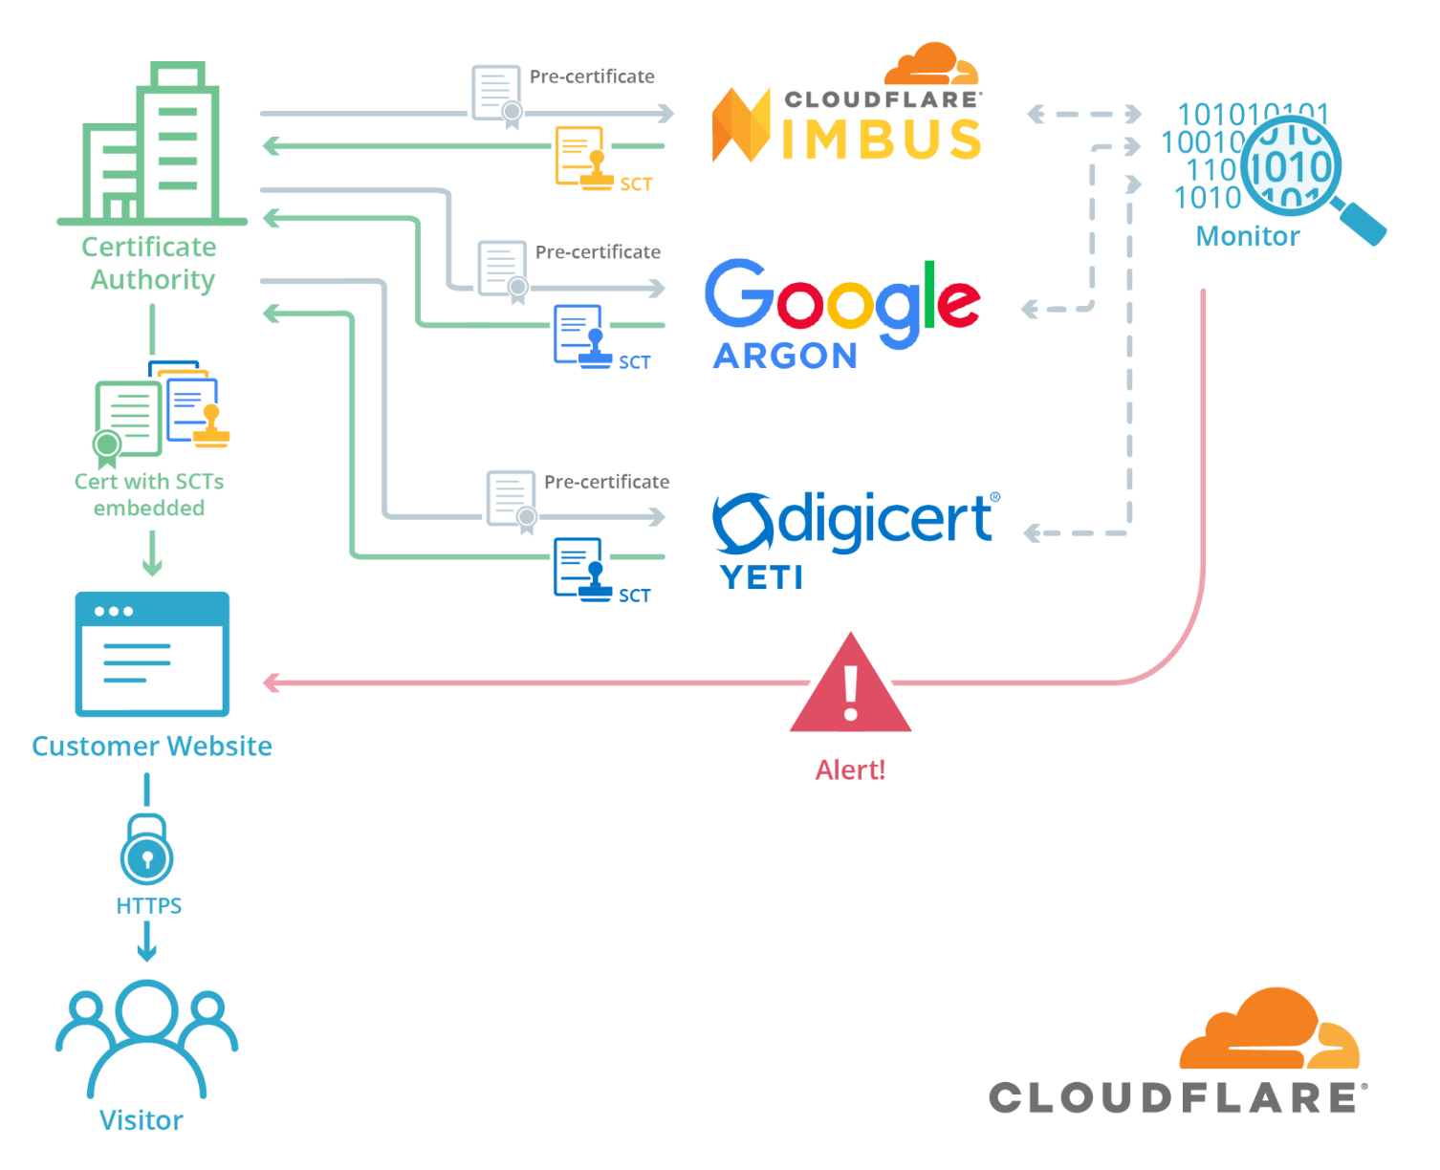
Certificate Transparency
Notes:
SCT = Signed Certificate Timestamp
Required by Chrome and Safari
Not required by Firefox
https://chromium.googlesource.com/chromium/src/+/master/net/docs/certificate-transparency.md
https://support.apple.com/en-gb/103214
https://developer.mozilla.org/en-US/docs/Web/Security/Certificate_Transparency

Slide 48
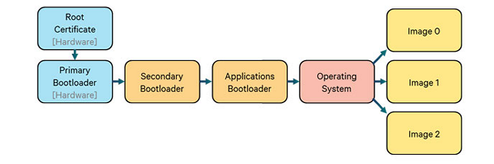
Hardware Root of Trust

Slide 49




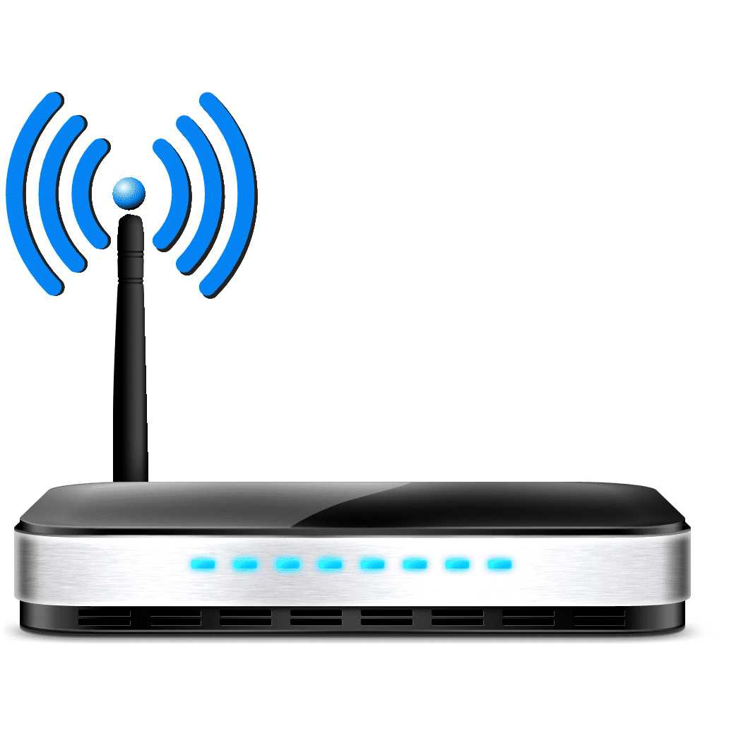

Other PKIs exist
Organization PKIs
  eduroam
TLS +
WPA2

Slide 50
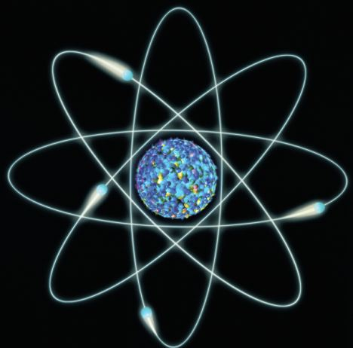
Next week
Quantum computers

