Slide 1
Lecture 1 – Introduction to cryptography
TEK4500
19.08.2026
Håkon Jacobsen
hakon.jacobsen@its.uio.no

Slide 2
Today's agenda
What is cryptography?
Some historical ciphers
Recap: modular arithmetic
Secure encryption: searching for a definition
Recap: probability theory

Slide 3

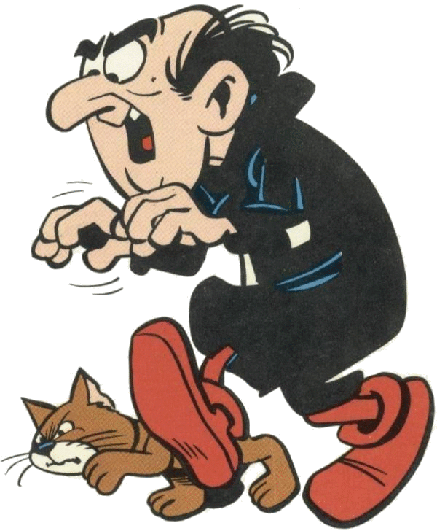

What is cryptography?
Internet
Alice
Bob
M
Adversary

Slide 4






What is cryptography?
Alice
Bob
M
Adversary

Slide 5
What is cryptography?
Alice
Bob
M
Adversary
Security goals:
Data privacy: adversary should not be able to read message M

Slide 6
What is cryptography?
Alice
Bob
M
M'
Adversary
Security goals:
Data privacy: adversary should not be able to read message M
Data integrity: adversary should not be able to modify message M
Data authenticity: message M really originated from Alice

Slide 7
Ideal solution: secure channels
But how to build?
Alice
Bob
M
Course done!
Adversary
Security goals:
Data privacy: adversary should not be able to read message M ✓
Data integrity: adversary should not be able to modify message M ✓
Data authenticity: message M really originated from Alice ✓

Slide 8


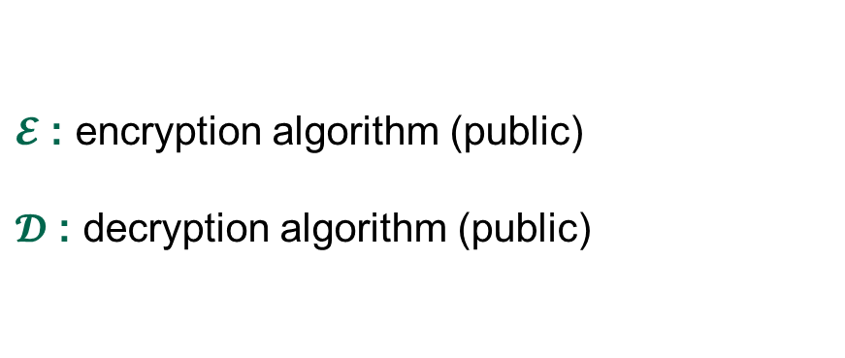
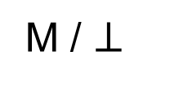
Creating secure channels: encryption schemes
Alice
Bob
K
K
$$ℰ$$
C
$$𝒟$$
M
M / $⊥$
Adversary
$𝓔$ : encryption algorithm (public)
$𝓓$ : decryption algorithm (public)
K : encryption / decryption key (secret)

Slide 9
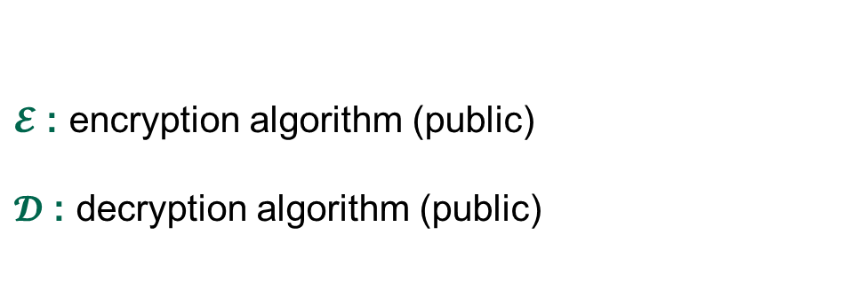
Creating secure channels: encryption schemes
Alice
Bob
K_{e}
K_{d}
$$ℰ$$
C
$$𝒟$$
M
M / $⊥$
Adversary
$𝓔$ : encryption algorithm (public)
$𝓓$ : decryption algorithm (public)
K_{e} : encryption key (public)
K_{d} : decryption key (secret)

Slide 10
Basic goals of cryptography
 | Message privacy | Message integrity / authentication
Symmetric keys | Symmetric encryption | Message authentication codes (MAC)
Asymmetric keys | Asymmetric encryption (public-key encryption) | Digital signatures

Slide 11
Basic goals of cryptography
 | Message privacy | Message integrity / authentication
Symmetric keys | Symmetric encryption | Message authentication codes (MAC)
Asymmetric keys | Asymmetric encryption (public-key encryption) | Digital signatures

Slide 12
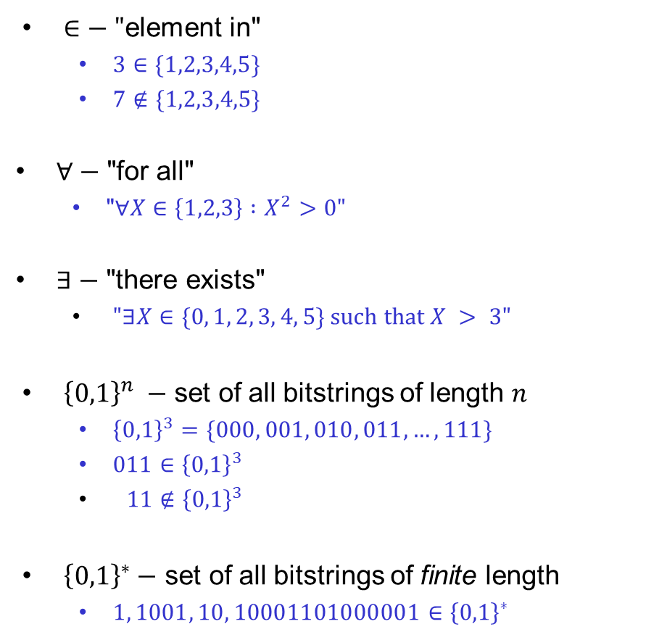
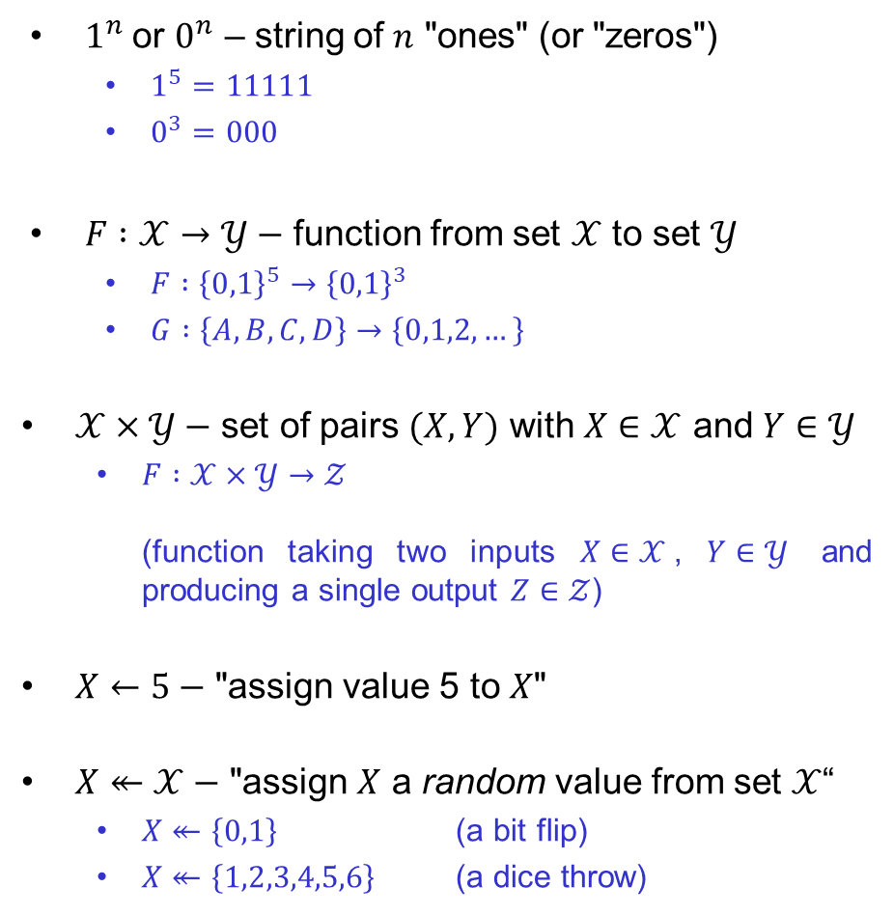
Some notation
$∈−$ "element in"
  $3∈\{1,2,3,4,5\}$
  $7∉\{1,2,3,4,5\}$
$∀−$ "for all"
  "$∀X∈\left\{1,2,3\right\} :X^{2}>0"$
$∃−$ "there exists"
  $"∃X∈\{0, 1, 2, 3, 4, 5\} such that X > 3"$
${\left\{0,1\right\}}^{n} −$ set of all bitstrings of length $n$
  ${\left\{0,1\right\}}^{3}=\{000, 001, 010, 011,…,111\}$
  $011∈{\left\{0,1\right\}}^{3}$
  $11∉{\left\{0,1\right\}}^{3}$
${\left\{0,1\right\}}^{∗}−$ set of all bitstrings of finite length
  $1, 1001, 10, 10001101000001∈{\left\{0,1\right\}}^{∗}$
$1^{n}$ or $0^{n}$ – string of $n$ "ones" (or "zeros")
  $1^{5}=11111$
  $0^{3}=000$
$F :𝒳→𝒴−$ function from set $𝒳$ to set $𝒴$
  $F :{\left\{0,1\right\}}^{5}→{\left\{0,1\right\}}^{3}$
  $G :\left\{A,B,C,D\right\}→\left\{0,1,2,…\right\}$
$𝒳×𝒴−$ set of pairs $(X,Y)$ with $X∈𝒳$ and $Y∈𝒴$
  $F :𝒳×𝒴→𝒵$
  (function taking two inputs $X∈𝒳$, $Y∈𝒴$ and producing a single output $Z∈𝒵$)
$X←5−$ "assign value 5 to $X$"
$X↞𝒳−$ "assign $X$ a random value from set $𝒳$“
  $X↞\left\{0,1\right\}$ (a bit flip)
  $X↞\left\{1,2,3,4,5,6\right\}$ (a dice throw)
…independent, and uniformly distributed…

Slide 13

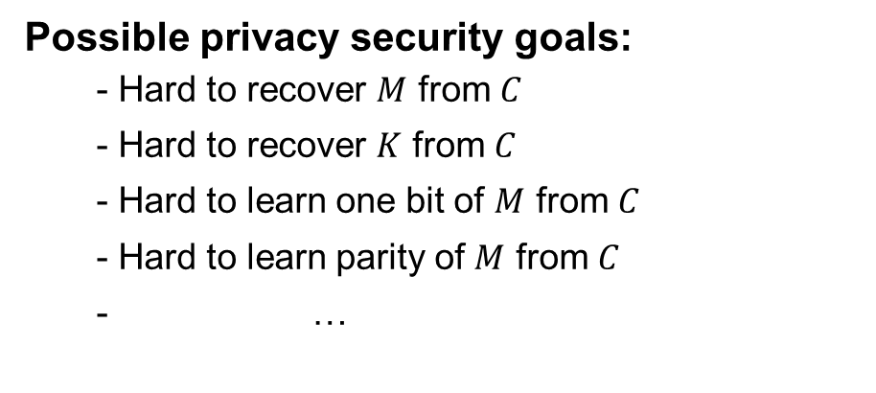
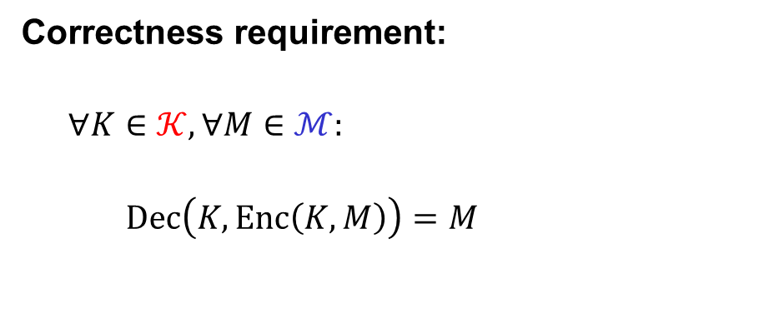




Symmetric encryption – syntax
$$Π=\left(Enc, Dec\right)$$
Examples:
$$Enc :𝒦×ℳ→𝒞$$
$$𝒦={\left\{0,1\right\}}^{128} ℳ={\left\{0,1\right\}}^{∗} 𝒞={\left\{0,1\right\}}^{∗}$$
$$Enc\left(K, M\right)={Enc}_{K}\left(M\right)=C$$
$$𝒦={\left\{0,1\right\}}^{128} ℳ=\left\{A,B,…, Z\right\} 𝒞=\left\{A,B,…, Z\right\}$$
$$Dec :𝒦×𝒞→ℳ$$
$$𝒦={\left\{0,1\right\}}^{128} ℳ=\left\{YES, NO\right\} 𝒞= {\left\{0,1\right\}}^{∗}$$
$$Dec\left(K, C\right)={Dec}_{K}\left(C\right)=M$$
$$𝒦=\left\{1,…,p\right\} ℳ=\left\{A,B,…,Z\right\} 𝒞={\left\{0,1\right\}}^{∗}$$
Correctness requirement:
$$∀K∈𝒦, ∀M∈ℳ:$$
  $$Dec\left(K, Enc\left(K, M\right)\right)=M$$
Possible privacy security goals:
  Hard to recover $M$ from $C$
  Hard to recover $K$ from $C$
  Hard to learn one bit of $M$ from $C$
  Hard to learn parity of $M$ from $C$
  …

Slide 14
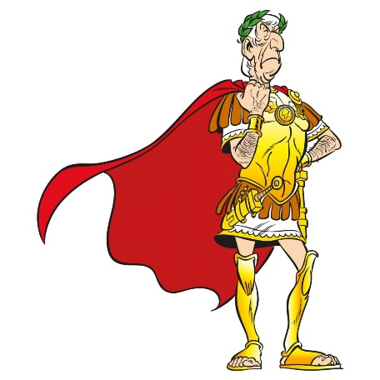
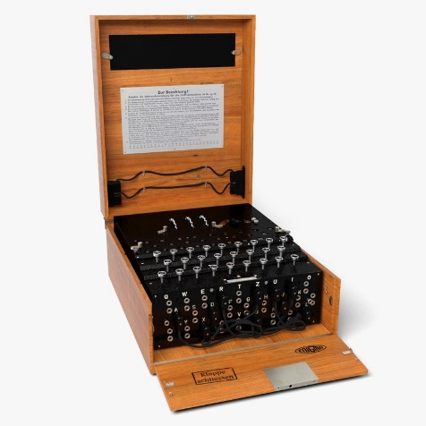
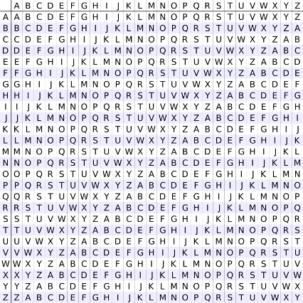
Historical encryption algorithms

Slide 15
Ceasar cipher
a b c d e f g h i j k l m n o p q r s t u v w x y z
…
a b c d e f g h i j k l m n o p q r s t u v w x y z
a
b
c
in the far distance a helicopter skimmed down between the roofs, hovered for an instant like a bluebottle, and darted away again with a curving flight. It was the police patrol, snooping into people's windows
lq wkh idu glvwdqfh d kholfrswhu vnlpphg grzq ehwzhhq wkh urriv, kryhuhg iru dq lqvwdqw olnh d eoxherwwoh, dqg gduwhg dzdb djdlq
zlwk d fxuylqj ioljkw. Lw zdv wkh srolfh sdwuro, vqrrslqj lqwr shrsoh'v zlqgrzv

Slide 16
Ceasar cipher (ROT-13)
a b c d e f g h i j k l m n o p q r s t u v w x y z
…
a b c d e f g h i j k l m n o p q r s t u v w x y z
in the far distance a helicopter skimmed down between the roofs, hovered for an instant like a bluebottle, and darted away again with a curving flight. It was the police patrol, snooping into people's windows
va gur sne qvfgnapr n uryvpbcgre fxvzzrq qbja orgjrra gur ebbsf, ubirerq sbe na vafgnag yvxr n oyhrobggyr, naq qnegrq njnl ntnva jvgu n pheivat syvtug. Vg jnf gur cbyvpr cngeby, fabbcvat vagb crbcyr'f jvaqbjf

Slide 17

Ceasar cipher
a ↔ 0
b ↔ 1
c ↔ 2
d ↔ 3
e ↔ 4
⁞
z ↔ 25
$$C←M+3 (\operatorname{mod}{26})$$

Slide 18


















Modular arithmetic
$$⋯$$
$$−4$$
$$−3$$
$$−2$$
$$−1$$
$$0$$
$$1$$
$$2$$
$$3$$
$$4$$
$$5$$
$$6$$
$$7$$
$$8$$
$$9$$
$$10$$
$$11$$
$$⋯$$

Slide 19




















Modular arithmetic
$$14$$
$$13$$
$$5$$
$$4$$
$$15$$
$$12$$
$$6$$
$$3$$
$$16$$
$$7$$
$$2$$
$$11$$
$$20$$
$$8$$
$$1$$
$$17$$
$$10$$
$$⋯$$
$$−4$$
$$−3$$
$$−2$$
$$−1$$
$$0$$
$$19$$
$$9$$
$$18$$

Slide 20




Modular arithmetic
$$14$$
$$13$$
$$5$$
$$4$$
$$15$$
$$−4$$
$$12$$
$$6$$
$$3$$
$$−3$$
$$16$$
$$7$$
$$−2$$
$$2$$
$$11$$
$$20$$
$$−1$$
$$8$$
$$1$$
$$17$$
$$10$$
$$0$$
$$19$$
$$9$$
$$18$$

Slide 21











Modular arithmetic
$$14$$
$$13$$
$$5$$
$$4$$
$$1+3=4$$
$$15$$
$$−4$$
$$12$$
$$5+8=13$$
$$≡4 \left(mod⁡9\right)$$
$$6$$
$$3$$
$$−3$$
$$5⋅4=20≡2 \left(mod⁡9\right)$$
$$\operatorname{mod}{9}$$
$$2−5=−3≡6 \left(mod⁡9\right)$$
$$16$$
$$7$$
$$−2$$
$$2$$
$$11$$
$$20$$
$$2^{10}=1024≡7 \left(mod⁡9\right)$$
$$−1$$
$$8$$
$$1$$
$$17$$
$$10$$
$$158$$
$$=9⋅m+r$$
$$≡r \left(mod⁡9\right)$$
$$0$$
$$19$$
$$r<9$$
$$9$$
$$18$$
$$m→9→18→27→36→…→153→162$$

Slide 22
Ceasar cipher
a ↔ 0
b ↔ 1
c ↔ 2
d ↔ 3
e ↔ 4
⁞
z ↔ 25
$$C←M+3 (\operatorname{mod}{26})$$

Slide 23










ROT-13
a ↔ 0
b ↔ 1
c ↔ 2
d ↔ 3
e ↔ 4
⁞
z ↔ 25
$$C←M+13 (\operatorname{mod}{26})$$
$$M←$$
$$C−13 (\operatorname{mod}{26})$$
$$=M+13−13 (\operatorname{mod}{26})$$
$$C$$
$$𝒦=\{13\}$$
$$ℰ :𝒦×ℳ→𝒞$$
$$ℳ=\{0,1,2,…, 25\}$$
$$𝒟 :𝒦×𝒞→ℳ$$
$$𝒞=\{0,1,2,…, 25\}$$

Slide 24



ROT-K
a ↔ 0
b ↔ 1
c ↔ 2
d ↔ 3
e ↔ 4
⁞
z ↔ 25
$$C←M+K (\operatorname{mod}{26})$$
$$M←$$
$$C−K (\operatorname{mod}{26})$$
$$𝒦=\{0,1,2…,25\}$$
$$ℰ :𝒦×ℳ→𝒞$$
$$ℳ=\{0,1,2,…, 25\}$$
$$𝒟 :𝒦×𝒞→ℳ$$
$$𝒞=\{0,1,2,…, 25\}$$

Slide 25



Attacking ROT-K
$K$ $M$
$$\left|𝒦\right|=26$$
0 va gur sne qvfgnapr n uryvpbcgre …
1 uz ftq rmd puefmzoq m tqxuoabfqd …
2 ty esp qlc otdelynp l spwtnzaepc …
3 sx dro pkb nscdkxmo k rovsmyzdob …
$C$ = va gur sne qvfgnapr n uryvpbcgre …
$$⋮$$
12 jo uif gbs ejtubodf b ifmjdpqufs …
13 in the far distance a helicopter …
14 hm sgd ezq chrszmbd z gdkhbnosdq …
Conclusion: key space must be large enough!
$$⋮$$
25 wb hvs tof rwghobqs o vszwqcdhsf …

Slide 26
Substitution cipher
a b c d e f g h i j k l m n o p q r s t u v w x y z
…
a b c d e f g h i j k l m n o p q r s t u v w x y z

Slide 27
Substitution cipher
a b c d e f g h i j k l m n o p q r s t u v w x y z
a b c d e f g h i j k l m n o p q r s t u v w x y z

Slide 28



Substitution cipher
$$26!$$
$$≈{10}^{26}≈2^{88}$$
$$\left|𝒦\right|=$$
a b c d e f g h i j k l m n o p q r s t u v w x y z
↕ ↕ ↕ ↕ … ↕
s x d y w q f m j k o i l g z b e n t u c p a r v h
in the far distance a helicopter skimmed down between the roofs, hovered for an instant like a bluebottle, and darted away again with a curving flight. It was the police patrol, snooping into people's windows
jg umw qsn yjtusgdw s mwijdzbuwn tojllwy yzag xwuawwg umw nzzqt, mzpwnwy qzn sg jgtusgu ijow s xicwxzuuiw, sgy ysnuwy sasv sfsjg
ajum s dcnpjgf qijfmu. ju ast umw bzijdw bsunzi, tgzzbjgf jguz bwzbiw't ajgyzat

Slide 29
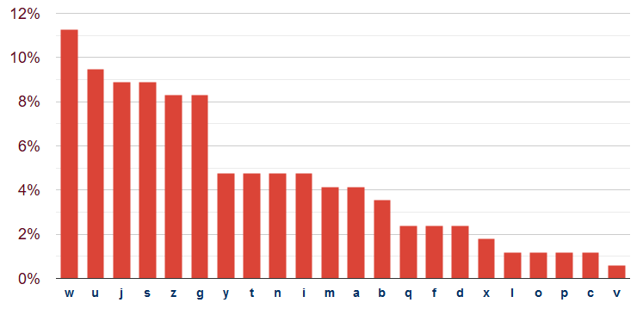
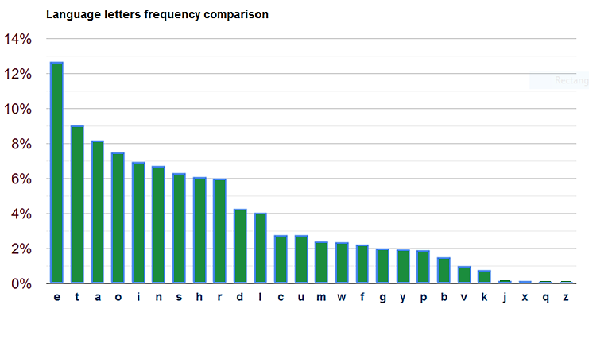
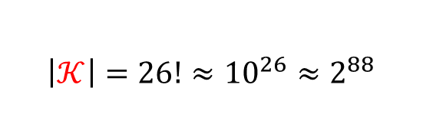
Attacking the substitution cipher
$\left|𝒦\right|=26!≈{10}^{26}≈2^{88}$
jg umw qsn yjtusgdw s mwijdzbuwn tojllwy yzag xwuawwg umw nzzqt, mzpwnwy qzn sg jgtusgu ijow s xicwxzuuiw, sgy ysnuwy sasv sfsjg ajum s dcnpjgf qijfmu. ju ast umw bzijdw bsunzi, tgzzbjgf jguz bwzbiw't ajgyzat
English letter frequency

Slide 30
Attacking the substitution cipher
$\left|𝒦\right|=26!≈{10}^{26}≈2^{88}$
jg ume qsn yjtusgde s meijdzbuen tojlley yzag xeuaeeg ume nzzqt, mzpeney qzn sg jgtusgu ijoe s xicexzuuie, sgy ysnuey sasv sfsjg ajum s dcnpjgf qijfmu. ju ast ume bzijde bsunzi, tgzzbjgf jguz bezbie't ajgyzat
English letter frequency
✓
✓

Slide 31
Attacking the substitution cipher
$\left|𝒦\right|=26!≈{10}^{26}≈2^{88}$
jg tme qsn yjttsgde s meijdzbten tojlley yzag xetaeeg tme nzzqt, mzpeney qzn sg jgttsgt ijoe s xicexzttie, sgy ysntey sasv sfsjg ajtm s dcnpjgf qijfmt. jt ast tme bzijde bstnzi, tgzzbjgf jgtz bezbie't ajgyzat
English letter frequency
✓
✓
✓
✓
Notes:
j or s? notice single s

Slide 32
Attacking the substitution cipher
$\left|𝒦\right|=26!≈{10}^{26}≈2^{88}$
jg tme qan yjttagde a meijdzbten tojlley yzag xetaeeg tme nzzqt, mzpeney qzn ag jgttagt ijoe a xicexzttie, agy yantey aaav afajg ajtm a dcnpjgf qijfmt. jt aat tme bzijde batnzi, tgzzbjgf jgtz bezbie't ajgyzat
English letter frequency
✓
✓
✓
✓
✓
✓
Notes:
J = o vs. i? notice "jt" -> "it"

Slide 33
Attacking the substitution cipher
$\left|𝒦\right|=26!≈{10}^{26}≈2^{88}$
ig tme qan yittagde a meiidzbten toilley yzag xetaeeg tme nzzqt, mzpeney qzn ag igttagt iioe a xicexzttie, agy yantey aaav afaig aitm a dcnpigf qiifmt. it aat tme bziide batnzi, tgzzbigf igtz bezbie't aigyzat
English letter frequency
✓
✓
✓
✓
✓
✓
✓
✓

Slide 34
Attacking the substitution cipher
$\left|𝒦\right|=26!≈{10}^{26}≈2^{88}$
ig tme qan yittagde a meiidobten toilley yoag xetaeeg tme nooqt, mopeney qon ag igttagt iioe a xicexottie, agy yantey aaav afaig aitm a dcnpigf qiifmt. it aat tme boiide batnoi, tgoobigf igto beobie't aigyoat
English letter frequency
✓
✓
✓
✓
✓
✓
✓
✓
✓
✓

Slide 35
Attacking the substitution cipher
$\left|𝒦\right|=26!≈{10}^{26}≈2^{88}$
in tme qan yittande a meiidobten toilley yoan xetaeen tme nooqt, mopeney qon an inttant iioe a xicexottie, any yantey aaav afain aitm a dcnpinf qiifmt. it aat tme boiide batnoi, tnoobinf into beobie't ainyoat
English letter frequency
✓
✓
✓
✓
✓
✓
✓
✓
✓
✓
✓
✓

Slide 36
Attacking the substitution cipher
$\left|𝒦\right|=26!≈{10}^{26}≈2^{88}$
in tme qan yistande a meiidobten soilley yoan xetaeen tme nooqs, mopeney qon an instant iioe a xicexottie, any yantey aaav afain aitm a dcnpinf qiifmt. it aas tme boiide batnoi, tnoobinf into beobie's ainyoas
English letter frequency
✓
✓
✓
✓
✓
✓
✓
✓
✓
✓
✓
✓
✓
✓

Slide 37
Attacking the substitution cipher
$\left|𝒦\right|=26!≈{10}^{26}≈2^{88}$
in the qar distande a heiidobter soilled down xetween the rooqs, hopered qor an instant iioe a xicexottie, and danted awav afain with a dcrpinf qiifht. it was the boiide batroi, tnoobinf into beobie's windows
English letter frequency
✓
✓
✓
✓
✓
✓
✓
✓
✓
✓
✓
✓
✓
✓
✓
✓
✓
✓
✓
✓
✓
✓
Notes:
https://planetcalc.com/8047/

Slide 38
Attacking the substitution cipher
$\left|𝒦\right|=26!≈{10}^{26}≈2^{88}$
in the far distande a helidopter soilled down xetween the roofs, hopered for an instant lioe a xlcexottle, and danted awav afain with a dcrpinf fiifht. it was the polide patrol, tnoopinf into people's windows
English letter frequency
✓
✓
✓
✓
✓
✓
✓
✓
✓
✓
✓
✓
✓
✓
✓
✓
✓
✓
✓
✓
✓
✓
✓
✓
✓
✓
✓
✓
Notes:
https://planetcalc.com/8047/

Slide 39
Conclusions
Key space must be large enough
Ciphertext should not reveal letter frequency of the message
Is this enough?

Slide 40
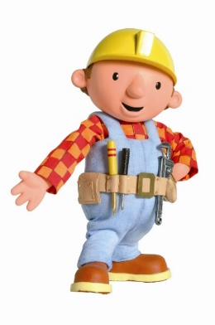


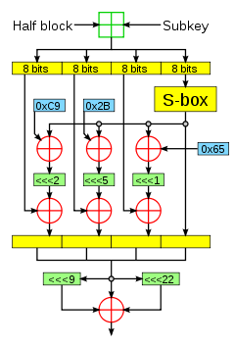

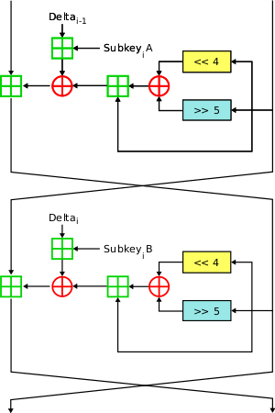
Historical approach to crypto development
build → break → fix → break → fix → break → fix ...
secure?

Slide 41
Modern approach
Trying to make cryptography more a science than an art
Focus on formal definitions of security (and insecurity)
Clearly stated assumptions
Analysis supported by mathematical proofs
... but old fashioned cryptanalysis continues to be very important!

Slide 42

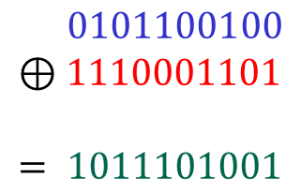








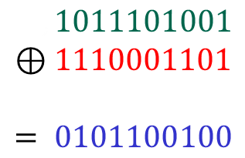



The one-time-pad (OTP)
$𝒦 ={\left\{0,1\right\}}^{n}$
$ℳ={\left\{0,1\right\}}^{n}$
$𝒞 ={\left\{0,1\right\}}^{n}$
$$ℰ\left(K, M\right)=K⊕M$$
$$𝒟\left(K, C\right)=K⊕C$$
$$=K⊕(K⊕M)$$
$$, 0101100100$$
$$⊕1110001101$$
$$= 1011101001$$
$$M$$
$$,1011101001$$
$$⊕1110001101$$
$$= 0101100100$$
$$C$$
$$K$$
$$K$$
$$C$$
$$M$$
Is the one-time pad secure?

Slide 43

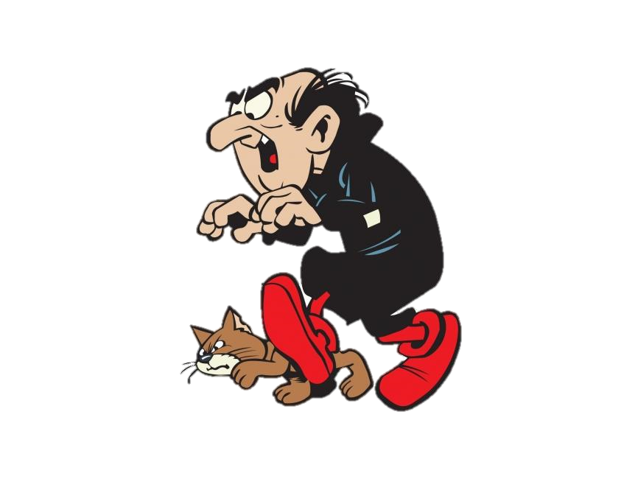

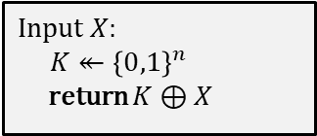





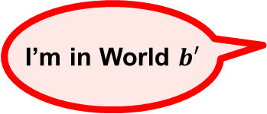

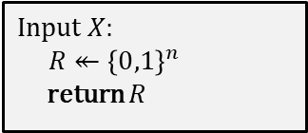


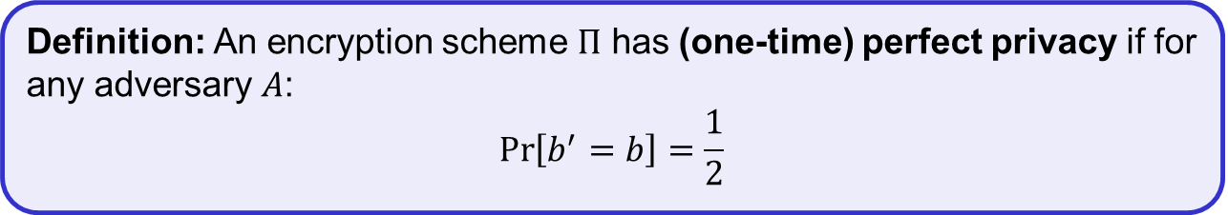

Defining security: (one-time) perfect privacy
$$\text{World}\text{ 0}$$
$$b$$
$$\text{World} \text{1}$$
Input $X$:
$K↞{\left\{0,1\right\}}^{n}$
return $K⊕X$
Input $X$:
$R↞{\left\{0,1\right\}}^{n}$
return $R$
$$Π. Enc(K,M)$$
$$b=0$$
$$b=1$$
$$M$$
$$M$$
$$C$$
$$C$$
I’m in World $b′$
Definition: An encryption scheme $Π$ has (one-time) perfect privacy if for any adversary $A$:
$$\operatorname{Pr}\left[b^{′}=b\right]=\frac{1}{2}$$

Slide 44




































The one-time-pad (OTP) – security
Theorem (Shannon 1949): The one-time pad has one-time perfect privacy
Proof:
$$(M=110)$$
Prob.
$$K$$
$$C$$
$$\text{World}\text{ 0}$$
$$b$$
$$\text{World} \text{1}$$
Input $X$:
$K↞{\left\{0,1\right\}}^{n}$
return $K⊕X$
Input $X$:
$R↞{\left\{0,1\right\}}^{n}$
return $R$
Need to show: $\operatorname{Pr}\left[b^{′}=b\right]=1/2$
$$1/8$$
$$000$$
$$110$$
Suppose $A$ submits $M=110$ and receives $C=101$
$$1/8$$
$$001$$
$$111$$
$$M$$
$$M$$
$$1/8$$
$$010$$
$$100$$
$$C$$
$$C$$
$$011$$
$$101$$
I’m in World $b′$
$$1/8$$
$$\operatorname{Pr}\left[C=101 ∣ M=110 ∧ b=0\right]=$$
$$1/8$$
$$1/8$$
$$100$$
$$010$$
$$1/8$$
$$101$$
$$011$$
$$\operatorname{Pr}\left[C=101 ∣ M=110 ∧ b=1\right]=$$
$$1/8$$
$$1/8$$
$$110$$
$$000$$
$$1/8$$
$$111$$
$$001$$
Probability that $A$ sees $C=101$ is independent of which world it's in!
$⟹$ seeing $C$ reveals no information about $b$
Same argument applies to any other choice of $M$ and $C$
$⟹$ $\operatorname{Pr}\left[b^{′}=b\right]=1/2$
Notes:
This of course generalizes to the case {0,1}^n:
For every $M$ and $C$ there is exactly one $K$ such that $K⊕M=C$. And since $K$ is chosen uniformly at random from ${\left\{0,1\right\}}^{n}$, it follows that $\operatorname{Pr}\left[C ∣ M∧ b=0\right]=1/2^{n}$ (which is ofc. also the case when $b=1$).
Summary of OTP security:
If the OTP key is chosen uniformly and independently for each encryption, and kept secret from the adversary, then ciphertexts appear uniformly distributed no matter how the plaintexts are chosen.

Slide 45



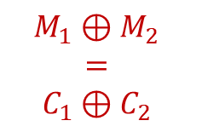
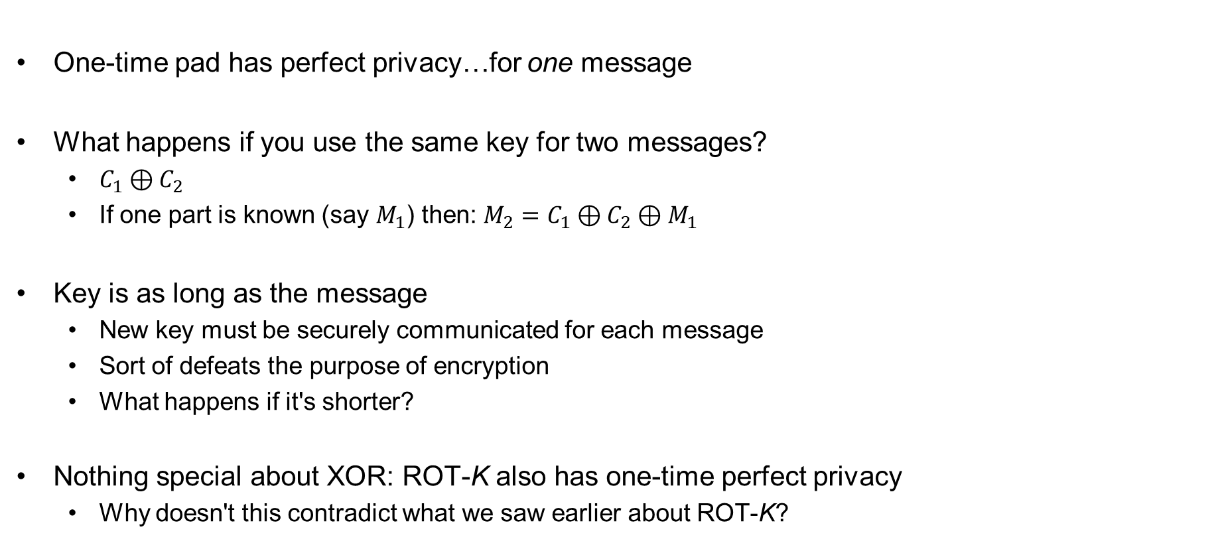
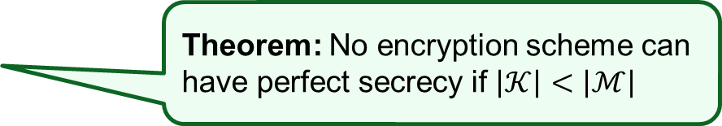



One-time pad – perfect?
One-time pad has perfect privacy…for one message
What happens if you use the same key for two messages?
  $C_{1}⊕C_{2}$
  If one part is known (say $M_{1}$) then: $M_{2}=C_{1}⊕C_{2}⊕M_{1}$
Key is as long as the message
  New key must be securely communicated for each message
  Sort of defeats the purpose of encryption
  What happens if it's shorter?
Nothing special about XOR: ROT-K also has one-time perfect privacy
  Why doesn't this contradict what we saw earlier about ROT-K?
$$M_{1}$$
$$M_{2}$$
$$⊕$$
$$=\left(K⊕M_{1}\right)⊕\left(K⊕M_{2}\right)=M_{1}⊕M_{2}$$
$$M_{1}⊕M_{2} \\ = \\ C_{1}⊕C_{2}$$
Theorem: No encryption scheme can have perfect secrecy if $\left|𝒦\right|<\left|ℳ\right|$
Notes:
https://crypto.stackexchange.com/questions/59/taking-advantage-of-one-time-pad-key-reuse

Slide 46

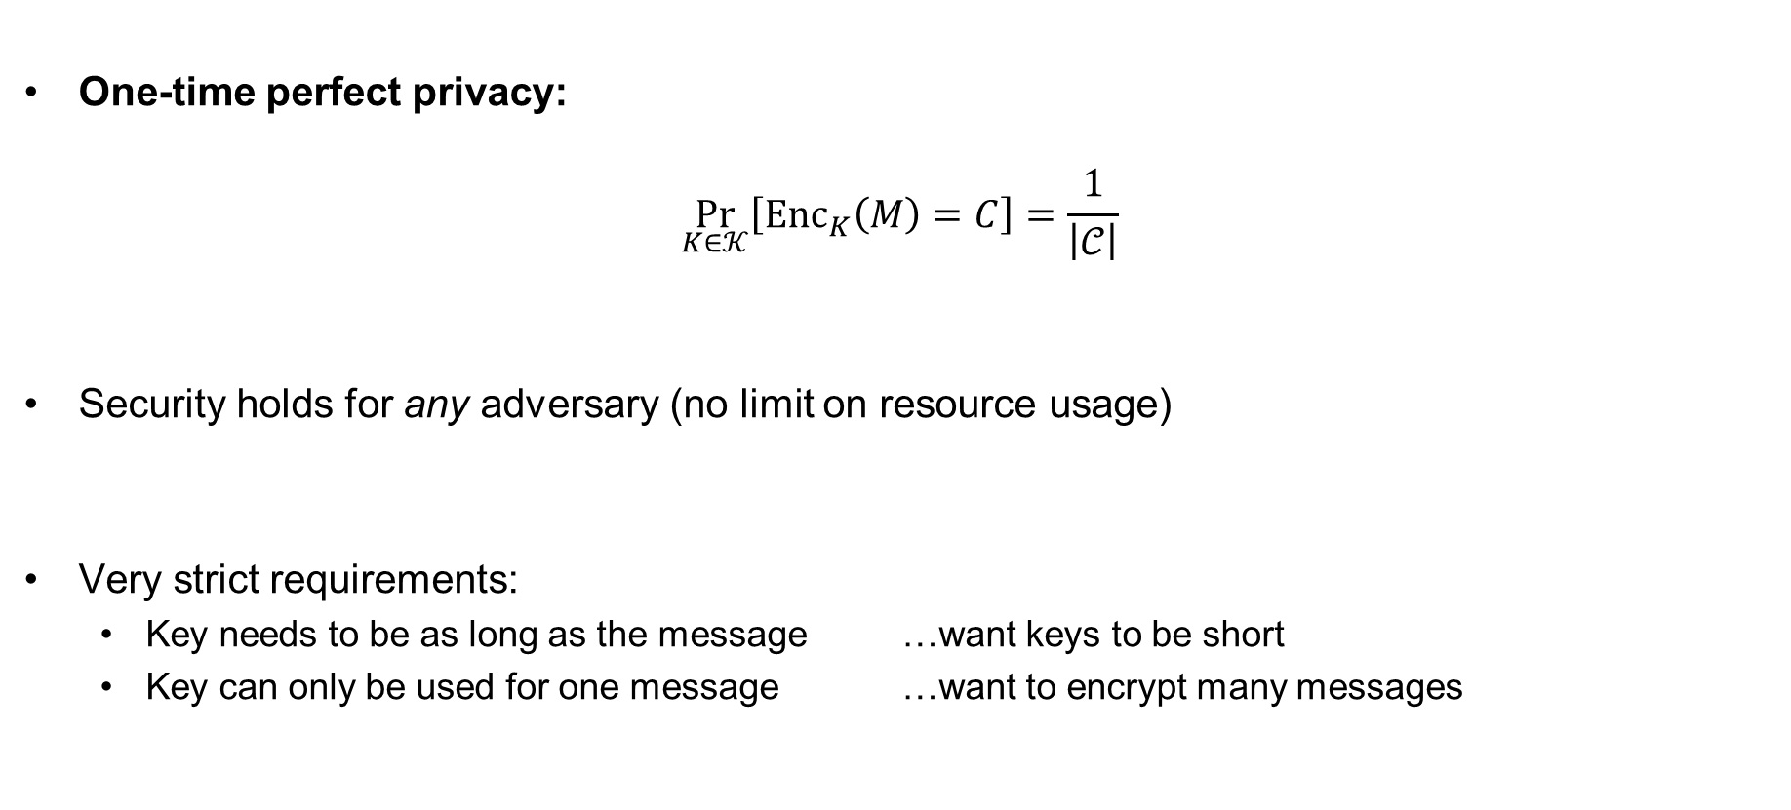
Wanted: security definition for symmetric encryption
One-time perfect privacy:
$$\underset{K∈𝒦}{Pr}\left[{Enc}_{K}\left(M\right)=C\right]=\frac{1}{\left|𝒞\right|}$$
Security holds for any adversary (no limit on resource usage)
Very strict requirements:
  Key needs to be as long as the message …want keys to be short
  Key can only be used for one message …want to encrypt many messages
computational
$$≈$$
resource bounded
✓
✓

Slide 47
Outline of course
 | Message privacy | Message integrity / authentication
Symmetric keys | Symmetric encryption | Message authentication codes (MAC)
Asymmetric keys | Asymmetric encryption (a.k.a. public-key encryption) | Digital signatures

Slide 48
Outline of course
 | Message privacy | Message integrity / authentication
Symmetric keys | Symmetric encryption | Message authentication codes (MAC)
Asymmetric keys | Asymmetric encryption (a.k.a. public-key encryption) | Digital signatures
Part I

Slide 49
Outline of course
 | Message privacy | Message integrity / authentication
Symmetric keys | Symmetric encryption | Message authentication codes (MAC)
Asymmetric keys | Asymmetric encryption (a.k.a. public-key encryption) | Digital signatures
Part II

Slide 50

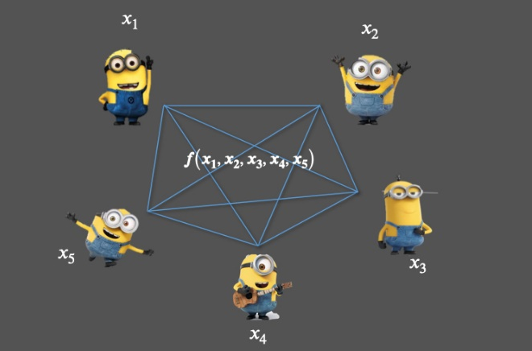
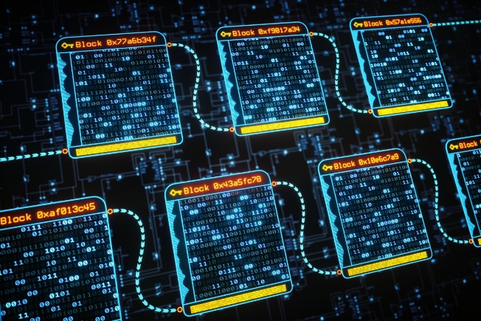
Much more to cryptography
Zero-knowledge proofs
Fully-homomorphic encryption
Multi-party computation
Blockchains
Password?
I know it
Welcome!
$${Enc}_{K}\left(M_{1}+M_{2}\right)={Enc}_{K}\left(M_{1}\right)+{Enc}_{K}\left(M_{2}\right)$$

Slide 51
The security pyramid
IN5280 – Security by design
IN5540 – Privacy by design
IN5290 – Ethical hacking
User
Secure
systems
TEK5510 – Security in operating systems and software
Communication
protocols
TEK5520 – Cyber security of industrial systems
IN4210 – Network and communications security
Cryptographic mechanisms
TEK4500 – Introduction to cryptography
TEK5550 – Advanced topics in cryptograpy
Notes:
Cryptography is harder
Cryptography is easier

Slide 52
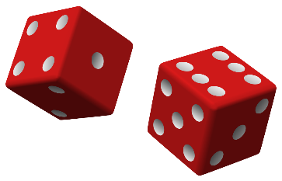
Discrete probability
…the bare minimum
More details: https://en.wikibooks.org/wiki/High_School_Mathematics_Extensions/Discrete_Probability and
https://joyofcryptography.com/math-review/

Slide 53
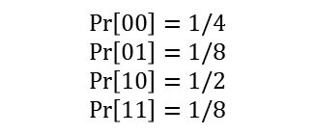
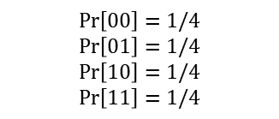
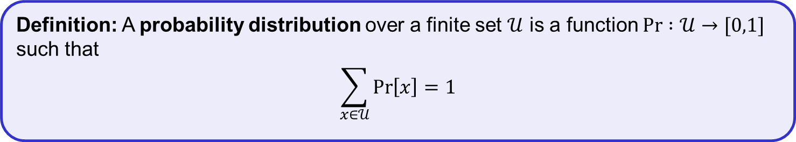

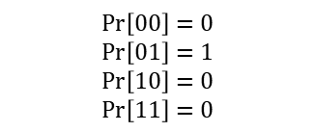
Discrete probability
Definition: A probability distribution over a finite set $𝒰$ is a function $\operatorname{Pr}{ :𝒰→[0,1]}$ such that
$$\sum_{x∈𝒰}{\operatorname{Pr}\left[x\right]=1}$$
$$𝒰={\left\{0,1\right\}}^{2}= \left\{00, 01, 10, 11\right\}$$
$$\operatorname{Pr}\left[x\right]$$
$$\operatorname{Pr}\left[00\right]=1/4$$
$$\operatorname{Pr}\left[01\right]=1/4$$
$$\operatorname{Pr}\left[10\right]=1/4$$
$$\operatorname{Pr}\left[11\right]=1/4$$
$$\operatorname{Pr}\left[00\right]=1/4$$
$$\operatorname{Pr}\left[01\right]=1/8$$
$$\operatorname{Pr}\left[10\right]=1/2$$
$$\operatorname{Pr}\left[11\right]=1/8$$
$$\operatorname{Pr}\left[00\right]=0$$
$$\operatorname{Pr}\left[01\right]=1$$
$$\operatorname{Pr}\left[10\right]=0$$
$$\operatorname{Pr}\left[11\right]=0$$
Uniform distribution
Point distribution

Slide 54
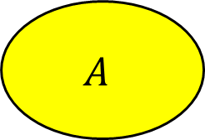
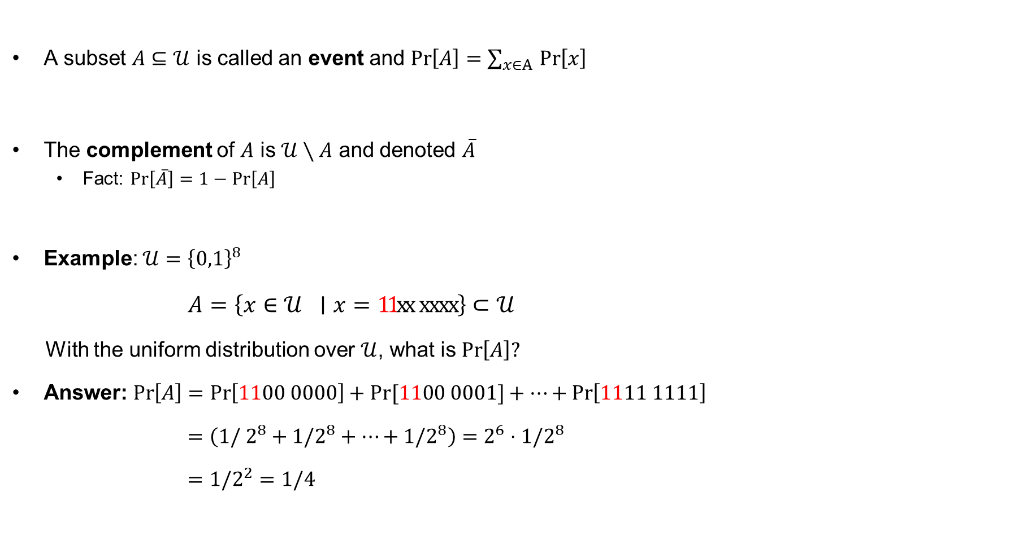
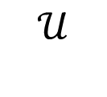
Discrete probability
A subset $A⊆𝒰$ is called an event and $\operatorname{Pr}\left[A\right]=\sum_{x∈A }{\operatorname{Pr}\left[x\right] }$
The complement of $A$ is $𝒰∖A$ and denoted $\overline{A}$
  Fact: $\operatorname{Pr}\left[\overline{A}\right]=1−\operatorname{Pr}\left[A\right]$
Example: $𝒰={\left\{0,1\right\}}^{8}$
  $A=\left\{x∈𝒰 ∣x=11xx xxxx\right\}⊂𝒰$
  With the uniform distribution over $𝒰$, what is $\operatorname{Pr}\left[A\right]?$
Answer: $\operatorname{Pr}\left[A\right]=\operatorname{Pr}\left[1100 0000\right]+Pr⁡[1100 0001]+…+\operatorname{Pr}\left[1111 1111\right]$
$=\left(1/ 2^{8}+1/2^{8}+…+1/2^{8}\right)=2^{6}⋅1/2^{8}$
$=1/2^{2}=1/4$
$$𝒰$$
$$A$$

Slide 55
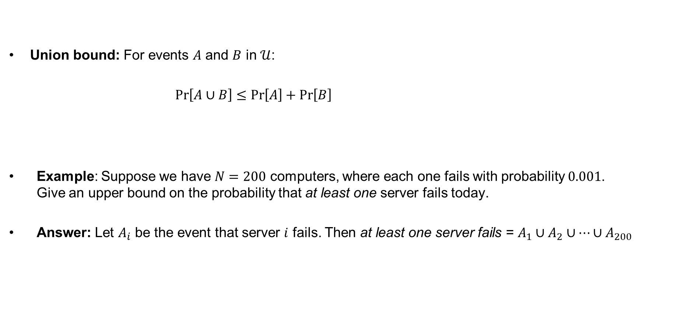
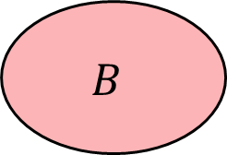

Union bound
Union bound: For events $A$ and $B$ in $𝒰$:
$\operatorname{Pr}\left[A∪B\right]≤\operatorname{Pr}\left[A\right]+\operatorname{Pr}\left[B\right]$
Example: Suppose we have $N=200$ computers, where each one fails with probability $0.001$.
Give an upper bound on the probability that at least one server fails today.
Answer: Let $A_{i}$ be the event that server $i$ fails. Then at least one server fails = $A_{1}∪A_{2}∪…∪A_{200}$
$$𝒰$$
$$A$$
$$B$$
$$\operatorname{Pr}\left[A_{1}∪A_{2}∪…∪A_{200}\right]≤\operatorname{Pr}\left[A_{1}\right]+\operatorname{Pr}\left[A_{2}\right]+…+\operatorname{Pr}\left[A_{200}\right]$$
$$=0.001+0.001+…+0.001=200⋅0.001=0.2$$

Slide 56
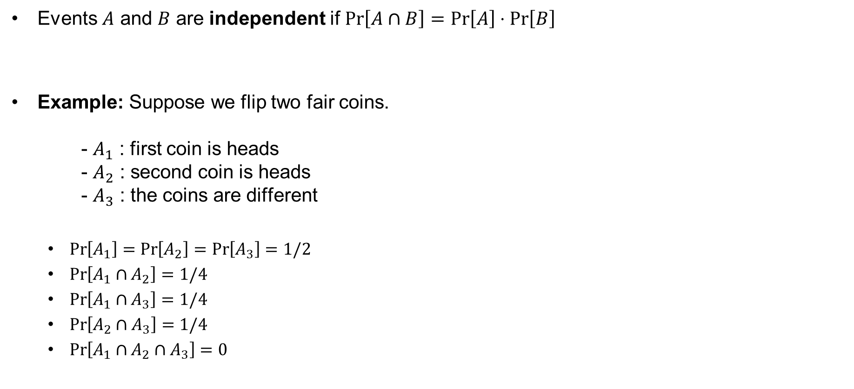
Independence
Events $A$ and $B$ are independent if $\operatorname{Pr}\left[A∩B\right]=\operatorname{Pr}\left[A\right]⋅\operatorname{Pr}\left[B\right]$
Example: Suppose we flip two fair coins.
- $A_{1}$ : first coin is heads
- $A_{2}$ : second coin is heads
- $A_{3}$ : the coins are different
  $\operatorname{Pr}\left[A_{1}\right]=\operatorname{Pr}\left[A_{2}\right]=\operatorname{Pr}\left[A_{3}\right]=1/2$
  $\operatorname{Pr}\left[A_{1}∩A_{2}\right]=1/4$
  $\operatorname{Pr}\left[A_{1}∩A_{3}\right]=1/4$
  $\operatorname{Pr}\left[A_{2}∩A_{3}\right]=1/4$
  $\operatorname{Pr}\left[A_{1}∩A_{2}∩A_{3}\right]=0$

Slide 57


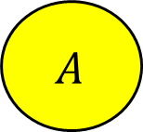


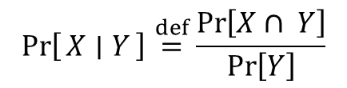

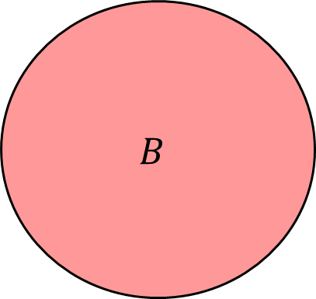


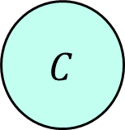


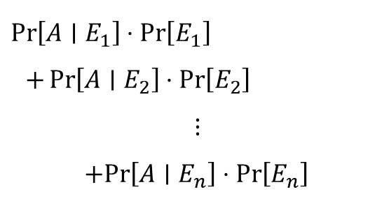





Law of total probability
Conditional probability
Law of total probability
$$B$$
$$\operatorname{Pr}\left[A∣B\right]$$
$$\operatorname{Pr}\left[A\right]$$
$$C$$
$$>$$
$$\operatorname{Pr}\left[X ∣ Y\right]\overset{def}{=}\frac{\operatorname{Pr}\left[X∩ Y\right]}{\operatorname{Pr}\left[Y\right]}$$
$$\operatorname{Pr}\left[A∣C\right]=0$$
$$A$$
assuming $\operatorname{Pr}\left[Y\right]>0$
$$E_{1}$$
$$\operatorname{Pr}\left[A∣E_{1}\right]⋅\operatorname{Pr}\left[E_{1}\right]$$
$+\operatorname{Pr}\left[A∣E_{2}\right]⋅\operatorname{Pr}\left[E_{2}\right]$
$⋮$
$+Pr\left[A∣E_{n}\right]⋅\operatorname{Pr}\left[E_{n}\right]$
$$E_{3}$$
$${≤\operatorname{Pr}\left[E_{1}\right]}$$
$${≤\operatorname{Pr}\left[E_{2}\right]}$$
$$\operatorname{Pr}\left[A\right]=$$
$$A$$
$$E_{2}$$
$$E_{n}$$
$${≤\operatorname{Pr}\left[E_{n}\right]}$$

Slide 58

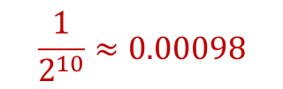
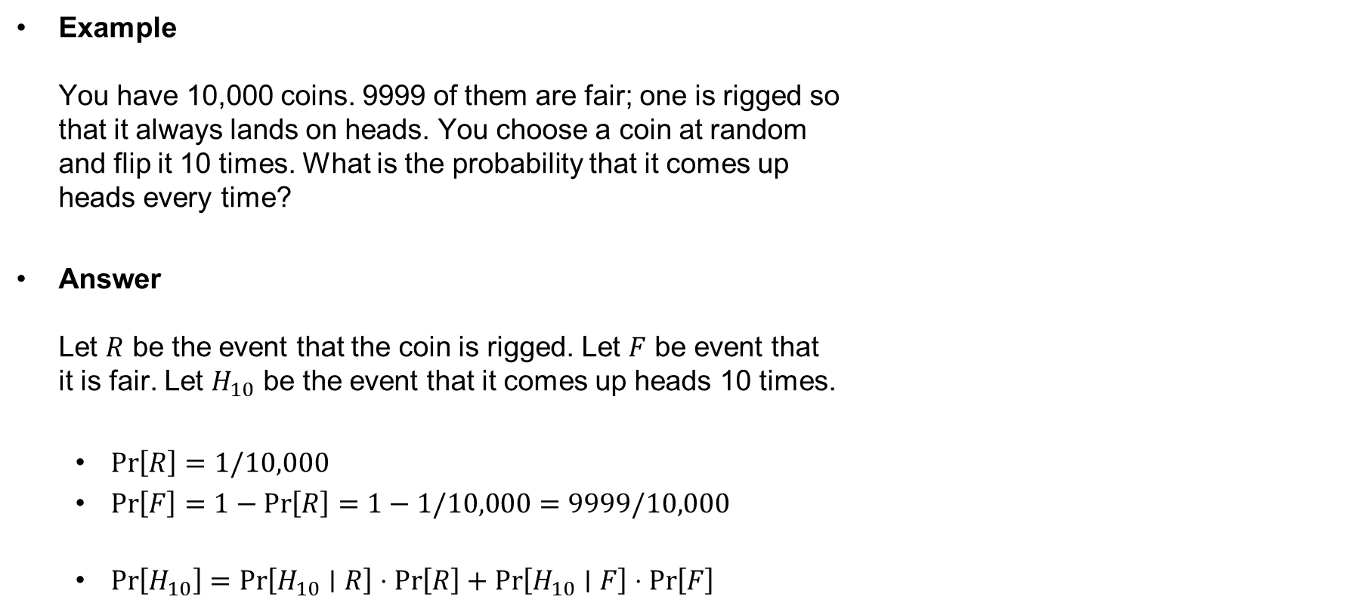

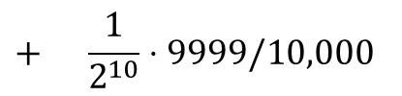
Law of total probability
See full problem here: https://nitter.poast.org/littmath/status/1827447490683003234
Example
You have 10,000 coins. 9999 of them are fair; one is rigged so
that it always lands on heads. You choose a coin at random
and flip it 10 times. What is the probability that it comes up
heads every time?
Answer
Let $R$ be the event that the coin is rigged. Let $F$ be event that
it is fair. Let $H_{10}$ be the event that it comes up heads 10 times.
  $\operatorname{Pr}\left[R\right]=1/10,000$
  $\operatorname{Pr}\left[F\right]=1−\operatorname{Pr}\left[R\right]=1−1/10,000=9999/10,000$
  $\operatorname{Pr}\left[H_{10}\right]=\operatorname{Pr}\left[H_{10}∣R\right]⋅\operatorname{Pr}\left[R\right]+\operatorname{Pr}\left[H_{10}∣F\right]⋅\operatorname{Pr}\left[F\right]$
$$E_{1}$$
$$E_{3}$$
$$A$$
$$E_{2}$$
$$E_{n}$$
$$+ \frac{1}{2^{10}}⋅9999/10,000$$
$$\frac{1}{2^{10}}≈0.00098$$
$$= 1⋅1/10,000$$
$$≈ 0.00108$$

Slide 59


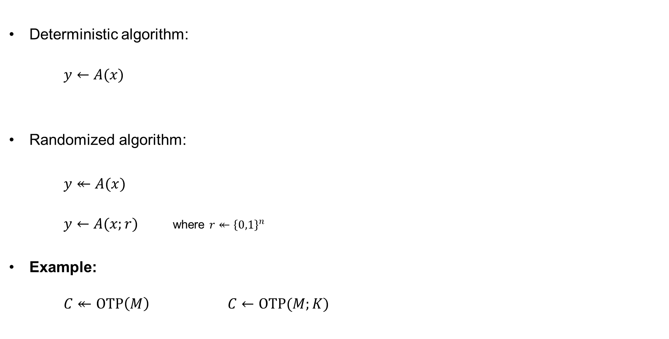





Randomized algorithms
Deterministic algorithm:
$y←A(x)$
Randomized algorithm:
$y↞A(x)$
$y←A(x;r)$ where $r↞{\left\{0,1\right\}}^{n}$
Example:
$C↞OTP\left(M\right)$ $C←OTP(M;K)$
Inputs
Outputs
$$x$$
$$A(x)$$
$A(x)$ is a random variable!
$$A(x)$$
$$x$$
$$A(x′)$$
$$x′$$

Slide 60
Next week
Block ciphers
Pseudorandom functions (PRF) and pseudorandom permutations (PRP)
AES

