Slide 1
Lecture 2 – Block ciphers,
PRFs, PRPs, AES
TEK4500
26.08.2026
Håkon Jacobsen
hakon.jacobsen@its.uio.no

Slide 2

Ideal solution: secure channels
Internet
But how to build?
Alice
Bob
M
Adversary
Security goals:
Data privacy: adversary should not be able to read message M ✓
Data integrity: adversary should not be able to modify message M ✓
Data authenticity: message M really originated from Alice ✓

Slide 3
Basic goals of cryptography
 | Message privacy | Message integrity / authentication
Symmetric keys | Symmetric encryption | Message authentication codes (MAC)
Asymmetric keys | Asymmetric encryption (a.k.a. public-key encryption) | Digital signatures

Slide 4

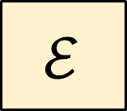



Encryption schemes
Plaintext
$$ℳ$$
$$ℰ$$
$$\$$$
$$𝒦$$
Key
Ciphertext
$$𝒞$$

Slide 5
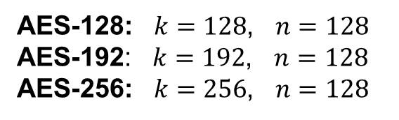



Block ciphers
Plaintext
$${\left\{0,1\right\}}^{n}$$
$$ℰ$$
$${\left\{0,1\right\}}^{k}$$
Key
AES
Ciphertext
$${\left\{0,1\right\}}^{n}$$
AES-128: $k=128$, $n=128$
AES-192: $k=192$, $n=128$
AES-256: $k=256$, $n=128$

Slide 6








Block cipher applications
Encryption of messages of exactly 128 bits (block length)
Actually want to encrypt messages of arbitrary length
  Splitting the message into multiple 128 bit blocks (like above) is not secure!
  A mode-of-operation is needed (covered later in the course)
Most useful viewpoint: block ciphers are not encryption schemes!
  A block cipher is a primitive used to construct other things
  Goal of primitive: produce random-looking output
$$K$$
$$E_{K}\left(X_{1}\right)$$
$$K$$
$$E_{K}\left(X_{2}\right)$$
$$E_{K}\left(X_{3}\right)$$
$$⋮$$

Slide 7
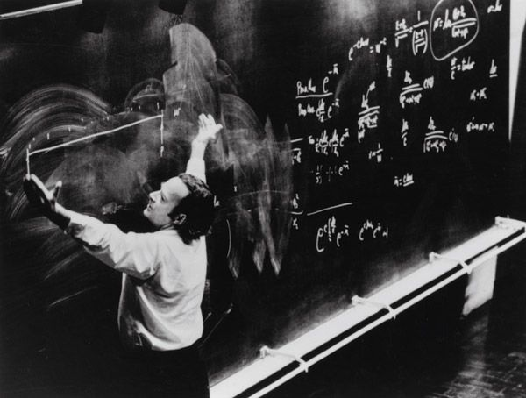
Pseduorandom functions (PRFs)

Slide 8
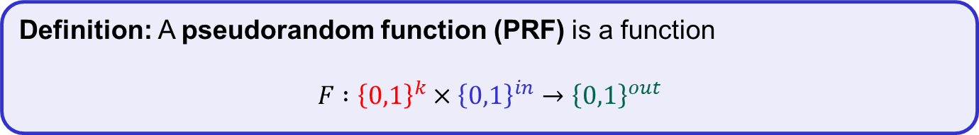
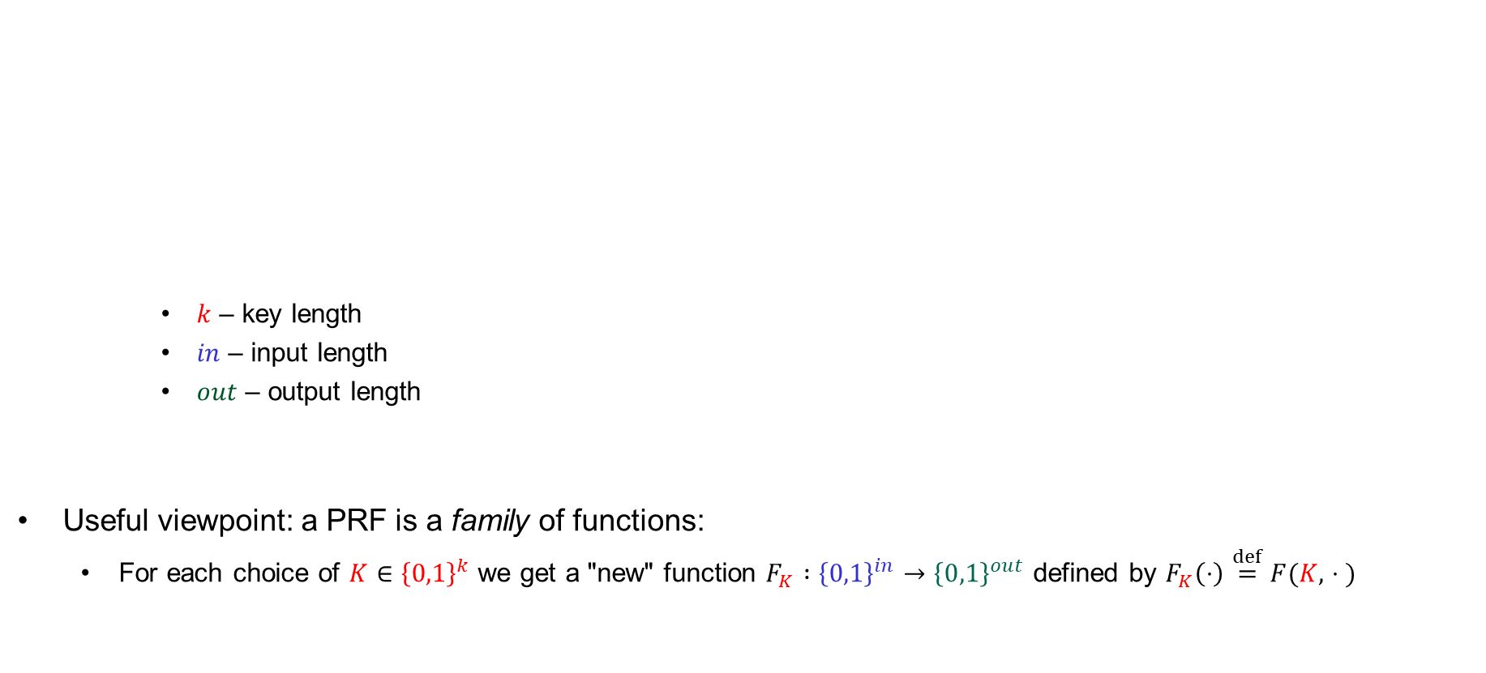
Pseudorandom functions (PRFs) – syntax
  $k$ – key length
  $in$ – input length
  $out$ – output length
Useful viewpoint: a PRF is a family of functions:
  For each choice of $K∈{\left\{0,1\right\}}^{k}$ we get a "new" function $F_{K} :{\left\{0,1\right\}}^{in}→{\left\{0,1\right\}}^{out}$ defined by $F_{K}\left(⋅\right)\overset{def}{=}F(K, ∙⋅ )$
Definition: A pseudorandom function (PRF) is a function
$$F :{\left\{0,1\right\}}^{k}×{\left\{0,1\right\}}^{in}→{\left\{0,1\right\}}^{out}$$

Slide 9



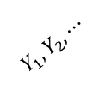
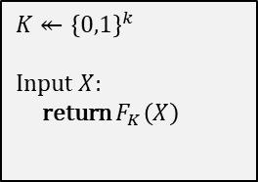
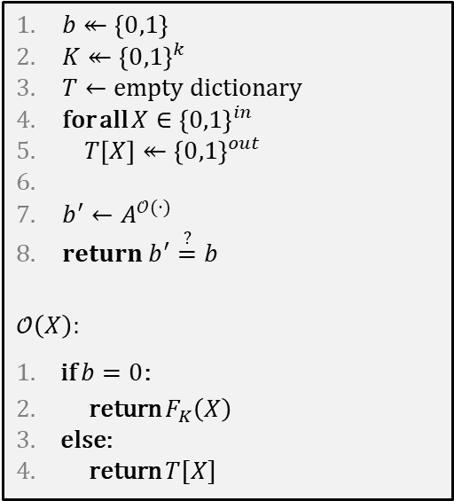


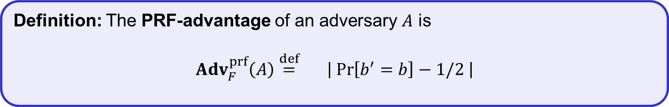


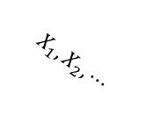
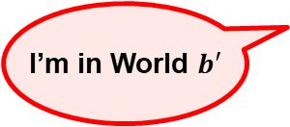
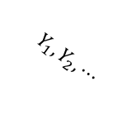
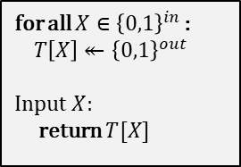

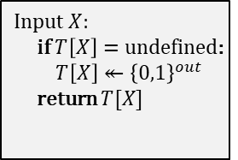
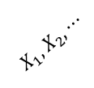


PRF – security
$$Exp_{F}^{prf}\left(A\right)$$
$$A=$$
$b↞\left\{0,1\right\}$
$K↞{\left\{0,1\right\}}^{k}$
$T←empty dictionary$
for all $X∈{\left\{0,1\right\}}^{in}$
$T\left[X\right]↞{\left\{0,1\right\}}^{out}$
$b^{′}←A^{𝒪(⋅)}$
$return b^{′}\overset{?}{=}b$
$$𝒪\left(X\right):$$
if $b=0$:
return $F_{K}\left(X\right)$
else:
return $T[X]$
$$\text{World}\text{ 0}$$
$$\text{World} \text{1}$$
$$b$$
for all $X∈{\left\{0,1\right\}}^{in }$:
$T\left[X\right]↞{\left\{0,1\right\}}^{out}$
Input $X$:
return $T[X]$
$$K↞{\left\{0,1\right\}}^{k}$$
Input $X$:
return $F_{K}\left(X\right)$
equivalent
$$b=0$$
$$b=1$$
$$\text{World} \text{1}$$
Input $X$:
if $T\left[X\right]=undefined$:
$T\left[X\right]↞{\left\{0,1\right\}}^{out}$
return $T[X]$
$$X_{1}, X_{2}, ⋯$$
$$X_{1}, X_{2}, ⋯$$
$$Y_{1}, Y_{2}, ⋯$$
$$Y_{1}, Y_{2}, ⋯$$
I’m in World $b′$
Definition: The PRF-advantage of an adversary $A$ is
$${Adv}_{F}^{prf}\left(A\right)\overset{def}{=}2⋅\left|\operatorname{Pr}\left[b^{′}=b\right]−1/2 \right|$$

Slide 10

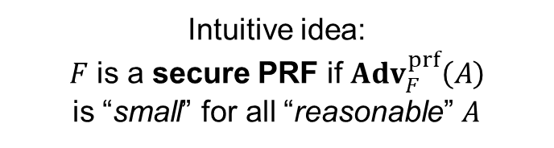

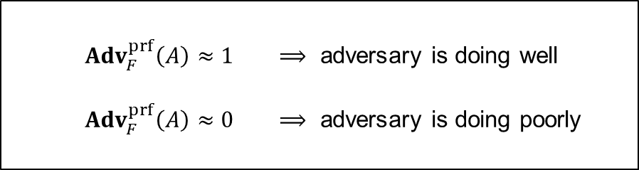
PRF – security
$$Exp_{F}^{prf}\left(A\right)$$
$$A=$$
$b↞\left\{0,1\right\}$
$K↞{\left\{0,1\right\}}^{k}$
$T←empty dictionary$
for all $X∈{\left\{0,1\right\}}^{in}$
$T\left[X\right]↞{\left\{0,1\right\}}^{out}$
$b^{′}←A^{𝒪(⋅)}$
$return b^{′}\overset{?}{=}b$
$$𝒪\left(X\right):$$
if $b=0$:
return $F_{K}\left(X\right)$
else:
return $T[X]$
$$\text{World}\text{ 0}$$
$$\text{World} \text{1}$$
$$b$$
for all $X∈{\left\{0,1\right\}}^{in }$:
$T\left[X\right]↞{\left\{0,1\right\}}^{out}$
Input $X$:
return $T[X]$
$$K↞{\left\{0,1\right\}}^{k}$$
Input $X$:
return $F_{K}\left(X\right)$
Intuitive idea:
$F$ is a secure PRF if ${Adv}_{F}^{prf}\left(A\right)$
is “small” for all “reasonable” $A$
${Adv}_{F}^{prf}\left(A\right)≈1$ $⟹$ adversary is doing well
${Adv}_{F}^{prf}\left(A\right)≈0$ $⟹$ adversary is doing poorly
$$/2$$
$$Y_{1}, Y_{2}, ⋯$$
$$Y_{1}, Y_{2}, ⋯$$
I’m in World $b′$
Definition: The PRF-advantage of an adversary $A$ is
$${Adv}_{F}^{prf}\left(A\right)\overset{def}{=}2⋅\left|\operatorname{Pr}\left[b^{′}=b\right]−1/2 \right|$$
$$2⋅$$

Slide 11


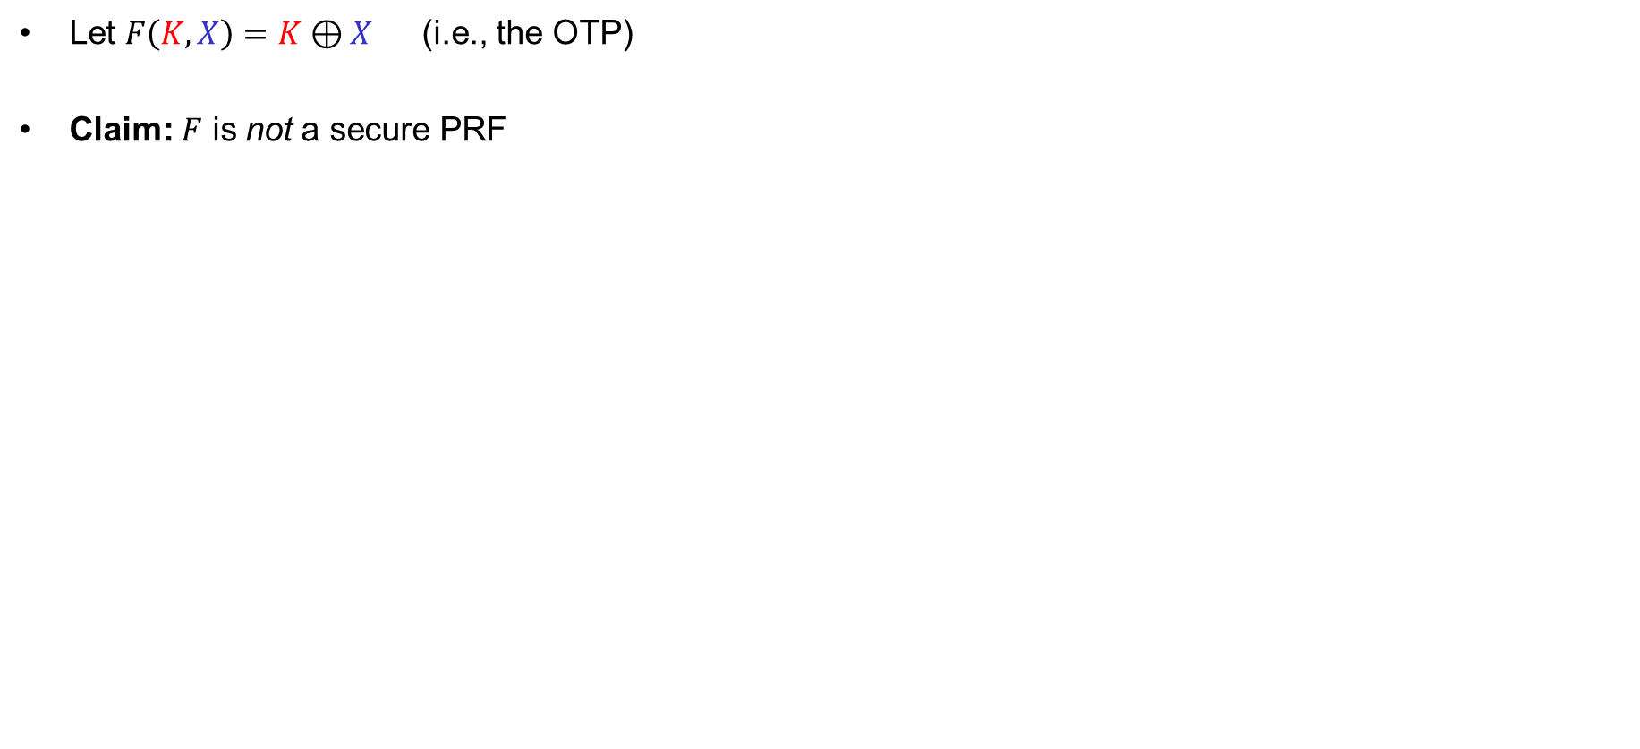


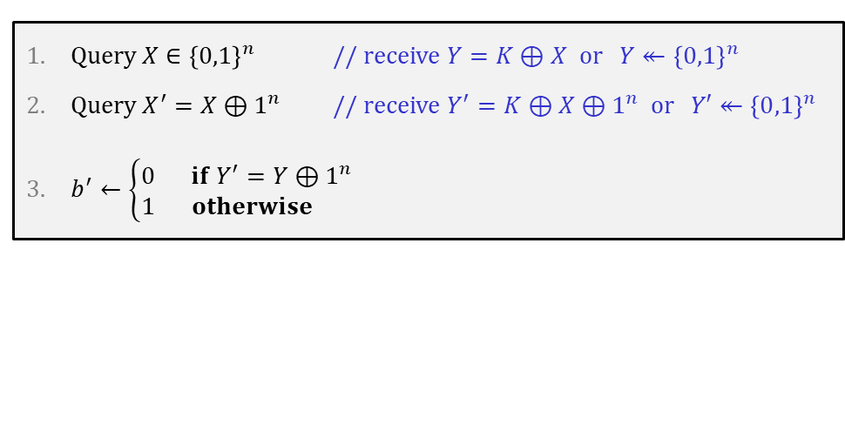
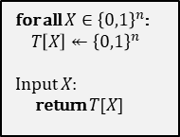

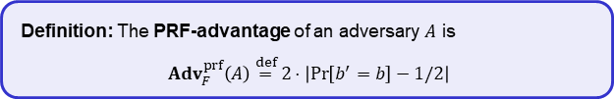


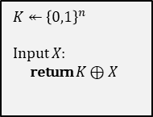
Example
Let $F\left(K, X\right)=K⊕X$ (i.e., the OTP)
Claim: $F$ is not a secure PRF
$$\text{World}\text{ 0}$$
$$\text{World} \text{1}$$
$$K↞{\left\{0,1\right\}}^{n}$$
Input $X$:
return $K⊕X$
$b$
for all $X∈{\left\{0,1\right\}}^{n}$:
$T\left[X\right]↞{\left\{0,1\right\}}^{n}$
Input $X$:
return $T[X]$
$$A$$
Query $X∈{\left\{0,1\right\}}^{n}$ // receive $Y=K⊕X$ or $Y↞{\left\{0,1\right\}}^{n}$
Query $X^{′}={X⊕1}^{n}$ // receive $Y^{′}=K⊕X⊕1^{n}$ or $Y′↞{\left\{0,1\right\}}^{n}$
$b^{′}←\left\{\begin{matrix}0 & if Y^{′}=Y⊕1^{n} \\ 1 & otherwise \end{matrix}\right.$
$$X$$
$$X^{′}$$
$$X$$
$$X^{′}$$
$$Y$$
$$Y^{′}$$
$$Y$$
$$Y^{′}$$
I’m in World $b′$
Definition: The PRF-advantage of an adversary $A$ is
$${Adv}_{F}^{prf}\left(A\right)\overset{def}{=}2⋅\left|\operatorname{Pr}\left[b^{′}=b\right]−1/2\right|$$
$$\operatorname{Pr}\left[b^{′}=b\right] =$$
$$= \operatorname{Pr}\left[b^{′}=0 ∣ b=0\right]⋅\operatorname{Pr}\left[ b=0\right]+\operatorname{Pr}\left[b^{′}=1 ∣ b=1\right]⋅\operatorname{Pr}\left[ b=1\right]$$
(law of total probability)
$$= \operatorname{Pr}\left[b^{′}=0 ∣ b=0\right]⋅1/2 +\operatorname{Pr}\left[b^{′}=1 ∣ b=1\right]⋅1/ 2$$
$$= Pr\left[Y^{′}=Y⊕1^{n}∣b=0\right]{⋅1/2} + ⋯$$
$$= 1⋅1/2 + ⋯$$
Notes:
0^n = 0000…0 (n bits)
1^n = 1111…1 (n bits)

Slide 12





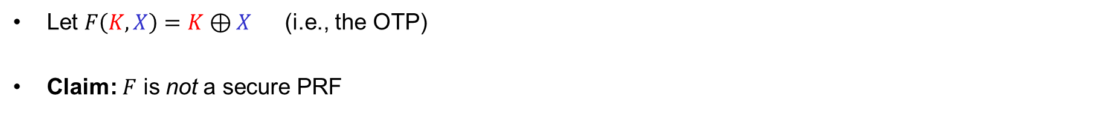
Example
Let $F\left(K, X\right)=K⊕X$ (i.e., the OTP)
Claim: $F$ is not a secure PRF
$$\text{World}\text{ 0}$$
$$\text{World} \text{1}$$
$$K↞{\left\{0,1\right\}}^{n}$$
Input $X$:
return $K⊕X$
$b$
for all $X∈{\left\{0,1\right\}}^{n}$:
$T\left[X\right]↞{\left\{0,1\right\}}^{n}$
Input $X$:
return $T[X]$
$$A$$
Query $X∈{\left\{0,1\right\}}^{n}$ // receive $Y=K⊕X$ or $Y↞{\left\{0,1\right\}}^{n}$
Query $X^{′}={X⊕1}^{n}$ // receive $Y^{′}=K⊕X⊕1^{n}$ or $Y′↞{\left\{0,1\right\}}^{n}$
$b^{′}←\left\{\begin{matrix}0 & if Y^{′}=Y⊕1^{n} \\ 1 & otherwise \end{matrix}\right.$
I’m in World $b′$
Definition: The PRF-advantage of an adversary $A$ is
$${Adv}_{F}^{prf}\left(A\right)\overset{def}{=}2⋅\left|\operatorname{Pr}\left[b^{′}=b\right]−1/2\right|$$
$$\operatorname{Pr}\left[b^{′}=b\right] =$$
$$= \operatorname{Pr}\left[b^{′}=0 ∣ b=0\right]⋅\operatorname{Pr}\left[ b=0\right]+\operatorname{Pr}\left[b^{′}=1 ∣ b=1\right]⋅\operatorname{Pr}\left[ b=1\right]$$
(law of total probability)
$$= \operatorname{Pr}\left[b^{′}=0 ∣ b=0\right]⋅1/2 +\operatorname{Pr}\left[b^{′}=1 ∣ b=1\right]⋅1/ 2$$
$$= Pr\left[Y^{′}=Y⊕1^{n}∣b=0\right]{⋅1/2} +\left(1−Pr\left[b^{′}=0 ∣ b=1\right]\right)⋅1/2$$
$$= 1⋅1/2 + ⋯$$
$$\left(1−Pr\left[Y^{′}=Y⊕1^{n} ∣ b=1\right]\right)⋅1/2$$
$$= 1/2 +\left(1−\frac{1}{2^{n}}\right)⋅1/2$$
$$= 1−\frac{1}{2^{n+1}}$$

Slide 13





Example
Let $F\left(K, X\right)=K⊕X$ (i.e., the OTP)
Claim: $F$ is not a secure PRF
$$\text{World}\text{ 0}$$
$$\text{World} \text{1}$$
$$K↞{\left\{0,1\right\}}^{n}$$
Input $X$:
return $K⊕X$
$b$
for all $X∈{\left\{0,1\right\}}^{n}$:
$T\left[X\right]↞{\left\{0,1\right\}}^{n}$
Input $X$:
return $T[X]$
$$A$$
Query $X∈{\left\{0,1\right\}}^{n}$ // receive $Y=K⊕X$ or $Y↞{\left\{0,1\right\}}^{n}$
Query $X^{′}={X⊕1}^{n}$ // receive $Y^{′}=K⊕X⊕1^{n}$ or $Y′↞{\left\{0,1\right\}}^{n}$
$b^{′}←\left\{\begin{matrix}0 & if Y^{′}=Y⊕1^{n} \\ 1 & otherwise \end{matrix}\right.$
I’m in World $b′$
Definition: The PRF-advantage of an adversary $A$ is
$${Adv}_{F}^{prf}\left(A\right)\overset{def}{=}2⋅\left|\operatorname{Pr}\left[b^{′}=b\right]−1/2\right|$$
$$\operatorname{Pr}\left[b^{′}=b\right] =$$
$$1−\frac{1}{2^{n+1}}$$
$${Adv}_{F}^{prf}\left(A\right)=2⋅\left|\operatorname{Pr}\left[b^{′}=b\right]−\frac{1}{2}\right|$$
$$= 2⋅\left|\left(1−\frac{1}{2^{n+1}}\right)−\frac{1}{2}\right|$$
$$= 1−2^{−n}$$
$$≈ 1$$

Slide 14

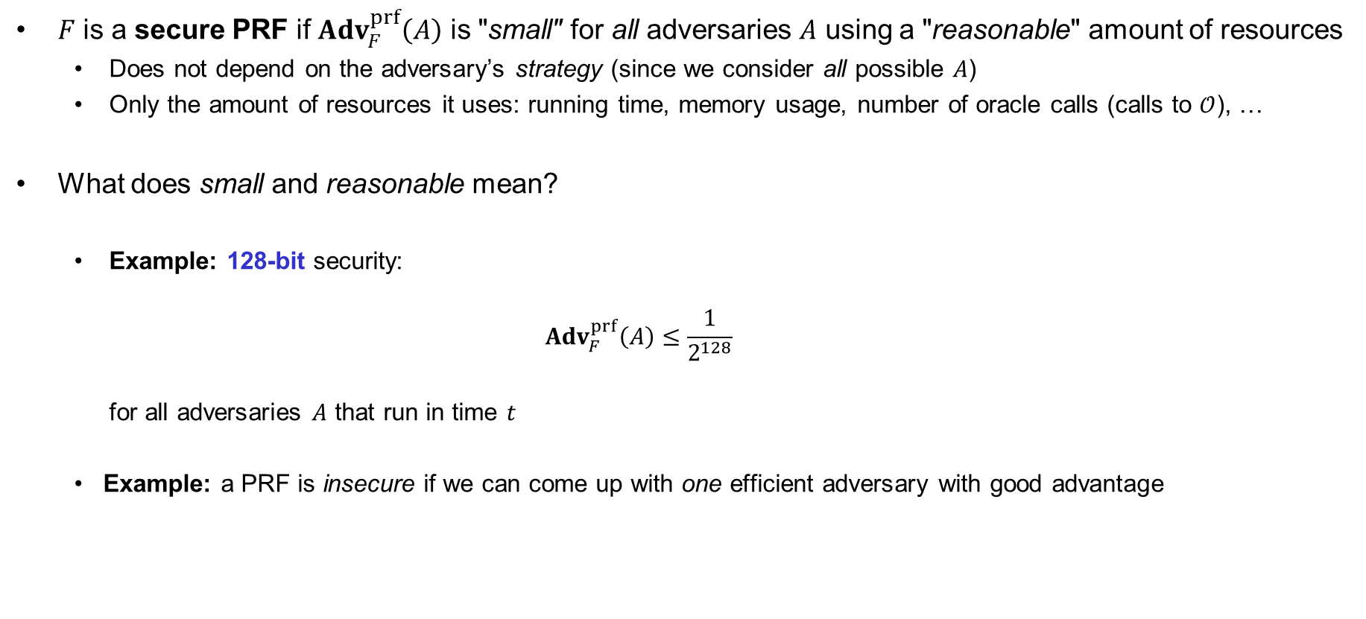


Understanding "advantage"
$F$ is a secure PRF if ${Adv}_{F}^{prf}\left(A\right)$ is "small" for all adversaries $A$ using a "reasonable" amount of resources
  Does not depend on the adversary’s strategy (since we consider all possible $A$)
  Only the amount of resources it uses: running time, memory usage, number of oracle calls (calls to $𝒪$), …
What does small and reasonable mean?
  Example: 128-bit security:
  ${Adv}_{F}^{prf}\left(A\right)≤\frac{1}{2^{128}}$
  for all adversaries $A$ that run in time $t$
  Example: a PRF is insecure if we can come up with one efficient adversary with good advantage
$$t$$
$$2^{80}$$
$$=2^{−48}≈0.0000000000000036$$
$$≤2^{80}$$

Slide 15

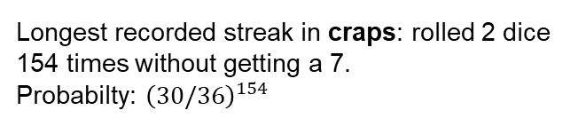
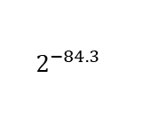


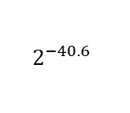




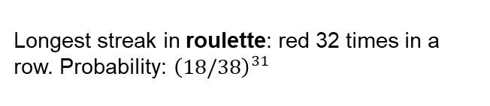



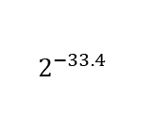
Huge numbers, tiny numbers
Cycles
Approx cost* (USD)
Point of reference
Prob.
Event
$$2^{50}$$
$3.50
Cup of coffee
$$2^{−28.1}$$
Winning the jackpot in the US Powerball lottery
$$2^{55}$$
$100
Good tickets to a Portland Trailblazers game
$$2^{−33.4}$$
Longest streak in roulette: red 32 times in a row. Probability: ${\left(18/38\right)}^{31}$
$$2^{65}$$
$130,000
Median home price in Chickasaw County, Iowa
$$2^{75}$$
$130 million
Budget of one of the Harry Potter movies
$$2^{−40.6}$$
Longest recorded streak in craps: rolled 2 dice 154 times without getting a 7.
Probabilty: ${\left(30/36\right)}^{154}$
$$2^{85}$$
$140 billion
GDP of Hungary
$$2^{−56.2}$$
Winning the jackpot in the US Powerball lottery
…two weeks in a row
$$2^{92}$$
$20 trillion
GDP of the United States
$$2^{99}$$
$2 quadrillion
All human economic activity since 300,000 BCE
$$2^{−84.3}$$
Winning the jackpot in the US Powerball lottery
…three weeks in a row
$$2^{128}$$
a lot!
A billion human civilation’s worth of effort
*running on cheapest available Amazon EC2 cloud service
Source: https://joyofcryptography.com/comp/

Slide 16
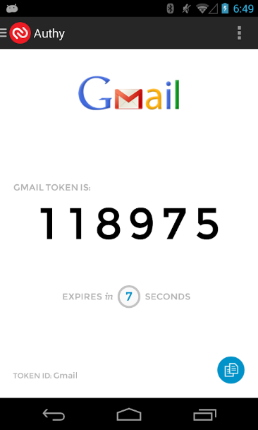

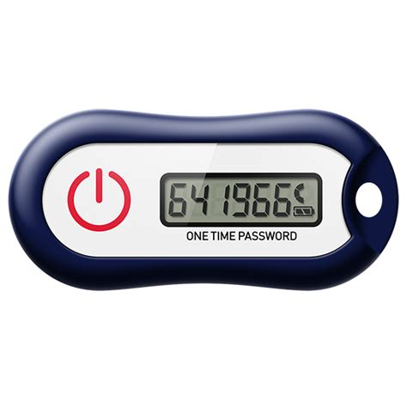




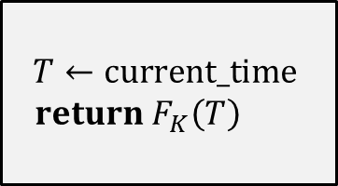






PRF applications: one-time tokens
$$T←current_time$$
$return F_{K}\left(T\right)$
$$K$$
$$F :{\left\{0,1\right\}}^{k}×{\left\{0,1\right\}}^{32}→\{0,1,2,…,999,999\}$$
PRF
$$⋮$$
$$OTT\overset{?}{=}F_{K}\left(T^{′}−2\right)$$
$$OTT\overset{?}{=}F_{K}\left(T^{′}−1\right)$$
$$641966←F_{K}\left(T\right)$$
$$OTT=641966$$
$$OTT\overset{?}{=}F_{K}\left(T^{′}\right)$$
$$OTT\overset{?}{=}F_{K}\left(T^{′}+1\right)$$
$$OTT\overset{?}{=}F_{K}\left(T^{′}+2\right)$$
$$⋮$$

Slide 17
PRF applications
The “work horse” of symmetric crypto
Can be used to build:
  One-time tokens
  Encryption of arbitrary length messages (including stream ciphers)
  Message authentication codes
  Authenticated encryption
  Hash functions
  Pseudorandom generators (PRNGs)
  Key derivation functions

Slide 18


Constructing PRFs
and block ciphers

Slide 19
Principles for designing PRFs / block ciphers
Claude Shannon, “Communication Theory of Secrecy Systems”(1949):
  Diffusion: input spread over large parts of the output
  Confusion: a complex relation between input, key and output

Slide 20


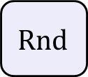


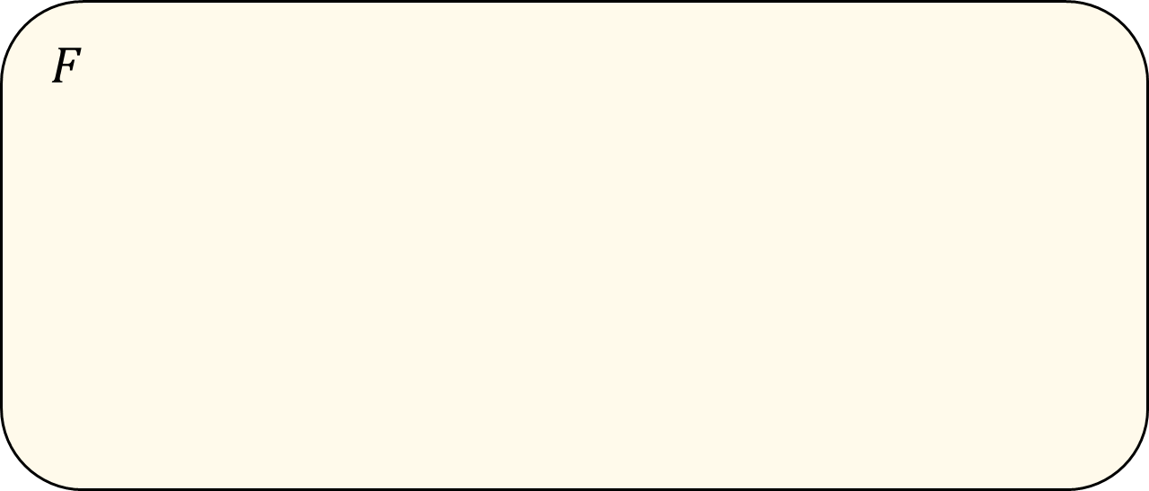




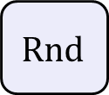



PRFs and block ciphers in practice
$K$
$$F$$
Key expansion
input
$$K_{1}$$
$$K_{2}$$
$$K_{3}$$
$$K_{R}$$
output
$$n$$
$$n$$
$$Rnd$$
$$Rnd$$
$$Rnd$$
$$⋯$$
$$Rnd$$
Rnd = round function (iterated $R$ times)
AES-128/192/256: $R=10/12/14$

Slide 21
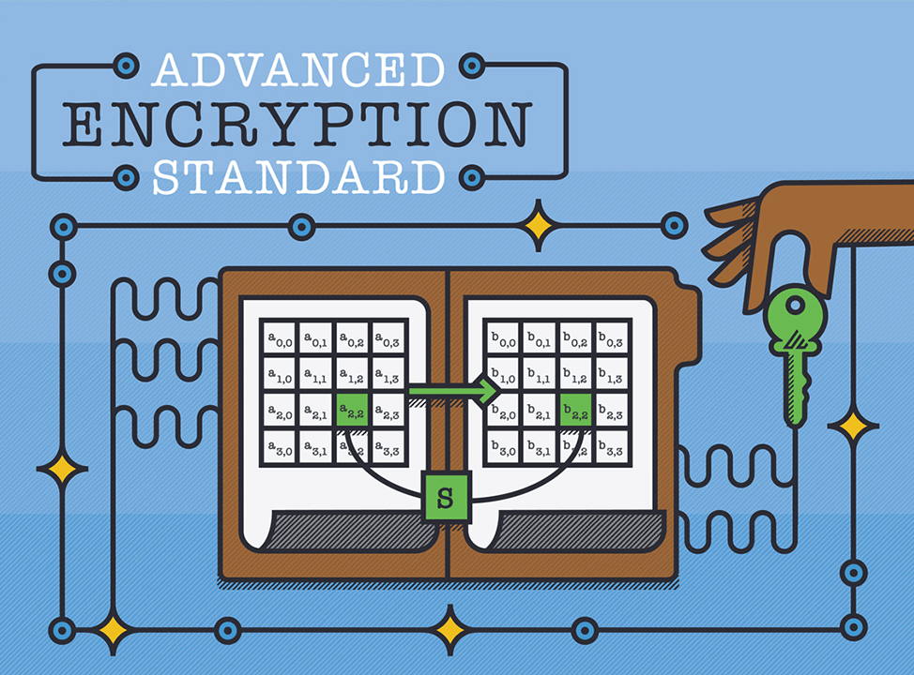
Advanced Encryption Standard
Notes:
https://formaestudio.com/portfolio/aes-animation/

Slide 22
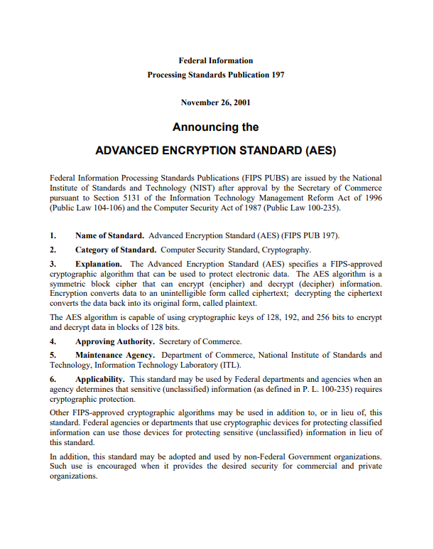
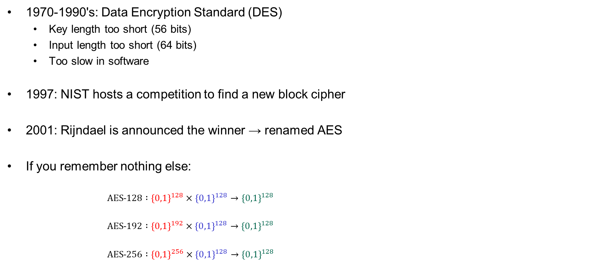
AES – history
1970-1990's: Data Encryption Standard (DES)
  Key length too short (56 bits)
  Input length too short (64 bits)
  Too slow in software
1997: NIST hosts a competition to find a new block cipher
2001: Rijndael is announced the winner → renamed AES
If you remember nothing else:
  $AES˗128 :{\left\{0,1\right\}}^{128}×{\left\{0,1\right\}}^{128}→{\left\{0,1\right\}}^{128}$
  $AES˗192 :{\left\{0,1\right\}}^{192}×{\left\{0,1\right\}}^{128}→{\left\{0,1\right\}}^{128}$
  $AES˗256 :{\left\{0,1\right\}}^{256}×{\left\{0,1\right\}}^{128}→{\left\{0,1\right\}}^{128}$

Slide 23













AES-128
128
$$K$$
128
128
128
128
128
$${ K}_{0}$$
$${ K}_{1}$$
$${ K}_{2}$$
$$⋯$$
$$K_{9}$$
$$K_{10}$$
input
SubBytes
ShiftRow
MixColumn
SubBytes
ShiftRow
MixColumn
SubBytes
ShiftRow
output
$$⊕$$
$$⊕$$
$$⊕$$
$$⋯$$
$$⊕$$
$$⊕$$
10 rounds
Notes:
https://formaestudio.com/portfolio/aes-animation/

Slide 24
AES-128
128
$$K$$
128
128
128
128
128
$${ K}_{0}$$
$${ K}_{1}$$
$${ K}_{2}$$
$$⋯$$
$$K_{9}$$
$$K_{10}$$
input
SubBytes
ShiftRow
MixColumn
SubBytes
ShiftRow
MixColumn
SubBytes
ShiftRow
output
$$⊕$$
$$⊕$$
$$⊕$$
$$⋯$$
$$⊕$$
$$⊕$$
10 rounds

Slide 25
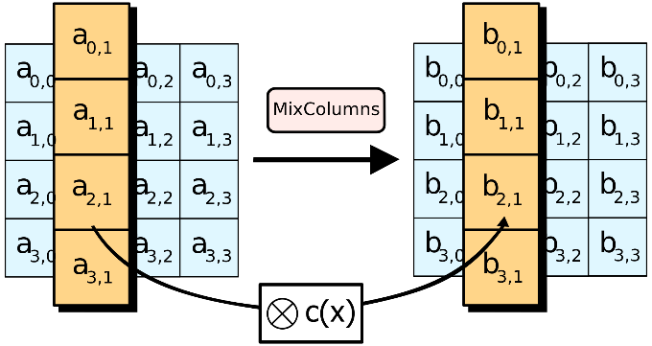
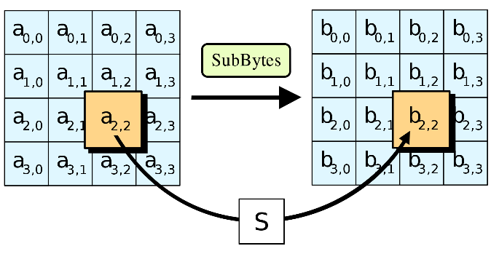
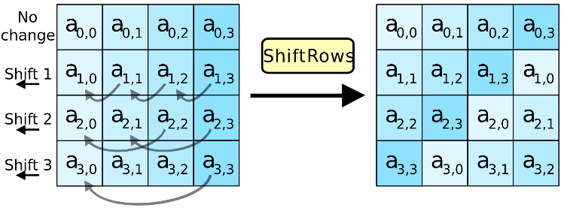
AES round function
SubBytes
ShiftRow
MixColumn

Slide 26
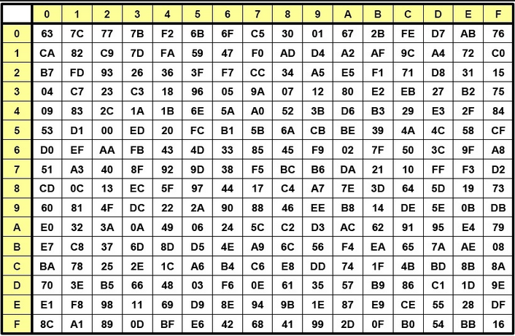


AES round function - SubBytes
SubBytes
ShiftRow
MixColumn
$a_{2,2}=$ 8A
$b_{2,2}=$ 7E

Slide 27
AES round function - ShiftRows
SubBytes
ShiftRow
MixColumn

Slide 28


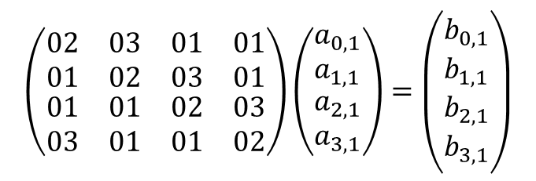

AES round function - MixColumns
$$a_{1}$$
$$b_{1}$$
$$Ma_{1}=b_{1}$$
$$\left(\begin{matrix}\begin{matrix}02 & 03 \\ 01 & 02\end{matrix} & \begin{matrix}01 & 01 \\ 03 & 01\end{matrix} \\ \begin{matrix}01 & 01 \\ 03 & 01\end{matrix} & \begin{matrix}02 & 03 \\ 01 & 02\end{matrix}\end{matrix}\right)\left(\begin{matrix}a_{0,1} \\ a_{1,1} \\ \begin{matrix}a_{2,1} \\ a_{3,1}\end{matrix}\end{matrix}\right)=\left(\begin{matrix}b_{0,1} \\ b_{1,1} \\ \begin{matrix}b_{2,1} \\ b_{3,1}\end{matrix}\end{matrix}\right)$$
SubBytes
ShiftRow
MixColumn
$$1⋅a_{0,1}+2⋅a_{1,1}+3⋅a_{2,1}+1⋅a_{3,1}=b_{1,1}$$
$$1∗a_{0,1}⊕2⋇a_{1,1}⊕3⋇a_{2,1}⊕1∗a_{3,1}=b_{1,1}$$

Slide 29







AES-128
128
$$K$$
128
128
128
128
128
$$K_{0}$$
$$K_{1}$$
$$K_{2}$$
$$K_{9}$$
$$K_{10}$$
input
SubBytes
ShiftRow
MixColumn
SubBytes
ShiftRow
MixColumn
SubBytes
ShiftRow
output
$$⊕$$
$$⊕$$
$$⊕$$
$$⋯$$
$$⊕$$
$$⊕$$
10 rounds

Slide 30
AES summary
AES is believed to be a secure PRF
  128/192/256-bit security for AES-128/192/256
  Based on the best currently known attacks
  Not formally proven
Reasonably efficient in software
  Table-based implementation is very fast (but not secure!)
  Difficult to implement AES both fast and securely in SW
Intel introduced dedicated AES instructions into their CPUs (AES-NI):
  aesenc: do one round of AES
  aesenclast: do final round of AES
  aeskeygenassist: do AES key expansion
  aesdec: do one round of AES decryption
  aesdeclast: do final round of AES decryption
  aesimc: do inverse MixColumns
  Now standard in all modern CPUs
Throughput
(my laptop)
AES-128 (no AES-NI) 0.27 GB/s
AES-128 (with AES-NI) 3.45 GB/s

Slide 31
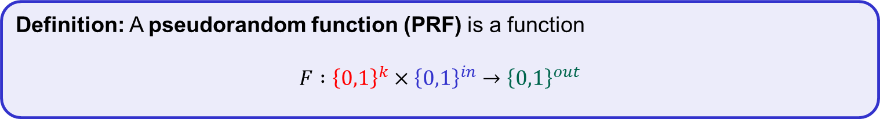
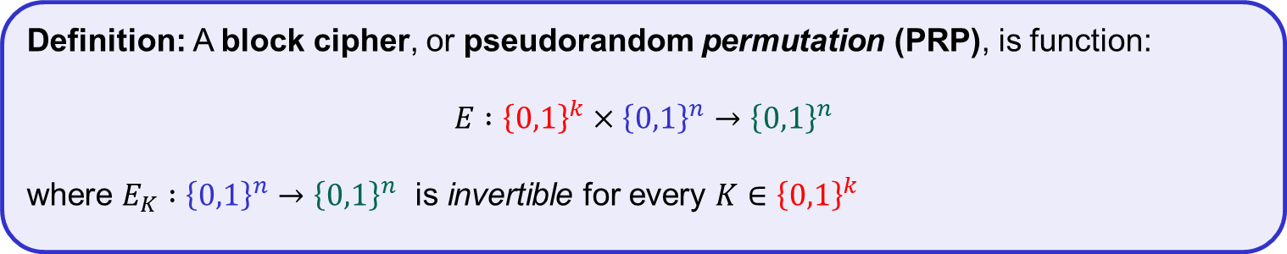
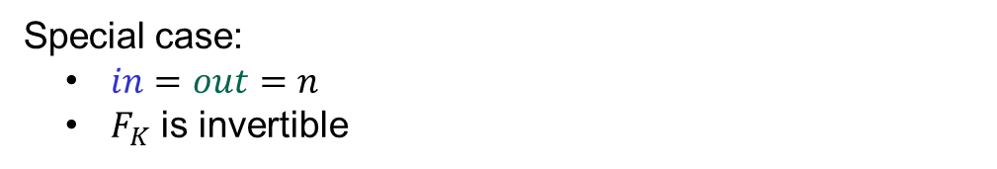
Block ciphers, a.k.a. pseudorandom permutations (PRP)
Definition: A pseudorandom function (PRF) is a function
$$F :{\left\{0,1\right\}}^{k}×{\left\{0,1\right\}}^{in}→{\left\{0,1\right\}}^{out}$$
Special case:
$in=out=n$
$F_{K}$ is invertible
Definition: A block cipher, or pseudorandom permutation (PRP), is function:
$$E :{\left\{0,1\right\}}^{k}×{\left\{0,1\right\}}^{n}→{\left\{0,1\right\}}^{n}$$
where $E_{K} :{\left\{0,1\right\}}^{n}→{\left\{0,1\right\}}^{n}$ is invertible for every $K∈{\left\{0,1\right\}}^{k}$

Slide 32
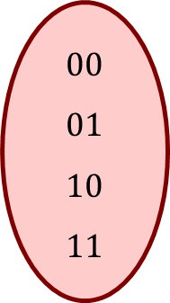

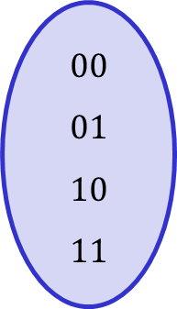
Permutations vs. functions
$$E_{K}$$
$$F_{K}$$
$$00 \\ 01 \\ 10 \\ 11$$
$$00 \\ 01 \\ 10 \\ 11$$
$$00 \\ 01 \\ 10 \\ 11$$
$$00 \\ 01 \\ 10 \\ 11$$
Permutation
Not a permutation

Slide 33



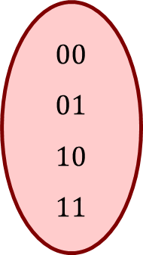
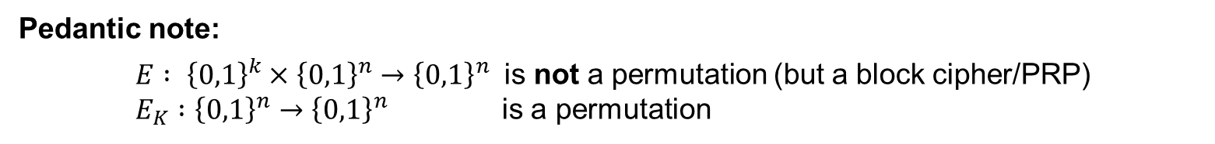
Permutations vs. functions
$$E^{−1}$$
$$E_{K}$$
$$F_{K}$$
$$00 \\ 01 \\ 10 \\ 11$$
$$00 \\ 01 \\ 10 \\ 11$$
$$00 \\ 01 \\ 10 \\ 11$$
$$00 \\ 01 \\ 10 \\ 11$$
Permutation
Not a permutation
Pedantic note:
${E : \left\{0,1\right\}}^{k}×{\left\{0,1\right\}}^{n}→{\left\{0,1\right\}}^{n}$ is not a permutation (but a block cipher/PRP)
$E_{K} :{\left\{0,1\right\}}^{n}→{\left\{0,1\right\}}^{n}$ is a permutation

Slide 34




PRF – security
$$\text{World}\text{ 0}$$
$$\text{World} \text{1}$$
$$b$$
for all $X∈{\left\{0,1\right\}}^{in }$:
$T\left[X\right]↞{\left\{0,1\right\}}^{out}$
Input $X$:
return $T[X]$
$$K↞{\left\{0,1\right\}}^{k}$$
Input $X$:
return $F_{K}\left(X\right)$
I’m in World $b′$

Slide 35






PRF PRP – security
$$Exp_{E}^{prp}\left(A\right)$$
$b↞\left\{0,1\right\}$
$K↞{\left\{0,1\right\}}^{k}$
$T←empty dictionary$
for all $X∈{\left\{0,1\right\}}^{in}$
$T\left[X\right]↞{\left\{0,1\right\}}^{out}∖T.values$
$b^{′}←A^{𝒪(⋅)}$
$return b^{′}\overset{?}{=}b$
$$𝒪\left(X\right):$$
if $b=0$:
return $E_{K}\left(X\right)$
else:
return $T[X]$
$$\text{World}\text{ 0}$$
$$\text{World} \text{1}$$
$$b$$
for all $X∈{\left\{0,1\right\}}^{in }$:
$T\left[X\right]↞{\left\{0,1\right\}}^{out}$
Input $X$:
return $T[X]$
$$K↞{\left\{0,1\right\}}^{k}$$
Input $X$:
return $E_{K}\left(X\right)$
$$∖T.values$$
I’m in World $b′$
Definition: The PRP-advantage of an adversary $A$ is
$${Adv}_{E}^{prf}\left(A\right)\overset{def}{=}2⋅\left|\operatorname{Pr}\left[b^{′}=b\right]−1/2 \right|$$
$$prp$$

Slide 36




















PRF security $⟺$ PRP security
PRF/PRP Switching Lemma: Let $E :{\left\{0,1\right\}}^{k}×{\left\{0,1\right\}}^{n}→{\left\{0,1\right\}}^{n}$ be a PRP. For all $A$ making exactly $q$ oracle queries:
$$\left|{Adv}_{E}^{prf}\left(A\right)−{Adv}_{E}^{prp}\left(A\right)\right|≤\frac{q^{2}}{2^{n+1}}$$
Proof sketch:
Event coll: two (or more) outputs from PRF oracle $𝒪\left(⋅\right)$ collide (are equal)
$$\text{World}\text{ 0}$$
$$\text{World} \text{1}$$
$$\text{World} \text{1}$$
$$\text{World}\text{ 0}$$
$$K↞{\left\{0,1\right\}}^{k}$$
Input $X$:
return $E_{K}\left(X\right)$
for all $X∈{\left\{0,1\right\}}^{in }$:
$T\left[X\right]↞{\left\{0,1\right\}}^{out}$
Input $X$:
return $T[X]$
for all $X∈{\left\{0,1\right\}}^{in }$:
$T\left[X\right]↞{\left\{0,1\right\}}^{out}$
Input $X$:
return $T[X]$
$$K↞{\left\{0,1\right\}}^{k}$$
Input $X$:
return $E_{K}\left(X\right)$
$${Adv}_{E}^{prf}\left(A\right)$$
$$\overset{\overline{coll} }{≈}$$
$$∖T.values$$
$${Adv}_{E}^{prp}\left(A\right)$$
$$\operatorname{Pr}\left[coll\right]=\operatorname{Pr}{[{coll}_{1}∪{coll}_{2}∪⋯∪{coll}_{q}]}$$
$$≤\operatorname{Pr}\left[{\text{coll}}_{1}\right]+\operatorname{Pr}\left[{coll}_{2}\right]+\operatorname{Pr}\left[{coll}_{3}\right]+⋯+\operatorname{Pr}\left[{coll}_{q}\right]$$
$$≤ \frac{0}{2^{n}}$$
$$+\frac{1}{2^{n}}$$
$$+\frac{2}{2^{n}}$$
$$+⋯+\frac{q−1}{2^{n}}$$
$$= \frac{q\left(q−1\right)}{2^{n}⋅2}$$
$$< \frac{q^{2}}{2^{n+1}}$$
output from call $i$ collides with any of the previous outputs
Notes:
This is only a proof sketch. Refer to https://joyofcryptography.com/prp/#sec.switching or Section 4.9 of https://web.cs.ucdavis.edu/~rogaway/classes/227/spring05/book/main.pdf for a full proof.

Slide 37


Attacking PRF/PRPs

Slide 38
Attacks on PRF/PRPs
Brute force attacks: search through every possible key in the key space
  Generic: works for all block ciphers
  Not practical for large key spaces
Specialized attacks: try to exploit the concrete details of the block cipher
  Differential cryptanalysis ('90, but known by the designers of DES and NSA since mid '70 )
  Linear cryptanalysis ('92)
  AES designed to resist both
Implementation attacks: vulnerabilities due to implementation characteristics
  Power draw
  Timing
  Cache misses

Slide 39
Summary
Block ciphers are very important primitives (building blocks) – not encryption schemes!
Correct abstraction: block ciphers = PRPs
More general (and useful) notion: PRFs
Security notion for PRFs: output indistinguishable from random
Concrete PRF/block cipher designs: DES, AES, …
Next week: how to create encryption schemes from PRFs

Slide 40



















PRF security – an equivalent view
$$Func\left[in, out\right]$$
$$\left|Func\left[in,out\right]\right|=$$
# bitstrings of length $2^{in}⋅out$
$$=2^{\left(2^{in}⋅out\right)}$$
$$\tilde{F}(X)$$
$$101…111$$
$$001…001$$
$$111…100$$
$$101…000$$
$$⋮$$
$$001…001$$
$$G\left(X\right)=1^{out}$$
Example:
$$\left|Func\left[3,2\right]\right|=$$
$$2^{2^{3}⋅2}$$
$$F\left(X\right)=1010⋯$$
$$2^{in}$$
$$V\left(X\right)=X⊕17$$
$$=2^{16}$$
$$=65536$$
$$H\left(X\right)=0^{out}$$
$$\tilde{F}$$
$$out$$
- Bits to specify one function: $2^{in}⋅out$
- Each distinct bitstring of length $2^{in}⋅out$
represents a unique function

Slide 41













PRF security – an equivalent view
$$Func\left[128, 128\right]$$
$$\left|Func\left[in,out\right]\right|=$$
# bitstrings of length $2^{in}⋅out$
$$=2^{\left(2^{in}⋅out\right)}$$
$$\tilde{F}(X)$$
$$101…111$$
$$001…001$$
$$111…100$$
$$101…000$$
$$⋮$$
$$001…001$$
$$G\left(X\right)=1^{128}$$
Example:
$$\left|Func\left[3,2\right]\right|=$$
$$2^{2^{3}⋅2}$$
$$F\left(X\right)=1010⋯$$
$$2^{128}$$
$$V\left(X\right)=X⊕17$$
$$=2^{16}$$
$$=65536$$
$$H\left(X\right)=0^{128}$$
$$\tilde{F}$$
$$128$$
$$AES$$
$$\left|Func\left[128,128\right]\right|=$$
$$2^{2^{128}⋅128}$$
$${AES}_{00…}\left(X\right)$$
$${AES}_{101…}\left(X\right)$$
- Bits to specify one function: $2^{in}⋅out$
$$\left|AES\right|=$$
$$2^{128}$$
$${AES}_{11…}\left(X\right)$$
- Each distinct bitstring of length $2^{in}⋅out$
represents a unique function

Slide 42

PRF security – an equivalent view
$$Func\left[128, 128\right]$$
$$\left|Func\left[in,out\right]\right|=$$
# bitstrings of length $2^{in}⋅out$
$$=2^{\left(2^{in}⋅out\right)}$$
$$\tilde{F}(X)$$
$$101…111$$
$$001…001$$
$$111…100$$
$$101…000$$
$$⋮$$
$$001…001$$
$$G\left(X\right)=1^{128}$$
Example:
$$\left|Func\left[3,2\right]\right|=$$
$$2^{2^{3}⋅2}$$
$$F\left(X\right)=1010⋯$$
$$2^{128}$$
$$V\left(X\right)=X⊕17$$
$$=2^{16}$$
$$=65536$$
$$H\left(X\right)=0^{128}$$
$$\tilde{F}$$
$$128$$
$$\left|Func\left[128,128\right]\right|=$$
$$2^{2^{128}⋅128}$$
- Bits to specify one function: $2^{in}⋅out$
$$\left|AES\right|=$$
$$2^{128}$$
$$AES$$
- Each distinct bitstring of length $2^{in}⋅out$
represents a unique function

Slide 43

PRP – security
$$\left|Func\left[128,128\right]\right|=$$
$$2^{2^{128}⋅128}$$
$$Func\left[128, 128\right]$$
$$G\left(X\right)=1^{128}$$
$$F\left(X\right)=1010⋯$$
$$V\left(X\right)=X⊕17$$
$$H\left(X\right)=0^{128}$$
$$\tilde{F}$$
$$\left|AES\right|=$$
$$2^{128}$$
$$AES$$

Slide 44







PRP – security
$$\left|Func\left[128,128\right]\right|=$$
$$2^{2^{128}⋅128}$$
$$Func\left[128, 128\right]$$
$$\left|Perm\left[128\right]\right|=$$
$$2^{128}!$$
$$Perm\left[128\right]$$
$$G\left(X\right)=\overline{X}$$
$$F\left(X\right)=X$$
$$V\left(X\right)=X⊕17$$
$$H\left(X\right)=00…0$$
$$\left|AES\right|=$$
$$2^{128}$$
$$AES$$

