Slide 1
Lecture 10 – Diffie-Hellman III,
PKE, KEM, ElGamal, Noise
TEK4500
21.10.2026
Håkon Jacobsen
hakon.jacobsen@its.uio.no

Slide 2
Basic goals of cryptography
 | Message privacy | Message integrity / authentication
Symmetric keys | Symmetric encryption | Message authentication codes (MAC)
Asymmetric keys | Asymmetric encryption (a.k.a. public-key encryption) | Digital signatures
Key exchange

Slide 3
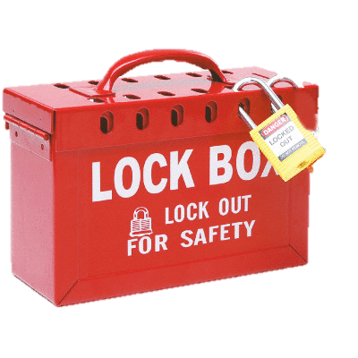







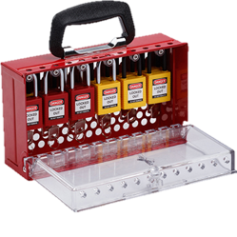
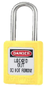


Public-key encryption

Slide 4





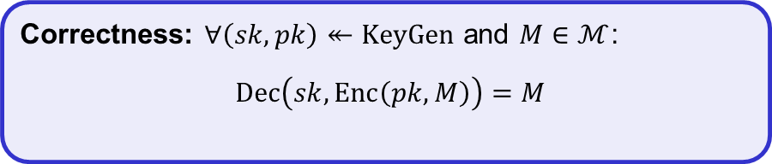
Public-key encryption (PKE) – syntax
A PKE is a tuple $PKE=\left(KeyGen, Enc, Dec\right)$ of algorithms
$$KeyGen :S𝒦×P𝒦$$
$$Enc :P𝒦×ℳ→𝒞$$
$$Dec :S𝒦×𝒞→ℳ∪\left\{⊥\right\}$$
$$\left(sk, pk\right)↞KeyGen$$
$$Enc\left(pk,M\right)=C$$
$$Dec\left(sk, C\right)=M/⊥$$
Correctness: $∀\left(sk,pk\right)↞KeyGen$ and $M∈ℳ$:
$$Dec\left(sk,Enc\left(pk,M\right)\right)=M$$

Slide 5


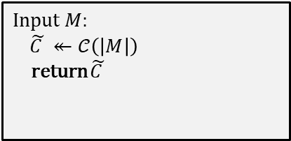
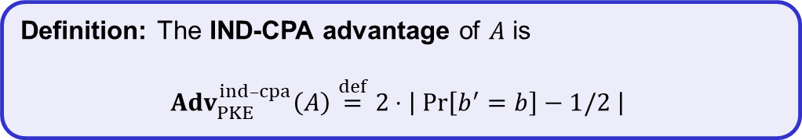
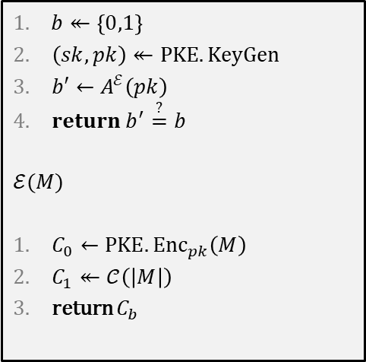

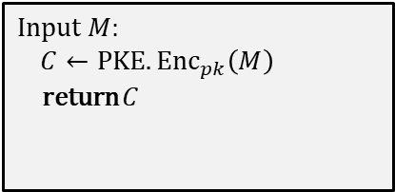


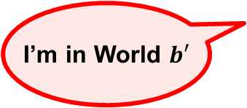



PKE-security: IND-CPA
$$Exp_{PKE}^{ind­­–cpa}\left(A\right)$$
$$\text{World}\text{ 0}$$
$b$
$$\text{World}\text{ 1}$$
$b↞\left\{0,1\right\}$
$\left(sk,pk\right)↞PKE.KeyGen$
$b′←A^{ℰ}\left(pk\right)$
$return b^{′}\overset{?}{=}b$
$$ℰ(M)$$
$C_{0}←PKE.{Enc}_{pk}\left(M\right)$
$C_{1}↞𝒞\left(\left|M\right|\right)$
return $C_{b}$
Input $M$:
$C←PKE.{Enc}_{pk}\left(M\right)$
return $C$
Input $M$:
$\tilde{C }↞𝒞\left(\left|M\right|\right)$
return $\tilde{C }$
$$pk$$
set of all possible ciphertexts for plaintexts of length $\left|M\right|$
I’m in World $b′$
Definition: The IND-CPA advantage of $A$ is
$${Adv}_{PKE}^{ind­–cpa}\left(A\right)\overset{def}{=}2⋅\left|\operatorname{Pr}\left[b^{′}=b\right]−1/2 \right|$$

Slide 6















Public-key encryption: ElGamal
$$G=〈g〉$$
$$M$$
$$A$$
$$B$$
$$a↞\left\{1, …, \left|G\right|\right\}$$
$$b↞\left\{1, …, \left|G\right|\right\}$$
$$A←g^{a}$$
$$C$$
$$B←g^{b}$$
$$Z←B^{a}=H\left(g^{ab}\right)$$
$$Z←A^{b}=H\left(g^{ab}\right)$$
$$C←Σ.Enc\left(Z, M\right)$$
$$M←Σ. Dec\left(Z, C\right)$$
Symmetric encryption scheme

Slide 7


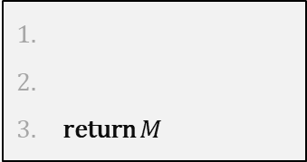

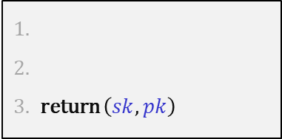




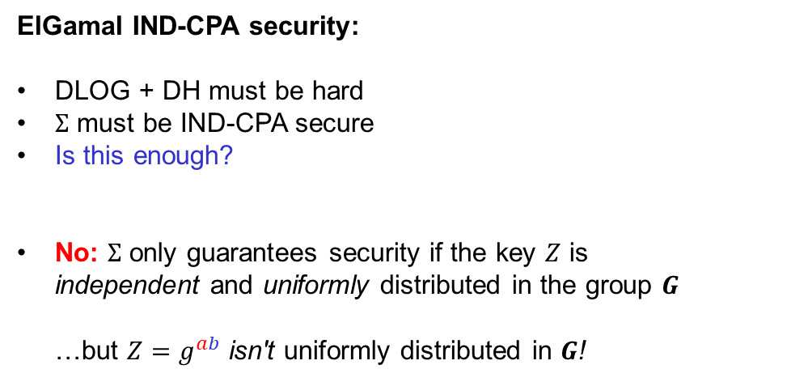



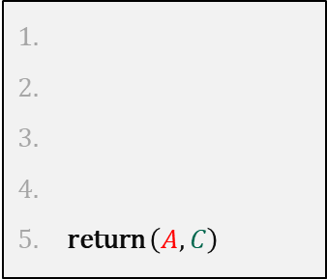











Public-key encryption: ElGamal
$$KeyGen$$
$$H :G→{\left\{0,1\right\}}^{k}$$
$$G=〈g〉$$
$$,B$$
return $\left(sk,pk\right)$
$$sk=$$
$$b↞\left\{1, …, \left|G\right|\right\}$$
$$M$$
$$B$$
$$pk=$$
$$B←g^{b}$$
$$,C$$
$$A$$
$$Enc\left(pk,M\right)$$
return $\left(A,C\right)$
$$a↞\left\{1, …, \left|G\right|\right\}$$
ElGamal IND-CPA security:
DLOG + DH must be hard
$Σ$ must be IND-CPA secure
Is this enough?
No: $Σ$ only guarantees security if the key $Z$ is
independent and uniformly distributed in the group $G$
…but ${Z=g}^{ab}$ isn't uniformly distributed in $G$!
$$A←g^{a}$$
$$C$$
$$Dec\left(sk,\left(A,C\right)\right)$$
$$Z←B^{a}=H\left(g^{ab}\right)$$
return $M$
$$Z←A^{b}=H\left(g^{ab}\right)$$
$$C←Σ.Enc\left(Z, M\right)$$
$$M←Σ. Dec\left(Z, C\right)$$
$$Σ. Enc :G×ℳ→𝒞$$
actually want $Σ. Enc :{\left\{0,1\right\}}^{k}×ℳ→𝒞$

Slide 8
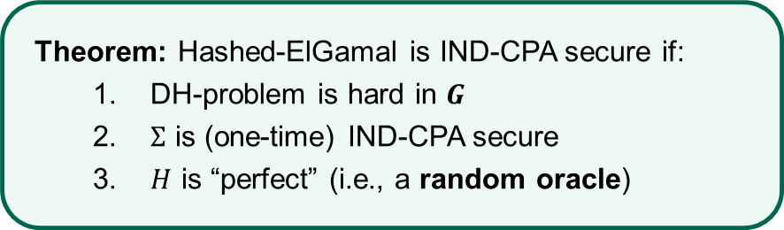


Public-key encryption: Hashed-ElGamal
$$KeyGen$$
$$H :G→{\left\{0,1\right\}}^{k}$$
$$G=〈g〉$$
return $\left(sk,pk\right)$
$$sk=$$
$$b↞\left\{1, …, \left|G\right|\right\}$$
$$M$$
$$B$$
$$pk=$$
$$B←g^{b}$$
$$,C$$
$$A$$
Theorem: Hashed-ElGamal is IND-CPA secure if:
  DH-problem is hard in $G$
  $Σ$ is (one-time) IND-CPA secure
  $H$ is “perfect” (i.e., a random oracle)
$$Enc\left(pk,M\right)$$
return $\left(A,C\right)$
$$a↞\left\{1, …, \left|G\right|\right\}$$
$$A←g^{a}$$
$$Dec\left(sk,\left(A,C\right)\right)$$
$$Z←H\left(B^{a}\right)=H\left(g^{ab}\right)$$
return $M$
$$Z←H\left(A^{b}\right)=H\left(g^{ab}\right)$$
$$C←Σ.Enc\left(Z, M\right)$$
$$M←Σ. Dec\left(Z, C\right)$$

Slide 9

Public-key encryption
AES-GCM++
X
K
M
X
K
M

Slide 10
Basic goals of cryptography
 | Message privacy | Message integrity / authentication
Symmetric keys | Symmetric encryption | Message authentication codes (MAC)
Asymmetric keys | Asymmetric encryption (a.k.a. public-key encryption) | Digital signatures
Key exchange
Key Encapsulation
Mechanisms (KEM)

Slide 11




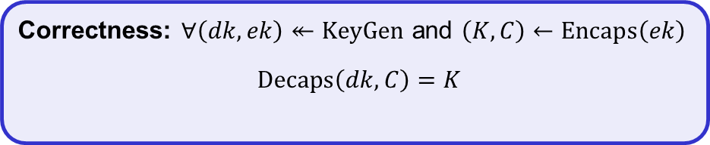


Key Encapsulation Mechanisms (KEM) – syntax
A KEM is a tuple $KEM=\left(KeyGen, Encaps, Decaps\right)$ of algorithms
$$KeyGen :D𝒦×ℰ𝒦$$
$$Encaps:ℰ𝒦→𝒦×𝒞$$
$$Decaps :𝒟𝒦×𝒞→𝒦∪\left\{⊥\right\}$$
$$\left(dk, ek\right)↞KeyGen$$
$$Encaps\left(ek\right)=(K,C)$$
$$Decaps\left(dk, C\right)=K/⊥$$
$𝒟𝒦$ – private key space
$ℰ𝒦$ – public key space
$𝒦$ – symmetric key space
$𝒞$ – ciphertext space
Correctness: $∀\left(dk,ek\right)↞KeyGen$ and $\left(K,C\right)←Encaps\left(ek\right)$
$$Decaps\left(dk,C\right)=K$$

Slide 12
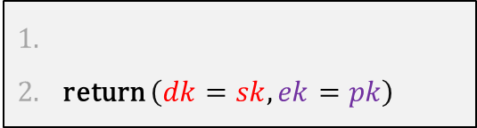





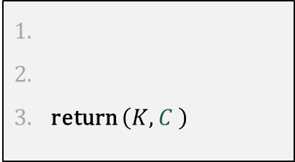



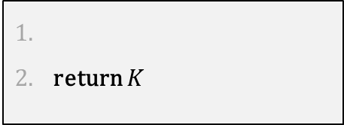

KEM from PKE
$$KEM.KeyGen$$
return $\left(dk=sk,ek=pk\right)$
$$\left(sk,pk\right)↞PKE.KeyGen$$
$$pk (=ek)$$
$$KEM.Encaps\left(pk\right)$$
return $\left(K,C \right)$
$$\text{KEM}\text{.}\text{Dec}\left(dk,C\right)$$
$$K↞ℳ$$
$$C←PKE.Enc(ek,K)$$
$$C$$
return $K$
$$K←PKE.Dec(dk,C)$$

Slide 13



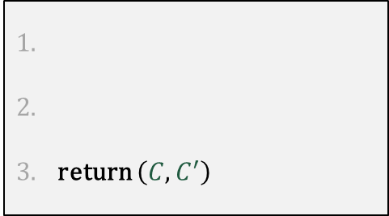





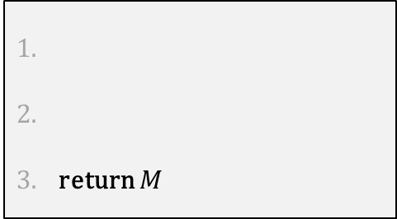


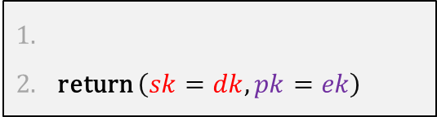


PKE from KEM
$$PKE.KeyGen$$
return $\left(sk=dk,pk=ek\right)$
$$\left(dk,ek\right)↞KEM.KeyGen$$
$$M$$
$$ek (=pk)$$
$$PKE.Enc\left(ek,M\right)$$
$$\text{PKE}\text{.}\text{Dec}\left(sk,\left(C,C′\right)\right)$$
return $\left(C,C^{′}\right)$
$$C$$
return $M$
$$\left(K,C\right)←KEM.Encaps(ek)$$
$$K←KEM.Decaps(sk,C)$$
$$C′←Σ.{Enc}_{K}(M)$$
$$C^{′}$$
$$M←Σ.{Dec}_{K}(C^{′})$$
KEM security is about this part
Symmetric encryption scheme

Slide 14

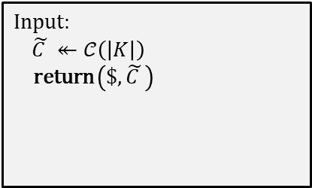
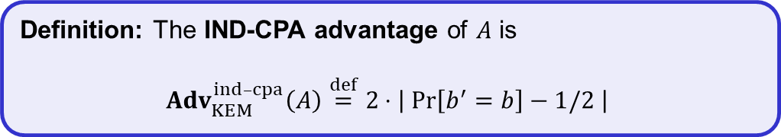

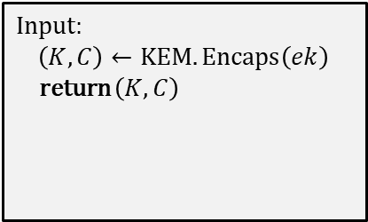

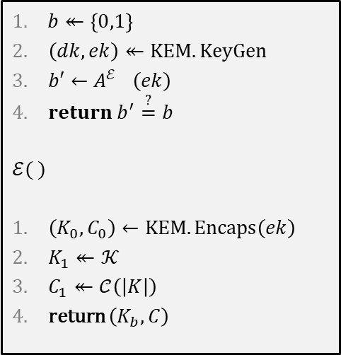
KEM-security: IND-CPA
$$\text{World}\text{ 0}$$
$$\text{World}\text{ 1}$$
$$Exp_{KEM}^{ind­­–cpa}\left(A\right)$$
Input:
$\left(K,C\right)←KEM.Encaps\left(ek\right)$
return $\left(K,C\right)$
$b$
Input:
$\tilde{C }↞𝒞\left(\left|K\right|\right)$
return $\left(\$,\tilde{C }\right)$
$b↞\left\{0,1\right\}$
$\left(dk,ek\right)↞KEM.KeyGen$
$b′←A^{ℰ\left(.\right)}\left(ek\right)$
$return b^{′}\overset{?}{=}b$
$$ℰ( )$$
$\left(K_{0},C_{0}\right)←KEM.Encaps\left(ek\right)$
$K_{1}↞𝒦$
$C_{1}↞𝒞\left(\left|K\right|\right)$
return $\left(K_{b},C\right)$
$$ek$$
I’m in World $b′$
Definition: The IND-CPA advantage of $A$ is
$${Adv}_{KEM}^{ind­–cpa}\left(A\right)\overset{def}{=}2⋅\left|\operatorname{Pr}\left[b^{′}=b\right]−1/2 \right|$$

Slide 15
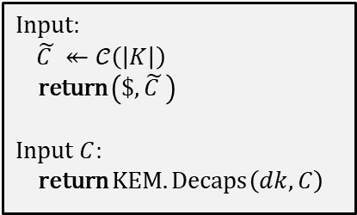
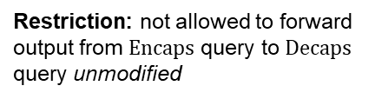
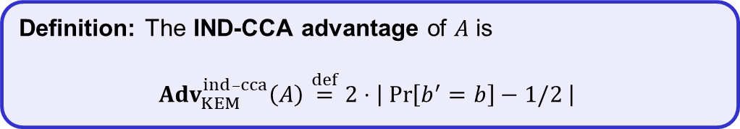
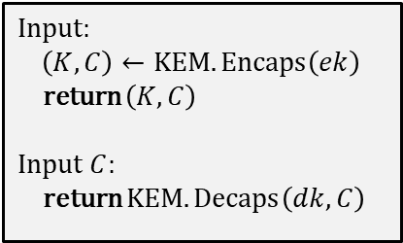
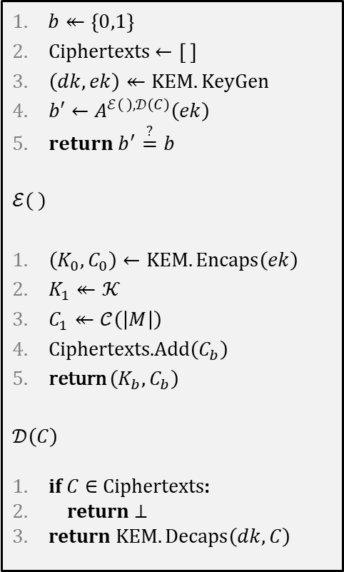

KEM-security: IND-CCA
$$\text{World}\text{ 0}$$
$$\text{World}\text{ 1}$$
$$Exp_{KEM}^{ind­­–cca}\left(A\right)$$
Input:
$\left(K,C\right)←KEM.Encaps\left(ek\right)$
return $\left(K,C\right)$
Input $C$:
return $KEM.Decaps\left(dk,C\right)$
$b$
Input:
$\tilde{C }↞𝒞\left(\left|K\right|\right)$
return $\left(\$,\tilde{C }\right)$
Input $C$:
return $KEM.Decaps\left(dk,C\right)$
$b↞\left\{0,1\right\}$
Ciphertexts $←\left[ \right]$
$\left(dk,ek\right)↞KEM.KeyGen$
$b′←A^{ℰ\left(.\right), 𝒟\left(C\right)}\left(ek\right)$
$return b^{′}\overset{?}{=}b$
$$ℰ( )$$
$\left(K_{0},C_{0}\right)←KEM.Encaps\left(ek\right)$
$K_{1}↞𝒦$
$C_{1}↞𝒞\left(\left|M\right|\right)$
Ciphertexts.Add$\left(C_{b}\right)$
return $\left(K_{b},C_{b}\right)$
$$𝒟\left(C\right)$$
if $C∈$ Ciphertexts:
return $⊥$
return $KEM.Decaps\left(dk,C\right)$
$$ek$$
I’m in World $b′$
Restriction: not allowed to forward output from $Encaps$ query to $Decaps$ query unmodified
Definition: The IND-CCA advantage of $A$ is
$${Adv}_{KEM}^{ind­–cca}\left(A\right)\overset{def}{=}2⋅\left|\operatorname{Pr}\left[b^{′}=b\right]−1/2 \right|$$

Slide 16


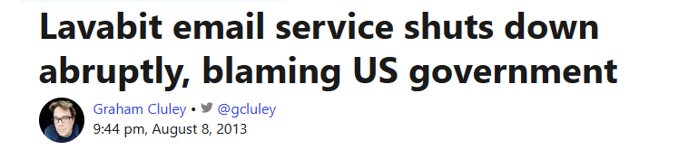
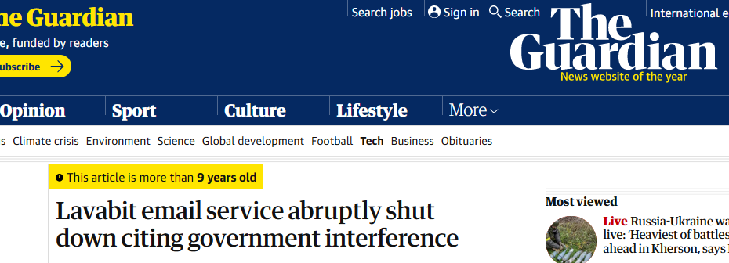
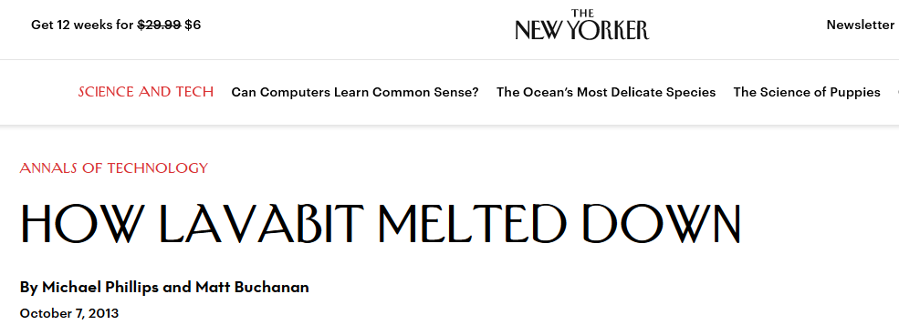
Lavabit

Slide 17










Lavabit and KEMs
$$ek$$
$$\left(dk,ek\right)↞KEM.KeyGen$$
lavabit.com
$$C$$
$$\left(K,C\right)←KEM.Encaps(ek)$$
TLS
$$K←KEM.Decaps(dk,C)$$

Slide 18
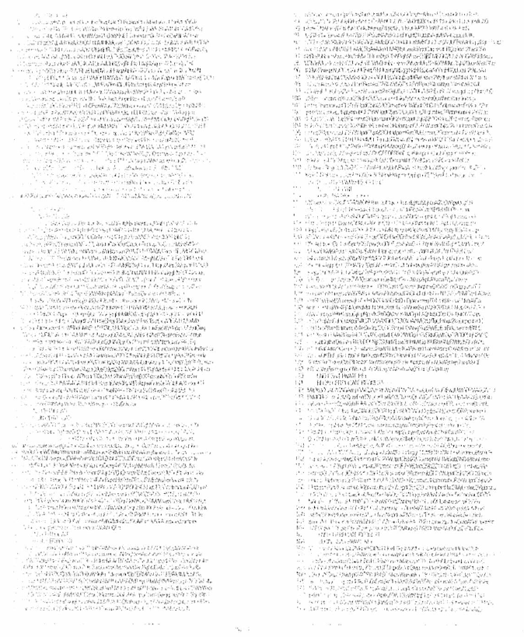
Lavabit

Slide 19
Forward secrecy
What Lavabit's solution lacked was forward secrecy:
But how is this possible?
Definition: A system has forward secrecy if an attacker cannot obtain previously sent data, even if it obtains the parties' long-term keys

Slide 20




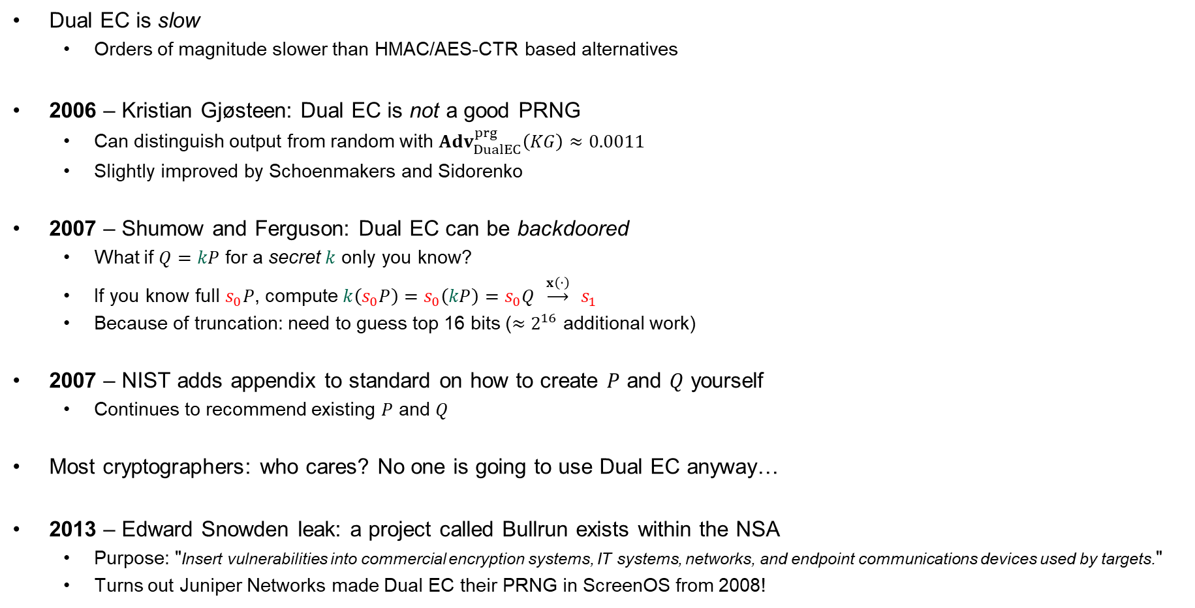



KEMs with forward secrecy
$$\left(dk,ek\right)↞KEM.KeyGen$$
$$ek$$
$$ek$$
$$\left(dk,ek\right)↞KEM.KeyGen$$
TLS
$$\left(K,C\right)←KEM.Encaps(ek)$$
$$C$$
$$K←KEM.Decaps(dk,C)$$

Slide 21
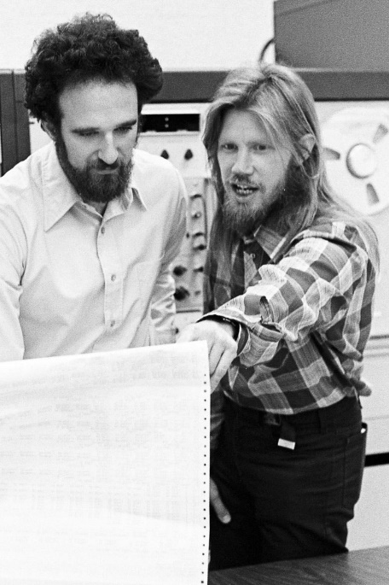

Attacking Diffie-Hellman

Slide 22









Diffie-Hellman – man-in-the-middle attack
$$G=〈g〉$$
$$A=g^{a}$$
$$B=g^{b}$$
$$a↞\left\{1, …, \left|G\right|\right\}$$
$$b↞\left\{1, …, \left|G\right|\right\}$$
$$Z←B^{a}=g^{ab}$$
$$Z←A^{b}=g^{ab}$$

Slide 23



Diffie-Hellman – man-in-the-middle attack
$$G=〈g〉$$
$$A=g^{a}$$
$$X=g^{x}$$
$$B=g^{b}$$
$$a↞\left\{1, …, \left|G\right|\right\}$$
$$b↞\left\{1, …, \left|G\right|\right\}$$
$$Z←B^{a}=g^{ab}$$
$$Z←A^{b}=g^{ab}$$
$$x$$
$$Z^{′}←X^{b}=g^{xb}$$

Slide 24








Diffie-Hellman – man-in-the-middle attack
$$G=〈g〉$$
$$Y=g^{y}$$
$$A=g^{a}$$
$$X=g^{x}$$
$$B=g^{b}$$
$$a↞\left\{1, …, \left|G\right|\right\}$$
$$b↞\left\{1, …, \left|G\right|\right\}$$
$$Z←B^{a}=g^{ab}$$
$$Z←A^{b}=g^{ab}$$
$$y$$
$$x$$
$$Z′′←Y^{a}=g^{ay}$$
$$Z^{′}←X^{b}=g^{xb}$$
AES-GCM++
AES-GCM++
$$Z^{′′}←A^{y}=g^{ay}$$
$$Z^{′}←B^{x}=g^{xb}$$
$$M$$
$$M$$
$$M$$

Slide 25













Noise-protocol
Long-term key
Long-term key
$$A=g^{a}$$
$$G=〈g〉$$
, $A$, $B$
$$B=g^{b}$$
$$X=g^{x}$$
$$Y=g^{y}$$
$$x↞\left\{1, …, \left|G\right|\right\}$$
$$y↞\left\{1, …, \left|G\right|\right\}$$
$$K←H\left(X,Y, B^{a},Y^{x}\right)$$
$$K←H\left(X,Y,A^{b},X^{y}\right)$$
$$g^{ab}$$
$$g^{xy}$$
$$g^{ab}$$
$$g^{xy}$$

Slide 26
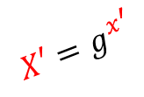







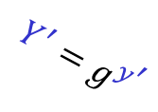
Noise-protocol
Long-term key
Long-term key
$$A=g^{a}$$
$$G=〈g〉$$
, $A$, $B$
$$B=g^{b}$$
$$Y^{′}=g^{y^{′}}$$
$$X=g^{x}$$
$$X′=g^{x^{′}}$$
$$Y=g^{y}$$
$$x↞\left\{1, …, \left|G\right|\right\}$$
$$y↞\left\{1, …, \left|G\right|\right\}$$
$$K←H\left(X,Y, B^{a},Y^{x}\right)$$
$$K←H\left(X,Y,A^{b},X^{y}\right)$$
$$y^{′}$$
$$x^{′}$$
$$K′←H\left(X,Y^{′}, B^{a},{Y′}^{x}\right)$$
$$K′←H\left(X′,Y,A^{b},{X^{′}}^{y}\right)$$
$$g^{ab}$$
adversary can't compute this due to DH/DLOG problem
Can't compute $K′$ or $K′$!

Slide 27







Noise-protocol
Long-term key
Long-term key
$$A=g^{a}$$
$$G=〈g〉$$
, $A$, $B$
$$B=g^{b}$$
(static)
(static)
$$X=g^{x}$$
$$Y=g^{y}$$
$$x↞\left\{1, …, \left|G\right|\right\}$$
$$y↞\left\{1, …, \left|G\right|\right\}$$
ephemeral
Many alternatives:
Used inside
$$K←H\left(X,Y, g^{ab},g^{xy} \right)$$
static-static, ephemeral-ephemeral
$$K←H\left(X,Y, g^{ay},g^{xb} \right)$$
static-ephemeral, ephemeral-static
$$K←H\left(X,Y, g^{ay},g^{xb},g^{xy}\right)$$
static-ephemeral, ephemeral-static, ephemeral-ephemeral
$$K←H\left(X,Y, g^{ab},g^{ay},g^{xb},g^{xy}\right)$$
static-static, static-ephemeral, ephemeral-static, ephemeral-ephemeral

Slide 28



Forward secrecy
Long-term key
Long-term key
$$A=g^{a}$$
$$G=〈g〉$$
, $A$, $B$
$$B=g^{b}$$
(static)
(static)
$$X=g^{x}$$
$$Y=g^{y}$$
$$x↞\left\{1, …, \left|G\right|\right\}$$
$$y↞\left\{1, …, \left|G\right|\right\}$$
AES-GCM++
ephemeral
$$K←H\left(X,Y, g^{ab},g^{xy} \right)$$
$$K←H\left(X,Y, g^{ab},g^{xy} \right)$$
Can't compute!
(Need to solve DH or DLOG problem)

Slide 29

Conspiracies…

Slide 30

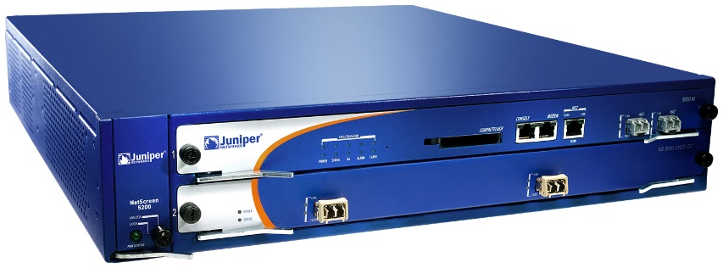
Juniper Networks
Juniper Networks: big manufacturer of network equipment (routers, VPNs, firewalls, etc.)
  Major customers: telcos, banks, US DoD
2015:
Hackers obtained access to source code repository
Only made one change:
--- Qx = 2c55e5e45edf713dc43475effe8813a60326a64d9ba3d2e39cb639b0f3b0ad10
+++ Qx = 9585320eeaf81044f20d55030a035b11bece81c785e6c933e4a8a131f6578107
IMPORTANT JUNIPER SECURITY ANNOUNCEMENT
During a recent internal code review, Juniper discovered unauthorized code in ScreenOS that could allow a knowledgeable attacker to gain administrative access to NetScreen® devices and to decrypt VPN connections.

Slide 31
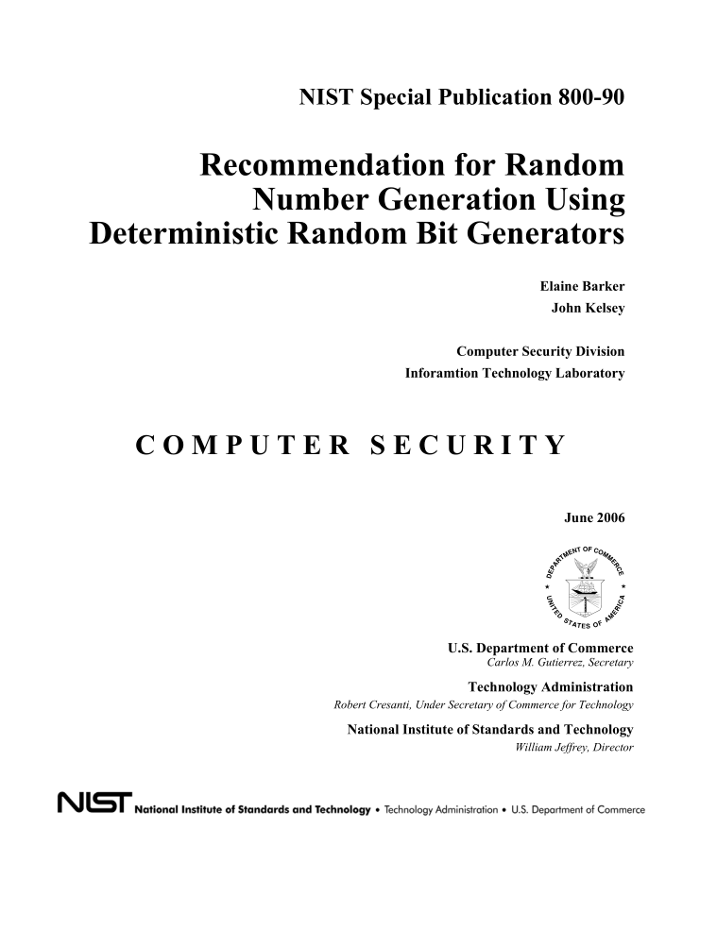
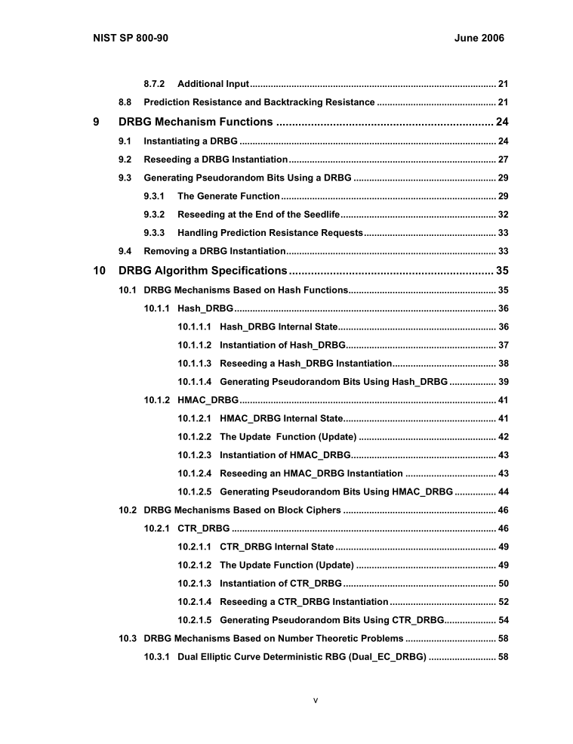
PRNG standardization

Slide 32
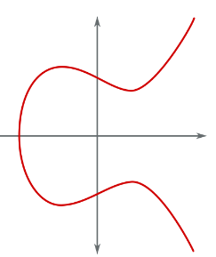



Elliptic curves summary
$P=(x,y)$ point on elliptic curve
$x$ and $y$ are elements in $Z_{p}$
Points $P$ and $Q$ can be added to get another point $P+Q$
Special case: add $P$ to itself $n$ times
$nP=P+P+…+P$
DLOG problem: given $P$ and $nP$, find $n$ (for secret $n$)
$$Q$$
$$P$$
$$P+Q$$

Slide 33





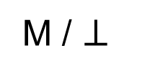



PRNG
$$G\left(s_{0}\right)$$
$$G\left(s_{1}\right)$$
$$G\left(s_{2}\right)$$
$${ s}_{0}$$
$${ s}_{1}$$
$${ s}_{2}$$
$$s_{3}$$
$$F\left(s_{0}\right)$$
$$F\left(s_{1}\right)$$
$$F\left(s_{2}\right)$$
$$⋯$$
$${ R}_{0}$$
$${ R}_{1}$$
$${ R}_{2}$$

Slide 34

















Dual EC DRBG
$P,Q:$public points on an elliptic curve
$x\left(⋅\right) :$x-coordinate of elliptic curve point (256 bits)
$$x\left(s_{0}Q\right)$$
$$x\left(s_{1}Q\right)$$
$$x\left(s_{2}Q\right)$$
256 bit
$${ s}_{0}$$
$${ s}_{1}$$
$${ s}_{2}$$
$$s_{0}P$$
$$x\left(s_{1}P\right)$$
$$x\left(s_{2}P\right)$$
$$⋯$$
$$x\left( \right)$$
$$r_{0}$$
$$r_{1}$$
$$r_{2}$$
keep 240 bits

Slide 35




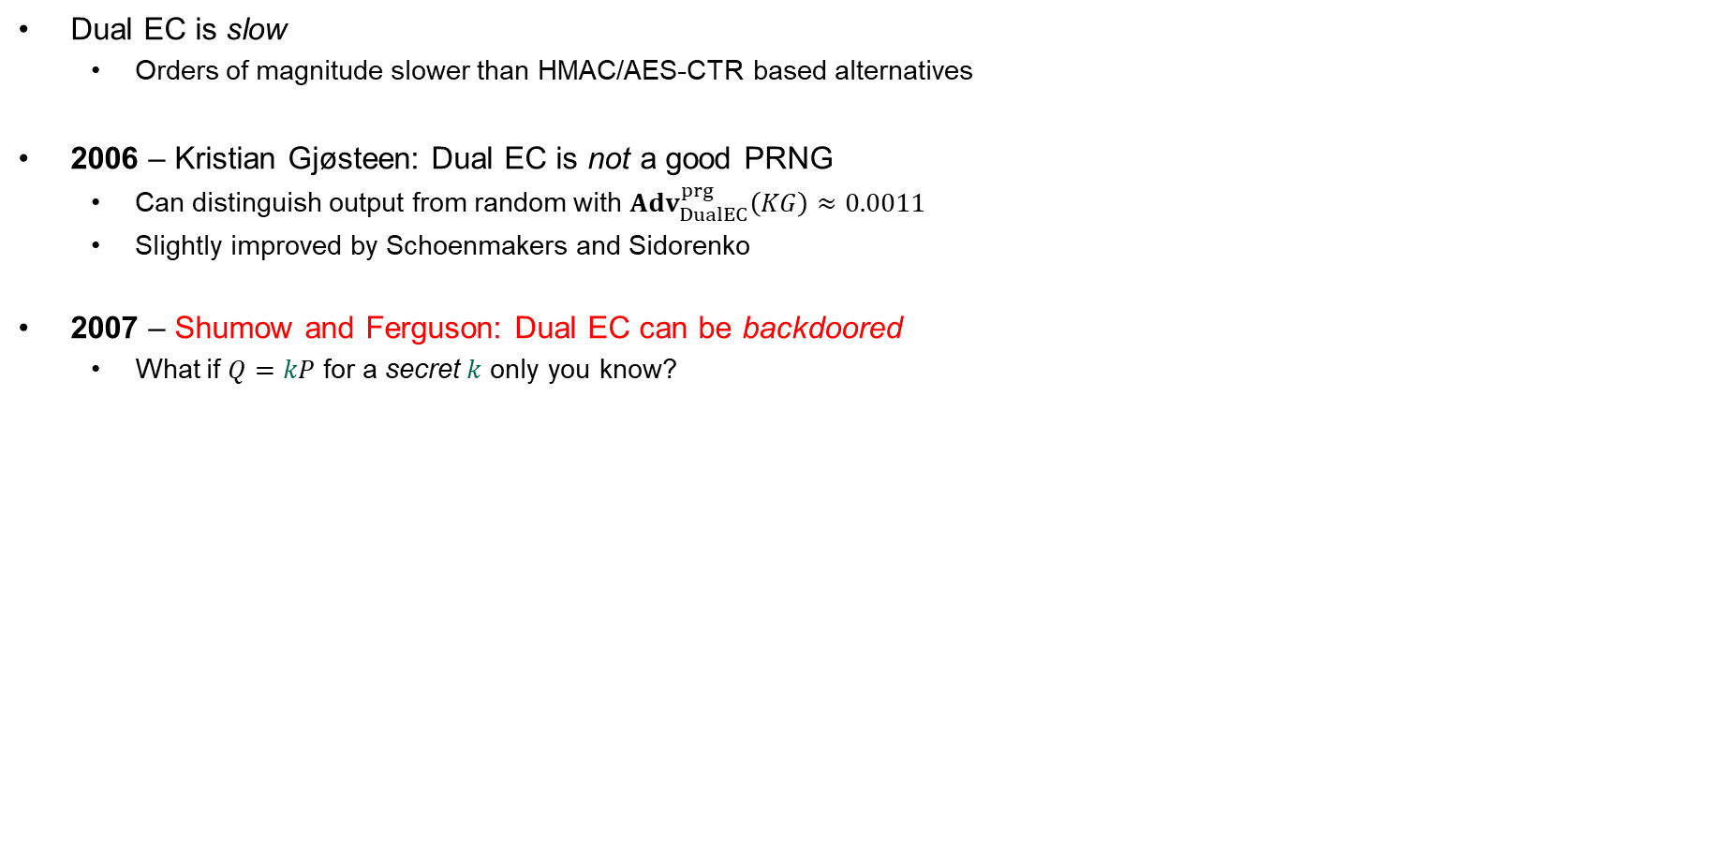






Dual EC DRBG – something's fishy
Dual EC is slow
  Orders of magnitude slower than HMAC/AES-CTR based alternatives
2006 – Kristian Gjøsteen: Dual EC is not a good PRNG
  Can distinguish output from random with ${Adv}_{DualEC}^{prg}\left(KG\right)≈0.0011$
  Slightly improved by Schoenmakers and Sidorenko
2007 – Shumow and Ferguson: Dual EC can be backdoored
  What if $Q=kP$ for a secret $k$ only you know?
$$x\left(s_{0}Q\right)$$
$$x\left(s_{1}Q\right)$$
$$x\left(s_{2}Q\right)$$
$${ s}_{0}$$
$${ s}_{1}$$
$${ s}_{2}$$
$$x\left(s_{0}P\right)$$
$$x\left(s_{1}P\right)$$
$$x\left(s_{2}P\right)$$
$$⋯$$
$$r_{0}$$
$$r_{1}$$
$$r_{2}$$

Slide 36


















Dual EC DRBG
$P,Q:$public points on an elliptic curve
$$Q=kP$$
$x\left(⋅\right) :$x-coordinate (256 bits)
$$x\left(s_{0}Q\right)$$
$$x\left(s_{1}Q\right)$$
$$x\left(s_{2}Q\right)$$
256 bit
$${ s}_{0}$$
$${ s}_{1}$$
$${ s}_{2}$$
$$s_{0}P$$
$$x\left(s_{1}P\right)$$
$$x\left(s_{2}P\right)$$
$$⋯$$
$$x\left( \right)$$
$$r_{0}$$
$$r_{1}$$
$$r_{2}$$
keep 240 bits
$${ R}_{0}$$
$${ R}_{1}$$
$${ R}_{2}$$
$${kR}_{0}$$
$$= k⋅\left(s_{0}P\right)$$
$$= s_{0}⋅\left(\text{k}\text{P}\right)$$
$$= s_{0}Q$$
$$\underset{→}{x\left(⋅\right)}{ s}_{1}$$

Slide 37
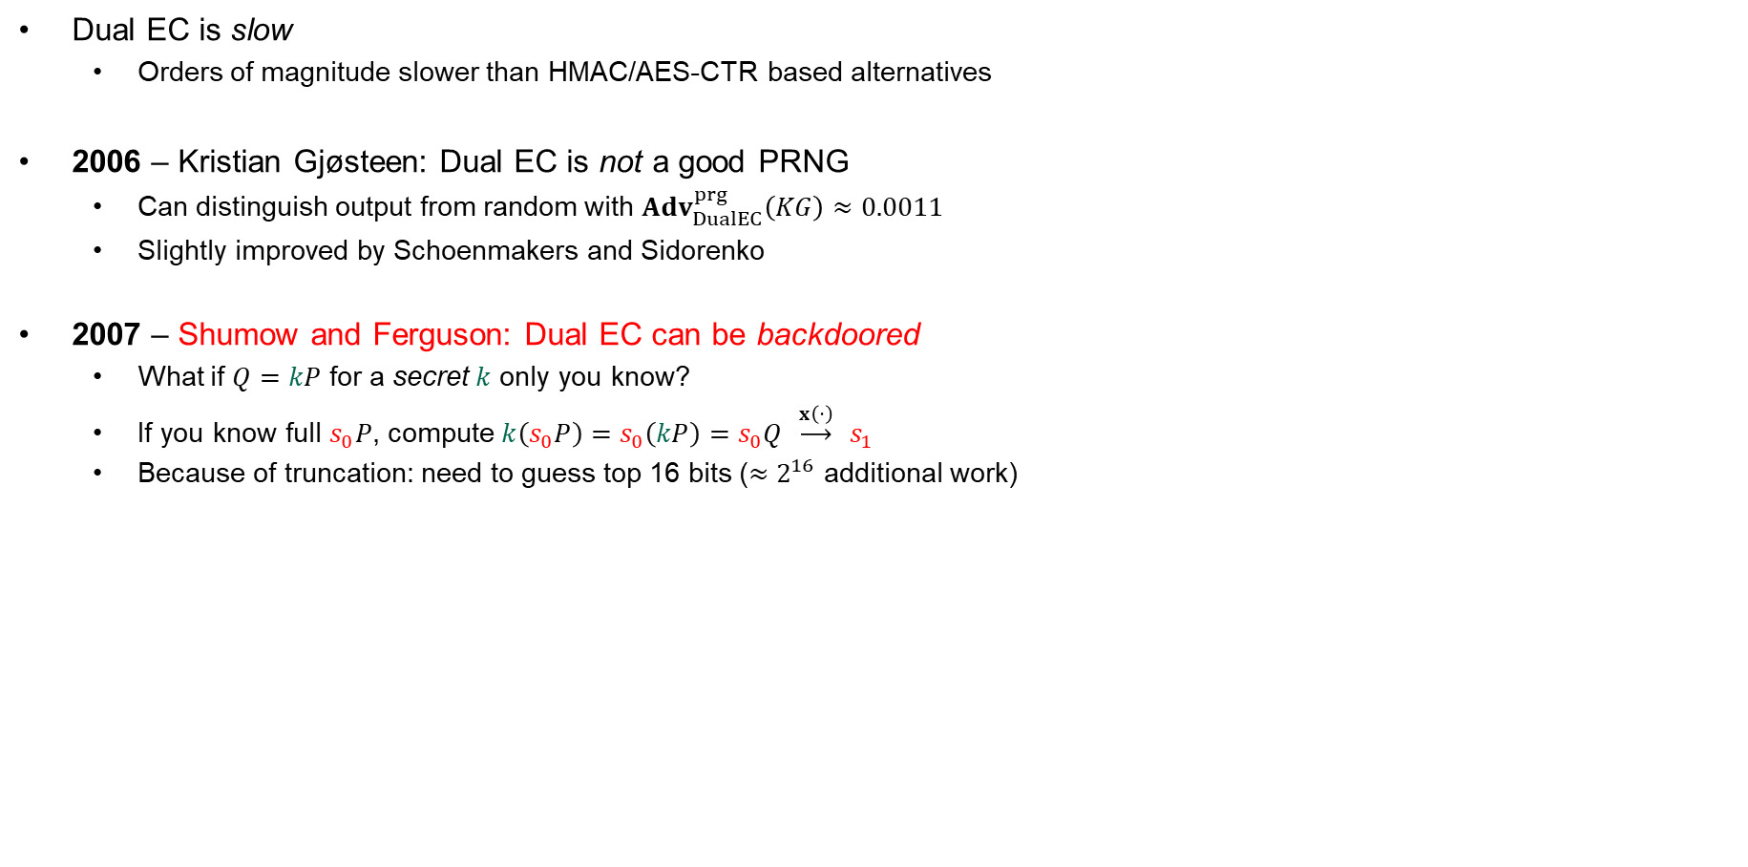
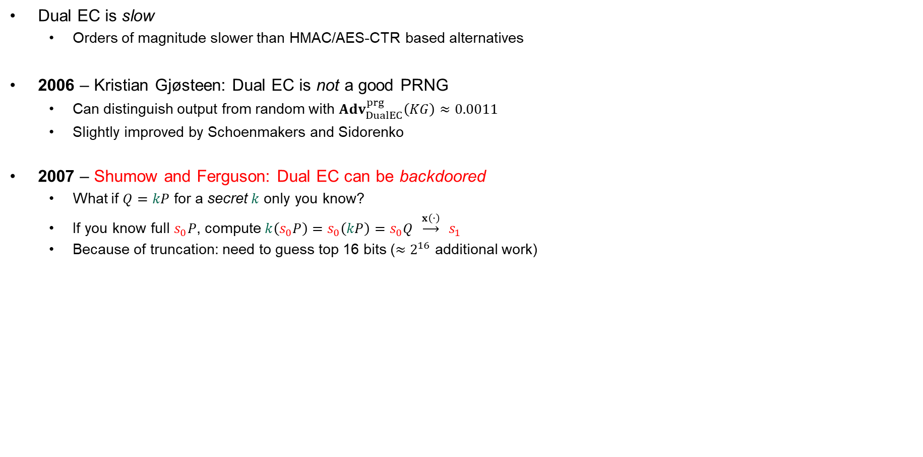
Dual EC DRBG – something's fishy
Dual EC is slow
  Orders of magnitude slower than HMAC/AES-CTR based alternatives
2006 – Kristian Gjøsteen: Dual EC is not a good PRNG
  Can distinguish output from random with ${Adv}_{DualEC}^{prg}\left(KG\right)≈0.0011$
  Slightly improved by Schoenmakers and Sidorenko
2007 – Shumow and Ferguson: Dual EC can be backdoored
  What if $Q=kP$ for a secret $k$ only you know?
  If you know full $s_{0}P$, compute $k\left(s_{0}P\right)=s_{0}\left(kP\right)=s_{0}Q \underset{→}{x\left(⋅\right)} s_{1}$
  Because of truncation: need to guess top 16 bits (${≈2}^{16}$ additional work)
$$x\left(s_{0}Q\right)$$
$$x\left(s_{1}Q\right)$$
$$x\left(s_{2}Q\right)$$
$${ s}_{0}$$
$${ s}_{1}$$
$${ s}_{2}$$
$$x\left(s_{0}P\right)$$
$$x\left(s_{1}P\right)$$
$$x\left(s_{2}P\right)$$
$$⋯$$
$$r_{0}$$
$$r_{1}$$
$$r_{2}$$

Slide 38
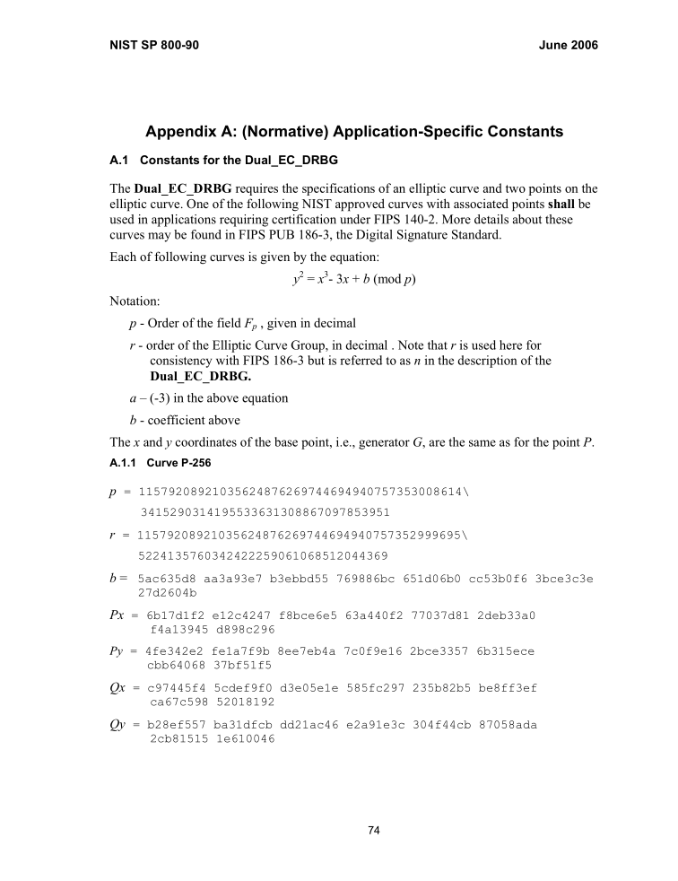
Where does $Q$ (and $P$) come from?
From: John Kelsey [mailto:john.kelsey@nist.gov]
Sent: Wednesday, October 27, 2004 11:17 AM
To: Don Johnson
Subject: Minding our Ps and Qs in Dual_EC
Do you know where Q comes from in Dual_EC_DRBG?
Thanks,
-Joh
----------------------------------------------------------------
Subject: RE: Minding our Ps and Qs in Dual_EC
From: "Don Johnson" <DJohnson@cygnacom.com>
Date: Wed, October 27, 2004 11:42 am
To: "John Kelsey" <john.kelsey@nist.gov>
John,
P=G.
Q is (in essence) the public key for some random private key.
It could also be generated like a(nother) canonical G, but NSA kyboshed
this idea, and I was not allowed to publicly discuss it, just in case you
may think of going there.
Don B. Johnson

Slide 39
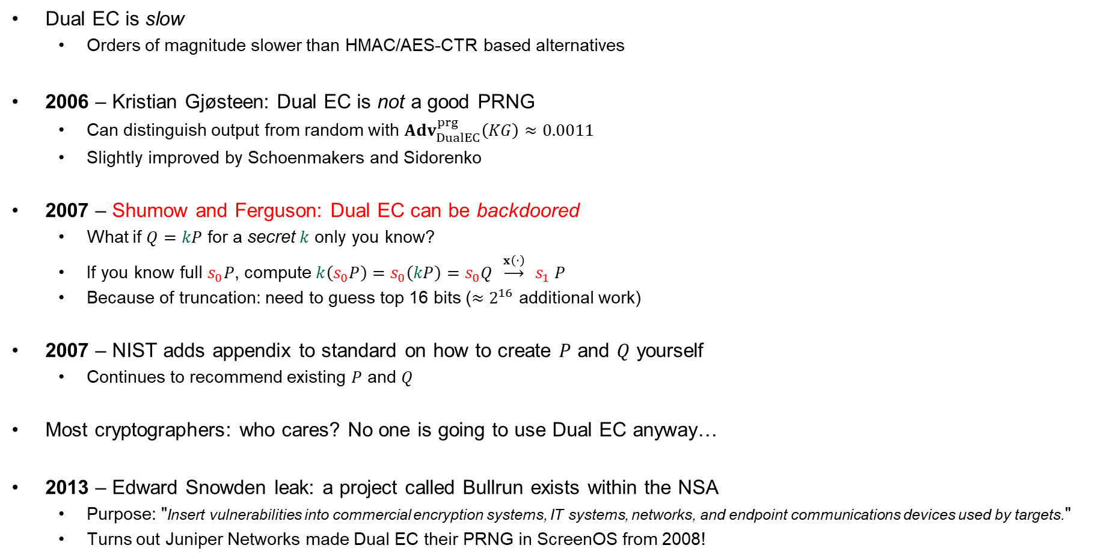
Dual EC DRBG – something's fishy
Dual EC is slow
  Orders of magnitude slower than HMAC/AES-CTR based alternatives
2006 – Kristian Gjøsteen: Dual EC is not a good PRNG
  Can distinguish output from random with ${Adv}_{DualEC}^{prg}\left(KG\right)≈0.0011$
  Slightly improved by Schoenmakers and Sidorenko
2007 – Shumow and Ferguson: Dual EC can be backdoored
  What if $Q=kP$ for a secret $k$ only you know?
  If you know full $s_{0}P$, compute $k\left(s_{0}P\right)=s_{0}\left(kP\right)=s_{0}Q \underset{→}{x\left(⋅\right)} s_{1} P$
  Because of truncation: need to guess top 16 bits (${≈2}^{16}$ additional work)
2007 – NIST adds appendix to standard on how to create $P$ and $Q$ yourself
  Continues to recommend existing $P$ and $Q$
Most cryptographers: who cares? No one is going to use Dual EC anyway…
2013 – Edward Snowden leak: a project called Bullrun exists within the NSA
  Purpose: "Insert vulnerabilities into commercial encryption systems, IT systems, networks, and endpoint communications devices used by targets."
  Turns out Juniper Networks made Dual EC their PRNG in ScreenOS from 2008!
$$x\left(s_{0}Q\right)$$
$$x\left(s_{1}Q\right)$$
$$x\left(s_{2}Q\right)$$
$${ s}_{0}$$
$${ s}_{1}$$
$${ s}_{2}$$
$$x\left(s_{0}P\right)$$
$$x\left(s_{1}P\right)$$
$$x\left(s_{2}P\right)$$
$$⋯$$
$$r_{0}$$
$$r_{1}$$
$$r_{2}$$

Slide 40
Juniper PRNG
ScreenOS does make use of the Dual_EC_DRBG standard,
but is designed to not use Dual_EC_DBRG as its primary random number generator. ScreenOS uses it in a way that should not be vulnerable to the possible issue that has been brought to light. Instead of using the NIST recommended curve points it uses self-generated basis points and then takes the output as an input to FIPS/ANSI X.9.31 PRNG, which is the random number generator used in ScreenOS cryptographic operations.
Juniper Knowledge Base Article KB28205

Slide 41
Juniper PRNG
ScreenOS v.6.1
ScreenOS v.6.2
char seed[8], key[24], block[8]; // X9.31 vars
int calls_since_reseed;
void prng_reseed(void) {
int index = 0;
char tmp_output[32];
system_rng_generate(tmp_output, 32);
memcpy(seed, tmp_output, 8);
index = 8;
memcpy(key, &tmp_output[index], 24)
index = 32;
calls_since_reseed = 0;
}
void prng_generate(char *output ) {
int index = 0;
calls_since_reseed++;
if (calls_since_reseed > 10 000)
prng_reseed();
for (; index < 20; index += 8) {
...
x9_31_generate_block(seed, key, block);
...
memcpy(&output[index], block, 8);
}
}
char seed[8], key[24], block[8]; // X9.31 vars
int calls_since_reseed, index;
char output[32];
void prng_reseed(void) {
index = 0;
dual_ec_generate(output, 32);
memcpy(seed, output, 8);
index = 8;
memcpy(key, &output[index], 24);
index = 32;
}
void prng_generate(void) {
index = 0;
prng_reseed();
for (; index < 32; index += 8) {
...
x9_31_generate_block(seed, key, block);
...
memcpy(&output[index], block, 8);
}
}
global variable
global shared buffer
local variable
local buffer
caller-supplied buffer
local variable
only called conditionally
called unconditionally
Dual EC output masked by this
…means this is skipped!
Source: Where did I leave my keys? Lessons from the Juniper Dual EC incident https://dl.acm.org/doi/10.1145/3266291
Notes:
Problem in v6.2:
index is a global variable set to 32 after prng_reseed
so for-loop in prng_generate never runs!
Output in output buffer comes directly from Dual_EC
Changes from 6.1 to 6.2:
replaced an entropy-gathering procedure for (re)seeding the ANS X9.31 PRNG with Dual EC using a custom Q point
modified the X9.31 reseed logic to reseed on every call rather than every 10,000 calls
changed the loop counter in the prng_generate procedure as well as the procedure’s output to be global variables, shared with the reseed procedure, thus ensuring that pseudorandom values are generated by Dual EC, and not X9.31
changed the IKE nonce length from 160 bits to 256 bits
added a nonce pre-generation queue.

Slide 42


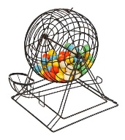









IKEv2 / IPsec
Knowledge of any of these allows deriving traffic encryption key
client nonce,
xG
server nonce,
yG
client authentication
Juniper v6.1: 20 bytes
Juniper v6.2: 32 bytes
server authentication
Dual EC
$$x\left(s_{0}Q\right)$$
$$x\left(s_{1}Q\right)$$
Created by Juniper PRNG
$${ s}_{0}$$
$${ s}_{1}$$
$$x\left(s_{0}P\right)$$
$$x\left(s_{1}P\right)$$
$$⋯$$
$$r_{0}$$
$$r_{1}$$
20 bytes
Notes:
Majority of IKE implementations use nonce sizes of 20 bytes…but not Juniper v6.2 (32 bytes)

Slide 43

Juniper Networks backdoor
Juniper Networks: big manufacturer of network equipment (routers, VPNs, firewalls, etc.)
  Major customers: telcos, banks, US DoD
2015:
Hackers had obtained access to source code repository
Only one change:
--- Qx = 2c55e5e45edf713dc43475effe8813a60326a64d9ba3d2e39cb639b0f3b0ad10
+++ Qx = 9585320eeaf81044f20d55030a035b11bece81c785e6c933e4a8a131f6578107
IMPORTANT JUNIPER SECURITY ANNOUNCEMENT
During a recent internal code review, Juniper discovered unauthorized code in ScreenOS that could allow a knowledgeable attacker to gain administrative access to NetScreen® devices and to decrypt VPN connections.
Juniper created $Q$ (yay! No NSA)
Who dis?

Slide 44
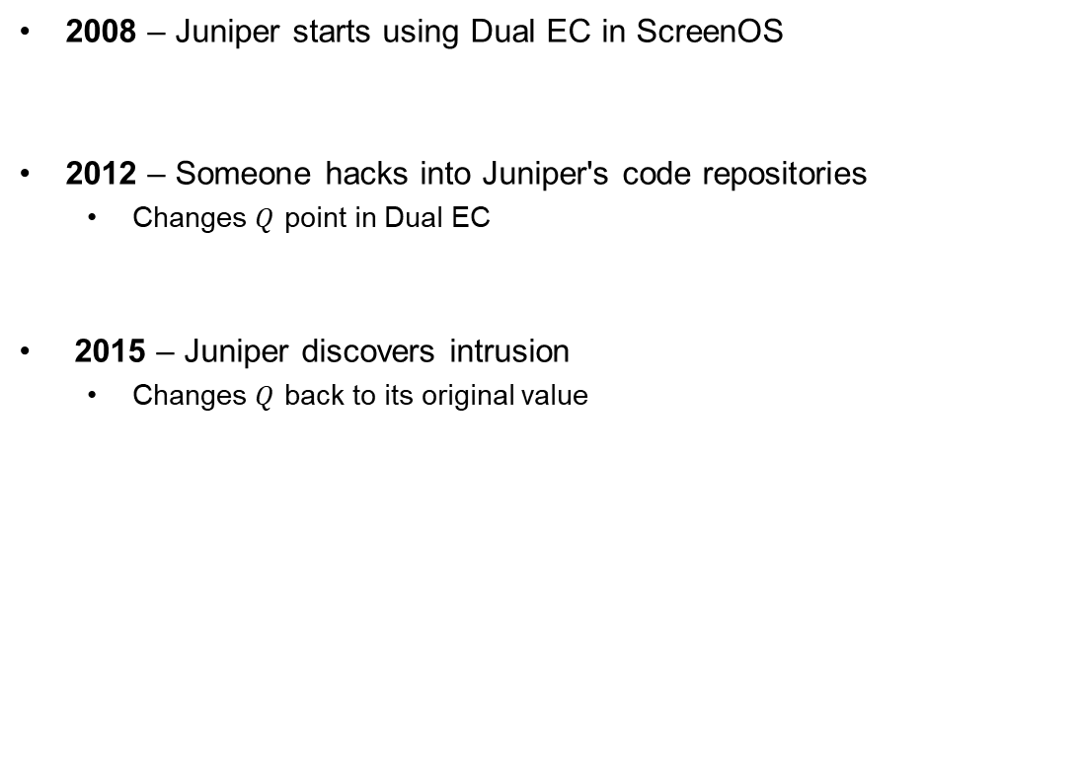
Juniper Networks backdoor
2008 – Juniper starts using Dual EC in ScreenOS
2012 – Someone hacks into Juniper's code repositories
  Changes $Q$ point in Dual EC
2015 – Juniper discovers intrusion
  Changes $Q$ back to its original value

Slide 45
TLS 1.2
Only 28 bytes ☹
client random
server random, yG
xG
Dual EC

Slide 46




Extended Random
NSA: please make the TLS nonces bigger…for reasons ;-)
Implementing Extended Random makes
exploiting Dual EC 10,000 times easier
No real cryptographic justification exists
for making them longer

Slide 47

RSA Security – BSAFE
Turns out Juniper weren't the only ones using Dual EC
RSA Security
  Big computer and network security company
  Creator of BSAFE cryptographic library
2004 – accepted $10 million from the NSA in order to make Dual EC the default in BSAFE
2014 – adapted the TLS Extended Random extension

Slide 48


Slide 49










NIST elliptic curves
NIST standardized a number of elliptic curves (created by the NSA) in the 90's:
  Most widely used: P-224, P-256, P-384, P-521
  $E :$ $y^{2}=x^{3}+ax+b$ for $x,y,a,b∈Z_{p}$
Parameter
Value
Justification
$$p_{256}$$
0xffffffff 00000001 00000000 00000000
00000000 ffffffff ffffffff ffffffff
Efficiency ($p_{256}=\text{2²⁵⁶ − 2²²⁴ + 2¹⁹² − 2³² − 1}$ allows for fast modular reduction)
$$\left|E\left(Z_{p_{256}}\right)\right|$$
0xffffffff 00000000 ffffffff ffffffff
bce6faad a7179e84 f3b9cac2 fc632551
Prime
$$a$$
$$−3$$
Efficiency
$$b$$
0x5ac635d8 aa3a93e7 b3ebbd55 769886bc
651d06b0 cc53b0f6 3bce3c3e 27d2604b
?
Generator $Q$
Qx = 0x6b17d1f2 e12c4247 f8bce6e5 63a440f2
77037d81 2deb33a0 f4a13945 d898c296
Not important (any generator will do, since the curve order is prime)
How was $b$ generated?
Chosen as the solution to $b^{2}c=−27 \left(mod p\right)$
$$X_{i+1} ←{25214903917⋅X}_{i}+11 (mod 2^{31})$$
How was $c$ generated?
Defined as $c←SHA1(seed)$ for some seed $seed$
How was $seed$ generated?
No one knows (not even the NSA themselves apparently)!
Claude AI found the answer a few days ago
…$seed$ was basically lrand48(current_time)

Slide 50
Next week
How to ensure keys are authentic?
Digital signatures
PKI

