Slide 1
Lecture 11 – Digital signatures, UF-CMA,
Schnorr, PKI
TEK4500
28.10.2026
Håkon Jacobsen
hakon.jacobsen@its.uio.no

Slide 2
Basic goals of cryptography
 | Message privacy | Message integrity / authentication
Symmetric keys | Symmetric encryption | Message authentication codes (MAC)
Asymmetric keys | Public key encryption & Key enapsulation (KEM) | Digital signatures
Key exchange

Slide 3


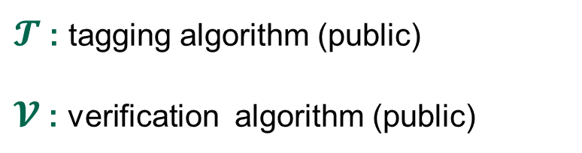

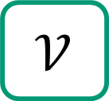
MACs
Internet
Alice
Bob
K
K
$$𝒯$$
M, T
$$𝒱$$
M
M / $⊥$
$𝓣$ : tagging algorithm (public)
$𝓥$ : verification algorithm (public)
K : tagging / verification key (secret)

Slide 4

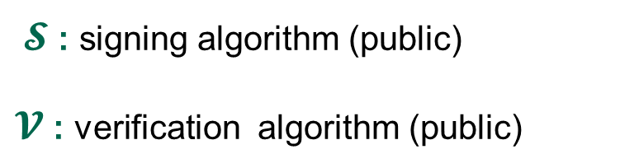
Digital signatures
Internet
Alice
Bob
sk
vk
$$𝒮$$
M, σ
$$𝒱$$
M
M / $⊥$
$𝓢$ : signing algorithm (public)
$𝓥$ : verification algorithm (public)
sk : signing key (secret)
vk : verification key (public)

Slide 5
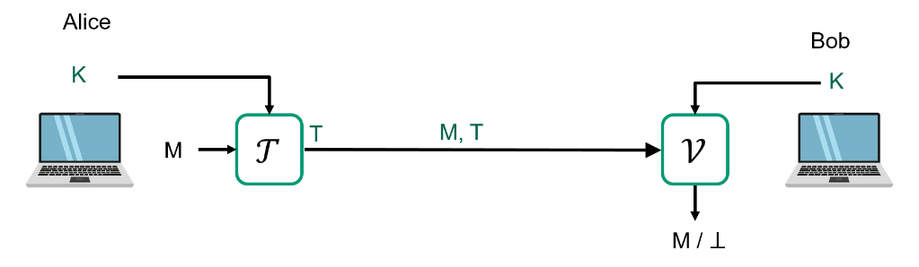
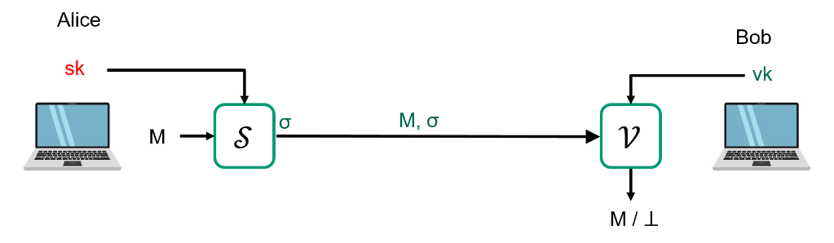
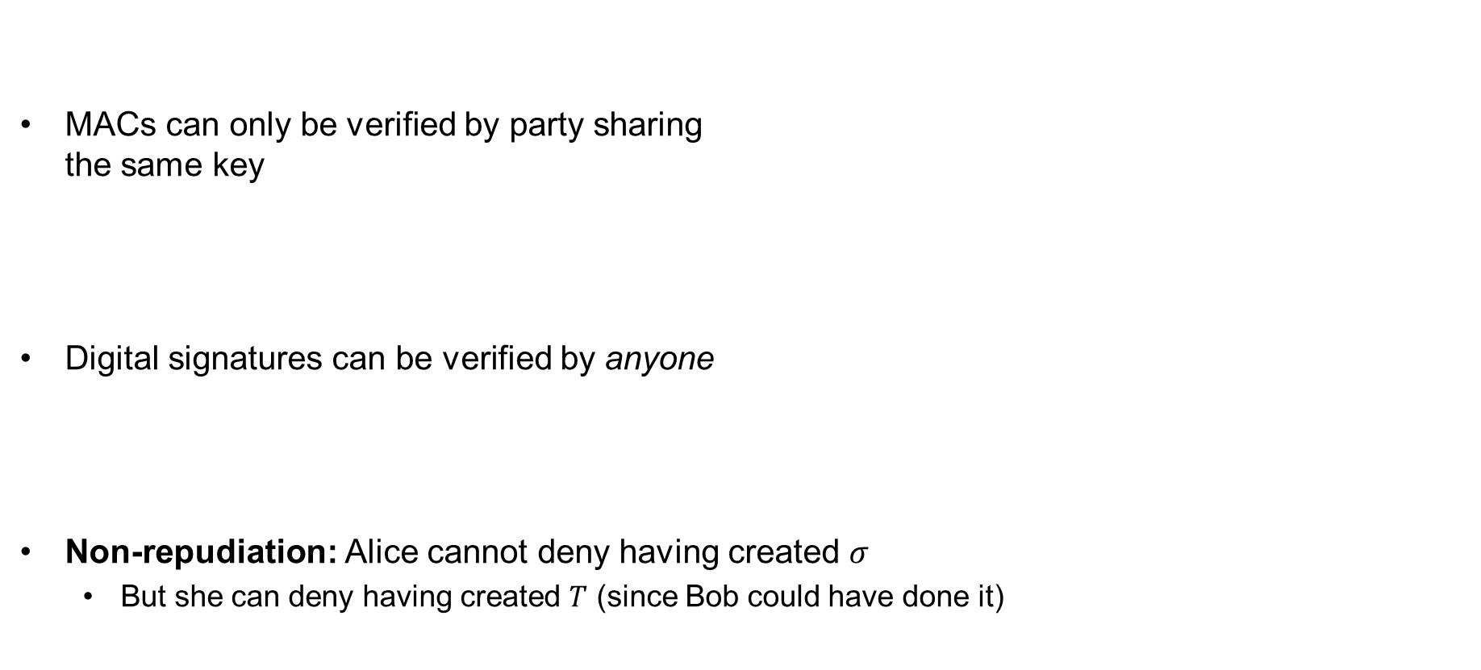
MACs vs. digital signatures
MACs can only be verified by party sharing
the same key
Digital signatures can be verified by anyone
Non-repudiation: Alice cannot deny having created $σ$
  But she can deny having created $T$ (since Bob could have done it)
MAC
Digital signature

Slide 6
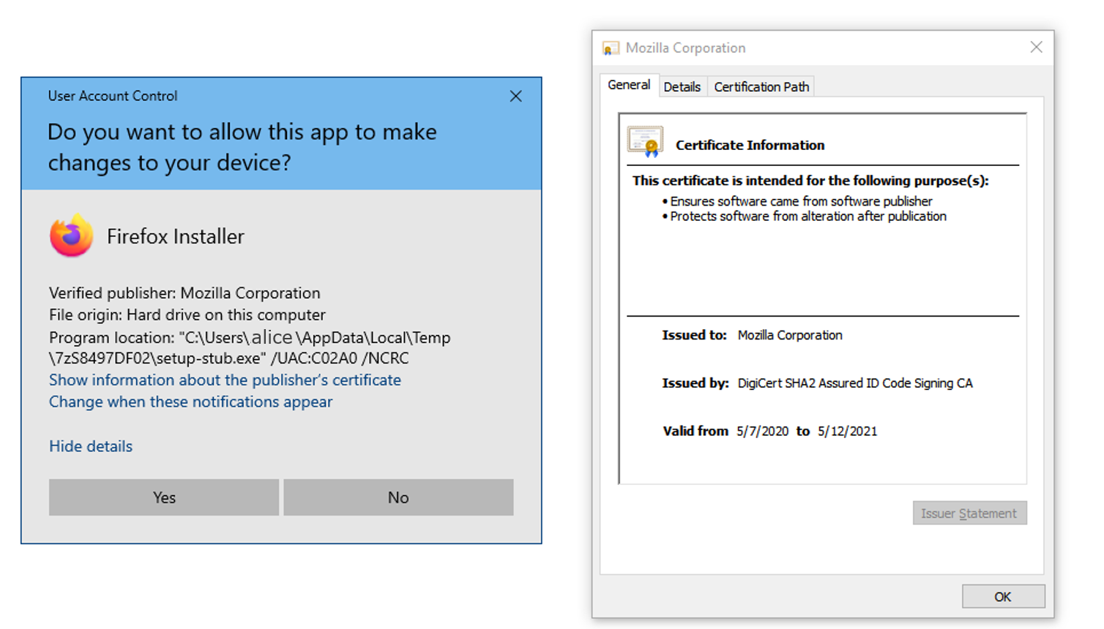
Applications of digital signatures
Electronic document signing
HTTPS / TLS certificates
Software installation
Email sender authentication
Bitcoin

Slide 7
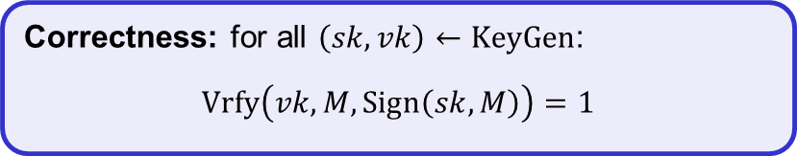
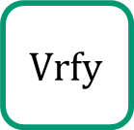






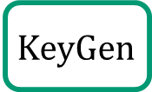




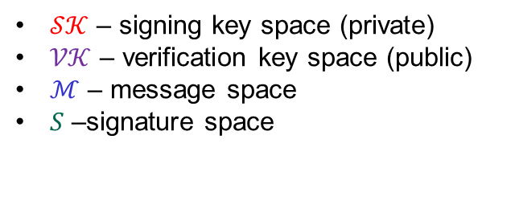





Digital signatures – syntax
A digital signature scheme is a tuple of algorithms $Σ=(KeyGen, Sign, Vrfy)$
$$KeyGen :𝒮𝒦×𝒱𝒦$$
$$Sign :𝒮𝒦×ℳ→𝒮$$
$$Vrfy :𝒱𝒦×ℳ×𝒮→\{0,1\}$$
$$\left(sk, vk\right)↞KeyGen$$
$$Sign\left(sk, M\right)={Sign}_{sk}\left(M\right)=σ$$
$$Vrfy\left(vk, M,σ\right)={Vrfy}_{vk}\left(M,σ\right)=1/0$$
$𝒮𝒦$ – signing key space (private)
$𝒱𝒦$ – verification key space (public)
$ℳ$ – message space
$S$ –signature space
Correctness: for all $\left(sk,vk\right)←KeyGen$:
$$Vrfy\left(vk, M, Sign\left(sk, M\right)\right)=1$$
$$\$$$
$$KeyGen$$
$sk$
$vk$
$\left(sk,vk\right)$
$$Sign$$
$$σ$$
$$M, σ$$
$$Vrfy$$
$$M$$
$$1/0$$
Adversary
7

Slide 8
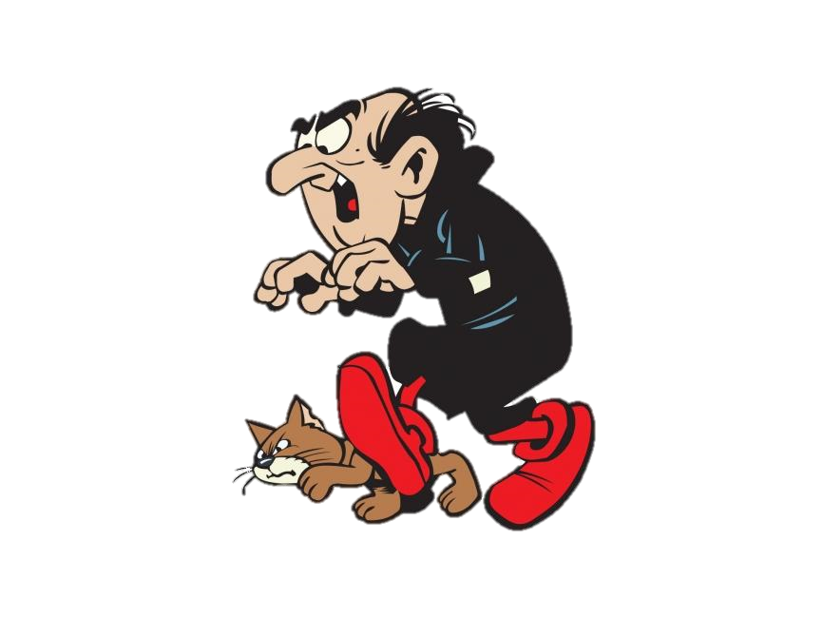
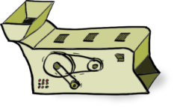
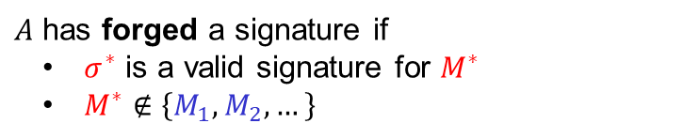
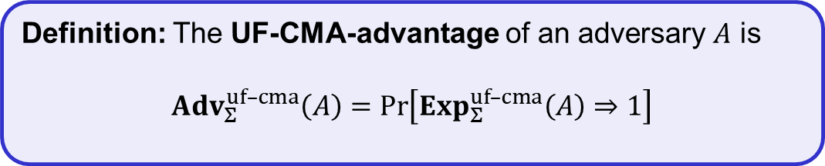

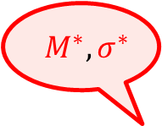


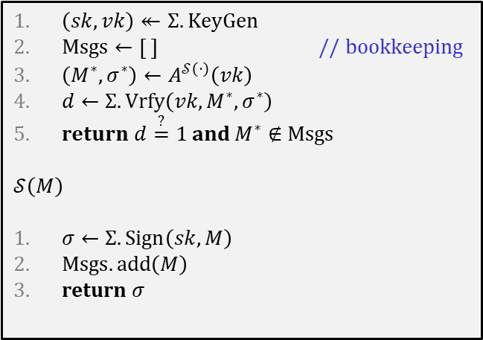


Digital signatures – security: UF-CMA
Challenger
$$Exp_{Σ}^{uf–cma}\left(A\right)$$
$${ M}^{∗}, σ^{∗}$$
$$vk$$
$\left(sk,vk\right)↞Σ.KeyGen$
$Msgs←\left[ \right]$ // bookkeeping
$\left(M^{∗}, σ^{∗}\right)←A^{𝒮\left(⋅\right)}\left(vk\right)$
$d←Σ.Vrfy\left(vk, M^{∗}, σ^{∗}\right)$
r$eturn d\overset{?}{=}1$ and $M^{∗}∉Msgs$
$$𝒮\left(M\right)$$
$σ←Σ.Sign\left(sk, M\right)$
$Msgs.add\left(M\right)$
return $σ$
$$\left(sk,vk\right)↞KeyGen$$
$$M_{1},M_{2}, …$$
$$Sign(sk, ⋅)$$
$$σ_{1},σ_{2}, …$$
$A$ has forged a signature if
  $σ^{∗}$ is a valid signature for $M^{∗}$
  $M^{∗}∉\left\{M_{1},M_{2},…\right\}$
Definition: The UF-CMA-advantage of an adversary $A$ is
$${Adv}_{Σ}^{uf–cma}\left(A\right)=\operatorname{Pr}\left[Exp_{Σ}^{uf–cma}\left(A\right)⇒1\right]$$

Slide 9


Designing signature schemes

Slide 10






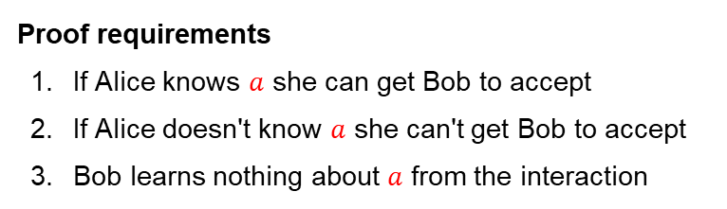
DLOG proof of knowledge
$$A=g^{a}$$
$$\left(G,⋆\right)=\left\langle g\right\rangle$$
$$a$$
accept if $g^{a}=A$
Proof requirements
If Alice knows $a$ she can get Bob to accept
If Alice doesn't know $a$ she can't get Bob to accept
Bob learns nothing about $a$ from the interaction
✓
✓
✗

Slide 11


DLOG proof of knowledge
$$A=g^{a}$$
$$\left(G,⋆\right)=\left\langle g\right\rangle$$
$$a+r \left(mod \left|G\right|\right)$$
$$r↞\left\{1, …, \left|G\right|\right\}$$
Proof requirements
If Alice knows $a$ she can get Bob to accept
If Alice doesn't know $a$ she can't get Bob to accept
Bob learns nothing about $a$ from the interaction
?
?
✓

Slide 12




DLOG proof of knowledge
$$A=g^{a}$$
$$\left(G,⋆\right)=\left\langle g\right\rangle$$
$$r$$
$$a+r \left(mod \left|G\right|\right)$$
$$r↞\left\{1, …, \left|G\right|\right\}$$
accept if $g^{z−r}=A$
$$z$$
Proof requirements
If Alice knows $a$ she can get Bob to accept
If Alice doesn't know $a$ she can't get Bob to accept
Bob learns nothing about $a$ from the interaction
✓
✓
✗

Slide 13









DLOG proof of knowledge
$$A=g^{a}$$
$$\left(G,⋆\right)=\left\langle g\right\rangle$$
$${R=g}^{r}$$
$$a+r \left(mod \left|G\right|\right)$$
$$r↞\left\{1, …, \left|G\right|\right\}$$
accept if $A⋆R=g^{z}$
$$z$$
Proof requirements
If Alice knows $a$ she can get Bob to accept
If Alice doesn't know $a$ she can't get Bob to accept
Bob learns nothing about $a$ from the interaction
✓
$$A⋆R$$
$$=g^{a}g^{r}$$
$$=g^{a+r}$$
$${=g}^{z}$$
✗
$$R←{A^{−1}⋆g}^{z}$$
$$⟹$$
$$A⋆R=A⋆A^{−1}⋆g^{z}=g^{z}$$
✓
(one-time pad + DLOG)

Slide 14












DLOG proof of knowledge
$$A=g^{a}$$
$$\left(G,⋆\right)=\left\langle g\right\rangle$$
$${R=g}^{r}$$
$$b$$
$$r↞\left\{1, …, \left|G\right|\right\}$$
$$b↞\left\{1, …, \left|G\right|\right\}$$
$$ab+r \left(mod \left|G\right|\right)$$
accept if $A^{b}⋆R=g^{z}$
$$z$$
Proof requirements
If Alice knows $a$ she can get Bob to accept
If Alice doesn't know $a$ she can't get Bob to accept
Bob learns nothing about $a$ from the interaction
✓
$$A^{b}⋆R=g^{ab}g^{r}$$
$$=g^{ab+r}=g^{z}$$
✓
$$R←{A^{−1}⋆g}^{z}$$
$$⟹$$
$$=A^{b}⋆A^{−1}⋆g^{z}$$
$$≠g^{z}$$
$$A^{b}⋆R$$
✓
(one-time pad + DLOG)
Notes:
Soundness (requirement 2) follows since now Alice cannot pick $z$ before she creates $R$. Once $R$ is chosen and $b$ is received, Alice is forced to find $a$ in order to create the only $z (mod p)$ that equals $ab+r$.
Zero-knowledge (requirement 3) is easy to prove for honest Bob (i.e., one that picks $b$ uniformly at random).
For dishonest Bob it is not so easy. However,

Slide 15



Interactive signature scheme
$$A=g^{a}$$
$$\left(G,⋆\right)=\left\langle g\right\rangle$$
$$M$$
$${R=g}^{r}$$
$$M$$
$$b$$
$$b↞\left\{1, …, \left|G\right|\right\}$$
$$r↞\left\{1, …, \left|G\right|\right\}$$
$$b←H(M)$$
$$ab+r \left(mod \left|G\right|\right)$$
accept if $A^{b}⋆R=g^{z}$
$$z$$
Proof requirements
If Alice knows $a$ she can get Bob to accept
If Alice doesn't know $a$ she can't get Bob to accept
Bob learns nothing about $a$ from the interaction
✓
✓
✓

Slide 16


Non-interactive signature scheme
$$A=g^{a}$$
$$\left(G,⋆\right)=\left\langle g\right\rangle$$
$$M$$
$${R=g}^{r}$$
$$b$$
$$r↞\left\{1, …, \left|G\right|\right\}$$
$$ab+r \left(mod \left|G\right|\right)$$
$$b←H(M)$$
accept if $A^{b}⋆R=g^{z}$
and $H\left(M\right)=b$
$$z$$
Proof requirements
If Alice knows $a$ she can get Bob to accept
If Alice doesn't know $a$ she can't get Bob to accept
Bob learns nothing about $a$ from the interaction
✓
✓
✓

Slide 17





Non-interactive signature scheme
$$A=g^{a}$$
$$\left(G,⋆\right)=\left\langle g\right\rangle$$
$$M$$
3
$$R=A^{−b}⋆g^{z}$$
$${R=g}^{r}$$
2
$$b$$
$$r↞\left\{1, …, \left|G\right|\right\}$$
$$z$$
1
$$ab+r \left(mod \left|G\right|\right)$$
$$b←H(M)$$
accept if $A^{b}⋆R=g^{z}$
and $H\left(M\right)=b$
$$z$$
Proof requirements
If Alice knows $a$ she can get Bob to accept
If Alice doesn't know $a$ she can't get Bob to accept
Bob learns nothing about $a$ from the interaction
✓
✓
✗
$$A^{b}⋆R=A^{b}A^{−b}⋆g^{z}$$
$$=g^{z}$$
✓

Slide 18



Non-interactive signature scheme
$$A=g^{a}$$
$$\left(G,⋆\right)=\left\langle g\right\rangle$$
$$M$$
$${R=g}^{r}$$
$$b$$
$$r↞\left\{1, …, \left|G\right|\right\}$$
$$σ=\left(R,b, z\right)$$
$$ab+r \left(mod \left|G\right|\right)$$
and $H\left(M\right)=b$
$$b←H(A,R,M)$$
and $H\left(A,R,M\right)=b$
$$b←H(M)$$
accept if $A^{b}⋆R=g^{z}$
$$z$$
Proof requirements
If Alice knows $a$ she can get Bob to accept
If Alice doesn't know $a$ she can't get Bob to accept
Bob learns nothing about $a$ from the interaction
✓
✓
✓

Slide 19




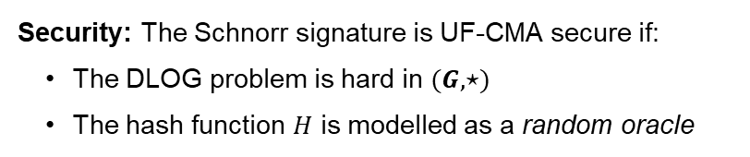
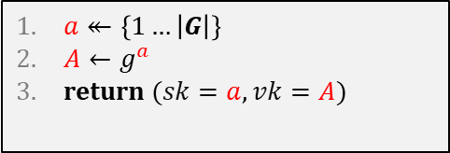

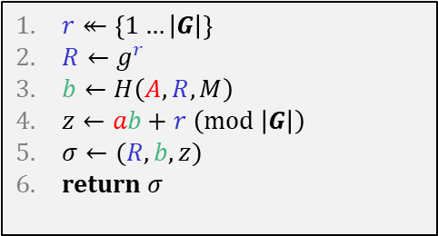



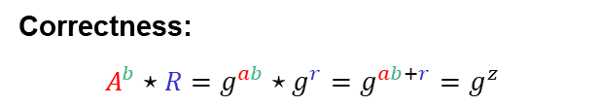


Schnorr signature scheme
$$A=g^{a}$$
$$\left(G,⋆\right)=\left\langle g\right\rangle$$
$$KeyGen$$
$a↞\left\{1…\left|G\right|\right\}$
$A←g^{a}$
return $(sk=a, vk=A)$
$$M$$
$${R=g}^{r}$$
$$Sign\left(sk=a,M\right)$$
$$b$$
$$r\underset{←}{\$}\left\{1, …, \left|G\right|\right\}$$
$$σ=\left(R,b, z\right)$$
$r↞\left\{1…\left|G\right|\right\}$
$R←g^{r}$
$b←H\left(A,R,M\right)$
$z←ab+r \left(mod \left|G\right|\right)$
$σ←(R,b,z)$
return $σ$
$$ab+r \left(mod \left|G\right|\right)$$
$$b←H(A,R,M)$$
$$Verify\left(vk=A,M,σ=(R,b,z)\right)$$
return $A^{b}⋆R\overset{?}{=}g^{z}$ and $H\left(A,R,M\right)\overset{?}{=}b$
$$z$$
Correctness:
$A^{b}⋆R=g^{ab}⋆g^{r}=g^{ab+r}=g^{z}$
  $r$ must be picked new every time!
Security: The Schnorr signature is UF-CMA secure if:
The DLOG problem is hard in $(G,⋆)$
The hash function $H$ is modelled as a random oracle
$$σ =\left(R,b,z \right)$$
$$σ′=\left(R,b′,z′\right)$$
$$⟹ z−z^{′}=(ab+r)−(ab^{′}+r)$$
$$=a⋅(b−b′)$$
$$⟹ a=\left(z−z^{′}\right)⋅{\left(b−b′\right)}^{−1} \operatorname{mod}{ \left|G\right|}$$
Learned private signing key!
Notes:
Many variations and optimizations for Schnorr scheme (see https://crypto.stackexchange.com/questions/34863/ec-schnorr-signature-multiple-standard/#50202)
For example, it possible to instead define the signature as $(b,z)$ (i.e., send $b$ instead of $R$). During verification we instead compute $R′←A^{−b}⋆g^{z}=g^{−ab}⋆g^{ab+r}=g^{r}$ and check that $H\left(A, R^{′}, M\right)=b$.

Slide 20
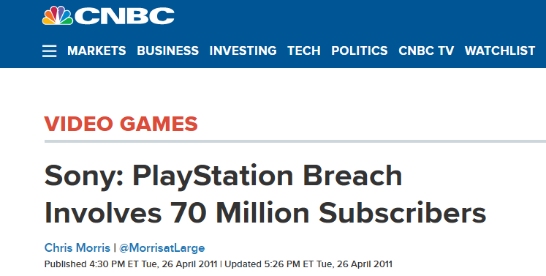
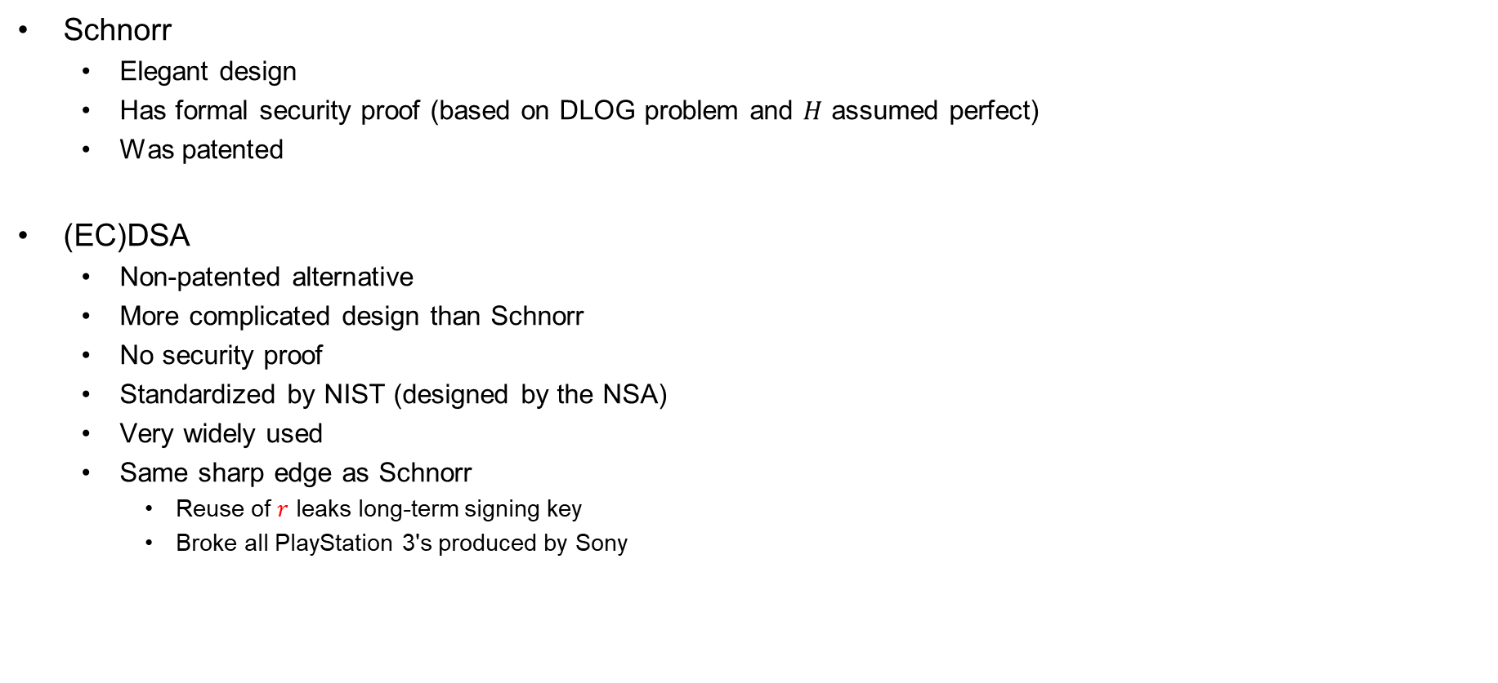
Discrete-log-based signatures
Schnorr
  Elegant design
  Has formal security proof (based on DLOG problem and $H$ assumed perfect)
  Was patented
(EC)DSA
  Non-patented alternative
  More complicated design than Schnorr
  No security proof
  Standardized by NIST (designed by the NSA)
  Very widely used
  Same sharp edge as Schnorr
    Reuse of $r$ leaks long-term signing key
    Broke all PlayStation 3's produced by Sony

Slide 21
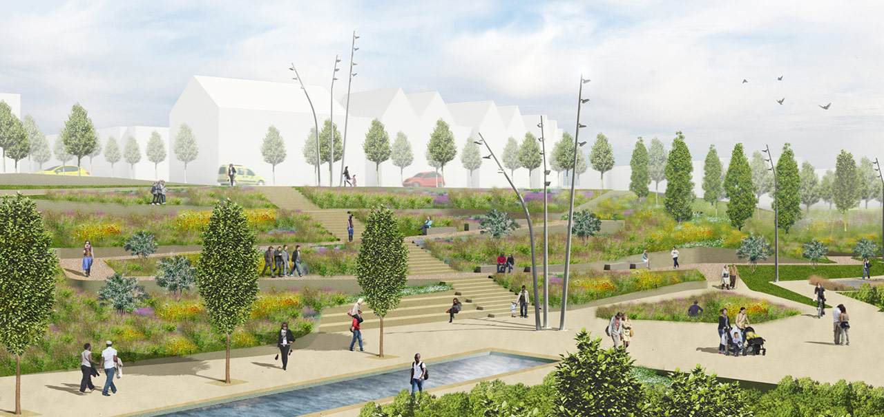
Public-key infrastructure (PKI)

Slide 22





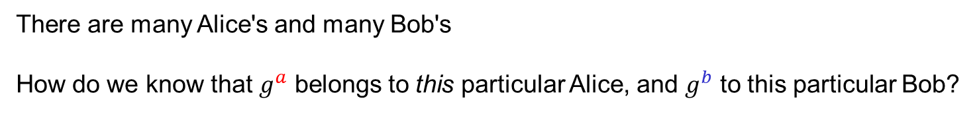
What are identities?
"Alice",
$$g^{a}$$
"Bob",
$$g^{b}$$
$${K←g}^{ab}$$
$${K←g}^{ab}$$
There are many Alice's and many Bob's
How do we know that $g^{a}$ belongs to this particular Alice, and $g^{b}$ to this particular Bob?
Need to bind public keys to entities

Slide 23



Identities on the internet
www.bob.com
"Alice",
$$g^{a}$$
www.bob.com,
$$g^{b}$$
$${K←g}^{ab}$$
$${K←g}^{ab}$$
There are many Alice's and many Bob's
How do we know that $g^{a}$ belongs to this particular Alice, and $g^{b}$ to this particular Bob?
Need to bind public keys to entities
– internet: bind public keys to domain names

Slide 24


Identities on the internet
www.evil.com
$$g^{a}$$
www.bob.com,
$$g^{b}$$
need proof these belong together
$$b↞\left\{1, …, \left|G\right|\right\}$$
$${K←g}^{ab}$$
$${K←g}^{ab}$$
There are many Alice's and many Bob's
How do we know that $g^{a}$ belongs to this particular Alice, and $g^{b}$ to this particular Bob?
Need to bind public keys to entities
– internet: bind public keys to domain names

Slide 25








Authenticated key exchange
www.bob.com
$$g^{a}$$
$$\left(sk_{B},vk_{B}\right)$$
$$g^{b}$$
www.bob.com,
$$,vk_{B}$$
if $Vrfy\left(vk_{B},…,σ\right)=1$
$$σ$$
$${K←g}^{ab}$$
$${K←g}^{ab}$$
else
abort
But why should we trust this $vk_{B}$?
Could have been created by the adversary itself

Slide 26
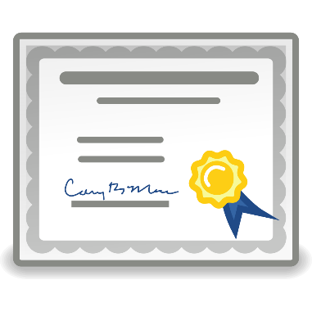
Digital certificates
Digital certificate: a way of binding a public key to an entity
A certificate consists of:
  The public key of the entity
  A bunch of information identifying the entity
    Name
    Address
    Occupation
    URL
    Email-address
    Phone number
    …
  A digital signature on all the above by a certificate authority (CA)

Slide 27
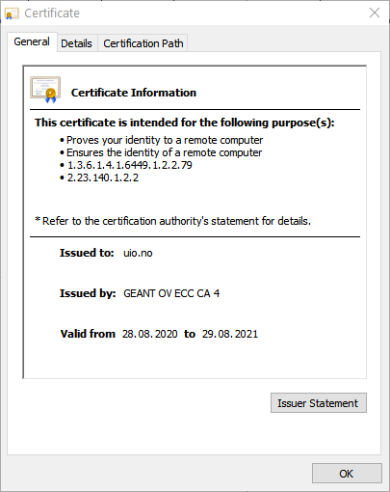
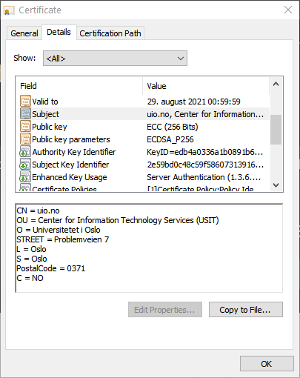
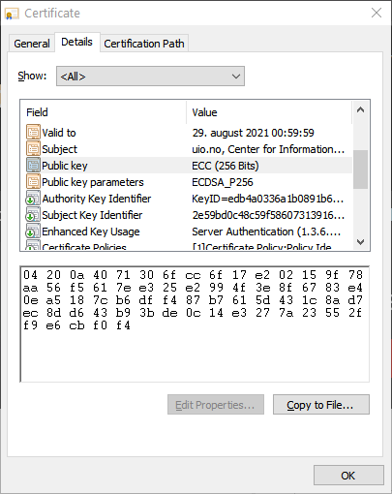
Digital certificates

Slide 28

Certificate authorities (CA)
CA: an issuer of digital certificates
Acts as a trusted third-party, certifying (i.e., signing)
the public keys of other entities
  Verifies the identity of a claimed public-key owner
The basis of a public-key infrastructure (PKI)
Certificate
Authority

Slide 29


















Authenticated key exchange + PKI
www.bob.com
$$vk_{{CA}_{2}}$$
$$g^{a}$$
$$vk_{B}$$
if $Vrfy\left(vk_{B},…,σ\right)=1$
www.bob.com
$$g^{b}$$
and $Vrfy\left(vk_{{CA}_{1}},…,σ\right)=1$
$$σ$$
and $Vrfy\left(vk_{{CA}_{2}},…,σ\right)=1$
$${K←g}^{ab}$$
$$vk_{B}$$
$$σ$$
$${K←g}^{ab}$$
$$vk_{{CA}_{1}}$$
$$σ$$
else
abort

Slide 30




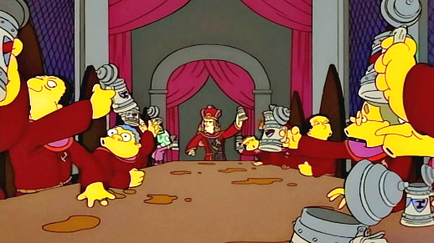

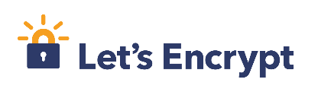
Root CAs
Root CAs: CAs that sign other CAs' public keys
  + only a few root CAs need to be trusted by end-users
  + root CAs can distribute the signing + verification load to smaller CAs
  - single point of failure
  Root CAs for the internet: a few large multinational corporations
  ; private key must be very heavily guarded
Root CA signing key

Slide 31
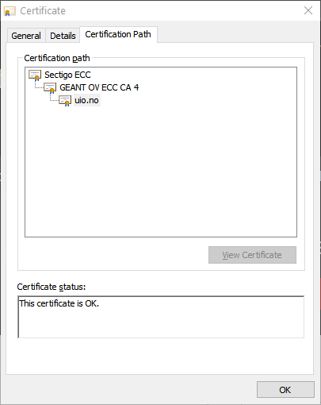
Certificate chains

Slide 32
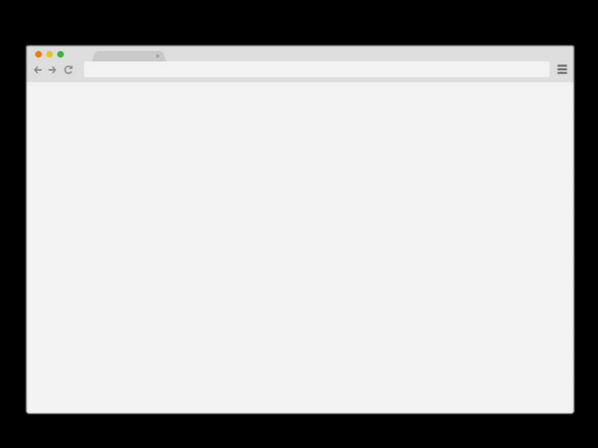

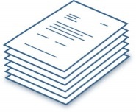






How to get a signed certificate?
4
www.bob.com
www.bob.com
2
$$vk_{B}$$
0x349a5
3
“Put 0x349a5 on your page”
5
Check
1
$$\left(sk_{B},vk_{B}\right)←KeyGen$$
Other validation methods also possible:
DNS entries
Confirmation emails
Physical verification
…
6
$$←Sign\left(sk_{dc}, vk_{B}, \right)$$
7

Slide 33




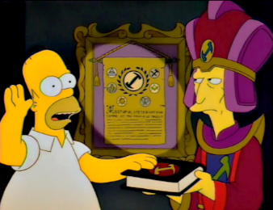
How to become an internet root CA?
Need to prove yourself (trust)worthy to browser and OS vendors
  Microsoft Root Certificate Program
  Mozilla CA Certificate Program
  Apple Root Certificate Program
  Chrome Root CA Program
Lot's of auditing and paperwork
Many formal technical and non-technical security requirements
  CA/Browser forum
  Baseline Requirements v1.7.3

Slide 34
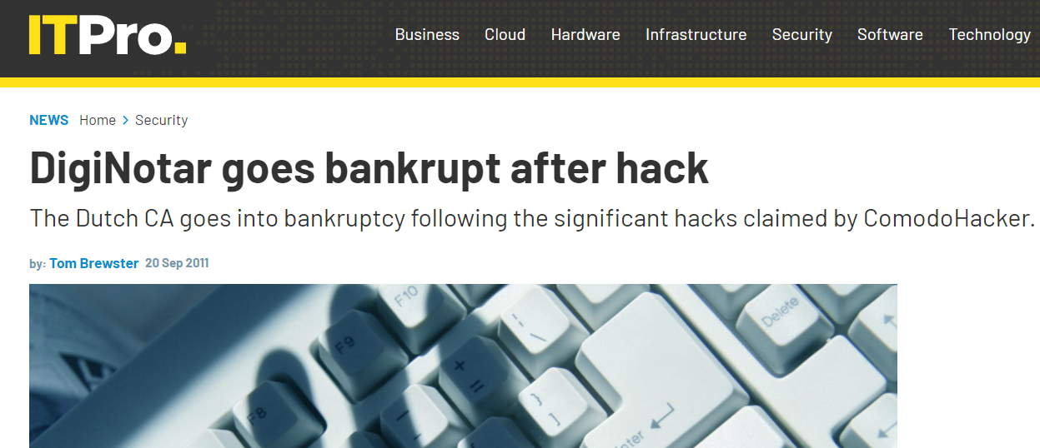
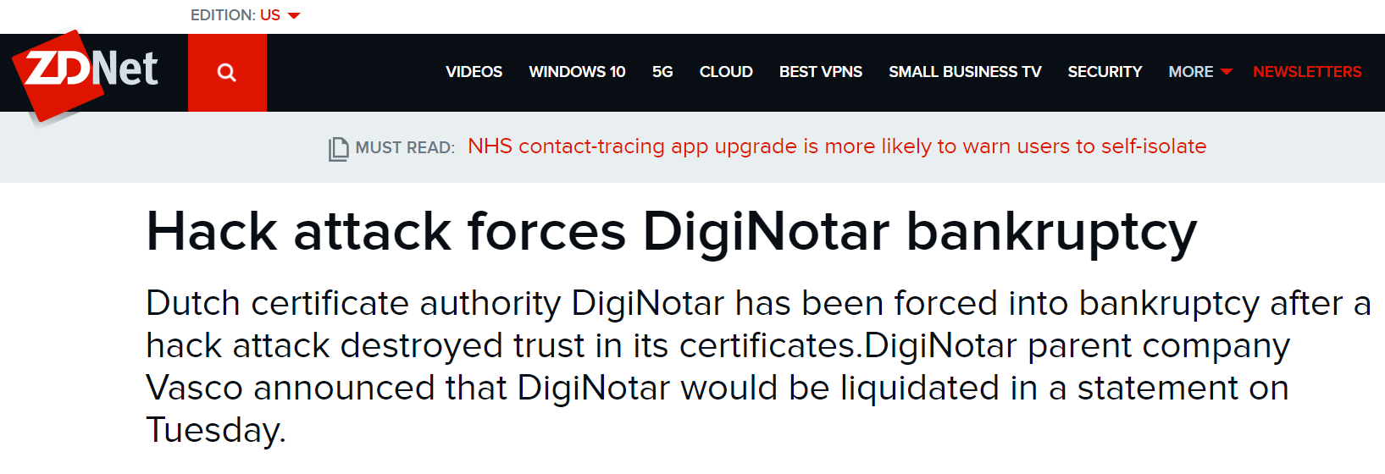
DigiNotar
Dutch root CA
Lost control of their private signing key in 2011
Fraudulent certificates issued for Gmail,
Yahoo!, Mozilla, WordPress, …
30 000 Iranian Gmail users targeted

Slide 35
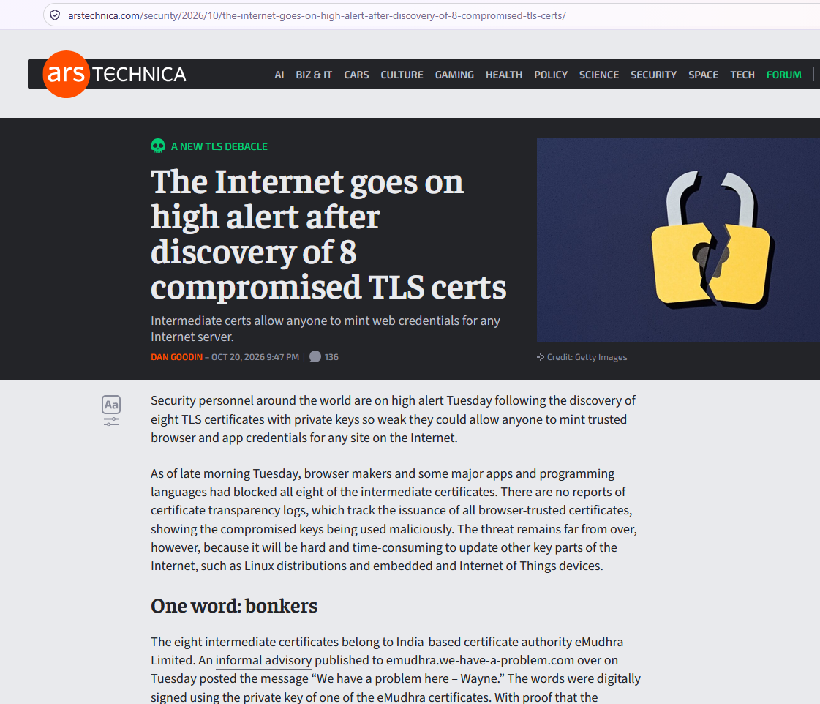
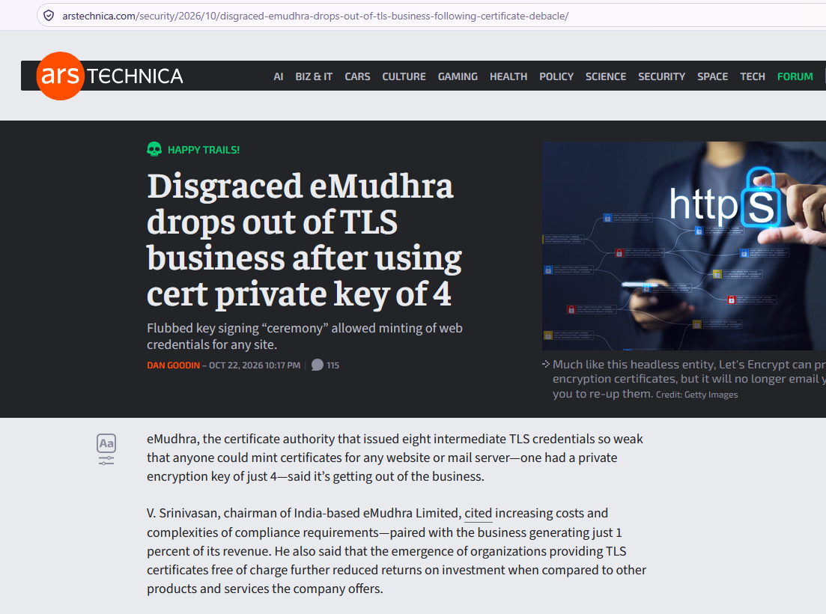
eMudhra
Indian intermediate CA
Created 8 CA certs where the private signing keys were (literally) numbers between 0 and 255!
Apparently due to confusing test certs with production certs
…no longer in the CA business

Slide 36
The problem with CAs
Trusted third-parties on the Internet
  One compromised CA enough to imitate any website on the Internet
Lots of CAs compromised throughout the years
Even more insidious:
How do we know that CAs don’t issue unauthorized
certificates at the behest of government agencies?
Above problems led to Certificate Transparency
  Effort to keep CAs honest

Slide 37
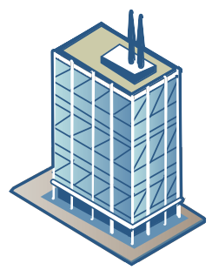


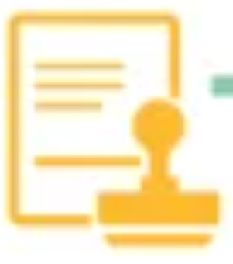








Certificate Transparency
CA
www.bob.com
$$vk$$
subscribe
SCT = Signed Certificate Timestamp
SCT
SCT
SCT
Monitor
Certificate Transparency Logs
Notes:
SCT = Signed Certificate Timestamp
Minst 2 SCT er påkrevd av Chrome, Safari og Firefox; 3 er vanlig
https://chromium.googlesource.com/chromium/src/+/master/net/docs/certificate-transparency.md
https://support.apple.com/en-gb/103214
https://developer.mozilla.org/en-US/docs/Web/Security/Certificate_Transparency
https://certificate.transparency.dev/logs/

Slide 38



















Authenticated key exchange + PKI + CT
www.bob.com
$$vk_{CT_{3}}$$
$$vk_{CT_{2}}$$
$$vk_{{CA}_{2}}$$
$$vk_{CT_{1}}$$
$$g^{a}$$
if $Vrfy\left(vk_{B},…,σ\right)=1$
www.bob.com
$$g^{b}$$
and $Vrfy\left(vk_{{CA}_{1}},…,σ\right)=1$
$$σ$$
and $Vrfy\left(vk_{{CA}_{2}},…,σ\right)=1$
$$vk_{B}$$
$$σ$$
$$σ$$
$${K←g}^{ab}$$
$$vk_{{CA}_{1}}$$
and $Vrfy\left(vk_{{CT}_{1}},…,σ_{sct_{1}}\right)=1$
$$σ_{sct_{1}}$$
and $Vrfy\left(vk_{{CT}_{2}},…,σ_{sct_{2}}\right)=1$
$$σ_{sct_{2}}$$
and $Vrfy\left(vk_{{CT}_{3}},…,σ_{sct_{3}}\right)=1$
$$σ_{sct_{3}}$$
$${K←g}^{ab}$$
else
abort

Slide 39






Certificate revocation
www.bob.com
$$g^{a}$$
$$\left(sk_{B},vk_{B}\right)$$
www.bob.com
$$g^{b}$$
$$σ$$
get CRL
if revoked:
abort
CA

Slide 40
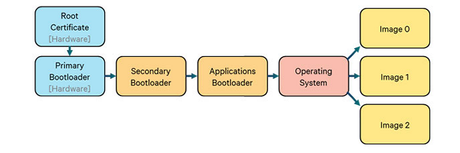
Hardware Root of Trust

Slide 41




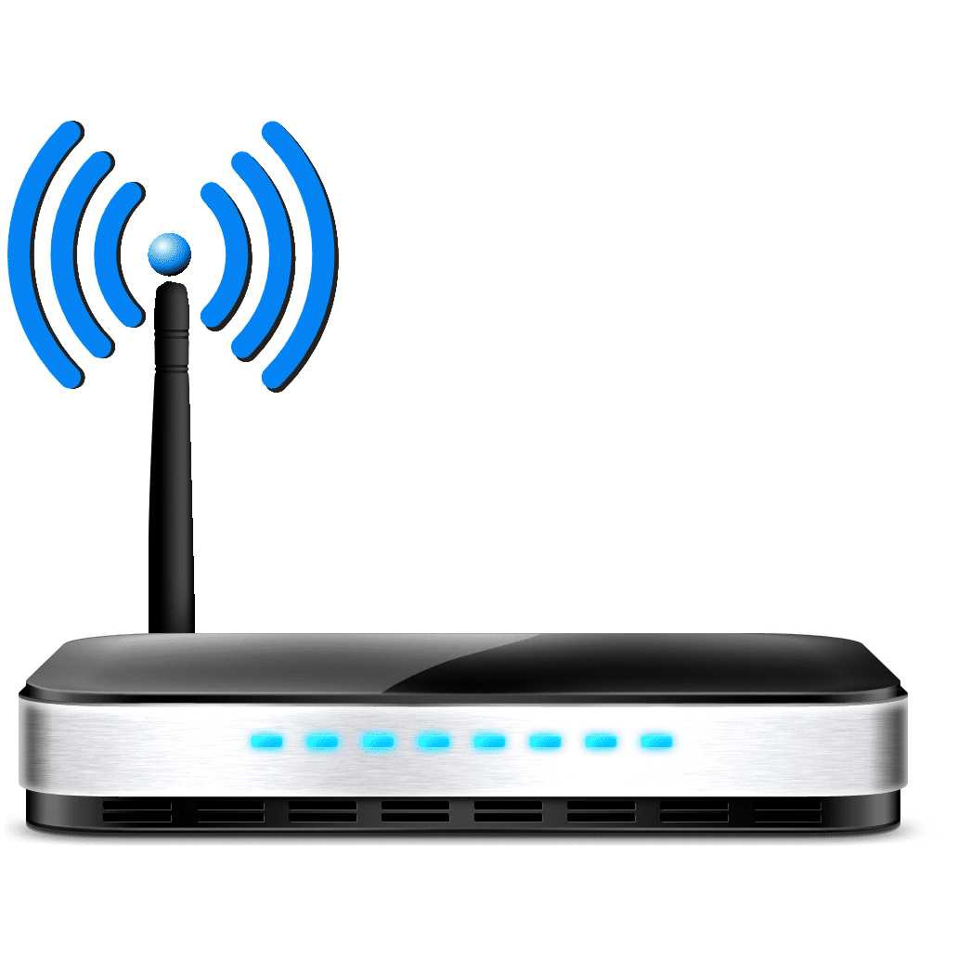

Other PKIs exist
Organization PKIs
  eduroam
TLS +
WPA2

Slide 42
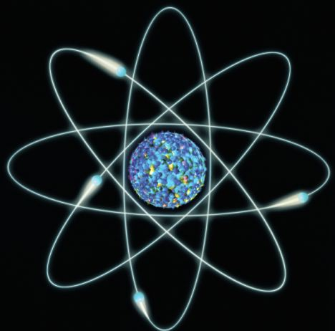
Next week
Quantum computers

